Slide 1
Unit 3 The Relational Model And From ER Diagrams to Relational Databases

Slide 2
Relational Implementation in Context

Slide 3
Introduction

Slide 4
Introduction
Here we learn how to implement an ER diagram as a relational database
We call this process logical design
Sometimes it is called physical design, if the creation of an ER diagram is referred to as logical design
We do not do that
Some use both “logical design” and “physical design” terms for this process, then
Logical design: relational implementation not targeting any specific DBMS: we will focus on this
Physical design: further development/refinement of a relational implementation targeting a specific DBMs
Our process will be “almost an algorithm,” but not quite
Therefore, it is important to understand the reasons for the various steps in the process

Slide 5
Importance Of Good Design
In contrast, to what’s frequently taught, we spend more time on that as opposed to learning how to write SQL statements
Quoting from Oracle Database Development Guide
The key to database and application performance is design, not tuning. While tuning is quite valuable, it cannot make up for poor design. Your design must start with an efficient data model, well-defined performance goals and metrics, and a sensible benchmarking strategy. Otherwise, you will encounter problems during implementation, when no amount of tuning will produce the results that you could have obtained with good design. You might have to redesign the system later, despite having tuned the original poor design.
Measure twice, cut once

Slide 6
Relations

Slide 7
Sets, Relations, and Tables
The basic “data type”, or a “variable” of a relational database, is a relation
In this unit, such a variable will be a set
Later, we will extend this, and such a variable will be a multiset
This distinction is not important for now
In SQL such a multiset is called a table
We may use the term “table” and “relation” interchangeably and not pay attention to whether we are talking about a set or a multiset

Slide 8
Sets
We will not use axiomatic set theory
A set is a “bag” of elements, some/all of which could be sets themselves and a binary relationship “is element of” denoted by ∈, such as 2 ∈ {2, 5, 3, 7}, {2,8} ∈ {2, {2, 8}, 5, 3, 7},
You cannot specify
How many times an element appears in a set (if you could, this would be a multiset)
In which position an element appears (if you could, this would be a sequence)
Therefore, as sets: {2, 5, 3, 7} = {2, 7, 5, 3, 5, 3, 3}
Note: in many places you will read: “an element can appear in a set at most once”
This statement is not quite right.
And it is important not to believe that statement, as we will see in a later unit

Slide 9
Sets
Two sets A and B are equal iff (that is, if and only if) they have the same elements
In other words, for every x: x is an element of A iff x is an element of B
In still a different way: A and B are equal iff for every possible x, the questions “is x in A?” and “is x in B?” give the same answer
Note that there is no discussion or even a way of saying how many times x appears in a set, really either zero or at least once
“Mathematically” and recalling that ∀ x means “for all x”
A = B means ∀ x { x ∈ A ↔ x ∈ B }
Therefore, as sets: {2, 5, 3, 7} = {2, 7, 5, 3, 5, 3, 3}
3 is in both and 4 is in neither, etc.
This reiterates what we have said previously
You cannot specify multiplicity
You cannot specify position

Slide 10
Relation
Consider a table, with a fixed number of columns where the elements of each column are drawn from some specific domain
The columns are labeled, and the labels are distinct
We will consider such a table to be a set of rows (another word for “row” in our context: tuple)
An example of a table S of two columns A and B
A relation is such a table
We will also write S(A,B) for table S with columns A and B
S | A | B
 | a | 2
 | a | 2
 | b | 3
 | c | 4
 | d | 3

Slide 11
Relational Schema
What we saw was an instance (current value for a relation with the defined columns and domains)
To specify this relation in general (not the specific instance) we need to talk about a relational schema
A relational schema defines a set of relations
In databases everything is finite, so a relational schema defines a finite set of finite relations

Slide 12
Relational Schema
Here is an informal, but complete, description what a relational schema of one relation is
We want to define a structure for some table
We give it a name (we had S)
We chose the number of columns (we had 2) and give them distinct names (we had A and B)
We decide on the domains of elements in the columns (we had letters for A and integers for B)
We decide on constraints, if any, on the permitted values (for example, we can assume as it was true for our example that any two rows that are equal on A must be equal on B) This part must not be omitted if such constraints hold!

Slide 13
Relational Schema
Let’s verify that the following hold in our example if it is supposed to satisfy
A: all lower-case (miniscule) letters in English
B: all positive integers less than 100
S(A,B) satisfies the condition that any two tuples that are equal on A must also be equal on B
Our example was an instance of that relational schema
S | A | B
 | a | 2
 | a | 2
 | b | 3
 | c | 4
 | d | 3

Slide 14
Relations
Since relations are sets of tuples, the following two relations are equal (are really one relation written in two different ways)
(This is a different example, not an instance of the previous relational schema)
S | A | B
 | a | 2
 | a | 56
 | b | 2
S | A | B
 | a | 56
 | a | 2
 | b | 2
 | a | 56
 | a | 2
 | a | 56

Slide 15
Relations
Since the positions in the tuple (1st, 2nd, etc.) are labeled with the column headings, the following two relations are equal (are really one relation written in two different ways)
S | A | B
 | a | 2
 | a | 56
 | b | 2
S | B | A
 | 56 | a
 | 2 | a
 | 2 | b
 | 56 | a
 | 2 | a
 | 56 | a

Slide 16
Relations
To specify relations, it is enough to do what we have done above
If we understand what the domains for the columns are, the following are formally fully specified relations (more formally relational schemas)
Relation (schema) P(Name, SSN, DOB, Grade) with some (not specified, but we should have done that) domains for attributes
Relation (schema) Q(Grade, Salary) with some (not specified, but we should have done that) domains for attributes
P | Name | SSN | DOB | Grade
 | A | 121 | 2367 | 2
 | B | 101 | 3498 | 4
 | C | 106 | 2987 | 2
Q | Grade | Salary
 | 1 | 90
 | 2 | 80
 | 3 | 70
 | 4 | 70

Slide 17
NULLs
Each domain is augmented with a NULL
NULL can be for now be considered as a synonym for “unknown”
We will discuss NULLs in greater depth later in the course

Slide 18
Keys

Slide 19
Keys
We will specify generally, as suitable for the schema:
Primary keys
Keys (beyond primary)
Foreign keys and what they reference (we will see soon what this means)
The above are most important structurally
Later, especially when we talk about SQL DDL, we will specify additional properties and constraints
For example, the height of a person must be positive, if it is known
Some of the constraints may involve more than one relation

Slide 20
Keys
Consider relation (schema) Person(FN, LN, Grade, YOB)
Instance:
We are told that any two tuples that are equal on both FN and LN are (completely) equal
We have some tuples appearing multiple times: this is just for clarifying that this permitted in the definition, we do not discuss here why we would have the same tuple more than once (we will talk about this later)
This is a property of every possible instance of Person in our application: we are told that
Then (FN, LN) is a key of Person, as this is a minimal set of attributes whose values identify a unique person
What does this mean exactly?
Person | FN | LN | Grade | YOB
 | John | Smith | 8 | 1976
 | Lakshmi | Smith | 9 | 1981
 | John | Smith | 8 | 1976
 | John | Yao | 9 | 1992

Slide 21
Keys
Given some relation R (here Person) as set of attributes, say S (here FN and LN) form a key if and only if
Any two tuples of R that are equal on all the attributes of S are (completely) equal
No proper subset of S has this property (the minimality property)
To reiterate completely for our example
Any two tuples that are equal on FN and LN are equal
No proper subset of the set FN, LN (formally the set {FN, LN}) has this property Indeed, there are tuples that equal on a proper subset FN that are not (completely) equal Indeed, there are tuples that equal on a proper subset LN that are not (completely) equal
The three attributes FN, LN, Grade do not form a key as the two attributes FN, LN already form a key (Grade is “too much”)

Slide 22
Keys (and Superkeys)
Consider relation (schema) Pay(Grade, Salary)
Example:
We are told that for any instance of Pay, any two tuples that are equal on Grade are (completely) equal
Of course, if each Grade appears in only one tuple, this is automatically true
Then, similarly to before, Grade is a key
What about Salary, is this a key also?
No, because we are not told (that is, we are not guaranteed) that any two tuples that are equal on Salary are equal on Grade in every possible instance of Pay
Pay | Grade | Salary
 | 8 | 128
 | 9 | 139
 | 7 | 147

Slide 23
Keys (And Superkeys)
A set of columns in a relation is a superkey if it is a superset of a key
Any two tuples that are equal on the attributes of a superkey are completely equal
Because they are equal on the attributes of a key, which is a subset of the given superkey
A relation always has at least one superkey
The set of all the attributes is a superkey
Because any two tuples that are equal on all the attributes are completely equal
We can try and “prune” the set of all the attributes “down” to a key
We just try to remove attributes one by one
We stop when removing an attribute would produce a set of attributes whose values “are compatible” with two different tuples

Slide 24
Keys
There may be more than one key in a relation, as we will see soon
Exactly one key is chosen as the primary key (there is no formal way to decide which one)
Other keys are just keys and sometimes they are called candidate keys (as they are candidates for the primary key, though not chosen)
Customarily, the names of the columns of the primary key are underlined
Note that FN, LN, Grade was as superkey but not a key
Person | FN | LN | Grade | YOB
 | John | Smith | 8 | 1976
 | Lakshmi | Smith | 9 | 1981
 | John | Smith | 8 | 1976
 | John | Yao | 9 | 1992

Slide 25
Keys (and Superkeys)
To summarize
Superkey: a set of columns whose values determine the values of all the columns in a row for every instance of the relation
All the columns together form a superkey (trivially)
Superkeys are only used in formal definitions
Key: a set of columns whose values determine the values of all the columns in a row for every instance of the relation, but any proper subset of that set of columns does not do that
Primary Key: a chosen key. Important: no attribute of a primary key can be NULL (the value of every attribute must be always known); why will be discussed later

Slide 26
Keys (and Superkeys)
We will underline the attributes of the chosen primary key when writing the schema as text
Returning to a previous unit and the example of City: City(Longitude, Latitude, Country, State, Name, Size)
We can have
City(Longitude, Latitude, Country, State, Name, Size)
This implies that (Longitude, Latitude) form the primary key
We also have a candidate key: (Country, State, Name)
We can have
City(Longitude, Latitude, Country, State, Name, Size) if the value of State is never NULL. This implies that (Country, State, Name) form the primary key
We also have a candidate key: (Longitude, Latitude)
The situation will be described more precisely concerning candidate keys when we talk about SQL DDL

Slide 27
Relational Databases

Slide 28
Relational Databases
A relational database is “basically” a set of tables with values drawn from specified domains, specified using a relational schema
This is formally correct, but it is misleading in practice
As we will see soon, a better way to define a relational database is to say that it is
A set of relations
A set of binary, many-to-one mappings between them (partial functions), mimicking child-to-mother relationships Looking from the “other side,” they are one-to-many mappings, mimicking mother-to-child relationships
Some other, less fundamental, components are ignored for now
We will know later what this means exactly, but I did not want to leave you with an overly simplistic concept
Note: “partial function” means “not necessarily defined everywhere”, but could be and then it is also “total”

Slide 29
From ER Diagram to Relational Database Fundamental Operations With Examples

Slide 30
From ER Diagrams to Relational Databases
We are now ready to convert ER diagrams into relational databases
Generally, but not always
An entity set is converted into a table
A relationship is converted into a table
As state earlier, this is logical design, though some call it physical design (as we also saw earlier)
We will first go very carefully over a very simple example
Then, we will be ready to go quickly through our large example
Then, we look at some additional aspects of interest
We will use SQL Power Architect for specifying relational databases
We will briefly look at MySQL Workbench

Slide 31
ER Diagram With Important Features

Slide 32
More About the Example
The given ER diagram is clear, other than
Discovered, which is the continent in which a particular species was first discovered
Each child is a “dependent” of only one employee in our database
If both parents are employees, the child is “assigned” to one of them (say the one whose ID# is smaller)
We are given additional information about the application
Values of attributes in a primary key must not be missing (this is a general rule as we know, not only for this example so I should not say that, and consider this a pedagogical reminder, not actually stated)
Other than attributes in a primary key, other attributes, unless stated otherwise, may be missing
The value of Name is known (not missing) for every Employee
To build up our intuition, let’s look at some specific instance of our application

Slide 33
Small Example
5 Employees:
1 is Alice has Erica and Frank, born in US, likes Horse and Cat
2 is Bob has Bob and Frank, born in US, likes Cat
4 is Carol
5 is David, born in IN
6 is Bob, born in CN, likes Yak
4 Countries
US
IN has 1347
CN has 1412
RU
5 Animals
Horse in Asia
Wolf in Asia
Cat in Africa
Yak in Asia
Zebra in Africa

Slide 34
Country
There are four countries, listing for them: Cname, Population (the latter only when known):
US
IN, 1347
CN, 1412
RU
We create a table for Country “in the most obvious way,” by creating a column for each attribute (underlining the attributes of the primary key) and that works:
Note that some “slots” contains NULLs, indicated by emptiness
Country | Cname | Population
 | US
 | IN | 1347
 | CN | 1412
 | RU

Slide 35
Animal
There are five animals, listing for them: Species, Discovered (note, that even though not required, Discovered happens to be known for every Species):
Horse, Asia
Wolf, Asia
Cat, Africa
Yak, Asia
Zebra, Africa
We create a table for Animal as before, and that works:
Animal | Species | Discovered
 | Horse | Asia
 | Wolf | Asia
 | Cat | Africa
 | Yak | Asia
 | Zebra | Africa

Slide 36
Employee
There are five employees, listing for them: ID#, Name, (name of) Child (note there may be any number of Child values for an Employee, zero or more):
1, Alice, Erica, Frank
2, Bob, Bob, Frank
4, Carol
5, David
6, Bob, Frank
We create a table for Employee in the most obvious way, and that does not work:
Employee | ID# | Name | Child | Child
 | 1 | Alice | Erica | Frank
 | 2 | Bob | Bob | Frank
 | 4 | Carol
 | 5 | David
 | 6 | Bob | Frank

Slide 37
Employee
Child is a multivalued attribute so, the number of columns labeled “Child” is, in principle, unbounded
A table must have a fixed number of columns
It must be an instance in/of a relational schema
If we are ready to store up to 25 children for an employee and create a table with 25 columns for children, perhaps tomorrow we get an employee with 26 children, who will not “fit”; Moulay Ismail ibn Sharif had more than 1,000 children
We replace our attempted single table for Employee by two tables
One for all the attributes of Employee other than the multivalued one (Child)
One for pairs of the form (primary key of Employee, Child)
Note that both tables have a fixed number of columns, no matter how many children an employee has, so we have correct structures

Slide 38
Employee and Child
Replace (incorrect)
By (correct)
Employee | ID# | Name | Child | Child
 | 1 | Alice | Erica | Frank
 | 2 | Bob | Bob | Frank
 | 4 | Carol
 | 5 | David
 | 6 | Bob | Frank
Employee | ID# | Name
 | 1 | Alice
 | 2 | Bob
 | 4 | Carol
 | 5 | David
 | 6 | Bob
Child | ID# | Child
 | 1 | Erica
 | 1 | Frank
 | 2 | Bob
 | 2 | Frank
 | 6 | Frank

Slide 39
Employee and Child With Better Column Names (This is not Required but Seems to be Good)
Replace (incorrect)
By (correct)
Employee | ID# | Name | Child | Child
 | 1 | Alice | Erica | Frank
 | 2 | Bob | Bob | Frank
 | 4 | Carol
 | 5 | David
 | 6 | Bob | Frank
Employee | ID# | Name
 | 1 | Alice
 | 2 | Bob
 | 4 | Carol
 | 5 | David
 | 6 | Bob
Child | Parent | Child
 | 1 | Erica
 | 1 | Frank
 | 2 | Bob
 | 2 | Frank
 | 6 | Frank

Slide 40
Employee and Child
The primary key of the table Employee is ID#
The primary key of the table Child is the pair: Parent,Child
One attribute is not sufficient to get a primary key for Child
By “correlating” ID# with Parent, we can answer queries such as: What is the Name of the Child’s Parent
It is clear from the example how to handle any number of simple multivalued attributes an entity has, basically
Create a “main” table with all the attributes other than multivalued ones
Its primary key is the original primary key of the entity set
Create a table for each multivalued attribute consisting of the primary key for the main table and of that multivalued attribute
Its primary key is the primary key of the entity combined with the original multivalued attribute

Slide 41
Foreign Key
Let us return to our example
Note that any value of ID# that appears in Child must also appear in Employee
Because a child must be a dependent of an existing employee
This is an instance of a foreign key
ID# in Child is a foreign key referencing Employee
This means that ID# appearing in Child must appear in some row “under” the columns (here only one) of primary key in Employee (slightly oversimplifying in this Unit: not necessarily primary key)
Note that ID# is not a key of Child (but is a part of a key), so a foreign key in a table does not have to be a key of that table
Employee | ID# | Name
 | 1 | Alice
 | 2 | Bob
 | 4 | Carol
 | 5 | David
 | 6 | Bob
Child | ID# | Child
 | 1 | Erica
 | 1 | Frank
 | 2 | Bob
 | 2 | Frank
 | 6 | Frank

Slide 42
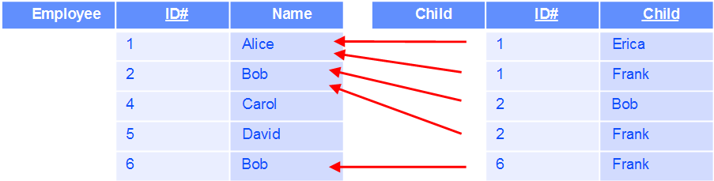
Foreign Key ≡ A Binary Many-To-One Relationship Between Tables (Partial Function)
Note:
Every row of Child has a single value of a primary key of Employee, so every row of Child “maps” to a single row of Employee
Every row of Employee has zero or more rows of Child mapped to it
In other words, no constraint
Here the function is total: defined everywhere

Slide 43

Foreign Key ≡ A Binary Many-To-One Relationship Between Tables
Another option
Note column names do not have to be the same for the mapping to take place
But you need to specify which column is foreign key referring to what
Here: Parent in Child is a foreign key referencing the column ID# in Employee
In SQL DDL, the syntax is more explicit: the specific column(s) of Employee are stated: we will see later
Employee | ID# | Name
 | 1 | Alice
 | 2 | Bob
 | 4 | Carol
 | 5 | David
 | 6 | Bob
Child | Parent | Child
 | 1 | Erica
 | 1 | Frank
 | 2 | Bob
 | 2 | Frank
 | 6 | Frank

Slide 44
Born
Born needs to specify which employees were born in which countries (for those for whom this information is known)
We can list what is the current state
Employee identified by 1 was born in country identified by US
Employee identified by 2 was born in country identified by IN
Employee identified by 5 was born in country identified by IN
Employee identified by 6 was born in country identified by CN

Slide 45
Born
Born needs to specify who was born where
We have tables for
Employee
Country
We know that each employee was born in at most one country (we either know the country or not)
We have a binary many-to-one relationship between Employee and Country, but no implementation yet
Employee | ID# | Name
 | 1 | Alice
 | 2 | Bob
 | 4 | Carol
 | 5 | David
 | 6 | Bob
Country | CName | Population
 | US
 | IN | 1347
 | CN | 1412
 | RU

Slide 46
Implementation for Born
Augment Employee so instead of
we have
Employee | ID# | Name
 | 1 | Alice
 | 2 | Bob
 | 4 | Carol
 | 5 | David
 | 6 | Bob
Country | CName | Population
 | US
 | IN | 1347
 | CN | 1412
 | RU
Employee | ID# | Name | CName
 | 1 | Alice | US
 | 2 | Bob | IN
 | 4 | Carol
 | 5 | David | IN
 | 6 | Bob | CN
Employee | ID# | Name | CName
 | 1 | Alice | US
 | 2 | Bob | IN
 | 4 | Carol
 | 5 | David | IN
 | 6 | Bob | CN
Country | CName | Population
 | US
 | IN | 1347
 | CN | 1412
 | RU

Slide 47
Implementation for Born
Augment Employee so instead of
we have two tables and a binary many-to-one mapping
Employee | ID# | Name
 | 1 | Alice
 | 2 | Bob
 | 4 | Carol
 | 5 | David
 | 6 | Bob
Country | CName | Population
 | US
 | IN | 1347
 | CN | 1412
 | RU
Employee | ID# | Name | CName
 | 1 | Alice | US
 | 2 | Bob | IN
 | 4 | Carol
 | 5 | David | IN
 | 6 | Bob | CN
Country | CName | Population
 | US
 | IN | 1347
 | CN | 1412
 | RU

Slide 48
Foreign Key Constraint Implementing Born
We have again a foreign key constraint
Any value of CName in Employee must also appear in Country as a primary key in some row
CName in Employee is a foreign key referencing Country
Note that CName in Employee is not even a part of its primary key
Note that the binary many-to-one mapping is not total in this example
Employee | ID# | Name | CName
 | 1 | Alice | US
 | 2 | Bob | IN
 | 4 | Carol
 | 5 | David | IN
 | 6 | Bob | CN
Country | CName | Population
 | US
 | IN | 1347
 | CN | 1412
 | RU

Slide 49
Foreign Key Constraint Implementing Born
Perhaps better (and frequently done in practice) use a different name for foreign keys
Any value of CBirth in Employee must also appear in Country as a primary key in some row
CBirth in Employee is a foreign key referencing Country
We will not talk here about such, possibly convenient, renaming
Employee | ID# | Name | CBirth
 | 1 | Alice | US
 | 2 | Bob | IN
 | 4 | Carol
 | 5 | David | IN
 | 6 | Bob | CN
Country | CName | Population
 | US
 | IN | 1347
 | CN | 1412
 | RU

Slide 50
Likes
Likes needs to specify which employees like which animals
We can list what is the current state:
Employee identified by 1 likes animal identified by Horse
Employee identified by 1 likes animal identified by Cat
Employee identified by 2 likes animal identified by Cat
Employee identified by 6 likes animal identified by Yak

Slide 51
Likes
We can describe Likes by drawing lines between the two tables
We need to “store” this set of red lines
Likes is a many-to-many relationship
It is not a many-to-one relationship and therefore it is not a partial function
Employee | ID# | Name
 | 1 | Alice
 | 2 | Bob
 | 4 | Carol
 | 5 | David
 | 6 | Bob
Animal | Species | Discovered
 | Horse | Asia
 | Wolf | Asia
 | Cat | Africa
 | Yak | Asia
 | Zebra | Africa

Slide 52
Likes (impossible implementation)
Cannot store with Employee (there is no limit on the number of animals an employee likes)
Employee | ID# | Name
 | 1 | Alice
 | 2 | Bob
 | 4 | Carol
 | 5 | David
 | 6 | Bob
Animal | Species | Discovered
 | Horse | Asia
 | Wolf | Asia
 | Cat | Africa
 | Yak | Asia
 | Zebra | Africa
Employee | ID# | Name | Species | Species
 | 1 | Alice | Horse | Cat
 | 2 | Bob | Cat
 | 4 | Carol
 | 5 | David
 | 6 | Bob | Yak

Slide 53
Likes (impossible implementation)
Cannot store with Animal (there is no limit on the number of employees who like an animal)
Employee | ID# | Name
 | 1 | Alice
 | 2 | Bob
 | 4 | Carol
 | 5 | David
 | 6 | Bob
Animal | Species | Discovered
 | Horse | Asia
 | Wolf | Asia
 | Cat | Africa
 | Yak | Asia
 | Zebra | Africa
Animal | Species | Discovered | ID# | ID#
 | Horse | Asia | 1
 | Wolf | Asia
 | Cat | Africa | 1 | 2
 | Yak | Asia | 6
 | Zebra | Africa

Slide 54
Likes
Each red line is an edge defined by its vertices
We create a table storing the red lines; that is, its vertices
We can do this using the primary keys of the entities
We do not need other attributes such as Name or Discovered
The table for Likes contains tuples:
1 likes Horse
1 likes Cat
2 likes Cat
6 likes Yak
Likes | ID# | Species
 | 1 | Horse
 | 1 | Cat
 | 2 | Cat
 | 6 | Yak

Slide 55
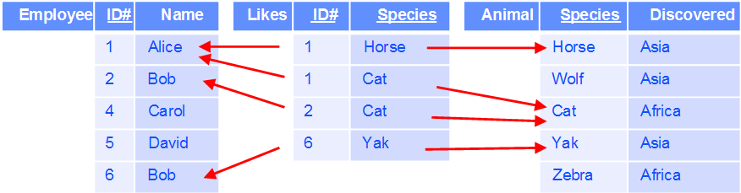
Likes
Note that there are foreign key constraints
ID# appearing in Likes is a foreign key referencing Employee
Species appearing in Likes is a foreign key referencing Animal
And two many-to-one mappings are induced
Note: a binary many-to-many relationship was replaced by a new table and two many-to one relationships

Slide 56
Specifying a Relational Implementation
You will use SQL Power Architect in the class
It is reasonable and available
It is very lightweight
We will cover it
We could even use software to generate database specifications from the diagram to SQL DDL (forward engineering)
SQL Power Architect can do that

Slide 57
Specifying a Relational Implementation Using SQL Power Architect
A drawing in SQL Power Architect does not deal with Entities and Relationships (though such terms are sometimes used in this context)
This is good, as it produces a relational schema, which is what we need, but this is a lower-level construct
It focuses on tables and the implicit many-to-one binary relationships induced by foreign keys
Table
A rectangle with three vertical subrectangles: name, list of attributes in the primary key, list of attributes not in the primary key
Required attributes characterized as such: NOT NULL
Attributes in the primary key and foreign keys are labeled as such
Relationship
A many-to-one binary (or perhaps one-to-one, which is discussed later) relationship induced by a foreign key constraint is explicitly drawn by means of a line segment with an arrow heads of various types

Slide 58
Relational Implementation For The Example: Tables And Binary Many-To-One Mappings
Country | CName | Population
 | US
 | IN | 1347
 | CN | 1412
 | RU
Child | ID# | Child
 | 1 | Erica
 | 1 | Frank
 | 2 | Bob
 | 2 | Frank
 | 6 | Frank
Employee | ID# | Name | CName
 | 1 | Alice | US
 | 2 | Bob | IN
 | 4 | Carol
 | 5 | David | IN
 | 6 | Bob | CN
Animal | Species | Discovered
 | Horse | Asia
 | Wolf | Asia
 | Cat | Africa
 | Yak | Asia
 | Zebra | Africa
Likes | ID# | Species
 | 1 | Horse
 | 1 | Cat
 | 2 | Cat
 | 6 | Yak

Slide 59
Standard Notation For Cardinality Constraints Crow’s Feet: Richer Than Standard Arrows
We will look at a binary many-to-one mapping relationship Likes from Person to Country
We will ask the following question: If I start from a Person, how many Countries can I reach
This is the same as: Given a Person, how many Countries can it Like?
We will ask the following question: If I start from a Country, how many Persons can I reach?
This is the same as: Given a Country, how many Person can Like it?
Our new notation will allow us to characterize 6 cases

Slide 60
Standard Notation For Cardinality Constraints Crow’s Feet: Richer Than Arrows
The notation will have various “ends of line”
Our previous notation had 2 types of ends of lines
Arrowhead
Plain, no arrowhead
We will have ends of lines consisting of some combinations of
Circle, standing for = 0
Vertical bar, standing for = 1
A “foot” with 3 “toes”, standing for > 1
Next, we look at all the possible cases
We will have
Person
Country
Binary many-to-one mapping from Person to Country specified, of course, using a foreign key
The lines will be dashed, not important why for now

Slide 61

Born With Crow’s Feet A Case
From Person we can reach 0 or 1 Countries
From Country we can reach 0, 1, or > 1 Persons

Slide 62

Born With Crow’s Feet A Case
From Person we can reach 1 Countries
From Country we can reach 0, 1, or > 1 Persons

Slide 63

Born With Crow’s Feet A Case
From Person we can reach 0 or 1 Countries
From Country we can reach 0 or 1 Persons

Slide 64

Born With Crow’s Feet A Case
From Person we can reach 1 Countries
From Country we can reach 0 or 1 Persons

Slide 65

Born With Crow’s Feet A Case
From Person we can reach 0 or 1 Countries
From Country we can reach 1 or > 1 Persons

Slide 66

Born With Crow’s Feet A Case
From Person we can reach 1 Countries
From Country we can reach 1 or > 1 Persons

Slide 67
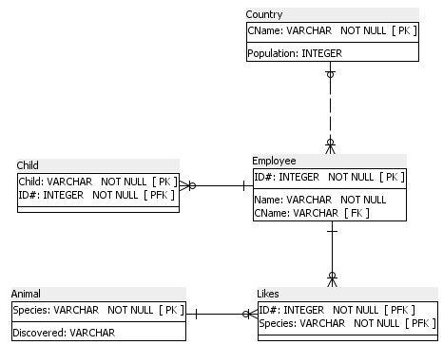
Relational Implementation Using SQL Power Architect
Country | CName | Population
 | US
 | IN | 1347
 | CN | 1412
 | RU
Child | ID# | Child
 | 1 | Erica
 | 1 | Frank
 | 2 | Bob
 | 2 | Frank
 | 6 | Frank
Employee | ID# | Name | CName
 | 1 | Alice | US
 | 2 | Bob | IN
 | 4 | Carol
 | 5 | David | IN
 | 6 | Bob | CN
Animal | Species | Discovered
 | Horse | Asia
 | Wolf | Asia
 | Cat | Africa
 | Yak | Asia
 | Zebra | Africa
Likes | ID# | Species
 | 1 | Horse
 | 1 | Cat
 | 2 | Cat
 | 6 | Yak

Slide 68
Same Drawing: Easier To Read

Slide 69
Observe The Shape Of The Line Ends And The Types Of Lines

Slide 70
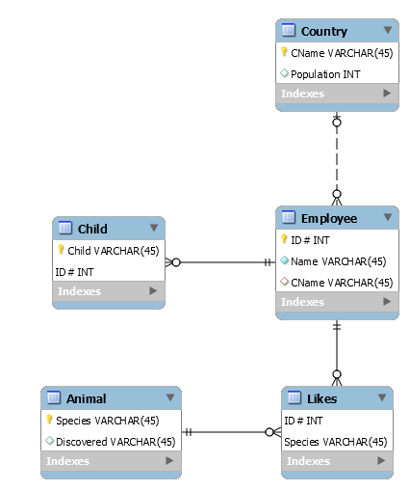
Relational Implementation Using MySQL Workbench

Slide 71
Observe The Shape Of The Line Ends And The Types Of Lines

Slide 72
Pattern of Lines
The line between Animal and Likes is solid because the primary key of the “many side”, Likes, includes the primary key of the “one side”, Animal, so Likes “cannot exist” without Animal; the relationship is “identifying”
The line between Employee and Likes is solid because the primary key of the “many side”, Likes, includes the primary key of the “one side”, Employee, so Likes “cannot exist” without Employee; the relationship is “identifying”
The line between Employee and Child is solid because the primary key of the “many side”, Child, includes the primary key of the “one side”, Employee, so Child “cannot exist” without Employee; the relationship is “identifying”
The line between Country and Employee is dashed because the primary key of the “many side”, Employee, does not include the primary key of the “one side”, Country, so Employee “can exist” without Country; the relationship is “non-identifying”

Slide 73
Pattern of Lines
This is not a question of the ends of lines “forcing” the pattern of lines
In the next slide, we see a slight modification of our example in which all lines have the same pair of endings
We now require that for each Employee the Country of Birth is known
Nevertheless, as Cname is not part of the primary key of Country, the line is dashed

Slide 74
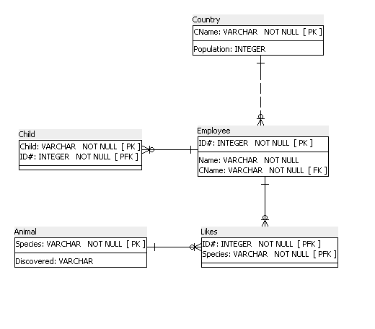
Example
Assume: Every employee has exactly one Country (that is we know the country of birth)

Slide 75
Alternative Implementation for Born
We need an “in-between” table for Likes because it is many-to-many
We do not need an “in-between” table for Born because it is many-to-one
But we can implement Born using such an “in-between” table
Note that CName is not part of the primary key of Born
Employee | ID# | Name
 | 1 | Alice
 | 2 | Bob
 | 4 | Carol
 | 5 | David
 | 6 | Bob
Born | ID# | CName
 | 1 | US
 | 2 | IN
 | 5 | IN
 | 6 | CN
Country | CName | Population
 | US
 | IN | 1347
 | CN | 1412
 | RU

Slide 76
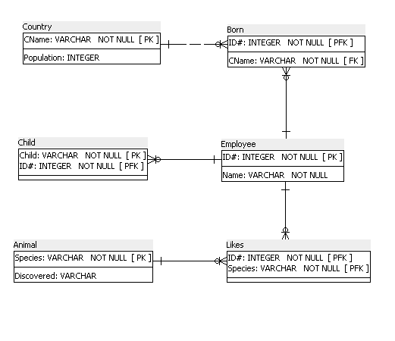
Alternative Implementation for the Example
Country | Cname | Population
 | US
 | IN | 1347
 | CN | 1412
 | RU
Born | ID# | CName
 | 1 | US
 | 2 | IN
 | 5 | IN
 | 6 | CN
Child | ID# | Child
 | 1 | Erica
 | 1 | Frank
 | 2 | Bob
 | 2 | Frank
 | 6 | Frank
Employee | ID# | Name
 | 1 | Alice
 | 2 | Bob
 | 4 | Carol
 | 5 | David
 | 6 | Bob
Animal | Species | Discovered
 | Horse | Asia
 | Wolf | Asia
 | Cat | Africa
 | Yak | Asia
 | Zebra | Africa
Likes | ID# | Species
 | 1 | Horse
 | 1 | Cat
 | 2 | Cat
 | 6 | Yak

Slide 77
Same Drawing: Easier To Read

Slide 78
Options for Relationships
General case
We have a relationship R among entity sets E₁, E₂, …, E_{n}, with properties P₁, P₂, …, P_{m}
Each E_{i} is implemented as a table
We can always implement R as a table with foreign key constraints referencing E₁, E₂, …, E_{n}, and with R also storing properties P₁, P₂, …, P_{m}
Special case: R is binary many-to-one from E₁ to E₂
We can, if we like, avoid introducing a table for R
We implement R as a foreign key constraint in E₁ referencing E₂, and with E₁ also storing properties P₁, P₂, …, P_{m}

Slide 79
Which Implementation to Use for Born? (And for Such Relationships in General)
We cannot give a general rule
Our original implementation would introduce NULLs for Persons for whom we do not know the country of birth
Our alternate implementation would introduce an additional table, which would have no NULLs
For the purpose of the class, we will always use our original implementation (without the additional table), to have better exercises and to reinforce the fundamental nature of binary many-to-one relationships
So do this for all your work when relevant

Slide 80
To Remember!
Structurally, a relational database consists of
A set of tables with identifiers (primary keys)
A set of many-to-one binary relationships between them, induced by foreign key constraints
In other words; a set of functions (in general partial), each from a table into a table
When designing a relational database, you should specify both (or you will produce a bad specification)
Technically, tables are enough, but this a very bad practice as you do not specify the relationships between tables

Slide 81

Many-To-One Mapping From Child to Employee (To Reiterate)
Partial function from a set of rows into a set of rows
 | 1 | Erica
 | 1 | Frank
 | 2 | Bob
 | 2 | Frank
 | 6 | Frank
 | 1 | Alice
 | 2 | Bob
 | 4 | Carol
 | 5 | David
 | 6 | Bob

Slide 82
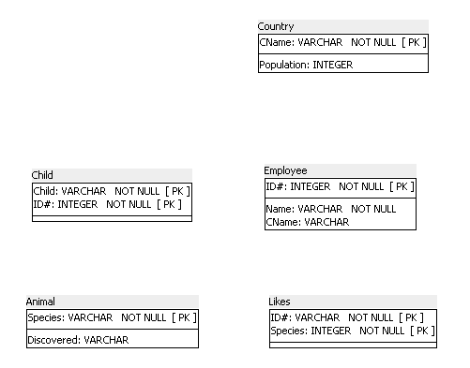
Very Bad Relational Implementation
Tables are listed with attributes, specifying only which are in the primary key
Foreign key constraints are not specified
So, the database does not know what to enforce

Slide 83
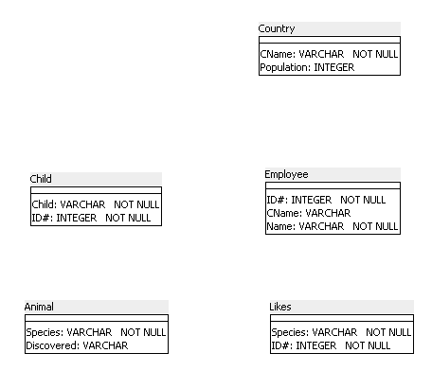
Terrible Relational Implementation
Even primary keys are not specified

Slide 84
Ternary Relationships, And So On…

Slide 85
Ternary Relationship (We Saw the ER Diagram Before)
Let’s look at Buys listing all tuples of (x,y,z) where Person x Buys Product y from Vendor z
We describe an instance informally:
Chee buys computer from IBM
Chee buys computer from Dell
Lakshmi buys computer from Dell
Lakshmi buys monitor from Apple
Chee buys monitor from IBM
Marsha buys computer from IBM
Marsha buys monitor from Dell

Slide 86
Ternary Relationship Implementation Three Binary Many-To-One Mappings
Person | Name
 | Chee
 | Lakshmi
 | Marsha
 | Michael
 | Jinyang
Buys | Com | Name | Type
 | IBM | Chee | com
 | Dell | Lakshmi | com
 | IBM | Marsha | com
 | IBM | Chee | mon
 | Dell | Marsha | mon
 | Dell | Chee | com
 | Apple | Lakshmi | mon
Vendor | Com
 | IBM
 | Apple
 | Dell
 | HP
Product | Type
 | com
 | mon
 | prin

Slide 87
Ternary Relationship Implementation Three Binary Many-To-One Mappings
We have 3 binary-many-to-one mappings
Also referred to as partial functions, which happen to be total in the implementation
Recall, “partial” means that the function does not have to be defined on all of its domain, but can be defined on all of its domain
Our 3 mappings are
From the rows of Buys into the rows of Person
From the rows of Buys into the rows of Vendor
From the rows of Buys into the rows of Product
These mapping are specified using foreign keys
We will see this again when we look at a relational implementation using SQL Power Architect
Same thing using MySQL Workbench

Slide 88
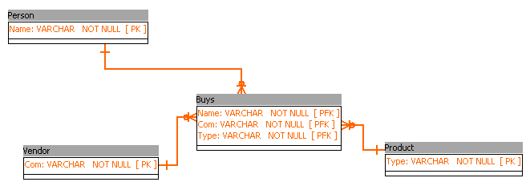
Ternary Relationship Implementation

Slide 89
Ternary Relationship Which Is a Function of Two Variables
Let’s look at Buys listing all tuples of (x,y,z) where person x Buys Product y from Vendor z
But now a Person Buys a specific Product only from one Vendor
This simply means that Vendor is a partial function from the cartesian product Person × Product
For every pair (person, product) there is at most one vendor
It is partial and not total, if for some pair (person, product) the vendor is not known
Otherwise, it is guaranteed to be total

Slide 90
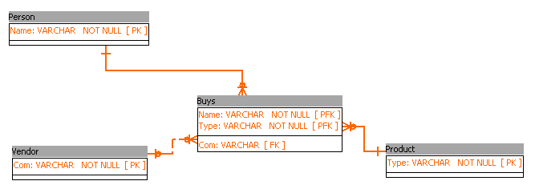
Ternary Relationship Com (pany) May Not Be Always Known
Note that Com (Vendor) is no longer a part of the primary key of Buys

Slide 91
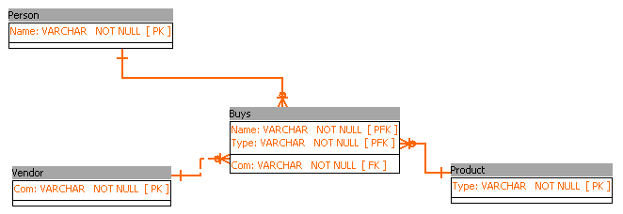
Ternary Relationship Com (pany) Always Known
Note that Com (Vendor) is no longer a part of the primary key of Buys

Slide 92
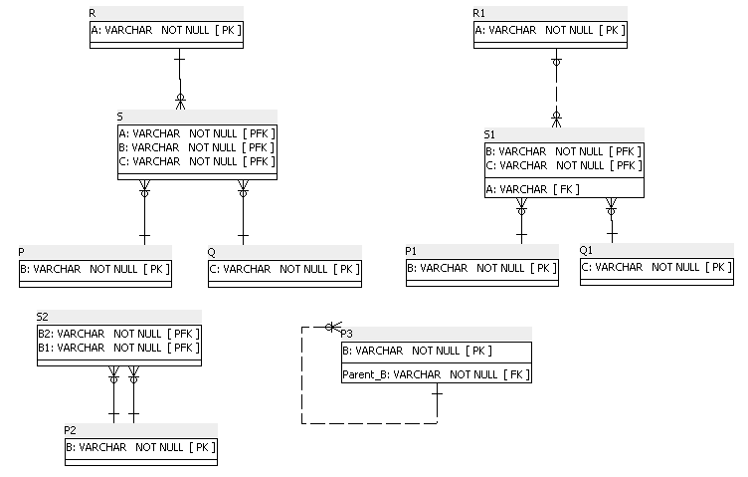
Synopsis of Four Representative Cases
General Ternary Relationship
Partial Function of Two Variables
Partial Function From a Table to Itself
General Binary Relationship Between a Table and Itself

Slide 93
From ER Diagram to Relational Database A Comprehensive Example

Slide 94
From ER Diagram to Relational Database
We now convert our big ER diagram into a relational database
We specify
Attributes that must not be NULL
Primary keys
Keys (beyond primary)
Foreign keys and what they reference
Cardinality constraints
Some additional “stubs”

Slide 95
From ER Diagram to Relational Database
We both give a narrative description, similar to actual SQL DDL (so we are learning about actual relational databases) and SQL Power Architect
We should specify domains also, but we would not learn anything from this here, so we do not do that here
This is really a comprehensive example and not an algorithmic procedure
It provides intuition to handle cases not explicitly appearing in the example
We are not trying to improve the design: we will do that later in the Normalization Unit: we just implement the ER diagram
We go bottom up, in the same order as the one we used in constructing the ER diagram

Slide 96
Our ER Diagram

Slide 97
Hierarchy for Our ER Diagram

Slide 98
Annotations For The ER Diagram
The graph describing the Dam relationship is a forest of rooted trees
LN, SS#, DOB in Person are always known
No two Persons can have the same SS#
Color in Car is always known
Weight in Automobile is always known
Type is total
Every Person Has at least 2 Cars
Salary is always known
Title in Course is always known
Prereq is a DAG (Directed Acyclic Graph)
Each Course has at least 1 Section related to it through Offered
A Section has between 3 and 50 Students

Slide 99
Annotations For The ER Diagram
GPA: Computed Attribute for Student by adding all the known numeric Grades, dividing by the number of Sections that the Student Took
Supervisor and Supervised cannot be the same Professor

Slide 100
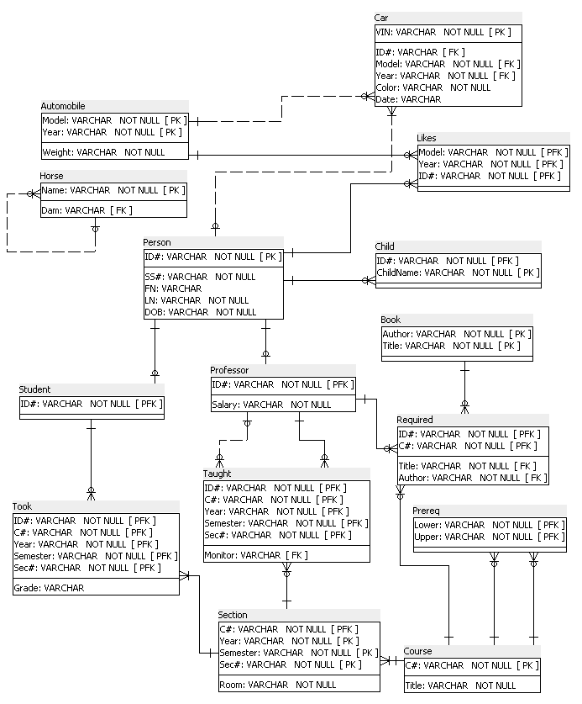
We Will Produce

Slide 101
Reminder: Our ER Diagram So We Do Not Have To Go Back To Look At It

Slide 102

Relational Database So Far

Slide 103
Comments
We will handle the Dam relationship at the end
This is a little subtle case so we will do it later
But if we were experienced, we could do it now

Slide 104
Reminder: Our ER Diagram So We Do Not Have To Go Back To Look At It

Slide 105
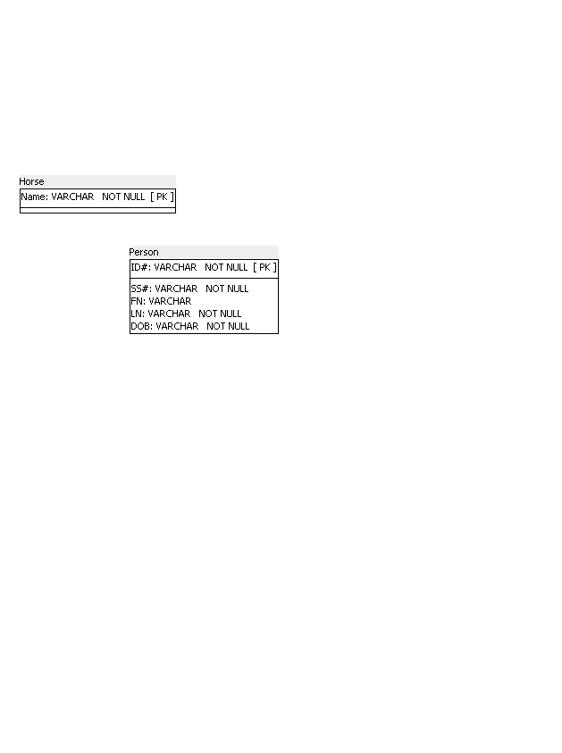
Relational Database So Far

Slide 106
Annotations
SS# is UNIQUE in Person

Slide 107
Comments
Note that annotation refers to specific tables and specific columns in the tables
Once our relational implementation is done, we no longer (at least in theory) refer to the ER diagram
UNIQUE can be specified using an index in a relational design; if we do that, we do not need an annotation

Slide 108
Reminder: Our ER Diagram So We Do Not Have To Go Back To Look At It

Slide 109
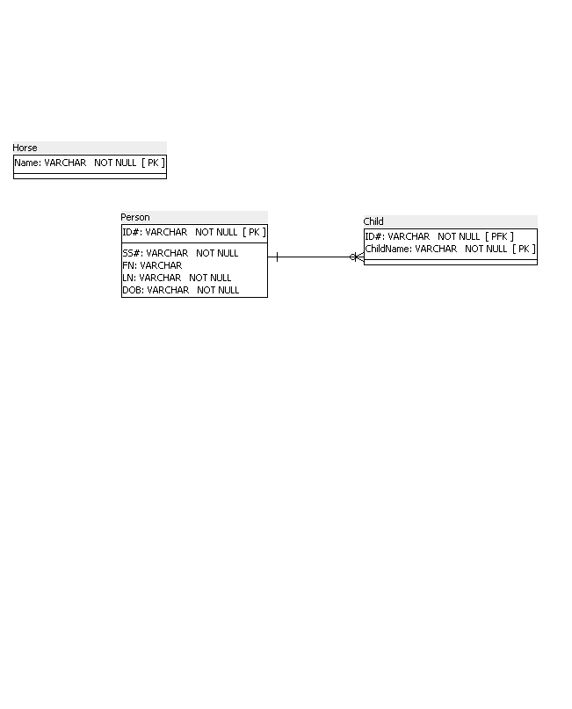
Relational Database So Far

Slide 110
Comments
Note the solid line
We see a relationship that is identifying
Child needs to be related to Person to be identified

Slide 111
Reminder: Our ER Diagram So We Do Not Have To Go Back To Look At It

Slide 112
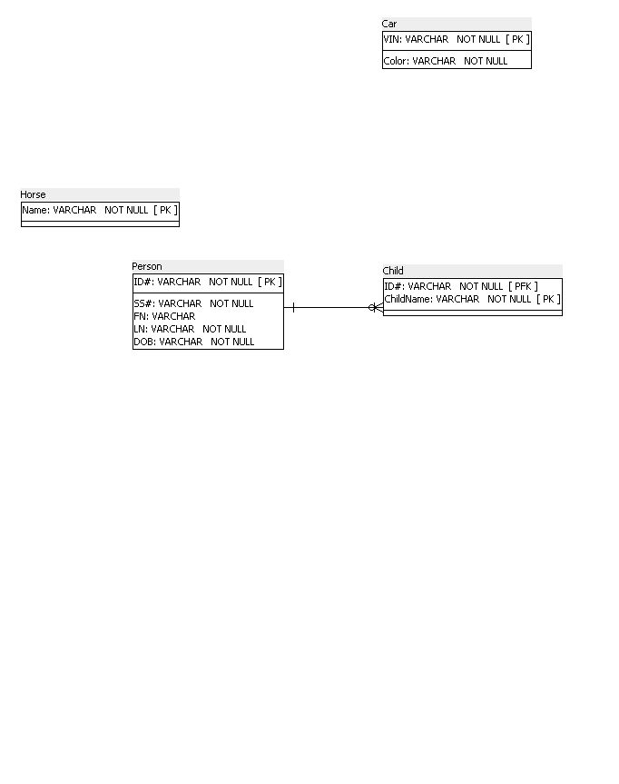
Relational Database So Far

Slide 113
Reminder: Our ER Diagram So We Do Not Have To Go Back To Look At It

Slide 114
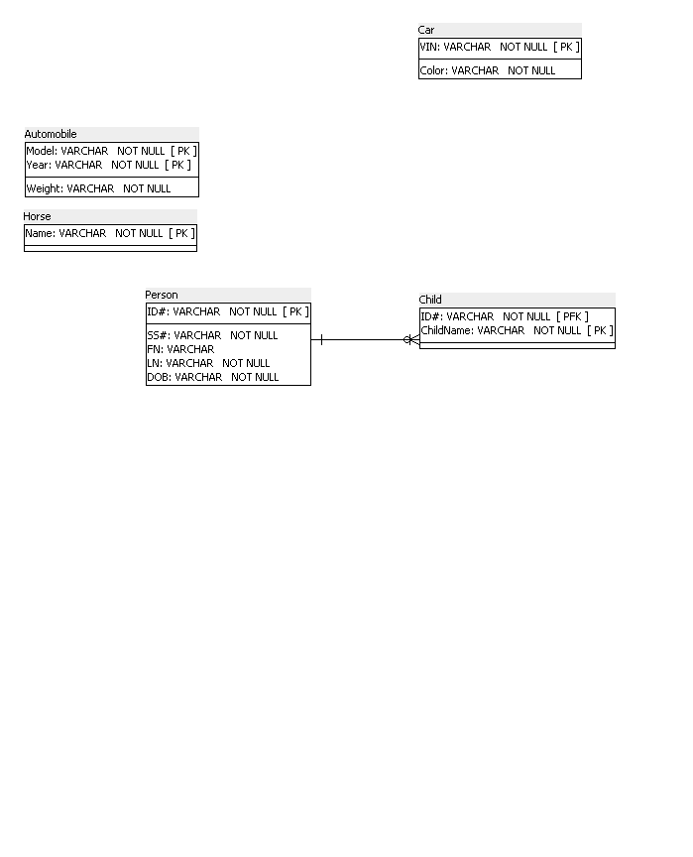
Relational Database So Far

Slide 115
Reminder: Our ER Diagram So We Do Not Have To Go Back To Look At It

Slide 116
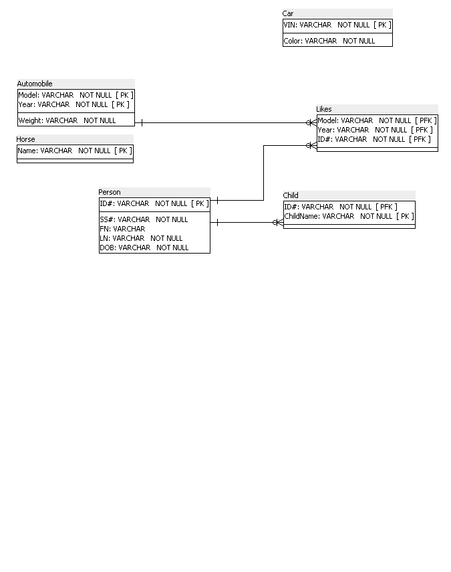
Relational Database So Far

Slide 117
Reminder: Our ER Diagram So We Do Not Have To Go Back To Look At It

Slide 118
Relational Database So Far

Slide 119
Comments
Note: the following is bad/incorrect, replacing one line by two lines
Foreign Key (Model) References Automobile
Foreign Key (Year) References Automobile
There are 2 induced binary many-to-one relationships
From Likes to Person
From Likes to Automobile

Slide 120
Reminder: Our ER Diagram So We Do Not Have To Go Back To Look At It

Slide 121
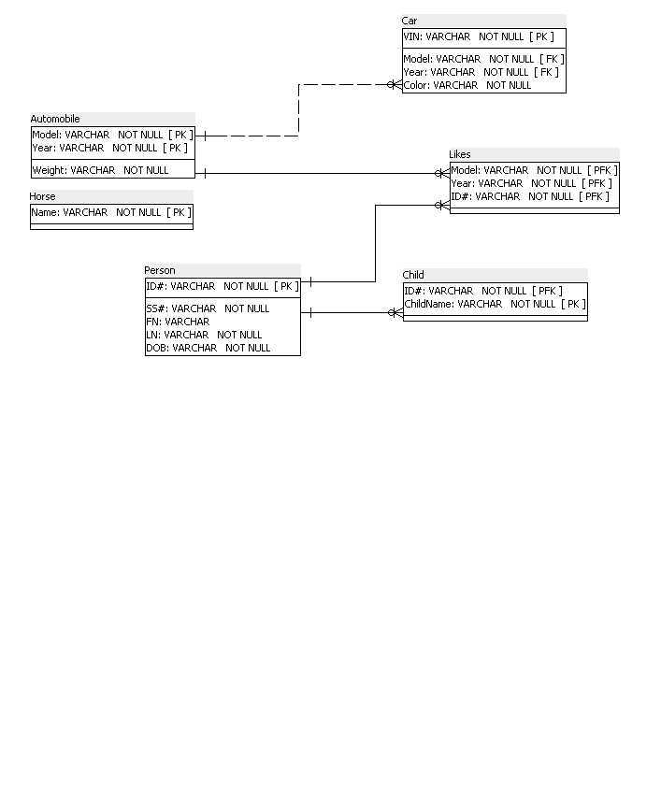
Relational Database So Far

Slide 122
Comments
Type is a binary many-to-one relationship, so we do not add a table to store this relationship
Note the dashed line
This is the first time we see a relationship that is not identifying
Car does not need to be related to Automobile to be identified

Slide 123
Reminder: Our ER Diagram So We Do Not Have To Go Back To Look At It

Slide 124
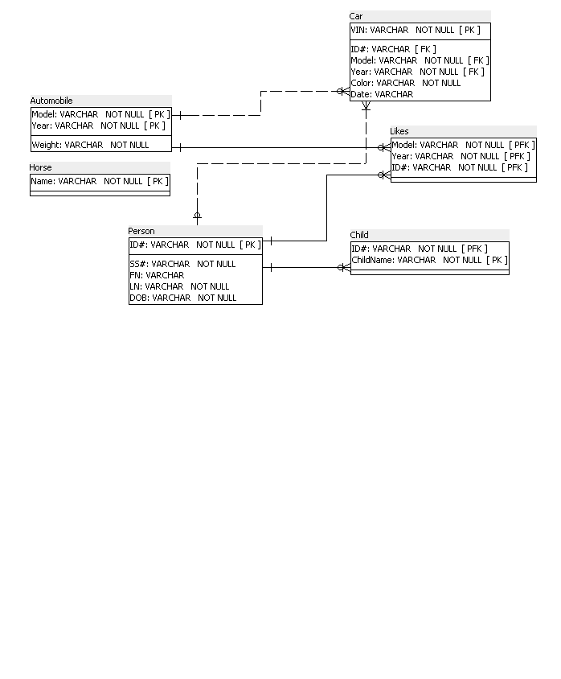
Relational Database So Far

Slide 125
Annotations
Every ID# must appear in at least two distinct tuples of table Car

Slide 126
Comments
Our Crow’s feet notation allows us to specify only the weaker condition: Every ID# must appear in at least one tuple of table Car
Note that the Date is stored inside Car
It could not have been stored inside Person
Note that the number 2 does not impact on the structure of the design on the correctness of an instance
We would have the same design if instead of 2 we had 500
That’s why the arrow notation was good enough and we did not use cardinality in our ER diagrams

Slide 127
Reminder: Our ER Diagram So We Do Not Have To Go Back To Look At It

Slide 128
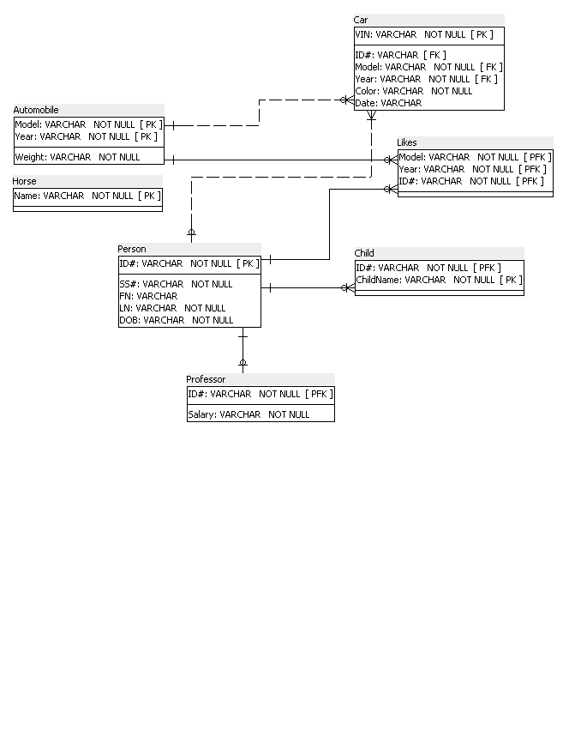
Relational Database So Far

Slide 129
Comments
Note the ends of the line
From Person you reach 0 or 1 Professors
From Professor you reach 1 Person

Slide 130
Reminder: Our ER Diagram So We Do Not Have To Go Back To Look At It

Slide 131
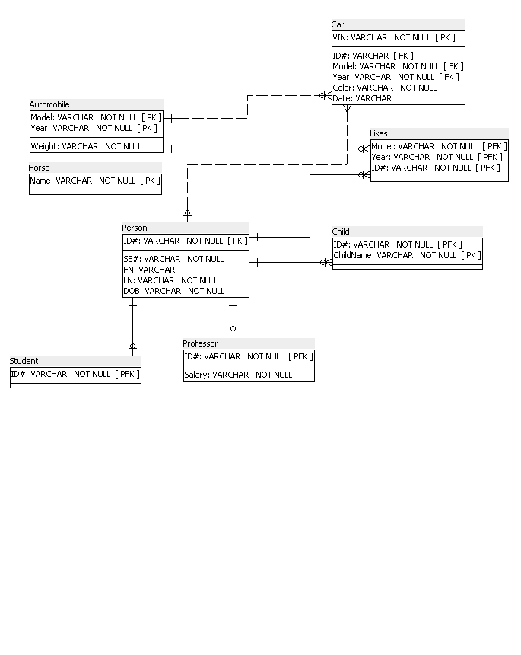
Relational Database So Far

Slide 132
Comment on ISA
We did not have these in our example, but they are important and that’s how should be phrased in annotations in your homework
If ISA is total, we will say: The union of the set of ID#s in Student and of the ID#s in Professor is equal to the set of ID#s in Person
If ISA is disjoint, we will say: The intersection of the set of ID#s in Student and of the ID#s in Professor is empty

Slide 133
Reminder: Our ER Diagram So We Do Not Have To Go Back To Look At It

Slide 134
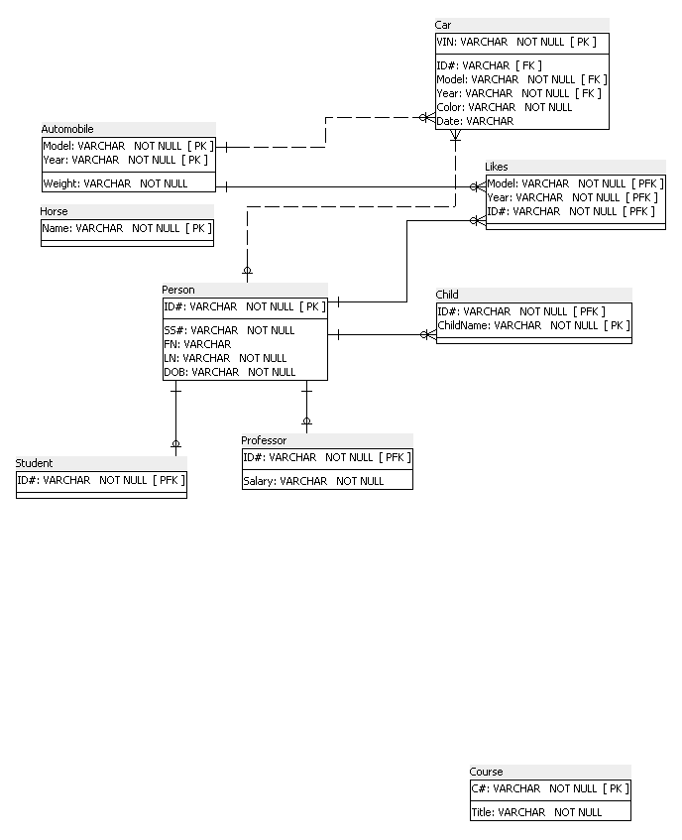
Relational Database So Far

Slide 135
Reminder: Our ER Diagram So We Do Not Have To Go Back To Look At It

Slide 136
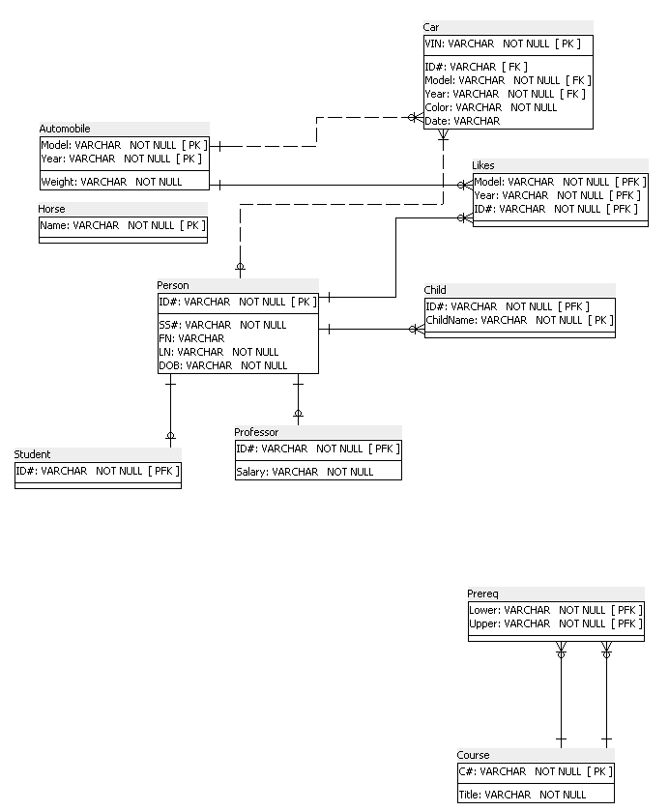
Relational Database So Far

Slide 137
Annotations
Table Prereq stores/is a Directed Acyclic Graph (DAG)

Slide 138
Comments
A binary relationship from a set to itself is also called recursive
If we draw the DAG, the arcs will naturally point from Lower to Upper
From roots/sources going down until they hit the leaves/sinks
Example
But we could also draw in the opposite direction

Slide 139
Reminder: Our ER Diagram So We Do Not Have To Go Back To Look At It

Slide 140
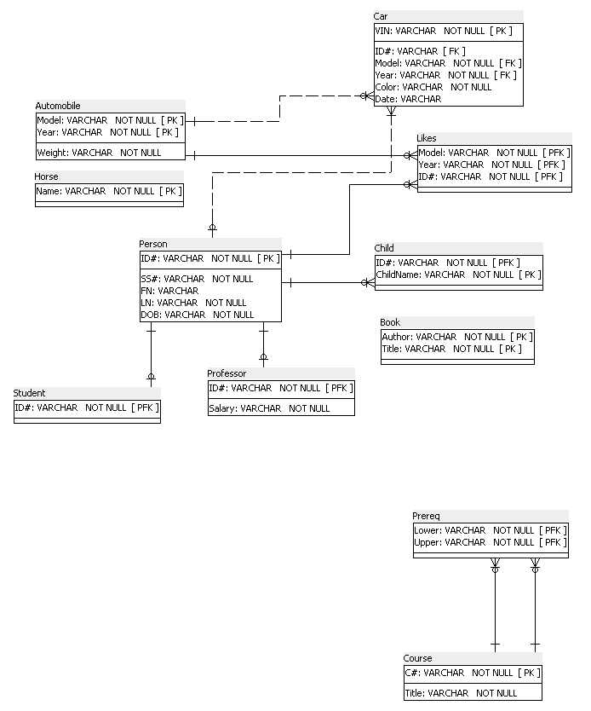
Relational Database So Far

Slide 141
Reminder: Our ER Diagram So We Do Not Have To Go Back To Look At It

Slide 142
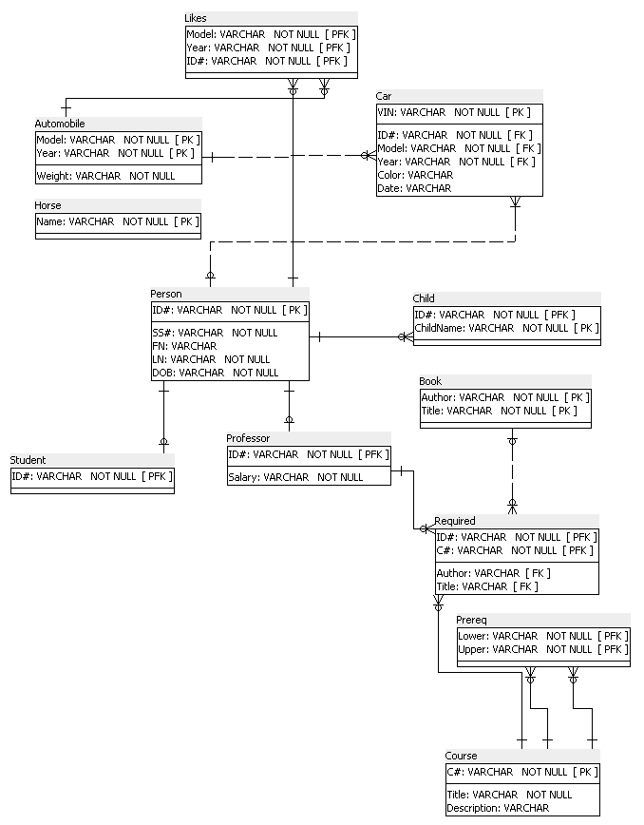
Relational Database So Far

Slide 143
Comments
Note that the Foreign Key (Title, Author) in Required is not part of the Primary Key
This shows that the ternary relationship stored in Required is somewhat restricted
It is many-to-one from Course and Professor into Book
It is a partial function of two variables
We saw this before, so this is just a reminder

Slide 144
Reminder: Our ER Diagram So We Do Not Have To Go Back To Look At It

Slide 145
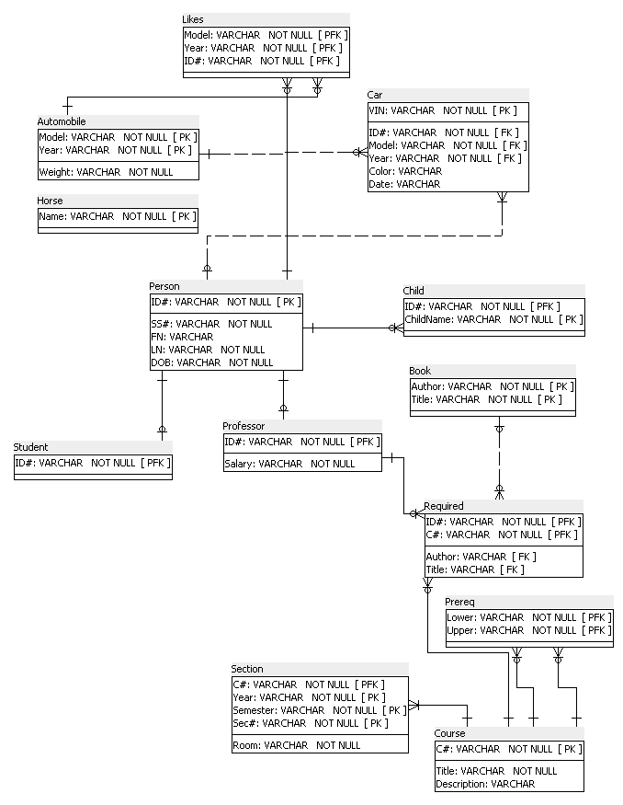
Relational Database So Far

Slide 146
Comments
One of our current sections (we have 3) is identified by the primary key: CSCI-GA.2433, 2021, Fall, 001
Compare with what we had in the previous unit
As Offered is binary many-to-one we do not need to have an “intermediate” table storing it
In fact, it would not make any sense to have it here, because it we had it here, it would be just part of Section with one column repeated A typical tuple would be primary keys from the Course table and from the Section table CSCI-GA.2433, CSCI-GA.2433, 2021, Fall, 001

Slide 147
Comments
A more common case for a weak entity would be that the strong entity (here Course) would be related to 0, 1, or > 1 weak entities (here Section)
But in our application, we specifically said that each Course has at least 1 Section
So, we have a special case: the strong entity is related to 1 or more than 1 weak entities

Slide 148
Reminder: Our ER Diagram So We Do Not Have To Go Back To Look At It

Slide 149
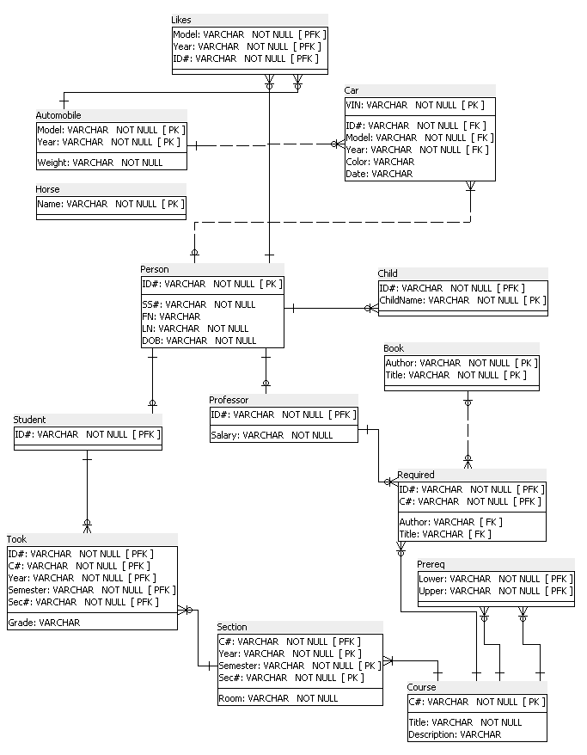
Relational Database So Far

Slide 150
Annotations
GPA: Computed Attribute for Student by adding all the known numeric Grades, dividing by the number of Sections that the Student Took and in which it got a numeric Grade

Slide 151
Comments
In some implementations a derived attribute is stored
If this were the case, we would store GPA as an attribute in Student

Slide 152
Reminder: Our ER Diagram So We Do Not Have To Go Back To Look At It

Slide 153
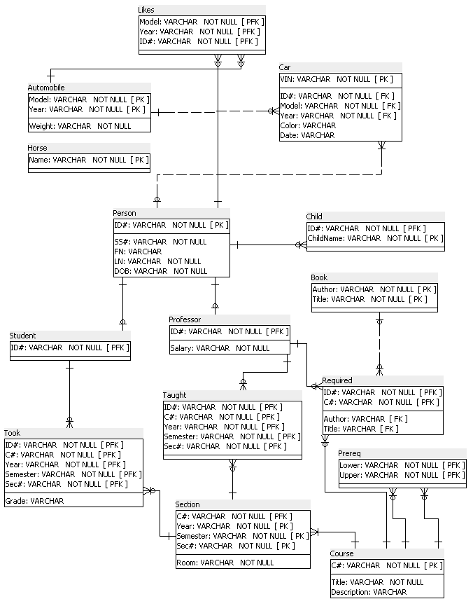
Relational Database So Far

Slide 154
Reminder: Our ER Diagram So We Do Not Have To Go Back To Look At It

Slide 155

Relational Database So Far

Slide 156
Annotations
In every tuple of table Taught, the values in columns ID# and Monitor must be different (if there is a Monitor)

Slide 157
Reminder: Our ER Diagram So We Do Not Have To Go Back To Look At It

Slide 158
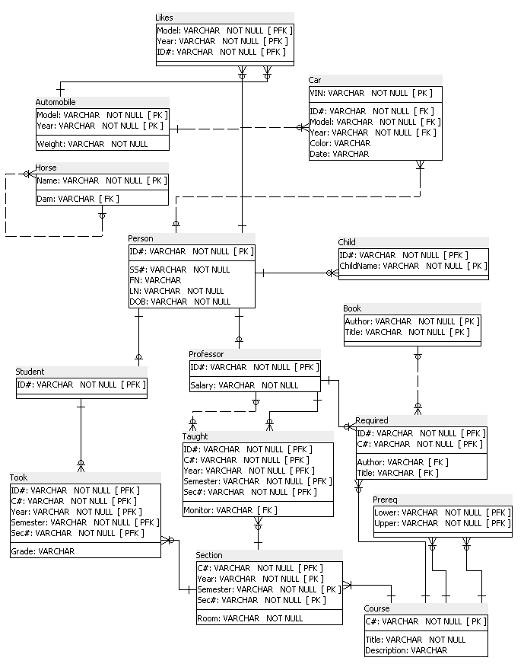
Relational Database So Far

Slide 159
Annotations
Table Dam stores/is a forest of rooted trees

Slide 160
Comments
This is a binary many-to-one relationship from a set to itself
If we drew the forest of rooted trees as we implement if here, the arcs would point from Child to Mother
From leaves/sources going up until they hit the root/sink
Because we have a function (from child to parent)
Example

Slide 161
We Are Done

Slide 162
Annotations for the Relational Implementation (Abbreviated: Do Not Abbreviate in Homework)
SS# is UNIQUE
Every ID# must appear in at least two distinct tuples of Car
Prereq is a Directed Acyclic Graph (DAG)
GPA: Computed Attribute for Student by adding all the known numeric Grades, dividing by the number of Sections that the Student Took and in which it got a numeric Grade
In every tuple of Taught, ID# and Monitor must be different (if there is a Monitor)
Dam is a forest of rooted trees

Slide 163
Comments
Good design: few annotations

Slide 164
Comparing Notations
It is useful for you to go over the full SQL Power Architect implementation to see the different ways the binary many-to-one mappings are represented
We have covered that earlier, but it’s good to practice to do that

Slide 165
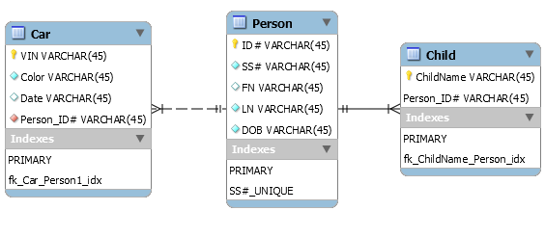
MySQL Workbench
A system tailored to MySQL with the capabilities to
Design a database (not restricted to MySQL)
Forward engineer a diagram/design into SQL DDL (we will see later what SQL DDL looks like more precisely)
Reverse engineer a MySQL database to obtain a diagram/design
A fragment of our database in MySQL Workbench
Next: The fragment forward-engineered SQL DDL

Slide 166
Forwarded-Engineered Database
-- MySQL Workbench Forward Engineering
SET @OLD_UNIQUE_CHECKS=@@UNIQUE_CHECKS, UNIQUE_CHECKS=0;
SET @OLD_FOREIGN_KEY_CHECKS=@@FOREIGN_KEY_CHECKS, FOREIGN_KEY_CHECKS=0;
SET @OLD_SQL_MODE=@@SQL_MODE, SQL_MODE='ONLY_FULL_GROUP_BY,STRICT_TRANS_TABLES,NO_ZERO_IN_DATE,NO_ZERO_DATE,ERROR_FOR_DIVISION_BY_ZERO,NO_ENGINE_SUBSTITUTION';
-- -----------------------------------------------------
-- Schema mydb
-- -----------------------------------------------------
-- -----------------------------------------------------
-- Schema mydb
-- -----------------------------------------------------
CREATE SCHEMA IF NOT EXISTS `mydb` DEFAULT CHARACTER SET utf8 ;
USE `mydb` ;

Slide 167
Forwarded-Engineered Database
-- -----------------------------------------------------
-- Table `mydb`.`Person`
-- -----------------------------------------------------
CREATE TABLE IF NOT EXISTS `mydb`.`Person` (
`ID#` VARCHAR(45) NOT NULL,
`SS#` VARCHAR(45) NOT NULL,
`FN` VARCHAR(45) NULL,
`LN` VARCHAR(45) NOT NULL,
`DOB` VARCHAR(45) NOT NULL,
PRIMARY KEY (`ID#`),
UNIQUE INDEX `SS#_UNIQUE` (`SS#` ASC) VISIBLE)
ENGINE = InnoDB;

Slide 168
Forwarded-Engineered Database
-- -----------------------------------------------------
-- Table `mydb`.`Child`
-- -----------------------------------------------------
CREATE TABLE IF NOT EXISTS `mydb`.`Child` (
`ID#` INT NOT NULL,
`ChildName` VARCHAR(45) NOT NULL,
PRIMARY KEY (`ID#`, `ChildName`),
CONSTRAINT `fk01`
FOREIGN KEY (`ID#`)
REFERENCES `mydb`.`Person` (`ID#`)
ON DELETE NO ACTION
ON UPDATE NO ACTION)
ENGINE = InnoDB;

Slide 169
Forwarded-Engineered Database
-- -----------------------------------------------------
-- Table `mydb`.`Child`
-- -----------------------------------------------------
CREATE TABLE IF NOT EXISTS `mydb`.`Child` (
`ChildName` VARCHAR(45) NOT NULL,
`Person_ID#` VARCHAR(45) NOT NULL,
PRIMARY KEY (`ChildName`, `Person_ID#`),
INDEX `fk_ChildName_Person_idx` (`Person_ID#` ASC) VISIBLE,
CONSTRAINT `fk_ChildName_Person`
FOREIGN KEY (`Person_ID#`)
REFERENCES `mydb`.`Person` (`ID#`)
ON DELETE NO ACTION
ON UPDATE NO ACTION)
ENGINE = InnoDB;

Slide 170
Forwarded-Engineered Database
-- -----------------------------------------------------
-- Table `mydb`.`Car`
-- -----------------------------------------------------
CREATE TABLE IF NOT EXISTS `mydb`.`Car` (
`VIN` VARCHAR(45) NOT NULL,
`Color` VARCHAR(45) NOT NULL,
`Date` VARCHAR(45) NULL,
`Person_ID#` VARCHAR(45) NOT NULL,
PRIMARY KEY (`VIN`),
INDEX `fk_Car_Person1_idx` (`Person_ID#` ASC) VISIBLE,
CONSTRAINT `fk_Car_Person1`
FOREIGN KEY (`Person_ID#`)
REFERENCES `mydb`.`Person` (`ID#`)
ON DELETE NO ACTION
ON UPDATE NO ACTION)
ENGINE = InnoDB;

Slide 171
Forwarded-Engineered Database
SET SQL_MODE=@OLD_SQL_MODE;
SET FOREIGN_KEY_CHECKS=@OLD_FOREIGN_KEY_CHECKS;
SET UNIQUE_CHECKS=@OLD_UNIQUE_CHECKS;

Slide 172
Renaming Attributes

Slide 173
Sometimes It Is Necessary To Rename Attributes
In practice, you may have constraints/policies on the permitted names of attributes
So, you may want, in practice, to change the names of the attributes from what they appear as in an ER diagram
We will not do it here, and please do not do that in your work as it will just cause more work for you and us
But sometimes we must rename attributes, as we will see next

Slide 174

Sometimes It Is Necessary To Rename Attributes
Consider the ER diagram
Likes is binary many-to-one, so we store it inside Man
As we already have attribute SSN in Man (Man’s SSN), woman’s attribute inside Man must be something different than SSN
So, we can have

Slide 175
Binary One-to-One Relationships

Slide 176
We Have Seen This Before
The relationship R is called one to one between A and B if and only if for each element of A there exists at most one element of B related to it and for each element of B there exists at most one element of A related to it
Example: R is Heads
Each Person is a Head (President, Queen, etc.) of at most one country (not true in reality)
Each country has at most one head (maybe the queen died and it is not clear who will be the monarch next)
In other words, R is one to one, if and only if
R is many to one from A to B, and
R is many to one from B to A
Notes:
35

Slide 177

ISA (We Saw This Before)
Student is a subset of Person and inherits the primary key of Person, NetID, as both
Its own primary key, and
As a foreign key referencing Person through the NetID attribute in Person
There is no need to do anything else
Person | NetID | B
 | g | 2
 | i | 56
 | h | 2
Student | NetID | D
 | g | 27
 | h | 6

Slide 178

Likes: One-To-One Case
From Man we can reach 0 or 1 Women
From Woman we can reach 0 or 1 Men
This is a one-to-one relationship (one-to-one partial function)
We can say: a partial function from Man to Woman
We can say: a partial function from Woman to Man
We discussed this case in the context of focusing only on the “arrowheads” in an uncluttered drawing
But to actually implement this we need to do more

Slide 179
Instance
We have two entity sets, neither a subset of the other one
We have one relationship: Likes
We have one sets of edges (ignore possible arrow heads)
An instance tells us who Likes whom
When we start with an individual Man, we reach at most one Woman
When we start with an individual Woman, we reach at most one Man
Man | ManID | Name
 | g
 | h
 | i
Woman | WomanID | Name
 | K
 | L
 | M
 | N

Slide 180
Instance
The instances below violate the one-to-one definition
These are really two binary many-to-one relationships and not a single one-to-one relationship
But our relationship was one-to-one
Man | ManID
 | g
 | h
 | i
Woman | WomanID
 | K
 | L
 | M
 | N
Man | ManID
 | g
 | h
 | i
Woman | WomanID
 | K
 | L
 | M
 | N

Slide 181
Relational Implementations
Man | ManID | WomanID
 | g | K
 | h | L
 | i
Woman | WomanID
 | K
 | L
 | M
 | N
Man.WomanID REFERENCES Woman.WomanID
Man.WomanID is UNIQUE
Woman.ManID REFERENCES Man.ManID
Woman.ManID is UNIQUE
Man | ManID
 | g
 | h
 | i
Woman | WomanID | ManID
 | K | g
 | L | h
 | M
 | N

Slide 182

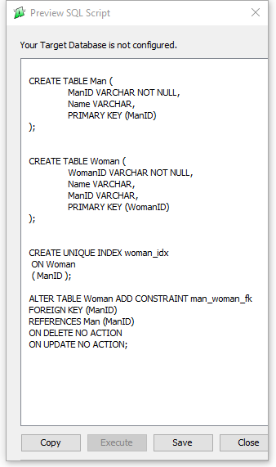
SQL Power Architect Implementation For the Second Alternative
Let’s not worry about NULLs; highly dependent on the relational DBMS used

Slide 183
SQL Power Architect Implementation
CREATE TABLE Man (
ManID VARCHAR NOT NULL,
Name VARCHAR,
PRIMARY KEY (ManID)
);
CREATE TABLE Woman (
WomanID VARCHAR NOT NULL,
Name VARCHAR,
ManID VARCHAR,
PRIMARY KEY (WomanID)
);
CREATE UNIQUE INDEX woman_idx
ON Woman
( ManID );
ALTER TABLE Woman ADD CONSTRAINT man_woman_fk
FOREIGN KEY (ManID)
REFERENCES Man (ManID)
ON DELETE NO ACTION
ON UPDATE NO ACTION;

Slide 184
Non-Binary Relationships That Are Many-To-One

Slide 185
Non-Binary Relationships That Are Many-To-One
We could not discuss this in the context of the University database, which was already quite complex
We did discuss it earlier, but we will elaborate a little and learn something new
We will discuss this now on several small examples
So, issue will be how to select the primary key
Again, we did it before
Our example will be a tiny database, essentially “extracted” from the University database
The example will deal with professors using books in courses

Slide 186
Non-Binary Relationships That Are Many-To-One
No additional specifications

Slide 187
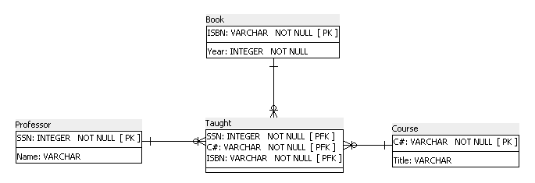
Non-Binary Relationships That Are Many-To-One

Slide 188
Non-Binary Relationships That Are Many-To-One
No additional specification
We understand this to mean that a professor taught a course using at most one book
We understand this to mean: Book is a function of (Professor, Course)
And this is actually a clearer phrasing
But in a specific course each professor can use a different book
But a specific professor can use a different book in each course or maybe no book at all

Slide 189
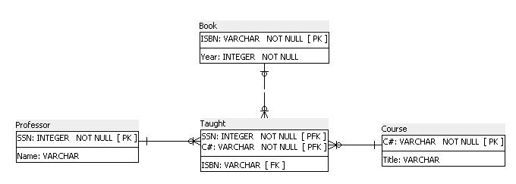
Non-Binary Relationships That Are Many-To-One
Note that the primary key of Taught has only two attributes (“inherited” from Professor and Course)

Slide 190
Non-Binary Relationships That Are Many-To-One
We are told by an annotation that each course is taught using at most the same (one) book only, no matter which professor taught it
We understand this to mean: Book is a function of Course
And this actually a clearer phrasing but we cannot specify this using our ER diagrams conventions and therefore an annotation is needed (in the absence of more careful thinking)
So in such cases you need to
Specify in a drawing using an arrow into the “target” entity set
Add an annotation on the “source,” or “sources” entity set(s)
Each course is taught using at most the same (one) book only

Slide 191
Non-Binary Relationships That Are Many-To-One
We annotate that ISBN in Taught is only a function of C#
Incidentally, this is a bad design, which was derived from the ER diagram without further considerations
In the Normalization unit we will formally understand why the design was bad and will learn algorithms for automatically fixing such bad designs

Slide 192
Non-Binary Relationships That Are Many-To-One
A much better ER diagram that expresses the constraint more naturally and without annotations
But do not do such improvements (in this unit)

Slide 193
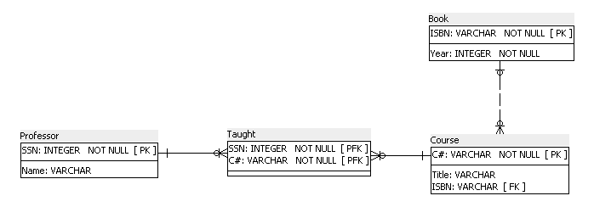
Non-Binary Relationships That Are Many-To-One
And the better ER diagram naturally transforms into a better relational implementation

Slide 194
Referential Integrity

Slide 195
Referential Integrity: Example
Assume that we have some professors in table Professor, with rows: 5,1 and 7,2
There is a row in Taught 5,G22.2433,2009,Spring,001,7
This means that 5 teaches a specific section and 7 monitors this assignment
Professor | ID# | Salary
 | 5 | 1
 | 7 | 2
 | 9 | 2
Taught | ID# | C# | Year | Semester | Sec# | Monitor
 | 5 | G22.2433 | 2009 | Spring | 001 | 7

Slide 196
Referential Integrity: Example
A user accesses the database and attempts to delete a row (or all rows like this, recall that duplicates are permitted) 5,1 from Professor
What should happen, as there is a row in Taught referencing this row in Professor?
A user accesses the database and attempts to delete row 9,2 from Professor?
What should happen, as there is no row in Taught referencing this row in Professor?
Professor | ID# | Salary
 | 5 | 1
 | 7 | 2
 | 9 | 2
Taught | ID# | C# | Year | Semester | Sec# | Monitors
 | 5 | G22.2433 | 2009 | Spring | 001 | 7

Slide 197
Referential Integrity: Example
Part of specification of foreign key in in Taught
Covered again in the SQL DDL unit
An action on Professor can be denied, or can trigger an action on Taught
For example
ON DELETE NO ACTION
This means that the “needed” row in Professor cannot be deleted
Of course, it is possible to delete the row from Taught and then from the Professor (if no other row in in any table in the database “needs” that row in Professor)
ON DELETE CASCADE
This means that if the a row is deleted from Professor, all the rows in Taught referring to it are deleted too
ON DELETE SET NULL
This means, that the value referring to no-longer-existing professor is replaced by NULL
In our example, this is not possible for ID# as it is a part of the primary key of Taught, but is possible for Monitor

Slide 198
Referential Integrity: Another Example
Part of specification of foreign key in in Professor
An action on Person can be denied, or can trigger an action on Professor
For example
ON UPDATE CASCADE
This means that if the value of ID# in Person is changed, this value of ID# also propagates to Professor
Could (and probably should) add to Taught and Required:
ON UPDATE CASCADE
In appropriate attributes, so that the change of ID# in Professor also propagates to them
In Taught in both ID# and Monitor
In Required in ID#
Good mechanism for maintenance of consistency

Slide 199
Surrogate Primary Keys

Slide 200
Surrogate Primary Keys Replacing Former “Semantic/Natural” Primary Keys
Frequently it is desirable that the primary keys not be interesting by themselves but serve as internal identifiers of tuples in a table
It is then less likely that the real world will impose legal or practical constraints on their use
For example, NYU used Social Security Numbers as identifiers, but a file of them was hacked
Also, in future, maybe it will be illegal to use Social Security Numbers for any purpose other than Social Security taxes
Maybe the manufacturer of Automobile will change retroactively the value of Model (name change to enhance sales)

Slide 201
How To Think About Surrogate Keys
You can think of them as just being row numbers
We will meet them again when we talk about AUTOINCREMENT keys
Note that surrogate keys “strip away” semantics
We will denote the surrogate using “&” in our examples

Slide 202
Designs With Natural And Surrogate Keys
Natural (semantic) primary keys
Surrogate primary key
Person | FN | LN | Height
 | a | P | 165
 | c | P | 187
 | a | Q
 | d | R | 173
Likes | FN | LN | Name
 | a | P | SA
 | c | P | US
 | a | Q | SA
 | c | P | IN
Country | Name
 | CN
 | IL
 | SA
 | US
 | IN
Person | Person& | FN | LN | Height
 | 1 | a | P | 165
 | 2 | c | P | 187
 | 3 | a | Q
 | 4 | d | R | 173
Likes | Likes& | Person& | Country&
 | 1 | 1 | 3
 | 2 | 2 | 4
 | 3 | 3 | 3
 | 4 | 2 | 5
Country | Country& | Name
 | 1 | CN
 | 2 | IL
 | 3 | SA
 | 4 | US
 | 5 | IN

Slide 203
Surrogate Primary Keys Replacing Former “Semantic/Natural” Primary Keys
We can redesign our application so that the primary keys are all surrogate and of one attribute only
A very obvious way is to assign serial numbers to entities in an entity set (and in other places too)
We discuss this in the unit dealing with SQL DDL
And, very loosely speaking in that Unit, as an entity set becomes a table in a relational implementation with each entity in its own row, make the (surrogate) key of the 1st row to be 1, of the 2nd row to be 2, etc.
There are advantages to indexing in the presence of surrogate keys
We will discuss that in the Unit dealing with physical design
Surrogate attributes are denoted in the following example by ending with “&”

Slide 204
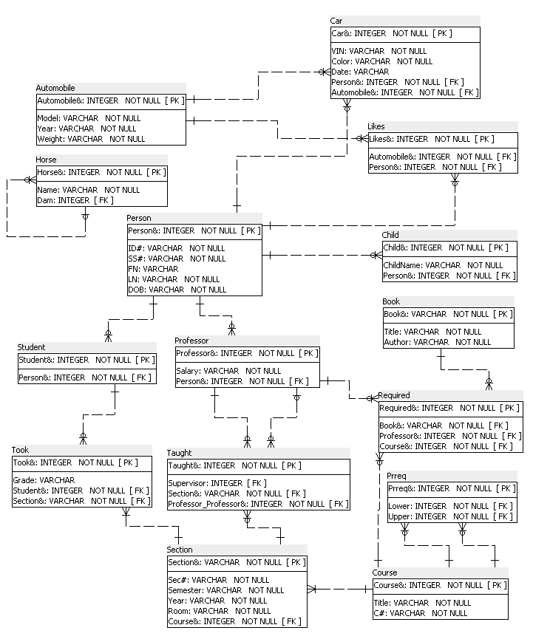
Our Application With Surrogate Primary Keys

Slide 205
Surrogate Primary Keys And Storage Of Some Data
Recall that in our previous example ID# was the primary key of Person
It propagated into many tables, e.g., Taught
What if it becomes illegal to store ID#?
We are in big trouble: need to reorganize the database
If we use surrogate primary keys, Person& is the attribute that propagates
We can delete ID# without much pain

Slide 206
Our Old Annotations
Our “old” annotations, such as the bounds on the size of a Section are needed and important, but we will skip them here

Slide 207
Important: Former Primary Keys Must Be Made UNIQUE and NOT NULL
Note that some of the former primary keys are now surrogates
For example, former primary key of Professor (ID#) is now replaced by a surrogate (Person&)
Note that some of the former primary key are now partially surrogates
For example, former primary key of Child (ID#,ChildName) is now replaced by (Person&,ChildName), which no longer is the actual primary key
But we need to tell the database that former primary keys are UNIQUE, as, e.g., no two Person& could have the same ID# and the ID#’s cannot be NULL

Slide 208
Caveat

Slide 209
Caveat
We have gone through a pretty complex example and examined important cases of transforming an ER diagram into a relational implementation
However, there is no complete set of “recipes” for doing this automatically
Just do the best reasonable thing you can, and be ready to justify it (to yourself and to your customer)

Slide 210
Annotate, Annotate, Annotate …
A relational schema specification should be annotated with all known constraints
Annotations are needed so that whoever converts a relational schema specification + annotations into an SQL DDL + any added necessary constraints can account for all the constraints imposed on the application
You do not need to put in annotations any constraints that are reflected in the schema specification, using a tool such as SQL Power Architect
In the assignments, you must not put such constraints (that is constraints implicit in what SQL Power Architect can express) in annotations
Just to make sure that you realize which constraints are already reflected in an SQL Power Architect specification

Slide 211
Important: Former Primary Keys Must Be Made UNIQUE and NOT NULL
Horse: UNIQUE(Name), Name NOT NULL
Person: UNIQUE(ID#), ID# NOT NULL, UNIQUE(SS#), SS# NOT NULL
Child: UNIQUE(Person&,ChildName), Person& NOT NULL, ChildName NOT NULL
Automobile: UNIQUE(Model,Year), Model NOT NULL, Year NOT NULL
Car: UNIQUE(VIN), VIN NOT NULL
Book: UNIQUE(Author,Title), Author NOT NULL, Title NOT NULL
Course: UNIQUE(C#), C# NOT NULL

Slide 212
Important: Former Primary Keys Must Be Made UNIQUE and NOT NULL
Prereq: UNIQUE(First,Second), First NOT NULL, Second NOT NULL
Required: UNIQUE(Book&,Professor&,Course&), Book& NOT NULL, Professor& NOT NULL, Course& NOT NULL
Section: UNIQUE(Year,Semester,Sec#,Course&), Year NOT NULL, Semester, NOT NULL, Sec# NOT NULL, Course& NOT NULL
Took: UNIQUE(Section&,Student&), Section& NOT NULL, Student& NOT NULL
Taught: UNIQUE(Professor&,Section&), Professor& NOT NULL, Section& NOT NULL

Slide 213
Key Ideas

Slide 214
Key Ideas
Sets
Relations and tables
Relational schema
Primary keys
Implementing an ER diagram as a relational schema (relational database)
General implementation of strong entities
Handling attributes of different types
General implementation of relationships
Possible special implementation of binary many-to-one relationships
Implementation of ISA
Implementation of weak entities

Slide 215
Key Ideas
Foreign keys
Primary key / foreign key constraints inducing many-to-one relationships between tables
Concept of referential integrity
SQL Power Architect
Crow’s feet notation: ends of lines
Crow’s feet notation: pattern of lines
Non-binary many-to-one relationships
Recursive relationships
Surrogate keys

Slide 216
Some Points to Remember for Homework
I list a few points covered in the notes that are worth remembering while doing the homework
They are phrased informally
Do not introduce a table for a relationship if that can be avoided
In our Animals example, do not introduce a table for Born
Be careful with non-binary many-to-one relationships and pay attention which attributes should be in the primary key
See our second Taught example
Note our treatment of recursive relationships, though if you think about it, that was essentially a special case of what we have considered before
Note how a one-to-one mapping is implemented using UNIQUE

Slide 217
Some Points to Remember for the Homework
Specify in annotations all the constraints that cannot be specified by the SQL Power Architect model (which will be assigned) and only such constraints
And refer to tables and columns and not to entities and attributes

