Slide 1
Integration of Cytoscape and Network Key Driver Analysis
Cytoscape Working Group
@ Sage Bionetworks

Slide 2

Integrating Key Driver Analysis into Cytoscape
Cytoscape
Gene list/
Module
Subnetwork
Key Driver
Analysis
Output
(text, image, cys)
Network
Repository

Slide 3
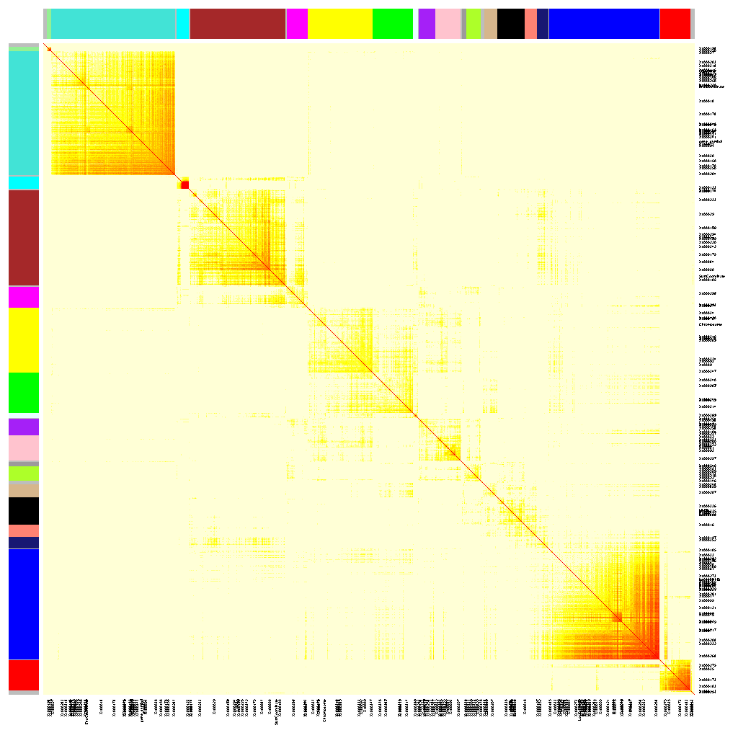
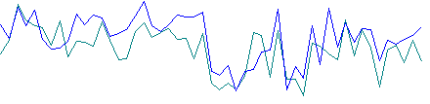
Transcriptional Networks
Gene Co-Expression Networks (undirected association network)
Probability-based networks: Bayesian network (directed regulatory network)
Expression
Individuals
A
D
Bayes’ theorem
Priors
Genetic
Genomic
Proteomic
Metabolomic
literature
C
B
p(B|A) =
p(A|B) x p(B) / p(A)
+
F
E
H
G

Slide 4
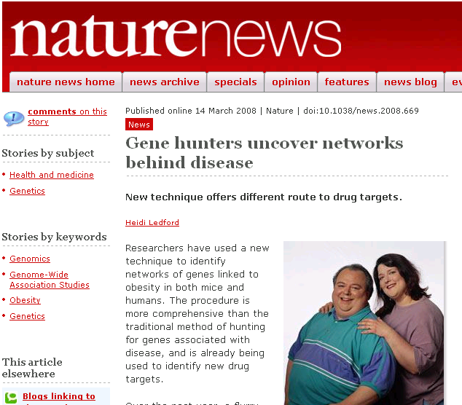
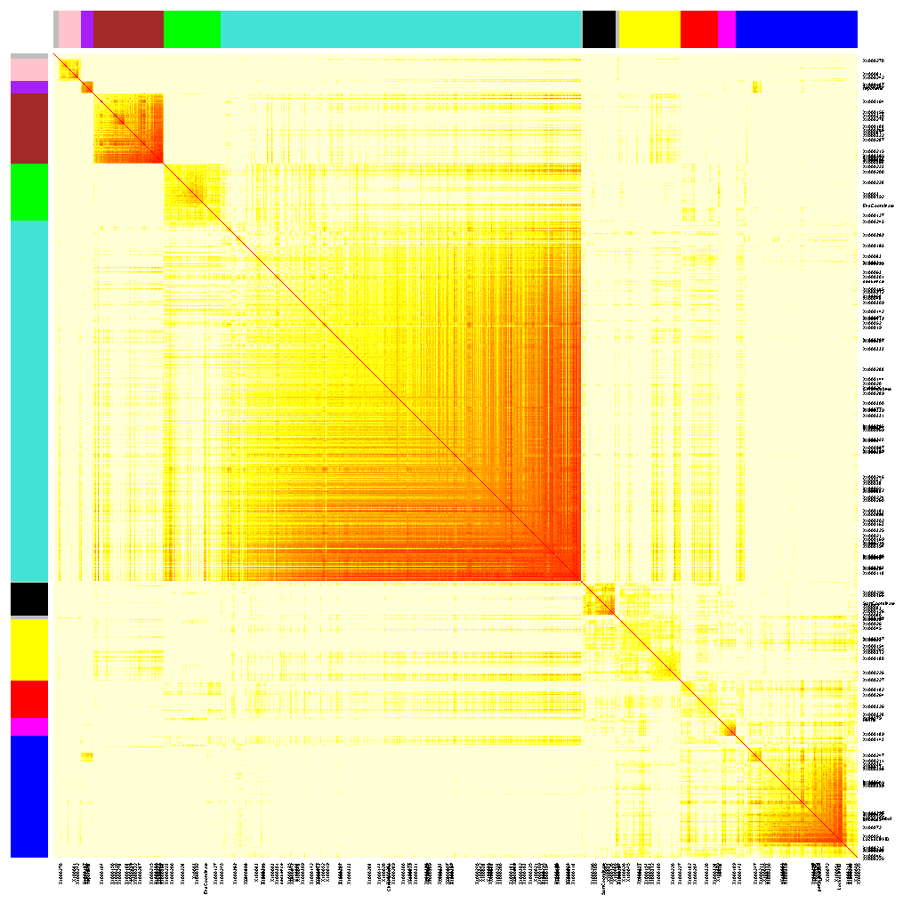
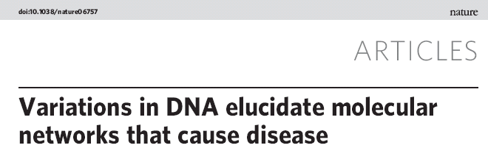
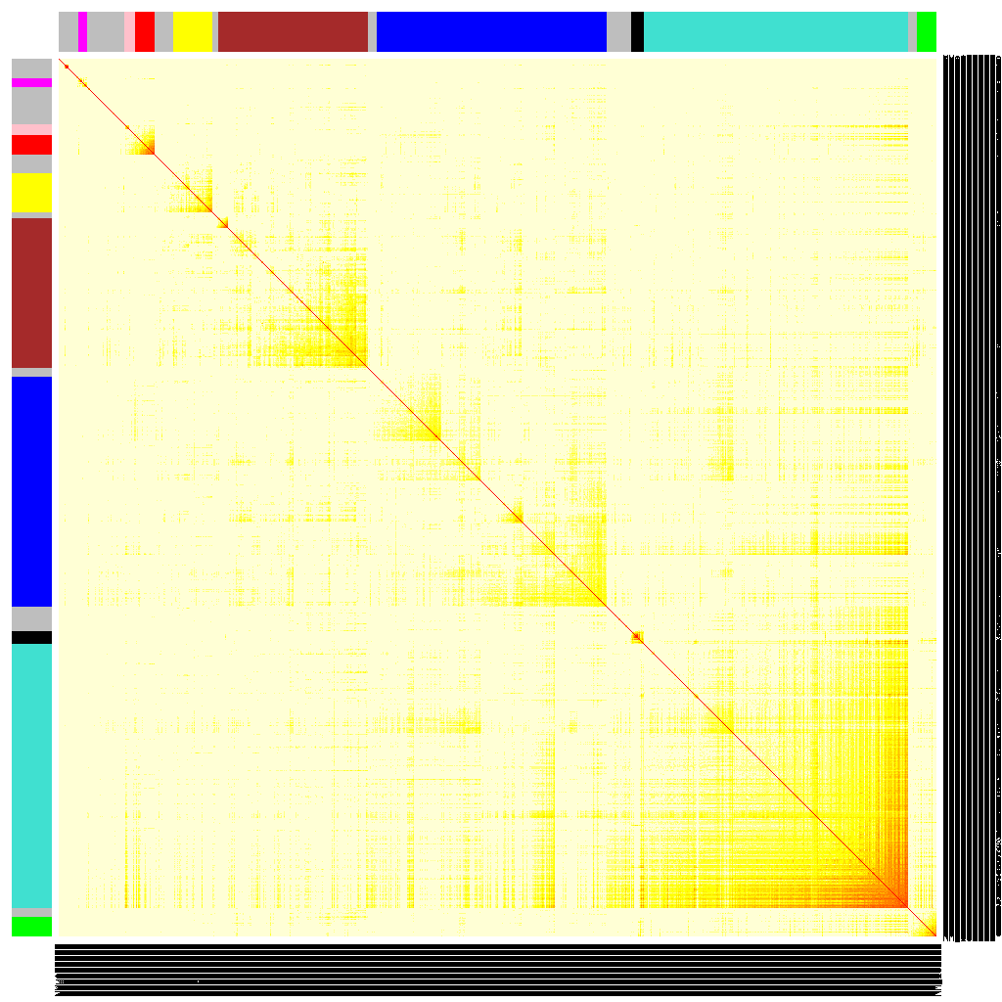
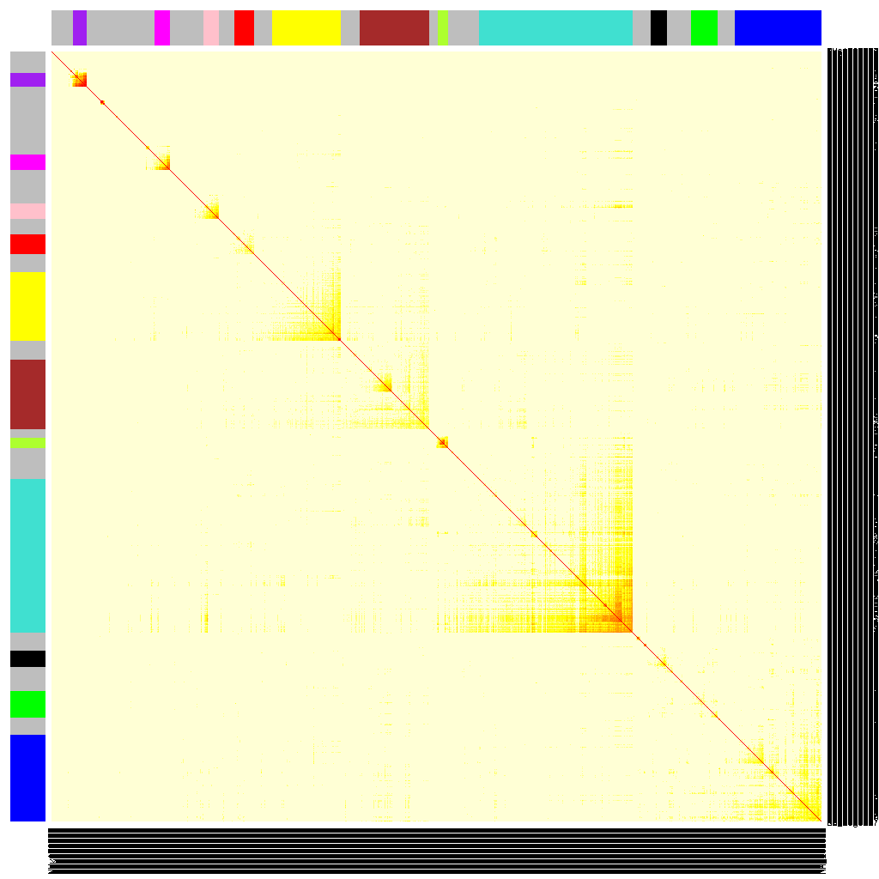
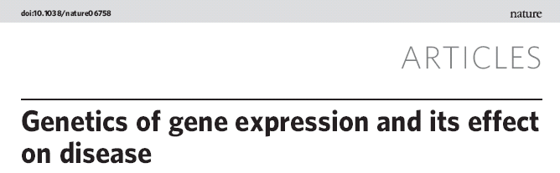
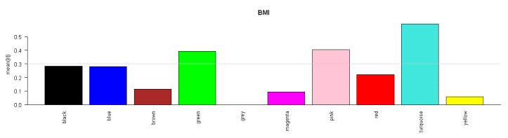
Exemplar Gene Coexpression Networks A macrophage-enriched metabolic network (MEMN) associated with obesity & diabetes
Female
Male
mouse
human
Module relevance to BMI
4

Slide 5
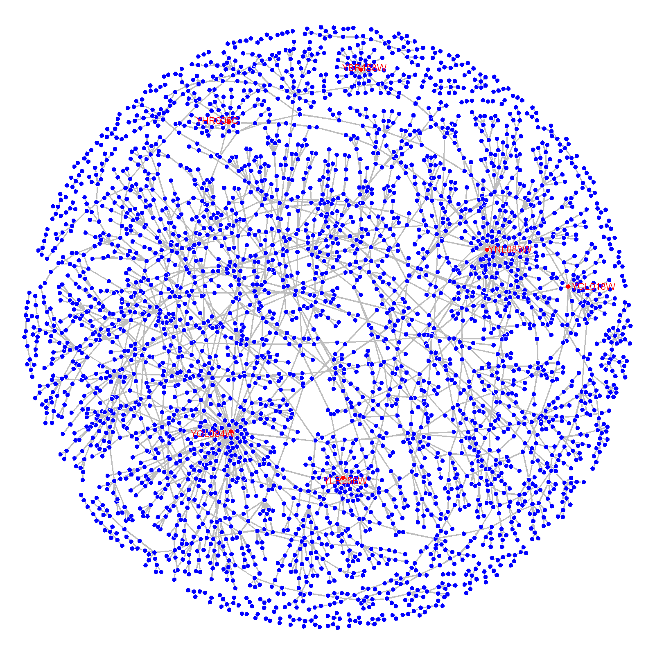
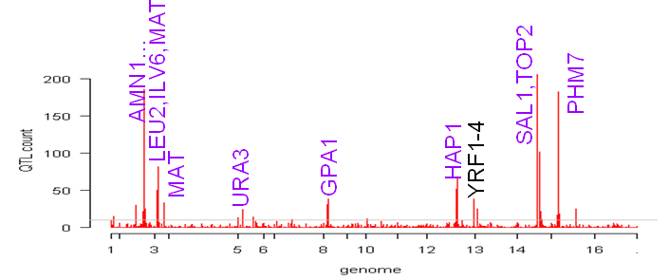
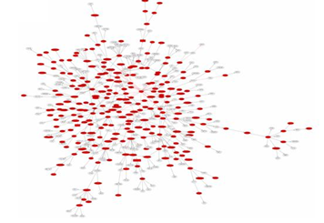
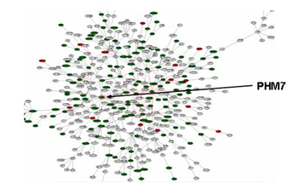
A Yeast Gene Bayesian Network
Predicted regulators under eQTL hotspots
PHM7
Experimental validation
of PHM7 as a key regulator of
hotspot 12
PHM7 is a gene of unknown function that is regulated by phosphate levels
Zhu J, Zhang B, et al., Nature Genetics 2008

Slide 6
Key Driver Analysis
Identify key regulators for a list of genes h and a network N
Check the enrichment of h in the downstream of each node in N
The nodes significantly enriched for h are the candidate drivers
Gene in the list
Key driver

Slide 7
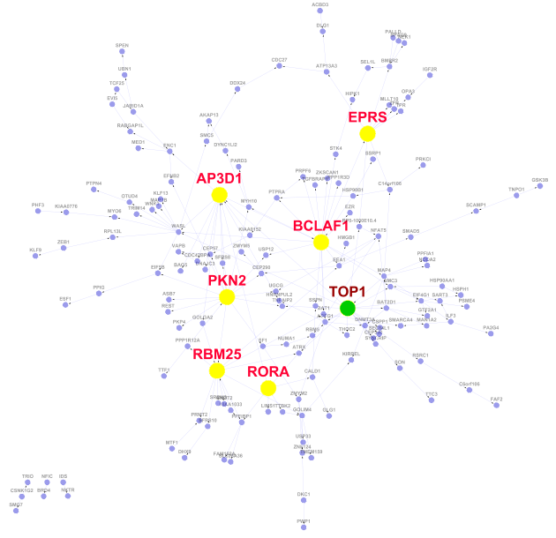
Key drivers for chromatin modification genes
Key driver
Key driver validated

