Slide 1
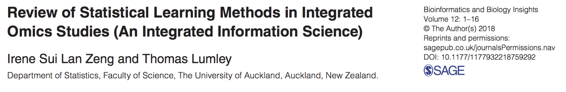
Jin Kweon
03/15 2019

Slide 2
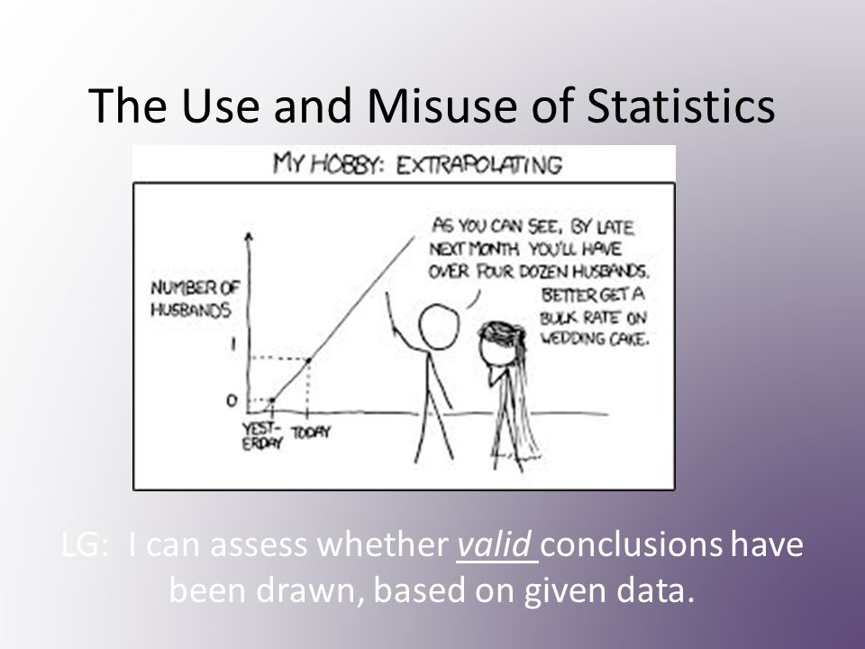
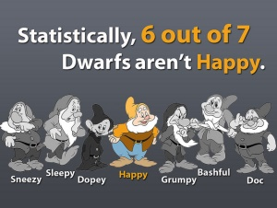
Notes:
When we apply statistics in different fields including biology, there a lot of things we should be closely careful of/pay attention to.
For example, when we make a guess based on our data, we need to use the correct models to get the right answer.
And, when we look at the data, we need clear reference to compare, right ways to get the data, unbiased interpretations, etc.

Slide 3
Outline
Motivations
Materials
Methods
Packages

Slide 4
Motivation
Investigate the complex molecular system and systematic learning for precision medicine
Integrated different types of information for inferences and decision making
Notes:
investigate the complex molecular system in modern biological science and sets foundations for systematic learning for precision medicine
this is generalizable to other disciplines with complex systematic structures, and it integrated different types of information for inferences and decision makings

Slide 5
Materials
Statistical learning methods of exploratory and supervised learning from 42 publications.
Available omics software and packages from 23 publications
Extended principal component analysis, cluster analysis, network analysis, regression, penalization for sparsity, Bayesian, etc.

Slide 6
Methods
Exploratory methods
Clustering methods
Network learning methods
Regression methods

Slide 7
Exploratory methods
consensus PCA (cPCA)
multiple-block PCA (MBPCA)
multiple factor analysis (MFA)
nonnegative matrix factorization (NMF)
Notes:
These are helping us to reduce the dimension. Dimension reduction helps us identify the hidden structures. And, PCA and factor analysis are popular statistical techniques for reducing dimensions.
So, cPCA is an extension of PCA that we can use for pairs of data sets. So, cPCA guarantees the orthogonality of global scores only and tends to find common patterns in the data sets. Thus, it is good when we try to find the joint patterns in multiple data sets.
MBPCA and cPCA can both use NIPLAS (nonlinear iterative partial least square), one of the deflation strategies, to identify hidden structures in a specific order. (go to the next slide)

Slide 8
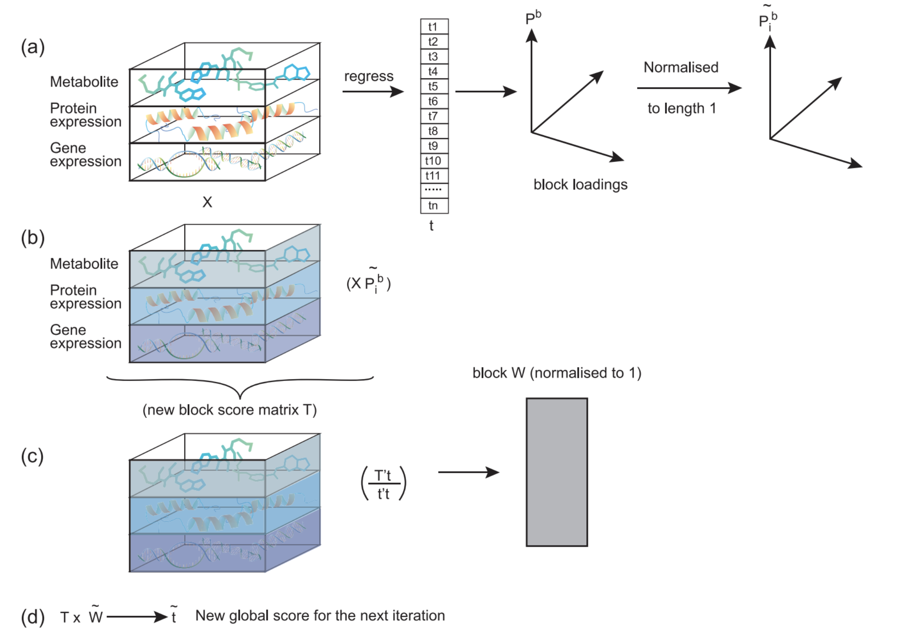
NIPLAS
Zeng, I.S.L., et al. (2018)
Notes:
NIPLAs helps to find the parameters of block and global loadings and scores.
So, it starts with the random global score vector, t.
The data block X, in our case the datasets for gene and protein expression with metabolite regress on t, and we get the principal loading Pb. And, this loading is the weight of each variable contributing to the latent structures.
WE multiply this loadings with the original dataset, and then, we call it block score matraix. And, we regress this score matrix T on our global loading t, and get weight. And, we get new global score.
And, we repeat this many times.

Slide 9
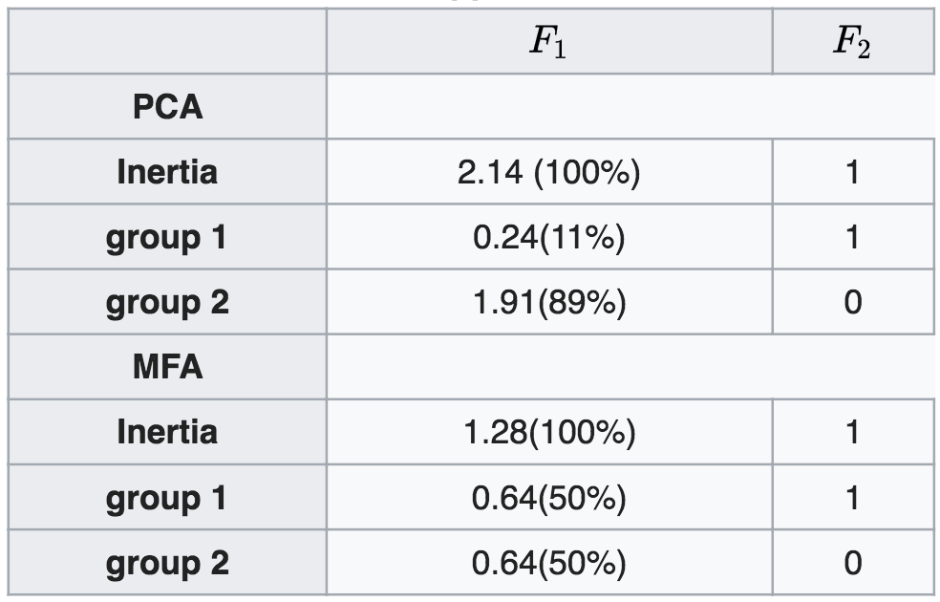
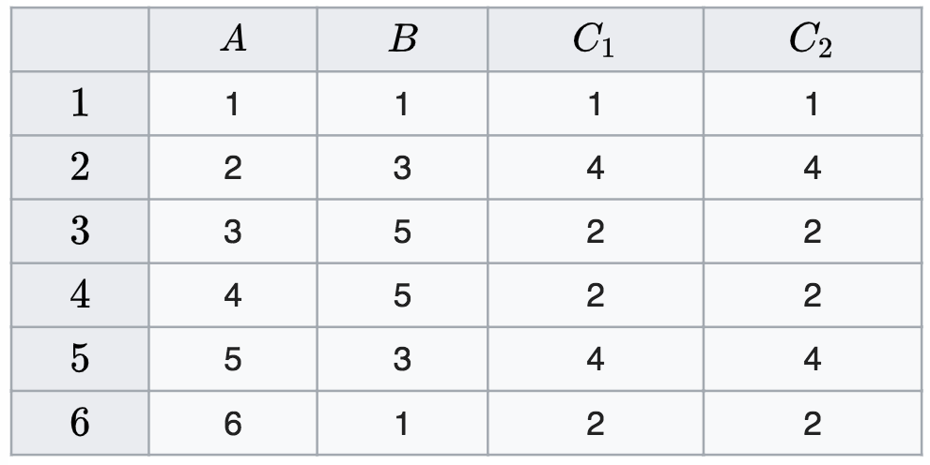
MFA
Group 1 (A & B)
Group 2 (C1 & C2)
Notes:
And, let’s look at Multiple factor analysis in real quick with one example.
This MFA can be used in both qualitative and quantitative datasets. However, since we are thinking of using it omics data sets, and since omics are made of numbers, I will talk about the quantitative example here.
In quantitative data sets, we can really think of MFA as an extension of PCA. Then, we can ask a question here. How, can MFA benefit us better in analyzing omics.
So, if we look at the table on the left hand side, A and B are belonged to group 1, and C1 and C2 are belonged to group 2, and these two groups are uncorrelated.
So, let’s look at how inertia is distributed in the first axis F1. In PCA, since A and B are uncorrelated, inertia is uniformly distributed in the plane made of A and B, and thus inertia concentrated on in one direction.
However, if we use MFA, the contribution of the group to inertia of the first axis is equal.
If we look at the second axis, we can see that the group 1 is the only one contributing to the 2nd axis, which makes sense, since group2 is 1 dimension, but the group1 is 2 dimension.

Slide 10
Exploratory methods
cPCA - uniformly curated datasets
MBPCA - large inter-platform variability
MFA - biological knonwledge
Notes:
I would not go over nonnegative matrix facotrization, but that is one way to reduce dimension for a single dataset, and you can think of it as a PCA with nonnegative constrain instead of making orthogonal.
And, actually let’s go back to the biology.
cPCA is for more uniformly organized datasets.
MBPCA can handle data with larger inter platform variabiltiy, meaning that it can handle data with more complex expriements.
MFA is useful when we have biological knowledge to interpret hidden common factors.

Slide 11
Packages
cPCA: cpca, “mogsa” in R
NMF: nmf, “nmf” in R
MBPCA: mbpcaiv, “ade4” in R
MFA: MFA, “FactoMineR” in R

Slide 12
Clustering methods
Auto self-organizing map (AutoSOME) with iterative maximum likelihood
Regularization in feature selections
Notes:
Yeah, so clustering helps us for sample or variable partitioning.
You know when we think of clustering, we think of hierarchial clusterinng with either classification or regression tree, K means clustering, model based clustering with different distance measures.
However, the datasets from multi-omics can have complex structures, and so we need other way.

Slide 13
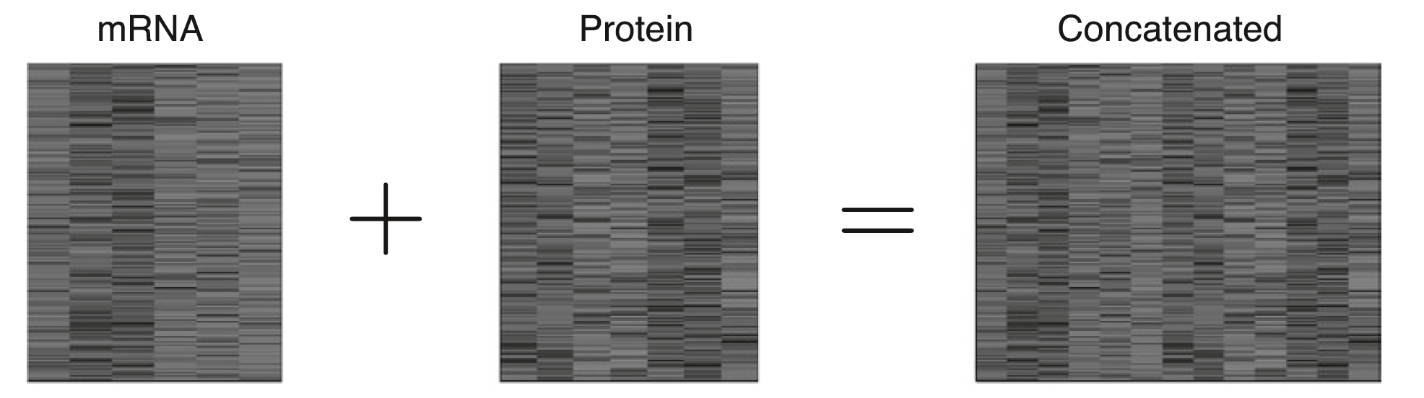
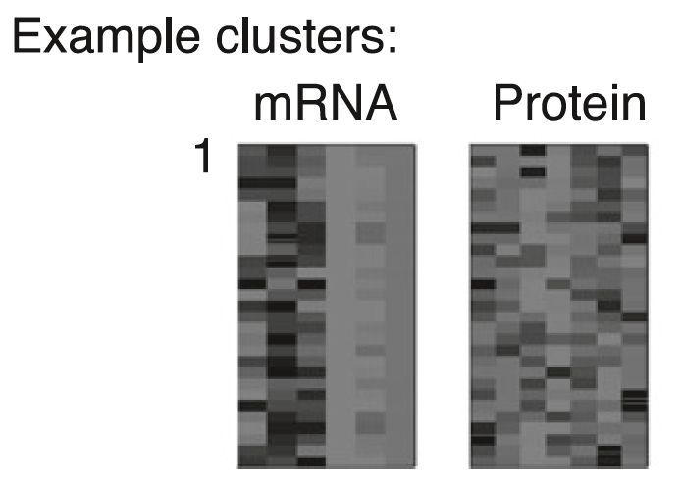
Naïve approach
Mayer, B., et. al. (2011)
Notes:
So, when we want to perform cluster analysis on two different datasets, we can try to concatenate them and use cluster algorithms we know of.
So, we get the cluster, and try to distinguish the patterns, and we might wanna just say that there is inter-dataset similarity between messanger RNA and protein datasets.
However, it is not true! It is true that the cluster has genes with similar behaviors to one another in two different datasets, but it does NOT mean that there is relationships between each other from two different datasets.
So, we cannot necessarily find groups of genes that show simiar correlated behaviors over two different datasets.

Slide 14
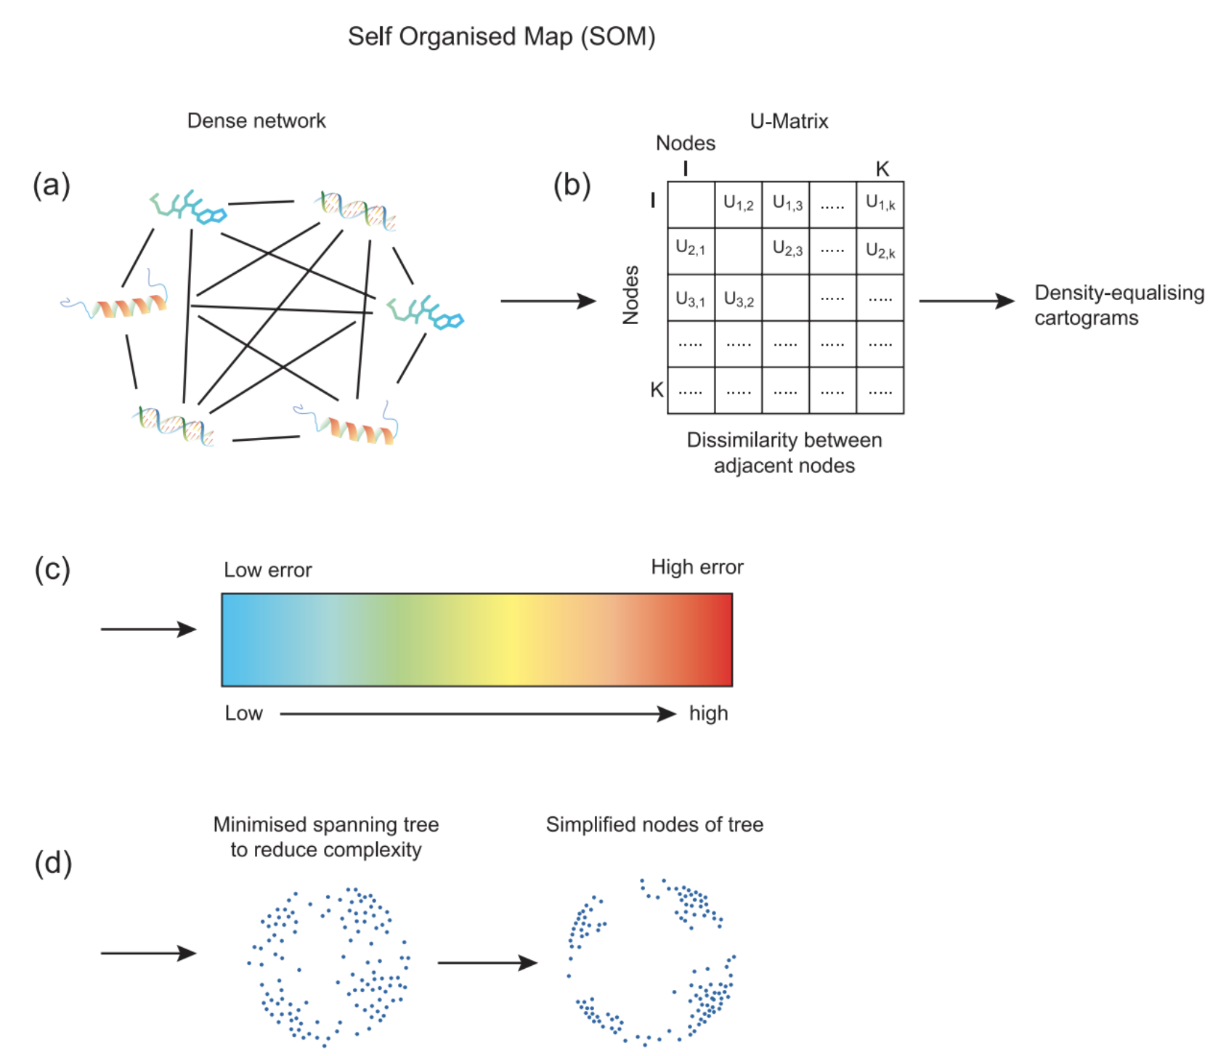
AutoSOME
Zeng, I.S.L., et al. (2018)
Notes:
So, the new method proposed was using iterative maximum likelihood and maybe include penalized terms, with stochastic clustering method called “SOM”
So, SOM is a stochastic clustering method to reduce the number of dimensions and at the same time preserve the local structure of gene expressions.
So, this helps us get the error matric based on similarity between nodes and identify border between each other iteratively
AutoSOM uses density eualization, meaning it uses this graphical feature output from SOM and rescale them, and they treat nodes of high errors with high density and thus force those nodes separated from each other. And, they treat nodes with low error with low density and force them to aggregate each other.
And, then, they perform tree algorithm with the rescaled nodes.
*By the way, for the penalization, they propose three different functions: lasso, elastic net, and fused lasso to control the # of clusters.

Slide 15
AutoSOME cluster
Outlier detections – Good!
Provide # of clusters objectively – Good!
Provide uncertainty measure – Good!
Handle mixed types of data variables – Soso
Speed and memory use – Good!
Notes:
They focused on 5 statistics and implementation performances.
Autosome does not need any prior knowledge of # of clusters and it is less sensitive to outliers.
And, it goes through error matrix, density equalization algorithm, minimum spanning tree, and it identifies objective # of clusters based on the threshold of P value.
And, its good at handling both clean and noisy gene expressions.
It can only be used in continuous data.

Slide 16
Packages
AutoSOME: som, “kohonen” in R

Slide 17
Network learning methods
Estimate associations between -omics
Estimate structures of multilayer networks
Notes:
Ranking based maximal first order partial correlation coefficients and adjusted RV help finding the associations between netwroks (these are not looking for causal relations of the data, but associations)
Multiplex fusion algorithms helps understand the structure of networks.
Since Zhou is working on this method, and he has talked about it a lot, I am going to skip it.

Slide 18
Packages
Bayesian network learning: “bnlearn” in R

Slide 19
Regression methods
Parallel regression
Sequential regression
Partial least square regression
Notes:
I want to talk about parallel and sequential regressions, as I spent decent amount of time talking about PLS from my projects.

Slide 20
Regression methods
Parallel regression:
Estimation of relations between different omics responses and explanatory variables simultaneously.
Sequential regression:
Used to facilitate biological enrichment analysis after the feature reduction.
Notes:
Parallel regression allows estimation of relations between different omics responses and explanatory variables simultaneously.
So, for example, in the pathway level analysis, when datasets have different types of variables in the same pathway, it can be useful.
And, sequential regression literally peforms seuqnetial analytical approaches: it uses random forest to screen variables from each omics dataset, then, they use integrated linkage map (quantity trait linkage), and then, final selected gene, protein and metabolites are used to contruct the networks.
Sequential model can be helpful in biological enrichment analysis when each platform has many variables. This allows correct selected genes, proteins, metabolites to be included in the network constructions at the final step/last stage

Slide 21
Packages
parallel regression: calm, “partools” in R
Sequential regression: “randomForest” and “metanetwork” in R

