Slide 1
Classification of Military Installations in North Korea on OpenStreetMap using Machine Learning
MUSA 6500 Deep Learning with Python
University of Pennsylvania
April 24, 2025
Jun, Youngsang
Notes:
Good morning. I am Youngsang Jun. Today I would like to introduce an application of remote sensing in urban planning, specifically regarding military installations in North Korea on OpenStreetMap.

Slide 2
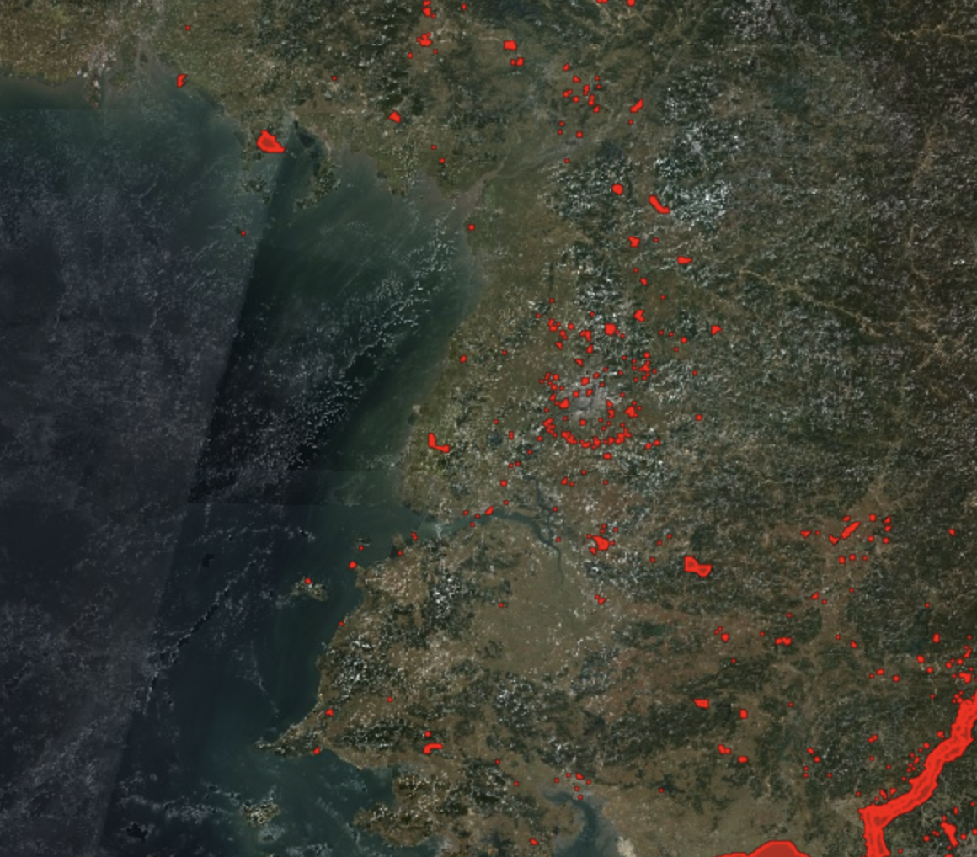
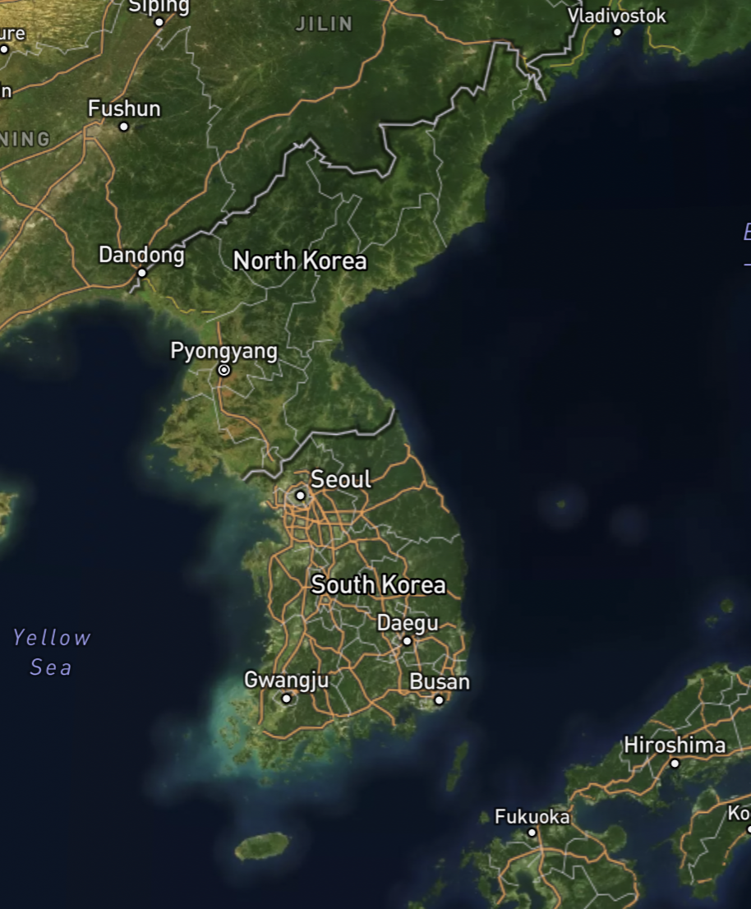
Background: Image and Polygons of Military Land Use in nK
Pyongyang
(c) Google, Mapbox, OpenStreetMap
Notes:
The image you see is a GEE satellite image, and the red polygons represent military land use in North Korea that has been revealed on OpenStreetMap. A total of 1,939 polygons were observed on OpenStreetMap. When I export the dataset and open the attribute table using QGIS,

Slide 3
Background: Attribute Data of Military Land Use of nK
OpenStreetMap (GeoJSON type)
Total 1,939 polygons, of which 231 have category values
ID | Category | Nation | Land use |  |  | Geometry
F3385380 | Airfield | nK | Military |  |  | POLYGON(…
F3385381 | Training Area | nK | Military |  |  | POLYGON(…
F3385382 | Range | nK | Military |  |  | POLYGON(…
F3385383 | NULL | nK | Military |  |  | POLYGON(…
F3385384 | NULL | nK | Military |  |  | POLYGON(…
Notes:
I was able to observe a total of 1,939 polygons, of which 231 belong to one of the sub-categories, and the rest have NULL values, which means they do not have any descriptive information beyond their designation as military land use.

Slide 4
Purpose
A complete classification of all military installations categories in nK based on satellite imagery and OpenStreetMap annotations
Notes:
So the purpose of this application is to complete …

Slide 5
Assumption
OpenStreetMap data is reliable enough for non-intelligence purposes, though it is user-contributed.

Slide 6
Method
“Non-image ML problem that uses image-derived data”
Model 1
(RF w/ directly obtained image values*)
Model 1 training & validation
* NDVI, BSI, NTL
Data Collection and Processing
Compare two models’ performance
Model 2
(RF w/ image-based pre-trained model**)
Model 2 training & validation
** Clay Foundation Model
Notes:
I defined this problem as a non-image ML problem that uses some image-derived data.

Slide 7
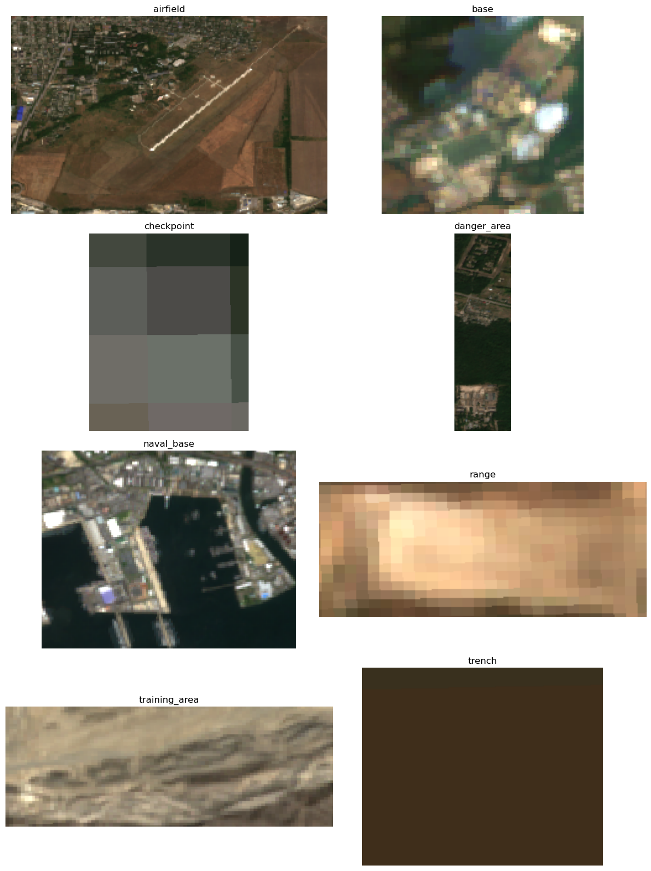
Method: Data Processing
OpenStreetMap (GeoJSON type)
Satellite Imagery (Sentinel-2, VIRRS)
ID | Category | Nation | Area | Lat | Lng | Geometry
F3385380 | Airfield | nK |  |  |  | POLYGON(…
F3385381 | Training Area | nK |  |  |  | POLYGON(…
F3385382 | Range | nK |  |  |  | POLYGON(…
F3385383 | NULL | nK |  |  |  | POLYGON(…
F3385384 | NULL | nK |  |  |  | POLYGON(…
NDVI | BSI | NTL
Calculated from Geometry
Clipped by polygons and calculated from Imagery
Calculated from Geometry
Clipped by polygons and calculated from Imagery
Prediction using RF model
F3385385 | Airfield | A |  |  |  | POLYGON(…
F3385386 | Training Area | B |  |  |  | POLYGON(…
Notes:
This slide shows data processing. I was able to calculate the mean values of the Normalized Difference Vegetation Index (NDVI), Bare Soil Index (BSI), and Nighttime Light (NTL) for each image segment clipped by polygons. I also was able to calculate the polygon geometry itself, such as area, latitude, and longtitude. The clip result was saved to one GeoDataFrame, and able to run random forest model to validate classification performance and predict.
To ensure an enough sample size, labeled military land use polygons from four additional nations surrounding nK was merged with these polygons.

Slide 8
Method: Data Processing
5,988 objects including labeled unlabeled nK areas and labeled non-nK areas.
Nation | Label | # of Objects | Usage
nK | unlabeled | 1,708 | To predict
nK | labeled | 231 | To train and validate
Non-nK | labeled | 4,049 | To train and validate
Total |  | 5,988
Notes:
So this table shows the number of objects and their usage.

Slide 9
Method: Model 1 (RF w/ directly obtained image values) Validation
Independent variables: Nation, latitude, longitude, area, NDVI, BSI, NTL
Dependent variable: Classification (# of categories: 8)
Used 4,280 labeled data
For validation, train 40% (1,735), test 60% (2,545) split

Slide 10
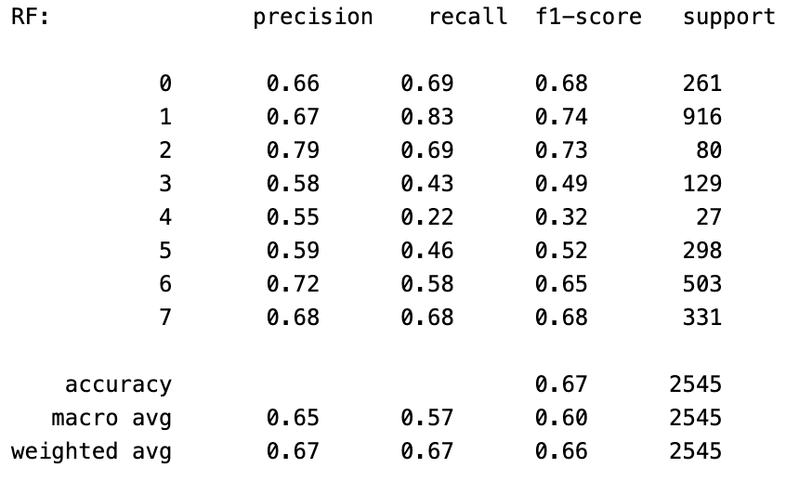
Result: Model 1 Overall accuracy
Overall accuracy 67%
Airfield
Base
Checkpoint
Danger Area
Naval Base
Range
Training Area
Trench

Slide 11
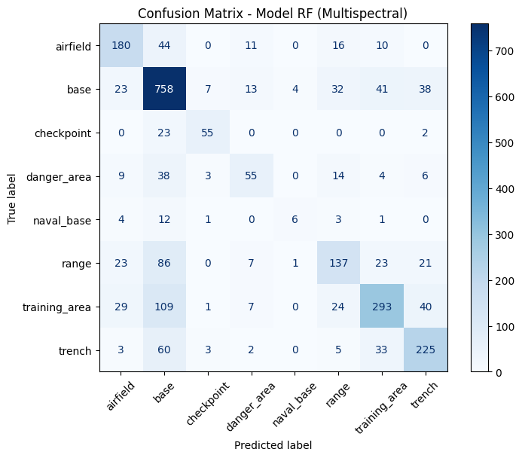
Result: Model 1 Confusion Matrix

Slide 12
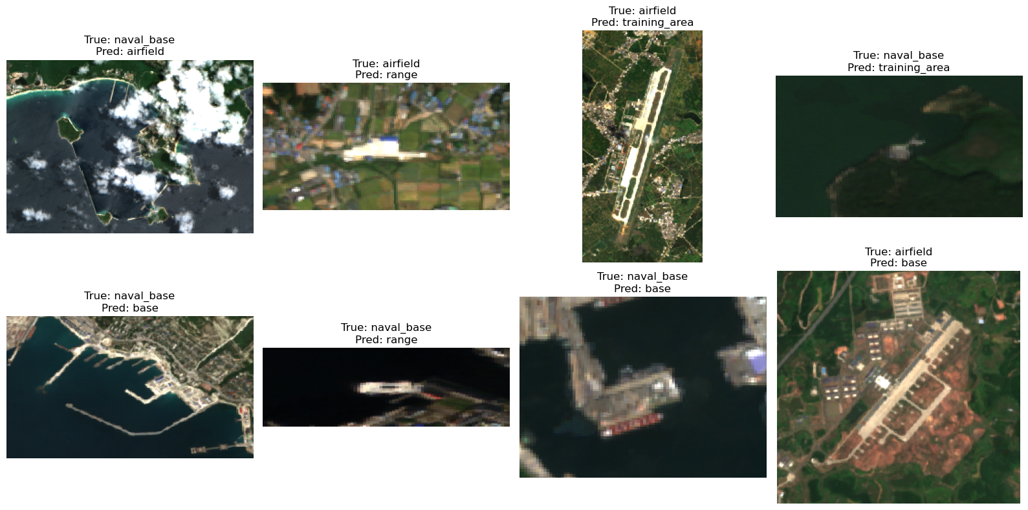
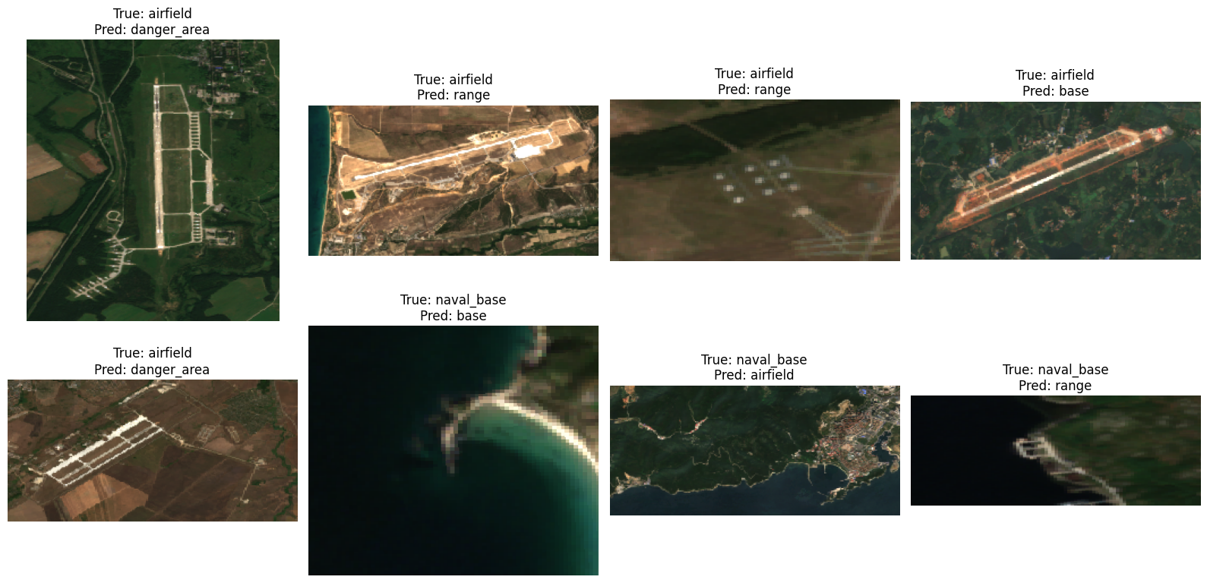
Result: Model 1 Misclassified examples

Slide 13
Method: Model 2 (RF/MLP/k-NN w/ Clay Foundation Model)
OpenStreetMap (GeoJSON type)
Satellite Imagery (Sentinel-2, VIRRS)
ID | Category | Nation | Area | Lat | Lng | Geometry
F3385380 | Airfield | nK |  |  |  | POLYGON(…
F3385381 | Training Area | nK |  |  |  | POLYGON(…
F3385382 | Range | nK |  |  |  | POLYGON(…
F3385383 | NULL | nK |  |  |  | POLYGON(…
F3385384 | NULL | nK |  |  |  | POLYGON(…
Pre-calculated Embedding
Calculated from Geometry
Clipped by polygons and calculated from Imagery
Prediction using RF/MLP, k-NN
model
F3385385 | Airfield | A |  |  |  | POLYGON(…
F3385386 | Training Area | B |  |  |  | POLYGON(…

Slide 14
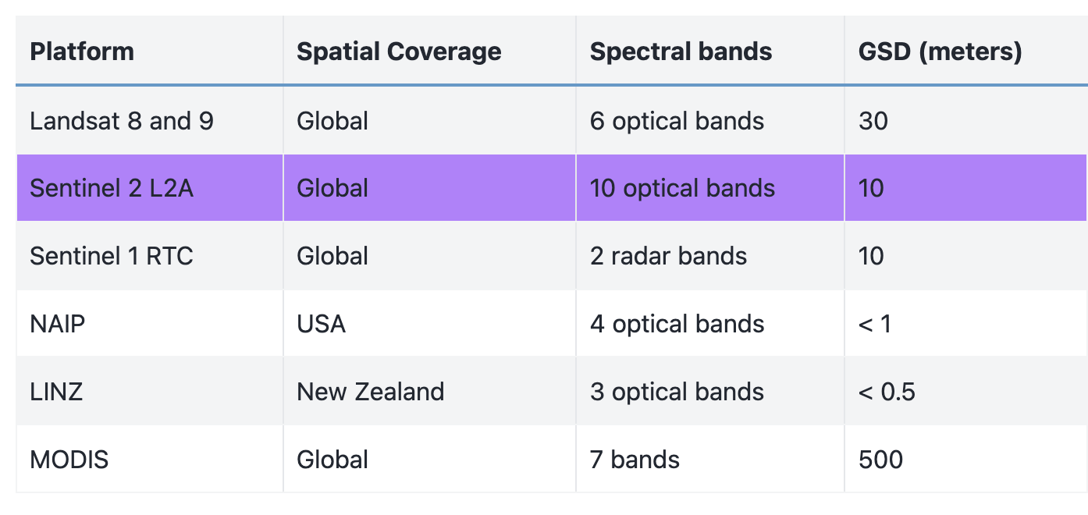
Strength of Clay Foundation Model
Clay’s model takes satellite imagery, along with information about location and time, as an input, and outputs embeddings, which are mathematical representations of a given area at a certain time on Earth’s surface. It uses a Vision Transformer architecture adapted to understand geospatial and temporal relations on Earth Observation data. The model is trained via Self-supervised learning (SSL) using a Masked Autoencoder (MAE) method.
Generate semantic embeddings for any location and time.
Fine-tune the model for downstream tasks such as classification, regression, and generative tasks
Use the model as a backbone for other models.
https://clay-foundation.github.io/model/index.html

Slide 15
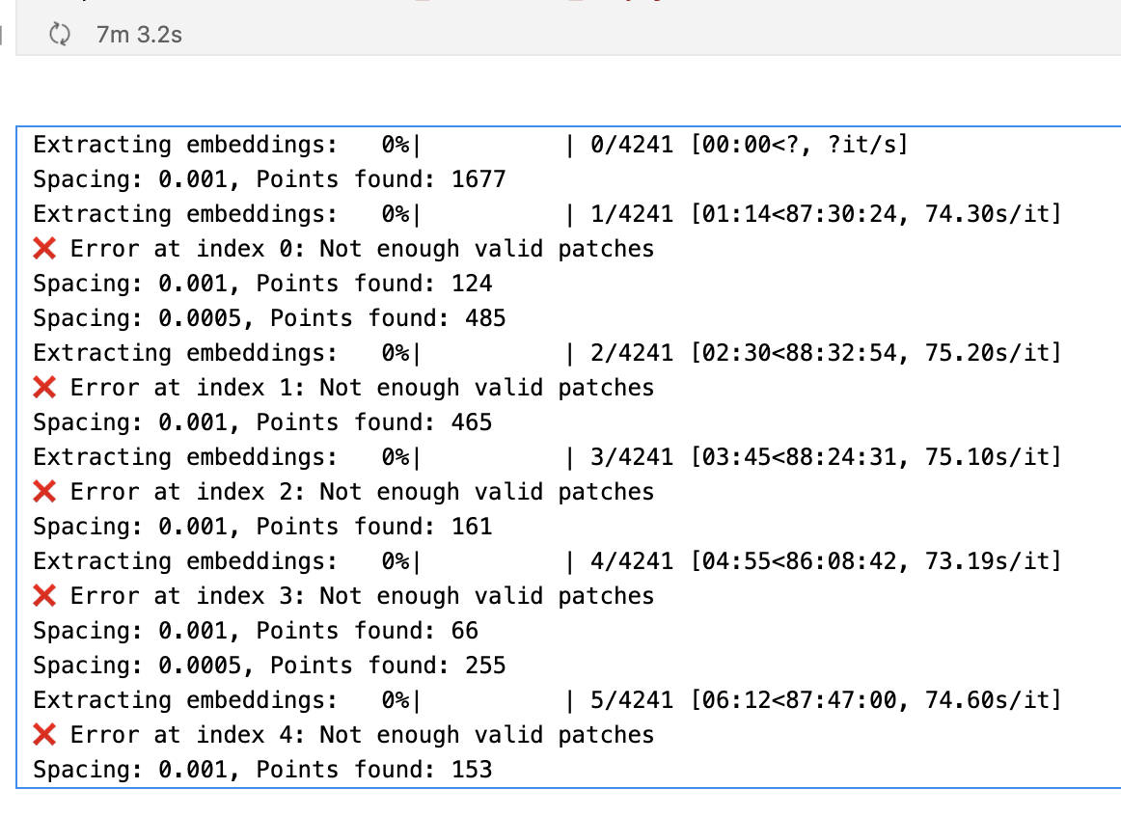
However…
Load Data (completed in the above, use `train_df`) (completed)
Define a function to extract grid coordination each polygon in `train_df` (completed)
Load Clay MAE model (completed) • clay_mae_base(...) • Import pretrained weight & metadata
Extract embedding for each feature (not completed) • model(datacube) • model.encoder.cls_token → projection → vector
Training (RandomForest, MLP, k-NN) (not completed) • gdf_labeled: X = embedding, y = military • gdf_unlabeled: X = embedding → y = prediction

Slide 16
Method
“Non-image ML problem that uses image-derived data”
Model 1
(RF w/ directly obtained image values*)
Model 1 training & validation
* NDVI, BSI, NTL
Data Collection and Processing
Compare two models’ performance
Model 2
(RF w/ image-based pre-trained model**)
Model 2 training & validation
** Clay Foundation Model
Notes:
I defined this problem as a non-image ML problem that uses some image-derived data.

Slide 17
Thank you
Notes:
The potential user for this application will be the non-intelligence users in the Republic of Korea government in considering the deployment of military bases while establishing urban plans in nK region in the event of future unification. Please note that this application is not intended for military purposes.

Slide 18
However…

Slide 19
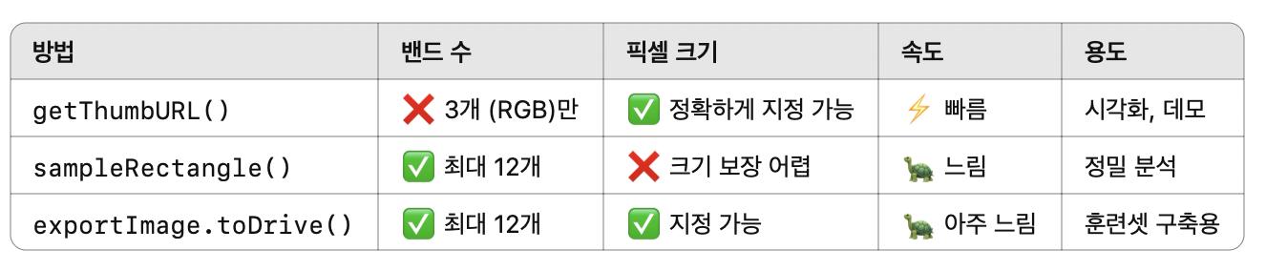

Slide 20
Method
1. Export nK’s military land use data from OpenStreetMap in GeoJSON format and create a column to distinguish between labeled and unlabeled polygon objects.
- For polygons with no category information but with an installation name (in at least one language), infer the category based on the installation name and input it in hand.
2. Using GEE, clip satellite imagery using polygons.
You might treat this as a non-image ML problem that uses some image-derived data as an input (e.g., NDVI, nighttime lights from MODIS)
3. Split the 231 labeled samples into training (60%) and testing (40%) sets to train a classification model
- The model follows HW4, but I am developing model details.
4. Use the trained model to predict the categories of the remaining 1,708 unlabeled military installations.

Slide 21
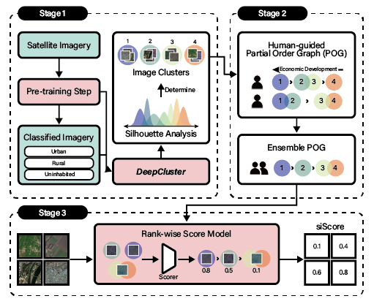
Model Description

Slide 22
Reference
Demir, İlke; Hughes, Forest; Raj, Aman; Dhruv, Kaunil; Muddala, Suryanarayana M; Garg, Sanyam; Doo, Barrett; and Raskar, Ramesh (2018), Generative Street Addresses from Satellite Imagery, ISPRS Int. J. Geo-Inf. 2018, 7(3), 84; https://doi.org/10.3390/ijgi7030084
Jun, Youngsang (2021), A Study on the Factors of Occurrence of Time Difference of Experience for a Transferred Policy: focusing on Address Policy in Republic of Korea (MPA thesis, not peer reviewed, Korean)
https://www.juso.go.kr
Ministry of the Interior and Safety, Republic of Korea (2017), Road Name Address Work Manual.
International Standard Organization (ISO) 19160-1:2015

