Slide 1

MSDS 6306: Doing Data Science
Employee Attrition Analysis & Prediction
Case Study 1
2026. 10. 25
Yongjoon Cho

Slide 2
Ⅰ. | Dataset Overview
Ⅱ. | Exploratory Data Analysis
III. | Predictive Modeling (KNN & Naive Bayes)
IV. | Conclusions
V. | Appendix

Slide 3













Project & Data Summary
Dataset Overview
The project aims to identify key factors associated with employee attrition, develop predictive models to identify employees at risk of leaving, and estimate potential cost savings through targeted retention incentives.
1
Overview
Total Employees
870
100%
Employees who left
(Attritions)
140
16.1%
Employees who stayed
(Non-Attritions)
730
83.9%
Attritions (16.1%)
Non-Attritions (83.9%)
2
Dataset Summary
Information
Variable Classification
Client | Frito Lay
Analytics Partner | DDSAnalytics
Total Observations | 870
Total Variables | 36
Identifier | ID, EmployeeNumber
Target | Attrition (Y/N)
Numerical
Ordinal
Nominal
Constant
14
10
6
3
Age, DailyRate, DistanceFromHome, HourlyRate, MonthlyIncome, MonthlyRate, NumCompaniesWorked, PercentSalaryHike, TotalWorkingYears, TrainingTimeLastYear, YearsAtCompany, YearsInCurrentRole, YearsSinceLastPromotion, YearsWithCurrManager
BusinessTravel, Education, EnvironmentSatisfaction, JobInvolvement, JobLevel, JobSatisfaction, PerformanceRating, RelationshipSatisfaction, StockOptionLevel, WorkLifeBalance
Department, EducationField, Gender, JobRole, MaritalStatus, OverTime
EmployeeCount, StandardHours, Over18
Key Takeaway
This data set includes 870 Frito Lay employees with an attrition rate of 16.1%
Contains 30 explanatory variables (14 numerical, 10 ordinal, 6 nominal), excluding 3 constants.

Slide 4
Ⅰ. | Dataset Overview
Ⅱ. | Exploratory Data Analysis
III. | Predictive Modeling (KNN & Naive Bayes)
IV. | Conclusions
V. | Appendix

Slide 5

EDA Results – Categorical Variables (1/3)
Exploratory Data Analysis
Four categorical variables (Work-Life Balance, OverTime, Job Involvement, and Job Satisfaction) were selected based on observed differences in attrition rates across categories.
1
Work Life Balance
2
Overtime
Key Findings
Employees who have poor work life balance (35.4%) tend to have higher attrition rates.
Employees who work overtime (31.7%) tend to have higher attrition rates.
Workload and Work-Life Conflict
Attrition Rate (%)
Attrition Rate (%)
Higher attrition among employees working overtime and those reporting poor work-life balance suggests that demanding working conditions may be associated with employee departure.
Employee Disengagement
Job Involvement exhibits the largest observed attrition-rate gap among the four variables (38.2 percentage points), potentially reflecting differences in employees' engagement with their work.
3
Job Involvement
4
Job Satisfaction
Employees who have lower job involvement (46.8%) tend to have higher attrition rates.
Employees who have lower job satisfaction (21.2%) tend to have higher attrition rates.
Attrition Rate (%)
Attrition Rate (%)
Job Experience and Satisfaction
Attrition consistently declines as Job Satisfaction increases, suggesting a negative association between employees' satisfaction with their work and their likelihood of leaving.

Slide 6
EDA Results – Categorical Variables (2/3)
Exploratory Data Analysis
Three categorical variables (Business Travel, Education, and Marital Status) were selected based on observed differences in attrition rates across categories.
5
Business Travel
6
Education
Key Findings
Employees who travel the most (22.2%) tend to have higher attrition rates.
Employees with lower education levels (18.4%) tend to have higher attrition rates.
Travel-Related Work Demands
Attrition Rate (%)
Attrition Rate (%)
Higher attrition among frequent business travelers may reflect travel-related fatigue, work-life conflicts, or differences in responsibilities associated with travel-intensive roles.
Career Opportunities and Job Fit
Differences in attrition across education levels may reflect variations in job assignments, career development opportunities, or employee-job fit rather than education alone.
7
Marital Status
Employees who are single (26.0%) tend to have higher attrition rates.
Attrition Rate (%)
Employee Mobility and Life Circumstances
Higher attrition among single employees may reflect differences in age, organizational tenure, career mobility, or personal circumstances across marital status groups.

Slide 7
EDA Results – Categorical Variables (3/3)
Exploratory Data Analysis
Job role and department show meaningful differences in employee attrition rates, with highest in Sales Representatives roles and
Sales department.
8
Job Role
Key Findings
Sales Representatives have the highest attrition rate (45.3%), compared with 16.1% overall.
Role-Specific Work Demands
Attrition Rate (%)
Higher attrition among Sales Representatives may reflect differences in performance pressure, workload, and customer-facing responsibilities associated with sales roles.
Departmental Work Environment
Differences in attrition across departments may reflect variations in working conditions, management practices, performance expectations, or career development opportunities.
9
Department
The Sales department has the highest attrition rate (21.6%), compared with 13.3% in R&D.
Attrition Rate (%)
Role-Level Concentration
The substantially higher attrition rate among Sales Representatives (45.3%) compared with the overall Sales department (21.6%) suggests that turnover may be concentrated in specific job roles within the department.

Slide 8
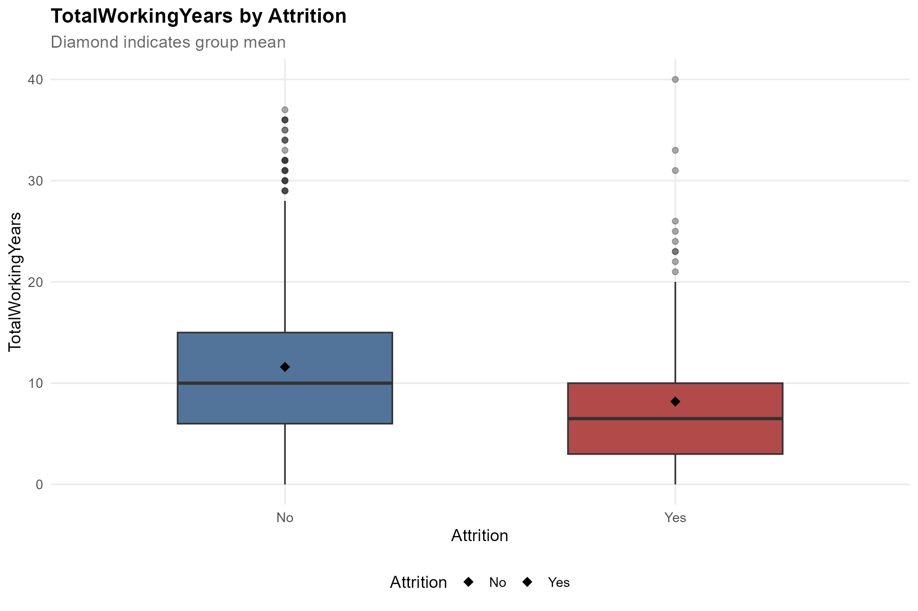
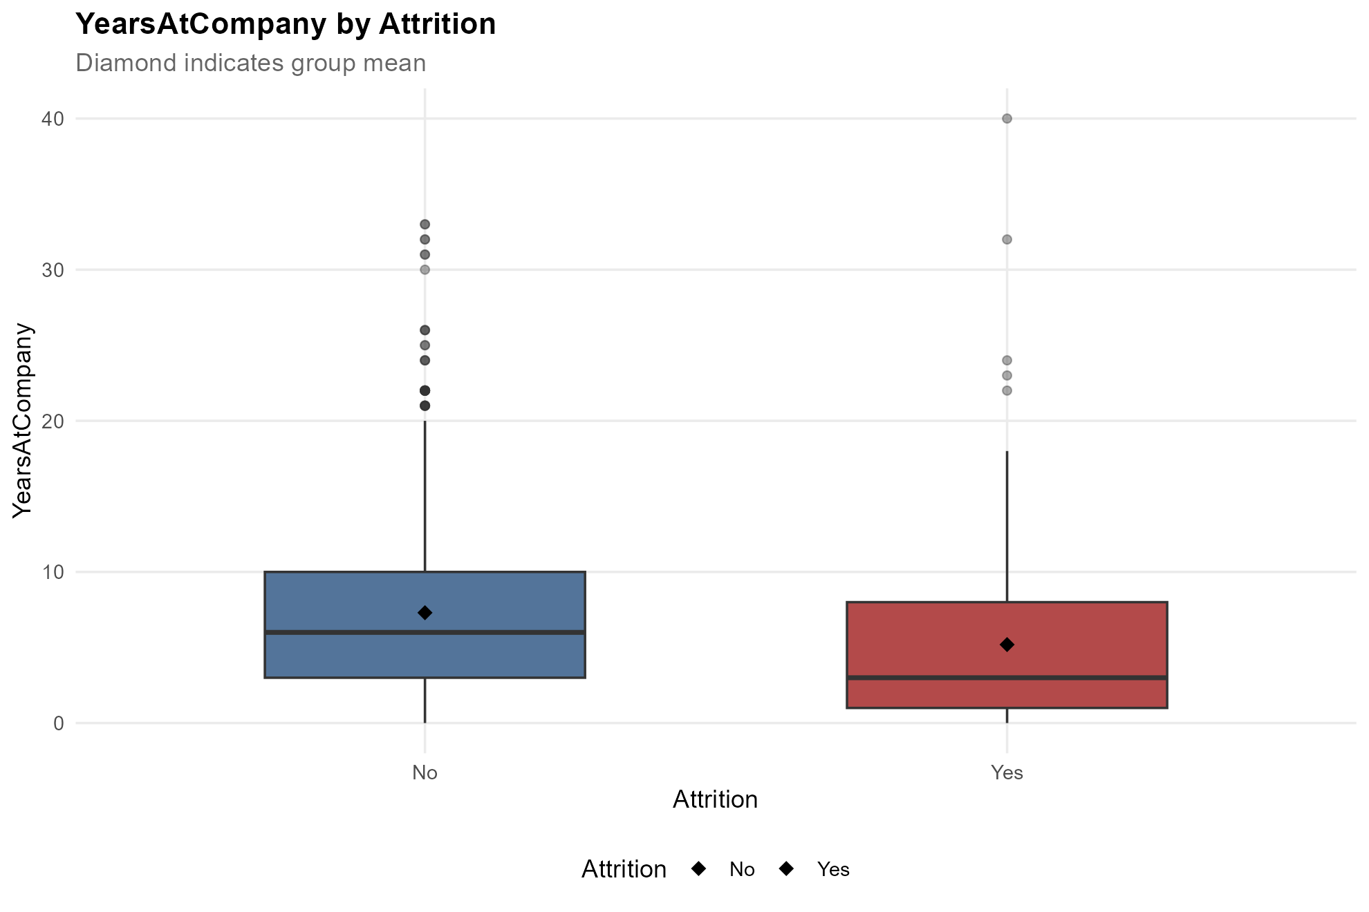
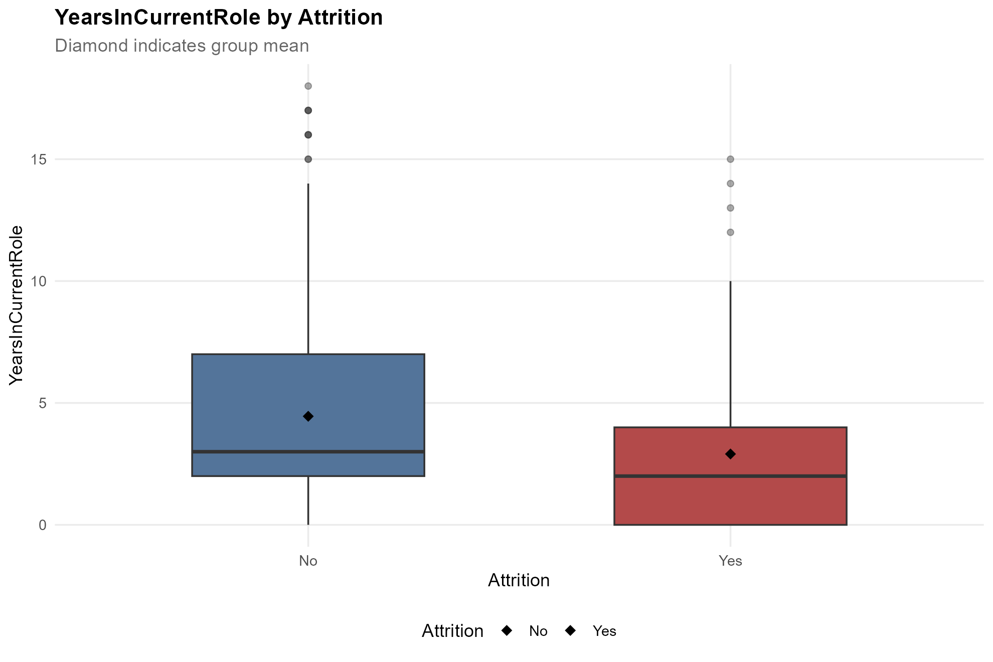
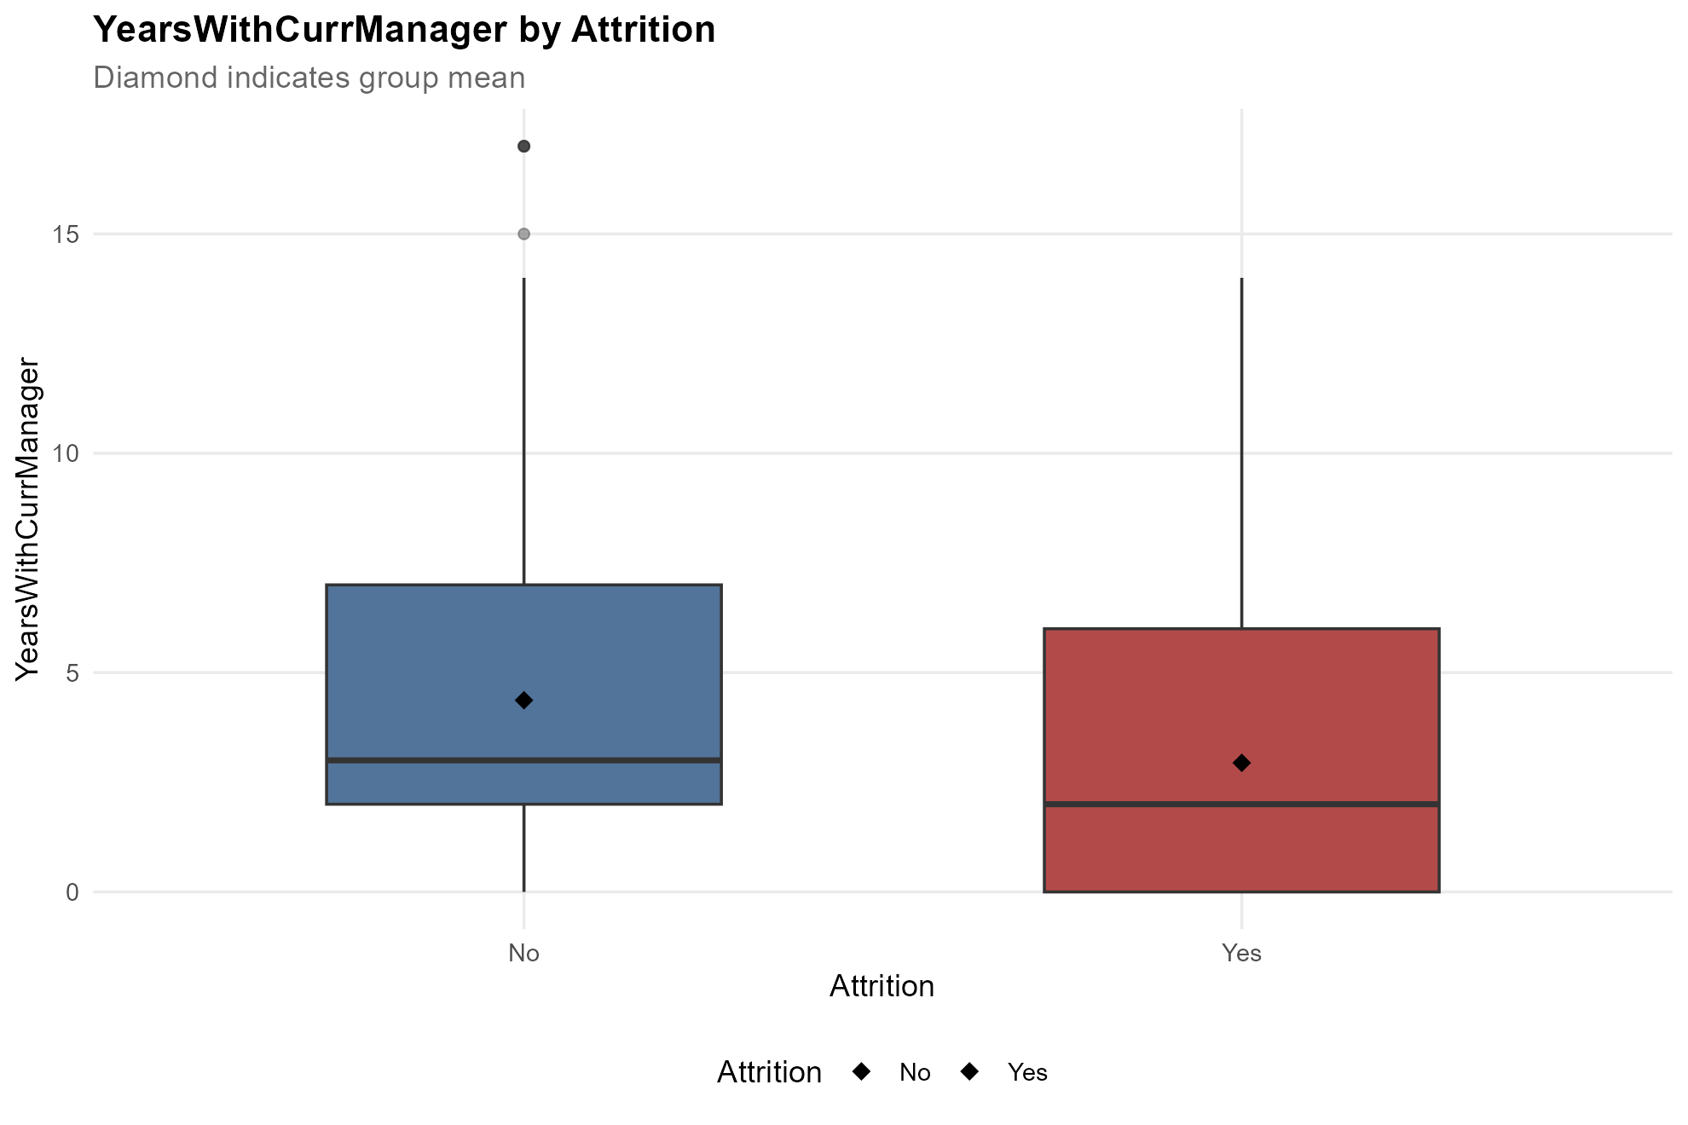
EDA Results – Numerical Variables (1/2)
Exploratory Data Analysis
Four numerical variables (Total Working Years, Years at Company, Years in Current Role, and Years with Current Manager) were selected based on observed differences in their distributions by attrition.
1
Total Working Years
2
Years at Company
Key Findings
Employees who left tend to have fewer total working years.
Employees who left tend to have fewer years at company.
Career Experience and Organizational Tenure
Employees who leave tend to have fewer total working years and shorter company tenure, suggesting that attrition is associated with both overall career experience and organizational tenure.
Role Familiarity and Organizational Relationships
3
Years in Current Role
4
Years with Current Manager
Shorter time spent in current roles and with managers may reflect less established organizational connections, limited role familiarity, or differences in employee integration.
Employees who left tend to have fewer years in current role.
Employees who left tend to have fewer years with current manager.

Slide 9
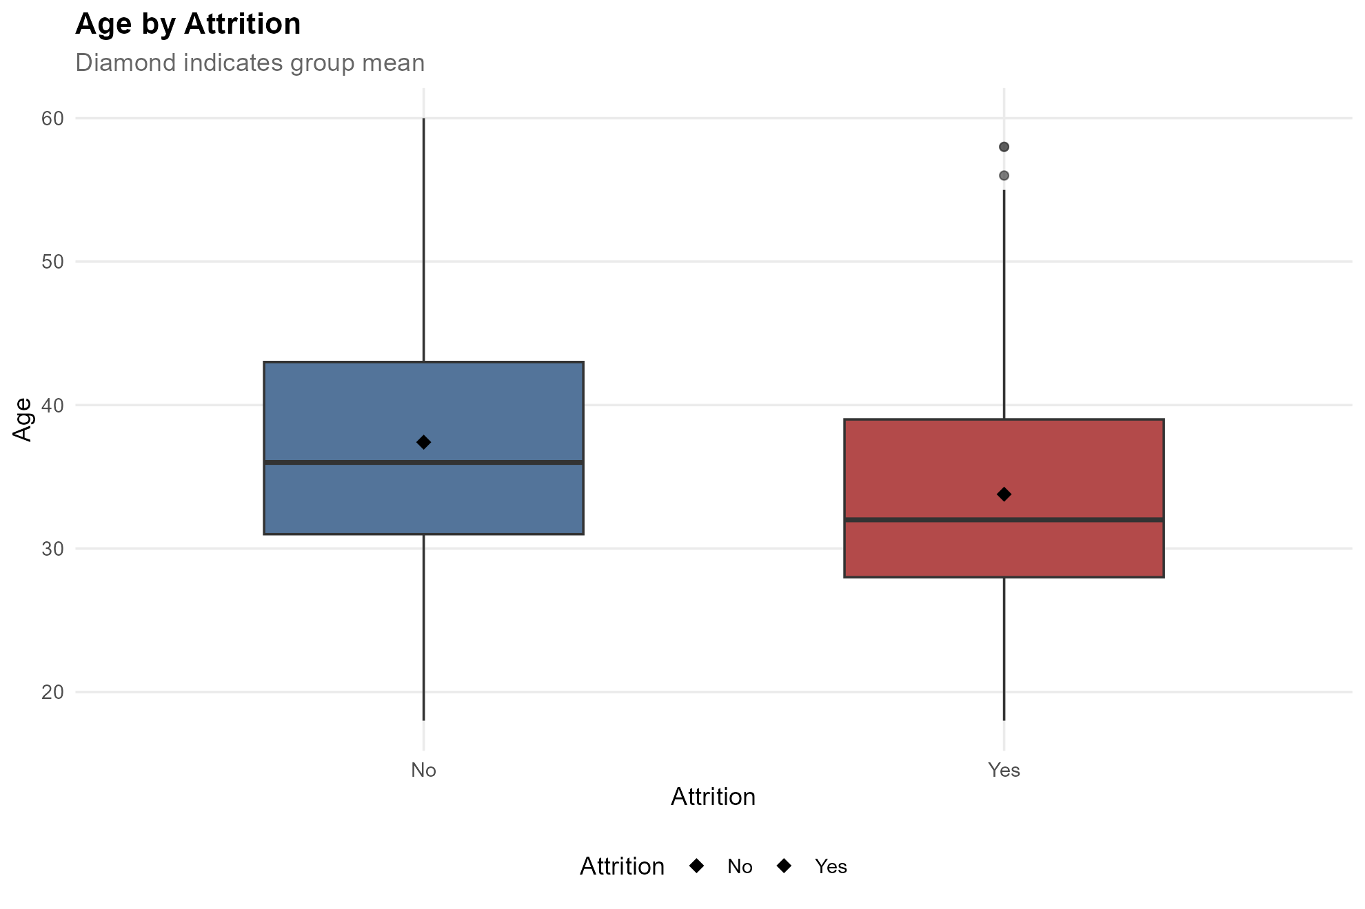
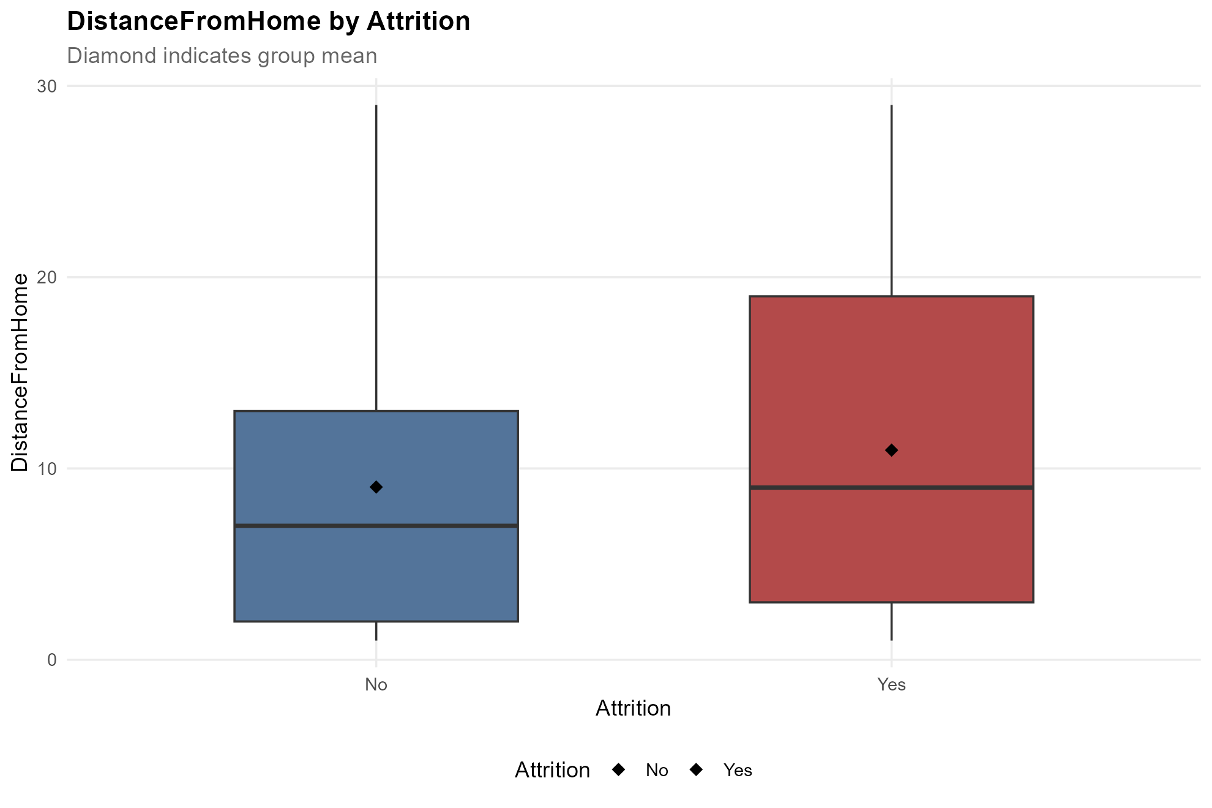
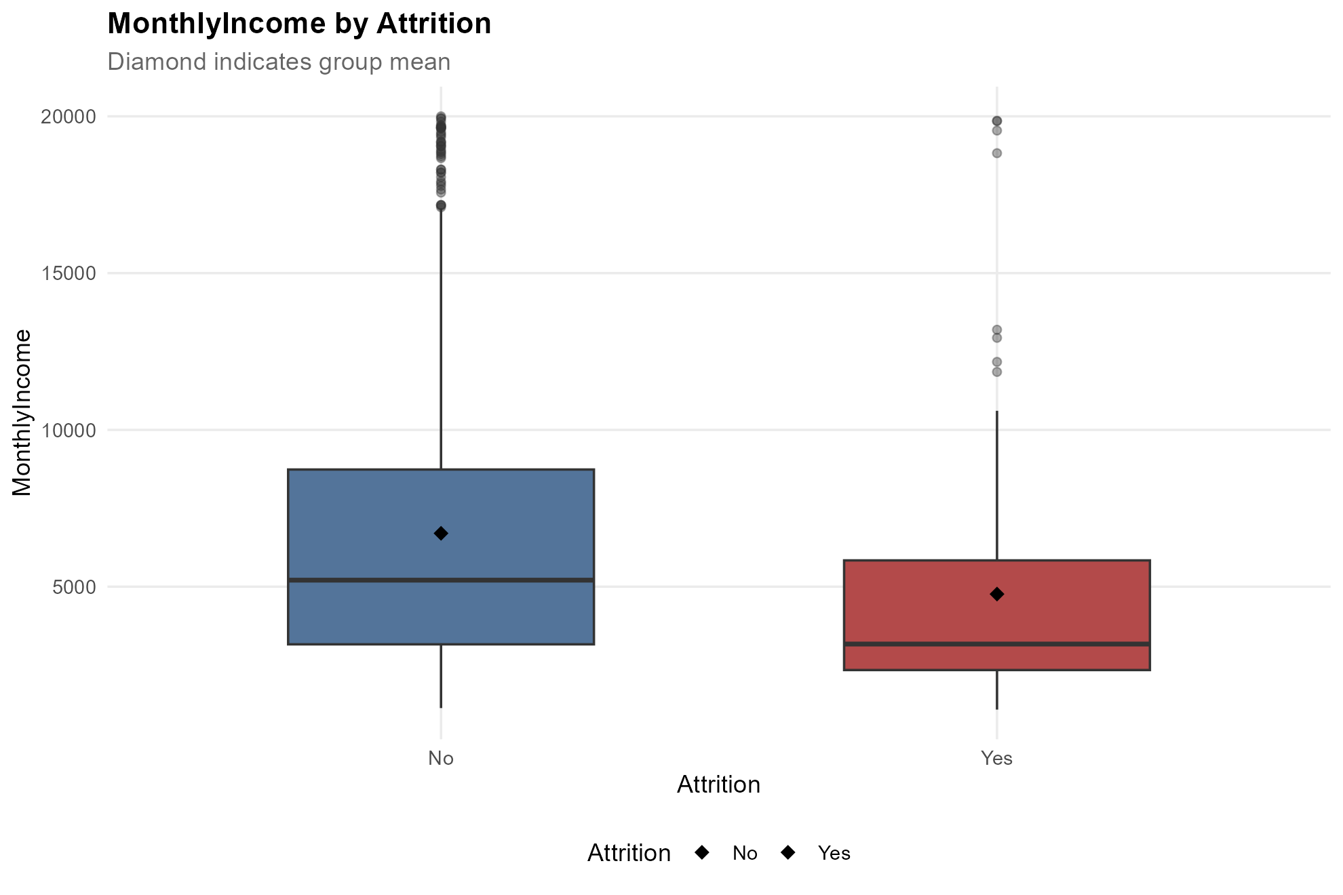
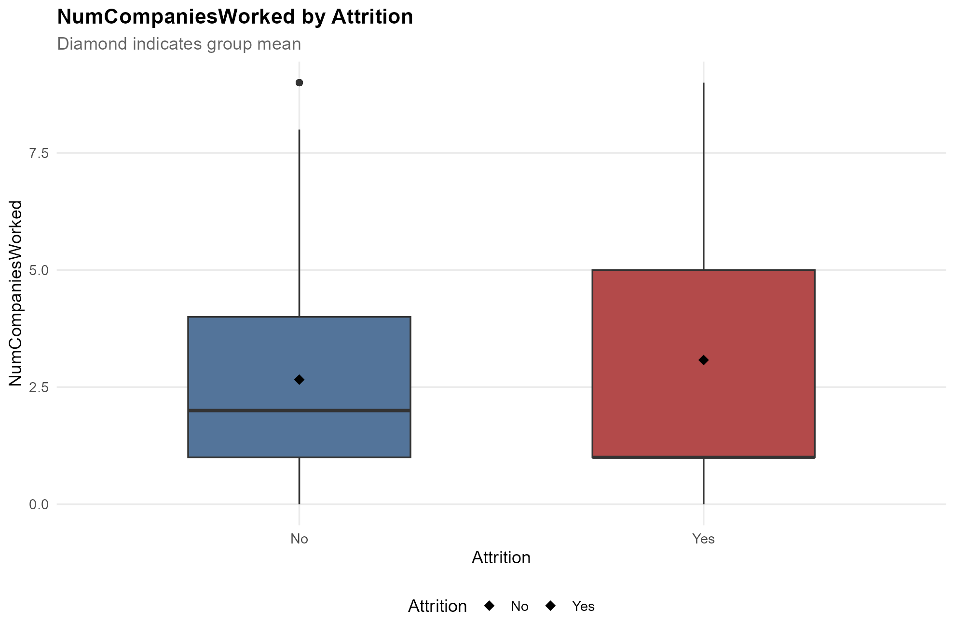
EDA Results – Numerical Variables (2/2)
Exploratory Data Analysis
Four numerical variables (Age, Distance from Home, Monthly Income, and Number of Companies Worked) were selected based on observed differences in their distributions by attrition.
5
Age
6
Distance from Home
Key Findings
Employees who leave tend to be younger.
Employees who left tend to have a job farther away from home.
Demographic and Employment Characteristics
Employees who leave tend to be younger, earn lower monthly incomes, and live farther from work, suggesting that career stage, compensation, and commuting demands may be associated with attrition.
Career Mobility and Employment History
7
Monthly Income
8
Number of Companies Worked
Employees who leave tend to have worked for more companies, potentially reflecting greater career mobility or more frequent transitions between employers.
Employees who left tend to have less monthly income.
Employees who left tend to have worked for a greater number of companies in the past.

Slide 10
Ⅰ. | Dataset Overview
Ⅱ. | Exploratory Data Analysis
III. | Predictive Modeling (KNN & Naive Bayes)
IV. | Conclusions
V. | Appendix

Slide 11




KNN & Naive Bayes
Predictive Modeling
Two classification algorithms were evaluated to identify employees at risk of attrition, with Naive Bayes demonstrating stronger overall predictive performance.
KNN
Naïve Bayes
Methodology
KNN identifies employees with similar characteristics using Euclidean distance and predicts attrition based on their observed outcomes, with an adjusted classification threshold.
Methodology
Naive Bayes estimates the probability of employee attrition using Bayes' theorem, assuming predictors are conditionally independent given attrition status.
Methodology
Model Setup
4 Predictors
Employee Profile: Age
Career & Tenure: Years in Current Role
Work Conditions: OverTime
Job Characteristics: Job Role
Model Setup
8 Predictors
Employee Profile: Age
Career & Tenure: Years at Company
Work Conditions: OverTime, Business Travel,
Work-Life Balance
Job Characteristics: Job Role, Job Involvement
Commute & Location: Distance from Home
K=29, Threshold = 0.20
Threshold = 0.21
Confusion Matrix
Actual
Confusion Matrix
Actual
 | Yes | No
Yes | 20 | 31 | 51
No | 8 | 115 | 123
 | 28 | 146 | 174
 | Yes | No
Yes | 20 | 22 | 42
No | 8 | 124 | 132
 | 28 | 146 | 174
Predicted
Predicted
Performance
Accuracy = (20+115) / 174 = 77.59%
Performance
Accuracy = (20+124)/174 = 82.76%
Sensitivity = 20/28 = 71.43%
Sensitivity = 20/28 = 71.43%
Specificity = 115/146 = 78.77%
Specificity = 124/146 = 84.93%
Train: n = 696 Test: n = 174
F1 = 2*20/(2*20+31+8) = 50.63%
Train: n = 696 Test: n = 174
F1 = 2*20/(2*20+22+8) = 57.14%
Naive Bayes maintained the same sensitivity as KNN (71.43%), while achieving higher accuracy (82.76%), specificity (84.93%),
and F1 score (57.14%), with fewer false positives (22 vs. 31).

Slide 12
Ⅰ. | Dataset Overview
Ⅱ. | Exploratory Data Analysis
III. | Predictive Modeling (KNN & Naive Bayes)
IV. | Conclusions
V. | Appendix

Slide 13
Key Findings & Strategic Recommendations
Conclusions
Frito Lay can shift from reactive turnover management to proactive, data-driven retention by identifying attrition risks early, targeting interventions, and validating their financial impact.
01
Overtime
Employees working overtime exhibited a 31.7% attrition rate, compared with 9.7% among those without overtime, highlighting overtime as a key indicator of elevated turnover risk.
Job Involvement
Employees with the lowest job involvement experienced a 46.8% attrition rate, compared with 8.6% among those with the highest involvement, representing a 38.2 percentage-point difference.
Top 3 Factors Associated with Attrition
Job Role
Sales Representatives recorded a 45.3% attrition rate, indicating that turnover risk varies considerably across job roles and supporting the need for role-specific retention strategies.
Model Performance
Financial Impact
Item | KNN | Naive Bayes
Accuracy | 77.59% | 82.76%
Sensitivity | 71.43% | 71.43%
Specificity | 78.77% | 84.93%
F1 Score | 50.63% | 57.14%
Employees Flagged (*TP + *FP) | 51 | 42
Incentive Cost | $ 10,200 | $ 8,400
*FN Total Annual Salary | $ 538,452 | $ 569,808
Total Cost = Incentive Cost + FN Total Annual Salary $×$ Replacement Cost Assumptions
Annual Salary = Monthly Income × 12
02
Replacement Cost Assumptions | KNN Total Cost | NB Total Cost | KNN Cost Advantage vs NB
50% | $ 279,426 | $ 293,304 | $ 13,878
100% | $ 548,652 | $ 578,208 | $ 29,556
200% | $ 1,087,104 | $ 1,148,016 | $ 60,912
400% | $ 2,164,008 | $ 2,287,632 | $ 123,624
Financial Impact
*TP (True Positive): Employees correctly predicted to leave, *FP (False Positive): Employees predicted to leave but who actually stayed, *FN (False Negative): Employees predicted to stay but who actually left, *TN (True Negative): Employees correctly predicted to stay.
Financial estimates assume that a $200 incentive successfully prevents attrition among correctly identified at-risk employees. Actual retention effectiveness has not been measured.
1. Conclusion | Transition to Proactive Retention Management
The analysis demonstrates that workforce data can identify meaningful attrition risk patterns and support predictive models, creating a foundation for shifting from reactive turnover management to proactive, evidence-based retention strategies.
2. Recommendation | Pilot, Measure, and Scale
Pilot Naive Bayes as the initial risk identification model based on its stronger classification performance.
Target interventions toward key attrition-related factors, measure actual retention outcomes and financial returns, and scale only after demonstrating effectiveness.
03
Conclusions & Recommendations

Slide 14
Ⅰ. | Dataset Overview
Ⅱ. | Exploratory Data Analysis
III. | Predictive Modeling (KNN & Naive Bayes)
IV. | Conclusions
V. | Appendix

Slide 15
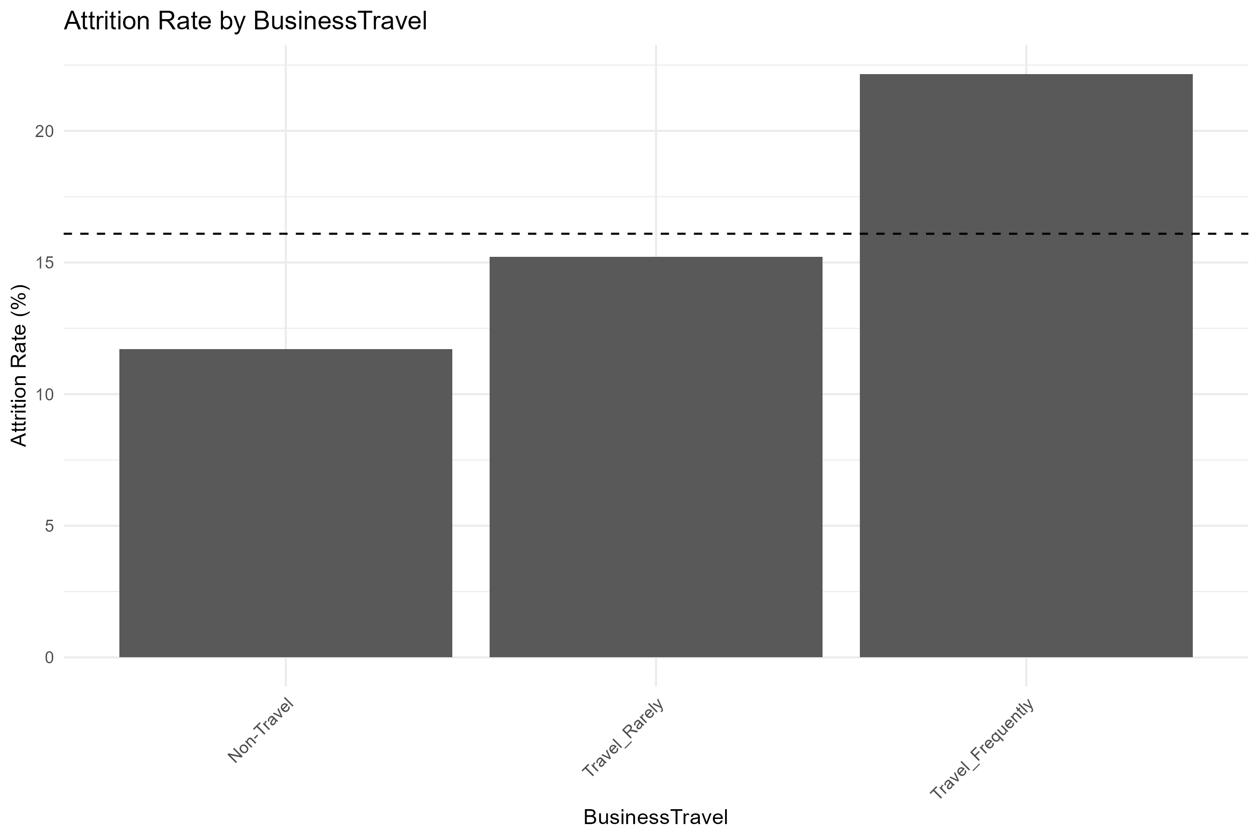
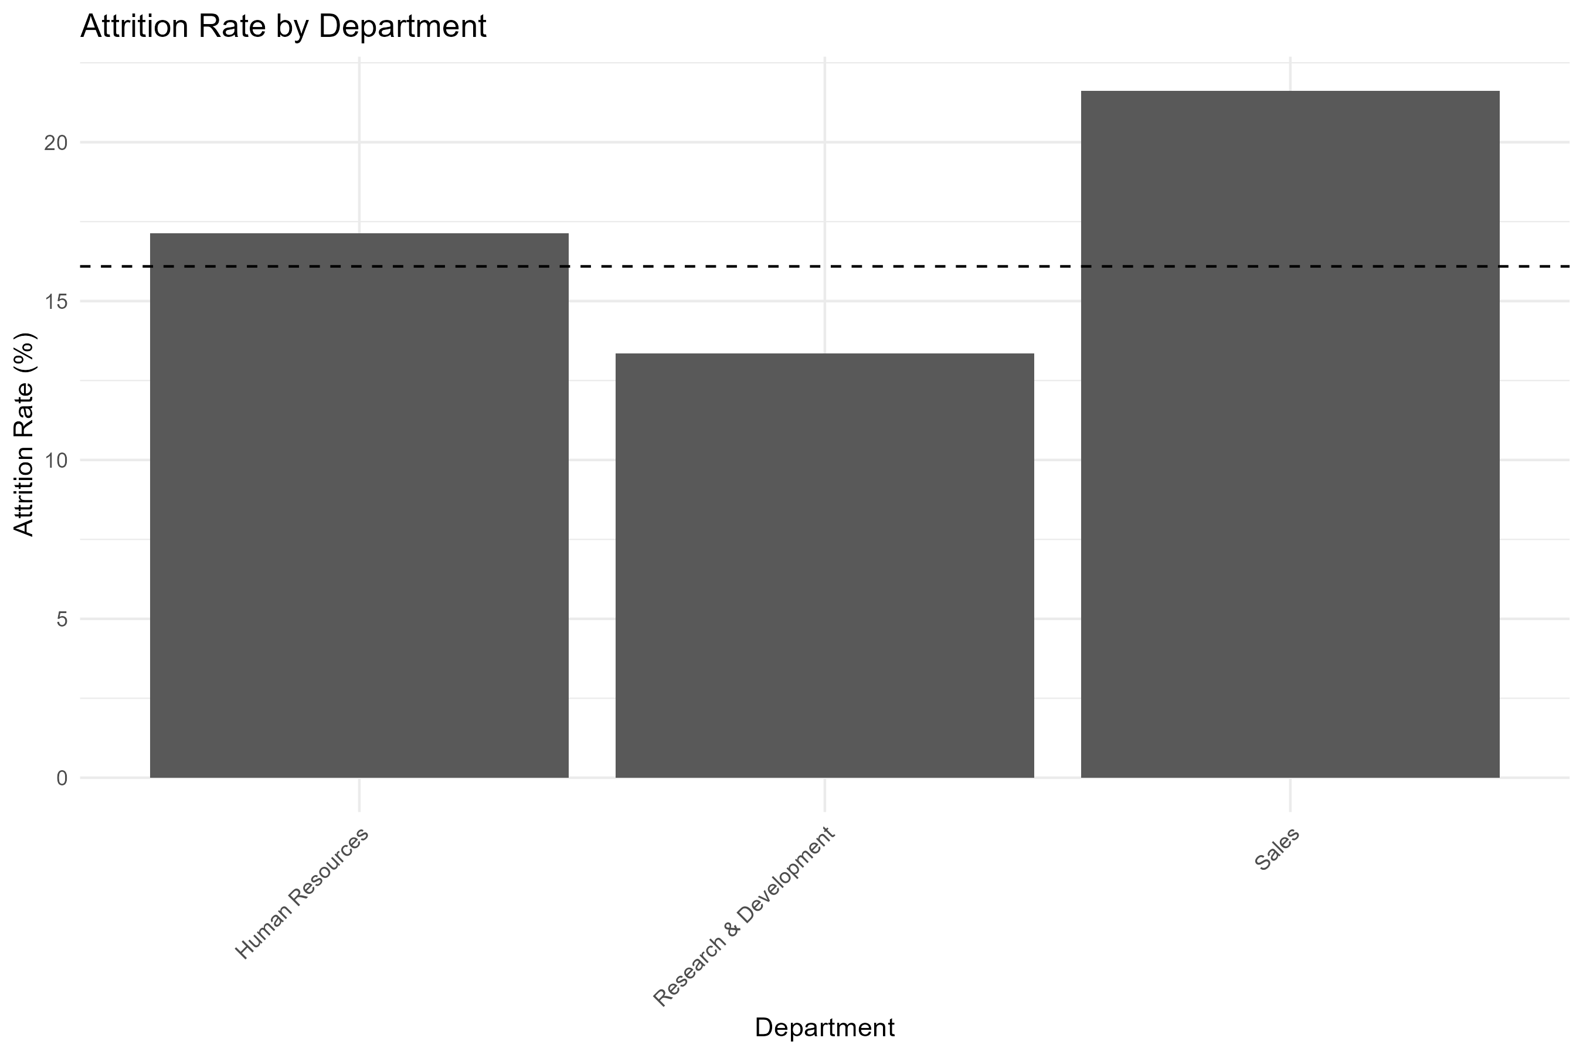
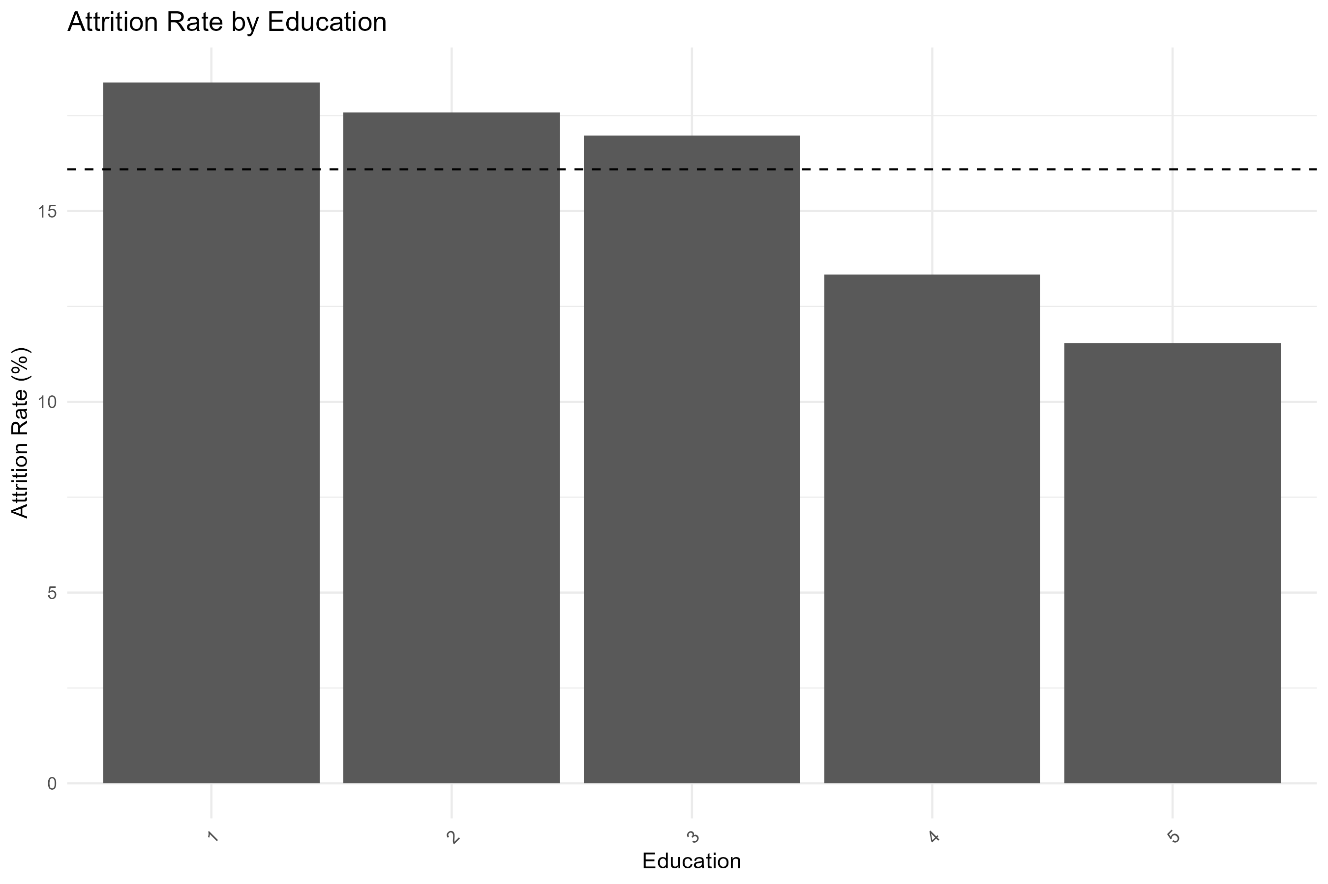
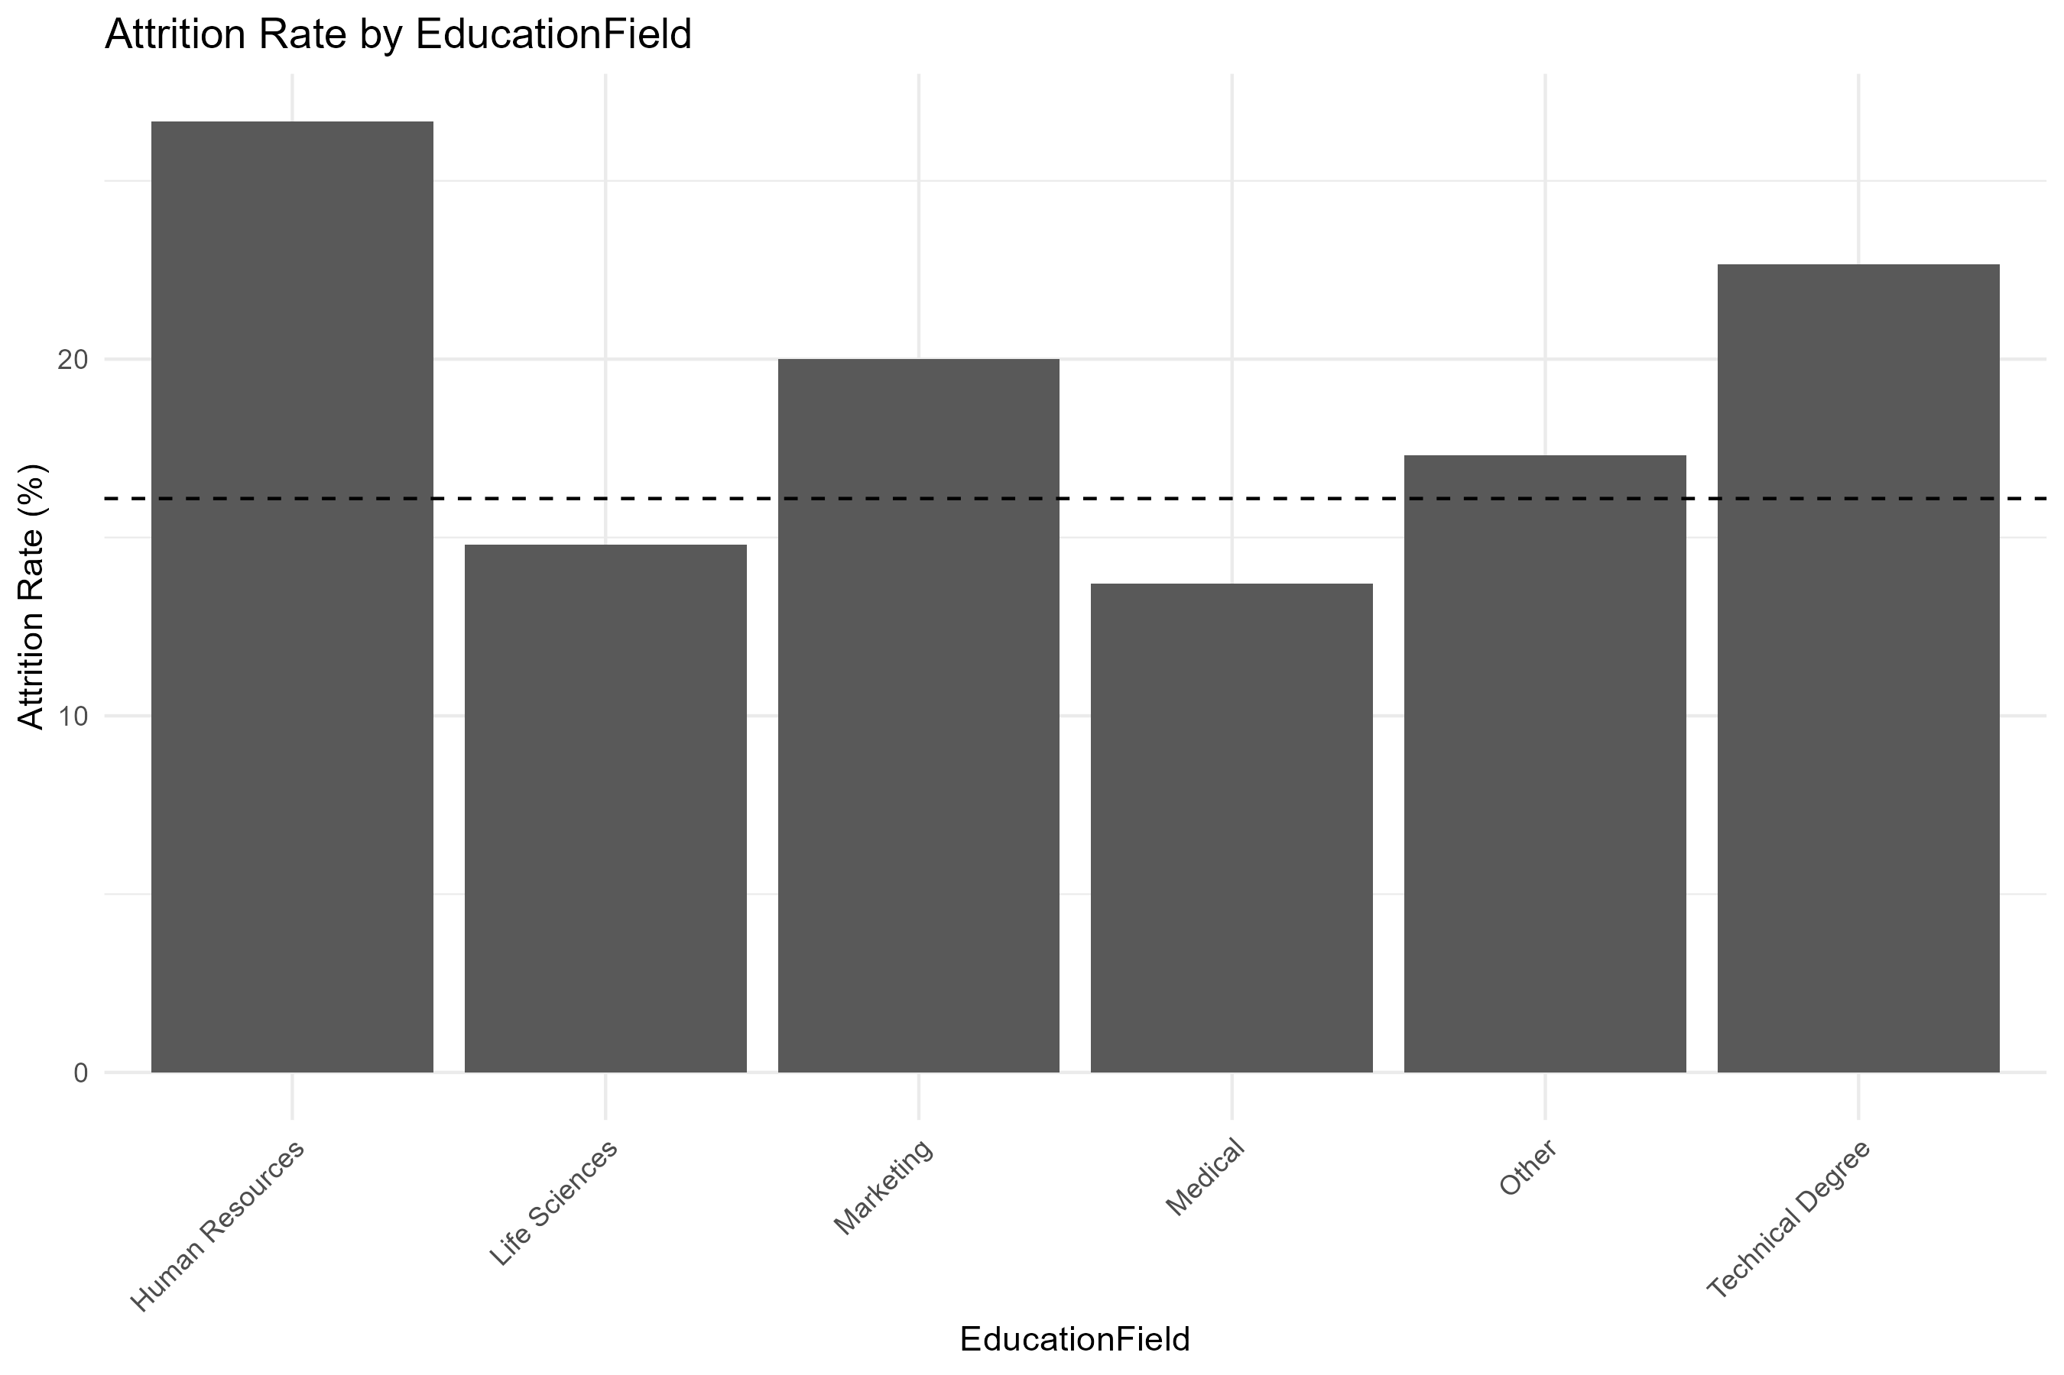
Categorical Variables: Business Travel, Department, Education, Education Field
Appendix.
Employees who travel more frequently have higher attrition rates, while those with higher education levels tend to have lower attrition rates.
Business Travel shows a stronger relationship with attrition.
Business Travel
Department
Education
Education Field

Slide 16
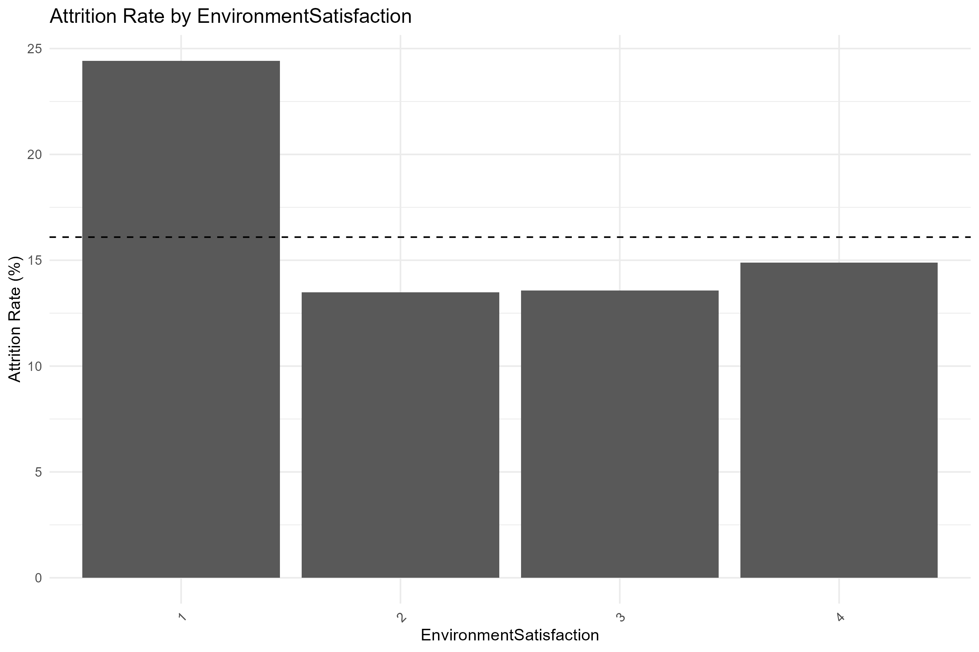
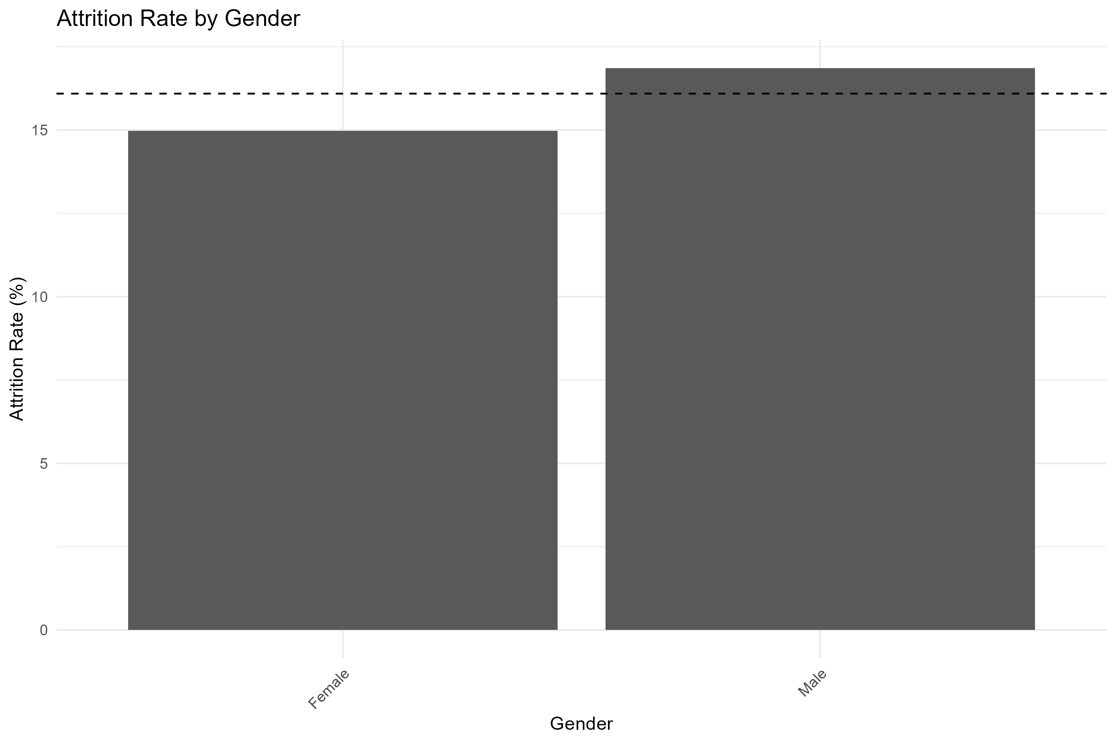
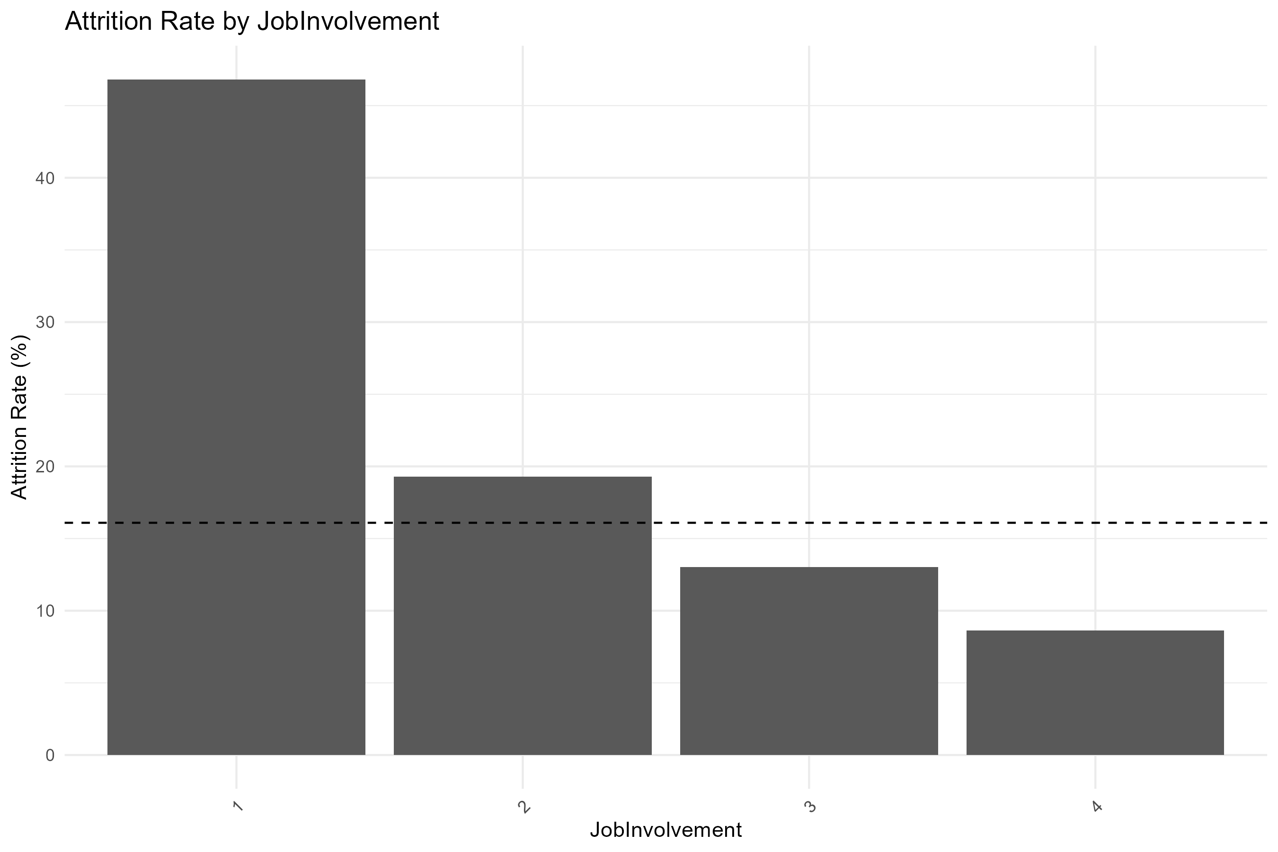
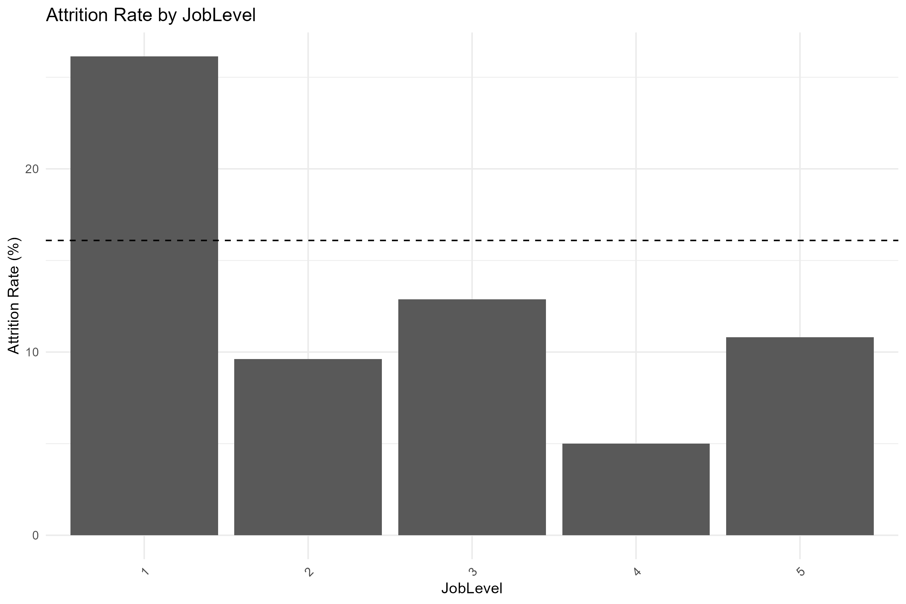
Categorical Variables: Environmental Satisfaction, Gender, Job Involvement, Job Level
Appendix.
Employees with lower job involvement have higher attrition rates. Attrition rates decrease significantly as job involvement increases.
Environment Satisfaction
Gender
Job Involvement
Job Level

Slide 17
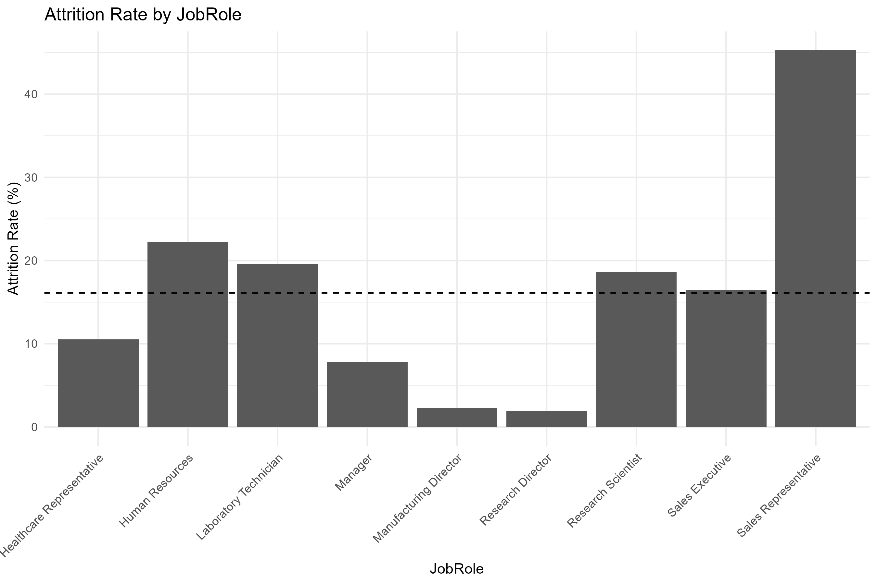
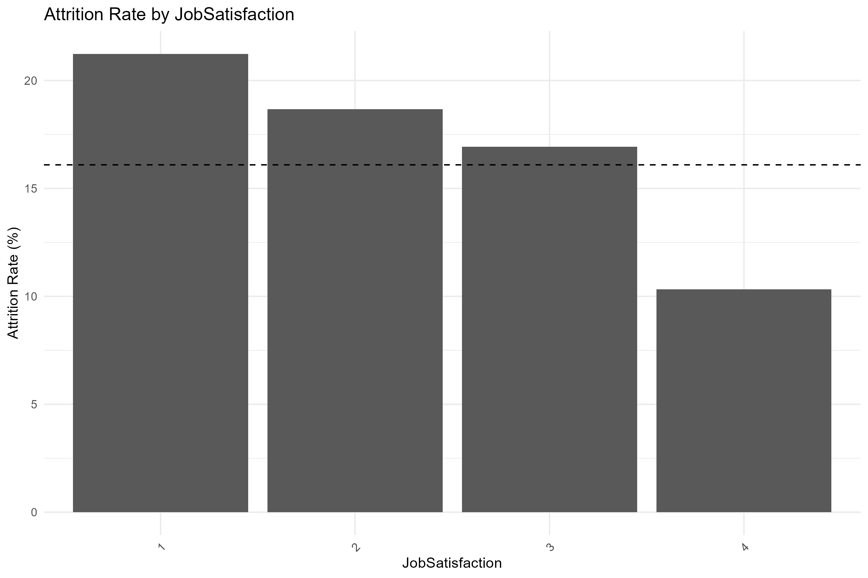
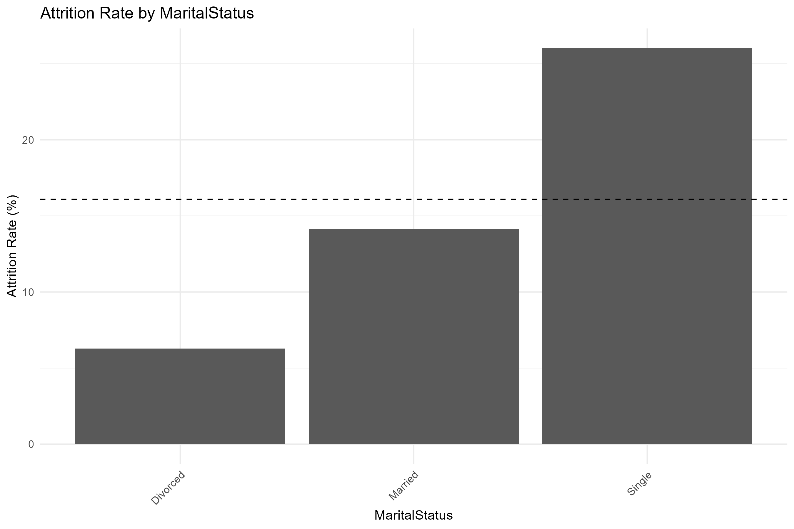
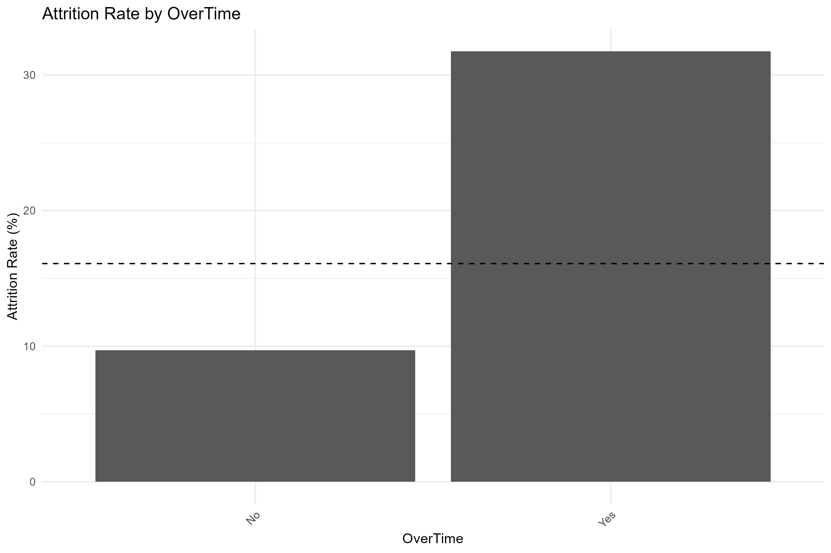
Categorical Variables: Job Role, Job Satisfaction, Marital Status, Overtime
Appendix.
Employees with lower job satisfaction, single employees, and those working overtime have higher attrition rates.
Overtime shows the strongest relationship with attrition.
Job Role
Job Satisfaction
Marital Status
Overtime

Slide 18
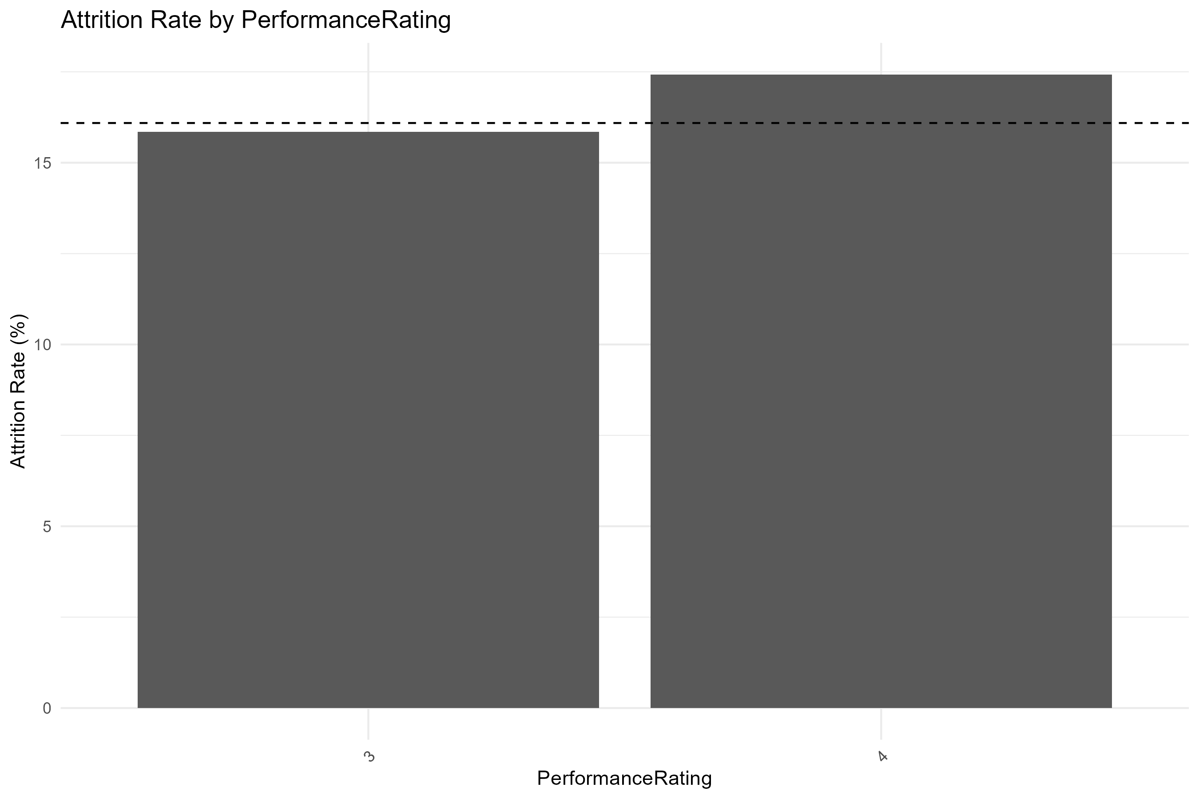
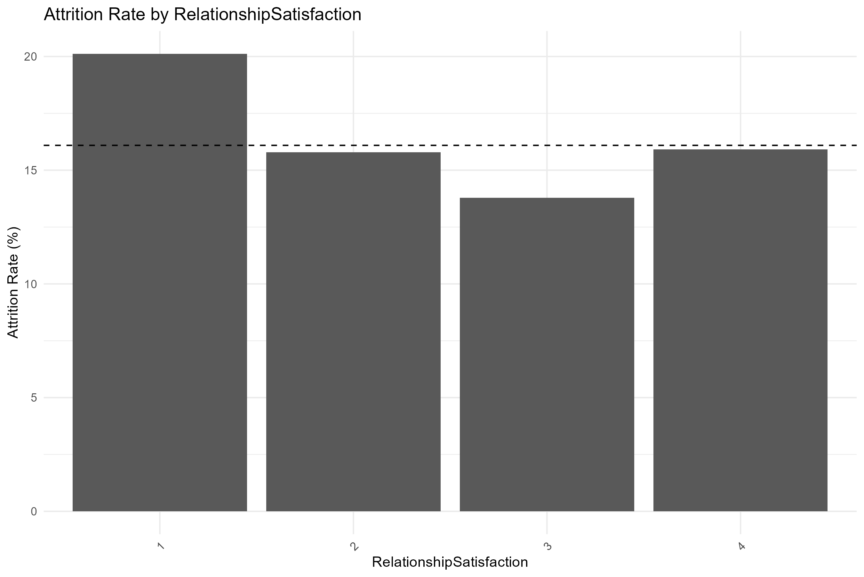
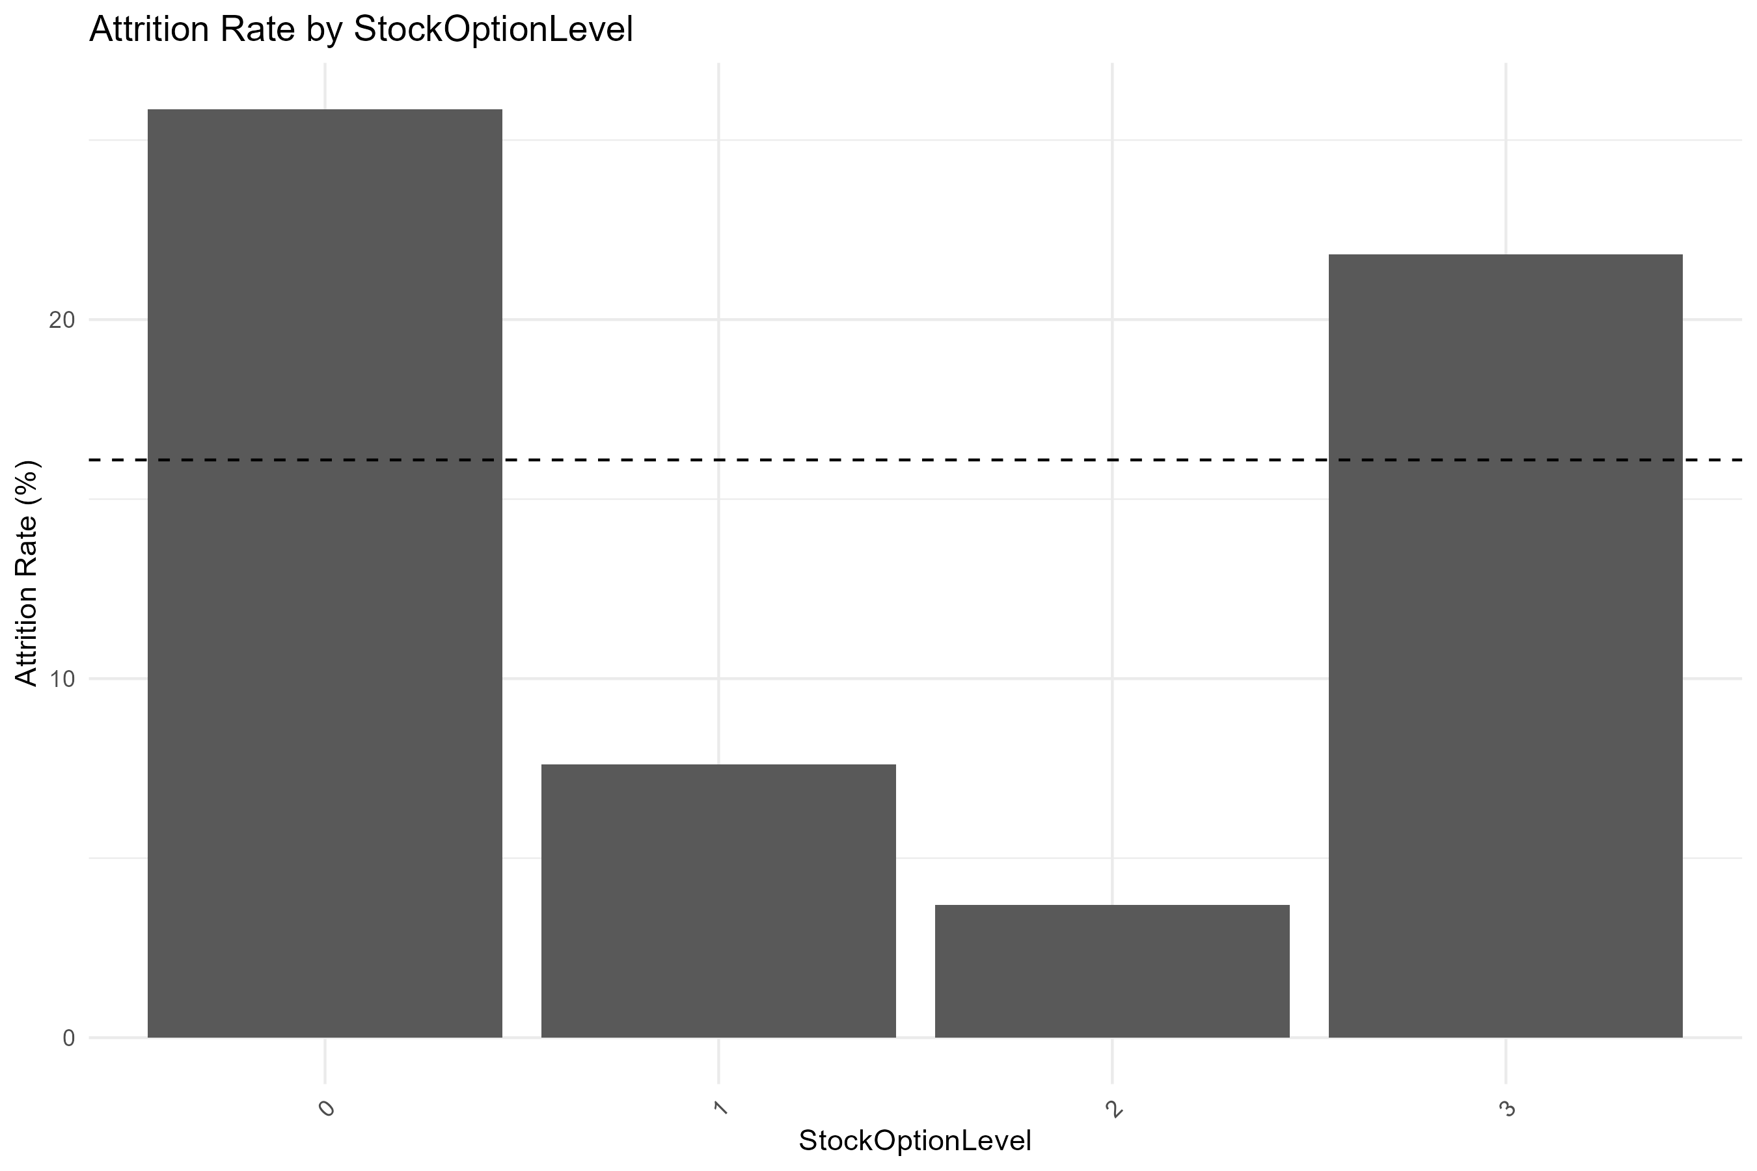
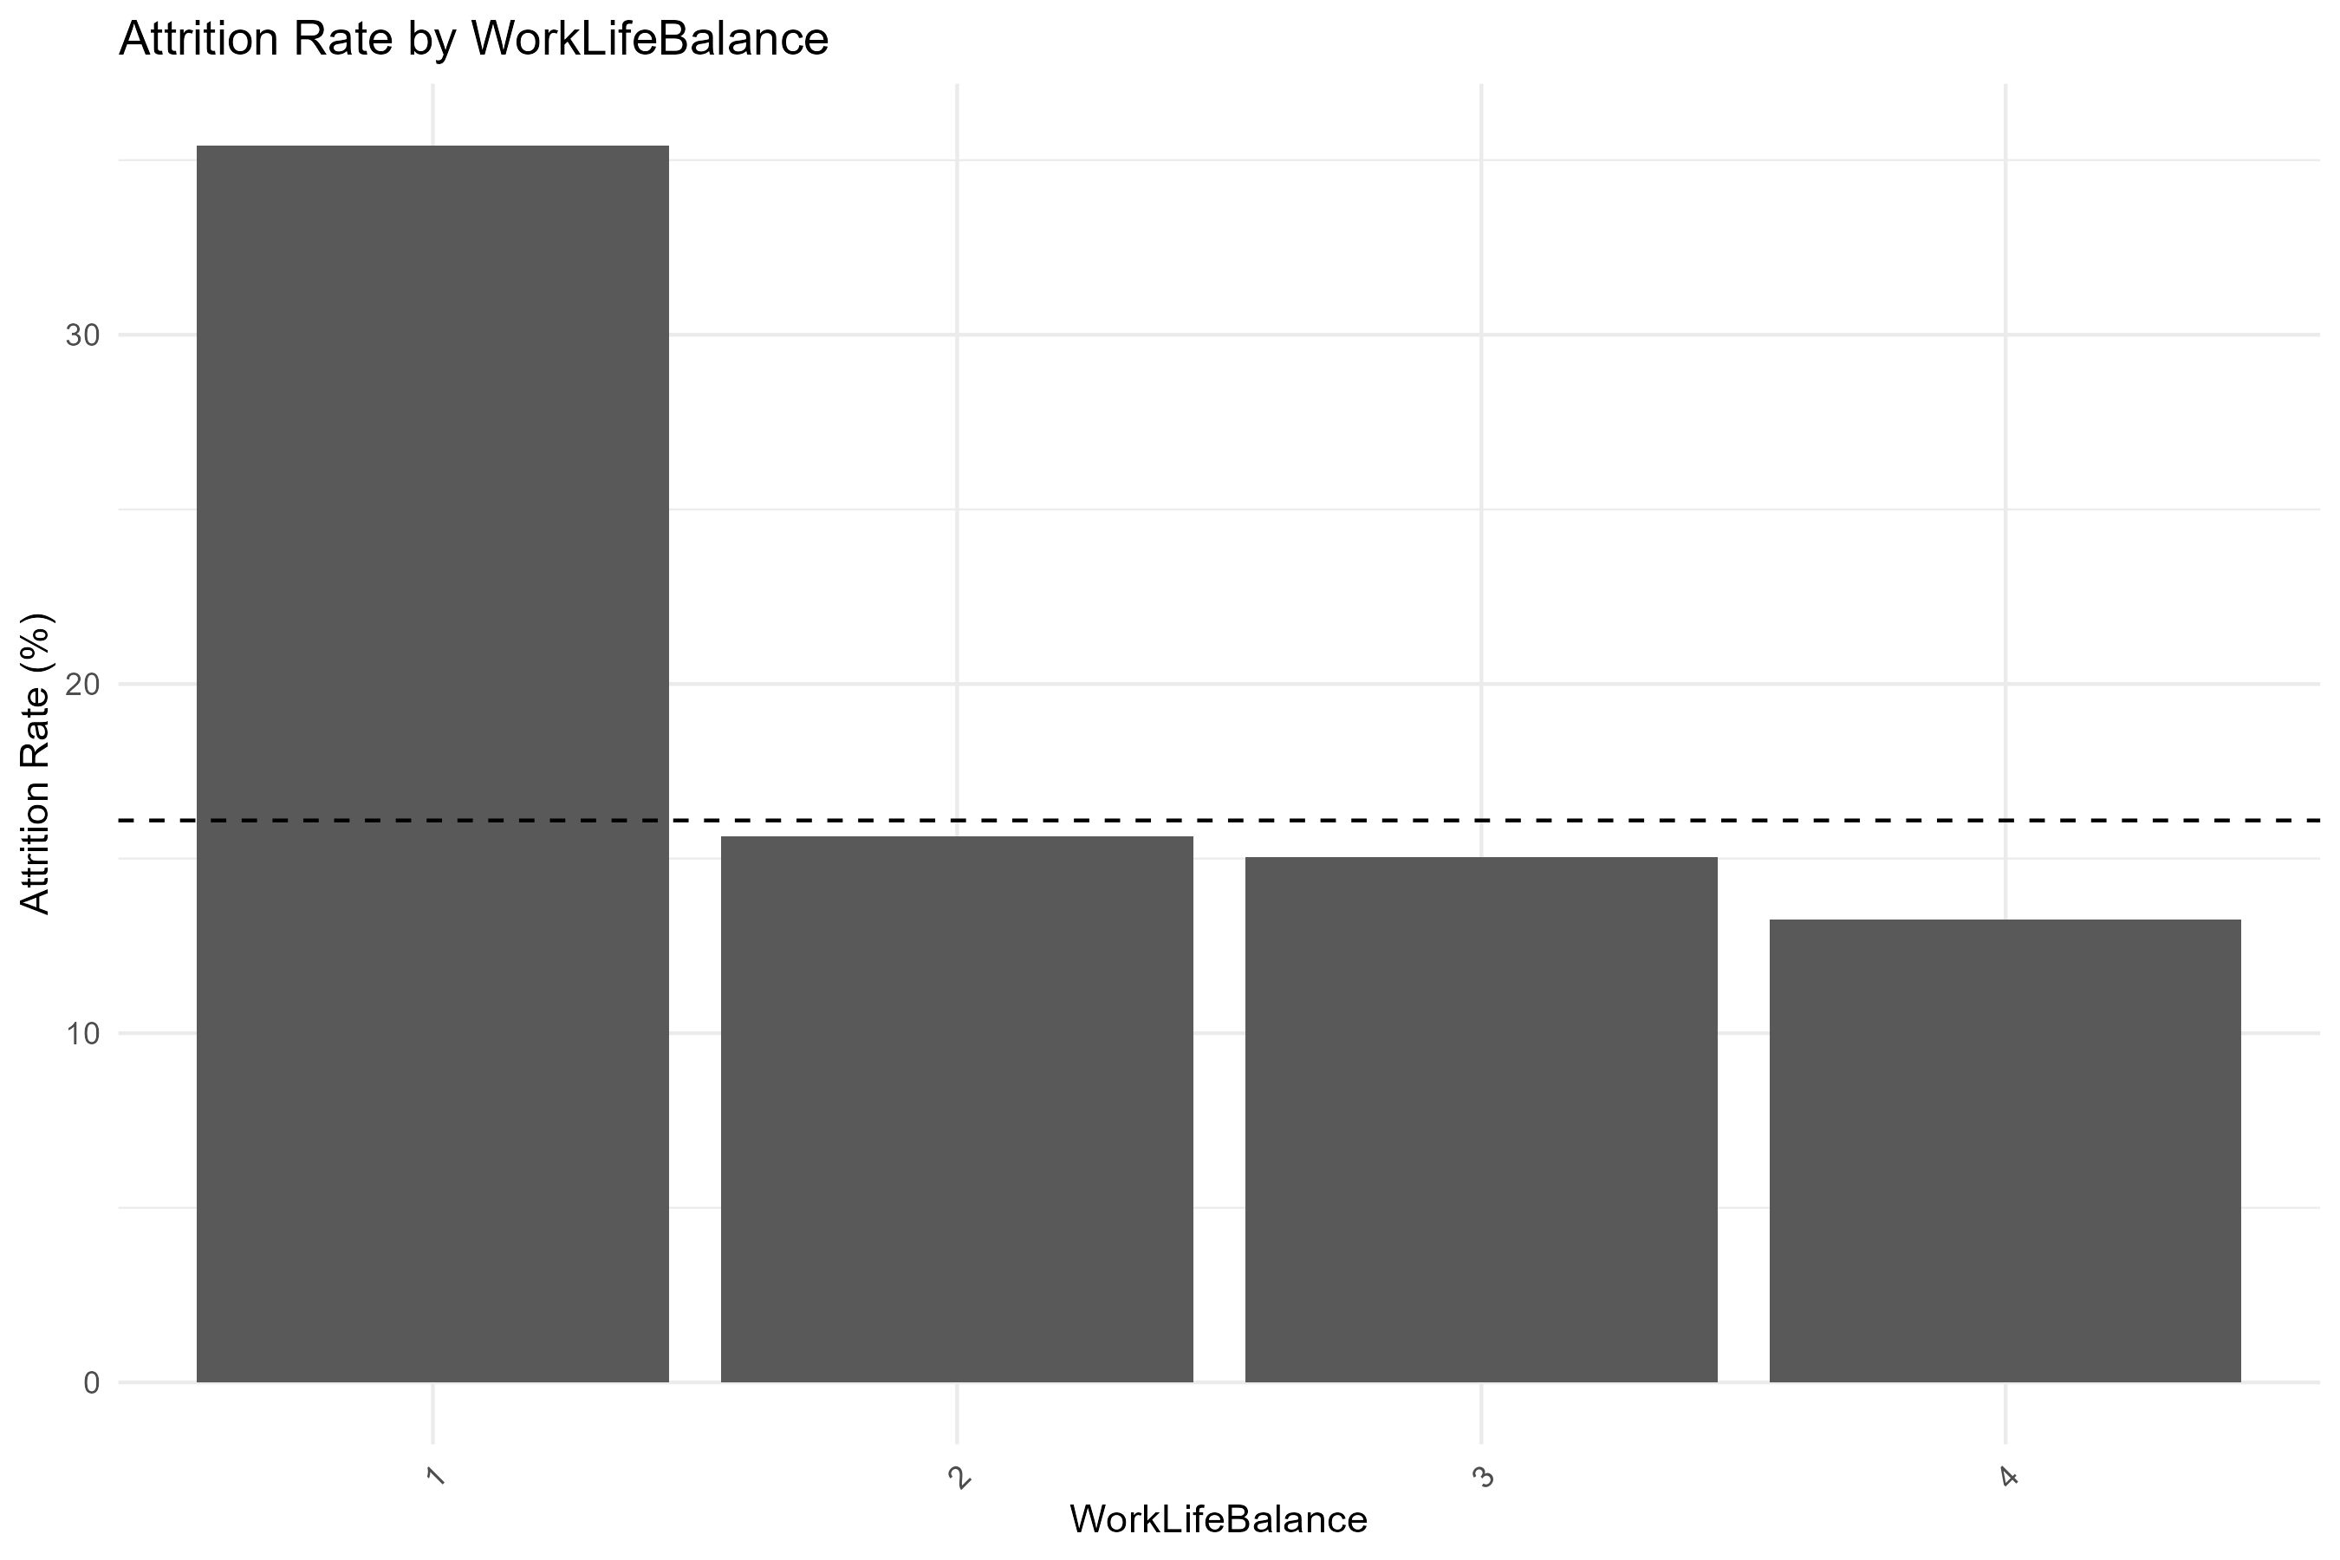
Categorical Variables: Performance Rating, Relationship Satisfaction, Stock Options, WLB
Appendix.
Employees with poor work-life balance have much higher attrition rates. Attrition rates are relatively similar among employees with better work-life balance.
Performance Rating
Relationship Satisfaction
Stock Option Level
Work Life Balance

Slide 19
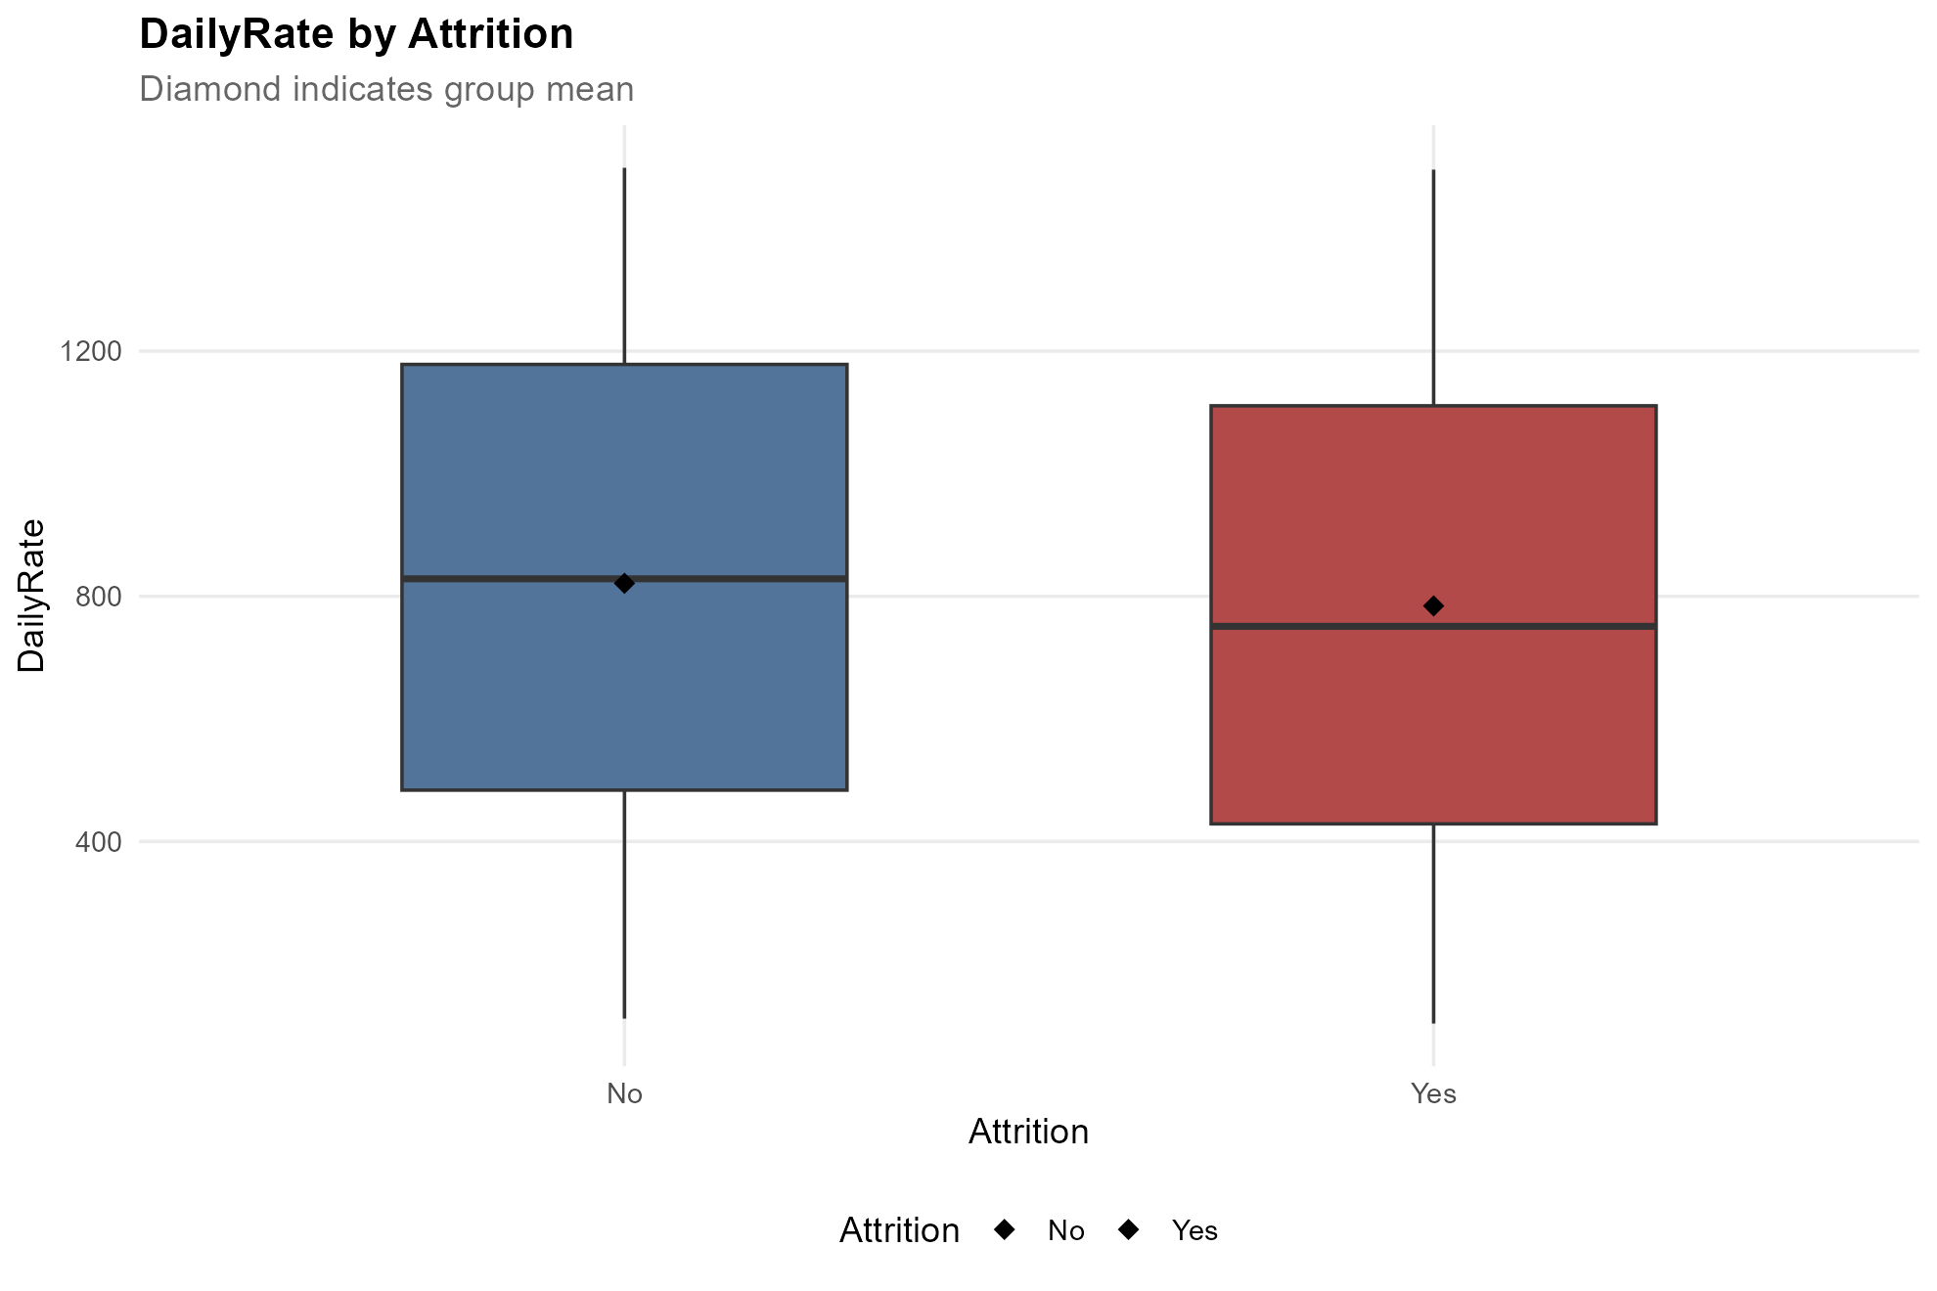
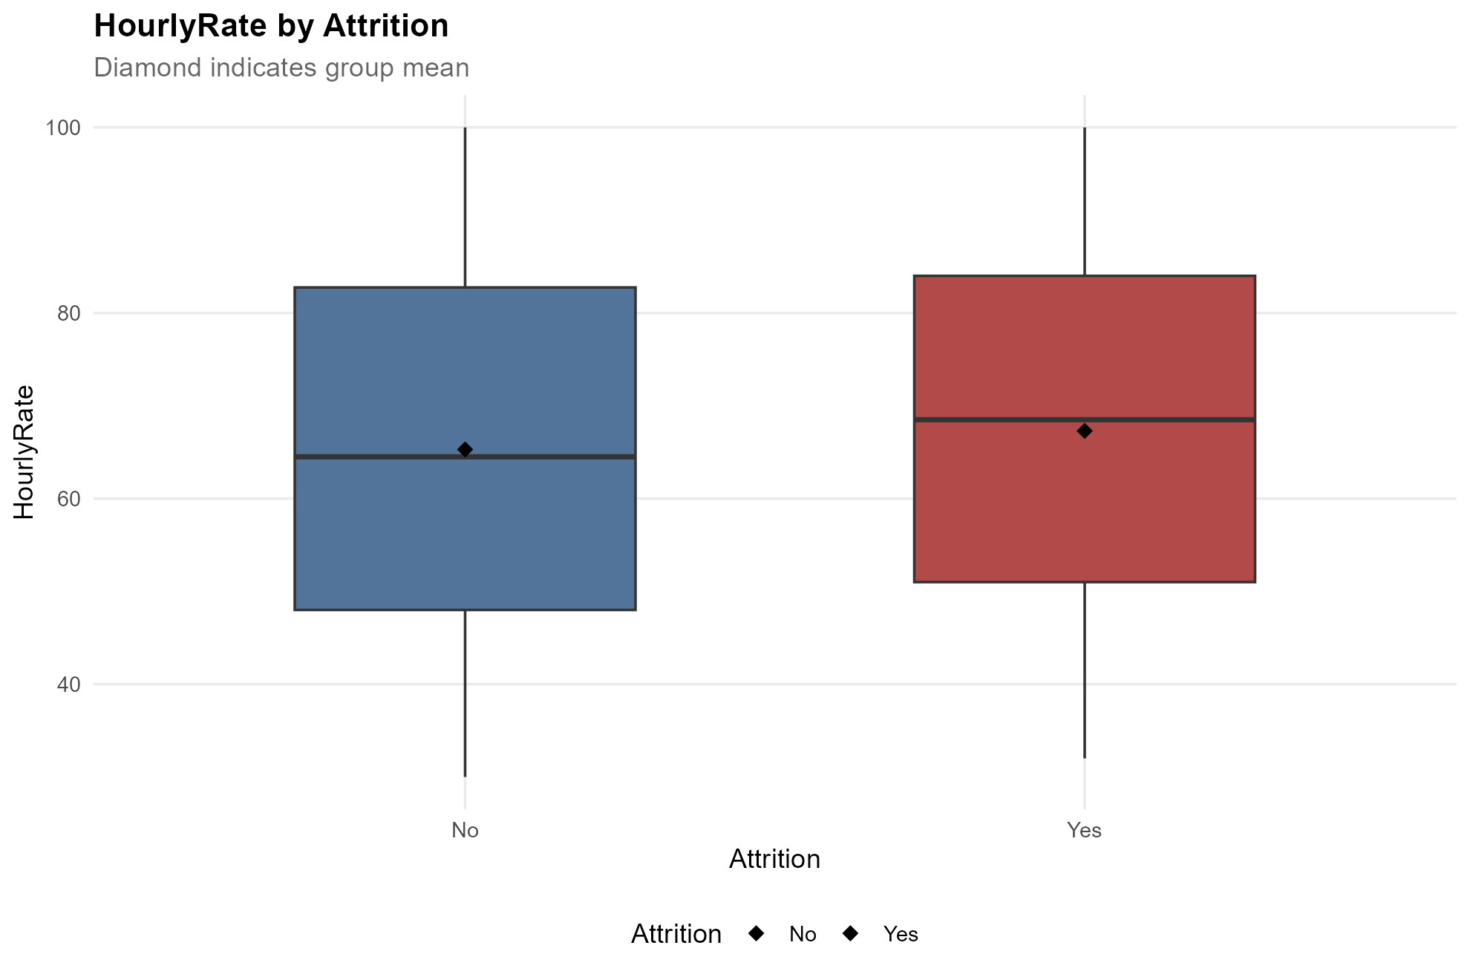
Numerical Variables: Age, Daily Rate, Distance from Home, Hourly Rate
Appendix.
Employees who leave tend to be younger and live farther from work.
Daily and hourly rates show little difference between employees who leave and those who stay.
Age
Daily Rate
Distance from Home
Hourly Rate

Slide 20
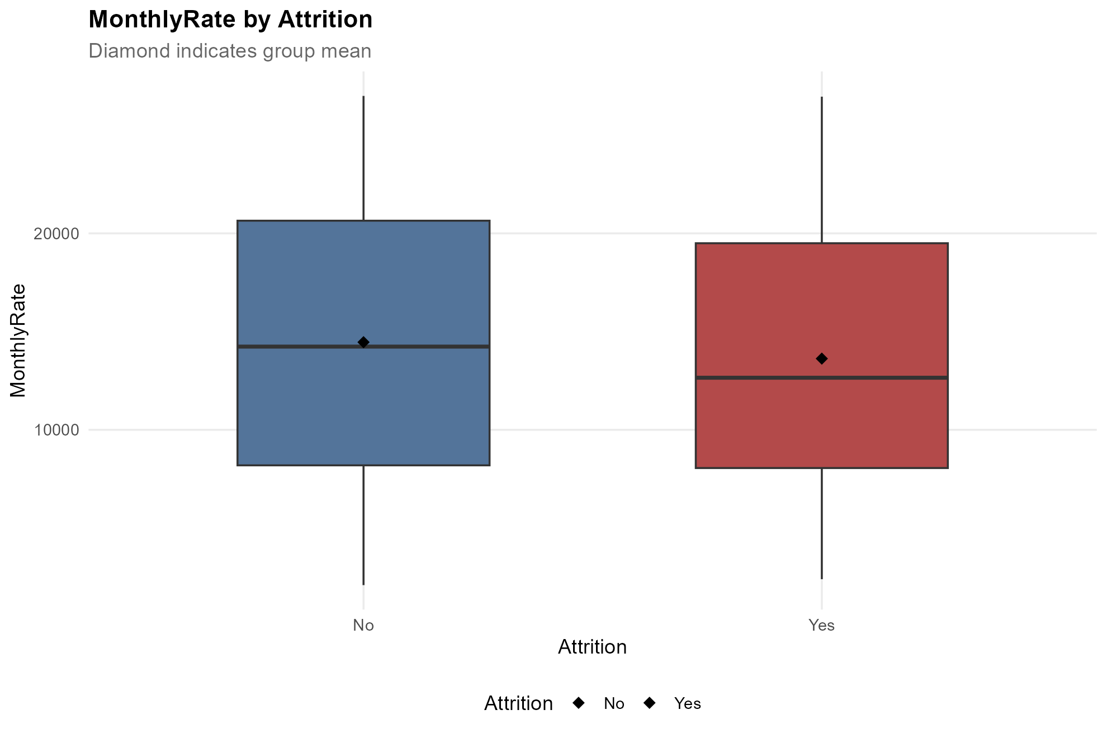
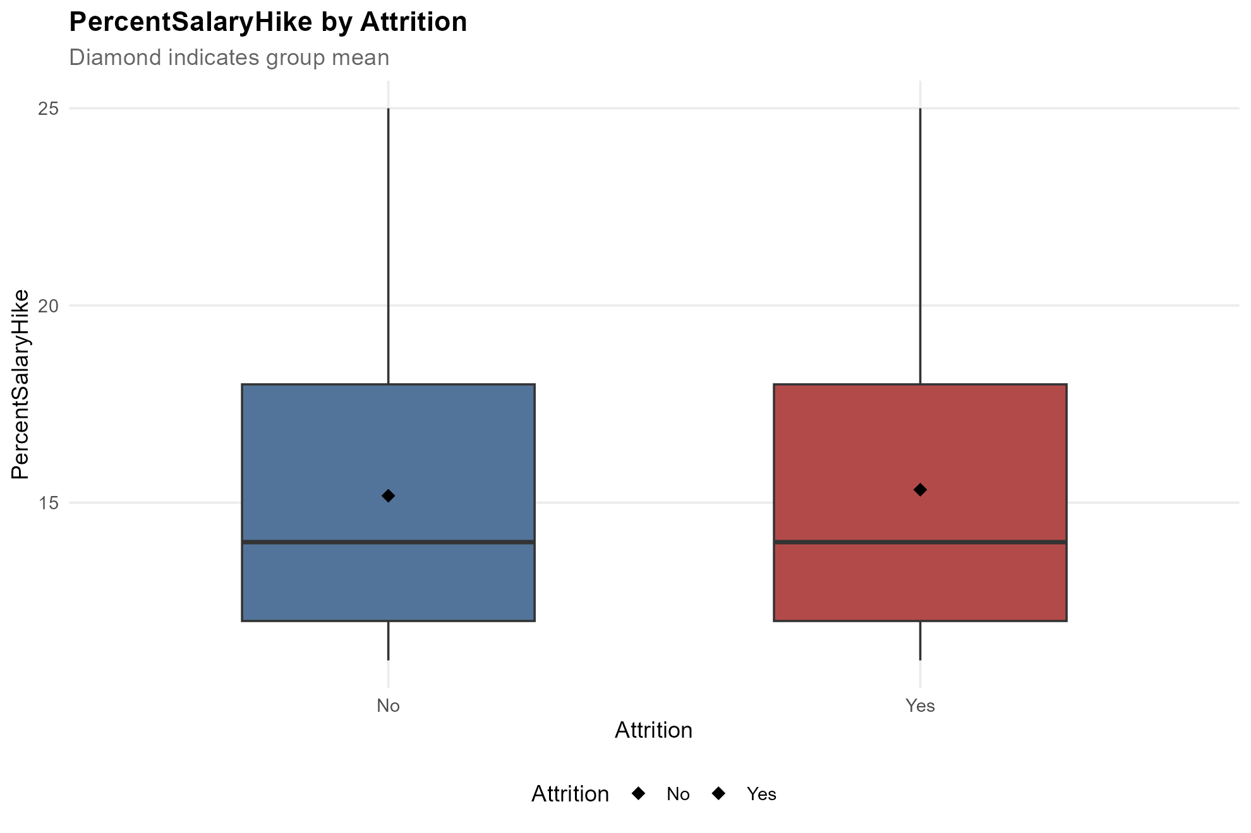
Numerical Variables: MonthlyIncome, MonthlyRate, NumCompaniesWorked, PercentSalaryHike
Appendix.
Employees who leave tend to have lower monthly incomes and have worked at more companies.
Monthly rates and salary increases show little difference between the two groups.
Monthly Income
Monthly Rate
Num Companies Worked
Percent Salary Hike

Slide 21
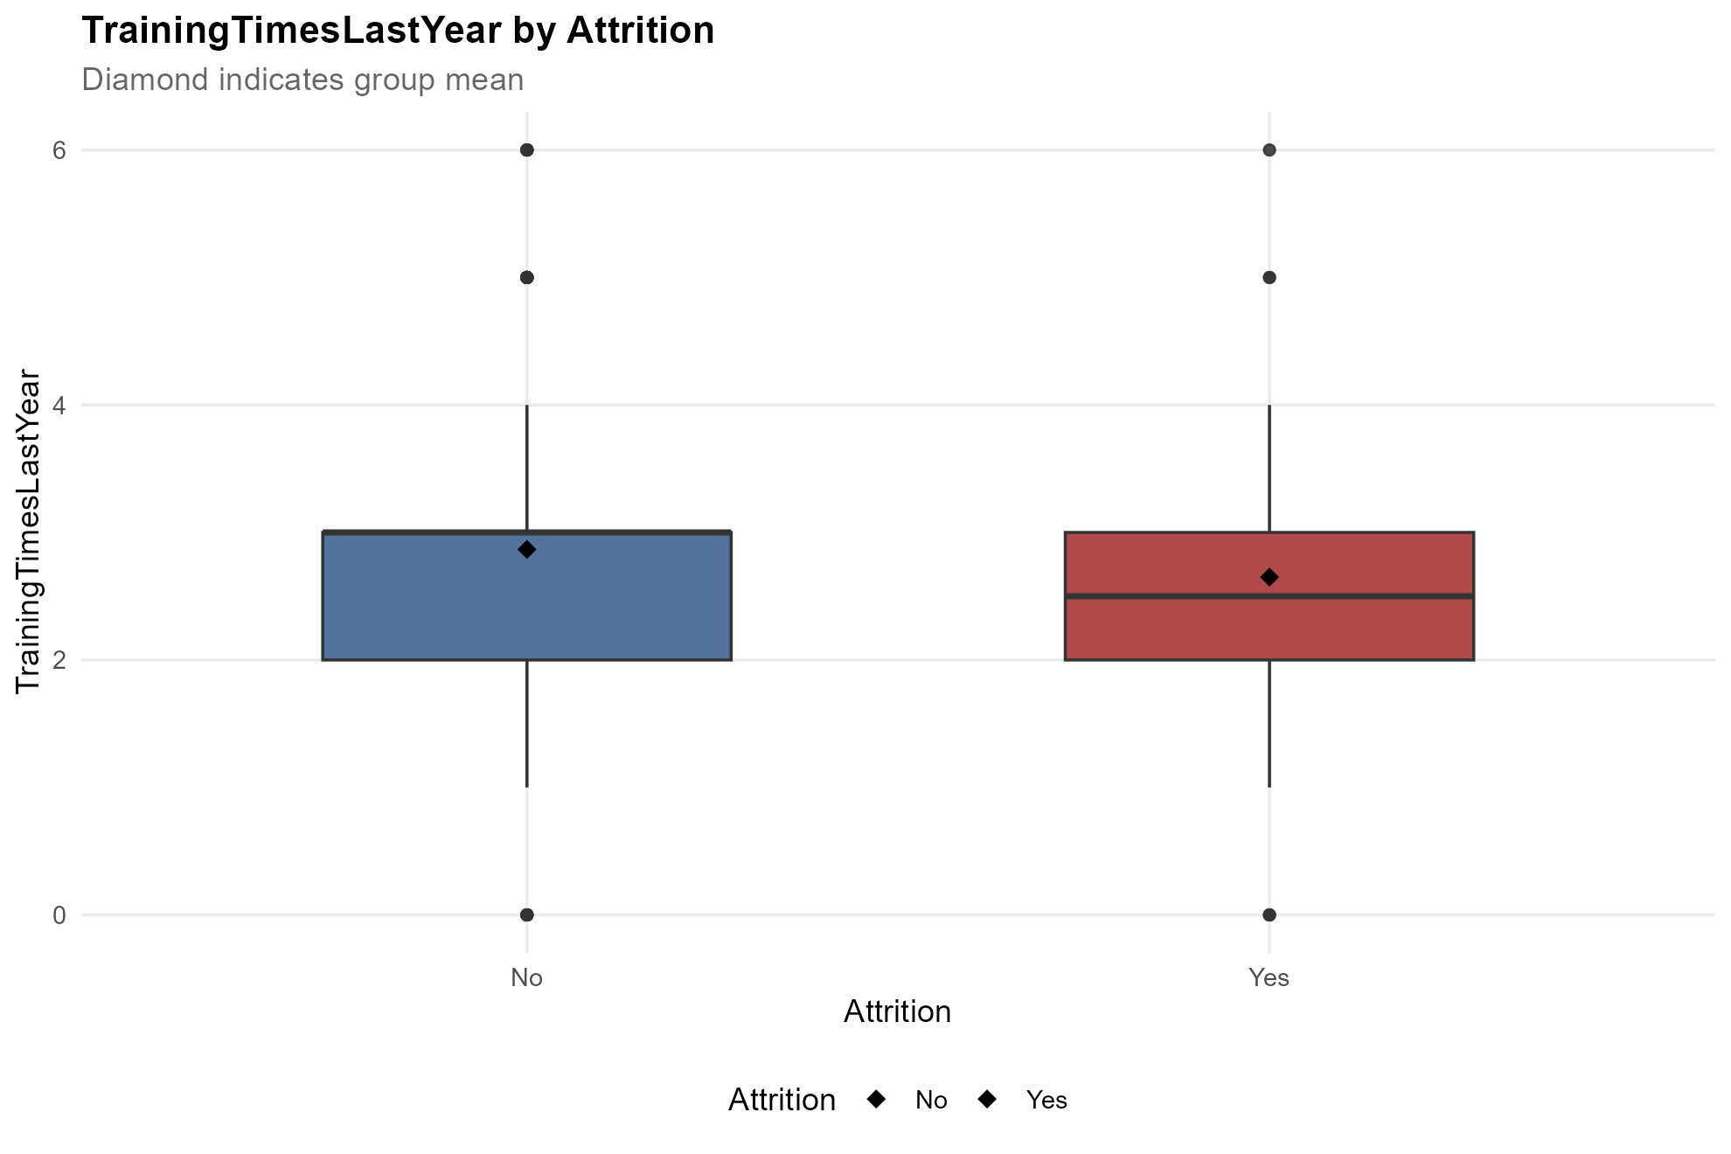
Numerical Variables: TotalWorkingYears, TrainingTimeLastYear, YearsAtCompany, YearsInCurrentRole
Appendix.
Employees who leave tend to have fewer total working years, shorter company tenure, and less time in their current roles.
Training frequency shows little difference between the two groups.
Total Working Years
Training Time Last Year
Years at Company
Years in Current Role

Slide 22
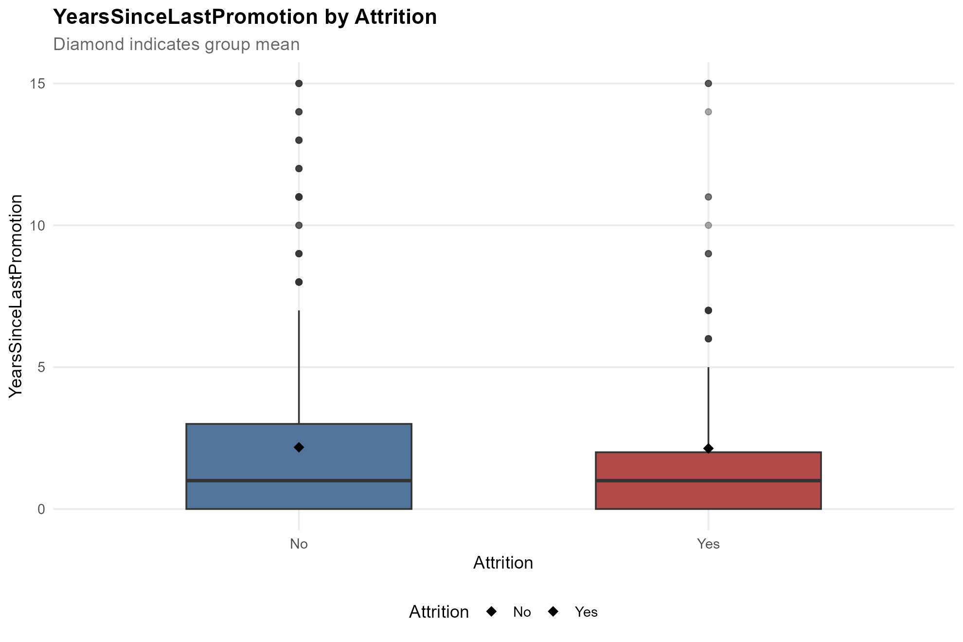
Numerical Variables: YearsSinceLastPromotion, YearsWithCurrentManager
Appendix.
Employees who leave tend to have spent less time with their current managers.
Years since the last promotion shows little difference between employees who leave and those who stay.
Years Since Last Promotion
Years with Current Manager

