Slide 1

Trip Type Classification
Team Murphy
김도영, 정영민, 왕보연

Slide 2
contents
RESULT
EDA
FEATURE SELECTION
MODELING
CONCLUSION

Slide 3

Introduction
Objective
각 고객의 Trip Type 분류하기
Examples of trip type
Daily Dinner Trip
Weekly grocery shopping
Small trip for gifts or holidays
Seasonal wardrobe shopping
Others

Slide 4
Data Description
Data Fields
Trip Type | 38 가지의 Trip Type
Visit Number | 고객의 Walmart 방문 id
Weekday | 구매 요일
Scan Count | 물품 구매수 반품 개수 (negative value)
Department Description | Walmart 의 69개의 코너
Fineline Number | Walmart 정의 상품 코드 5196 가지
Upc | 상품 바코드 97715 가지

Slide 5
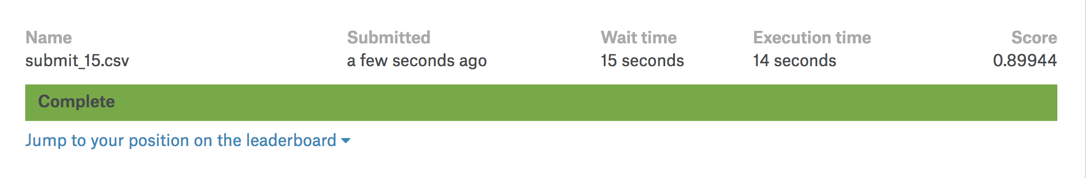
Result
상위 35% (375등/1047등)

Slide 6
Feature
Selection
Model
Parameter
Tuning
Result
Import
Department
Description& Weeknum
Scancount
Return
(78)
ExtraTree
Classifier
LightGBM
i
GridSearch
0.8994
Data
+
Fineline
(5354)
Feature
Importance
Features = Features -100Feat.
+ 800 feat.
(2120)
Top 1300
Top 1000
N = 7

Slide 7
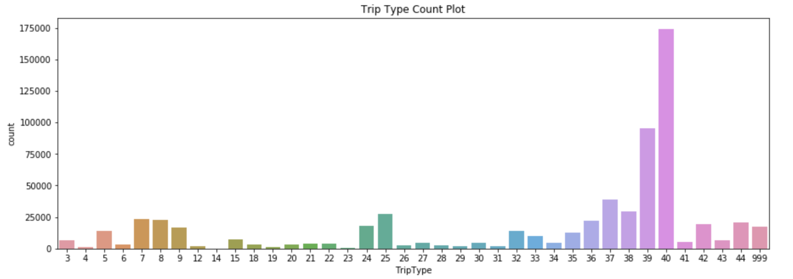
EDA
Trip Type Count Plot
4회
174164회

Slide 8
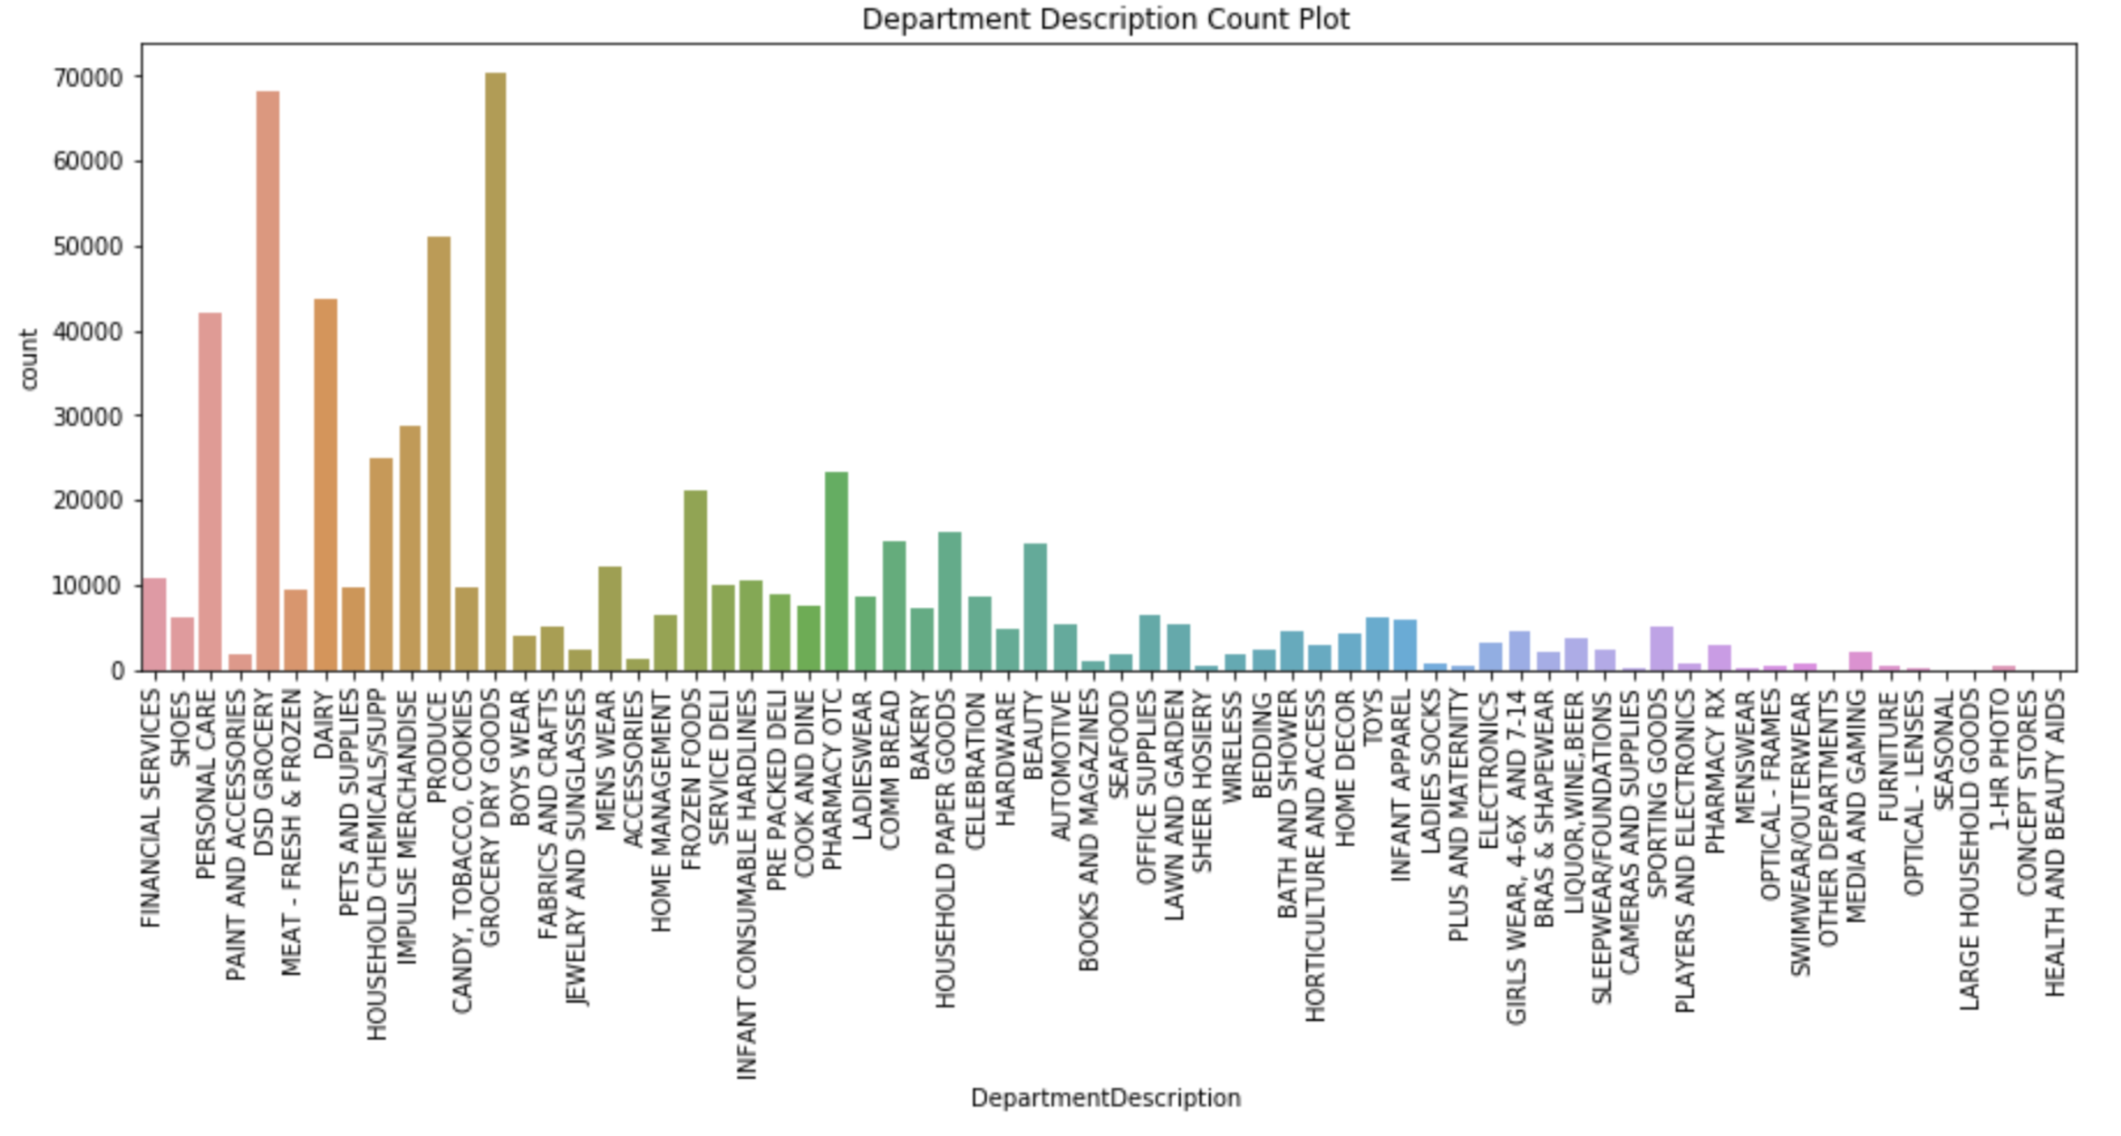
EDA
Department Description Count Plot

Slide 9
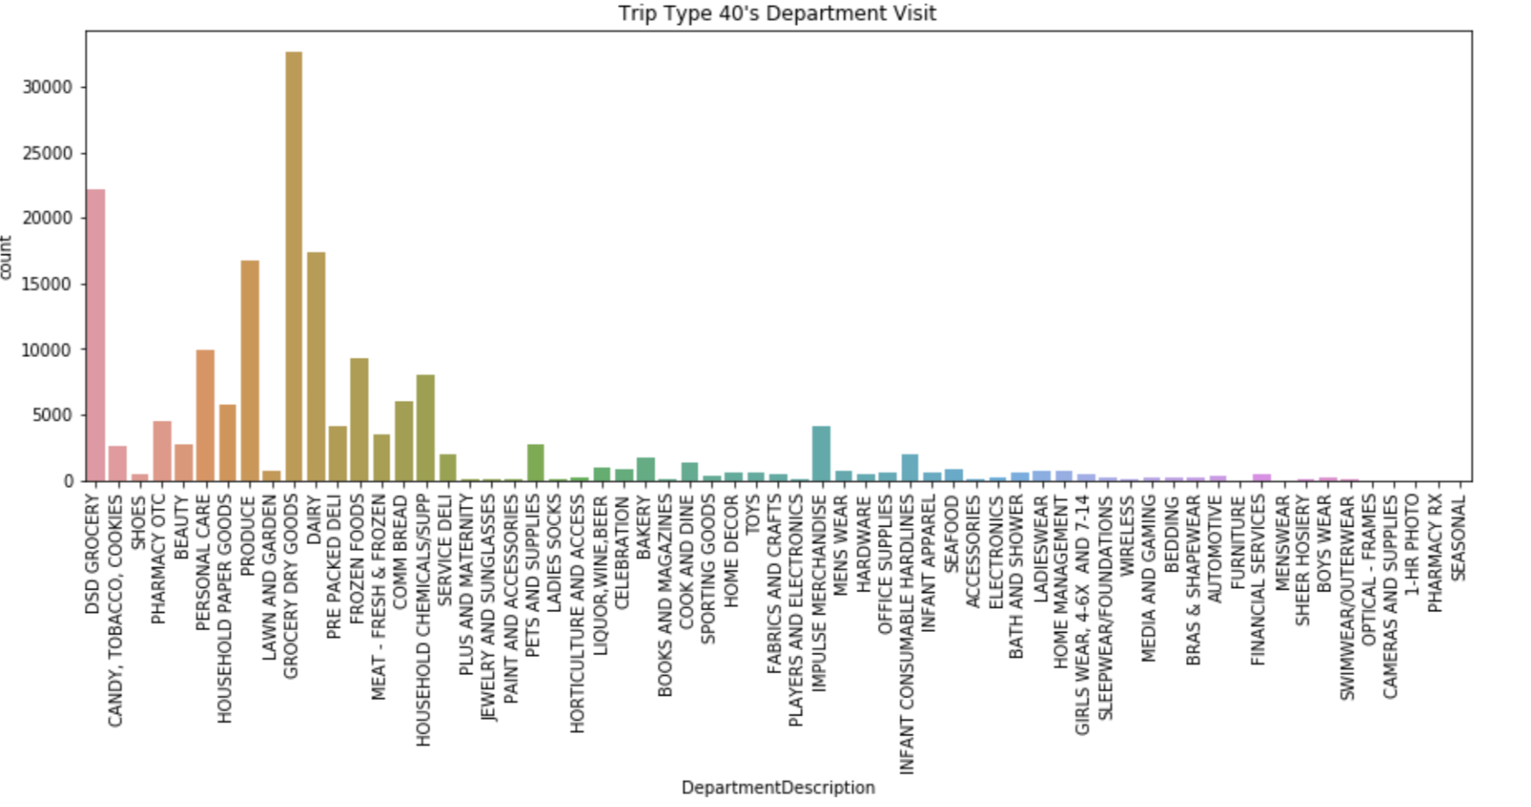
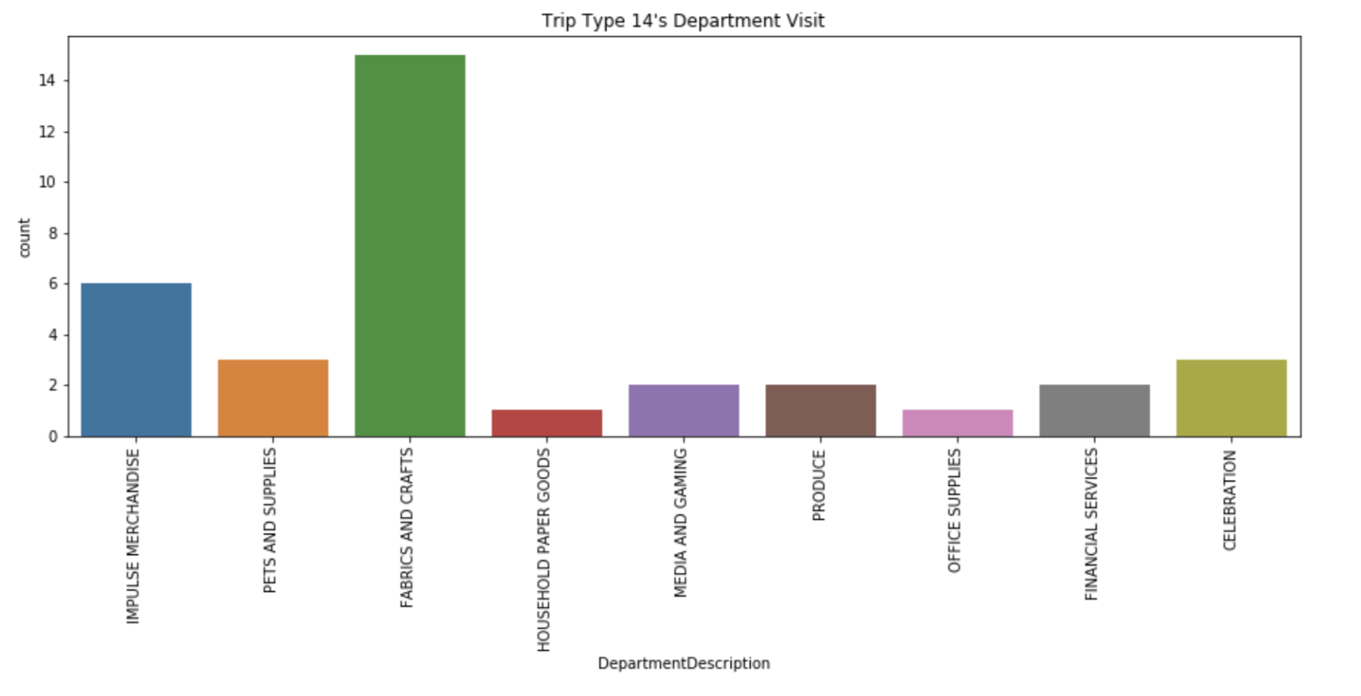
Triptype 40
(most frequent)
Triptype 14
(least frequent)

Slide 10
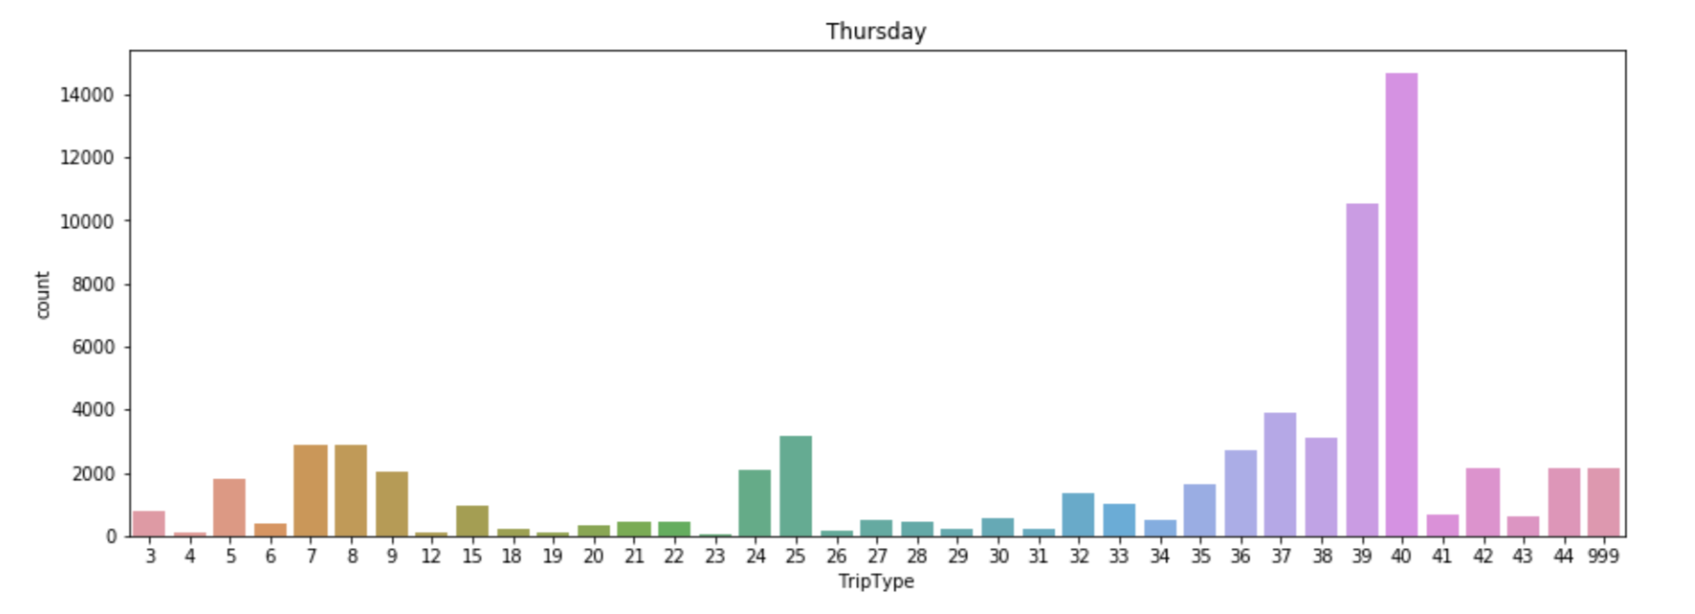
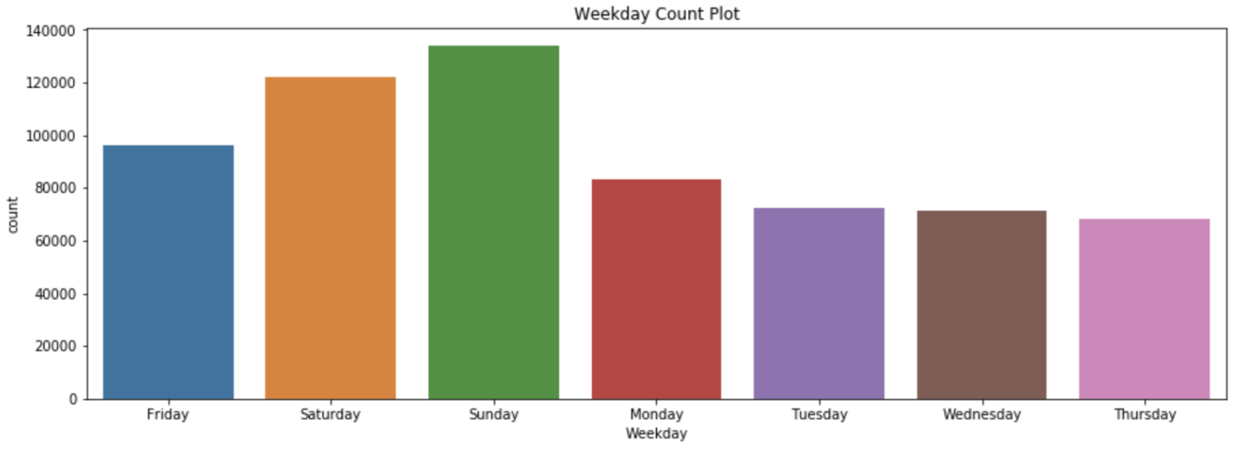
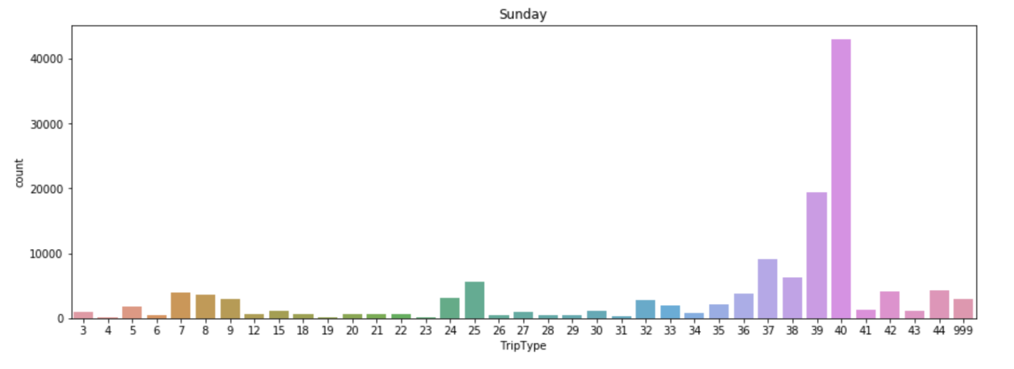
Thursday
Max 14000
Sunday
Max 40000

Slide 11
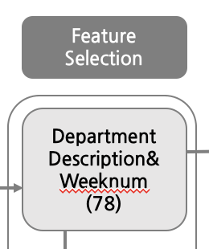
Feature Selection
Initial Selection
Total ScanCount
Total Return
Department Description
Weekday

Slide 12
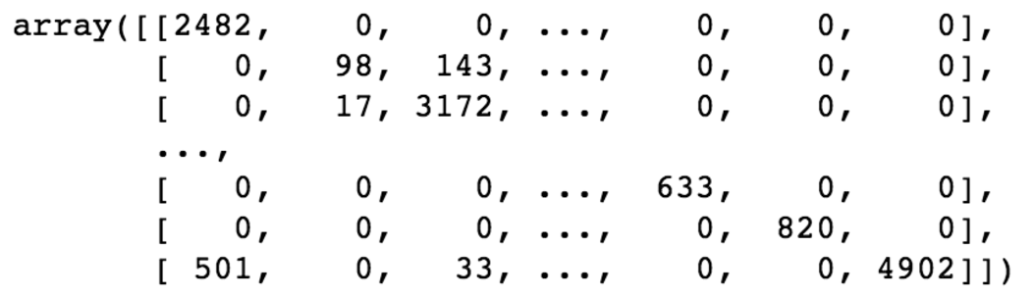
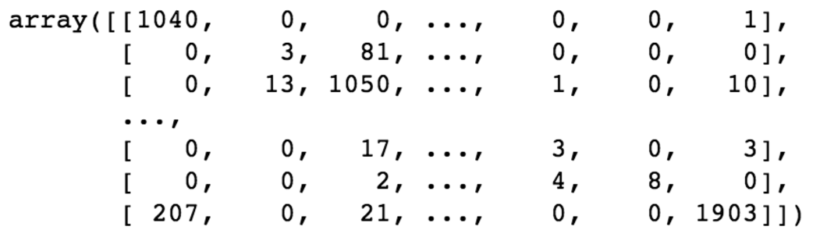
Model
ExtraTreeClassifier
- Parameters: (n_estimators = 100, random_state = 0)
 | Confusion Matrix | Classification Report | Kaggle Score
Train (70%) |  | Precision avg: 0.94 Recall avg: 0.94 F1-score: 0.94 | (train 100%) 2.3
Test (30%) |  | Precision avg: 0.64 Recall avg: 0.66 F1-score: 0.64

Slide 13
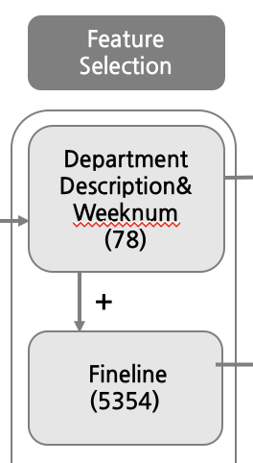
Feature Selection
Second Feature Selection
Total ScanCount
Total Return
Department Description
Weekday
FinelineNumber

Slide 14
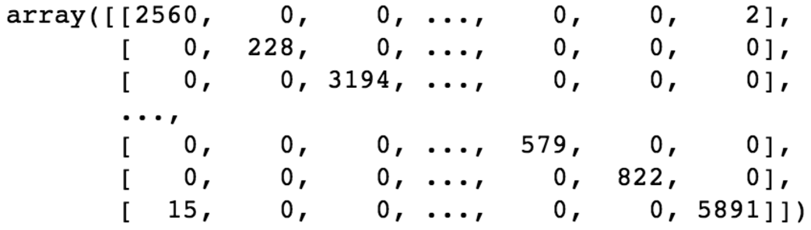
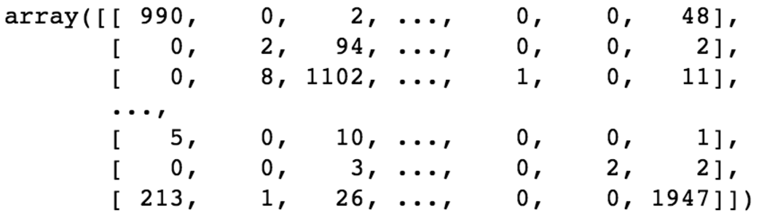
Model
ExtraTreeClassifier
- Parameters: (n_estimators = 100, random_state = 0)
 | Confusion Matrix | Classification Report | Kaggle Score
Train (70%) |  | Precision avg: 1.00 Recall avg: 1.00 F1-score: 1.00 | (train 100%) 1.6
Test (30%) |  | Precision avg: 0.62 Recall avg: 0.64 F1-score: 0.61

Slide 15
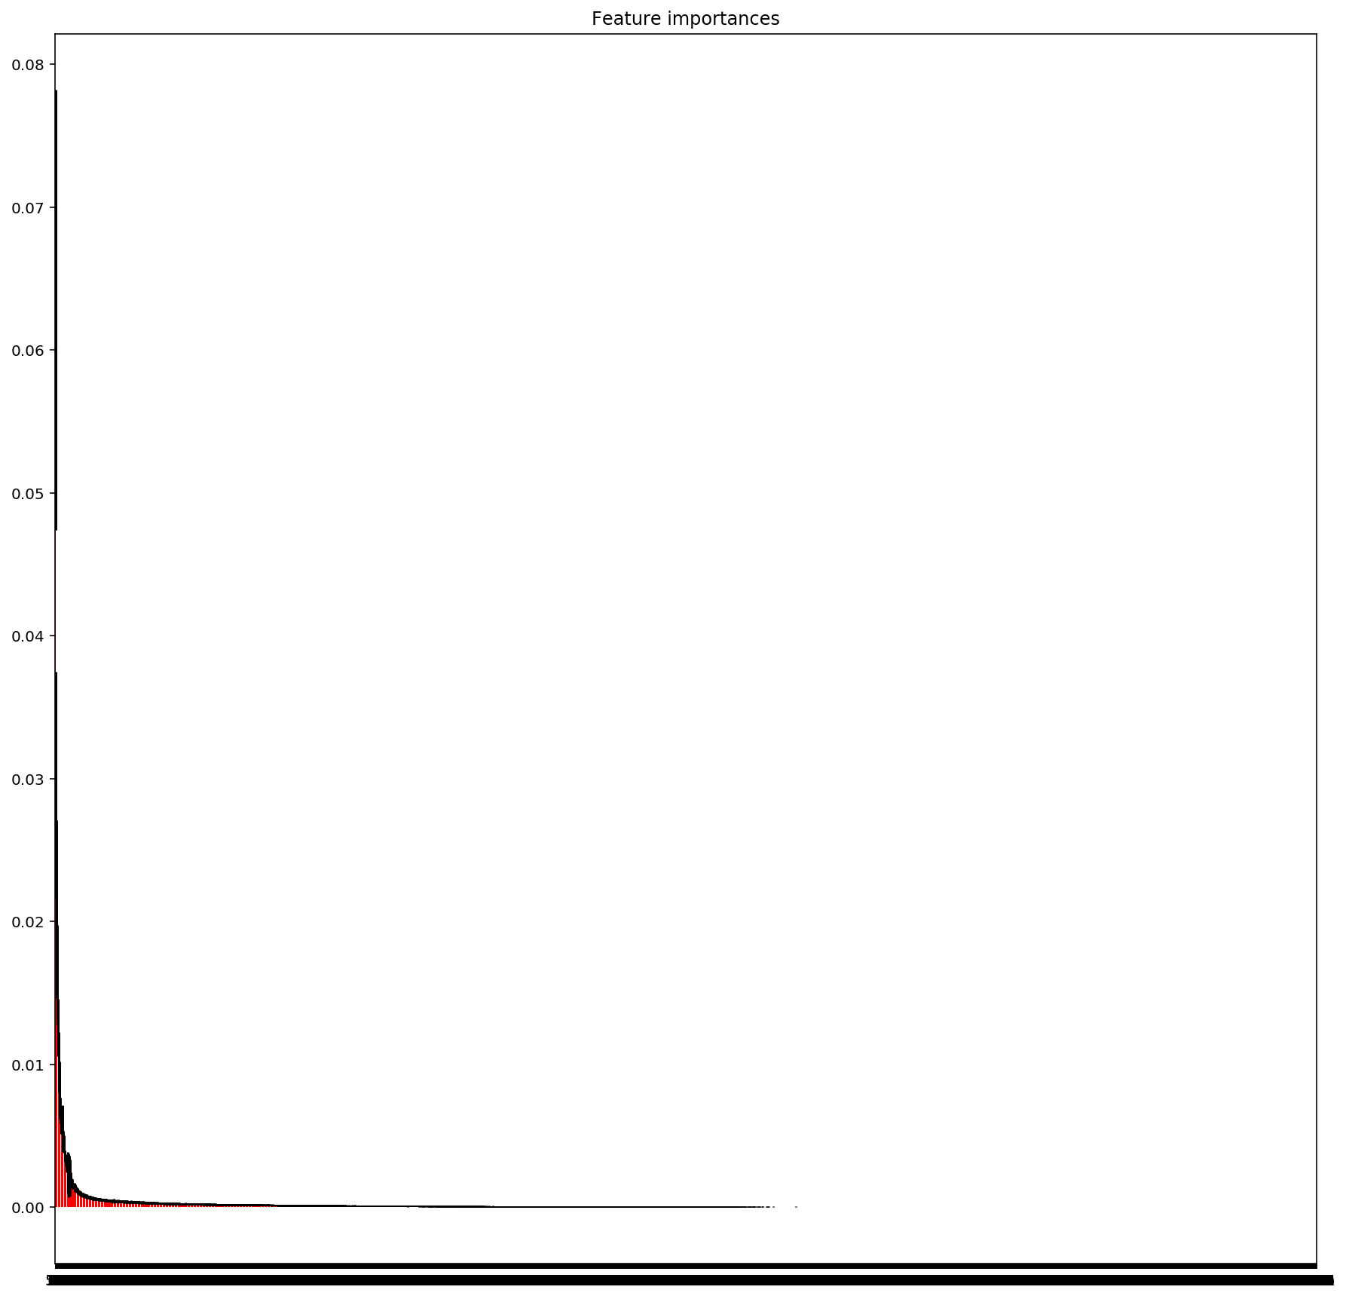
Feature Importance
Scancount,
Return
Department Description
Visit number
Fineline # 5501(produce), 135(impulse merchandise), 808(impulse merchandise), etc...

Slide 16
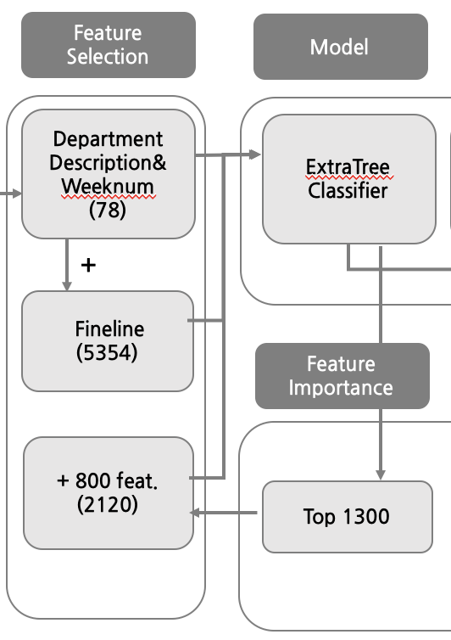
Feature Engineering
11가지의 FE 820개의 새로운 열 추가
- 상위 50% 최빈 방문 코너의 two-way interactions
비율: 코너당 할당된 fineline # 비율,
코너당 할당된 Upc 수 비율
Upc 수, Fineline 수, 방문 코너 수
- Etc.

Slide 17
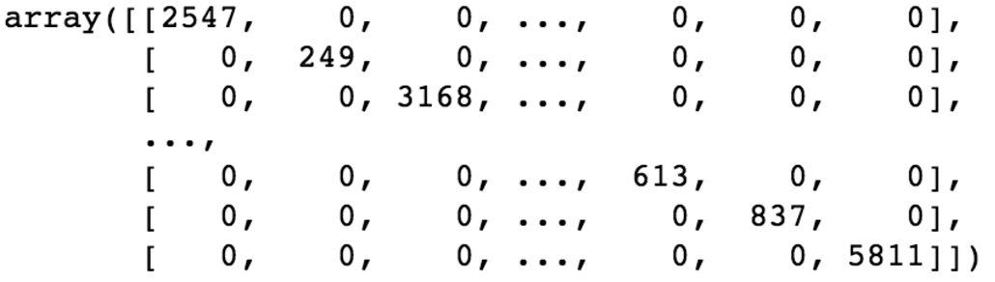
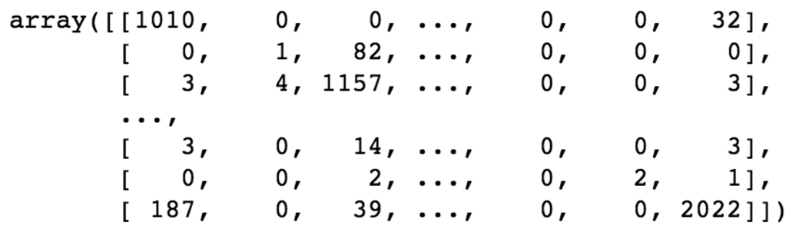
Model
ExtraTreeClassifier
- Parameters: (n_estimators = 100, random_state = 0)
 | Confusion Matrix | Classification Report | Kaggle Score
Train (70%) |  | Precision avg: 1.00 Recall avg: 1.00 F1-score: 1.00 | (train 100%) 1.4
Test (30%) |  | Precision avg: 0.63 Recall avg: 0.64 F1-score: 0.61

Slide 18
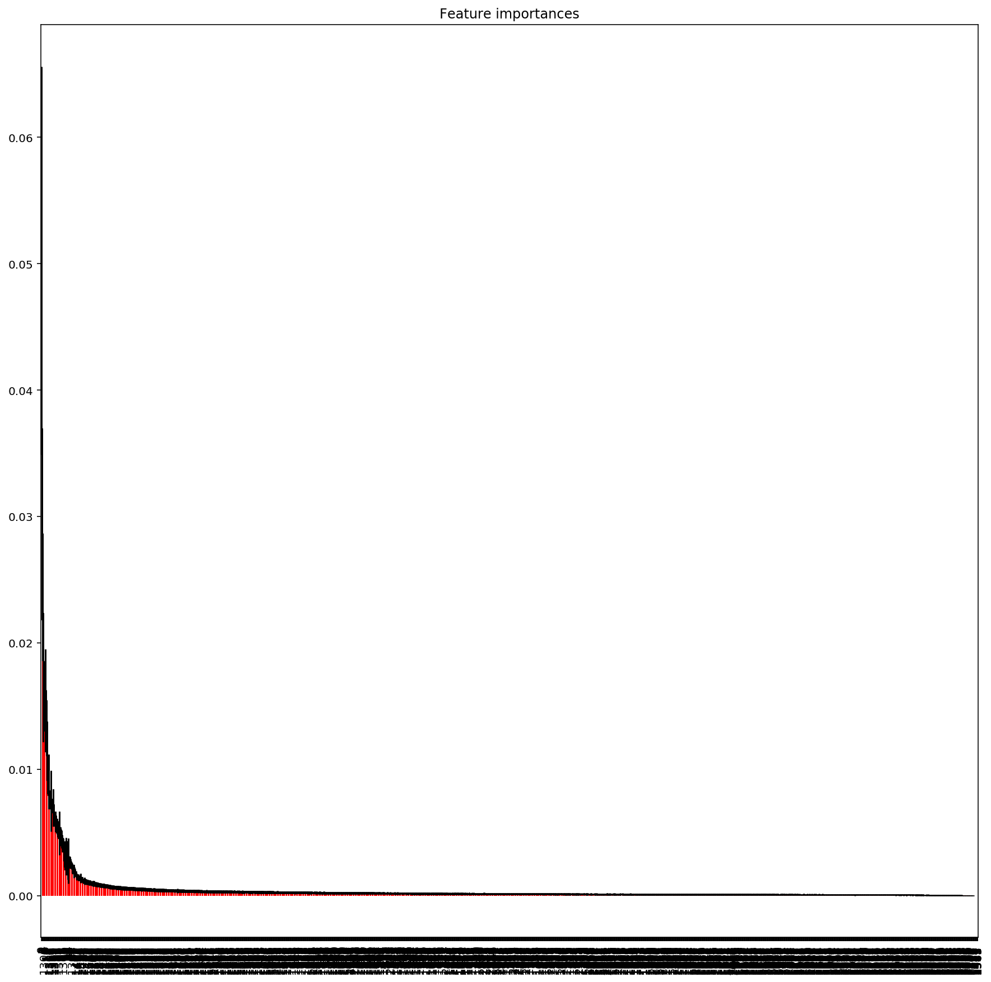
Feature Importance
Scancount
Visit Number
Department Description
fineline, upc, DD 구매개수
Return
코너당 할당된 upc 수 비율
produce, grocery & personal care, impulse merchandise, bread, pharmacy, paper goods
Personal care & beauty
Pharmacy OTC & impulse merchandise
Etc.

Slide 19
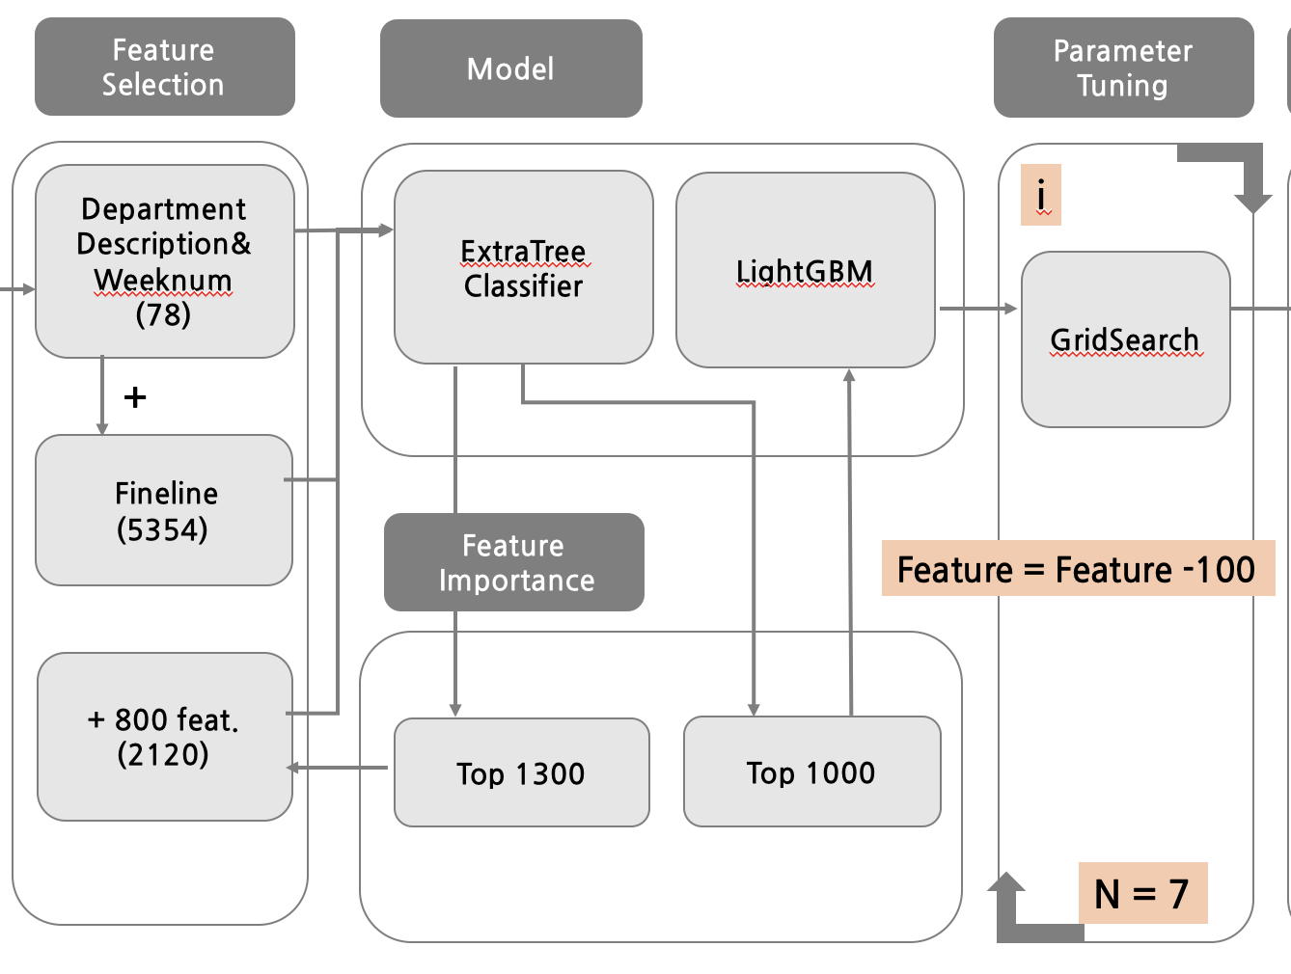

Slide 20
Model
Evaluation Criteria = log_loss
LightGBM
- Parameter Tuning
Params | 200 | 170 | 140 | 100 | 80 | 60 | 40
reduced 1000 | - | - | 1.05 | 1.04 | 1.02 | 1.016 | 1.014
reduced 900 | - | - | 3.7 | 2.2 | 1.04 | 1.013 | 1.013
reduced 800 | - | - | 3.47 | 1.1 | 1.03 | 1.015 | 1.013
reduced 700 | - | - | 3.06 | 1.44 | 1.016 | 1.014 | 1.014
reduced 600 | 2.73 | 1.82 | 1.07 | 1.015 | 1.013 | 1.012 | 1.013
reduced 500 | - | - | 2.4 | 1.075 | 1.017 | 1.013 | 1.021
reduced 400 | 1.41 | 1.27 | 1.23 | 1.09 | 1.03 | 1.021 | 1.001
reduced 300 | 7.42 | 4.9 | 3.9 | 1.8 | 1.022 | 1.021 | 1.012

Slide 21
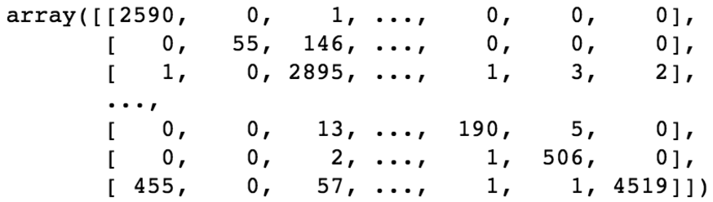
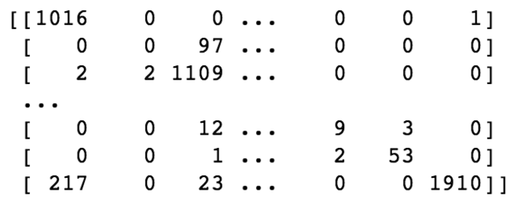
Model
LightGBM
- Parameters: (n_estimators = 100, reg_alpha=1.5)
 | Confusion Matrix | Classification Report | Kaggle Score
Train (70%) |  | Precision avg: 0.80 Recall avg: 0.79 F1-score: 0.79 | (100%) 0.89
Test (30%) |  | Precision avg: 0.69 Recall avg: 0.70 F1-score: 0.68

Slide 22
THANK YOU

Slide 23
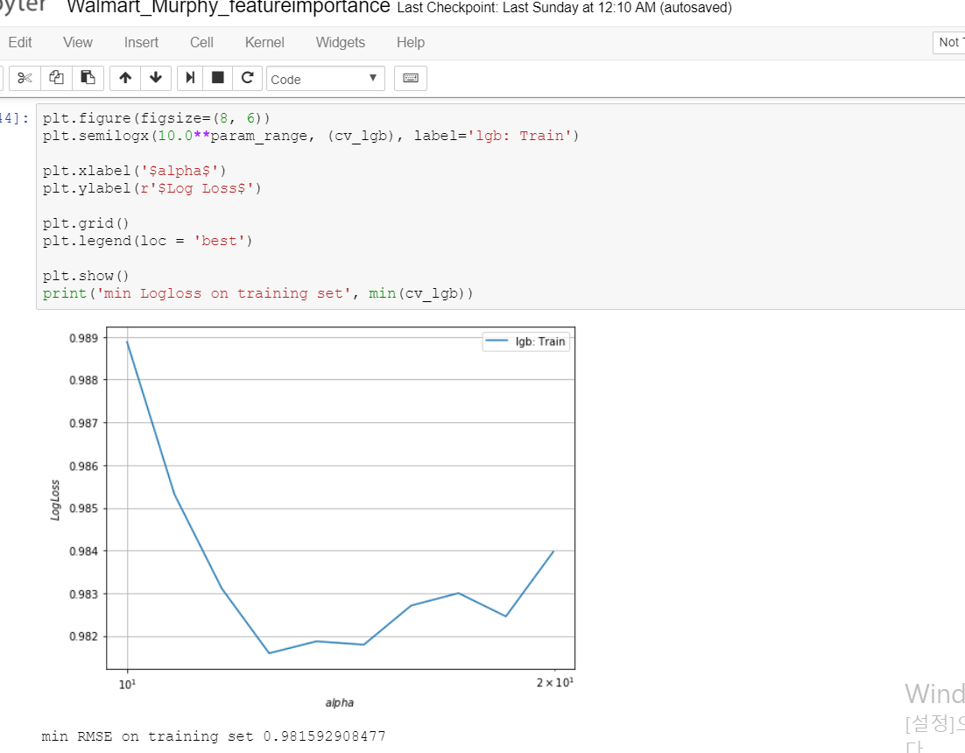
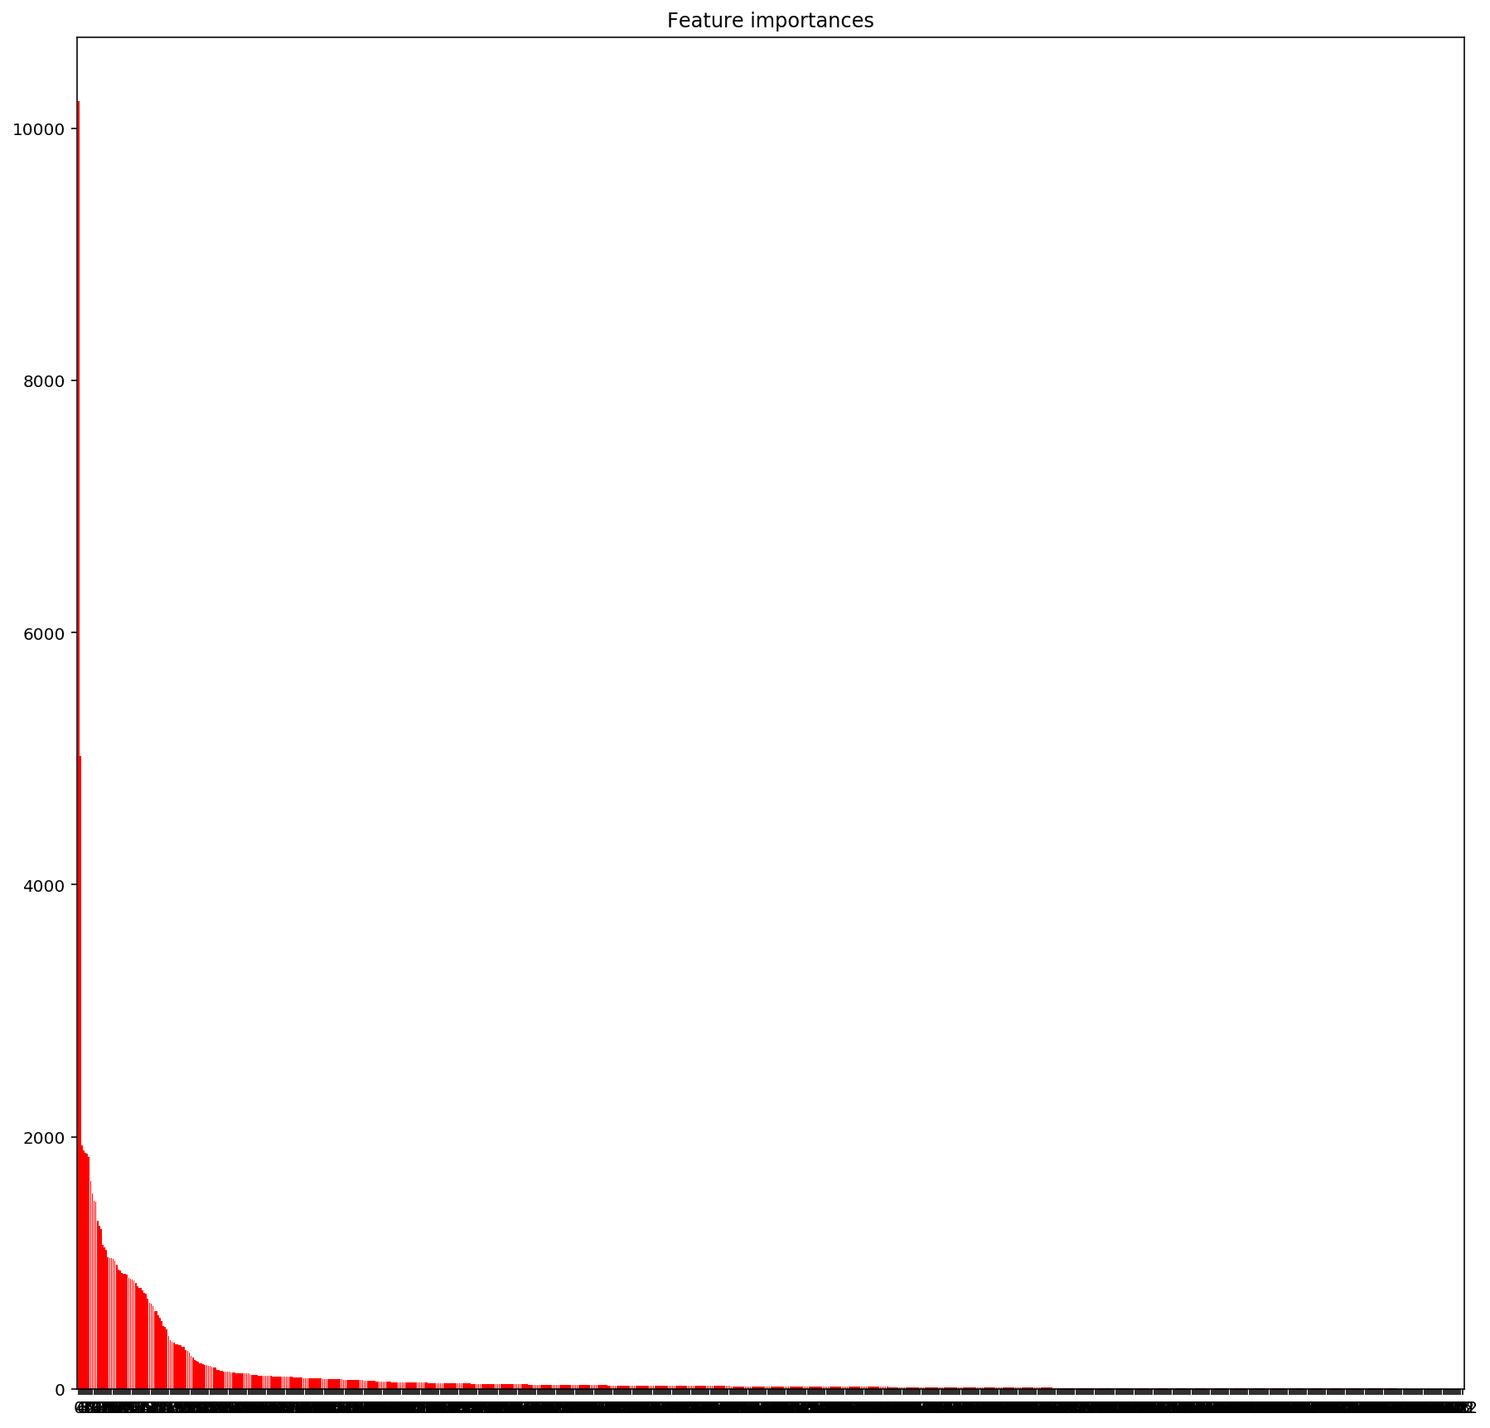
Reg_alpha param optimization

