Slide 1
KDD Group Seminar
Dynamic Bayesian Networks
Friday, August 23, 2002
Haipeng Guo
KDD Research Group
Department of Computing and Information Sciences
Kansas State University

Slide 2
Presentation Outline
Introduction to State-space Models
Dynamic Bayesian Networks(DBN)
Representation
Inference
Learning
Summary
Reference

Slide 3
The Problem of Modeling Sequential Data
Sequential Data Modeling is important in many areas
Time series generated by a dynamic system
  Time series modeling
A sequence generated by an one-dimensional spatial process
  Bio-sequences

Slide 4
The Solutions
Classic approaches to time-series prediction
  Linear models: ARIMA(auto-regressive integrated moving average), ARMAX(autoregressive moving average exogenous variables model)
  Nonlinear models: neural networks, decision trees
Problems with classic approaches
  prediction of the future is based on only a finite window
  it’s difficult to incorporate prior knowledge
  difficulties with multi-dimentional inputs and/or outputs
State-space models
  Assume there is some underlying hidden state of the world(query) that generates the observations(evidence), and that this hidden state evolves in time, possibly as a function of our inputs
  The belief state: our belief on the hidden state of the world given the observations up to the current time y_{1:t} and our inputs u_{1:t} to the system, P( X | y_{1:t}, u_{1:t} )
  Two most common state-space models: Hidden Markov Models(HMMs) and Kalman Filter Models(KFMs)
  a more general state-space model: dynamic Bayesian networks(DBNs)

Slide 5
State-space Models: Representation
Any state-space model must define a prior P(X₁) and a state-transition function, P(X_{t} | X_{t-1}) , and an observation function, P(Y_{t} | X_{t}).
Assumptions:
  Models are first-order Markov, i.e., P(X_{t} | X_{1:t-1}) = P(X_{t} | X_{t-1})
  observations are conditional first-order Markov P(Y_{t} | X_{t} , Y_{t-1}) = P(Y_{t} | X_{t})
  Time-invariant or homogeneous
Representations:
  HMMs: X_{t} is a discrete random variables
  KFMs: X_{t} is a vector of continuous random variables
  DBNs: more general and expressive language for representing state-space models

Slide 6
State-space Models: Inference
A state-space model defines how X_{t} generates Y_{t} and X_{t.}
The goal of inference is to infer the hidden states(query) X_{1:t} given the observations(evidence) Y_{1:t}.
Inference tasks:
  Filtering(monitoring): recursively estimate the belief state using Bayes’ rule
    predict: computing P(X_{t} | y_{1:t-1} )
    updating: computing P(X_{t} | y_{1:t} )
    throw away the old belief state once we have computed the prediction(“rollup”)
  Smoothing: estimate the state of the past, given all the evidence up to the current time
    Fixed-lag smoothing(hindsight): computing P(X_{t-l} | y_{1:t} ) where l > 0 is the lag
  Prediction: predict the future
    Lookahead: computing P(X_{t+h} | y_{1:t} ) where h > 0 is how far we want to look ahead
  Viterbi decoding: compute the most likely sequence of hidden states given the data
    MPE(abduction): x*_{1:t} = argmax P(x_{1:t} | y_{1:t} )

Slide 7
State-space Models: Learning
Parameters learning(system identification) means estimating from data these parameters that are used to define the transition model P( X_{t} | X_{t-1} ) and the observation model P( Y_{t} | X_{t} )
The usual criterion is maximum-likelihood(ML)
The goal of parameter learning is to compute
  θ*_{ML} = argmax _{θ} P( Y| θ) = argmax _{θ} log P( Y| θ)
  Or θ*_{MAP} = argmax _{θ} log P( Y| θ) + logP(θ) if we include a prior on the parameters
  Two standard approaches: gradient ascent and EM(Expectation Maximization)
Structure learning: more ambitious

Slide 8
HMM: Hidden Markov Model
X₁
X₂
X₃
X₄
Y₁
Y₂
Y₃
Y₄
one discrete hidden node and one discrete or continuous observed node per time slice.
X: hidden variables
Y: observations
Structures and parameters remain same over time
Three parameters in a HMM:
  The initial state distribution P( X₁ )
  The transition model P( X_{t} | X_{t-1} )
  The observation model P( Y_{t} | X_{t} )
HMM is the simplest DBN
  a discrete state variable with arbitrary dynamics and arbitrary measurements

Slide 9
KFL: Kalman Filter Model
KFL has the same topology as an HMM
all the nodes are assumed to have linear-Gaussian distributions
x(t+1) = F*x(t) + w(t),
- w ~ N(0, Q) : process noise, x(0) ~ N(X(0), V(0))
y(t) = H*x(t) + v(t),
- v ~ N(0, R) : measurement noise
Also known as Linear Dynamic Systems(LDSs)
  a partially observed stochastic process
  with linear dynamics and linear observations: f( a + b) = f(a) + f(b)
  both subject to Gaussian noise
KFL is the simplest continuous DBN
  a continuous state variable with linear-Gaussian dynamics and measurements
X₁
X₂
Y₁
Y₂

Slide 10
DBN: Dynamic Bayesian networks
DBNs are directed graphical models of stochastic process
DBNs generalize HMMs and KFLs by representing the hidden and observed state in terms of state variables, which can have complex interdependencies
The graphical structure provides an easy way to specify these conditional independencies
A compact parameterization of the state-space model
An extension of BNs to handle temporal models
Time-invariant: the term ‘dynamic’ means that we are modeling a dynamic model, not that the networks change over time

Slide 11
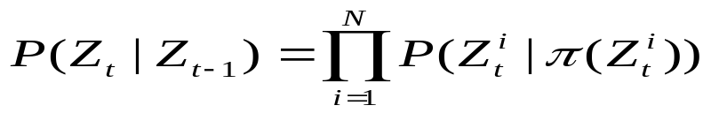
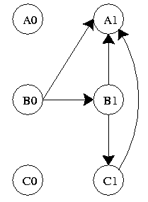
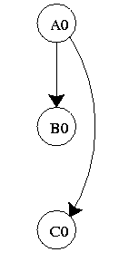
DBN: a formal definition
Definition: A DBN is defined as a pair (B₀, B→), where B₀ defines the prior P(Z₁), and is a two-slice temporal Bayes net(2TBN) which defines P(Z_{t} | Z_{t-1}) by means of a DAG(directed acyclic graph) as follows:
Z(i,t) is a node at time slice t, it can be a hidden node, an observation node, or a control node(optional)
Pa(Z_{( i, t)}) are parent nodes of Z(i,t), they can be at either time slice t or t-1
The nodes in the first slice of a 2TBN do not have parameters associated with them
But each node in the second slice has an associated CPD(conditional probability distribution)

Slide 12

DBN representation in BNT(MatLab)
To specify a DBN, we need to define the intra-slice topology (within a slice), the inter-slice topology (between two slices), as well as the parameters for the first two slices. (Such a two-slice temporal Bayes net is often called a 2TBN.)
We can specify the topology as follows:
intra = zeros(2);
intra(1,2) = 1; // node 1 in slice t connects to node 2 in slice t
inter = zeros(2);
inter(1,1) = 1; // node 1 in slice t-1 connects to node 1 in slice t
We can specify the parameters as follows, where for simplicity we assume the observed node is discrete.
Q = 2; // num hidden states
O = 2; // num observable symbols
ns = [Q O];
dnodes = 1:2;
bnet = mk_dbn(intra, inter, ns, 'discrete', dnodes);
for i=1:4 bnet.CPD{i} = tabular_CPD(bnet, i); end
eclass1 = [1 2]; eclass2 = [3 2]; eclass = [eclass1 eclass2];
bnet = mk_dbn(intra, inter, ns, 'discrete', dnodes, 'eclass1', eclass1, 'eclass2', eclass2);
prior0 = normalise(rand(Q,1));
transmat0 = mk_stochastic(rand(Q,Q));
obsmat0 = mk_stochastic(rand(Q,O));
bnet.CPD{1} = tabular_CPD(bnet, 1, prior0);
bnet.CPD{2} = tabular_CPD(bnet, 2, obsmat0);
bnet.CPD{3} = tabular_CPD(bnet, 3, transmat0);

Slide 13
Representation of DBN in XML format
<dbn>
<prior>
//…a static BN(DAG) in XMLBIF format defining the
//state-space at time slice 1
</prior>
<transition>
// a transition network(DAG) including two time slices t and t+1;
// node has an additional attribute showing which time slice it
// belongs to
// only nodes in slice t+1 have CPDs
</transition>
</dbn>

Slide 14
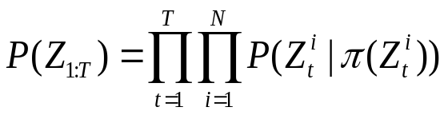
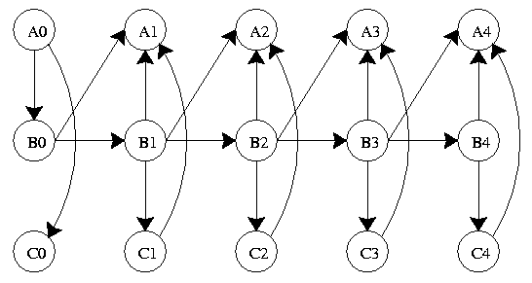
The Semantics of a DBN
First-order markov assumption: the parents of a node can only be in the same time slice or the previous time slice, i.e., arcs do not across slices
Inter-slice arcs are all from left to right, reflecting the arrow of time
Intra-slice arcs can be arbitrary as long as the overall DBN is a DAG
Time-invariant assumption: the parameters of the CPDs don’t change over time
The semantics of DBN can be defined by “unrolling” the 2TBN to T time slices
The resulting joint probability distribution is then defined by

Slide 15
DBN, HMM, and KFM
HMM’s state space consists of a single random variable; DBN represents the hidden state in terms of a set of random variables
KFM requires all the CPDs to be linear-Gaussian; DBN allows arbitrary CPDs
HMMs and KFMs have a restricted topology; DBN allows much more general graph structures
DBN generalizes HMM and KFM; has more expressive power

Slide 16

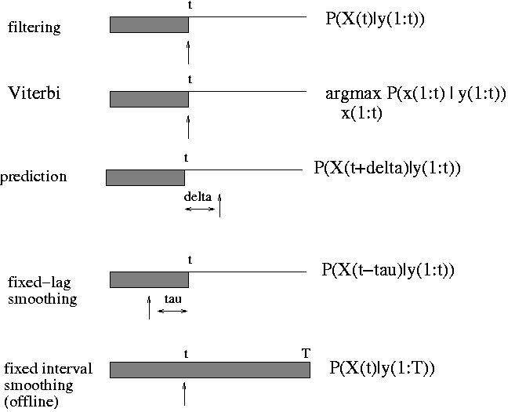
DBN: Inference
The goal of inference in DBNs is to compute
  Filtering: r = t
  Smoothing: r > t
  Prediction: r < t
  Viterbi: MPE

Slide 17
DBN inference algorithms
DBN inference algorithms extend HMM and KFM’s inference algorithms, and call BN inference algorithms as subroutines
DBN inference is NP-hard
Exact Inference algorithms:
  Forwards-backwards smoothing algorithm (on any discrete-state DBN)
  The frontier algorithm(sweep a Markov blanket, the frontier set F, across the DBN, first forwards and then backwards)
  The interface algorithm (use only the set of nodes with outgoing arcs to the next time slice to d-separate the past from the future)
  Kalman filtering and smoothing
Approximate algorithms:
  The Boyen-Koller(BK) algorithm (approximate the joint distribution over the interface as a product of marginals)
  Factored frontier(FF) algorithm
  Loopy propagation algorithm(LBP)
  Kalman filtering and smoother
  Stochastic sampling algorithm:
    importance sampling or MCMC(offline inference)
    Particle filtering(PF) (online)

Slide 18
DBN: Learning
The techniques for learning DBN are mostly straightforward extensions of the techniques for learning BNs;
Parameter learning
  Offline learning
    Parameters must be tied across time-slices
    The initial state of the dynamic system can be learned independently of the transition matrix
  Online learning
    Add the parameters to the state space and then do online inference(filtering).
Structure learning
  The intra-slice connectivity must be a DAG
  Learning the inter-slice connectivity is equivalent to the variable selection problem, since for each node in slice t, we must choose its parents from slice t-1.
  Learning for DBNs reduces to feature selection if we assume the intra-slice connections are fixed
Learning uses inference algorithms as subroutines

Slide 19
DBN Learning Applications
Learning genetic network topology using structural EM
  Gene pathway models
Inferring motifs using HHMMs
  Motifs are short patterns which occur in DNA and have certain biological significance; {A, C G, T}*
Inferring people’s goals using abstract HMMs
  Inferring people’s intentional states by observing their behavior
Modeling freeway traffic using coupled HMMs

Slide 20
Summary
DBN is a general state-space model to describe stochastic dynamic system
HMMs and KFMs are special cases of DBNs
DBNs have more “expressive power”
DBN inference includes filtering, smoothing, prediction; uses BNs inference as subroutines
DBN structure learning includes the learning of intra-slice connections and inter-slice connections
DBN has a broad range of real world applications, especially in bioinformatics.

Slide 21
References
K. P. Murphy, "Dynamic Bayesian Networks: Representation, Inference and Learning“, PhD thesis. UC Berkeley, Computer Science Division, July 2002.
Todd A. Stephenson, An Introduction to Bayesian Network Theory and Usage(2000)
Zweig, Geoffrey. 1997. Speech Recognition with Dynamic Bayesian Networks. Ph.D. Thesis, University of California, Berkeley. http://www.cs.berkeley.edu/~zweig/ Applications of Bayesian Networks
K. Murphy, S. Mian, "Modelling Gene Expression Data using Dynamic Bayesian Networks," Technical Report, University of California, Berkeley, 1999.
N. Friedman, K. Murphy, and S. Russel. Learning the structure of dynamic probabilistic networks. In 12th UAI, 1998.
Kjrulff, U. (1992), A computational scheme for reasoning in dynamic probabilistic networks , Proceedings of the Eighth Conference on Uncertainty in Artificial Intelligence, 121-129, Morgan Kaufmann, San Francisco.
Boyen, X. and Koller R, D. 1998: Tractable Inference for Complex Stochastic Processes. In UAI98.

