Slide 1

Raon
Notes:
We are team Raon, which is Korean word for ‘Joyful’.
We are Na Young An, JiSoo Yoon, EunBin Lee and MinJeong Yoo from DanKook University in Korea and would like to present you I‘m, a demonstrator, a concept and a vision on how to implement the right to be forgotten that is attractive and efficient for consumers and the vast majority of merchants and service providers.

Slide 2

01
About
Notes:
So what is I’m about?

Slide 3






01 About
The Right to be Forgotten
Notes:
The subject of 2016 Atos IT Challenge is “Right to be forgotten”.
The right to be forgotten means that personal data, which is no longer required after a consumer/merchant transaction has finished, will be deleted automatically at the merchant side without any action required from the consumer.
There are lots of data on the web, such as digital data, location information, personal data, picture, video, and so on.
Of these fields, we chose personal data as subject of our project.

Slide 4
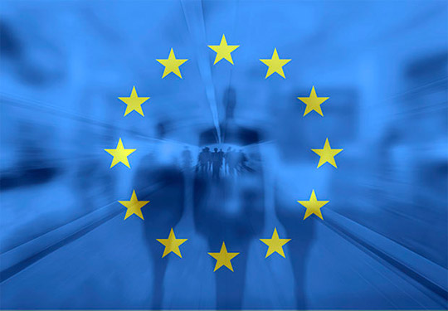
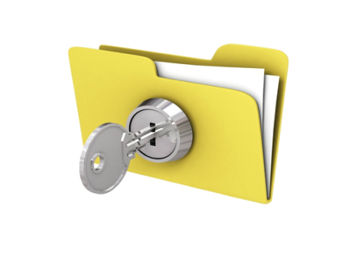
01 About
GDPR General Data Protection Regulation
Notes:
The European Parliament has passed the General Data Protection Regulation or GDPR on April 14th.
It will turn into law in all of Europe or almost a quarter of the world economy in April 2018.
The new regulation is based on popular demand for privacy and has sharp teeth:
Regular audits can be imposed and if a company is found to violate privacy regulation it can be fined up to 4% of its global turnover.
This is a penalty level similar to EU anti-trust offences and to our knowledge no company ever got fined twice.
It turns the possession of personal data for which permission, purpose and remaining retention need cannot be proven into a liability with disastrous monetary and public perception consequences.
The GDPR may turn the possession of personal data for merchants and service providers from an asset into a liability as troublesome and toxic as credit card data is today under rules of PCI-DSS.

Slide 5
01 About
Lets you manage and track your own personal data easily
Notes:
I’m completely reverses current personal data management and retention habits:
Personal information and responsibility is pushed as far away from the merchant side as possible towards the consumer, you.
Instead of collecting and storing personal data, merchants always go back to the source, to you or I‘m,
the personal data management scheme
who they can trust to deliver the best information
just as long as they need it
They no longer have to pay Google or Facebook for an illusion of value.
Not only is that becoming illegal, but the current ad-blocking war signals perhaps a rather more fundamental shift.
Customers or consumers instead will maintain the freshest
and the most wide ranging data and knowledge about themselves,
including detailed policies on who gets to see what data,
for which purpose and
for how long that is to be retained.
I‘m follows the human approach
which is all about balance and fairness
(In a bazar merchants and buyers perform a dance of bartering
Neither side puts all cards on the table from the start, but reveal bit after bit and only as long as agreement remains in sight.
)
I’m is your broker, your digital bartering agent, who will reveal bits of personal information only when and as long as it is in your interest.

Slide 6
01 About
So what does I’m look like?
Notes:
So how would I’m actually work?

Slide 7












01 About
I’m Server
Reference
Name
Name
Gender
Name
Phone
Phone
Email
Email
Phone
Nationality
Email
Address
〮〮〮
Individuals
Companies
Notes:
It starts with the I’m app on your phone, tablet or PC, the users personal data management assistant or PDMA, which gets to know you during setup
Perhaps it is designed like an interview,
going into details where it senses your interest
skipping others where it doesn’t.
It then learns through observation, seeing what you do or enter and what you don‘t, occasionally asking questions
Merchants participating in the I‘m personal data management scheme will provide a plug-in.
In our demonstrator it just looks like a login but it manages the merchant side of I‘m,
asking for all data elements the merchant would
need,
prefer or
accommodate
in order to fulfill a service request, transaction or purpose,
including information on how long those data elements would be required for proper processing.
It then receives answers from your I’m app via the I’m server
but not necessarily to all questions,
only the once you instructed I‘m to answer at this stage and for this type of merchant
So even if I‘m maintains all information about clothing sizes, material preferences, music and food tastes or allergies if you order a pizza they won‘t know you‘re BigFoot.
And once the pizza has been delivered, the I’m server will expire merchant access to your data,
so they will no longer know that you like double onions,
until you order the next one, and I’m includes that information auto-magically

Slide 8
01 About
Video
https://youtu.be/cED77SnRZdw
Notes:
So this is our video which will help you understand more easily about I’m

Slide 9
02
Progress
Notes:
This part is the technical part of I’m

Slide 10


02 Progress
I’m Application
Notes:
This is how I’m Application looks like.

Slide 11
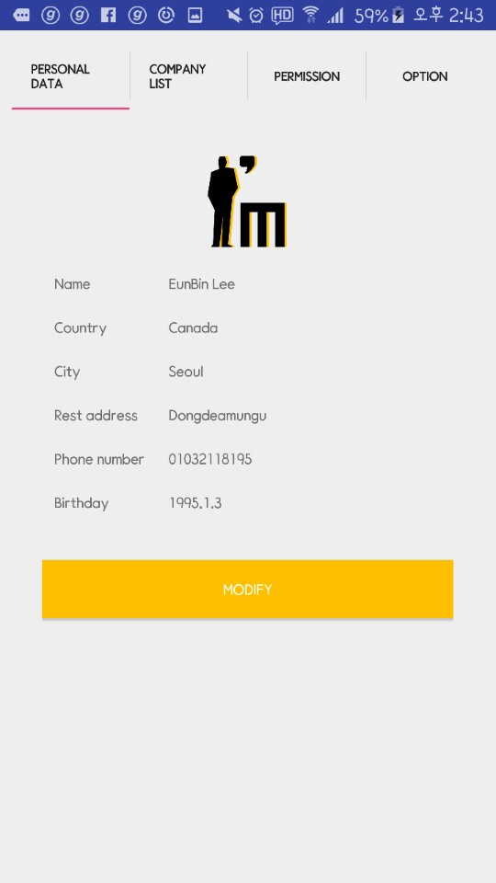
02 Progress
Personal Data page
Notes:
This is personal data page which shows the information the user has stored on the device.

Slide 12
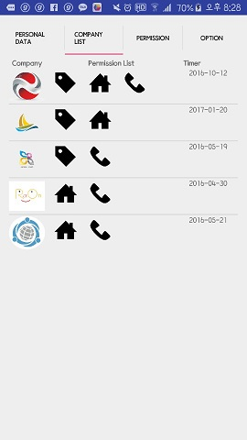
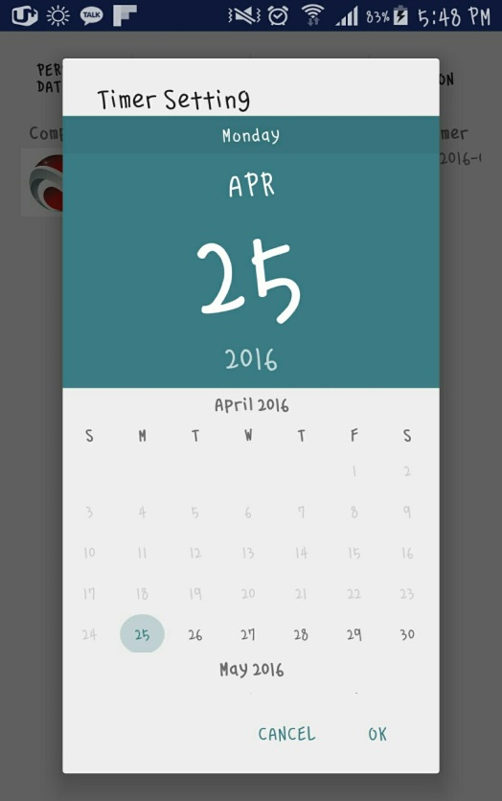

02 Progress
Company List page & Timer
Notes:
This page shows how you would maintain rules about personal data for distinct companies or merchant types
and how you would maintain data retention policies
All this data is kept synchronized and secured on the I‘m server.

Slide 13
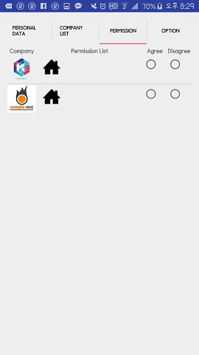

02 Progress
Permission page
Notes:
This app screens demonstrate permission management,
where you manage which companies have your personal data
And what they need to know

Slide 14
03
The Vision
Notes:
This is the vision of I‘m

Slide 15
03 The Vision
GDPR General Data Protection Regulation
ONLY
What is required
ONLY
Client
has the authority
ONLY
As long as it is
required
ONLY
With consent
of the client
Notes:
The new EU general data protection regulation forces all service providers and merchants to reduce the storage of personal data to a minimum
store only
what is required for a purpose,
store only as long as it’s required for that purpose,
store only with consent of the person described
and enforce that person’s authority
to have it corrected, transferred or erased.
We believe that companies and organizations will be extremely interested in a solution which not only removes that risk but helps to position themselves as trustworthy defenders of privacy.
I’m not only performs delivery on privacy but actually allows merchants and consumers to exchange data with much better quality, more detail and convenience.

Slide 16





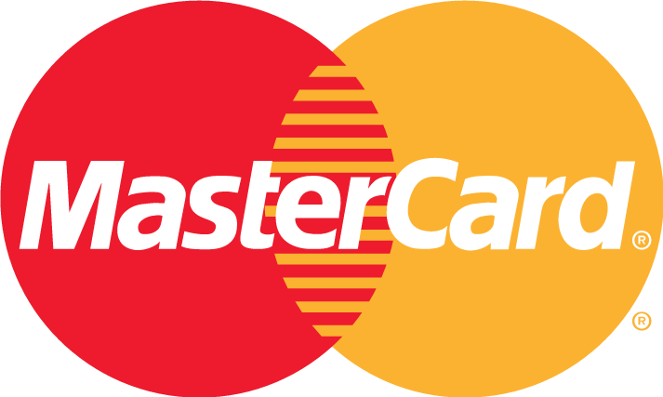
03 The Vision
PCI DSS Payment Card Industry Data Security Standard
Access
Restricted
Information
Protected
System
Protected
Security
Policy
Notes:
The Payment Council International Data Security Standards are designed to protect credit cards and it has effectively become the security law on the Internet.
It designed to be global, open, neutral and high quality so everybody can implement it while nobody will want to implement something “better” and introduce fragmentation.
The four characteristics of PCI-DSS follows :
- cardholder information must be protected wherever it is stored
- systems should be protected against the activities of malicious hackers by using frequently updated anti-virus software, anti-spyware programs, and other anti-malware solutions.
- access to system information and operations should be restricted and controlled
- a formal information security policy must be defined, maintained, and followed at all times and by all participating entities
It also has teeth: If you want to sell services on the Internet, you cannot avoid having to implement it. You will have to prove your compliance or close down.
IT service providers have developed an eco-system of services and products based on PCI, and companies like Bull and Worldline are well established and trusted by consumers and companies alike.
I’m likewise will have to be open, neutral, high quality, licensed at no cost and perhaps available as open source, so nobody will fragment the market and kill convenience and economy of scale.
I’m works best with full adoption by consumers and merchants alike. To achieve that, absolute trust, achieved via complete openness and world class security is the minimum, not easily achieved by device makers like Apple, or Internet giants like Google, Facebook or Amazon.
I’m must be designed as anti-lock-in and free to use by everyone.
I’m manages and automates the majority of personal data interchange and it can build on a foundation of technology already established via PCI-DSS in the credit card payment industry.

Slide 17
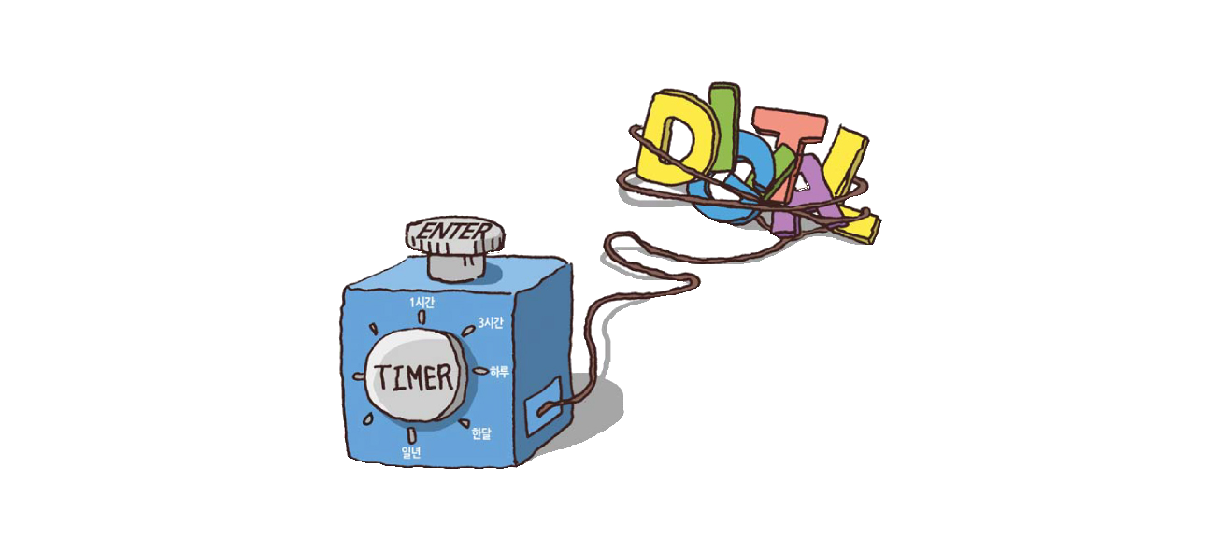
03 The Vision
DAS Digital Aging System
System for “Right to be forgotten” in South Korea
Technology to remove digital trace fundamentally
Every data operates Aging Timer/DAS Timer at the creation of the digital data
If times up, data disappear
Notes:
DAS는 2016년 01월 한국에서 제시 된 잊혀질 권리를 위해 나온 세계 최초의 모델입니다.
디지털 데이터의 흔적을 근본적으로 지우는 것을 목표로 합니다.
이를 위해 모든 데이터의 생성 단계에서 aging time, das timer를 가동하여, 시간이 되면 이 데이터가 시한 폭탄처럼 소멸하는 프로그램입니다. 마치 I’m의 시스템처럼 말이죠.
DAS is the world first model for right to be forgotten which is opened in January, 2016 in Korea.
It aims to fundamentally delete all the traces of digital data.
To approach this, at every data creation stage, aging timer/DAS timer is operated, and when times up, data disappears.
I’m manages to remove personal data by means of similar technology already utilized via DAS as a timer function of I’m.

Slide 18
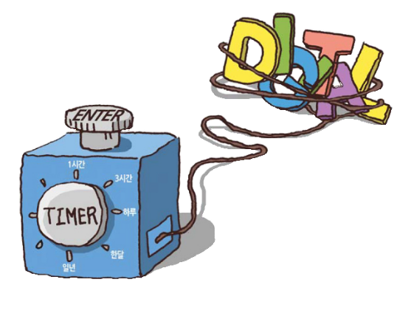

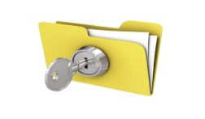
03 The Vision
Evolution
I’m Policy
GDPR
PCI DSS
DAS
Evolution
Notes:
We entered the IT-Challenge a little naive:
처음, 아임은 App과 Server로 동작하는 단순한 시스템이었습니다.
하지만 15팀에 선정 된 이후 약 2달동안 아임은 큰 변화를 겪었습니다.
프로젝트 중 GDPR, PCI-DSS, DAS와 같은 정책들에 대해서 알게 됐습니다.
우리는 아임 또한 위의 정책들과 같은 강력한 정책으로 성장할 수 있다고 생각했습니다.
At first, I’m was a simple system operation with App and server.
But, as we have been chosen in 15 teams, I’m has gone through a great change over 2 months.
We learned about the policies such as GDPR, PCI-DSS, DAS.
We thought I’m could also grow like those policies.
So we designed and programmed the App and mock-ups of merchant sites with the plug-ins.
Since it‘s against the nature of normal IT systems and Internet giants like Google and Facebook to forget things,
we believed that an applications
which keeps track of the information we enter
as we order from merchants
or participate in social networks
could implement The Right to be Forgotten
simply by using tracking data
to send deletion requests to these sites,
which they would have to follow under the GDPR
We believe that we could make our policy with GDPR, PCI-DSS and Digital Aging System.
With those standards, I’m could make effort for users to control and manage their own personal data by themselves.

Slide 19
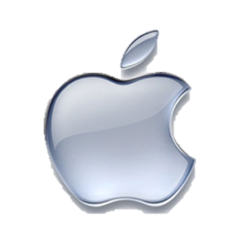
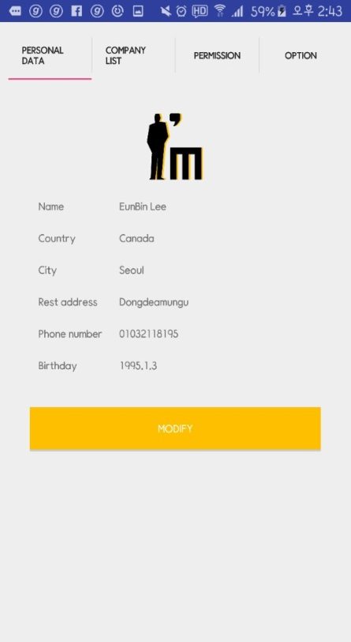


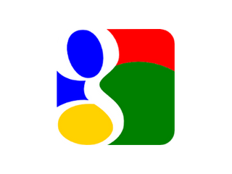

03 The Vision
Benefits of Customer
Convenience
Convenience
Enforceability
Enforceability
Ownership
Ownership
Notes:
Ownership : 나의 개인정보가 나에게 있고, 승낙/거절의 권한이 나에게 존재한다.
Traceability : 어떤 회사에게 어떤 정보를 제공했는지 볼 수 있으며, 타이머로 제공 기간 조절 가능하다.
Convenience : 사용자가 회원가입시 개인정보를 입력하지 않고 I‘m에서 제공하며, 개인정보 변경 시 제공된 정보를 일괄적으로 자동 수정할 수 있다.
To consumers it offers both the convenience of minimal effort for data maintenance, control and the confidence that their wishes regarding privacy or exposure are fully respected.
For the consumer, convenience is crucial:
No data must ever be entered twice or get lost,
it should be learned instead of entered if possible
could be based on a personality profile obtained via an interview or shared among friends etc.
Consumers may not want an I‘m monopoly,
and fully migrate data between them
so you don’t have to re-enter data
Trust is just as crucial:
Your data must be safe from everyone, including governments while stored (data transfer has to follow laws)
You must be sure that no merchant even asks for inappropriate data like your shoe size when you order a pizza
You must be assured that merchants will treat all data you gave them in accordance to your policies
Ownership is another benefit that user can take advantage
Your data is stored on your device which makes you the real one to possess the data.
Even though your data is stored on I’m Server, as the validation of your data expires, we ensure you that no trace of data remains.

Slide 20
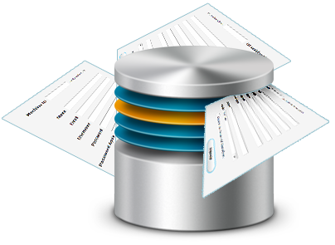







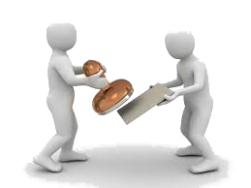

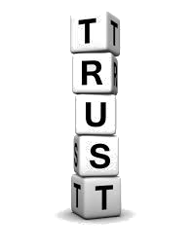



03 The Vision
Benefits of Company
Credibility
Credibility
Compliance
Free
Compliance
Free
Data Quality
Data Quality
Notes:
Credibility : 개인정보 제공 주권을 사용자에게 양보함으로서 신뢰와 좋은 기업이미지를 얻을 수 있다.
Compliance Free : 기존 DB에서 유령회원의 Data를 유지할 이유가 없으므로, DB유지비와 인건비에 사용되는 비용을 줄일 수 있다. 또한, 회사마다 개인 정보를 자신의 회사에 맞게 준수하여 제작하여야 하지만 아임은 이 과정을 대신 해준다.
Data Quality : 아임은 사용자로부터 개인정보 수정을 알림 받아 기업들에게 갱신된 최신의 정보를 제공한다.
Merchants also need convenience and trust: They need
accurate and up-to-date data, as detailed as possible in their area of interest
assurance that all required data will remain available as long as they need it
trust that I‘m manages data retention rules perfectly and keeps them clear of GDPR violations
Merchants may not want an I‘m monopoly, but all I‘ms must be indistinguishable and interoperable
Companies get advantage of Compliance work
The idea behind I‘m is to offer a complete context and purpose aware personal data management solution that is easy to integrate for merchants, yet frees them from all compliance burdens now being enforced on personal data.
Also I’m offers higher data quality.
Each merchant will get freshest data of each person via I’m whenever a person changes his data.

Slide 21
04
Business of
Notes:
This is the business part of I‘m

Slide 22





04 Business of
Partnership – Security company
Notes:
To get closer to the completion, “I’m” needs cooperation with security company to store personal data safely since there are multiple outside dangers during transmission of data.
Through cooperation with “I’m”, the security company could strengthen influence in security market for both mobile application and corporation, and this cooperation will set the stage for the company to become a worldwide security company.

Slide 23





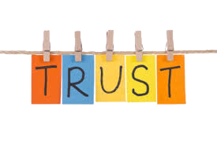
04 Business of
Business Profitability
Reference
Individuals
Companies
Notes:
아임은 사용자에게 기본적으로 무료로 제공된다.
아임이 가진 편리한 기능들은 사용자에게 매력적으로 다가갈 것이며, 무료 제공은 그 효과를 배가 시킬 것이다.
이렇게 아임 사용자들이 늘어남에 따라 기업들은 사용자에게 아임 플러그인을 제공하게 될 것이다.
-> 고객과 회사에 둘다 무료로 제공해서 둘 다 잘 사용할 때 이익이 발생하니깐 고객이 많이 쓰니깐 회사도 플러그인을 많이 사용할 것이다가 아니라 애초에 둘다에 무료로 제공한다가 어떄요?
이런 환경속에서 아임은 주기적으로 아임 플러그 인을 사용하는 회사들을 대상으로 정기 점검을 실시한다.
정기 점검시, 타이머가 종료 된 데이터를 기업이 유지하고 있다면 해당 기업을 대상으로 벌금을 부과한다.
-> 타이머만 보는 것이 아니라 요구된 사항만 가지고 있는지도 검사해도 될거 같아요. PCI-DSS 처럼
이 시스템은 아임의 주 수입원이 될 것이며,
이 비즈니스 모델을 통해 아임의 목적인 사용자와 기업간의 신뢰성 향상에 큰 영향을 미칠 것이다.
I’m is basically free to the users, both clients and companies.
The convenience functions of I’m will attract them, and free offer would double the effect.
When this environment is constructed, I’m will check about the validation of the data, and check merchant’s system periodically whether the data is really in use.
If the validation no longer exists, I’m removes personal data from the server.
this business model will influence trust between clients and companies, which is one of the objects of I’m.
So how does I’m make money?
The most important part of I’m will be the brand and its reputation.
While a workable and initial I’m app will always be free, App vendors striving to integrate with I’m apps or augmenting the Artificial Intelligence and thus convenience of their apps need to certify their I’m privacy data management scheme compliance and pay for that service to the I’m franchise.
The I’m franchise could delegate such certification by certifying App auditors, ensuring that there will be no bottleneck scaling out nor a risk of a practical monopoly.
Likewise merchants will need pay for having their shopping system certified for I’m compliance and compelled to license domain specific negotiation policies, which can negotiate with the consumer for a deeper insight into their likes and dislikes and thus allows the merchant to regain similar insights into his consumer base as Facebook will sell him today.
Except that this time that data collection is both legal and matches the exact consent of the consumer.
The service industry around personal data management consulting may become as rich and diverse as tax software or services are today, simple for those who have simple needs, sophisticated for those who believe a higher investment will deliver a better return.
Distinct branches of economy or government service, distinct governments and cross-border scenarios, distinct systems of government, ideology or religion will require adjustments on consumer side and merchant side information policies and we consider that an opportunity to service and sell.
Free open standard and open source implementations are nice but don‘t pay the bills.
I‘m as a brand, scheme and franchise will require and provide licenses,
free to many if not most,
requiring sustenance from others.
Auditing and awarding certification are labor intensive processes,
which will be paid on effort base
to licensed and certified auditors.
Many center around making the I‘m App really, really smart,
using the new artificial intelligence capabilities of cognitive computing <This is a “bonus” term: Just using that word will get you extra points, so enounce carefully>
The merchant side could be running a complement of the I‘m app, using at least as much intelligence to implement the bartering from the bazar you may remember.
We see swarms of consumer and merchant agents bartering in a balanced and fair way. <Please believe me, „swarms“ will also get you extra points so enunciate that extra slowly>
Because the individual policies and legal requirements around data element exchanges can grow incredibly complex, human consultants and peer help organizations can spring up to achieve the proper compromise between effort and result to consumers and merchants.
These advisors and the AIs may also want or need certification and training.
and so on…
Unfortunately we have run out of time today,
but please let us talk about getting the I’m global personal data management scheme launched
as soon as possible
and before somebody else does!

Slide 24
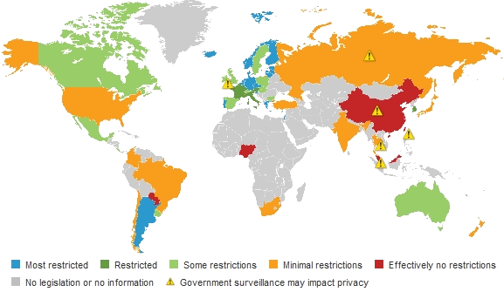
04 Business of
Target Market
Notes:
이 자료는 각 국가들이 기업에게 요구하는 개인정보의 제한 정도이다.
이를 통해 각 국가들의 개인정보에 대한 성격을 알 수 있다.
아임은 크게 타겟마켓을 3가지 종류로 분류한다.
첫번째 타겟마켓은 메인 타겟마켓으로 유럽과 한국, 러시아로 선택했다.
유럽의 경우, GDPR을 통해 아임과 상호작용 할 수 있는 국가이다. 그리고 한국은 DAS라는 세계 최초의 잊혀질 권리 모델을 설계하였고 디지털 세탁소라는 시장이 활성화 되어있다. 마지막으로 러시아는 현재 잊혀질 권리에 대한 법안을 시행중인 국가다. 이러한 이유로 유럽, 한국, 러시아를 메인 타겟마켓으로 선택했다.
두번째는 서브 타겟마켓이다. 적극적이진 않지만 현재 관련 법안에 대하여 1차적으로 통과된 국가들로, 일본과 브라질이 이에 속한다.
이외의 나라들은 아직 잊혀질 권리에 대한 뚜렷한 법안이 제정되어 있지 않아 잠정적 타겟마켓으로 선택했다.
This material informs the limitation level of personal data which each country requires the companies.
This lets us know that many country is concerned about data protection more than superficial concern like GDPR, PCI-DSS, and DAS.
I’m aims to all nations except the red and gray countries since they are not interested in personal data protection.
(->But those red and gray countries are potential targets of I’m since the world is interested in data protection and in the future, those cannot bare limitation of personal data.)
Especially in Europe and Korea, we will be able to construct powerful system with GDPR and DAS.
Also as we could know from Telegram, Russia is very sensitive to personal data. But Russia has no policy like GDPR, so we could think of preoccupancy of the market.

Slide 25
THANK YOU

