Slide 1

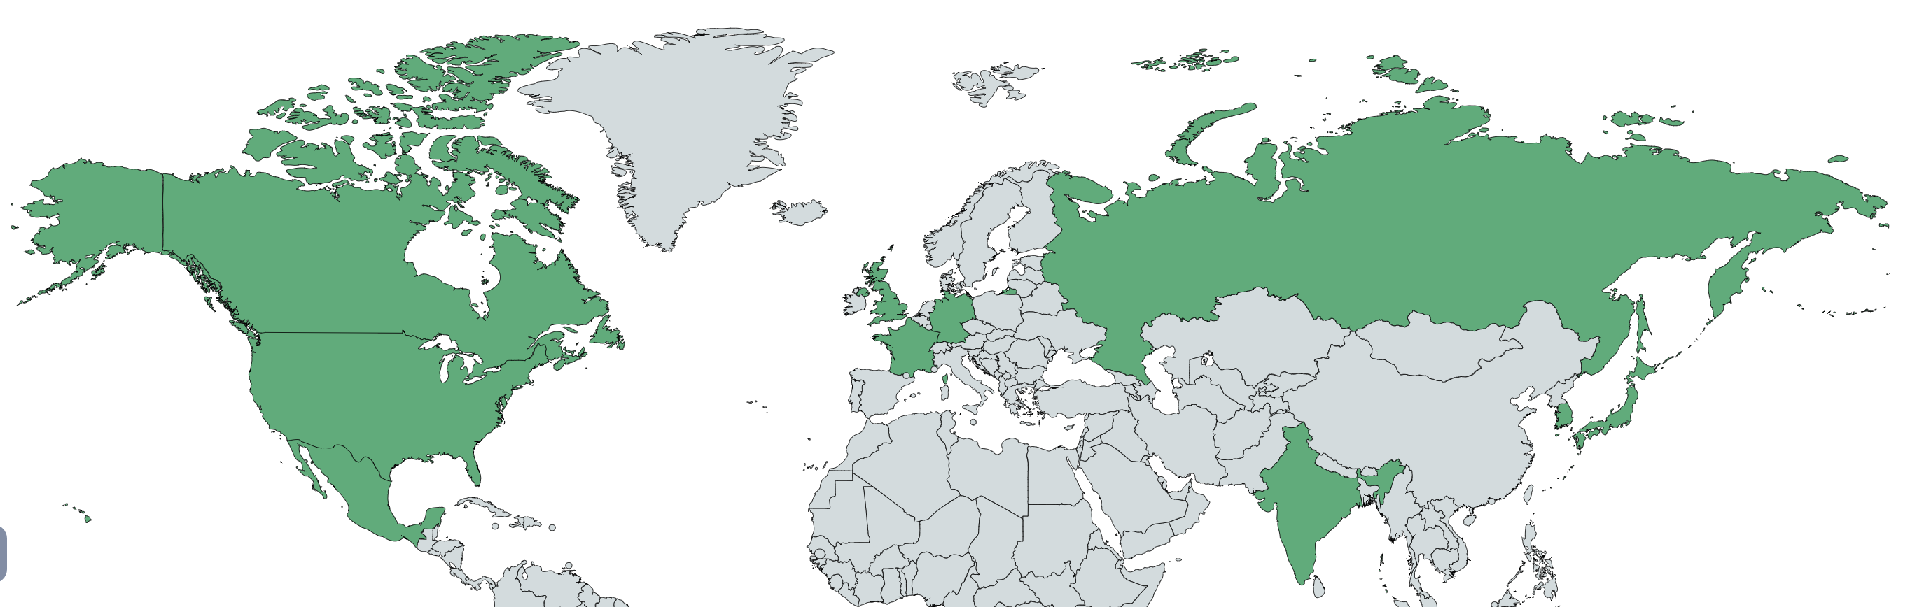
Data Preprocessing
Model Architecture
Input
Output
Label
Number of Likes
Popular
Number of Dislikes
Regression Algorithm
Predicted Number of Views
Threshold
Days Published
Not Popular
Number of Comments
Dataset Selected
375942 pieces of YouTube data from 10 countries
Canada
Russia
Great Britain
Germany
France
US
Japan
Mexico
India
South Korea

Slide 2
Algorithm Selection
Regression Algorithm Selection
Selected
Regression Algorithm
Algorithm | CV | MSE Error
Linear Regression | 0.6953 | 15,433,411,971,867.74
Ridge Regression | 0.6953 | 15,433,411,971,866.65
Random Forest Regression | 0.9703 | 1,084,290,013,297.92
Random Forest
Regression
Highest CV
Lowest MSE Error
Threshold Selection
Mega-hit
Threshold = 100 million
Not Mega-hit

Slide 3
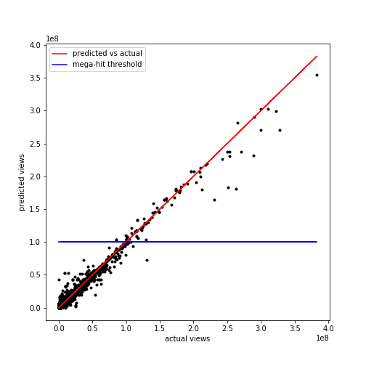
Analyze and Conclusion
Result Analyze
Parameter | Value
Precision | 0.935484
Recall | 0.966667
F1-score | 0.950820
Most points locates on or near red line, where predicted views original number of views; Even if the difference is large, it usually does not affect the relative position with blue line.
Conclusion
The developed model could well predict the number of views of a video and whether it is popular or not, given the number of likes, dislikes and comments, and days it has been published.

