Slide 1
Declarative Integration of Interactive 3D Graphics into the World-Wide Web Principles, Current Approaches, and Research Agenda
Jacek Jankowski, Sandy Ressler, Kristian Sons, Yvonne Jung, Johannes Behr, and Philipp Slusallek

Slide 2
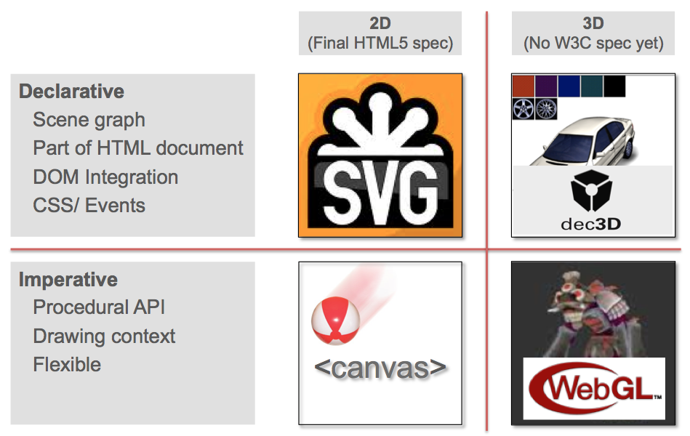
Introduction

Slide 3
Outline
Declarative 3D Principles
Declarative 3D Frameworks
Evaluation Platforms: X3DOM and XML3D
Declarative 3D Essentials
Level of Integration and Polyfill Approach
Declarative 3D Agenda
Conclusions

Slide 4
Principles of Declarative 3D

Slide 5
Declarative 3D Principles
Following the Established Principles of the Web
Separation of structure from content
Separation of content from style
Use of the Document Object Model (DOM)
3D Content Creation and Reuse
Platform Independence
Efficiency and Scalability
Security and Digital Rights Management
Accessibility and Usability
Leveraging Web Development Infrastructure

Slide 6
Declarative 3D Frameworks

Slide 7
X3DOM: History
2004: X3D: ISO Standard; Plugin integration model
2007: HTML5 Spec:: http://www.w3.org/TR/2009/WD-html5-20090212/no.html#declarative-3d-scenes
13.2 Declarative 3D scenes Embedding 3D imagery into XHTML documents is the domain of X3D, or technologies based on X3D that are namespace aware.
2008: First experiment by Philip Taylor, W3C: http://philip.html5.org X3D in DOM, no DOM manipulation (Canvas3D for rendering)
2009: x3dom by Fraunhofer IGD, Based on code of Taylor: Full DOM integration. Maps to Native, X3D-Plugin, WebGL or Flash Utilizes HTML/JS/CSS for scripting and interaction HTML-Profile: Reduced complexity and implementation effort
2011: W3C Declarative 3D Community Group
2012: Component-Plugins: Volume, GEO, CAD, Geo2D, …

Slide 8
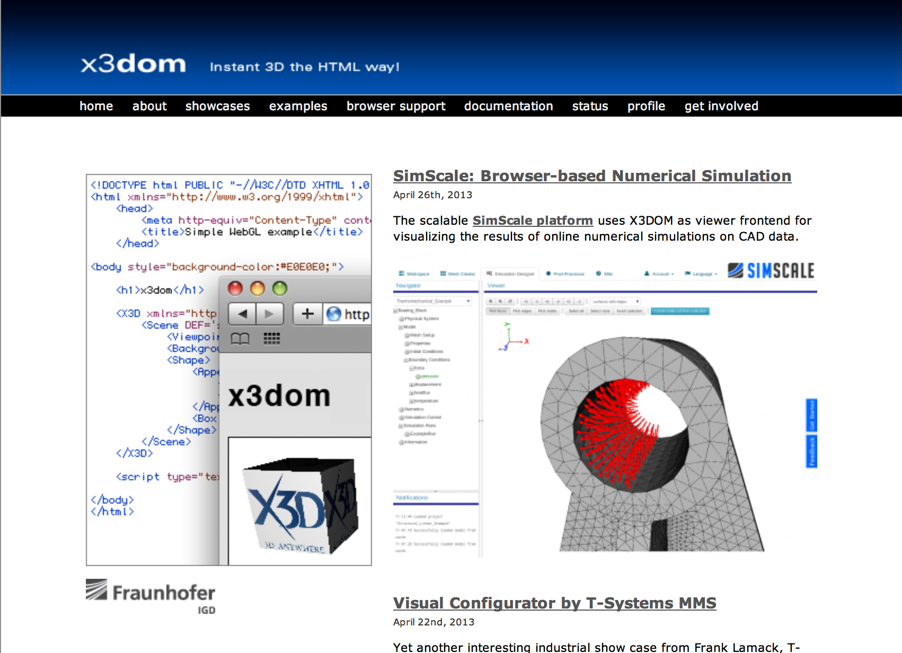
X3DOM: Portal

Slide 9
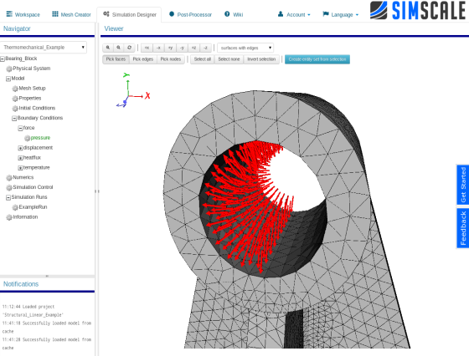
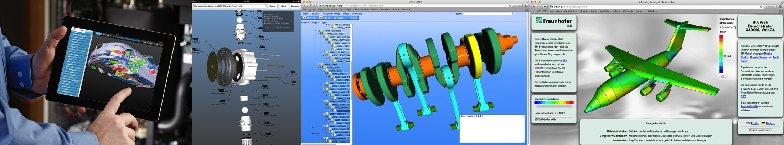
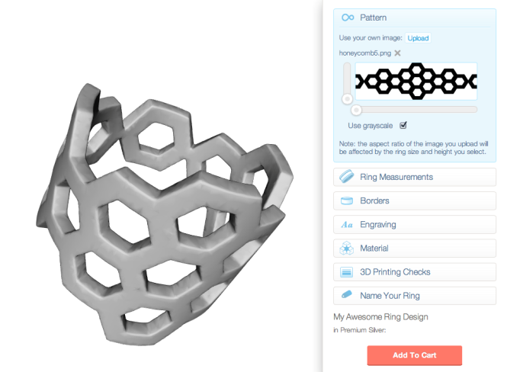
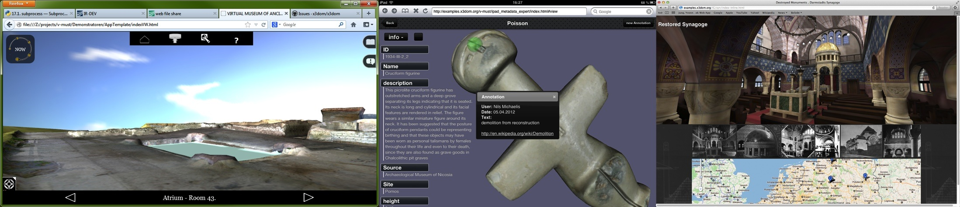
X3DOM: Showcases

Slide 10
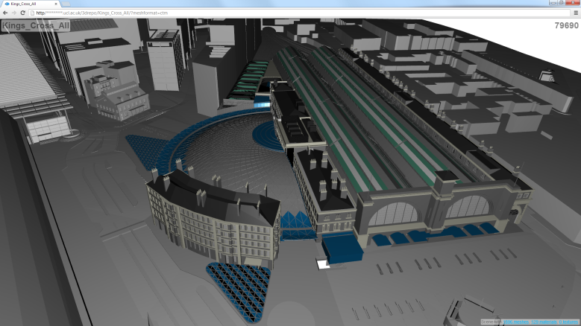
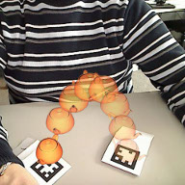
XML3D
Designed from scratch
Granular data compositing
Data structures aligned with VBOs
Consistent resource handling, XML3DRepo
[Doboš, Web3D2013]
Integrated dataflow concept (Xflow)
Skeleton animation, Image Processing, Augmented Reality
[Klein, Web3D2013]
Can be mapped to HW (GPU, River Trail, WebCL?)
Available on Github:
https://github.com/xml3d/xml3d.js

Slide 11
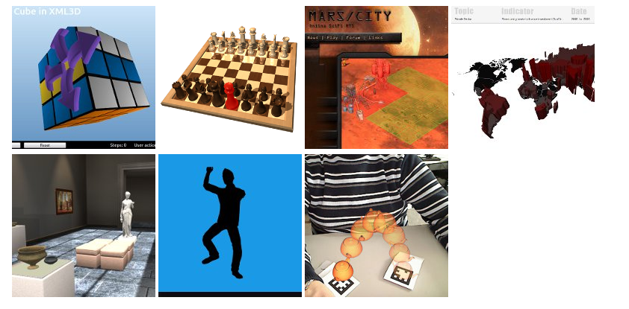
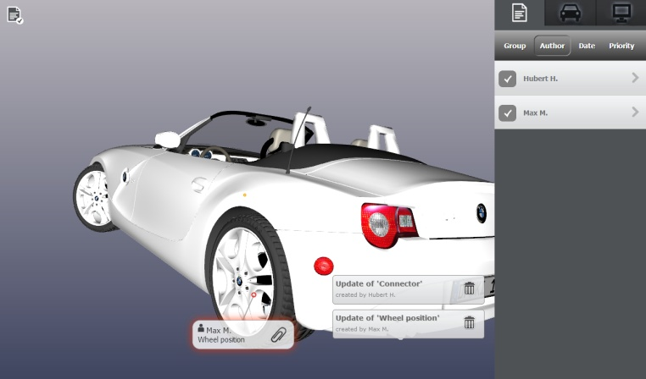
XML3D
Designed from scratch
Granular data compositing
Data structures aligned with VBOs
Consistent resource handling
Integrated dataflow concept (Xflow)
Skeleton animation, Image Processing, Augmented Reality
Can be mapped to HW (GPU, River Trail, WebCL?)

Slide 12
Declarative 3D Essentials
Extracted 15 essentials for HTML/DOM-based 3D graphics
For instance:
Use CSS 3D Transforms for transformations
How tight can we integrate 3D with web technology?
<div>
<dec3d style="border: 1px solid black;">
<div style="transform: scale3d(2, 2, 2);">
...
</div>
</dec3d>
</div>

Slide 13
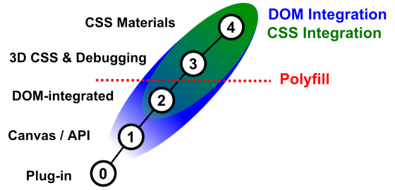
Level of Integration (LOI)
LOI 0: Classical integration using plug-ins
LOI 1: Dedicated element in the DOM + API (WebGL)
LOI 2: Scene description integrated in the DOM
LOI 3 and LOI 4: Tight integration with CSS

Slide 14
Demo

Slide 15
Polyfill Approach
What is Polyfill?
UA requirements:
DOM: Polyfill Layer must be able to access and monitor changes in related DOM elements
Events: The UA must support registration, firing, and extending UI events
CSS: Supporting scene management though custom CSS properties
CSS 3D Transforms: Extending for optimal performance
TypedArrays: ...
...

Slide 16
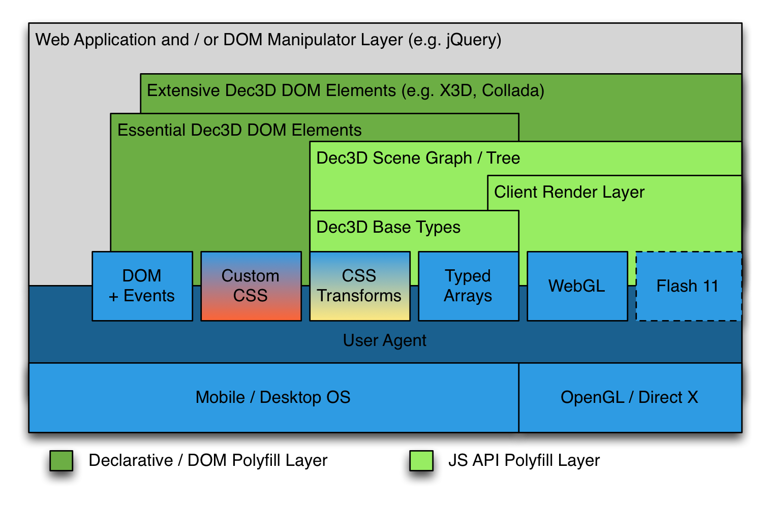
Proposed Declarative 3D Polyfill Runtime Architecture

Slide 17
Declarative 3D Agenda

Slide 18
Declarative 3D Agenda
Encourage Participation
Clear Definition of Use Cases and Requirements
Clear Technical Specification
Outreach and Exemplar Applications
W3C Working Group Proposal

Slide 19
Conclusions

Slide 20
Conclusions
Declarative vs. Imperative
Need more participation from the Web3D community
Ultimate goal: 3D for everyone and everywhere
Join us now!
Visit: http://declarative3d.org/

