Slide 1
Questions:
What is the age demographics of Udacity students?
How does the total number of hours to complete a project differ by highest level of education?
What was the most helpful tool for students when they got stuck in their Nanodegree programs?
Does the number of books consumed vary between individual contributors and managers & executives?

Slide 2
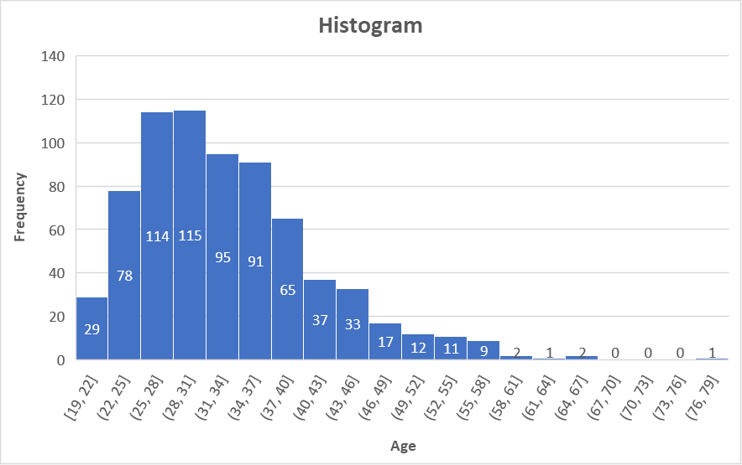
What is the age demographics of Udacity students?
Mean | 33
Median | 31
Mode | 22
St Dev. | 8.35
Range | 59
The histogram is right-skewed with the measures of center and spread shown in the right table. The youngest and oldest student are 19 and 78 years old, respectively. Most students are between 22 and 40 years old. Removing 41 outliers was necessary because their birthdates in the original data were either unavailable or incorrect.

Slide 3
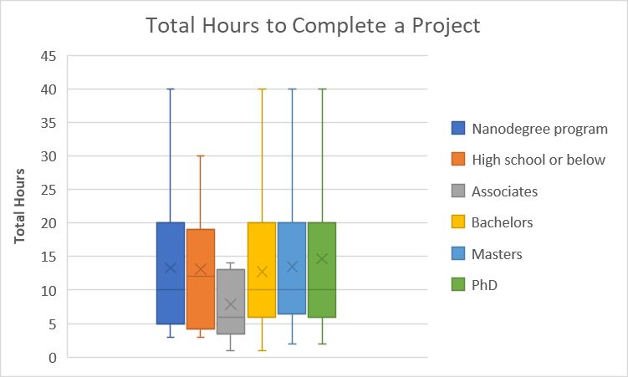
How does the total number of hours to complete a project differ by highest level of education?
Nanodegree Program | 38
High school or below | 16
Associates | 9
Bachelors | 217
Masters | 253
PhD | 62
The six box plots show that total hours of completion does not vary by the highest level of education except for the associates degree holder. This has to be verified by the use of a Chi-test (comparing the means for each degree holder). The number for each degree holder significantly varies which poses a big limitation. The total hours exceeding 40 hours are excluded in the analysis since they are treated as outliers in the box plots. Total hours to complete a project is only based on a students’ perception which may not be completely accurate and subject to different interpretations.

Slide 4
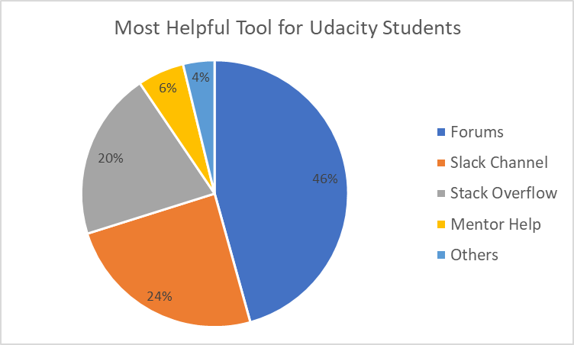
What was the most helpful tool for students when they got stuck in their Nanodegree programs?
Others
Ask Me Anythings (AMAs)
Books
External resources (khan academy, coursera)
Feedback from graders
Feedback from submissions
google
Google search
I received no help.
Internet searches
Just googling for answers
Live Help
Me
So far, I did not get really stuck
Stackoverflow and official Documentation i.e. on Keras.org or tensorflow.org
Videos
When students get stuck in their nanodegree program, most of them turn to the forums to ask for help. The slack channel and stack overflow are almost equally as helpful as the second choices. Unfortunately, mentors are the least helpful for some unknown reasons which cannot be explained by this pie chart alone. Other tools are listed on the right which may already be similar to the more popular tools.

Slide 5
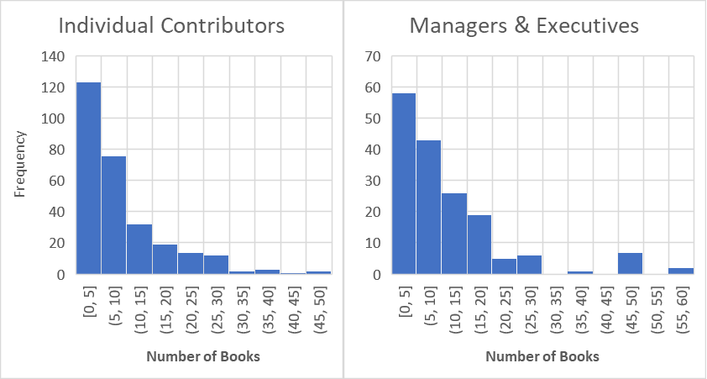
Does the number of books consumed vary between individual contributors and managers & executives?
 | IC | M&E
Minimum | 0 | 0
Q1 | 3 | 5
Q2 | 6 | 10
Q3 | 12 | 15
Maximum | 50 | 60
Both histograms are right-skewed with the five number summary shown in the right table. Executives include directors, c-levels, vice presidents and presidents. Comparing the five number summary shows that managers and executives read more books than individual contributors. This has to be verified by the use of other statistical tools. Above 60 books consumed for either category were treated as outliers and excluded from the analysis.

