Slide 1
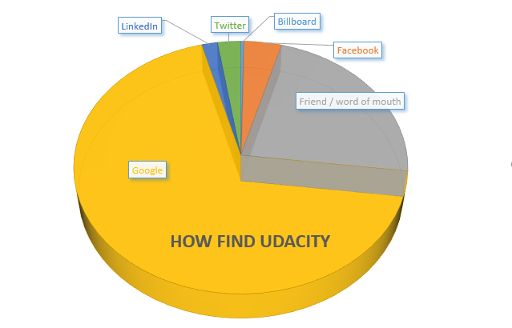
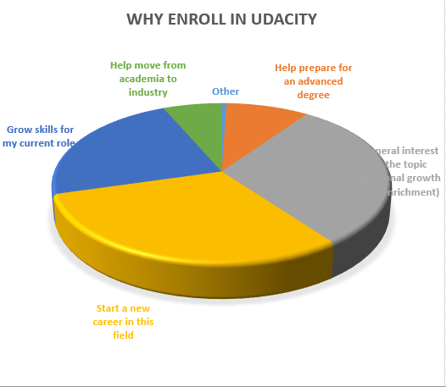
How and Why do people get interested in Udacity?
The proportional distributions of why people learn in udacity and how do they know udacity are drawn into pie charts. According to the mode, we can find that the major reason for learning is about employment. In contrast, the ideal employment companies don’t provide enough advertisements for udacity except google. It’s better for udacity to strengthen cooperation with enterprises in order to benefit both itself and the students.
N/A

Slide 2
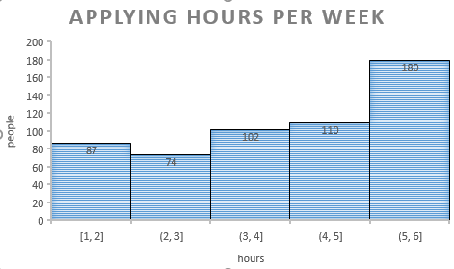
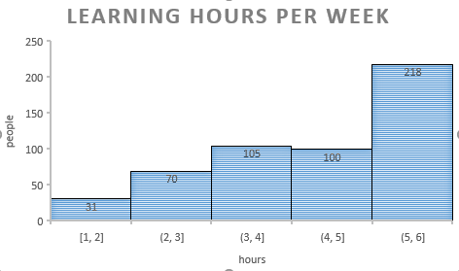
How Do Students Allocate Time for Materials and Applying?
 | learning | applying
minimum | 1 | 1
Q1 | 4 | 3
Q2 | 5 | 5
Q3 | 6 | 6
maximum | 6 | 6
mean | 4.8 | 4.4
The time of students spend learning materials and applying knowledge are drawn into a histogram. Both modes fall into [5,6], so the majority of students are hardworking and they have the sense of putting knowledge into practice. According to means and mediums, the general learning condition is also good. By computation, both ranges are 5. The data distribution is relatively concentrated.
N/A

Slide 3
Do the Average hours of Sleeping and Sitting vary based on Industry?
Use select function to remove null and apparently wrong data.
Compute mean data in each industry with individual’s data
arrange average sitting hours from small to large.
 | Average sitting hours | Average sleeping hours
standard deviation | 1.399951 | 0.257656
The means can reflect the general situation of the same industry. According to standard deviations, we can find that people’s sleeping hours are similar, while sitting hours relate to the assignments of different jobs. For example, the mean sitting hour for people working in agriculture industry is only 5 hours, maybe they need time to grow plants.
N/A

Slide 4
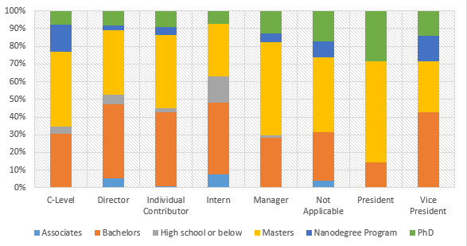
Does the Level of Jobs vary based on Educational Background?
Use PivotTable to view the distribution of background levels at different job levels
Comparing different levels of education, there appears people having level of high school or below have difficulty advancing in jobs. Masters are slightly more competed than bachelors. PhDs often occupy higher level of jobs.
N/A

