Slide 1
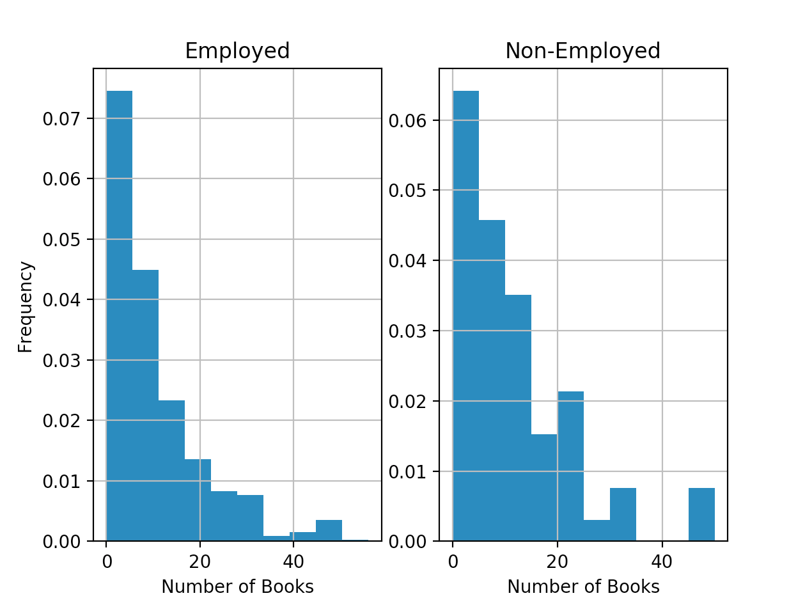
Example: Does the Number of Books read vary based on Employment?
Number of Books Read
 | Employed | Unemployed
Minimum | 0 | 0
Q1 | 4 | 4
Q2 | 8 | 6
Q3 | 15 | 15
Maximum | 600 | 100
Comparing the employed to unemployed, there does not appear to be much of a difference between the number of books they read. If we didn’t pay attention to the extreme readers (those that read a ton) in each group, they are very similar in distribution and summary statistics.

