Slide 1
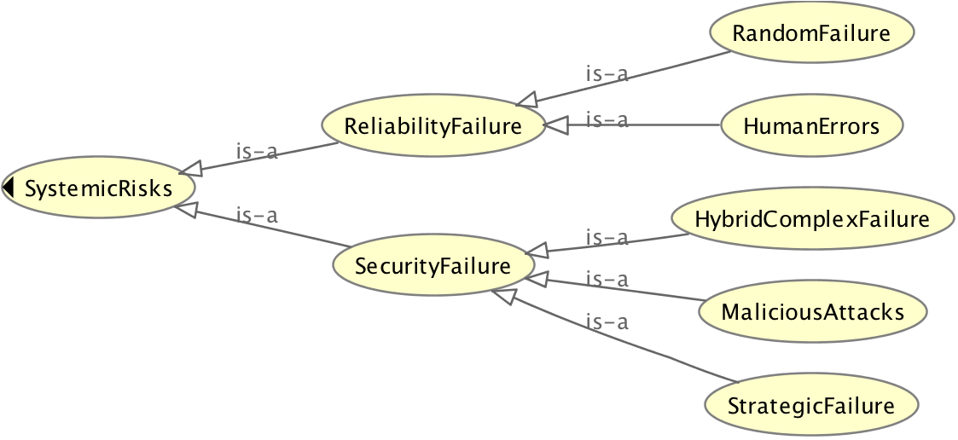
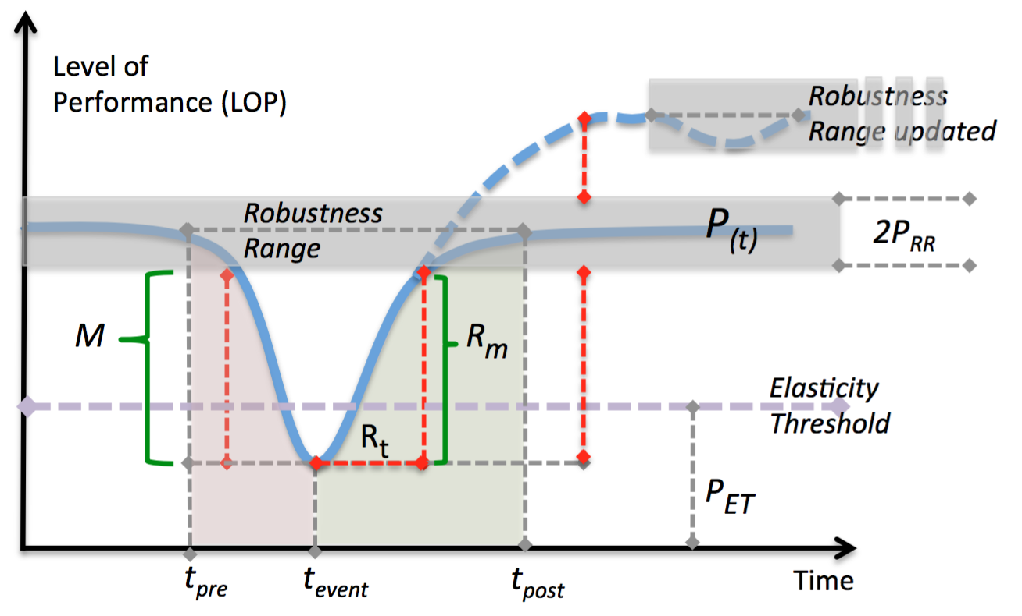
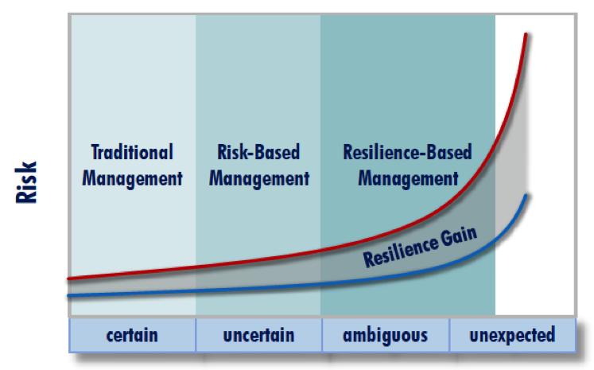
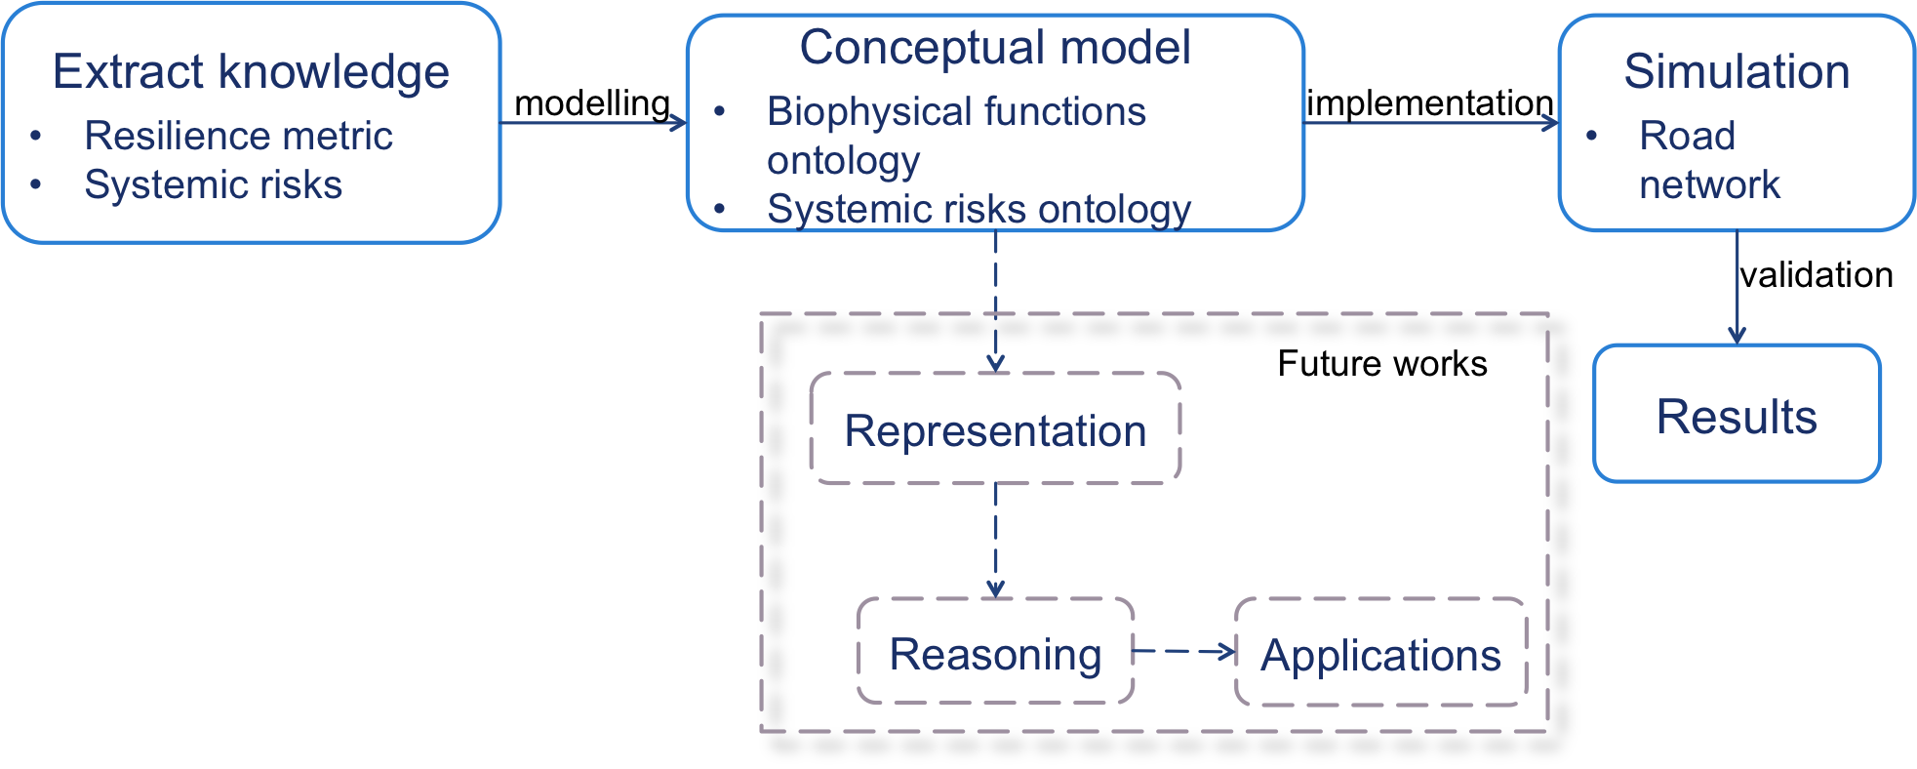
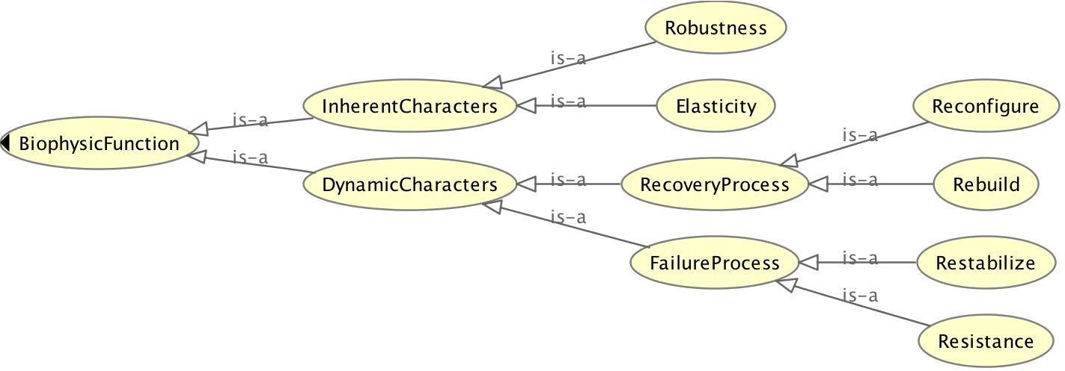
Module
color
Resilience-oriented analysis of risk management and Ontology-based categorisation of hazards in interdependent infrastructure systems
Jingya YAN jingya.yan@frs.ethz.ch; Junqing TANG junqing.tang@frs.ethz.ch
PROBLEM AND INTRODUCTION
A resilient and safe infrastructure network should represent high connectivity efficiency, tolerable robustness to the disturbance, and moderate service flow. The disruptions can be roughly classified as random failures and deliberate attacks from either natural hazards or technical system failures. Here either traditional risk management approach or resilience analysis of general infrastructure system all comprehensively emphasise on the critical understandings of unexpected hazards. There are two main gaps:
Resilience: The organic connection between resilience-based and traditional events-based risk analysis (Figure 1);
Risk: During the evaluation of resilience of interdependent infrastructure systems, most of the existing modelling and approaches work on only one type of risk, such as a terrorist attack or natural disaster. However, it lacks of a general structure to connect risk classification and resilience metrics.
APPROACH
This work includes three main steps (Figure 2):
Extraction of the knowledge:
Resilience metric: We incorporate dimensions from intrinsic system characters, which have not been considered before in quantification.
Systemic risks: Two types of systemic risks are categorized in terms of various engineering failures: Reliability failure and Security failure.
Creation of ontology-based conceptual model:
Biophysical Functions Ontology (Figure 4): ontology creation is based on the structure of Failure-recovery cycle (Figure 3).
Systemic Risks Ontology (Figure 5)
Summary
An ontology framework to organise the knowledge of resilience metrics and risk classification of critical infrastructure in a system-of-systems way and to identify the interdependencies between them.
Separating ontologies can be easily extended to incorporate new features of the systems, thus it is adaptive to the future scenarios.
With such ontology-based resilience analysis and interdependence analysis, the system network will be well understood. the corresponding serviceability and safety could be enhanced.
Further Research
Building the connection between Biophysical functions ontology and Systemic risks ontology.
Using the conceptual model on the road network, in order to evaluate the model and realise ontology-based resilience analysis.
Studying of smooth regime transition in risk analysis realm, and conduct empirical study on the real system performance so that the proposed approach could be future validated.
REFERENCES
Junqing Tang, Hans heinimann. A generic metric for quantitative assessment of resilience in urban complex systems. Working paper.
Figure 5 Systemic risks ontology
Figure 1 The evolution process of risk management and a new paradigm for risk, which is the resilience-based approach.
Figure 3 Typical draw-down and draw-up cycle, with corresponding elemental functions.
Figure 2 Development architecture.
Figure 4 Biophysical functions ontology

