Slide 1
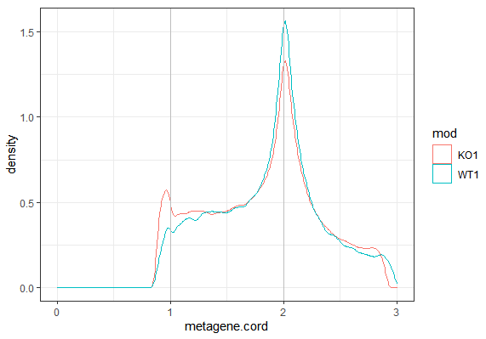
m6A Reads Density
samples
5’ UTR
CDS
3’ UTR

