Slide 1

Transition of Life Expectancy Before and After COVID-19
Presenter Name:
Date: 17/01/2025
Notes:
Good morning, everyone. Today, I will be presenting an analysis on the impact of COVID-19 on life expectancy,
focusing on how it differs by gender and region.
In this presentation, we'll look at global trends, with a specific focus on different regions and genders.
I'll explain how we can see significant effects in the years after the pandemic, and discuss the statistical results that support these conclusions.

Slide 2
Overview To analyze the impact of COVID-19 on life expectancy across different genders and regions
Life expectancy trends before, during, and after COVID-19
Regional comparisons of life expectancy
Key statistical results (T-test, ANOVA)
Insights from the analysis, limitations of the data and analysis
Future directions for research
Notes:
The main objective today is to understand how life expectancy was affected by COVID-19 and explore which factors
such as gender and region—have the most significant impact.
Life expectancy trends before, during, and after COVID-19:
We'll review how global life expectancy changed from 2019 to 2024, highlighting the impact of COVID-19.
Regional comparisons of life expectancy:
We'll also look at how different regions experienced changes in life expectancy during this period.
Key statistical results (T-test, ANOVA):
The statistical analysis, including T-tests and ANOVA, will help us understand significant differences by gender and region.
Insights from the analysis:
We’ll summarize the key findings from the data, including trends and factors that influence life expectancy.
Limitations of the data and analysis:
We’ll discuss the limitations, such as missing data for some regions and the unclear long-term effects of COVID-19.
Future directions for research:
Finally, we’ll suggest future steps to better understand the impacts of COVID-19 on life expectancy.

Slide 3


Dataset Breakdown
Source: United Nations (UN DATA)*¹
Data Format: CSV (Comma-Separated Values)
Data Columns: "Country or Area", "Year(s)", "Variant", "Value“
Period: 2019–2024 (Pre-COVID, COVID, Post-COVID)*²
Region*³:
AFRO (African Region), AMRO (Americas Region), EMRO (Eastern Mediterranean Region), EURO (European Region), SEARO (South-East Asia Region), WPRO (Western Pacific Region), World (Global Data)
Gender: Mixed, Male, Female
Records: 49 per category
Data Sources: *¹ Life expectancy data (2019-2024): UN DATA *² COVID-19 period: WHO *³ Regional breakdown: WHO
Notes:
This presentation defines the COVID period spanning from January 2020 to May 2023.(Point *² COVID-19 period: WHO)
The year 2024 is considered the first year of post-COVID life expectancy reporting.
However, we acknowledge that the impact of COVID-19 continues in some regions,
so 2024 data is positioned as "post-COVID" while recognising lingering effects.
Data comes from reliable UN DATA, and regions are classified based on WHO regions.
In this presentation, we use the WHO classification of regions for consistency and comparability. The regions are as follows:
AFRO (African Region): Countries in Africa.
AMRO (Americas Region): North, Central, and South America.
EMRO (Eastern Mediterranean Region): Middle East and North Africa.
EURO (European Region): European countries.
SEARO (South-East Asia Region): South Asian countries.
WPRO (Western Pacific Region): East Asia and Pacific Islands.
World: Global data combining all regions.
Gender data is categorized into three groups: combined (male and female), male, and female.
This slide outlines the main questions and objectives of the presentation, introduces the data sources, and clarifies the definitions of the time periods we’re analyzing.

Slide 4
Quiz
How many years did global life expectancy change
before and after COVID-19?
Notes:
Can you guess how much life expectancy changed globally before and after COVID-19.
The answer will be revealed in the next slide with a graph.

Slide 5
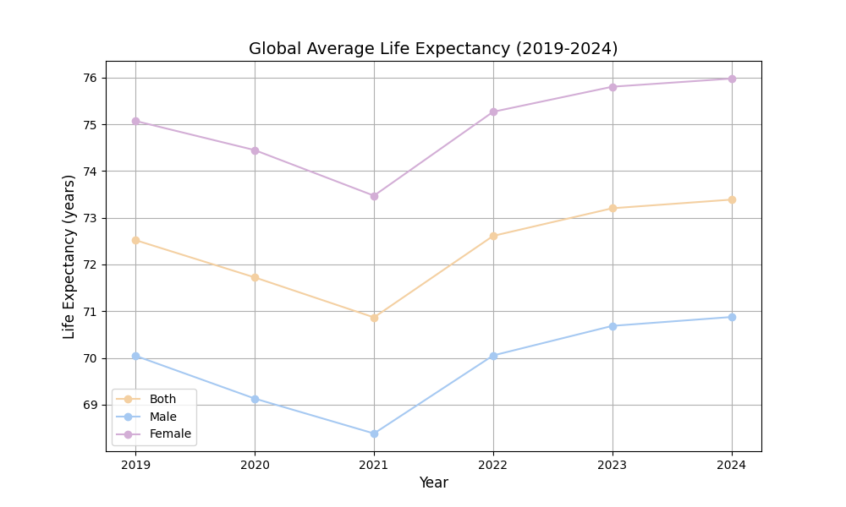
Global Life Expectancy (2019-2024)
Key Insights
Life Expectancy:
Female > Both > Male
COVID-19 Impact:
2021:Significant drop from 2019
2024: Recovery, with life expectancy about 1 year higher than 2019 for all groups
Notes:
The answer is life expectancy in post-COVID is longer than pre-COVID in both genders.
Let’s break down this graph.
Life expectancy trends:
(From the graph, we can see that females have the highest life expectancy, followed by both genders combined, and then males.)
This order is interesting because typically, females live longer than males, but it’s not clear why both genders combined have a higher value than females in this case.
Impact of COVID-19:
The 2021 drop shows a significant decrease in life expectancy compared to 2019, which likely reflects the effects of the pandemic.
However, in 2024, life expectancy has recovered, and it is now about one year higher than in 2019 for all groups (both, males, and females).

Slide 6
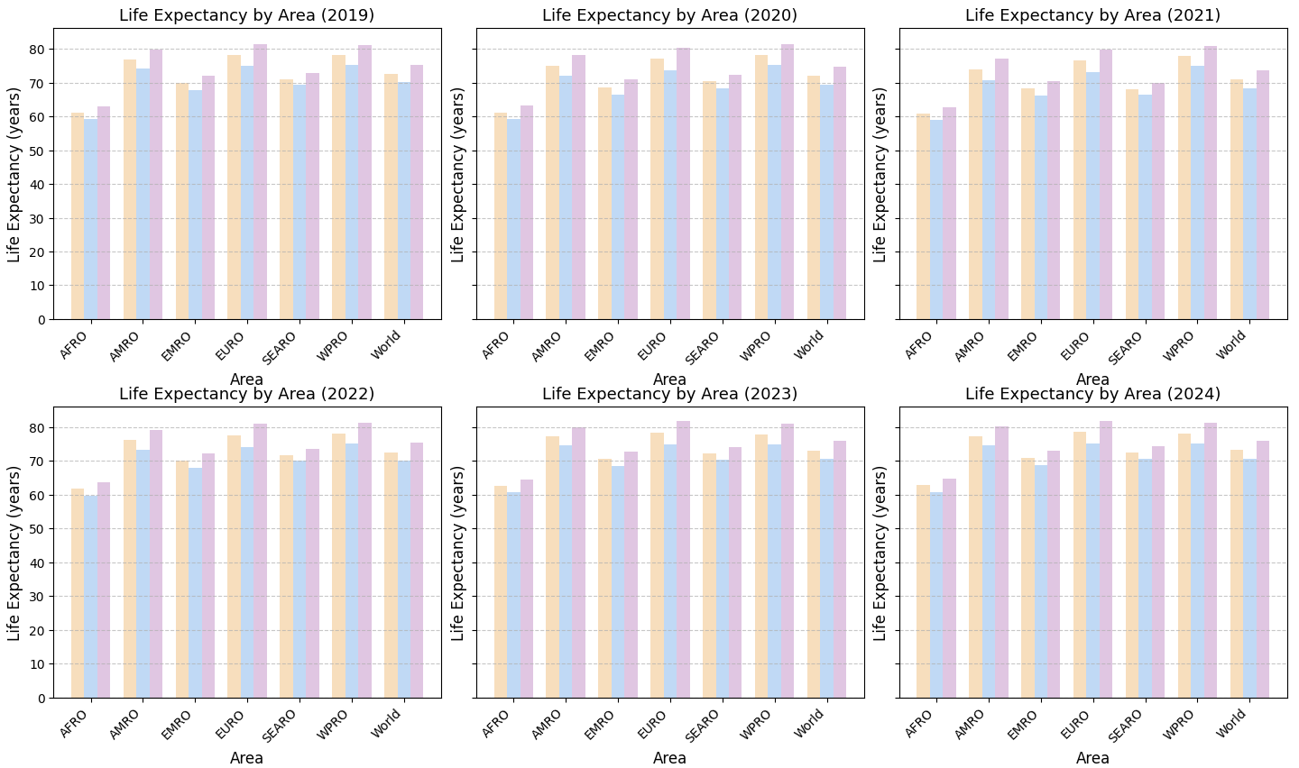
Regional Life Expectancy Trends (2019-2021)
EURO (European Region) and AMRO (Americas Region) saw a larger drop in life expectancy due to COVID-19, while Africa and Asia were less impacted.
AFRO: African Region
AMRO: Americas Region
EMRO: Eastern Mediterranean Region
EURO: European Region
SEARO: South-East Asia Region
WPRO: Western Pacific Region
World: Global (All Regions)
Notes:
I’ve divided the six years of data into two slides for better clarity.
This slide focuses on the years 2019 to 2021, highlighting the changes in average life expectancy before and during the onset of the COVID-19 pandemic,
broken down by region.
As you can see, this period captures the initial impact of COVID-19 on life expectancy,
revealing distinct patterns and variations across different regions.
Let's take a closer look at these differences and discuss the trends observed during this critical time.
The chart on this slide visually compares the year-length change in life expectancy across the regions between 2019 and 2021.
Notice the steeper declines in EURO and AMRO, compared to the relatively minor changes in other regions.

Slide 7
Regional Life Expectancy Trends (2022-2024)
EURO (European Region) and AMRO (Americas Region) saw notable recovery between 2022 and 2024.
AFRO: African Region
AMRO: Americas Region
EMRO: Eastern Mediterranean Region
EURO: European Region
SEARO: South-East Asia Region
WPRO: Western Pacific Region
World: Global (All Regions)
Notes:
The chart on this slide visually compares the year-length change in life expectancy across the regions between 2022 and 2024.
Notice notable recovery in EURO and AMRO, compared to the relatively minor changes in other regions.
This graph provides a visual representation, however, we’ll now use statistical analysis to examine the data numerically.

Slide 8
Statistical Methods (T-test & ANOVA)
T-test
Purpose:
To compare life expectancy between males and females before and after COVID.
Formula:
t = (x̄₁ - x̄₂) / √(s₁²/n₁ + s₂²/n₂)
ANOVA
Purpose:
To analyze life expectancy differences across regions and years.
Formula:
F = Variance between groups / Variance within groups
If p-value less than 0.05 suggests significant differences.
Notes:
First, I used a T-test to compare life expectancy between males and females before and after COVID-19.
The T-test is used to check if there is a statistically significant difference between the two groups, male and female.
I also applied ANOVA to examine life expectancy differences between regions and over the years.
The ANOVA test helps to check if the differences in life expectancy are significant across multiple groups.

Slide 9
Results (T-test & ANOVA)
T-test(Gender Comparison)
Pre-COVID:
p-value = 0.1501
Post-COVID:
p-value = 0.1133
ANOVA(Region and Year Comparison)
Region:
p-value = 3.1482e-44
Year:
p-value = 0.7499
No significant difference in life expectancy between genders (p > 0.05).
Significant differences in life expectancy by region (p < 0.05), but not by year (p > 0.05).
Rounded all p-values to 4 decimal places
Notes:
Here are the statistical results for T-tests and ANOVA.
For the T-test, both pre- and post-COVID p-values are above 0.05,
whih means no significant difference in life expectancy between males and females.
For the ANOVA, the region p-value is extremely small, showing big differences in life expectancy between regions.
However, the year p-value is above 0.05, meaning no significant differences across years.
(I’ve rounded all p-values to 4 decimal places to make them easier to read.)

Slide 10
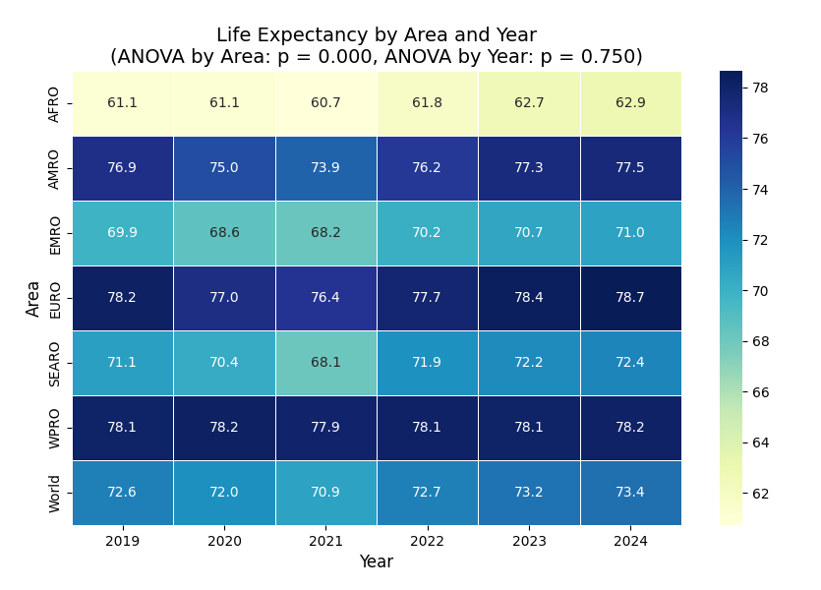
Key Insights from Statistical Analysis
Gender:
No significant difference in life expectancy between males and females (p > 0.05).
Region:
Significant differences in life expectancy across regions (p < 0.001)
Year:
No significant changes globally over time (p > 0.05)
Notes:
Here, I’ll explain the statistical results and examine the ANOVA heatmap.
There are three key findings:
There is no significant difference in life expectancy between males and females, as indicated by a p-value greater than 0.05.
Significant differences in life expectancy are observed across regions, with a p-value less than 0.001.
Globally, there are no significant changes in life expectancy over time, with a p-value greater than 0.05.
Let’s take a closer look at the ANOVA heatmap to better understand these results visually.(Point the heatmap)
When we look at the data by region, we can see that in 2021, the average life expectancy drops significantly across all regions.
However, in 2020, the changes in life expectancy vary by region.
Some regions show a gradual decline in life expectancy, while others experience a sharp drop followed by a rapid recovery.
This highlights the differences in how regions were impacted and their resilience in recovering from the effects of COVID-19.

Slide 11
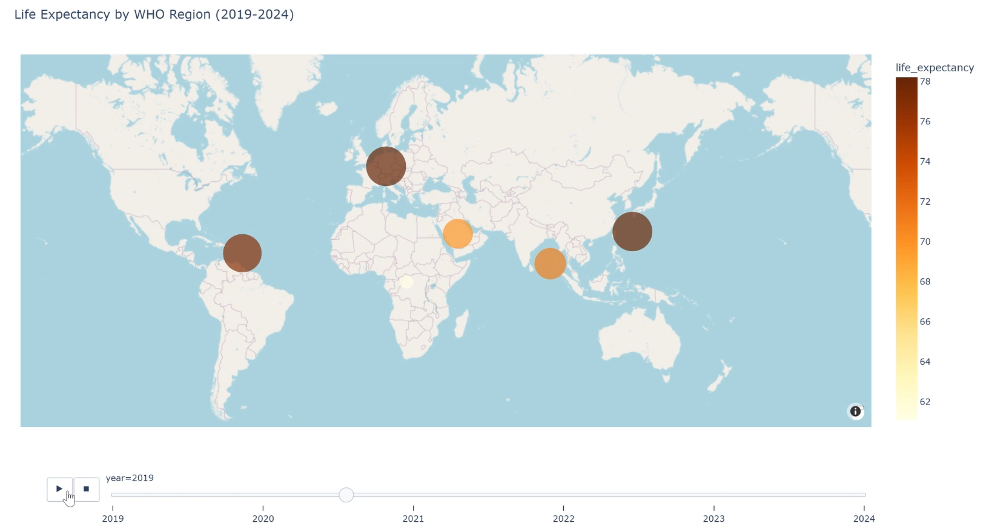
Trends in Global Life Expectancy by Region (2019-2024)
Notes:
(**Animation Slide – Click the slide and start the animation.)
Before the conclusion, let’s look at this map.
This animation shows life expectancy trends across six WHO regions.
Each bubble represents a region, and its size and colour correspond to the average life expectancy.
In the South-East Asia region (SEARO), life expectancy shows relatively stable trends from 2019 to 2024, with only slight fluctuations.

Slide 12
What We Can and Cannot Conclude
What We Can Conclude:
COVID-19 significantly impacted life expectancy.
Regional differences are statistically significant in life expectancy.
What We Cannot Conclude:
Long-term effects of COVID-19 on life expectancy are unclear.
Social and economic factors affecting life expectancy in regions remain uncertain.
Notes:
What We Can Conclude
COVID-19 caused a sharp drop in life expectancy, particularly in the years following the pandemic.
This is especially clear when looking at the post-COVID period.(Since 2024 is the first year as post-COVID)
When I analyzed gender and region, I saw that they had a significant statistical impact on life expectancy.
Certain regions and genders were more affected than others, and this pattern has shown up clearly in the results.
What We Cannot Conclude
While COVID-19 had an immediate effect, I can't definitively say what the long-term impacts will be yet.
More data is needed over a longer period to make that clear.
Social and economic factors play a role in these trends, but I still can't fully explain how they affect life expectancy across different regions.
There’s more research to be done to understand these complexities.

Slide 13
Future Challenges
Data Expansion:
Gather more detailed data (longer year span, urban/rural, socio-economics).
Prediction Models:
Develop ML models for future trends.
Socioeconomic Impact:
Study healthcare, education, and economic effects.
Notes:
For future research, we need more detailed data to uncover regional trends,
such as breaking down by age and socio-economic factors.
Machine learning models can help predict how life expectancy might change.
Lastly, analyzing the influence of healthcare, education, and economic conditions will give a clearer picture of what drives these trends.

Slide 14
Reference List
United Nations (n.d.) UN Data. Available at: https://data.un.org/ (Accessed: 13 January 2025).
World Health Organization (n.d.) Global regions and WHO regional offices. Available at: https://www.who.int/about/who-we-are/regional-offices (Accessed: 13 January 2025).
World Health Organization (n.d.) The coronavirus disease (COVID-19) pandemic. Available at: https://www.who.int/europe/emergencies/situations/covid-19 (Accessed: 13 January 2025).
Notes:
These are references.

Slide 15
Thank you

