Slide 1
MGM's College of Engineering and Technology Kamothe, Navi Mumbai – 410 209 Department of Information Technology
A.Y.2026-27
Fire Department Inspection & NoC Management
Roll no. UID Name of students
28 123IT1337A Yogesh Kumawat
27 123IT1185A Gaurav Kudake
26 124IT3253A Aniket Kolekar
Under the guidance of
Mrs. Mitrakshi Patil

Slide 2
Outline
Introduction
Literature Survey
Problem Statement
Objectives
Features
Proposed System
Conclusion
References

Slide 3
Introduction
Fire safety is an essential requirement for protecting human lives, property, and the environment from fire-related hazards. However, managing fire department inspections and No Objection Certificates (NoC) through traditional methods can be time-consuming, complex, and prone to errors. Manual verification of documents, inspection scheduling, and tracking application status can cause delays and inefficiencies.
Therefore, the Fire Department Inspection & NoC Management System aims to streamline and digitize the entire process. It provides a centralized platform for application management, document verification, inspection scheduling, and NoC tracking, improving transparency, reducing administrative workload, and ensuring a more efficient and reliable fire safety approval process.

Slide 4
Literature Survey
Sr. No. | Title / Source | Authors, Year | Objective | Method / Technique | Key Findings | Limitation / Gap for SmartFire-NOC
1 | [1] The Maharashtra Fire Prevention and Life Safety Measures Act, 2006 (Mah. Act No. III of 2007), as amended incl. Mah. Act No. 24 of 2023 | Government of Maharashtra, 2006 (amended 2023) | Legal framework for fire prevention and life safety in listed buildings | Statute: Provisional and Final Fire Safety Approval, and renewal, from the Chief Fire Officer or the Director | Provisional approval is given at building-plan stage before construction. Final approval is issued after verifying that measures conform to the provisional approval, before the completion or occupancy certificate | Legal text, not a software system. Checklist rules must be extracted from the official source and validated, not written from memory
2 | [2] DIGIT Fire NOC | eGovernments Foundation, undated web documentation | Online Fire NOC application and processing | Role-based workflow with document scrutiny, field inspection and approval; fee payment; status dashboards; application history; QR-code certificates | Shows that digitizing submission, payment and tracking of Fire NOCs is feasible | Public description emphasizes submission and tracking. It does not describe document-consistency checks, drawing analysis or tamper-evident auditing (internal features not claimed to be absent)
3 | [3] Comprehensive online application for Fire Department (Telangana) | Centre for Good Governance, Hyderabad, undated web page | Let applicants request fire services online instead of visiting offices | Online provisional NOC, occupancy NOC and renewal; inspection reports visible to applicants; SMS alerts | Online services and visible inspection status are workable in a state fire department | No decision-support analytics described

Slide 5
Literature Survey
Sr. No. | Title / Source | Authors, Year | Objective | Method / Technique | Key Findings | Limitation / Gap for SmartFire-NOC
4 | [4] Firebird: Predicting fire risk and prioritizing fire inspections in Atlanta | Madaio et al., ACM SIGKDD, 2016 | Prioritize commercial properties for inspection | Machine learning (SVM, Random Forest), geocoding, information visualization, interactive map | Risk scores for 5,000+ buildings, true positive rate up to 71% in predicting fires | Selects properties by predicted fire risk from historical data. Does not manage an application queue or the NOC workflow
5 | [5] Data-driven structural fire risk prediction for city properties | Dey and Fern, AAAI, 2024 | Decide which properties to inspect with limited resources | XGBoost on data of 72,000+ properties from a South Dakota fire department; feature-importance analysis | Ranks property fire risk while coping with missing data and a skewed class distribution | Needs historical incident data that a new prototype does not have
6 | [6] A knowledge-driven approach for automated fire safety compliance checking in operational buildings | Chen et al., Knowledge-Based Systems, vol. 336, 2026 | Automate fire-safety compliance checking | Multimodal perception, semantic integration and rule-based inference over layouts, images and regulatory clauses | Pixel accuracy 0.90 (layout extraction), mAP 0.91 (safety-asset detection); domain-adapted VQA improves compliance descriptions | Broader scope (knowledge graphs, vision-language models). No application-to-certificate workflow

Slide 6
Literature Survey
Sr. No. | Title / Source | Authors, Year | Objective | Method / Technique | Key Findings | Limitation / Gap for SmartFire-NOC
7 | [7] FloorPlanCAD: A large-scale CAD drawing dataset for panoptic symbol spotting | Fan et al., ICCV, 2021 | Benchmark symbol spotting in CAD drawings | Large annotated CAD drawing dataset for panoptic symbol spotting | Shows symbol detection in architectural drawings is a recognized task with a dedicated benchmark | Vector CAD focus; submitted drawings may be scanned PDFs or images, and symbol conventions may differ. Own annotated sample set needed
8 | [8] LayoutLMv3: Pre-training for document AI with unified text and image masking | Huang et al., ACM Multimedia, 2022 | General pre-training for Document AI | Multimodal Transformer with unified text and image masking and word-patch alignment | State-of-the-art reported on form and receipt understanding, document VQA, document image classification and layout analysis | Results are on public benchmarks, not on ownership records, approved plans or fire-equipment certificates. Must be measured on project data against simpler baselines
9 | [9] Secure audit logs to support computer forensics | Schneier and Kelsey, ACM TISSEC, vol. 1, no. 3, 1999 | Protect log files on an untrusted machine | Cryptographic method for secure audit logs | Earlier entries cannot be read, and cannot be modified or destroyed without detection, after a compromise | Stronger than the simple SHA-256 hash chain planned here. SmartFire-NOC uses only the tamper-evidence idea and does not claim immutability

Slide 7
Literature Survey
Sr. No. | Title / Source | Authors, Year | Objective | Method / Technique | Key Findings | Limitation / Gap for SmartFire-NOC
10 | [10] An overview of the Tesseract OCR engine | Smith, ICDAR, 2007 | Describe an open-source OCR engine | OCR engine architecture overview | Candidate engine for the text-extraction step | OCR errors flow into later steps, and OCR success does not prove a document is authentic
11 | [11] JSON Web Token (JWT), IETF RFC 7519 | Jones, Bradley and Sakimura, 2015 | Standard token format for claims | Compact signed tokens | Basis for session authentication in SmartFire-NOC | A token proves identity only; backend role and ownership checks are still required
12 | [12] Role-based access control models | Sandhu et al., IEEE Computer, 1996 | Define RBAC models | Permissions assigned to roles, users assigned to roles | Basis for the applicant and inspector permissions | Roles alone do not stop an applicant reading another applicant's record, so ownership checks are added

Slide 8
Problem Statement & Objectives
Problem Statement
The existing Fire Department Inspection and NoC Management process often involves extensive paperwork, manual document verification, and time-consuming inspection procedures. Managing different fire safety requirements for residential, commercial, and industrial buildings makes the process complex and increases the possibility of errors, delays, and inconsistent evaluations. Applicants may face difficulties understanding the required documents and tracking their application status.
Fire department officials also encounter challenges in scheduling inspections, verifying compliance, and maintaining accurate records. Therefore, there is a need for an intelligent digital system that automates requirement generation through a dynamic rule engine, assists document verification using artificial intelligence, supports floor plan analysis, streamlines inspection scheduling, and enables transparent application tracking while ensuring that final approval decisions remain with authorized fire department officials.

Slide 9
Fire Department Inspection & NOC Management
Objectives
To digitize and streamline the Fire Department Inspection and NoC application process.
To develop a dynamic rule engine that generates building-specific fire safety requirements.
To implement AI-based document verification to identify missing or inconsistent documents.
To support fire safety evaluation through floor plan analysis.
To automate inspection scheduling and application status tracking.
To maintain digital audit trails for transparency and accountability.
To improve efficiency, reduce paperwork, and assist officials in making informed NOC approval decisions.

Slide 10
Features
Online NOC Application
Document Management
Inspection Scheduling & Assignment
Inspection Checklist & Reports
Application Status Tracking
Follow-up & Re-inspection Management
NOC Generation & Verification
Real-time Notifications
Admin & Inspector Dashboards
Application History & Audit Trail

Slide 11
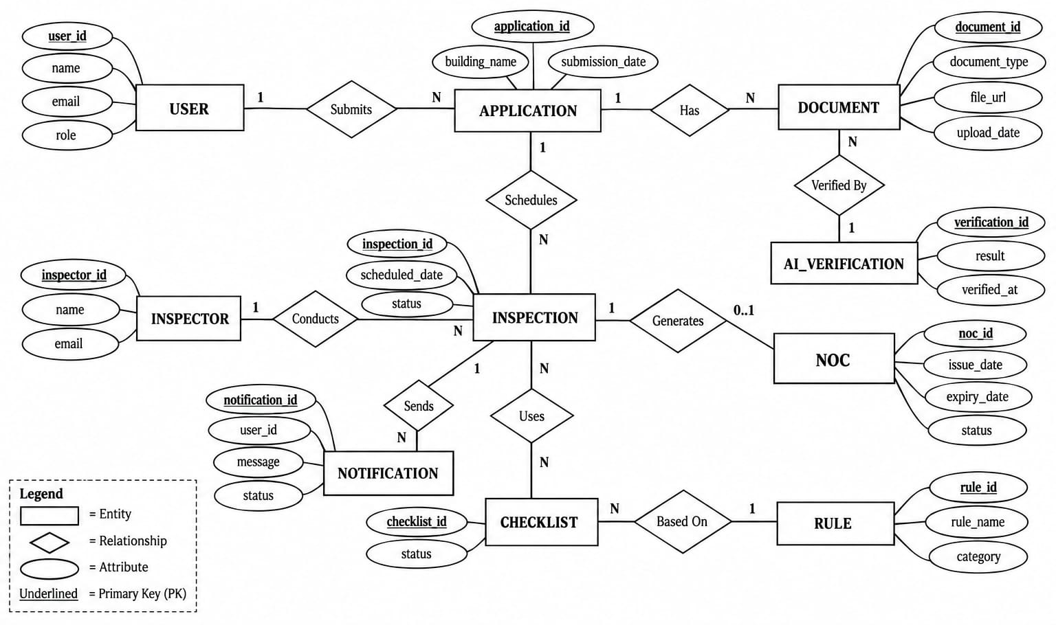
Proposed System

Slide 12
Conclusion
The proposed Fire Department Inspection & NOC Management System aims to digitize and streamline the complete fire NOC process, from application and inspection to approval and follow-up. By introducing risk-based inspection prioritization, smart inspector management, centralized records, and real-time tracking, the system can reduce delays, improve transparency, and make fire safety administration more efficient.

Slide 13
References
[1] Government of Maharashtra, “The Maharashtra Fire Prevention and Life Safety Measures Act, 2006 (Mah. Act No. III of 2007),” as amended, including the Maharashtra Fire Prevention and Life Safety Measures (Amendment) Act, 2023 (Mah. Act No. 24 of 2023).
[2] eGovernments Foundation, “DIGIT Fire NOC.” [Online]. Available: https://digit.org/digit-urban-fire-noc (accessed Oct. 22, 2026).
[3] Centre for Good Governance, Hyderabad, “Comprehensive online application for Fire Department,” e-Governance Projects. [Online]. Available: https://cgg.gov.in/it_project/1618/ (accessed Oct. 22, 2026).
[4] M. Madaio, S.-T. Chen, O. L. Haimson, W. Zhang, X. Cheng, M. Hinds-Aldrich, D. H. Chau, and B. Dilkina, “Firebird: Predicting fire risk and prioritizing fire inspections in Atlanta,” in Proc. 22nd ACM SIGKDD Int. Conf. Knowledge Discovery and Data Mining, San Francisco, CA, USA, Aug. 2016, doi: 10.1145/2939672.2939682.
[5] R. Dey and A. Fern, “Data-driven structural fire risk prediction for city properties,” in Proc. AAAI Conf. Artificial Intelligence, vol. 38, no. 21, 2024, doi: 10.1609/aaai.v38i21.30325.

Slide 14
References
[6] D. Chen, L. Chen, Y. Yang, Q. Lu, C. Hancock, R. Lock, and S. Sølvsten, “A knowledge-driven approach for automated fire safety compliance checking in operational buildings,” Knowledge-Based Systems, vol. 336, Art. no. 115156, Mar. 2026, doi: 10.1016/j.knosys.2025.115156.
[7] Z. Fan, L. Zhu, H. Li, X. Chen, S. Zhu, and P. Tan, “FloorPlanCAD: A large-scale CAD drawing dataset for panoptic symbol spotting,” in Proc. IEEE/CVF Int. Conf. Computer Vision (ICCV), 2021, pp. 10128–10137.
[8] Y. Huang, T. Lv, L. Cui, Y. Lu, and F. Wei, “LayoutLMv3: Pre-training for document AI with unified text and image masking,” in Proc. 30th ACM Int. Conf. Multimedia, 2022, doi: 10.1145/3503161.3548112.
[9] B. Schneier and J. Kelsey, “Secure audit logs to support computer forensics,” ACM Trans. Information and System Security, vol. 1, no. 3, pp. 159–176, 1999.
[10] R. Smith, “An overview of the Tesseract OCR engine,” in Proc. 9th Int. Conf. Document Analysis and Recognition (ICDAR), 2007, pp. 629–633.

Slide 15
References
[11] M. Jones, J. Bradley, and N. Sakimura, “JSON Web Token (JWT),” IETF RFC 7519, May 2015.
[12] R. S. Sandhu, E. J. Coyne, H. L. Feinstein, and C. E. Youman, “Role-based access control models,” Computer, vol. 29, no. 2, pp. 38–47, Feb. 1996.

Slide 16
Thank you

