Slide 1
MGM's College of Engineering and Technology Kamothe, Navi Mumbai – 410 209 Department of Information Technology
A.Y.2026-27
Fire Department Inspection & NoC Management
Roll no. UID Name of students
35 123IT1337A Yogesh Kumawat
27 123IT1185A Gaurav Kukade
34 124IT3253A Aniket Kolekar
Under the guidance of
Mrs. Mitrakshi Patil

Slide 2
Fire Department Inspection & NOC Management
Problem Statement
Real-time monitoring and evaluation software for application received in Fire Department relating to inspections, follow-ups, issue of NOCs and such licensing requirement so as to ensure automatic system monitoring without any manual support.
Objective
To reduce delays and manual work in Fire NOC processing by providing a centralized, real-time platform for monitoring inspections, follow-ups, and approvals.

Slide 3
Introduction
A Fire Department Inspection & NOC Management System is a web-based platform that digitizes and monitors the complete Fire NOC process, from application submission and inspection to follow-ups and final approval, ensuring faster, transparent, and organized processing.
Online NOC Application
Document Management
Inspection Scheduling & Assignment
Inspection Checklist & Reports
Application Status Tracking
Follow-up & Re-inspection Management
NOC Generation & Verification
Real-time Notifications
Admin & Inspector Dashboards
Application History & Audit Trail

Slide 4
Literature Survey
Sr. No. | Author & Year | Paper Title | Methodology | Result / Findings | Limitations
1 | Juliet et al., 2025 | Real Time Monitoring and Evaluation Software for Application Received in Fire Department Relating to Inspections, Follow-ups, Issue of NOCs | Developed a web-based system using HTML, CSS, JavaScript and backend processing for application submission, inspection tracking, follow-ups, approvals/rejections and NOC issuance. | Digital processing improves transparency, status tracking, accuracy and response time. Centralized dashboards can help fire officials monitor applications and NOC processes. | Prototype-oriented study with limited real-world government deployment and validation. Legal, security, scalability and integration requirements require further evaluation.
2 | Khan et al., 2020 | Converging Technologies for Safety Planning and Inspection Information System of Portable Firefighting Equipment | Developed a Portable Firefighting Equipment Inspection Planning System using BIM, OCR and Blockchain, together with a smartphone-based inspection information system. Two case studies were used for validation. | The system improved inspection-data recording, transparency and accessibility. BIM supported safety planning while blockchain provided reliable and tamper-resistant inspection records. | Some BIM inputs still required manual effort. Tested mainly through case studies and focused on portable firefighting equipment at construction sites.
3 | Kpamma & Adjei-Kumi, 2013 | Construction Permits and Flow of Projects within the Sunyani Municipality, Ghana | Case study using interviews, records, observations and stakeholder data to examine building, environmental and fire-permit acquisition processes. | Permit processes were found to cause delays because of poor information flow, lack of process integration and inefficient permit-processing procedures. | Study was conducted in one municipality in Ghana. Government procedures and regulations may differ considerably in India or other regions.

Slide 5
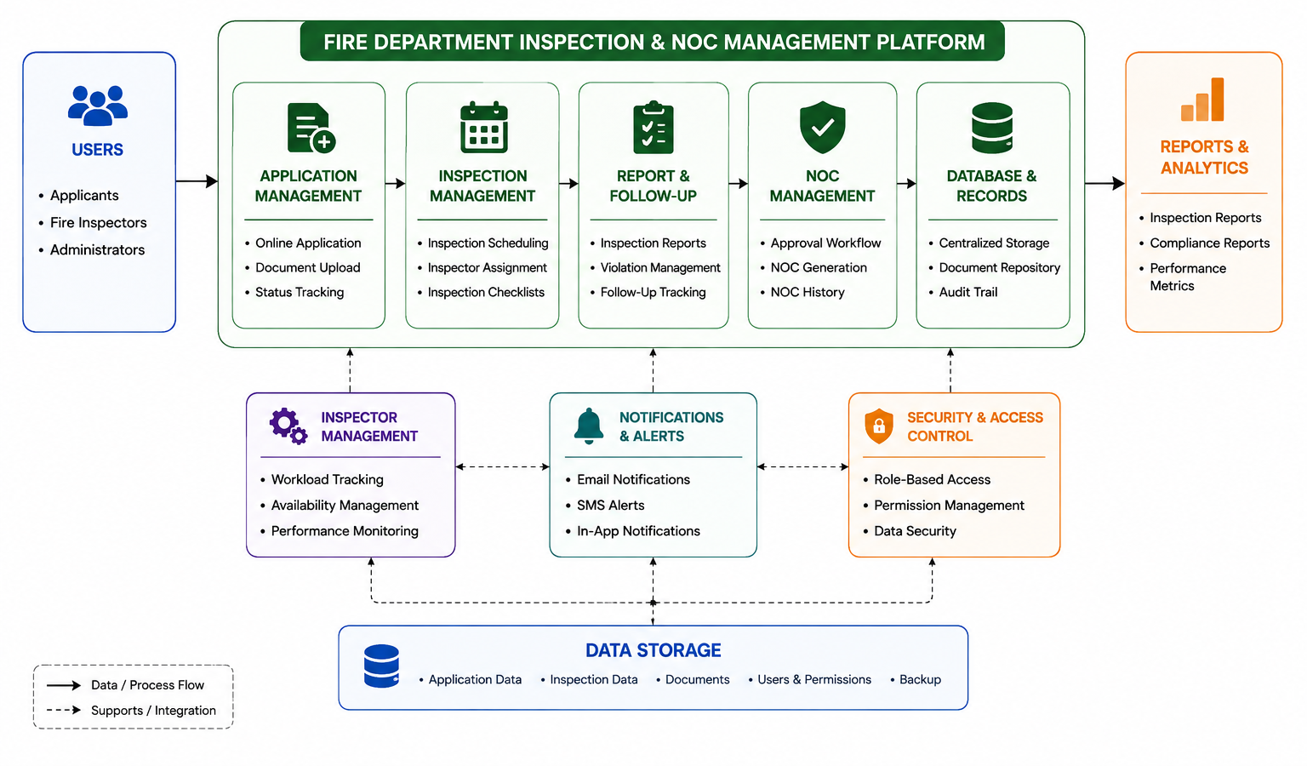
Proposed System

Slide 6
Conclusion
The proposed Fire Department Inspection & NOC Management System aims to digitize and streamline the complete fire NOC process, from application and inspection to approval and follow-up. By introducing risk-based inspection prioritization, smart inspector management, centralized records, and real-time tracking, the system can reduce delays, improve transparency, and make fire safety administration more efficient.

Slide 7
References
[1] K. Juliet, D. Divya, H. Veena, M. Manohar, and R. B. Rahul, “Real Time Monitoring and Evaluation Software for Application Received in Fire Department Relating to Inspections, Follow-Ups, Issue of NOCs,” International Research Journal of Modernization in Engineering Technology and Science, vol. 7, no. 12, Dec. 2025.
[2] A. Garg, A. Kaur, and H. Dangi, “Outsourcing of Fire Inspection Services: An Analytical Approach,” Asian Journal of Water, Environment and Pollution, vol. 21, no. 6, pp. 189–194, 2024.
[3] J. A. Vanlandingham, Developing an Effective Fire Inspection Program, Executive Fire Officer Research Paper, National Fire Academy, Chambersburg Fire Department, Pennsylvania, Jan. 2006.

Slide 8
Thank you

