Slide 1
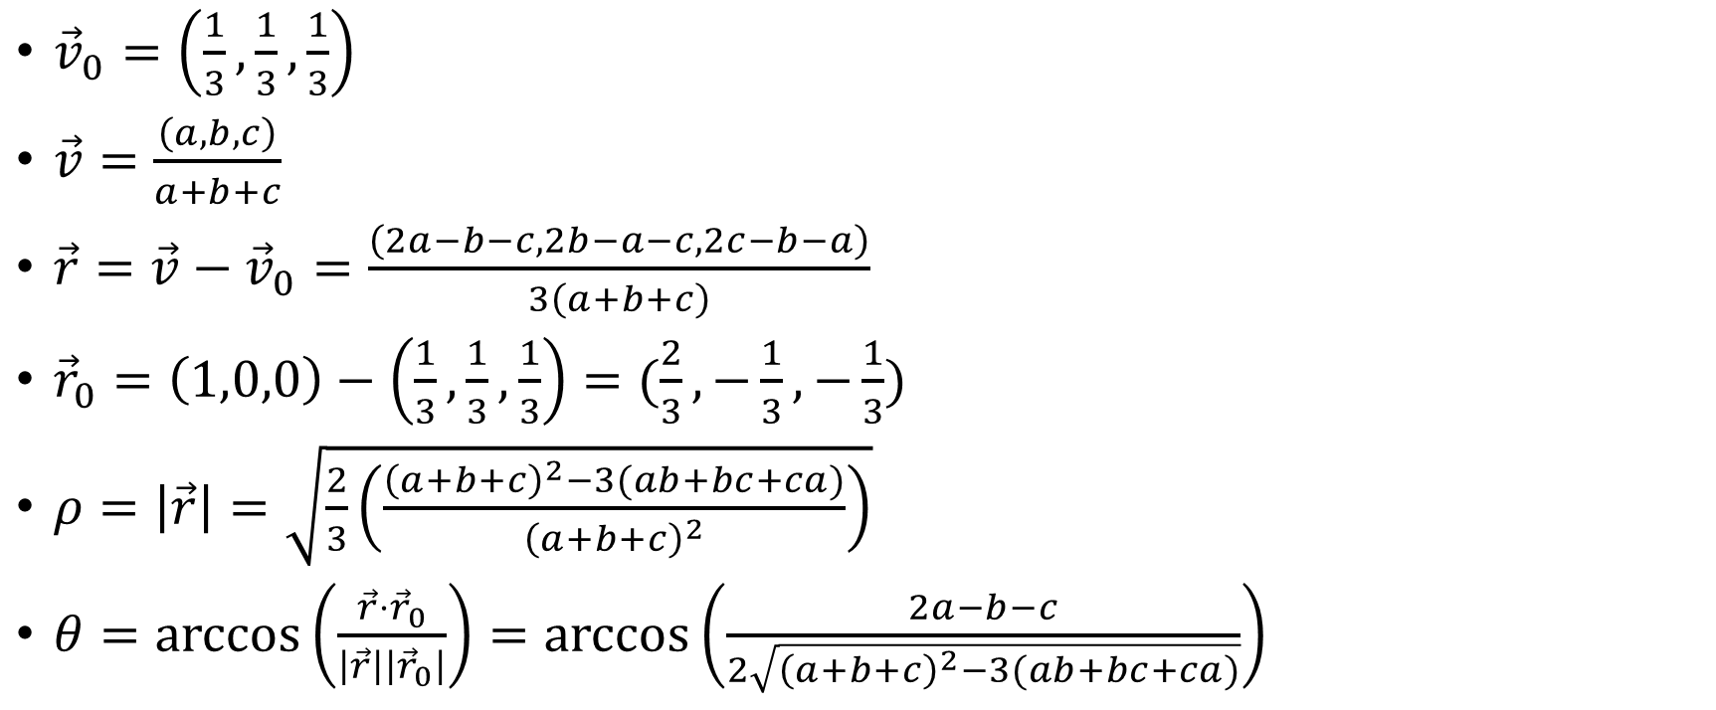
${\vec{v}}_{0}=\left(\frac{1}{3},\frac{1}{3},\frac{1}{3}\right)$
$\vec{v}=\frac{\left(a,b,c\right)}{a+b+c}$
$\vec{r}=\vec{v}−{\vec{v}}_{0}=\frac{\left(2a−b−c,2b−a−c,2c−b−a\right)}{3\left(a+b+c\right)}$
${\vec{r}}_{0}=\left(1,0,0\right)−\left(\frac{1}{3},\frac{1}{3},\frac{1}{3}\right)=(\frac{2}{3},−\frac{1}{3},−\frac{1}{3})$
$ρ=\left|\vec{r}\right|=\sqrt{\frac{2}{3}\left(\frac{{\left(a+b+c\right)}^{2}−3(ab+bc+ca)}{{\left(a+b+c\right)}^{2}}\right)}$
$θ=\arccos\left(\frac{\vec{r}⋅{\vec{r}}_{0}}{\left|\vec{r}\right|\left|{\vec{r}}_{0}\right|}\right)=\arccos\left(\frac{2a−b−c}{2\sqrt{{\left(a+b+c\right)}^{2}−3(ab+bc+ca)}}\right)$

