Slide 1
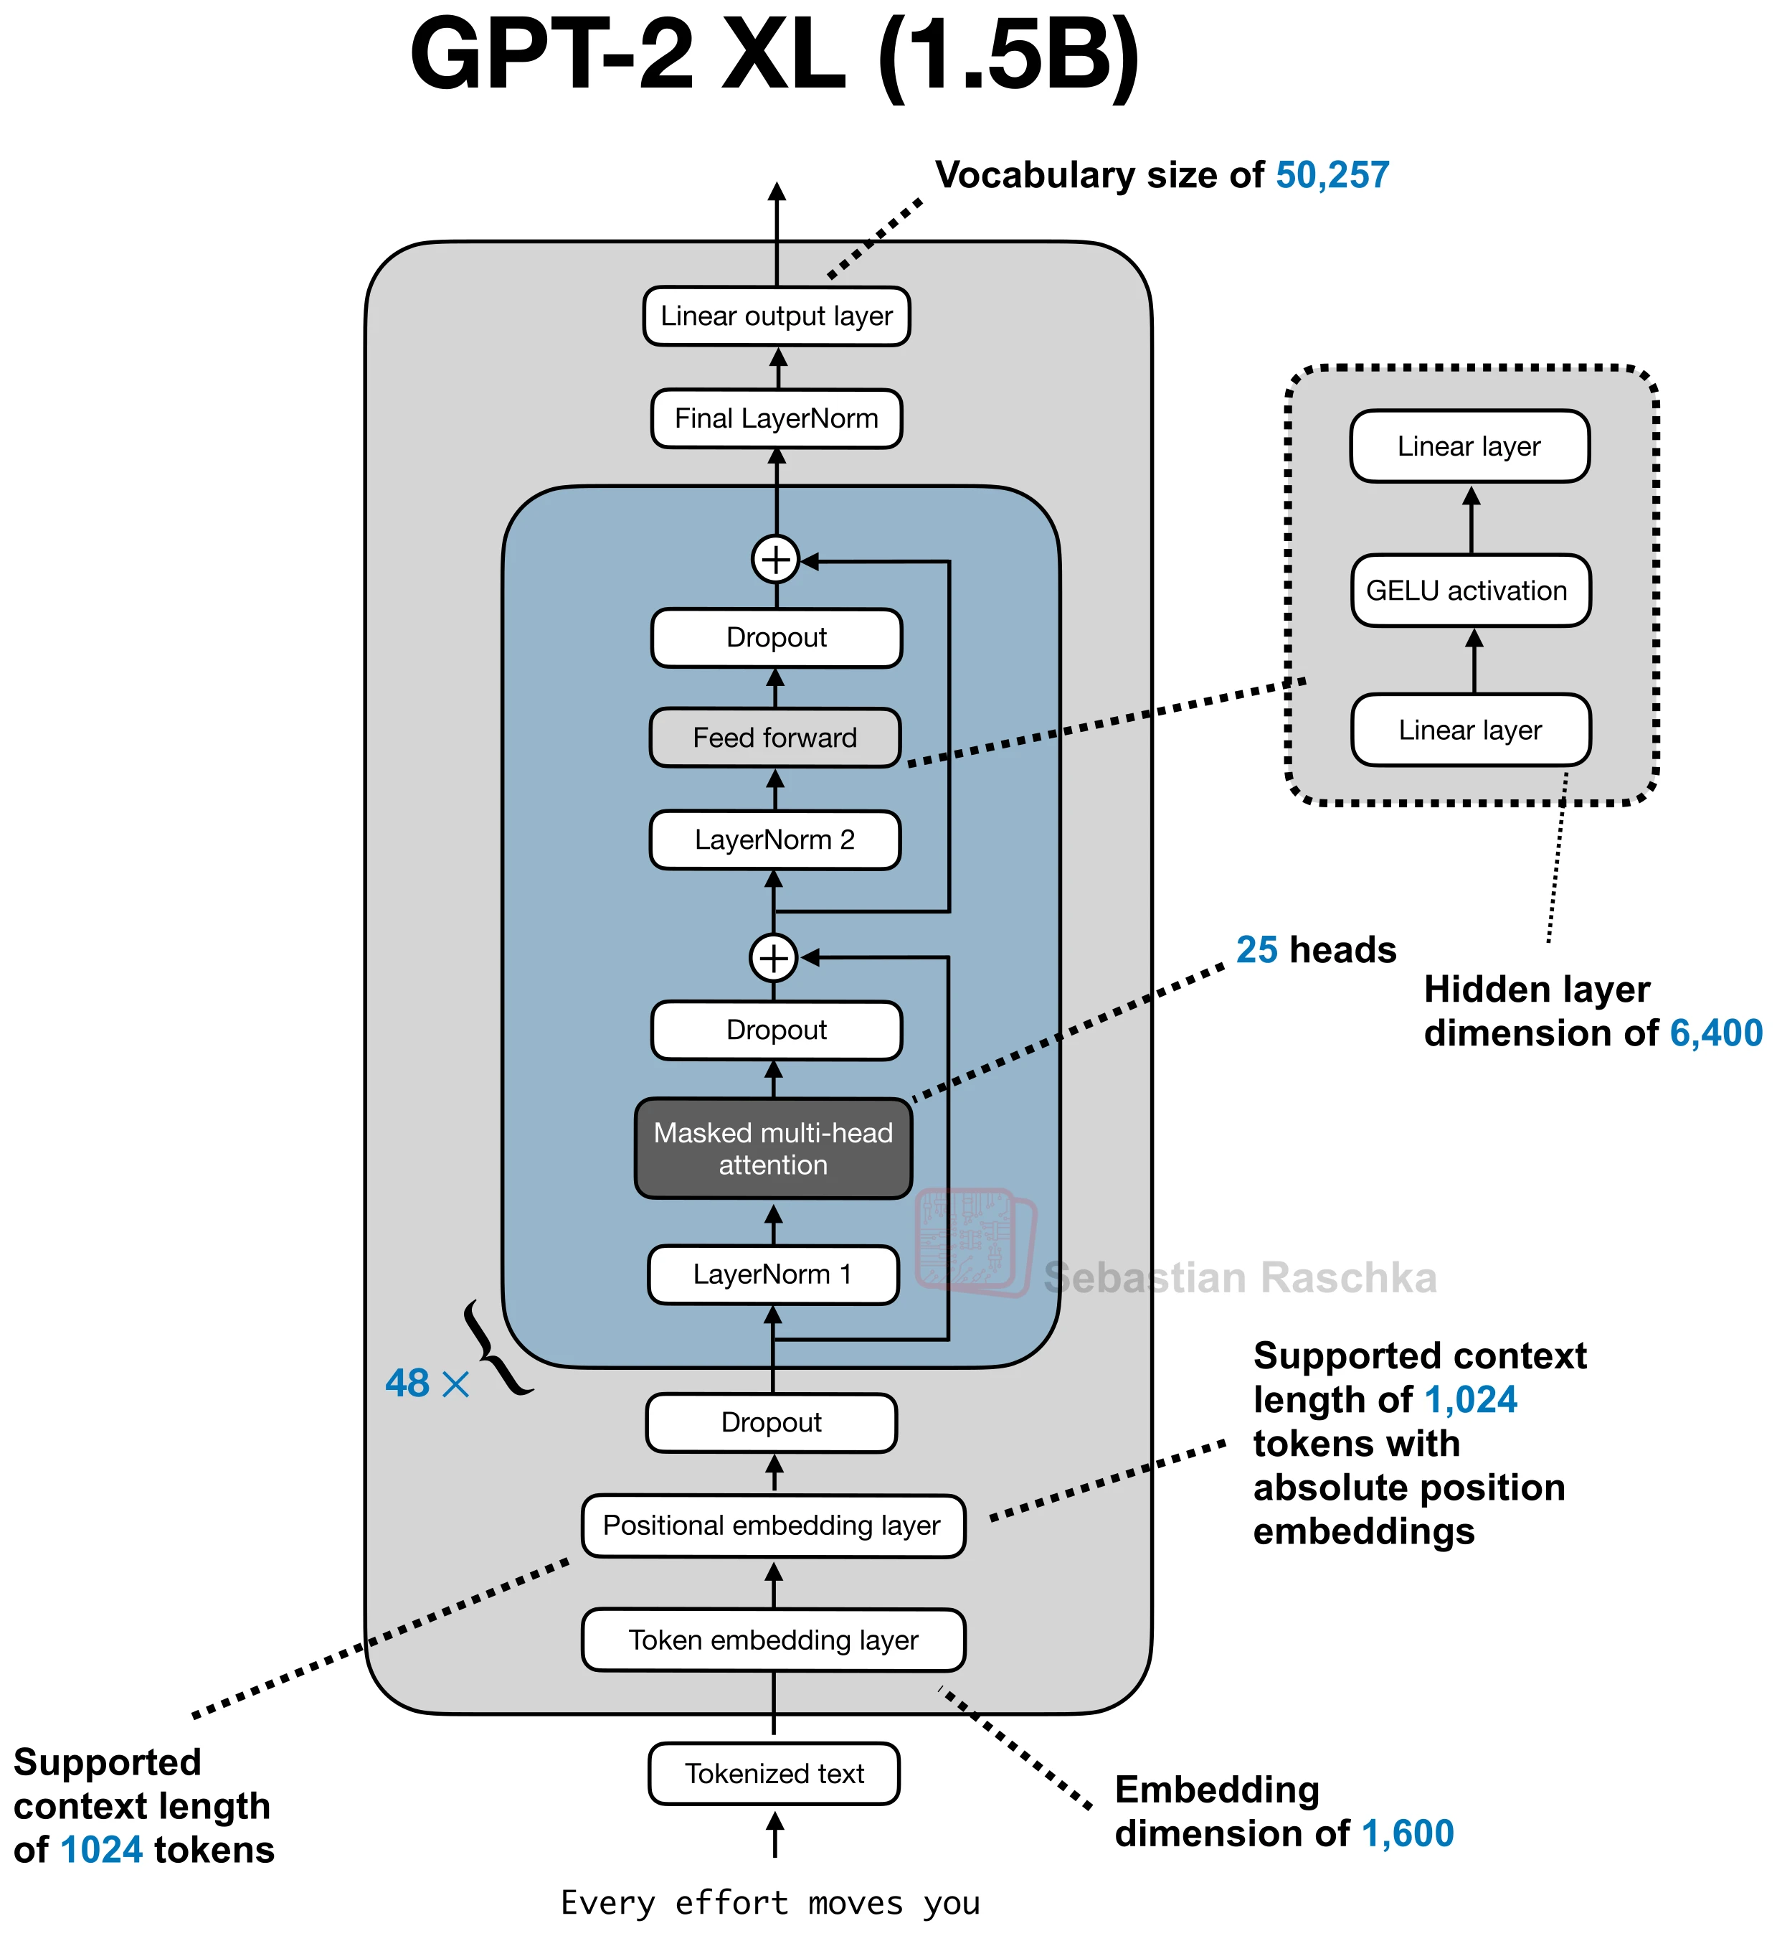
LLM Architecture Components
One-slide roadmap: from embeddings and positional structure to attention, normalization, and feed-forward variants used in modern LLMs
Positional Embedding
Attention
Decide how token order is represented.
Govern token-token interaction patterns and efficiency.
SPE (Sinusoidal Positional Embedding)
RoPE (Rotary Positional Embedding)
ALiBi (Attention with Linear Biases)
MHA (Multi-Head Attention)
SDPA (Scaled Dot-Product Attention)
MQA (Multi-Query Attention)
GQA (Grouped-Query Attention)
MLA (Multi-Head Latent Attention)
SWA (Sliding Window Attention)
Gated Attention
Hybrid Attention
KV Cache
Normalization
Control training stability.
Dropout
LayerNorm
RMSNorm
QK-Norm
Feed Forward Network (FFN)
Determines per-token nonlinear transformation.
Fully-connected FFN
Mixture-of-Experts
Activations (GELU, SiLU, SwiGLU)
Notation used throughout
B=batch • T=sequence length • d=model dim • H=number of heads • d_h=per-head dim • G=KV groups • r=latent rank • E=experts • k=top-k routed experts
References: https://sebastianraschka.com/llm-architecture-gallery/

Slide 2
Positional Embedding
Position & order
The original Transformer paper uses fixed sinusoidal positional encodings, added to token embeddings at the bottoms of the encoder and decoder stacks.
Math formula / tensor contract
PyTorch implementation
1 class SinusoidalPositionalEncoding(nn.Module): 2 def __init__(self, d, max_len=5000): 3 super().__init__() 4 position = torch.arange(max_len).unsqueeze(1) 5 div_term = torch.exp( 6 torch.arange(0, d, 2) * (-torch.log(torch.tensor(10000.0)) / d) 7 ) 8 pe = torch.zeros(max_len, d) 9 pe[:, 0::2] = torch.sin(position * div_term) 10 pe[:, 1::2] = torch.cos(position * div_term) 11 self.register_buffer('pe', pe.unsqueeze(0)) 12 13 def forward(self, tok_emb): 14 tok_emb = tok_emb * (tok_emb.size(-1) ** 0.5) 15 return tok_emb + self.pe[:, :tok_emb.size(1)]
In Attention Is All You Need, the stack input is √d · token_embedding + PE, with PE shared across the batch.
Shape-aware diagram
Shapes: token ids [B,T], token embeddings [B,T,d], sinusoidal PE table [T,d], stack input [B,T,d].
Introduced in: Vaswani et al., Attention Is All You Need (2017) • Used in: GPT-2, BERT, GPT-3

Slide 3
RoPE (Rotary Position Embeddings)
Position & order
Rotates paired Q/K coordinates by position-dependent angles, turning dot products into a relative-position-aware similarity measure.
Math formula / tensor contract
PyTorch implementation
1 def apply_rope(x, cos, sin): 2 x1, x2 = x[..., ::2], x[..., 1::2] 3 rot = torch.stack((-x2, x1), dim=-1).flatten(-2) 4 return x * cos + rot * sin 5 6 q = apply_rope(q, cos, sin) # [B,H,T,d_h] 7 k = apply_rope(k, cos, sin) # [B,H,T,d_h]
RoPE is applied after Q/K projection and before computing attention scores.
Shape-aware diagram
Shapes: Q,K [B,H,T,d_h], angle table [T,d_h/2], rotated Q/K keep the same shape, scores [B,H,T,T].
Introduced in: Su et al., RoFormer (2021) • Used in: LLaMA/Llama 2/3, DeepSeek-V2/V3

Slide 4
ALiBi (Attention with Linear Biases)
Position & order
Adds a head-specific linear distance penalty directly to attention scores so the model can represent recency bias without explicit positional vectors.
Math formula / tensor contract
PyTorch implementation
1 def alibi_attention(q, k, v, slopes): 2 B, H, T, D = q.shape 3 pos = torch.arange(T, device=q.device) 4 dist = (pos[:, None] - pos[None, :]).clamp_min(0) # [T,T] 5 bias = -slopes[:, None, None] * dist.unsqueeze(0) # [H,T,T] 6 scores = q @ k.transpose(-2, -1) / D ** 0.5 7 scores = scores + bias.unsqueeze(0) 8 weights = scores.softmax(dim=-1) 9 return weights @ v
Different heads use different slopes m_h, giving a spectrum from local to more global attention bias.
Shape-aware diagram
Shapes: Q,K [B,H,T,d_h], raw scores [B,H,T,T], ALiBi bias [H,T,T], biased scores [B,H,T,T].
Introduced in: Press et al., Train Short, Test Long (2021) • Used in: BLOOM, MPT

Slide 5
Dropout
Normalization & score shaping
Randomly drops activations during training and rescales the survivors, reducing co-adaptation and overfitting.
Math formula / tensor contract
PyTorch implementation
1 class DropoutBlock(nn.Module): 2 def __init__(self, p=0.1): 3 super().__init__() 4 self.drop = nn.Dropout(p) 5 6 def forward(self, x): 7 return self.drop(x)
At evaluation time, dropout is disabled and the identity map is used.
Shape-aware diagram
Shapes: x, mask, y all share the same tensor shape, often [B,T,d] or [B,H,T,T] in attention dropout.
Introduced in: Srivastava et al., Dropout (2014) • Used in: Transformer, BERT, GPT-2

Slide 6
LayerNorm
Normalization & score shaping
Normalizes each token across its feature dimension using mean and variance, then applies learned affine parameters.
Math formula / tensor contract
PyTorch implementation
1 class LayerNormLastDim(nn.Module): 2 def __init__(self, d, eps=1e-5): 3 super().__init__() 4 self.gamma = nn.Parameter(torch.ones(d)) 5 self.beta = nn.Parameter(torch.zeros(d)) 6 self.eps = eps 7 8 def forward(self, x): 9 mean = x.mean(dim=-1, keepdim=True) 10 var = x.var(dim=-1, keepdim=True, unbiased=False) 11 x_hat = (x - mean) / torch.sqrt(var + self.eps) 12 return self.gamma * x_hat + self.beta
In Transformers, μ and σ² are computed over the last dimension d for each token independently.
Shape-aware diagram
Shapes: x,y [B,T,d]; mean and variance are [B,T,1]; γ and β are [d].
Introduced in: Ba et al., Layer Normalization (2016) • Used in: Transformer, BERT, GPT-2, OPT

Slide 7
RMSNorm
Normalization & score shaping
Normalizes only by root-mean-square magnitude and omits mean subtraction, which is cheaper and popular in modern LLMs.
Math formula / tensor contract
PyTorch implementation
1 class RMSNorm(nn.Module): 2 def __init__(self, d, eps=1e-6): 3 super().__init__() 4 self.weight = nn.Parameter(torch.ones(d)) 5 self.eps = eps 6 7 def forward(self, x): 8 rms = torch.rsqrt(x.pow(2).mean(dim=-1, keepdim=True) + self.eps) 9 return x * rms * self.weight
RMSNorm keeps the direction of x but rescales its RMS magnitude on the last dimension.
Shape-aware diagram
Shapes: x,y [B,T,d]; rms factor [B,T,1]; learned scale γ [d].
Introduced in: Zhang & Sennrich, RMSNorm (2019) • Used in: LLaMA/Llama 2, Mistral, OpenELM

Slide 8
Scaled Dot-Product Attention
Attention & inference
The core attention operator: compare queries against keys, normalize with softmax, then aggregate values.
Math formula / tensor contract
PyTorch implementation
1 def scaled_dot_product_attention(q, k, v, mask=None): 2 d_h = q.size(-1) 3 scores = q @ k.transpose(-2, -1) / d_h ** 0.5 4 if mask is not None: 5 scores = scores.masked_fill(mask, float('-inf')) 6 weights = scores.softmax(dim=-1) 7 return weights @ v
The mask M is often causal and/or padded; scores are normalized along the key axis.
Shape-aware diagram
Shapes: Q [B,H,T_q,d_h], K [B,H,T_k,d_h], V [B,H,T_k,d_v], output [B,H,T_q,d_v].
Introduced in: Vaswani et al., Attention Is All You Need (2017) • Used in: BERT, GPT-2, Llama 2/3

Slide 9
Multi-Head Attention (MHA)
Attention & inference
Projects Q/K/V into multiple subspaces, runs attention independently in each head, then concatenates the results.
Math formula / tensor contract
PyTorch implementation
1 class MultiHeadAttention(nn.Module): 2 def __init__(self, d, num_heads): 3 super().__init__() 4 self.h = num_heads 5 self.d_h = d // num_heads 6 self.qkv = nn.Linear(d, 3 * d) 7 self.out = nn.Linear(d, d) 8 9 def forward(self, x): 10 B, T, D = x.shape 11 q, k, v = self.qkv(x).chunk(3, dim=-1) 12 q = q.view(B, T, self.h, self.d_h).transpose(1, 2) 13 k = k.view(B, T, self.h, self.d_h).transpose(1, 2) 14 v = v.view(B, T, self.h, self.d_h).transpose(1, 2) 15 y = scaled_dot_product_attention(q, k, v) 16 y = y.transpose(1, 2).reshape(B, T, D) 17 return self.out(y)
Each head gets its own learned projections and can specialize to different patterns.
Shape-aware diagram
Shapes: X [B,T,d], Q/K/V [B,H,T,d_h], concat [B,T,H·d_h], projected output [B,T,d].
Introduced in: Vaswani et al., Attention Is All You Need (2017) • Used in: Transformer, BERT, GPT-2/3

Slide 10
Multi-Query Attention (MQA)
Attention & inference
Uses many query heads but a single shared key/value head, giving the smallest KV cache among standard attention-sharing variants.
Math formula / tensor contract
PyTorch implementation
1 class MultiQueryAttention(nn.Module): 2 def __init__(self, d, num_heads): 3 super().__init__() 4 self.h = num_heads 5 self.d_h = d // num_heads 6 self.wq = nn.Linear(d, num_heads * self.d_h) 7 self.wk = nn.Linear(d, self.d_h) 8 self.wv = nn.Linear(d, self.d_h) 9 10 def forward(self, x): 11 B, T, _ = x.shape 12 q = self.wq(x).view(B, T, self.h, self.d_h).transpose(1, 2) 13 k = self.wk(x).unsqueeze(1) # [B,1,T,d_h] 14 v = self.wv(x).unsqueeze(1) 15 y = scaled_dot_product_attention(q, k.expand(-1, self.h, -1, -1), v.expand(-1, self.h, -1, -1)) 16 return y
MQA is the extreme sharing case: all query heads reuse the same K and V tensors.
Shape-aware diagram
Shapes: Q [B,H,T,d_h], K/V [B,1,T,d_h], expanded shared KV [B,H,T,d_h], output [B,T,d].
Introduced in: Shazeer, Fast Transformer Decoding (2019) • Used in: PaLM, Falcon, StarCoder

Slide 11
Grouped-Query Attention (GQA)
Attention & inference
Uses many query heads but fewer K/V groups, reducing KV-cache memory and decode bandwidth while keeping more query diversity than MQA.
Math formula / tensor contract
PyTorch implementation
1 class GroupedQueryAttention(nn.Module): 2 def __init__(self, d, num_q_heads, num_kv_groups): 3 super().__init__() 4 self.h = num_q_heads 5 self.g = num_kv_groups 6 self.d_h = d // num_q_heads 7 self.wq = nn.Linear(d, self.h * self.d_h) 8 self.wk = nn.Linear(d, self.g * self.d_h) 9 self.wv = nn.Linear(d, self.g * self.d_h) 10 11 def forward(self, x): 12 B, T, _ = x.shape 13 q = self.wq(x).view(B, T, self.h, self.d_h).transpose(1, 2) 14 k = self.wk(x).view(B, T, self.g, self.d_h).transpose(1, 2) 15 v = self.wv(x).view(B, T, self.g, self.d_h).transpose(1, 2) 16 repeat = self.h // self.g 17 k = k.repeat_interleave(repeat, dim=1) 18 v = v.repeat_interleave(repeat, dim=1) 19 return scaled_dot_product_attention(q, k, v)
Query head h maps to one KV group g(h); each group is shared across several heads.
Shape-aware diagram
Shapes: Q [B,H,T,d_h], K/V [B,G,T,d_h], repeated KV after sharing [B,H,T,d_h], output [B,T,d].
Introduced in: Ainslie et al., GQA (2023) • Used in: Llama 2 70B, Llama 3, OpenELM

Slide 12
Multi-Head Latent Attention (MLA)
Attention & inference
Compresses KV information into a lower-rank latent state, then reconstructs or expands head-specific K/V features from that compact cache.
Math formula / tensor contract
PyTorch implementation
1 class LatentAttention(nn.Module): 2 def __init__(self, d, num_heads, latent_rank): 3 super().__init__() 4 self.h = num_heads 5 self.d_h = d // num_heads 6 self.wq = nn.Linear(d, num_heads * self.d_h) 7 self.wc = nn.Linear(d, latent_rank) 8 self.wk = nn.Linear(latent_rank, num_heads * self.d_h) 9 self.wv = nn.Linear(latent_rank, num_heads * self.d_h) 10 11 def forward(self, x): 12 B, T, _ = x.shape 13 q = self.wq(x).view(B, T, self.h, self.d_h).transpose(1, 2) 14 c = self.wc(x) # [B,T,r] 15 k = self.wk(c).view(B, T, self.h, self.d_h).transpose(1, 2) 16 v = self.wv(c).view(B, T, self.h, self.d_h).transpose(1, 2) 17 return scaled_dot_product_attention(q, k, v)
The exact DeepSeek implementation is more detailed; this slide shows the core low-rank compression idea.
Shape-aware diagram
Shapes: X [B,T,d], latent cache C [B,T,r], Q [B,H,T,d_h], reconstructed K/V [B,H,T,d_h or d_v].
Introduced in: DeepSeek-AI, DeepSeek-V2 (2024) • Used in: DeepSeek-V2, DeepSeek-V3, DeepSeek-R1

Slide 13
Sliding Window Attention (SWA)
Attention & inference
Restricts each token to attend only to a local window of nearby keys, improving long-context efficiency by sparsifying the attention pattern.
Math formula / tensor contract
PyTorch implementation
1 def sliding_window_attention(q, k, v, window): 2 T = q.size(-2) 3 scores = q @ k.transpose(-2, -1) / q.size(-1) ** 0.5 4 idx = torch.arange(T, device=q.device) 5 too_old = idx[None, :] < (idx[:, None] - window + 1) 6 causal = idx[None, :] > idx[:, None] 7 mask = too_old | causal 8 scores = scores.masked_fill(mask, float('-inf')) 9 return scores.softmax(dim=-1) @ v
The local window size w replaces full O(T²) connectivity with a banded pattern.
Shape-aware diagram
Shapes: Q/K/V [B,H,T,d_h], local scores [B,H,T,w], output [B,H,T,d_h].
Introduced in: Beltagy et al., Longformer (2020) • Used in: Longformer, Mistral 7B

Slide 14
KV Cache
Attention & inference
Stores past keys and values during autoregressive decoding so each new token only computes attention against the growing cache instead of recomputing old projections.
Math formula / tensor contract
PyTorch implementation
1 def decode_step(x_t, k_cache, v_cache, wq, wk, wv): 2 q_t = wq(x_t) # [B,H,1,d_h] 3 k_t = wk(x_t) 4 v_t = wv(x_t) 5 k_cache = torch.cat([k_cache, k_t], dim=-2) # [B,H,t,d_h] 6 v_cache = torch.cat([v_cache, v_t], dim=-2) 7 y_t = scaled_dot_product_attention(q_t, k_cache, v_cache) 8 return y_t, k_cache, v_cache
At decode step t, the query has sequence length 1 while the cached K/V length grows with t.
Shape-aware diagram
Shapes: x_t [B,1,d], q_t [B,H,1,d_h], cached K/V [B,H,t,d_h], output y_t [B,H,1,d_h].
Introduced in: Vaswani et al., Attention Is All You Need (2017); fast-decoding analysis in Shazeer (2019) • Used in: GPT-2/3, Llama 2/3, DeepSeek

Slide 15
QK-Norm
Normalization & score shaping
Normalizes query and key vectors before the dot product, controlling score magnitude and often improving optimization stability.
Math formula / tensor contract
PyTorch implementation
1 def qk_norm_attention(q, k, v, scale): 2 q = F.normalize(q, p=2, dim=-1) 3 k = F.normalize(k, p=2, dim=-1) 4 scores = scale * (q @ k.transpose(-2, -1)) 5 weights = scores.softmax(dim=-1) 6 return weights @ v
A learned scalar s or per-head scale often replaces the usual 1/√d_h factor.
Shape-aware diagram
Shapes: Q,K [B,H,T,d_h], normalized Q/K same shape, scores [B,H,T,T], output [B,H,T,d_v].
Introduced in: Henry et al., Query-Key Normalization for Transformers (2020) • Used in: OLMo 2, Chameleon

Slide 16
Mixture-of-Experts (MoE)
Sparse capacity
Routes each token to a small subset of experts so the model gets high total capacity while activating only a few feed-forward blocks per token.
Math formula / tensor contract
PyTorch implementation
1 class SimpleMoE(nn.Module): 2 def __init__(self, d, d_hidden, num_experts, k=2): 3 super().__init__() 4 self.router = nn.Linear(d, num_experts) 5 self.experts = nn.ModuleList([ 6 nn.Sequential(nn.Linear(d, d_hidden), nn.GELU(), nn.Linear(d_hidden, d)) 7 for _ in range(num_experts) 8 ]) 9 self.k = k 10 11 def forward(self, x): 12 gates = self.router(x).softmax(dim=-1) 13 topw, topi = gates.topk(self.k, dim=-1) 14 out = 0 15 for weight, idx in zip(topw.unbind(-1), topi.unbind(-1)): 16 expert_out = torch.stack([self.experts[j](x[n]) for n, j in enumerate(idx.view(-1))]) 17 out = out + weight.unsqueeze(-1) * expert_out.view_as(x) 18 return out
A shared expert path is sometimes added on top of the routed experts in modern sparse LLMs.
Shape-aware diagram
Shapes: x [B,T,d], router logits [B,T,E], top-k weights [B,T,k], expert outputs [B,T,d], final y [B,T,d].
Introduced in: Jacobs et al., Adaptive Mixtures of Local Experts (1991); Transformer-scale MoE: Shazeer et al. (2017) • Used in: Switch Transformer, Mixtral, DeepSeek-V2/V3

Slide 17
GELU
Activations & gated MLPs
A smooth nonlinearity that keeps small negative values instead of hard-clipping them like ReLU.
Math formula / tensor contract
PyTorch implementation
1 class GELUActivation(nn.Module): 2 def forward(self, x): 3 return F.gelu(x) 4 5 # or explicitly 6 # y = 0.5 * x * (1.0 + torch.tanh(math.sqrt(2 / math.pi) * (x + 0.044715 * x**3)))
Widely used in feed-forward blocks of GPT/BERT-style Transformers.
Shape-aware diagram
Shapes: pointwise activation on x and y with identical shape, typically [*, d_ff].
Introduced in: Hendrycks & Gimpel, GELUs (2016) • Used in: BERT, GPT-2, Falcon

Slide 18
SiLU / Swish
Activations & gated MLPs
Multiplies each value by its sigmoid gate, giving a smooth self-gating activation widely used in modern gated MLPs.
Math formula / tensor contract
PyTorch implementation
1 class SiLUActivation(nn.Module): 2 def forward(self, x): 3 return F.silu(x) 4 5 # equivalent: 6 # y = x * torch.sigmoid(x)
SiLU often appears inside gated feed-forward blocks such as SwiGLU variants.
Shape-aware diagram
Shapes: pointwise activation on x and y with identical shape, typically [*, d_ff].
Introduced in: Elfwing et al., SiLU (2017); popularized as Swish by Ramachandran et al. (2017) • Used in: Inside SwiGLU in PaLM, Llama 2/3, Mistral

Slide 19
SwiGLU
Activations & gated MLPs
A gated feed-forward block that combines a SiLU gate branch with a value branch before projecting back to the model dimension.
Math formula / tensor contract
PyTorch implementation
1 class SwiGLU(nn.Module): 2 def __init__(self, d, d_ff): 3 super().__init__() 4 self.wg = nn.Linear(d, d_ff, bias=False) 5 self.wu = nn.Linear(d, d_ff, bias=False) 6 self.wo = nn.Linear(d_ff, d, bias=False) 7 8 def forward(self, x): 9 gate = F.silu(self.wg(x)) 10 up = self.wu(x) 11 return self.wo(gate * up)
SwiGLU is commonly used in modern Transformer MLPs because the gate improves expressivity at similar compute cost.
Shape-aware diagram
Shapes: x [B,T,d], gate/up [B,T,d_{ff}], gated product [B,T,d_{ff}], output [B,T,d].
Introduced in: Shazeer, GLU Variants Improve Transformer (2020) • Used in: PaLM, Llama 2/3, Mistral, OpenELM

