Slide 1
Recommendation using Reinforcement Learning

Slide 2





Kaitao Yang
<number>

Slide 3
Outline
Data Exploration
Reinforcement learning introduction
Multi-armed Bandit
Contextual Multi-armed Bandit
Future work

Slide 4
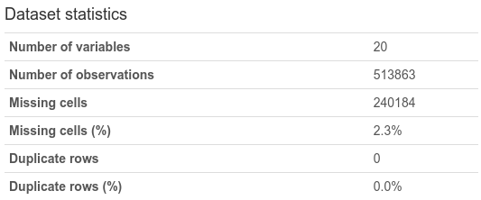
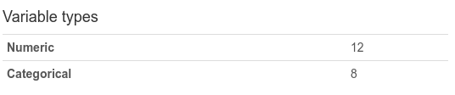
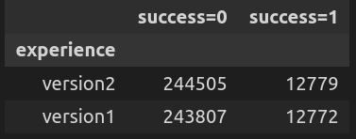
Data Exploration
Missing value ratio:
('20.99%', 'days_since_last_visit'),
('2.33%', 'year_home_built'),
('2.33%', 'net_worth'),
('2.33%', 'montrd_home_security_sys_own_value'),
('2.33%', 'mkt_trend_env_focused_hh_value'),
('2.33%', 'mkt_organic_product_purchasers_value'),
('2.33%', 'mkt_green_product_purchasers_value'),
('2.33%', 'length_of_residence'),
('2.33%', 'income'),
('2.33%', 'home_market_value'),
('2.33%', 'high_end_shoppers_value'),
('2.33%', 'do_it_yourselfer_value'),
('0.15%', 'zipcode'),
('0.0%', 'visit_id'),
('0.0%', 'success'),
('0.0%', 'repeat_visit'),
('0.0%', 'pro'),
('0.0%', 'new_movers'),
('0.0%', 'experience'),
('0.0%', 'date_time')
Click here for data_profiling_report.html

Slide 5
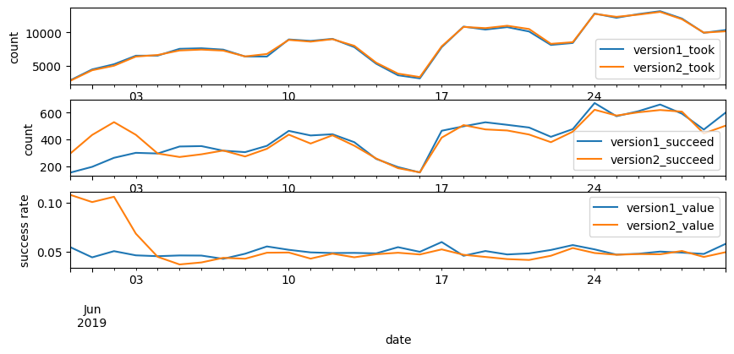
Data Exploration (continued)

Slide 6
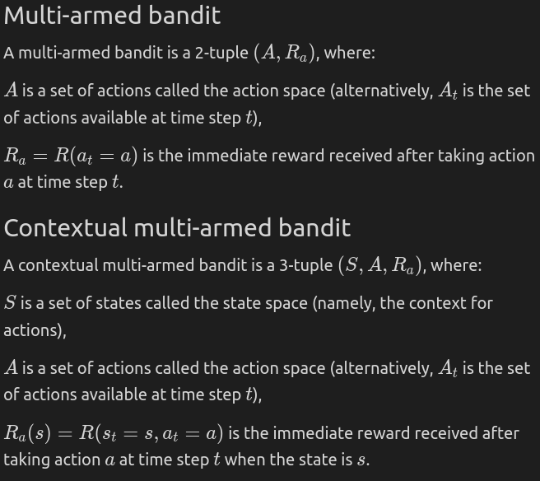




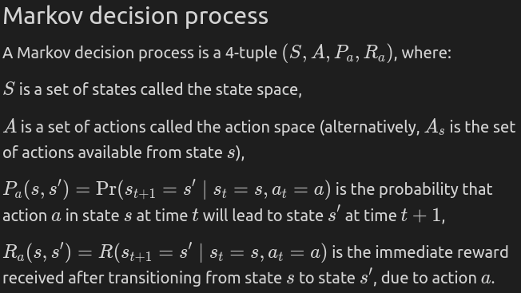
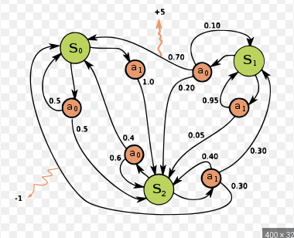
Reinforcement learning introduction
$AMarkovdecisionprocessisa4−tuple\left(S,A,P_{a},R_{a}\right),where:Sisasetofstatescalledthestatespace,Aisasetofactionscalledtheactionspace\left(alternatively,A_{s}A_{s}isthesetofactionsavailable | | statess\right),P_{a}\left(s,s'\right)=\left(s_{t+1}=s's_{t}=s,a_{t}=a\right)P_{a}\left(s,s'\right)=\left(s_{t+1}=s's_{t}=s,a_{t}=a\right)istheprobabilitythatactionaa∈statessattimettwillleadstates's'attimet+1t+1,R_{a}\left(s,s'\right)R_{a}\left(s,s'\right)istheimmediatereward\left(expectedimmediatereward\right)receivedaftertransitioningstatessstates's',dueactionaa$
...
Click here for: Reinforcement learning lecture notes

Slide 7
How to evaluate a policy?
Deterministic policy
Maximize the total number of success of n days
e.g., policy1: always choosing version1, leads to 12,772 success in given the dataset.
e.g., policy2: always choosing version 2 leads to 12,779 success.
Stochastic policy
Maximize the expectation of total number of success of n days (and minimize the variance of it)

Slide 8
Multi armed bandit (deterministic)
Time step: daily (we are free to choose other time granularity: e.g., weekly, hourly, etc.).
Policy3: at the current time step, choose an action (version1 or version 2) which had the higher success rate at the previous time step.
Result: 13,436 success in given the dataset (5.1% better than policy2).

Slide 9
Multi armed bandit (stochastic)
Policy4: the same as policy3, but .
Result: .

Slide 10
Contextual multi armed bandit
Policy: a model (e.g., a decision tree, or a logistic regression model) is used to predict the action based on state. At each time step, the model is trained using data of previous time step.
Result: 19,496 success using decision tree, 19,596 success (53.3% better than policy2) using logistic regression.

