Slide 1
Recommendation using Reinforcement Learning

Slide 2



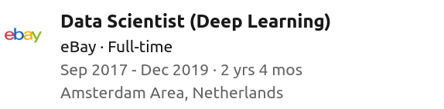

Kaitao Yang
<number>

Slide 3
Comparison of policies
ID | Policy | Number of success
1 | Always select `version1` | 12,772
2 | Always select `version2` | 12,779
3 | Choose an action (version1 or version2) which had the higher success rate yesterday | 13,436
4 | The same as policy #3, except that has ε=0.01 probability to uniform-randomly select an action. | mean: 13,427, std: 36
5 | Use a model to predict action (version1 or version2) based on new_movers, length_of_residence, model at time t is trained using data at time t-1. Model is a decision tree. | 19,496
6 | The same as policy #5 except that model is a logistic regression model. | 19,596
7 | Choose version1 if new_comer<=0.5 else version2 | 19,451

Slide 4
Outline
Data Exploration
Reinforcement learning introduction
Multi-armed Bandit
Contextual Multi-armed Bandit
Future work

Slide 5
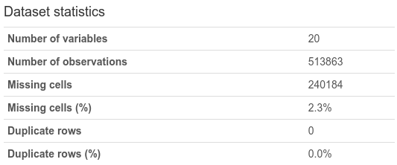
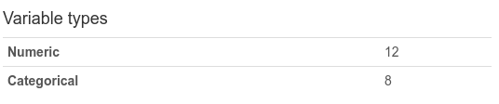
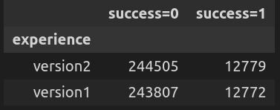
Data Exploration
Missing value ratio:
('20.99%', 'days_since_last_visit'),
('2.33%', 'year_home_built'),
('2.33%', 'net_worth'),
('2.33%', 'montrd_home_security_sys_own_value'),
('2.33%', 'mkt_trend_env_focused_hh_value'),
('2.33%', 'mkt_organic_product_purchasers_value'),
('2.33%', 'mkt_green_product_purchasers_value'),
('2.33%', 'length_of_residence'),
('2.33%', 'income'),
('2.33%', 'home_market_value'),
('2.33%', 'high_end_shoppers_value'),
('2.33%', 'do_it_yourselfer_value'),
('0.15%', 'zipcode'),
('0.0%', 'visit_id'),
('0.0%', 'success'),
('0.0%', 'repeat_visit'),
('0.0%', 'pro'),
('0.0%', 'new_movers'),
('0.0%', 'experience'),
('0.0%', 'date_time')
Click here for data_profiling_report.html

Slide 6
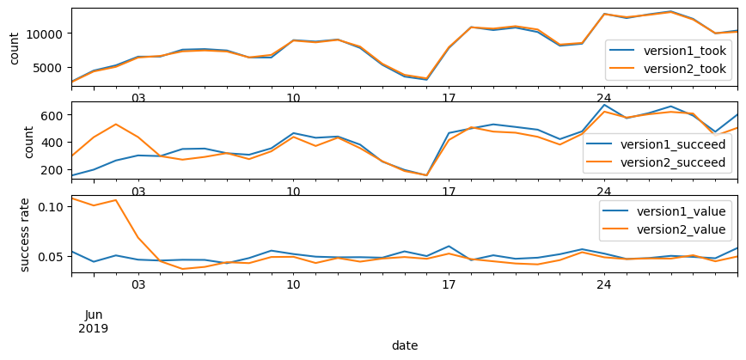
Data Exploration (continued)

Slide 7
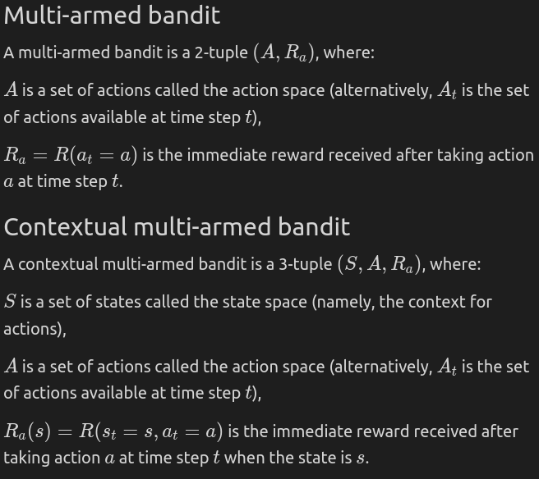
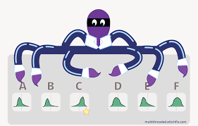

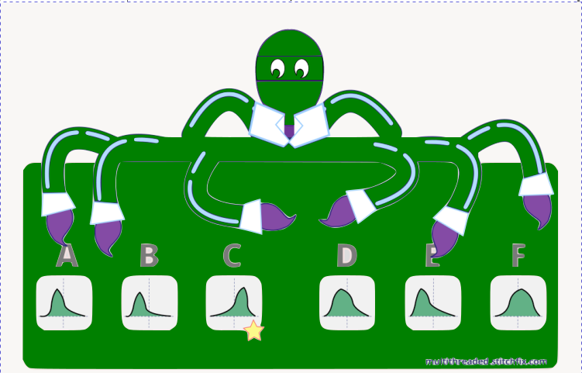
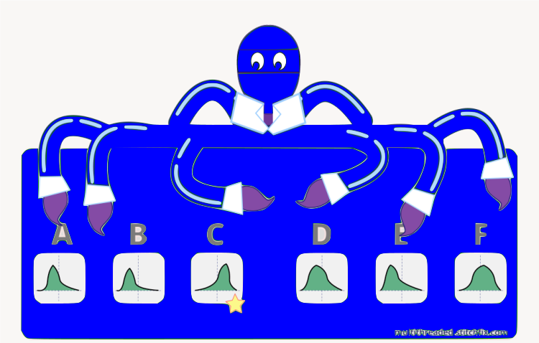
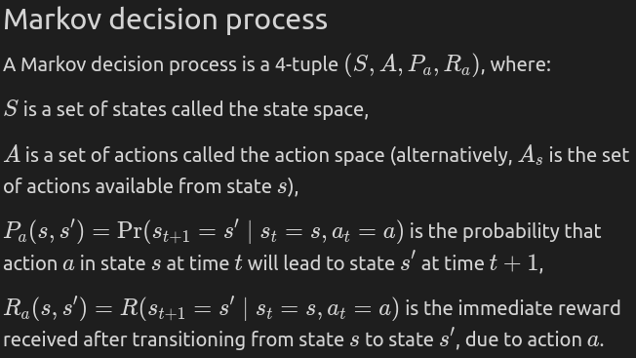
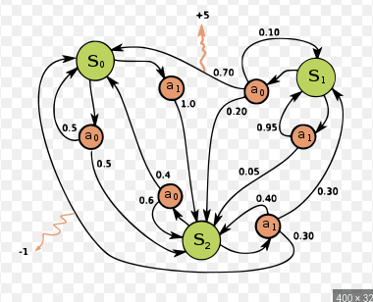
Reinforcement learning introduction
$AMarkovdecisionprocessisa4−tuple\left(S,A,P_{a},R_{a}\right),where:Sisasetofstatescalledthestatespace,Aisasetofactionscalledtheactionspace\left(alternatively,A_{s}A_{s}isthesetofactionsavailable | | statess\right),P_{a}\left(s,s'\right)=\left(s_{t+1}=s's_{t}=s,a_{t}=a\right)P_{a}\left(s,s'\right)=\left(s_{t+1}=s's_{t}=s,a_{t}=a\right)istheprobabilitythatactionaa∈statessattimettwillleadstates's'attimet+1t+1,R_{a}\left(s,s'\right)R_{a}\left(s,s'\right)istheimmediatereward\left(expectedimmediatereward\right)receivedaftertransitioningstatessstates's',dueactionaa$
...
Click here for: Reinforcement learning lecture notes

Slide 8
How to evaluate a policy?
Deterministic policy
Maximize the total number of success of n days
e.g., policy1: always choosing version1, leads to 12,772 success in given the dataset.
e.g., policy2: always choosing version2 leads to 12,779 success.
Stochastic policy
Maximize the expectation of total number of success of n days (and minimize the variance of it)

Slide 9
Multi armed bandit (deterministic, greedy action selection)
Time step: daily (we are free to choose other time granularity: e.g., weekly, hourly, etc.).
Policy3: choose an action (version1 or version2) which had the higher success rate yesterday.
Result: 13,436 success in given the dataset (5.1% better than policy2).
$\begin{aligned}Q_{t}\left(a\right)=\frac{\text{number of success when `a` taken at t-1}}{\text{number of times `a` taken at t-1}} \\ A_{t}=\underset{a}{argmax}Q_{t}\left(a\right)\end{aligned}$

Slide 10
Multi armed bandit (stochastic, ε-greedy action selection)
Policy4: the same as policy3, except that:
Result: mean: 13,427, std: 36, ε=0.01.
$A_{t}=\left\{\begin{aligned}\underset{a}{argmax}Q_{t}\left(a\right)\text{ with probability }1−ϵ \\ \text{a random action with probability }ϵ\end{aligned}\right.$

Slide 11
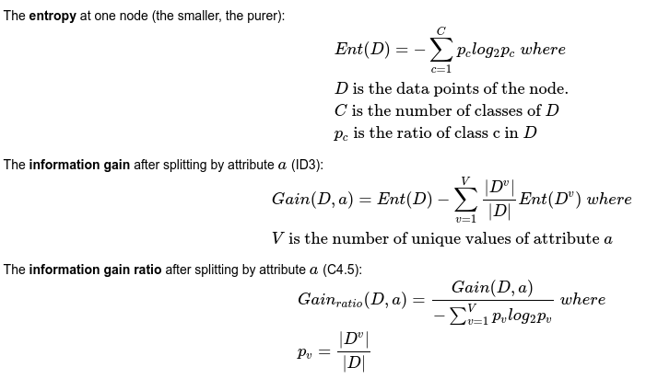
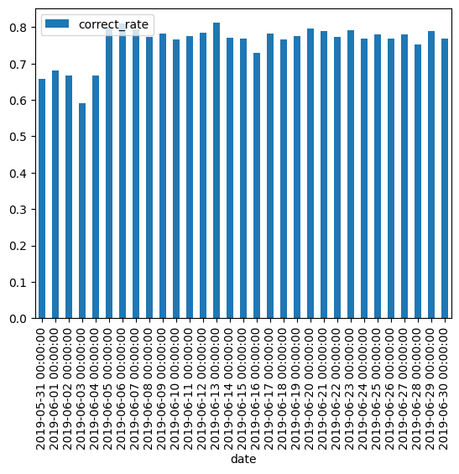
Contextual multi armed bandit (deterministic)
Policy: a model (e.g., a decision tree, or a logistic regression model) is used to predict the action based on state. At each time step, the model is trained using data of previous time step. At the first time step, the actions are randomly chosen from action set with equal probability.
Result: 19,496 success using decision tree, 19,596 success (53.3% better than policy2) using logistic regression.
information gain ratio:
(0.3012, 'length_of_residence'),
(0.2896, 'new_movers'),
(0.0683, 'visit_id'),
(0.0584, 'date_time'),
(0.0541, 'zipcode'),
(0.0459, 'year_home_built'),
(0.038, 'montrd_home_security_sys_own_value'),
(0.0347, 'mkt_green_product_purchasers_value'),
(0.0294, 'days_since_last_visit'),
(0.0222, 'mkt_organic_product_purchasers_value'),
(0.0176, 'mkt_trend_env_focused_hh_value'),
(0.0168, 'home_market_value'),
(0.0157, 'income'),
(0.0107, 'high_end_shoppers_value'),
(0.0071, 'net_worth'),
(0.0032, 'do_it_yourselfer_value'),
(0.0005, 'pro'),
(0.0002, 'repeat_visit')

Slide 12
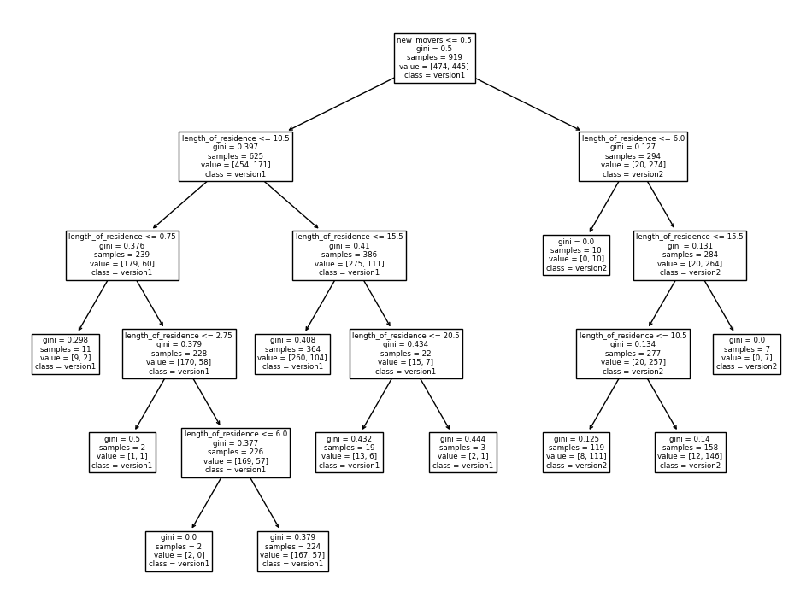
An example of the decision tree

Slide 13
A policy derived from decision tree
Policy: choose version1 if new_comer<=0.5 else version2
Result: 19,451 success (compared to 19,496 for the decision tree based model)

Slide 14
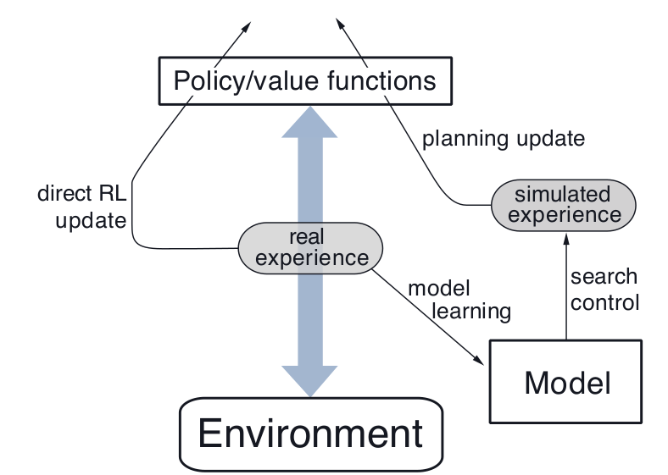
Future work
Make use of unsuccessful data points?
Dyna-Q
Try other time granularity (e.g., seconds, minutes, hours, days, weeks, etc.)
Try other definitions of action valuation function Qt(a).

Slide 15
The end
Thanks for your attention, I am open to questions.

