Slide 1
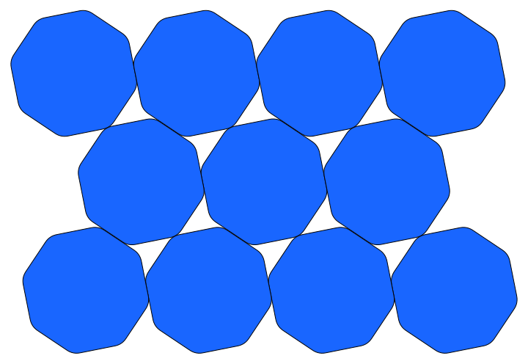
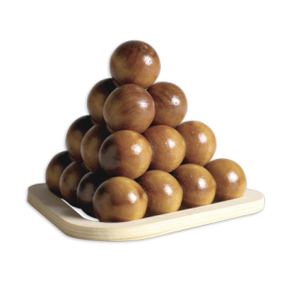
On Ulam's Packing Conjecture
Yoav Kallus
Princeton University
j/w: Fedor Nazarov
Kent University
APS March Meeting, Baltimore, Mar. 18, 2013

Slide 2
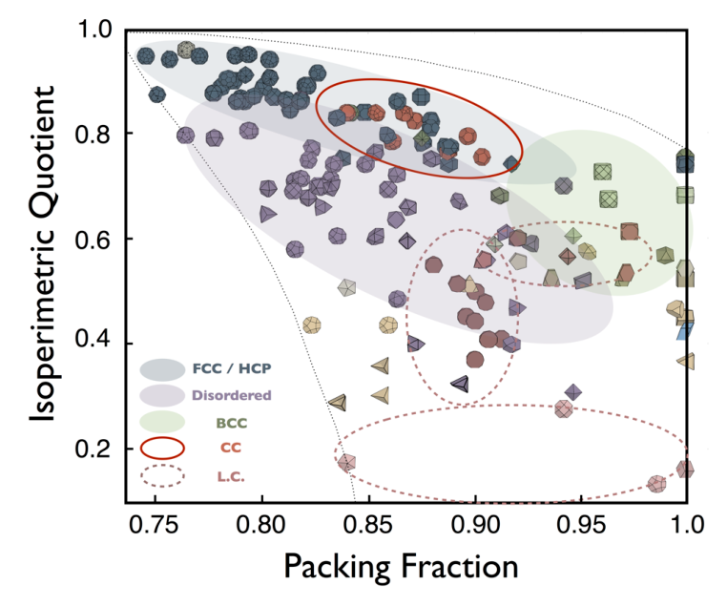
Damasceno, Engel & Glotzer (unpublished)

Slide 3
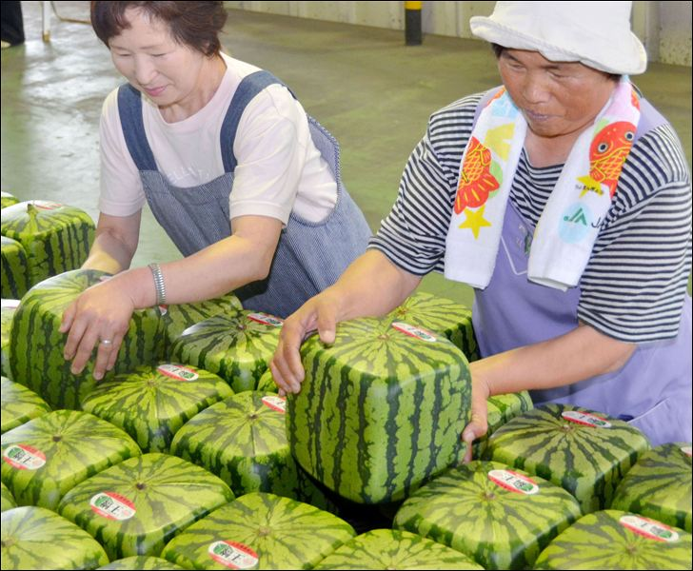
Best packing
shapes are
trivial

Slide 4
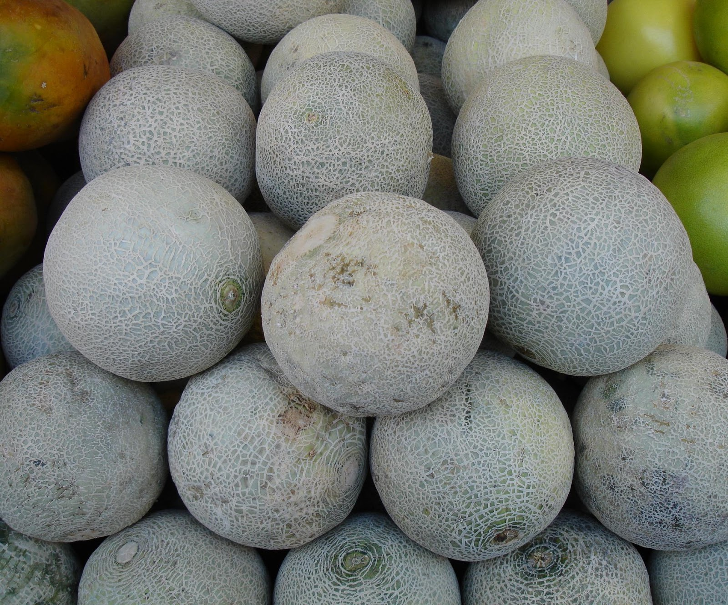
Best packing
shapes are
trivial
Worst packing
(convex) shape?

Slide 5
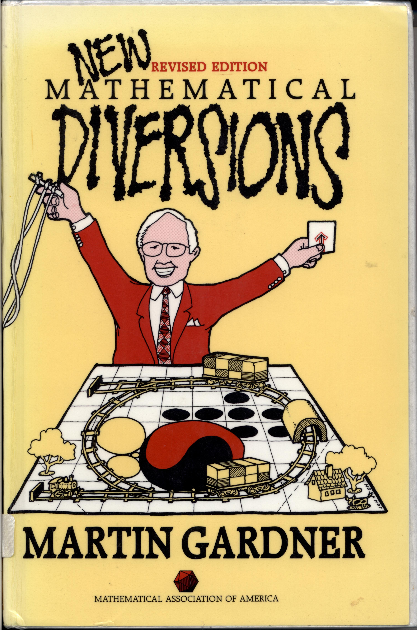
Ulam's Conjecture
“Stanislaw Ulam told me in
1972 that he suspected the
sphere was the worst case of
dense packing of identical
convex solids, but that this
would be difficult to prove,”
--- 1995 postscript to
“Packing Spheres”.

Slide 6
Ulam's “Last” Conjecture
“Stanislaw Ulam told me in
1972 that he suspected the
sphere was the worst case of
dense packing of identical
convex solids, but that this
would be difficult to prove,”
--- 1995 postscript to
“Packing Spheres”.

Slide 7
Ulam's “Last” Conjecture
“Stanislaw Ulam told me in
1972 that he suspected the
sphere was the worst case of
dense packing of identical
convex solids, but that this
would be difficult to prove,”
--- 1995 postscript to
“Packing Spheres”.
Naive motivation: sphere is the least free
solid (three degrees of freedom vs. six for
most solids).

Slide 8
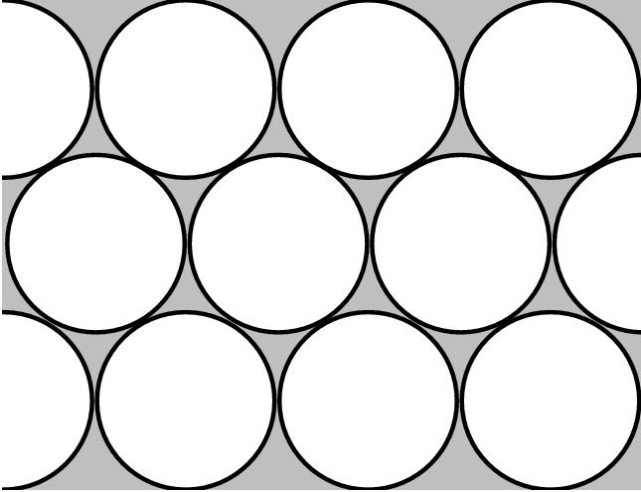
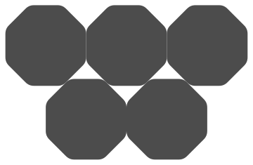
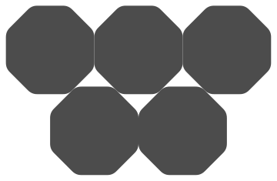
In 2D disks are not worst packing
0.9069
0.9024
0.8926

Slide 9
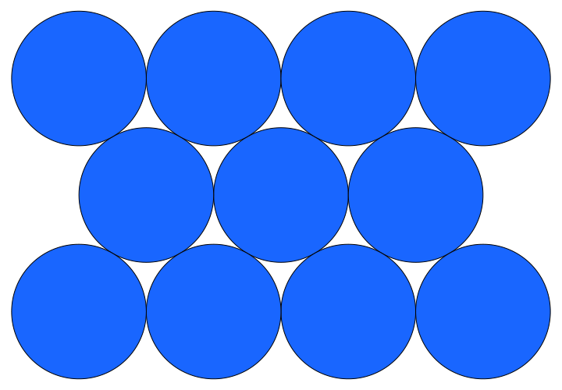
Why can we improve over circles?

Slide 10
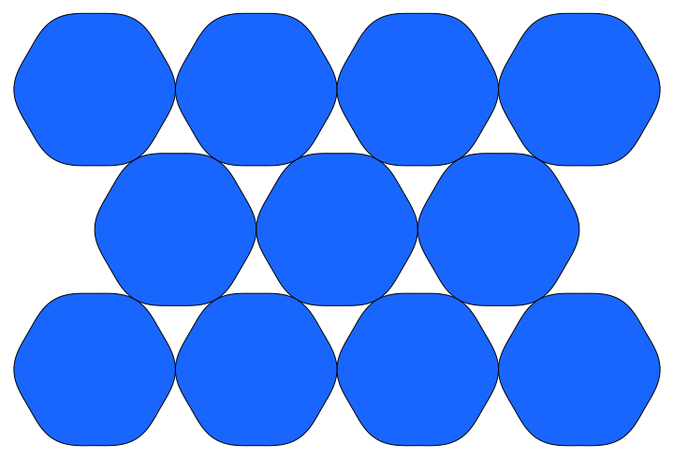
Why can we improve over circles?

Slide 11
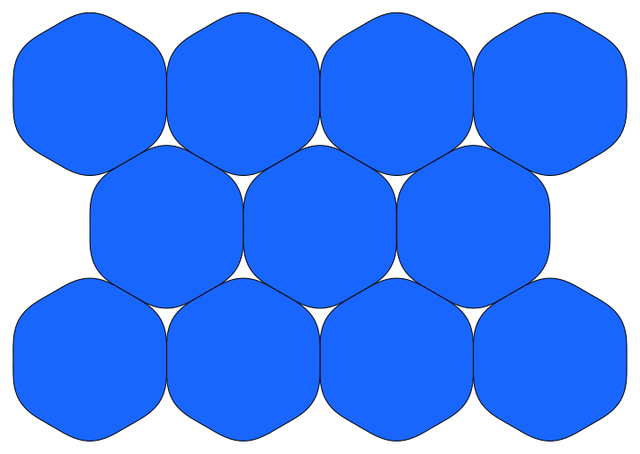
Why can we improve over circles?

Slide 12
Why can we improve over circles?

Slide 13
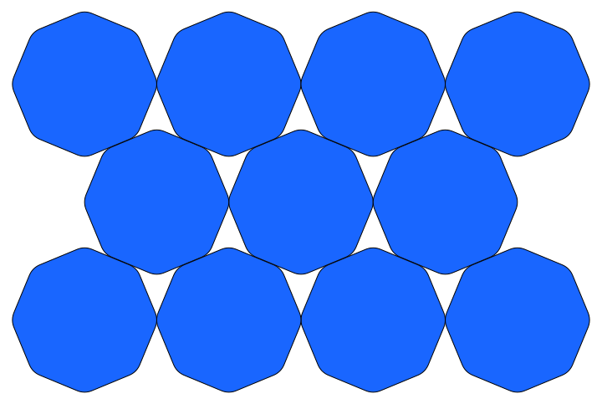
Why can we improve over circles?

Slide 14
Why can we improve over circles?

Slide 15
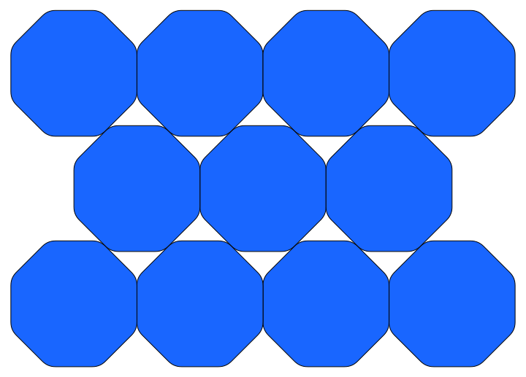
Why can we improve over circles?

Slide 16
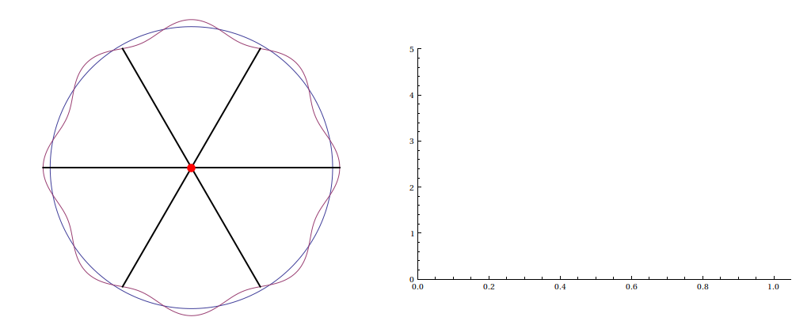
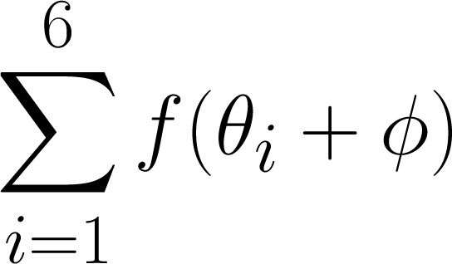
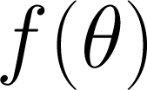
Why can we improve over circles?

Slide 17
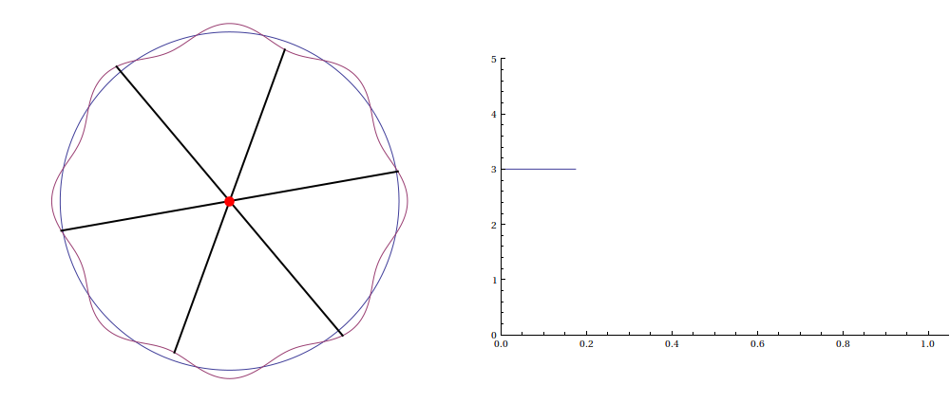
Why can we improve over circles?

Slide 18
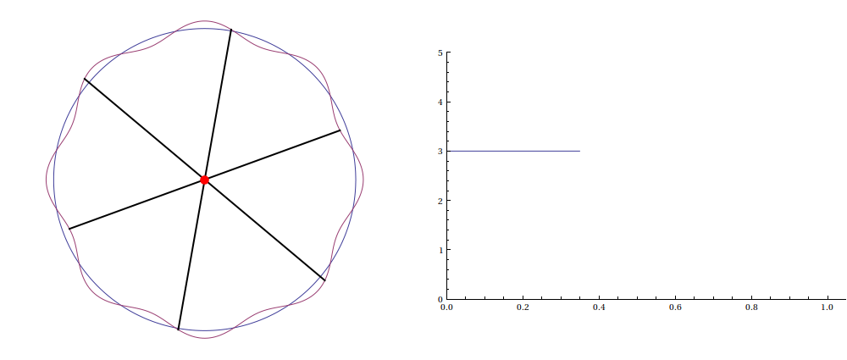
Why can we improve over circles?

Slide 19
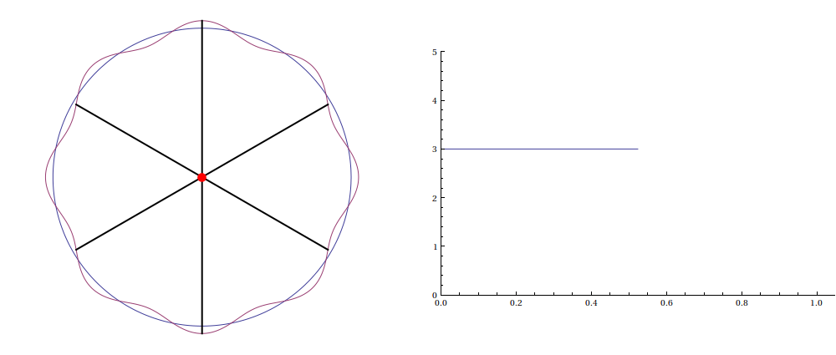
Why can we improve over circles?

Slide 20
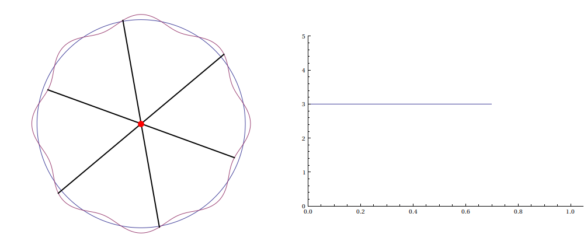
Why can we improve over circles?

Slide 21
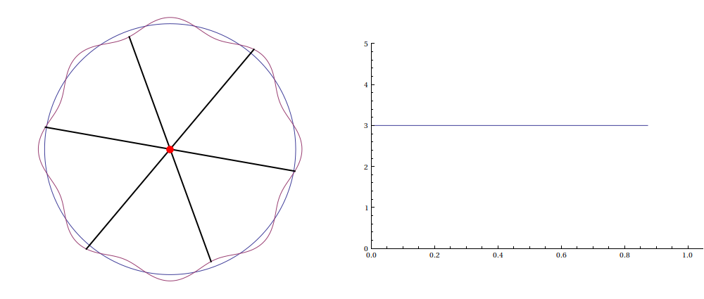
Why can we improve over circles?

Slide 22
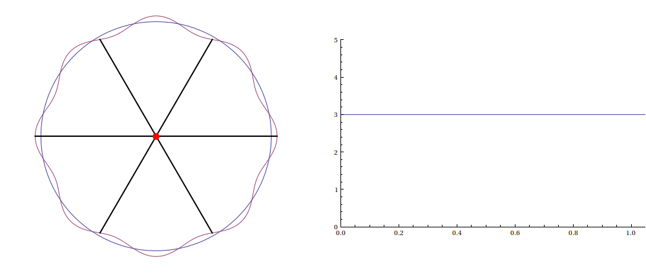
Why can we improve over circles?

Slide 23
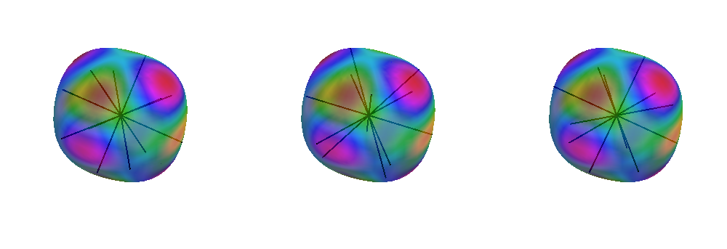
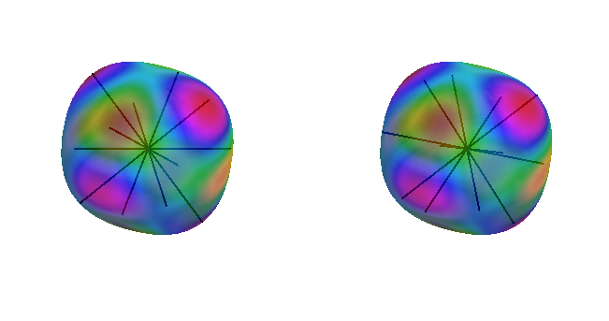
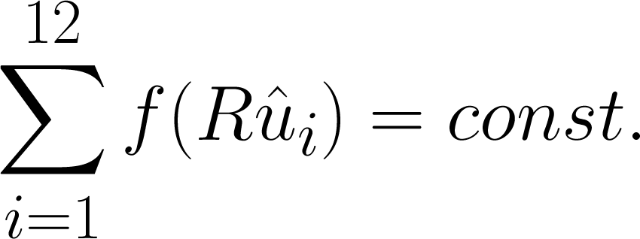
Why can we not improve over spheres?
if and only if
f(u) = monopole + dipole

Slide 24
Why can we not improve over spheres?
Theorem (Kallus, Nazarov):
Sphere is locally worst among convex, centrally-symmetric solids.
arXiv: 1212.2551

Slide 25
Higher dimensions, covering
d | 2 | 3 | 4 | 5 | 6 | 7 | 8 | 24
L. worst packing |  | X
L. worst covering | X | X
arXiv: 1212.2551, 1301.5895

