Slide 1
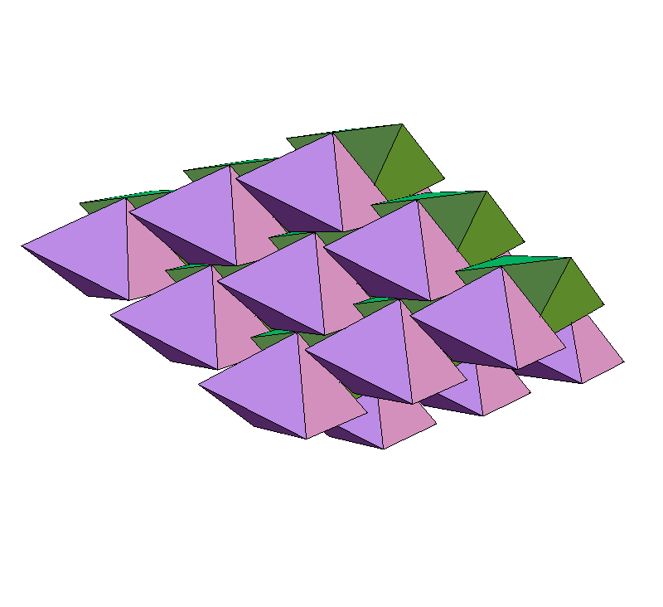
The Divide and Concur
approach to packing
Yoav Kallus
Physics Dept.
Cornell University
j/w:
Veit Elser
Simon Gravel
Particulate matter workshop
MPIPKS, Dresden May 31, 2010

Slide 2
Packing problems:
Optimization: given a collection of figures, arrange them without overlaps
as densely as possible.
Feasibility: find an arrangement of density > φ
Possible computational approaches:
Complete algorithm
Specialized incomplete (heuristic) algorithm
General purpose incomplete algorithm
e.g.: simulated annealing, genetic algorithms, etc.
Divide and Concur belongs to the last category

Slide 3

Two constraint feasibility
Example:
A = permutations of “acgiknp”
B = 7-letter English words

Slide 4
Two constraint feasibility
Example:
A = permutations of “acgiknp”
B = 7-letter English words
x = “packing”

Slide 5
More structure
A, B are sets in a Euclidean configuration space Ω
simple constraints:
easy, efficient projections to A, B

Slide 6
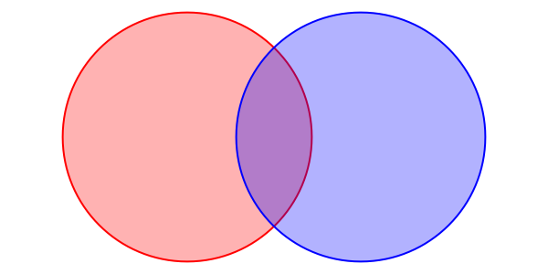
Projection to the packing (no overlaps) constraint

Slide 7
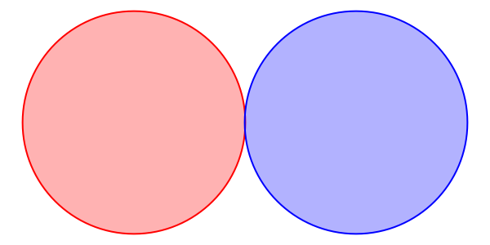
Projection to the packing (no overlaps) constraint

Slide 8
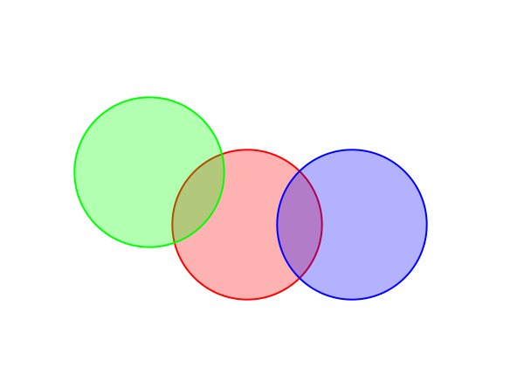
Dividing the Constraints

Slide 9
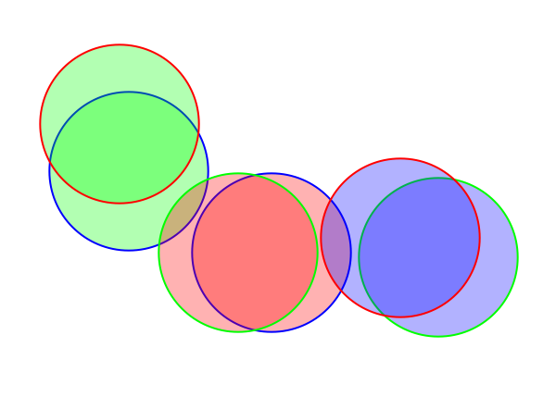
Dividing the Constraints

Slide 10
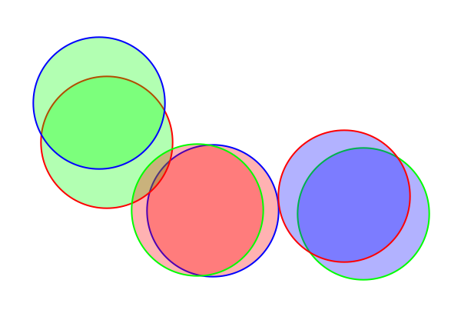
Dividing the Constraints

Slide 11
Projection to concurrence constraint

Slide 12
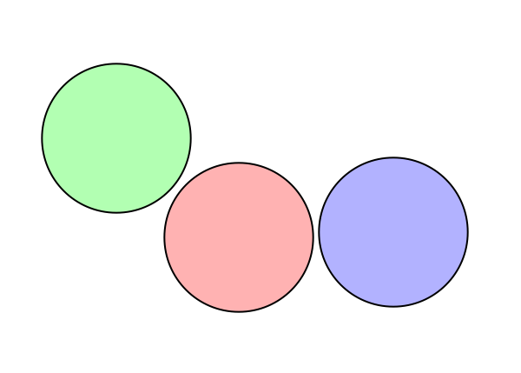
Projection to concurrence constraint

Slide 13
Divide and Concur scheme
A
B
No overlaps between designated replicas
All replicas of a particular figure concur
“divided” packing constraints
“concurrence” constraint

Slide 14
What can we do with projections?
alternating projections:
Douglas-Rachford iteration (a/k/a difference map):

Slide 15
Finite packing problems
Gravel & Elser, Phys. Rev. E (2008)

Slide 16
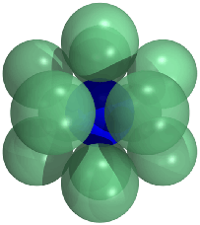


Finite packing problems
The kissing number problem in 10D
Special dimensions matter!
Elser & Gravel, Disc. Compu. Geom. (2010)

Slide 17
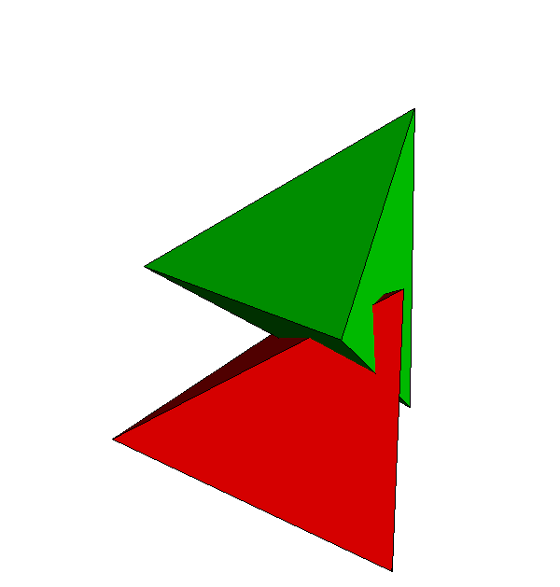
Generalization to non-spherical Particles

Slide 18
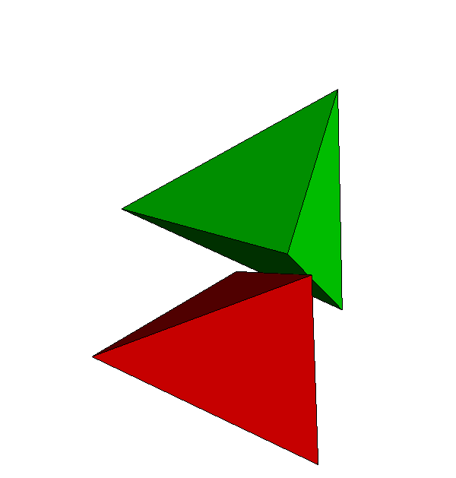
Generalization to non-spherical Particles

Slide 19
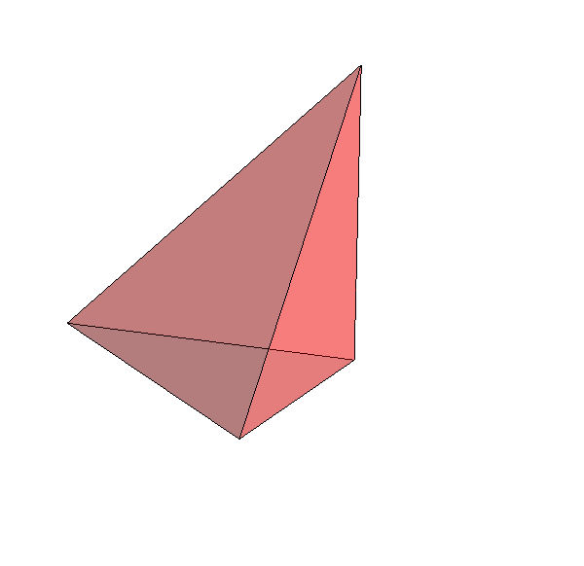
Generalization to non-spherical Particles
A
B
“divided” packing constraints (rigidity relaxed)
“concurrence” + rigidity constraints

Slide 20
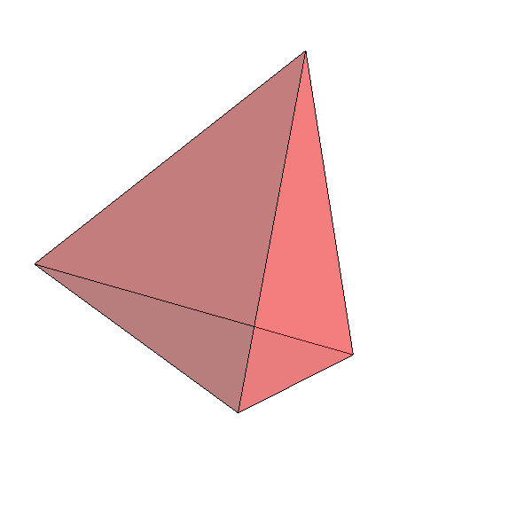
Generalization to non-spherical Particles
A
B
“divided” packing constraints (rigidity relaxed)
“concurrence” + rigidity constraints

Slide 21
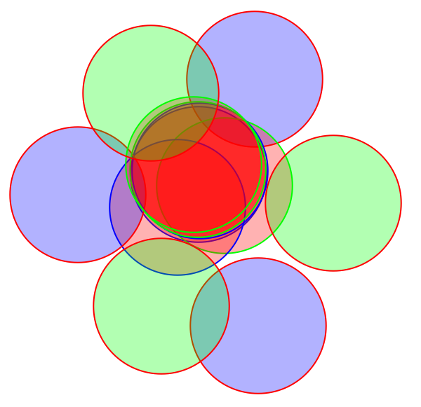
Generalization to periodic packings
replicas
replicas + periodic images

Slide 22
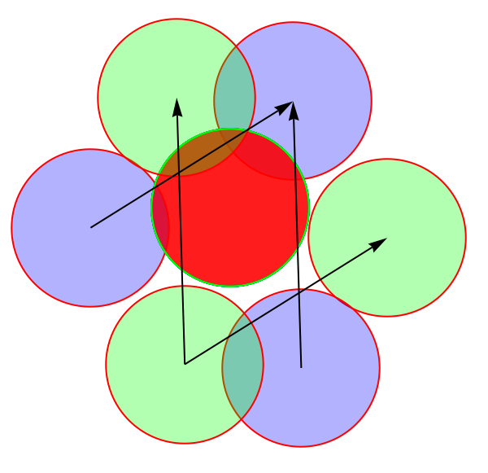
Generalization to periodic packings
replicas
replicas + periodic images

Slide 23
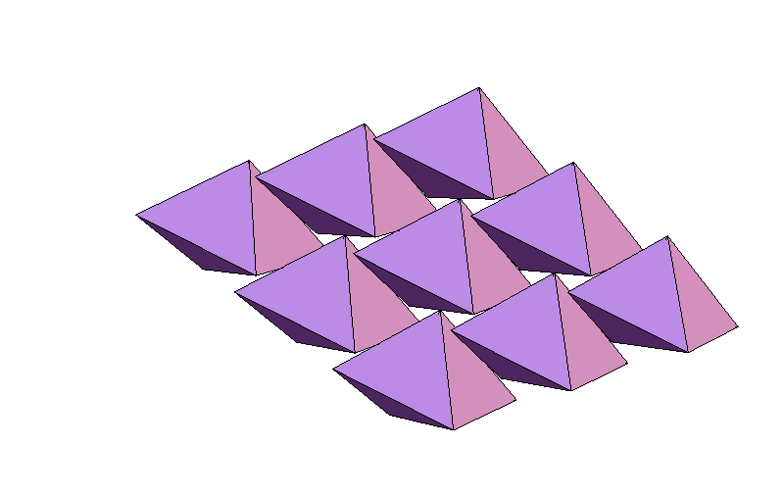
Regular tetrahedron packing
(Stay tuned for next talk)
Kallus, Elser, & Gravel, Disc. Compu. Geom. (2010)

Slide 24
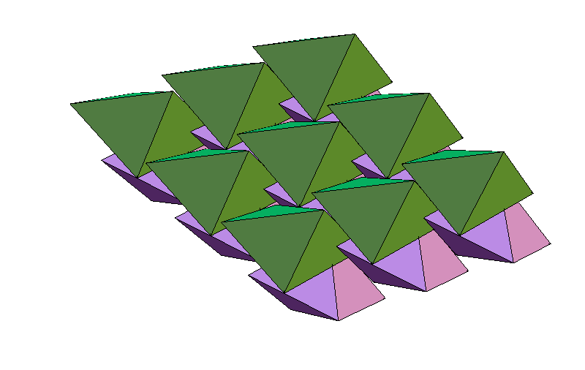
Regular tetrahedron packing
Kallus, Elser, & Gravel, Disc. Compu. Geom. (2010)

Slide 25
Regular tetrahedron packing
Kallus, Elser, & Gravel, Disc. Compu. Geom. (2010)

Slide 26
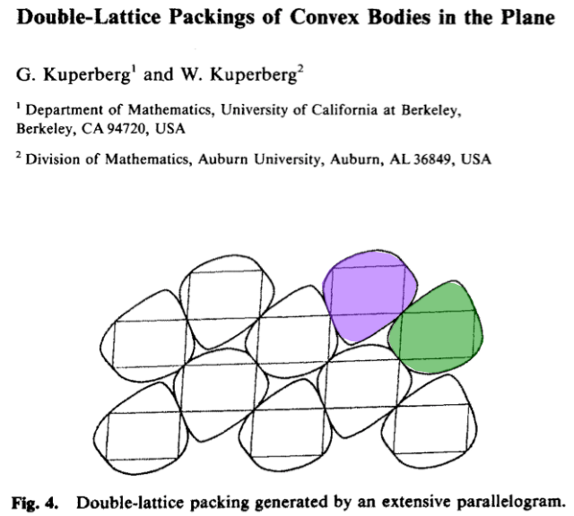
Disc. Compu. Geom. (1990)

Slide 27
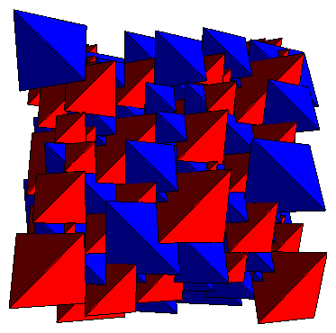
Dense regular pentatope packing –
also a dimer double lattice!
φ = 128/219 = 0.5845
Kallus, Elser, & Gravel, arXiv: 1003.3301 (2010)

Slide 28
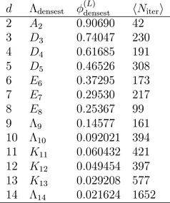
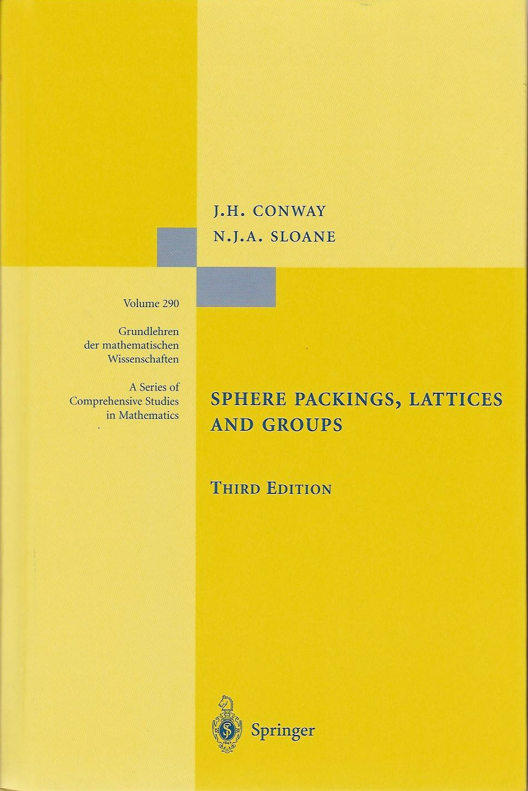
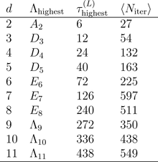
Sphere packing and kissing in higher dimensions
Densest known
lattice packing
in d dimensions:
lattice with highest
known kissing
number in d
dimensions:
Kallus, Elser, & Gravel, arXiv: 1003.3301 (2010)

Slide 29
Tetrahedron packing upper bound
Challenge:
1. Prove φ ≤ 1 – ε, where ε > 0
2. Maximize ε

Slide 30
Tetrahedron packing upper bound
Tetrahedron packing upper bound
Challenge:
1. Prove φ ≤ 1 – ε, where ε > 0
2. Maximize ε
2'. Minimize length of proof
Solution: ε = 5.01... x 10⁻ ² ⁵ (15 pages)
Gravel, Elser, & Kallus, in preparation

