Slide 1
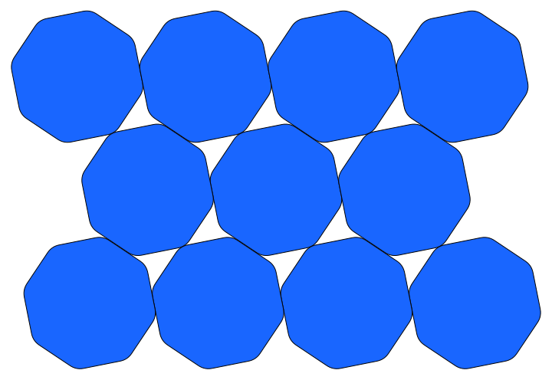
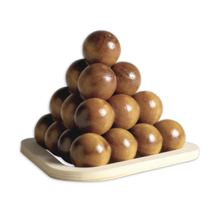
Worst Packing Shapes
Yoav Kallus
Princeton University
j/w: Fedor Nazarov
Kent University
International Workshop on Packing Problems
Trinity College, Dublin Sep. 3, 2012

Slide 2
The Miser's Problem
A miser is required by a contract to deliver
a tray covered with a single layer of gold
coins, filling the tray as densely as possible.
The coins must be convex, of a certain width,
and much smaller than the tray. What shape
of coin should the miser choose so as to part
with as little gold as possible?

Slide 3

The Miser's Problem
A miser is required by a contract to deliver
a tray covered with a single layer of gold
coins, filling the tray as densely as possible.
The coins must be convex, of a certain width,
and much smaller than the tray. What shape
of coin should the miser choose so as to part
with as little gold as possible?

Slide 4
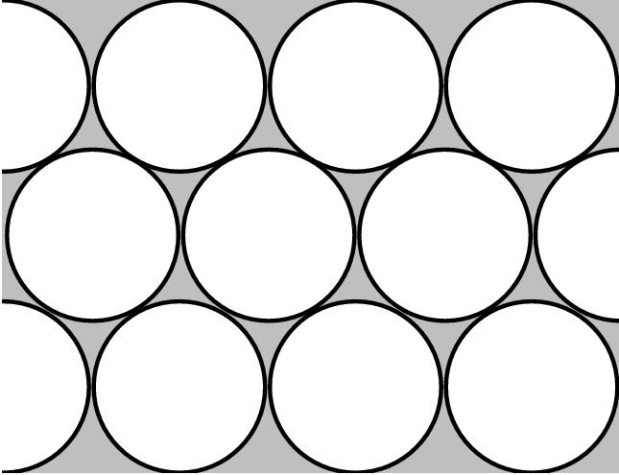
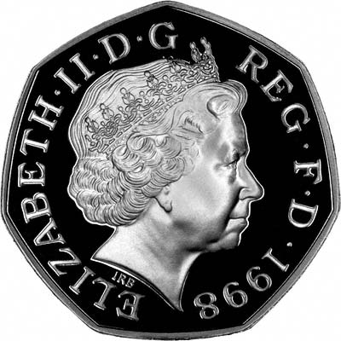
The Miser's Problem
0.9069
0.8926

Slide 5
The Miser's Problem
A miser is required by a contract to deliver
a tray covered with a single layer of gold coins,
arranged in a lattice as densely as possible.
The coins must be convex, centrally symmetric,
of a certain width, and much smaller than the
tray. What shape of coin should the miser choose
so as to part with as little gold as possible?

Slide 6
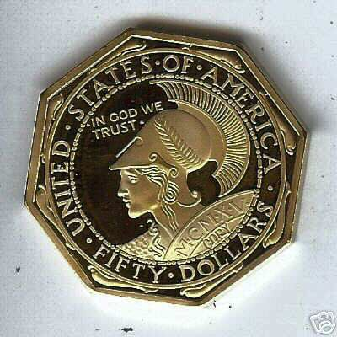
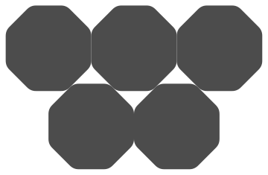
The Miser's Problem
0.9069
0.9024
Conjecture (Reinhardt 1934): rounded octagon
is the worst symmetric packer.

Slide 7
The Miser's 3D Problem
A miser is required by a contract to deliver
a chest of gold bars, arranged in a lattice as
densely as possible. The bars must be convex,
centrally symmetric, and much smaller than
the chest. What shape of bar should the miser
cast so as to part with as little gold as possible?

Slide 8
The Miser's 3D Problem
A miser is required by a contract to deliver
a chest of gold bars, arranged in a lattice as
densely as possible. The bars must be convex,
centrally symmetric, and much smaller than
the chest. What shape of bar should the miser
cast so as to part with as little gold as possible?
Conjecture (Ulam 1972):
ball is the worst
symmetric packer.

Slide 9




Some terminology
= optimal number density
= optimal packing fraction
=
Note:
is defined over the Banach-Mazur
Compactum.

Slide 10


Some terminology
Note:
if
Definition: if the inequality is strict whenever
K' is strictly contained in K, then K is
“irreducible”.
Note: if K is a local minimum of
then K is irreducible.

Slide 11
Some terminology
Note:
if
Definition: if the inequality is strict whenever
K' is strictly contained in K, then K is
“irreducible”.
Note: if K is a local minimum of
then K is irreducible.
The rounded octagon is a local minimum
of optimal packing fraction (Nazarov 1986).
The circle is irreducible, but is not a local
minimum.

Slide 12
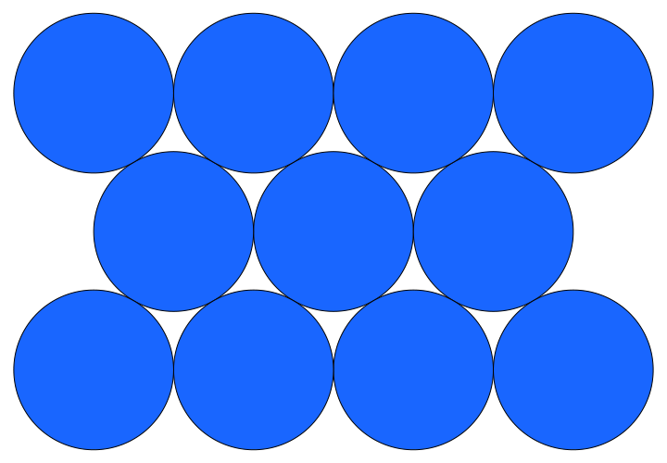
Why can we improve over circles?

Slide 13
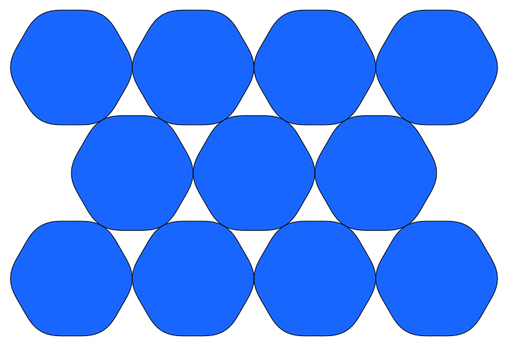
Why can we improve over circles?

Slide 14
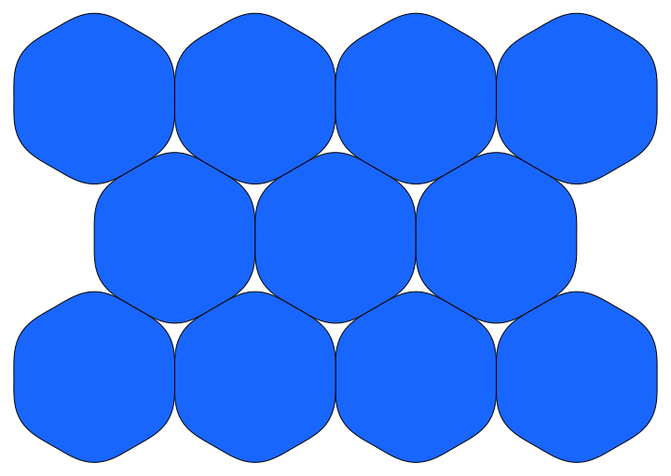
Why can we improve over circles?

Slide 15
Why can we improve over circles?

Slide 16
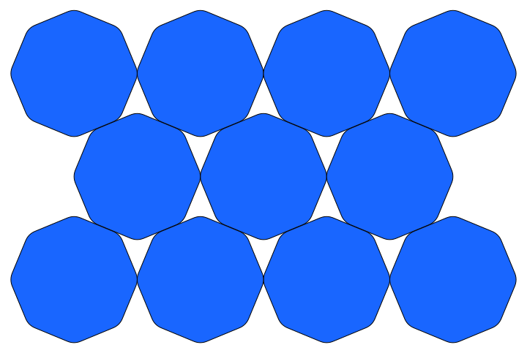
Why can we improve over circles?

Slide 17
Why can we improve over circles?

Slide 18
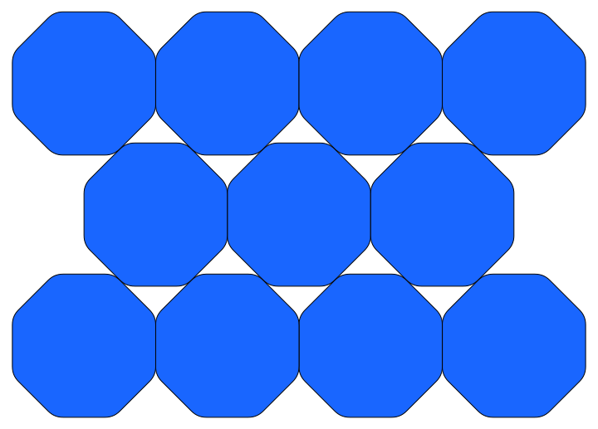
Why can we improve over circles?

Slide 19
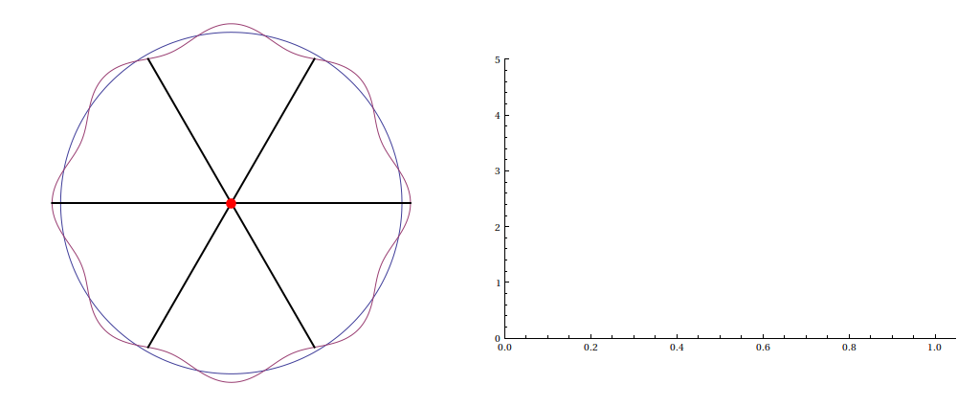
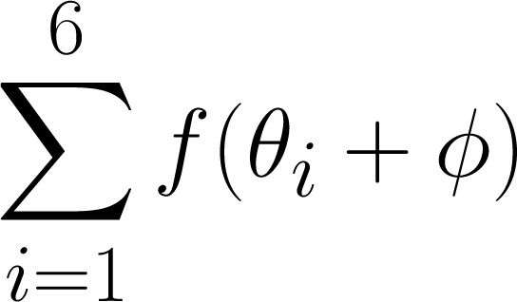
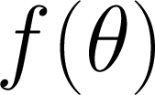
Why can we improve over circles?

Slide 20
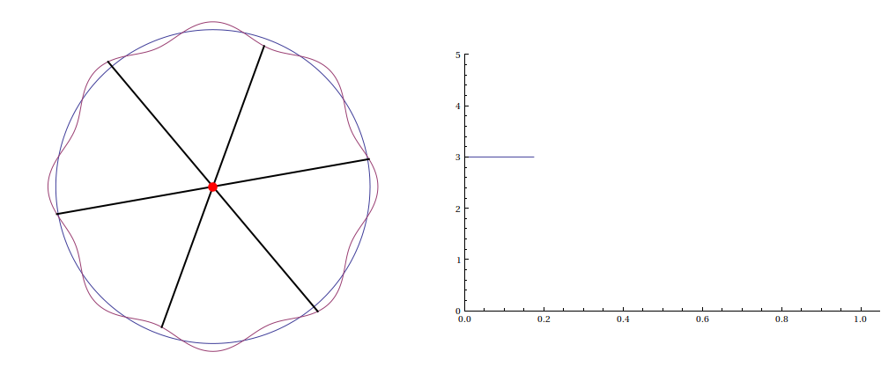
Why can we improve over circles?

Slide 21
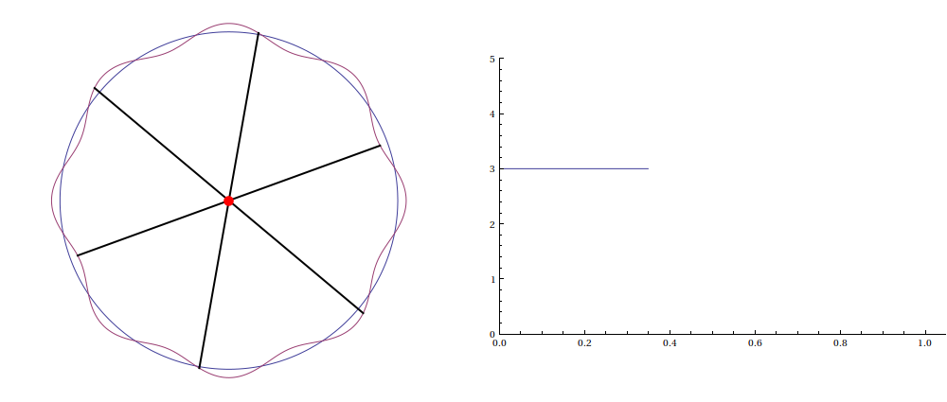
Why can we improve over circles?

Slide 22
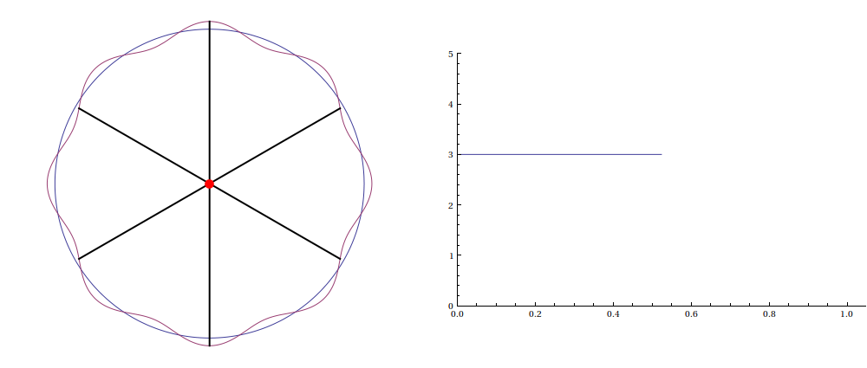
Why can we improve over circles?

Slide 23
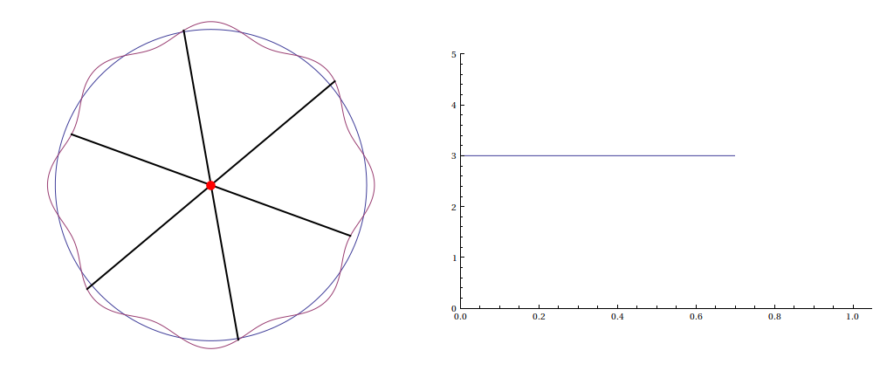
Why can we improve over circles?

Slide 24
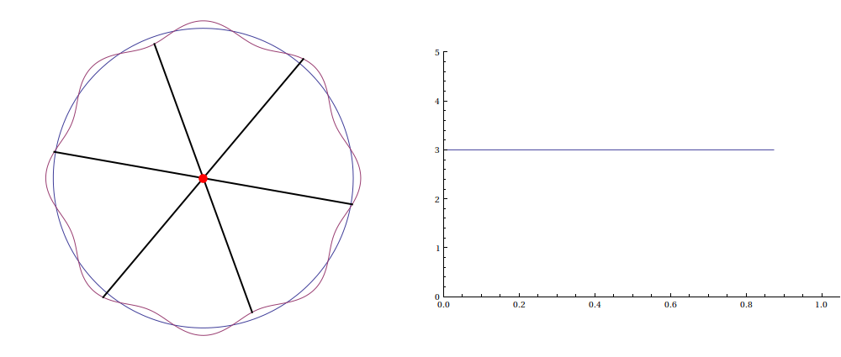
Why can we improve over circles?

Slide 25
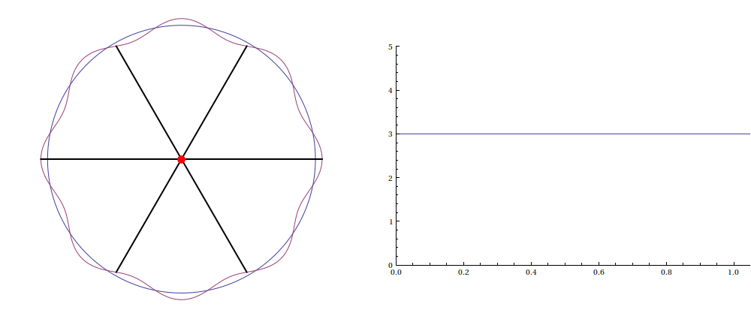
Why can we improve over circles?

Slide 26
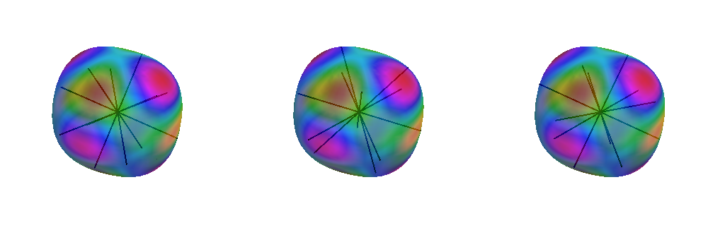
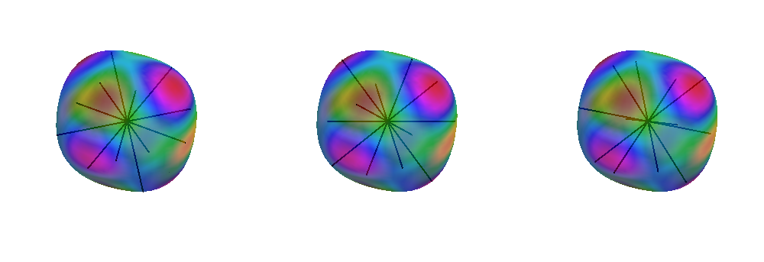
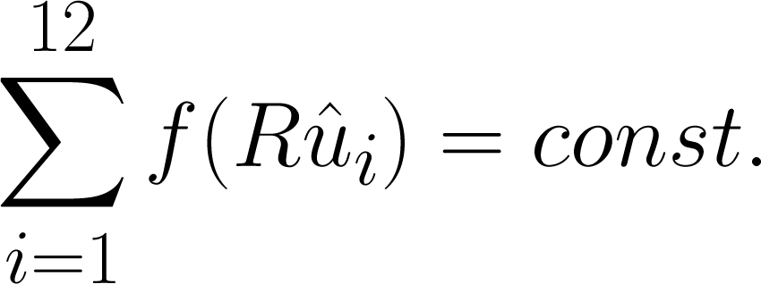
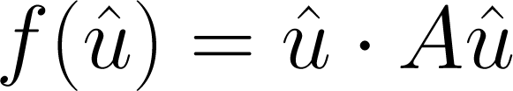
Why can we not improve over spheres?
if and only if

Slide 27
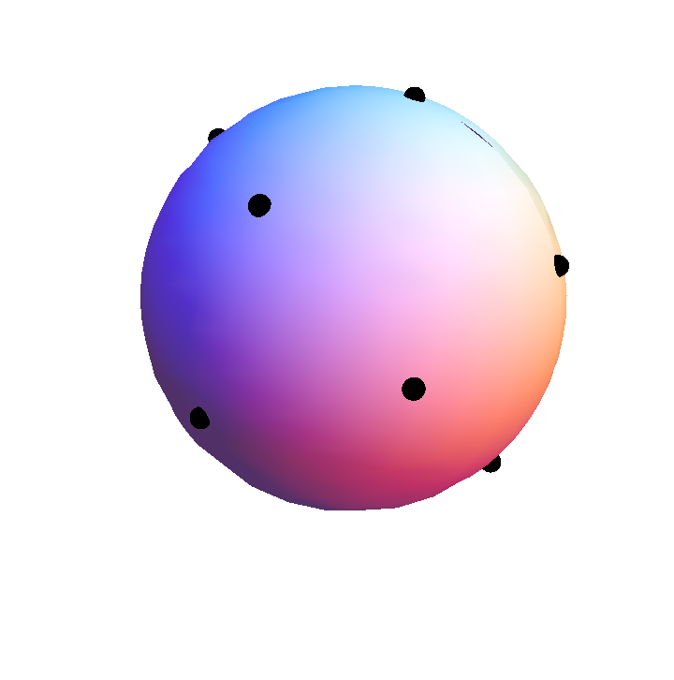

Higher Dimensions
Q: When is a lattice packing of hyperspheres
locally best?
Contact points:
S
A: If and only if for
S is “perfect and eutactic”

Slide 28
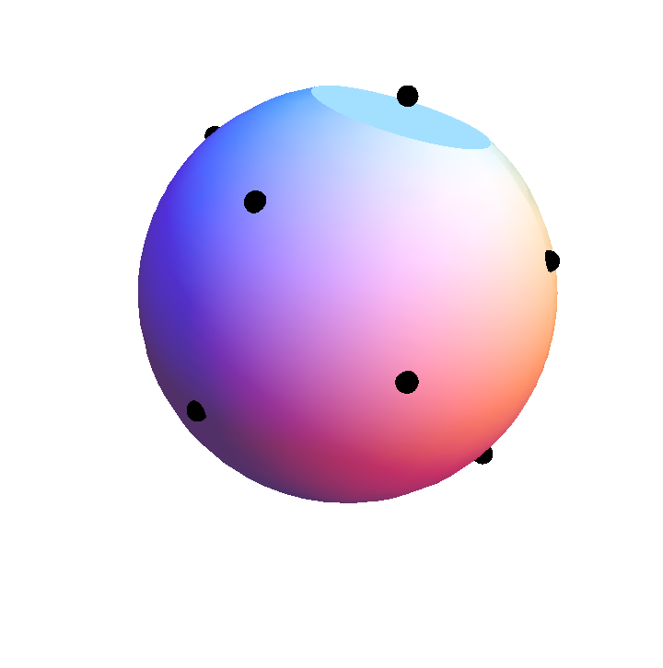
Higher Dimensions
Packing of a dented hypersphere
ε
For d = 6, 7, 8, 24 the configuration of minimal
vectors is redundantly perfect and eutactic.
Therefore, the d-ball is reducible.

Slide 29
Higher Dimensions
Packing of a dented hypersphere
For d = 4, 5, the optimal number density of a
dented d-ball rises only as the square of the
depth of the dent.

Slide 30
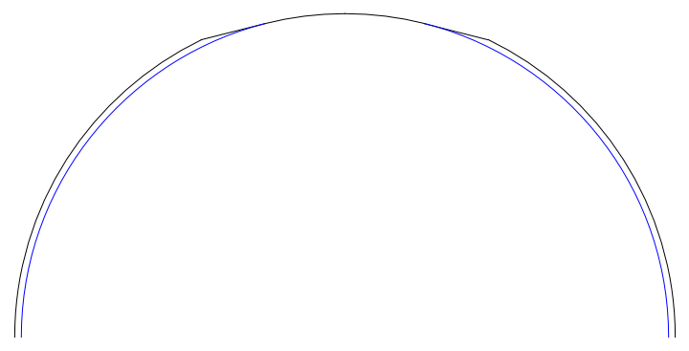


Higher Dimensions
Packing of a shaved hypersphere
1-ε
Therefore, for d=4, 5 the d-ball is irreducible but is not a local minimum of

Slide 31
Status of d-dimensional balls
d | 2 | 3 | 4 | 5 | 6 | 7 | 8 | 24
Irreduc. | X | X | X | X
L. worst packing |  | X

Slide 32
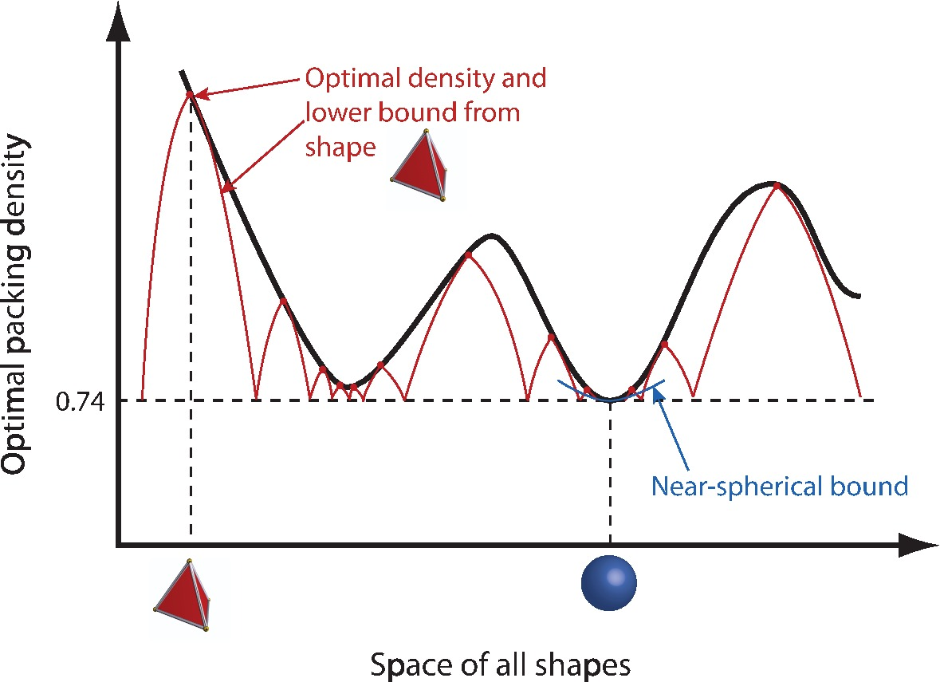
From local result to global result

Slide 33
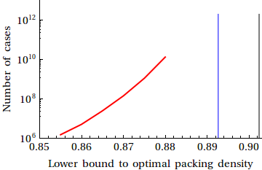
From local result to global result

