Slide 1
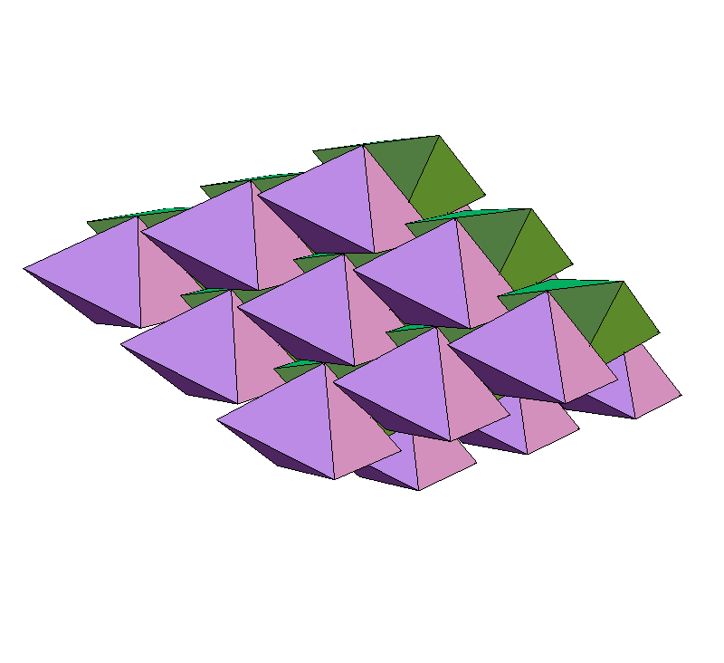
Packing tetrahedra and
other figures using
Divide and Concur
Yoav Kallus
Physics Dept.
Cornell University
j/w:
Veit Elser
Simon Gravel
Widely applied math seminar
Harvard University Nov. 1, 2010

Slide 2
General packing problem
Let φmax(K) be the highest achievable density for packings of
convex d-dimensional body K.
2D periodic examples:
φ = 0.817
φ = 0.854
φ = 0.921
N = 1
N = 2
N = 2
φmax(K) for d > 2 known only for spheres, space-filling solids.
2

Slide 3
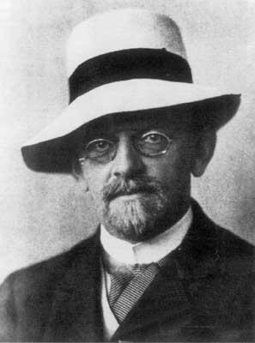
From Hilbert's 18th problem:
“How can one arrange most densely in space an infinite number of equal solids of a given form, e.g., spheres with given radii or regular tetrahedra with given edges (or in prescribed position), that is, how can one so fit them together that the ratio of the filled to the unfilled space may be as large as possible?”
David Hilbert
(1862-1943)
3

Slide 4
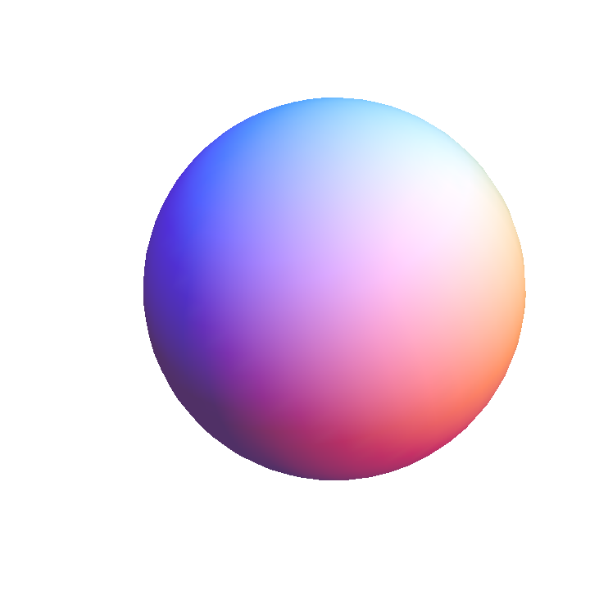
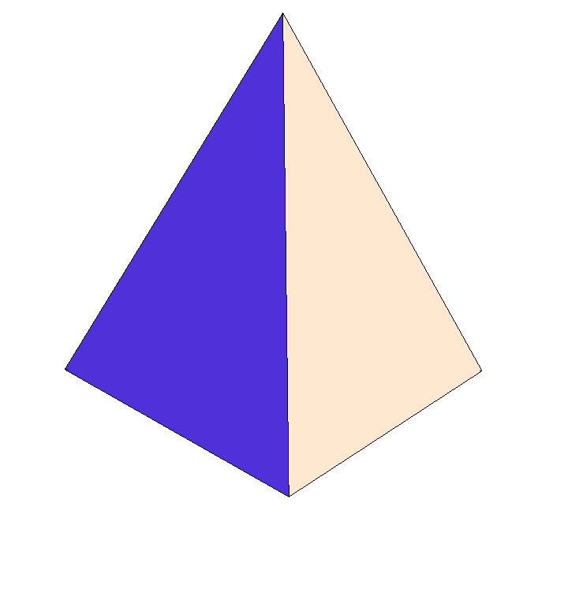
φ
Some upper and lower bounds
1.0
0.9
0.7796 Rogers (1958)
0.8563 Chen et al. (2010)
0.7731 Muder (1993)
0.8547 Kallus et al. (2009)
0.8
0.7405 Hales (1998)
0.7786 Chen (2008)
0.7175 Conway &
Torquato (2006)
0.7
4

Slide 5
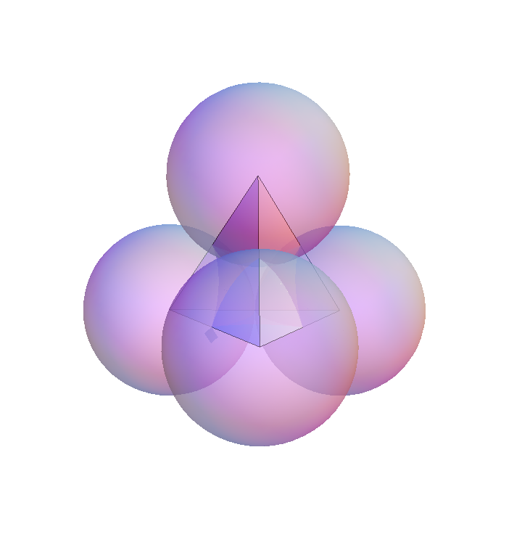
Rogers bound
φ(B) ≤ 0.7796
Argument: the sphere cannot fill its
Voronoi region, a polyhedron
5

Slide 6
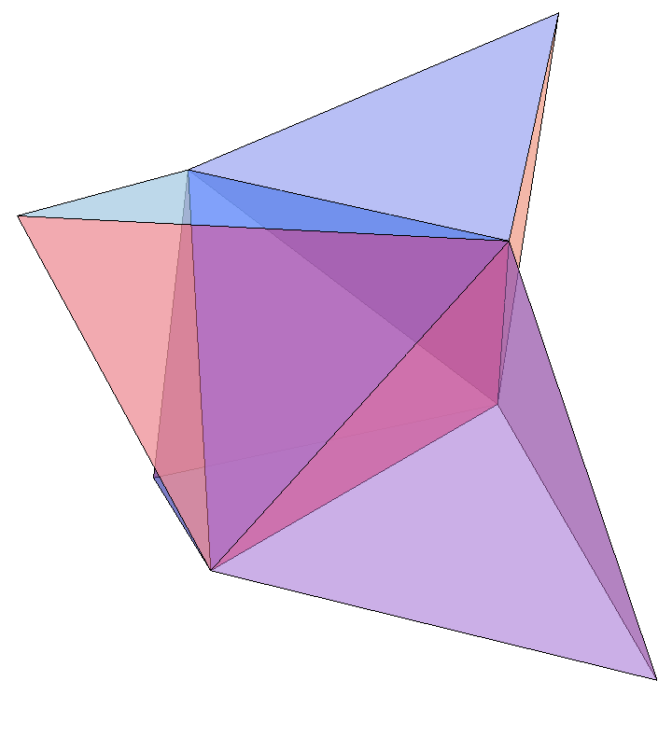
Rogers bound
φ(B) ≤ 0.7796
Argument: the sphere cannot fill its
Voronoi region, a polyhedron
The tetrahedron can easily
fill its Voronoi region
6

Slide 7
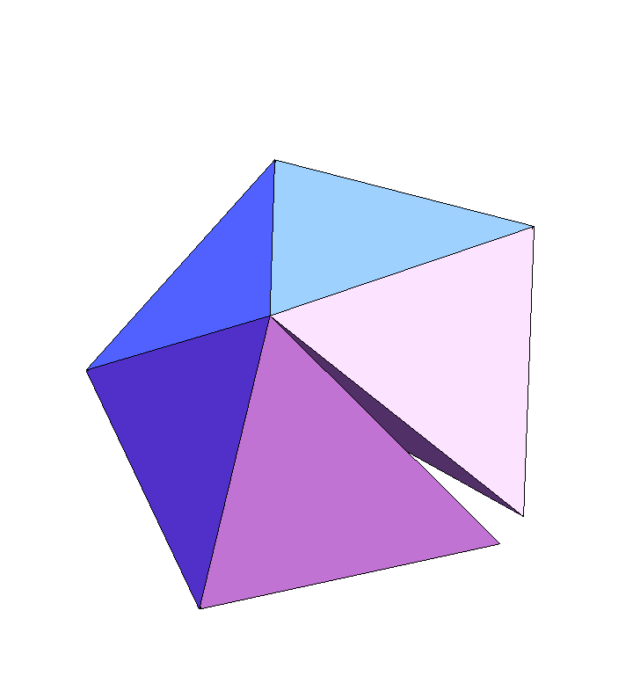
Regular tetrahedra do not fill space
Missing angle: 7.4º
Therefore, φ(T) < 1
But can we find φ^{U} < 1 such that φ(T) ≤ φ^{U}?
8

Slide 8
Tetrahedron packing upper bound
Optimization challenge:
1. Prove φ ≤ 1 – ε, where ε > 0
2. Maximize ε

Slide 9
Tetrahedron packing upper bound
Tetrahedron packing upper bound
Optimization challenge:
1. Prove φ ≤ 1 – ε, where ε > 0
2. Maximize ε
2'. Minimize length of proof
Solution: ε = 2.6... x 10⁻ ²⁵ (15 pages)
Gravel, Elser, & Kallus, Discrete and Computational Geometry (2010)

Slide 10
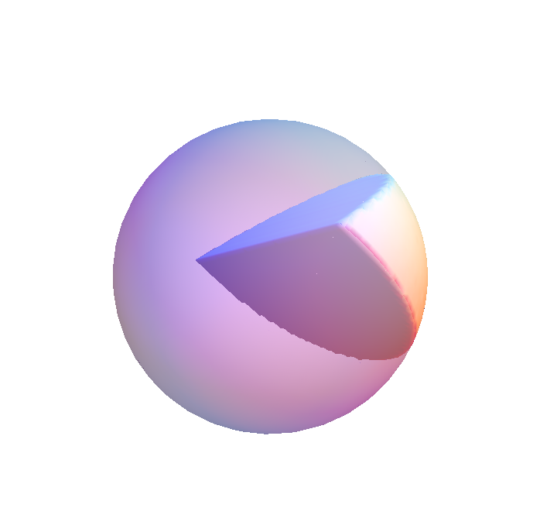
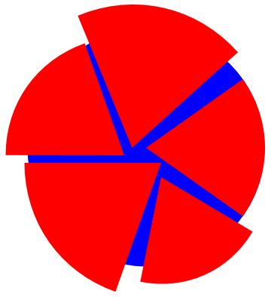
Bound from angle mismatch
“Wedge”
If we can put a lower bound the amount of uncovered space in a unit ball with five non-overlapping wedges, we can get a non-trivial upper bound on the density of a tetrahedron packing.
10

Slide 11
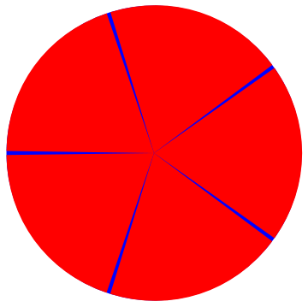
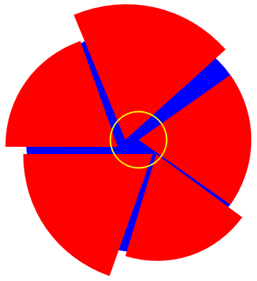
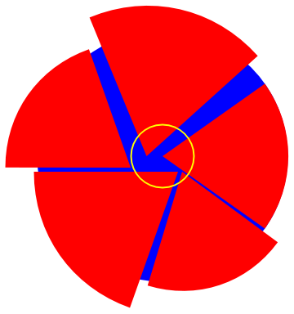
If all wedge edges pass through the center, we can easily calculate the uncovered volume. Unfortunately, this isn't given.
Still, if all wedge edges pass within a given distance of the center, we can still easily calculate a bound on the uncovered volume.
And if one or more edge wedges fall outside the yellow sphere, we are left with a simpler configuration inside the yellow sphere, and we can try to put a bound on the uncovered volume inside it.
11
By applying this argument iteratively:
φ(T) ≤ 1 – (2.6...) x 10⁻²⁵

Slide 12
φ
Some upper and lower bounds
1.0
1 – 2.6x10^{–25} Gravel et al. (2010)
0.9
0.7796 Rogers (1958)
0.8563 Chen et al. (2010)
0.7731 Muder (1993)
0.8547 Kallus et al. (2009)
0.8
0.7405 Hales (1998)
0.7786 Chen (2008)
0.7175 Conway &
Torquato (2006)
0.7
4

Slide 13
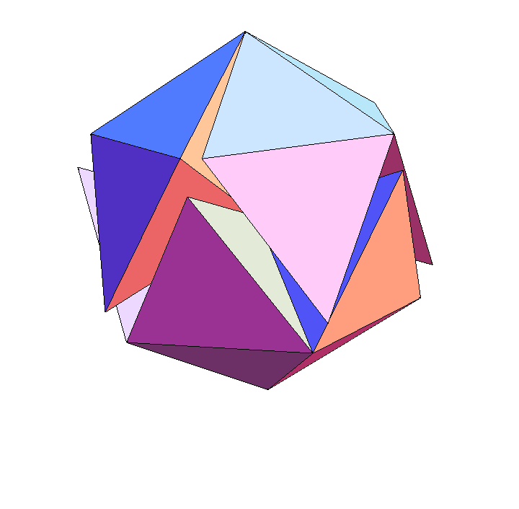
Lower bounds (densest known packings)
1. Conway & Torquato (2006)
Icosahedral packing: φ = 0.7166
N=20
“Welsh” packing: φ = 0.7175
N=34
Conjecture: φmax(T) < φmax(B)
PNAS (2006)
14

Slide 14
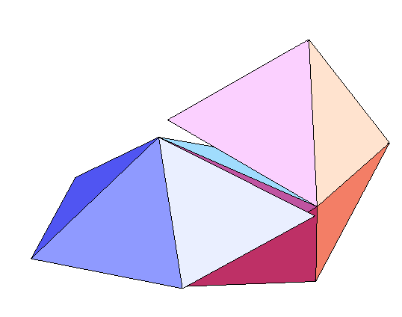
Densest known packings
2. Chen (2008)
“wagon wheels” packing: φ = 0.7786
N=18
φmax(T) > φmax(B)
Discrete & Compu. Geom. (2008)
15

Slide 15
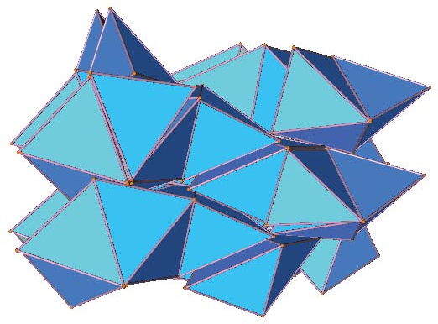
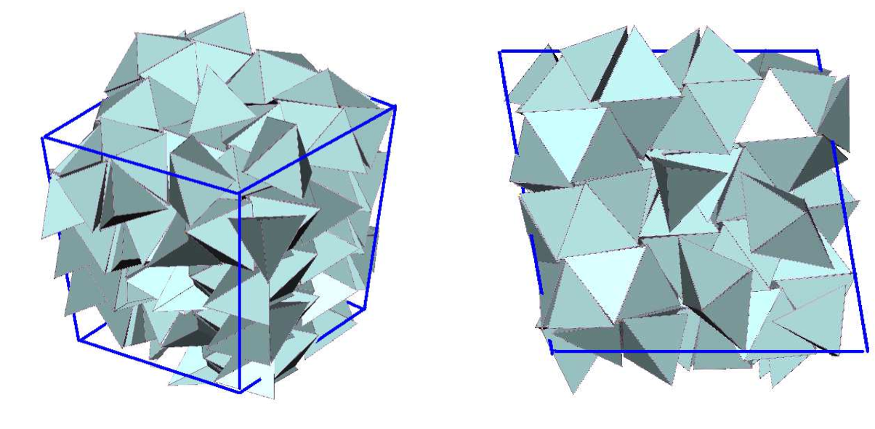
Densest known packings
3. Torquato & Jiao (2009)
Challenge for numerical search: highly frustrated optimization problem
φ = 0.7820
N = 72
Search often got stuck at local optima
Nature (2009)
φ = 0.8226
N = 314
Phys. Rev. E (2009)
16

Slide 16
Densest known packings
4. Kallus et al. (2009)
Method: “divide and concur”
φ = 0.8547
N = 4 (!)
All tetrahedra equivalent
(tetrahedron-transitive packing)
Discrete & Compu. Geom. (2010)
5. Chen et al. (2010)
Slight analytical improvement to the above structure: φ = 0.8563
(New, denser, packing is no longer tetrahedron-transitive)
Discrete & Compu. Geom. (2010)
17

Slide 17
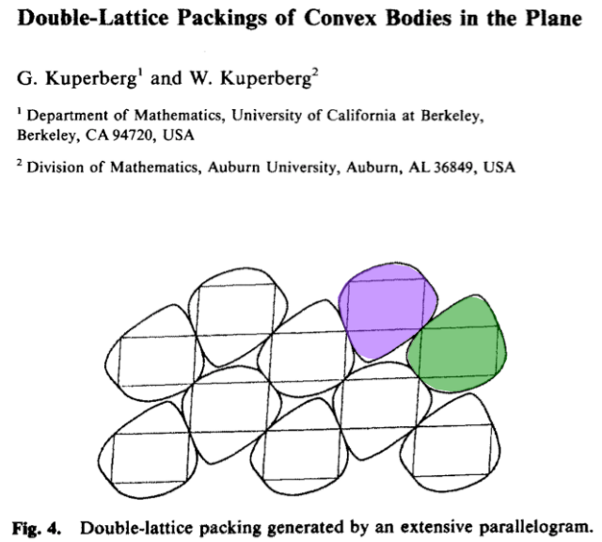
Disc. Compu. Geom. (1990)
Kuper-pair

Slide 18
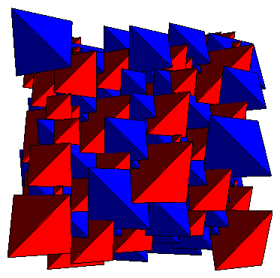
Dense regular pentatope packing –
also a dimer double lattice!
φ = 128/219 = 0.5845
Kallus, Elser, & Gravel, Phys. Rev. E (2010)

Slide 19
Computational approach to packing problems:
Optimization: given a collection of figures, arrange them without overlaps
as densely as possible.
Feasibility: find an arrangement of density > φ
Possible approaches:
Complete algorithm
Specialized incomplete (heuristic) algorithm
General purpose incomplete algorithm
e.g.: simulated annealing, genetic algorithms, etc.
Divide and Concur belongs to the last category

Slide 20

Two constraint feasibility
Example:
A = permutations of “acgiknp”
B = 7-letter English words

Slide 21
Two constraint feasibility
Example:
A = permutations of “acgiknp”
B = 7-letter English words
x = “packing”

Slide 22
More structure
A, B are sets in a Euclidean configuration space Ω
simple constraints:
easy, efficient projections to A, B

Slide 23
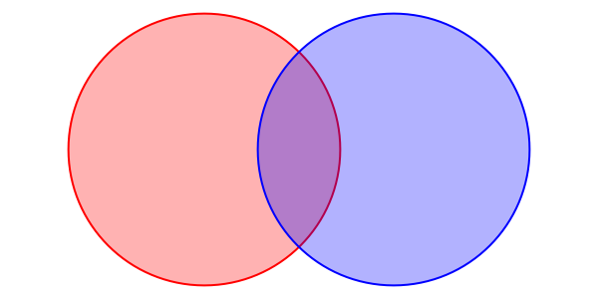
Projection to the packing (no overlaps) constraint

Slide 24
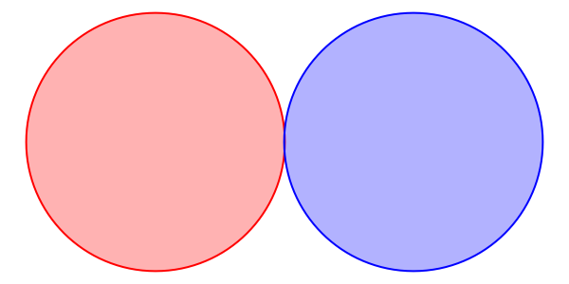
Projection to the packing (no overlaps) constraint

Slide 25
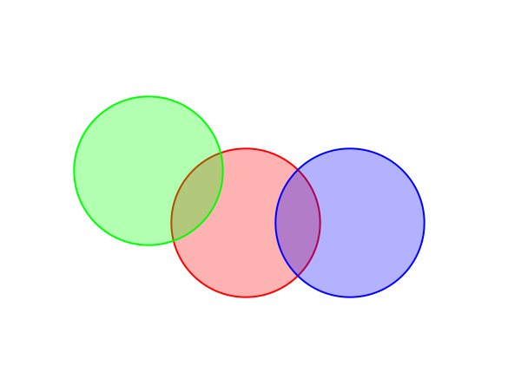
Dividing the Constraints

Slide 26
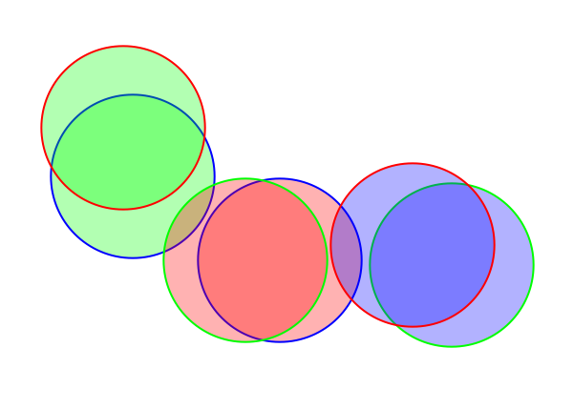
Dividing the Constraints

Slide 27
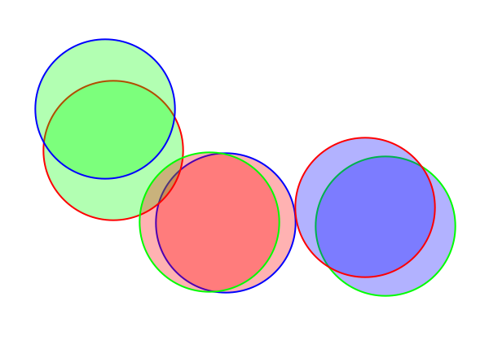
Dividing the Constraints

Slide 28
Projection to concurrence constraint

Slide 29
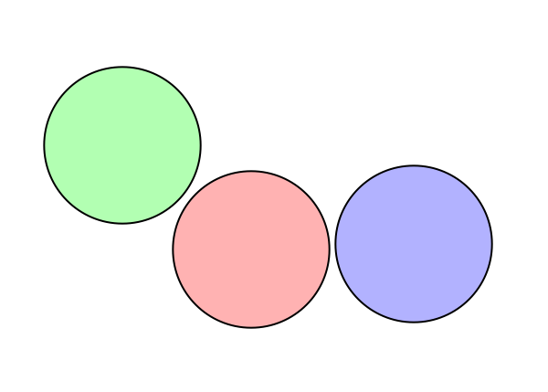
Projection to concurrence constraint

Slide 30
Divide and Concur scheme
A
B
No overlaps between designated replicas
All replicas of a particular figure concur
“divided” packing constraints
“concurrence” constraint

Slide 31
What can we do with projections?
alternating projections:
Douglas-Rachford iteration (a/k/a difference map):

Slide 32
Brief (incomplete) history of
J. Douglas and H. H. Rachford, On the numerical solution of
heat conduction problems in two or three space variables,
Trans. Am. Math. Soc. 82 (1956), 421–439.
splitting scheme for numerical PDE solutions
J.R. Fienup, Phase retrieval algorithms: a comparison, Applied
Optics 21 (1982), 2758-2769.
rediscovery, control theory motivation, phase retrieval
V. Elser, I. Rankenburg, and P. Thibault, Searching with iterated
maps, PNAS 104, (2007), 418-423.
generalized form, applied to hard/frustrated problems:
spin glass, SAT, protein folding, Latin squares, etc.

Slide 33
Finite packing problems
Gravel & Elser, Phys. Rev. E (2008)

Slide 34
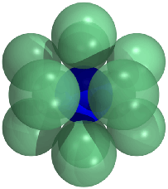


Finite packing problems
The kissing number problem in 10D
Special dimensions matter!
Elser & Gravel, Disc. Compu. Geom. (2008)

Slide 35
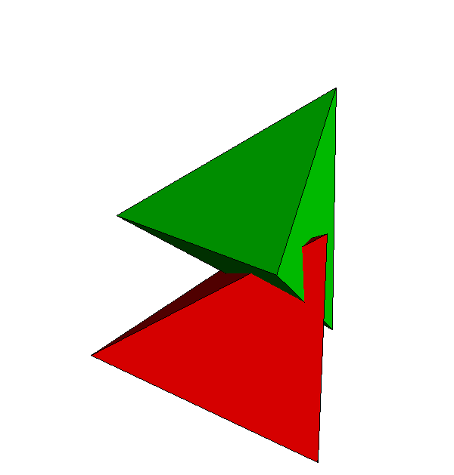
Generalization to non-spherical Particles

Slide 36
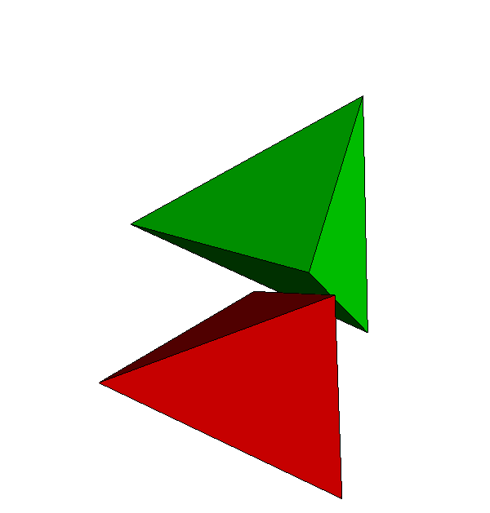
Generalization to non-spherical Particles

Slide 37
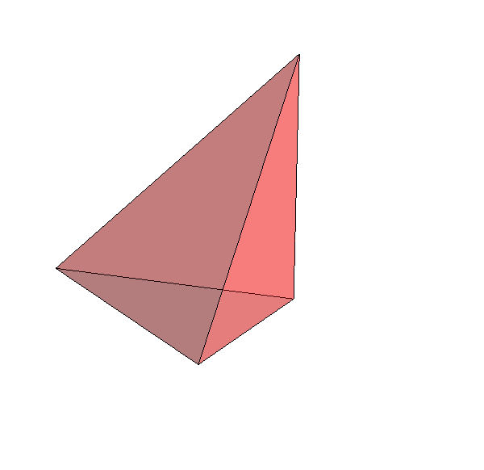
Generalization to non-spherical Particles
A
B
“divided” packing constraints (rigidity relaxed)
“concurrence” + rigidity constraints

Slide 38
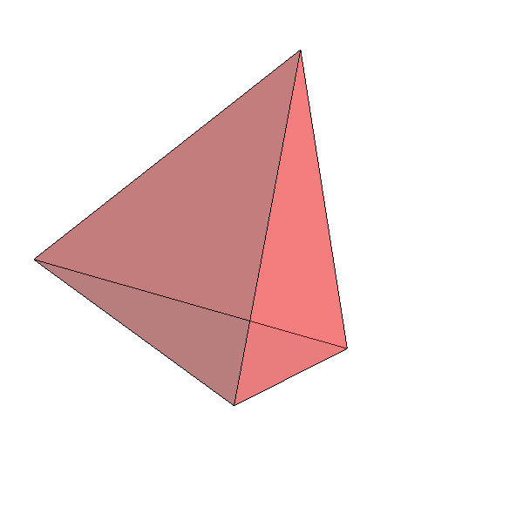
Generalization to non-spherical Particles
A
B
“divided” packing constraints (rigidity relaxed)
“concurrence” + rigidity constraints

Slide 39
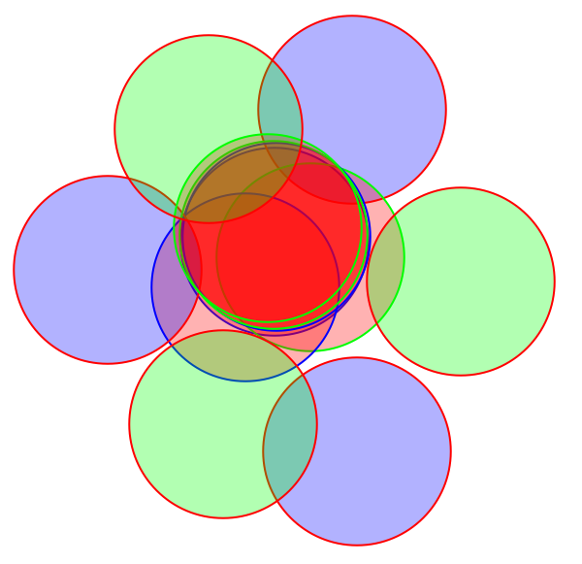
Generalization to periodic packings
replicas
replicas + periodic images

Slide 40
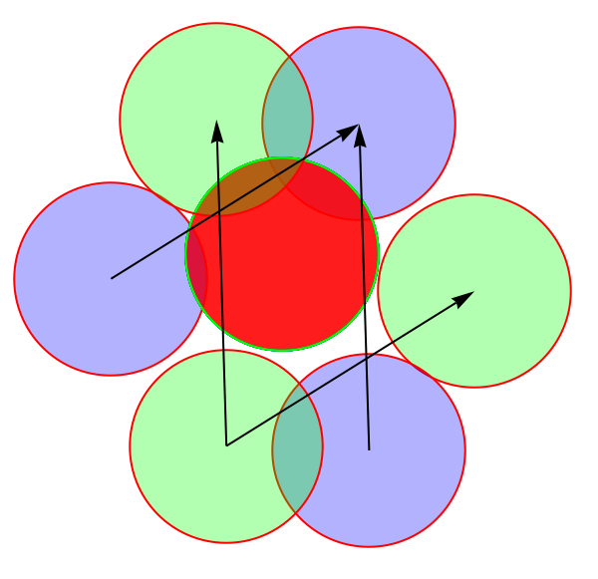
Generalization to periodic packings
replicas
replicas + periodic images

Slide 41
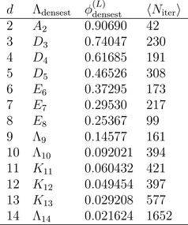
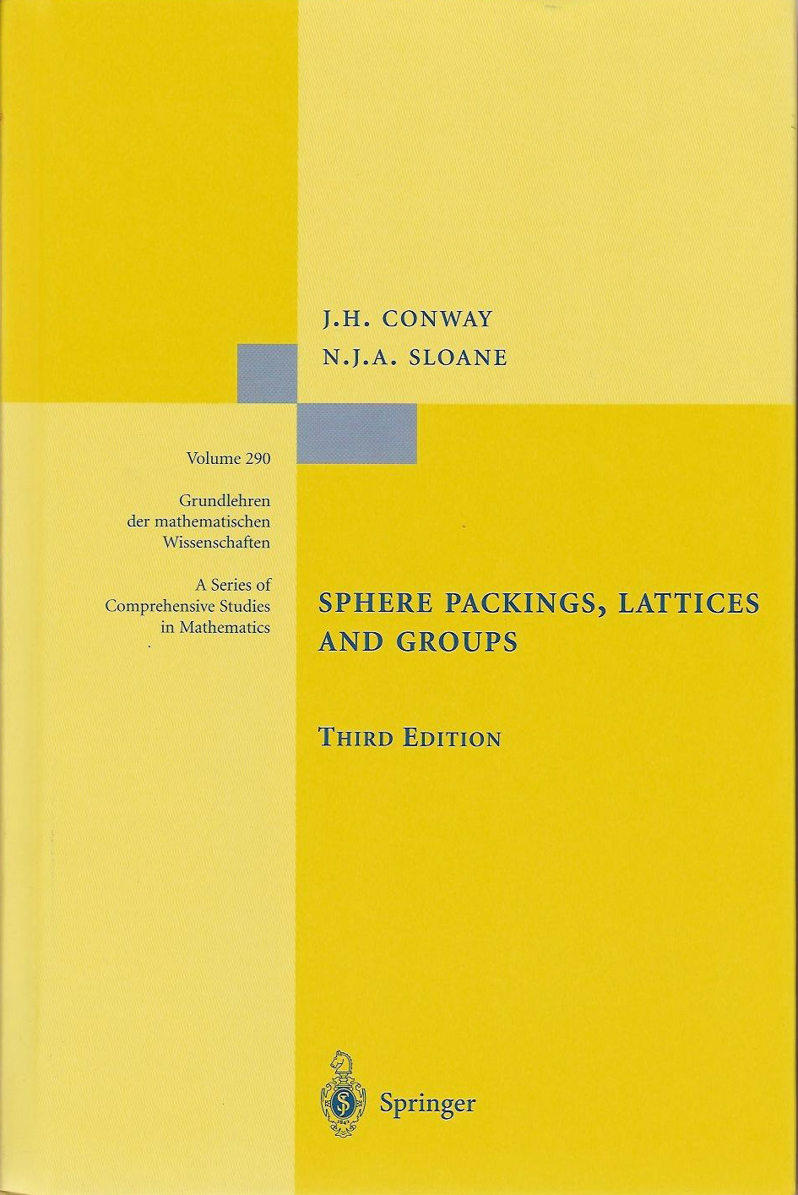
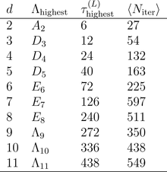
Sphere packing and kissing in higher dimensions
Densest known
lattice packing
in d dimensions:
lattice with highest
known kissing
number in d
dimensions:
Kallus, Elser, & Gravel, Phys. Rev. E (2010)

Slide 42
φ
Some upper and lower bounds
1.0
1 – 2.6x10^{–25} Gravel et al. (2010)
0.9
0.7796 Rogers (1958)
0.8563 Chen et al. (2010)
0.7731 Muder (1993)
0.8547 Kallus et al. (2009)
0.8
0.7405 Hales (1998)
0.7786 Chen (2008)
0.7175 Conway &
Torquato (2006)
0.7
4

Slide 43
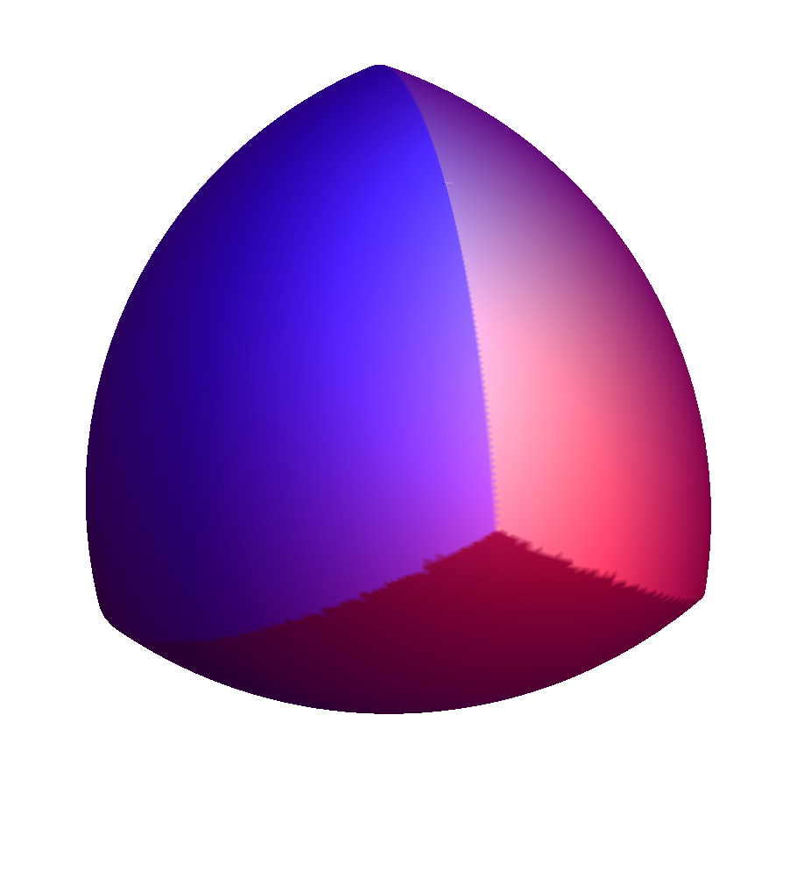
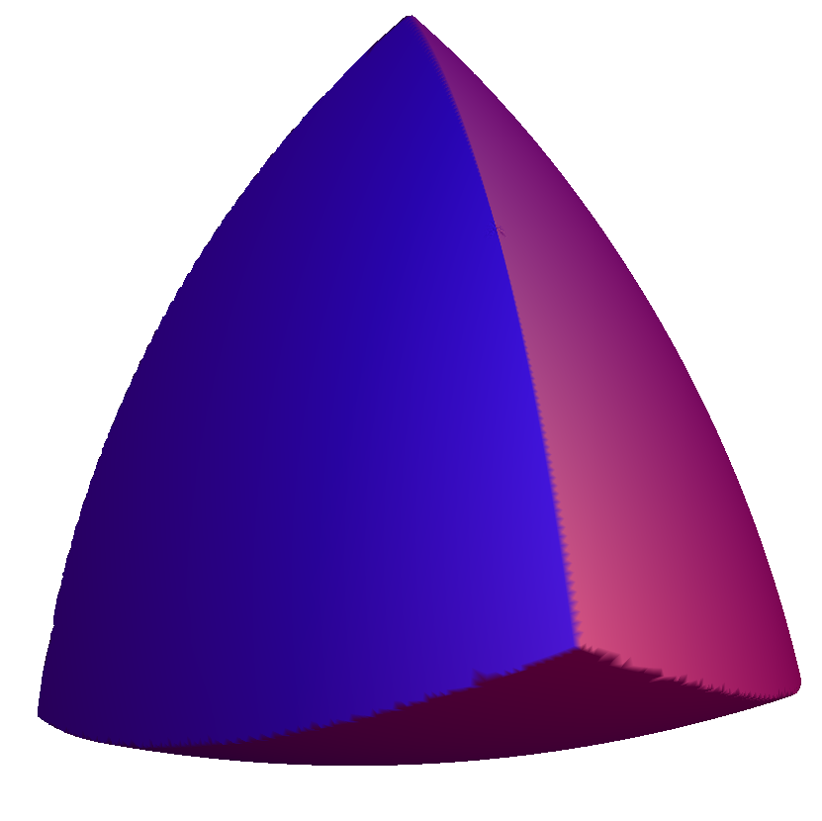
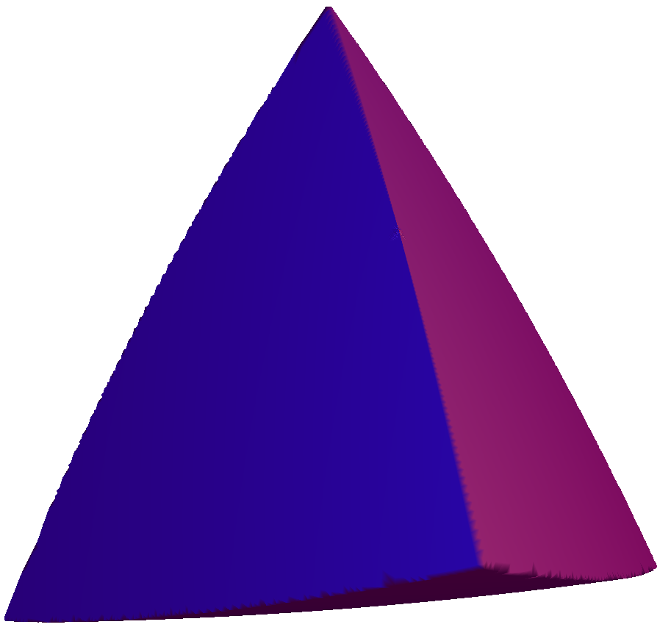
φ
Some upper and lower bounds
1.0
1 – 2.6x10^{–25} Gravel et al. (2010)
0.9
0.7796 Rogers (1958)
0.8563 Chen et al. (2010)
0.7731 Muder (1993)
0.8547 Kallus et al. (2009)
0.8
0.7405 Hales (1998)
0.7786 Chen (2008)
0.7175 Conway &
Torquato (2006)
0.7

Slide 44
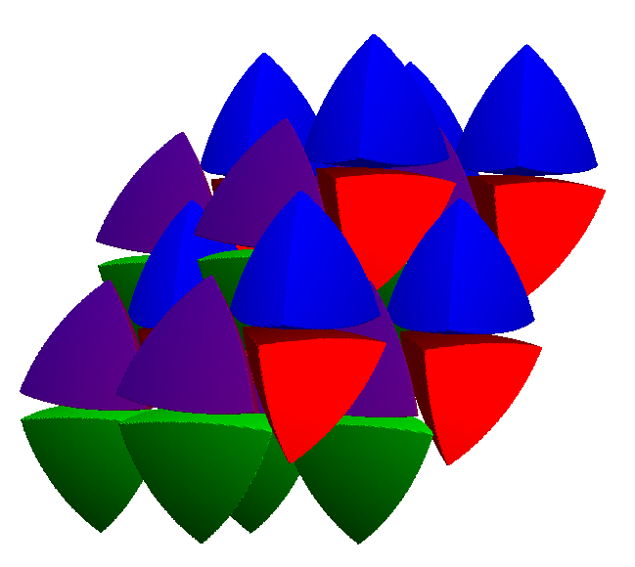
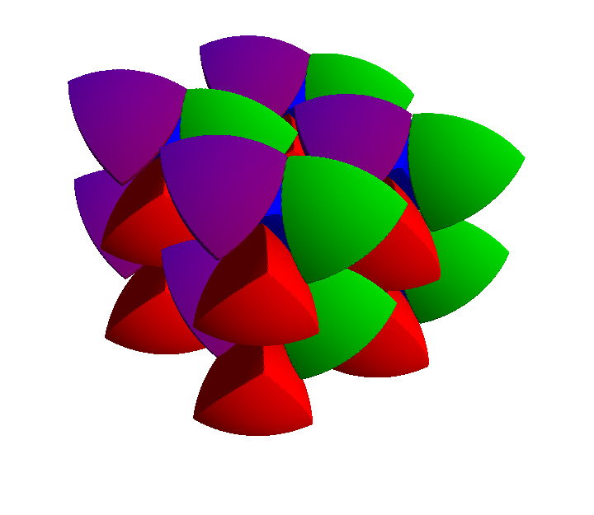
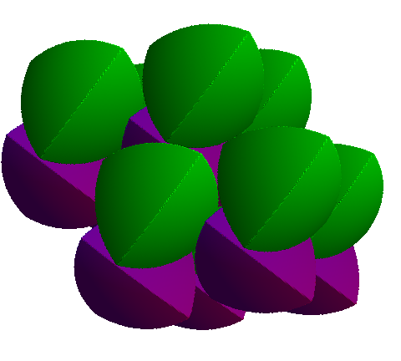
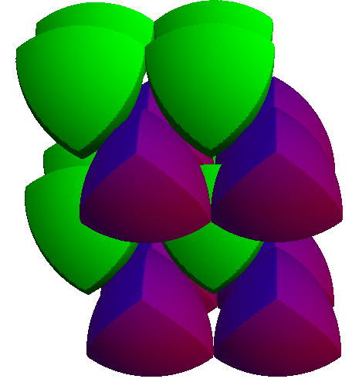
“physical” tetrahedra
Kallus & Elser, preprint (2010)

