Slide 1
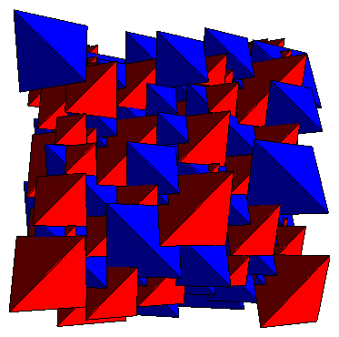
Tetrahedron Packing
Yoav Kallus
Cornell University
Geometry Seminar
Courant Institute
February 9, 2010
1
Veit Elser, Simon Gravel

Slide 2
General packing problem
Let φm a x(K) be the highest achievable density for packings of
convex d-dimensional body K.
2D periodic examples:
φ = 0.817
φ = 0.854
φ = 0.921
N = 1
N = 2
N = 2
φm a x(K) for d > 2 known only for spheres, space-filling solids.
2

Slide 3
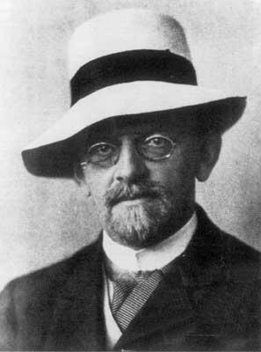
From Hilbert's 18th problem:
“How can one arrange most densely in space an infinite number of equal solids of a given form, e.g., spheres with given radii or regular tetrahedra with given edges (or in prescribed position), that is, how can one so fit them together that the ratio of the filled to the unfilled space may be as large as possible?”
David Hilbert
(1862-1943)
3

Slide 4
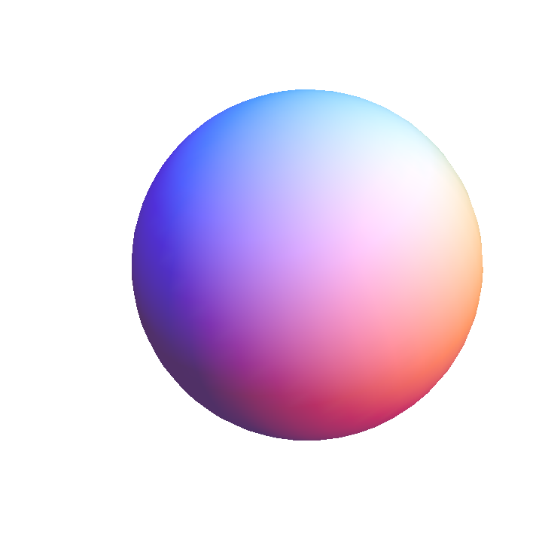
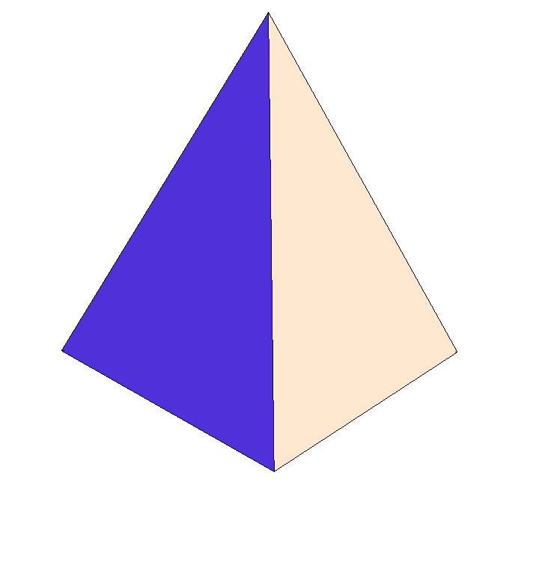
φ
Some upper and lower bounds
1.0
0.9
0.7796 Rogers (1958)
0.8563 Chen et al. (2010)
0.7731 Muder (1993)
0.8547 Kallus et al. (2009)
0.8
0.7405 Hales (2005)
0.7786 Chen (2008)
0.7175 Conway &
Torquato (2006)
0.7
4

Slide 5
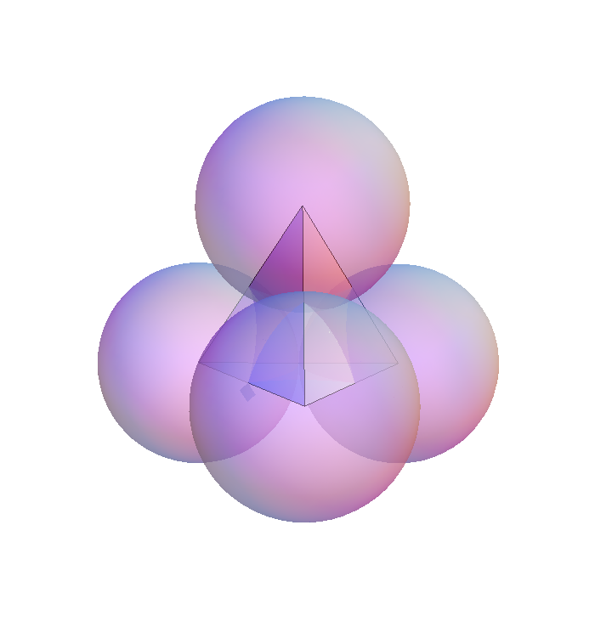
Rogers bound
φ(B) ≤ 0.7796
Argument: the sphere cannot fill its
Voronoi region, a polyhedron
5

Slide 6
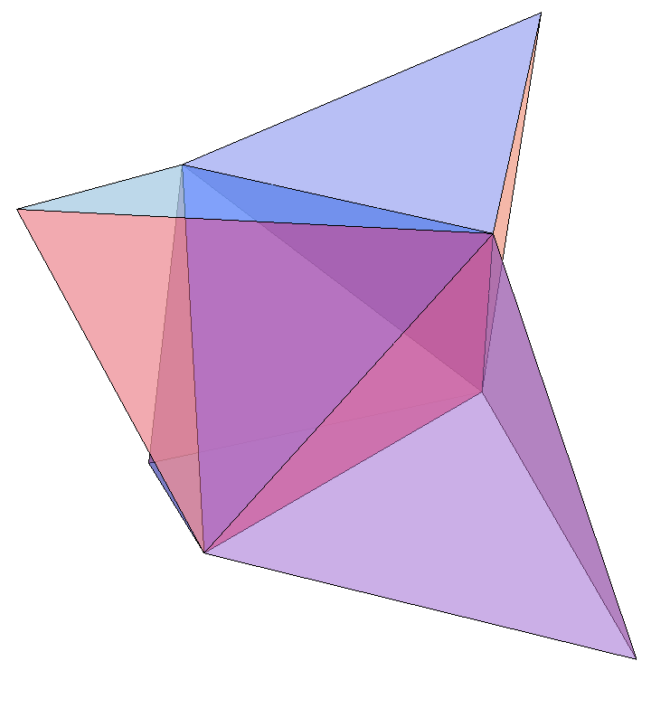
Rogers bound
φ(B) ≤ 0.7796
Argument: the sphere cannot fill its
Voronoi region, a polyhedron
The tetrahedron can easily
fill its Voronoi region
6

Slide 7
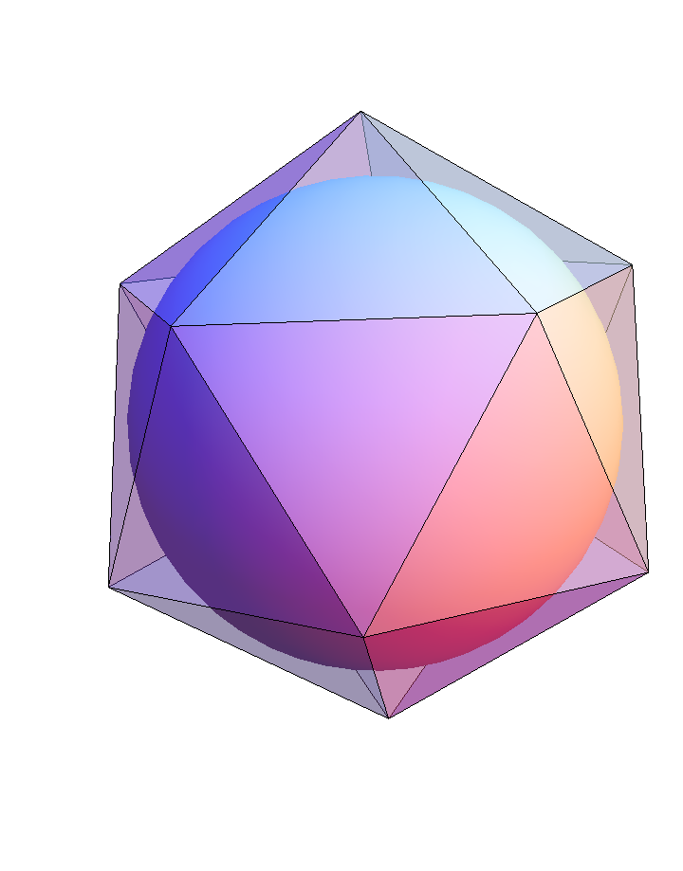
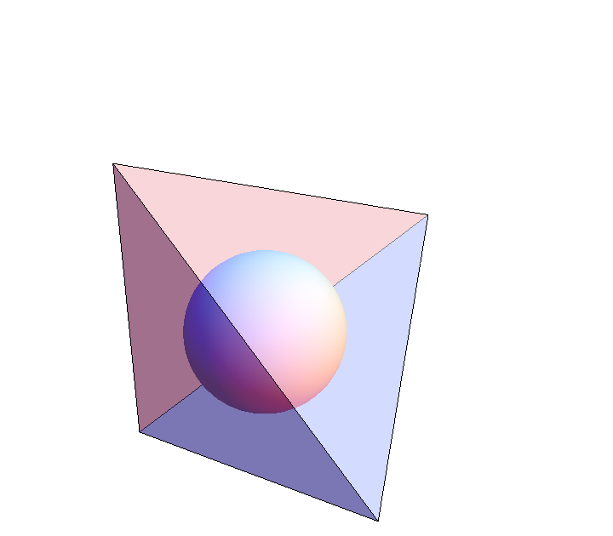
Bound from inscribed spheres
φ(I) ≤ 0.8934
Compare to lower bound: φ(I) ≥ 0.8364
φ(T) ≤ 2.449
7

Slide 8
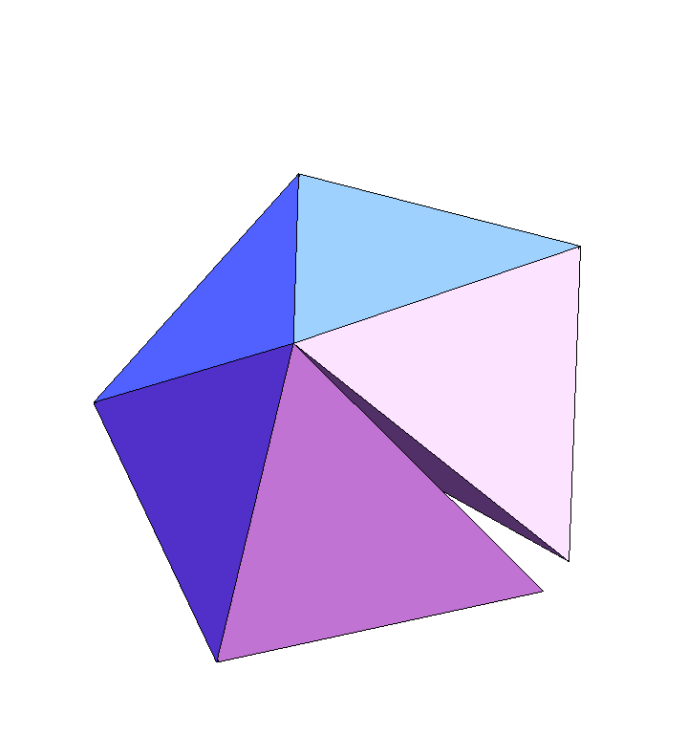
Regular tetrahedra do not fill space
Missing angle: 7.4º
Therefore, φ(T) < 1
But can we find φ^{U} < 1 such that φ(T) ≤ φ^{U}?
We believe we have come up with an argument giving the first non-trivial upper bound on the packing density of tetrahedra, but we feel kind of silly reporting it:
8

Slide 9
Regular tetrahedra do not fill space
Missing angle: 7.4º
Therefore, φ(T) < 1
But can we find φ^{U} < 1 such that φ(T) ≤ φ^{U}?
We believe we have come up with an argument giving the first non-trivial upper bound on the packing density of tetrahedra, but we feel kind of silly reporting it:
φ(T) ≤ 1 – (2.6...) x 10⁻ ² ⁸
9

Slide 10
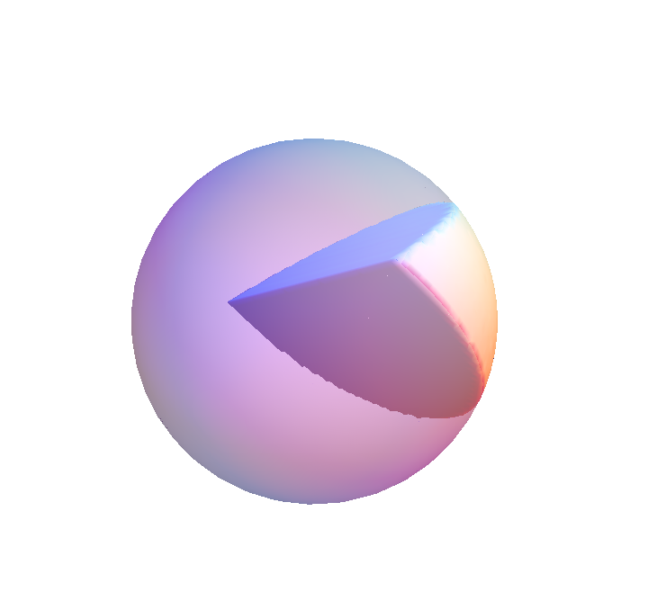
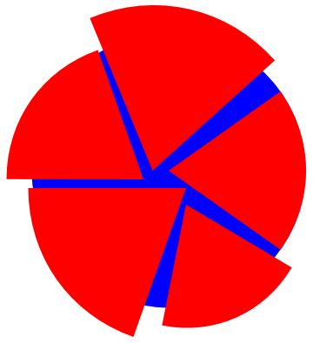
Bound from angle mismatch?
“Wedge”
If we can put a lower bound the amount of uncovered space in a unit ball with five non-overlapping wedges, we can get a non-trivial upper bound on the density of a tetrahedron packing.
10

Slide 11
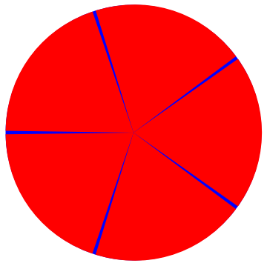
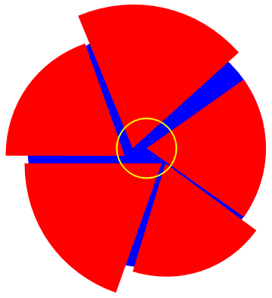
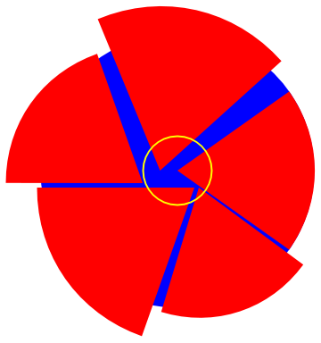
If all wedge edges pass through the center, we can easily calculate the uncovered volume. Unfortunately, this isn't given.
Still, if all wedge edges pass within a given distance of the center, we can still easily calculate a bound on the uncovered volume.
And if one or more edge wedges fall outside the yellow sphere, we are left with a simpler configuration inside the yellow sphere, and we can try to put a bound on the uncovered volume inside it.
By applying this argument iteratively, we get a bound on the unfilled space in the original sphere, but that bound is very small.
11

Slide 12
φ
Some upper and lower bounds
1.0
0.9
0.7796 Rogers (1958)
0.8563 Chen et al (2010)
0.7731 Muder (1993)
0.8547 Kallus et al. (2009)
0.8
0.7405 Hales (2005)
0.7786 Chen (2008)
0.7175 Conway &
Torquato (2006)
0.7
12

Slide 13
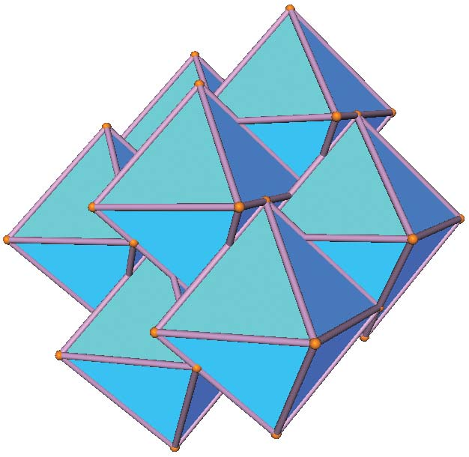
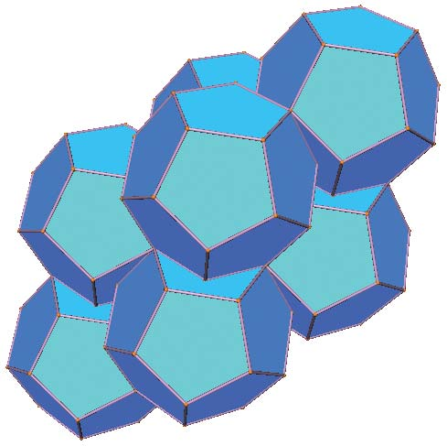
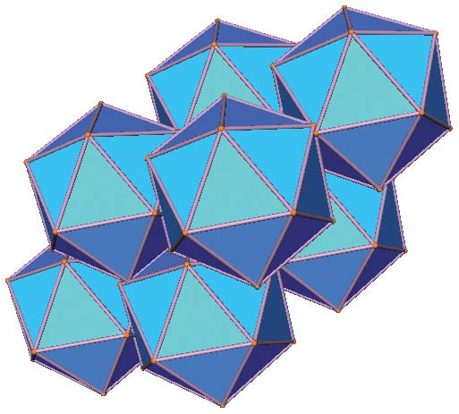
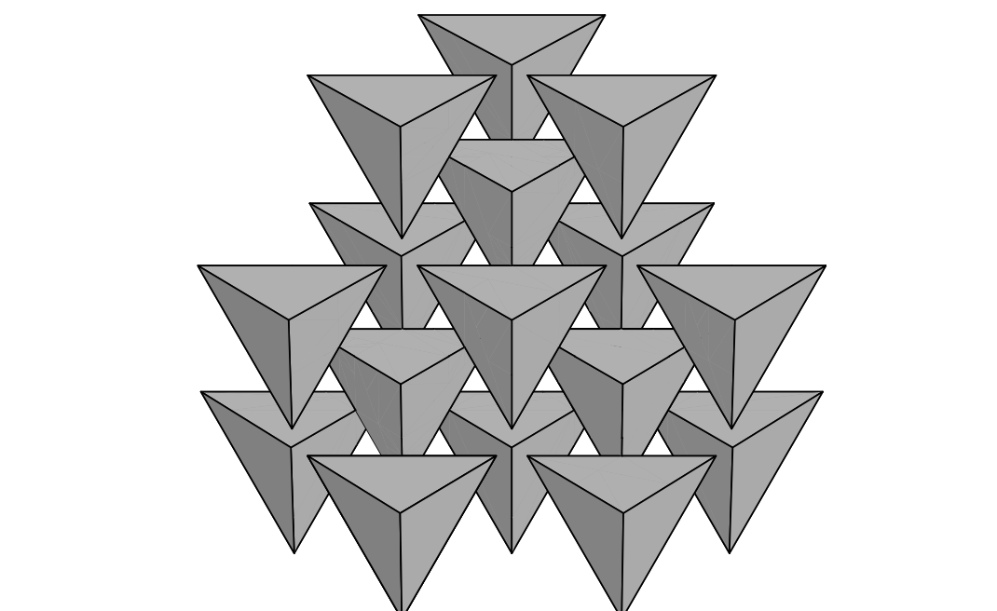
Densest known packings of the Platonic solids
φ = 0.9474
φ = 0.9045
φ = 0.8364
All are lattice packings (N=1)
Compare with densest lattice packing of regular tetrahedra:
φ = 0.3673
13

Slide 14
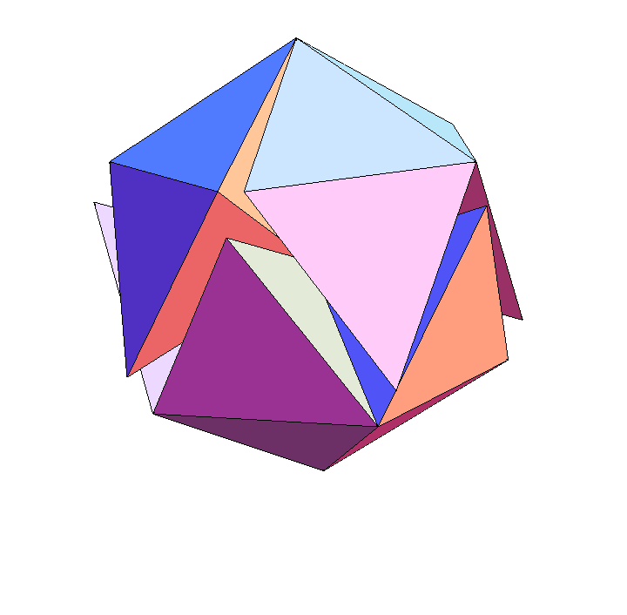
Lower bounds (densest known packings)
1. Conway & Torquato (2006)
Icosahedral packing: φ = 0.7166
N=20
“Welsh” packing: φ = 0.7175
N=34
14

Slide 15
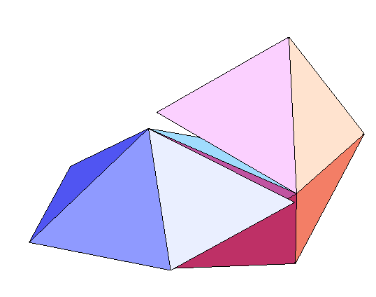
Densest known packings
2. Chen (2008)
“wagon wheels” packing: φ = 0.7786
N=18
φ > φm a x(B)
15

Slide 16
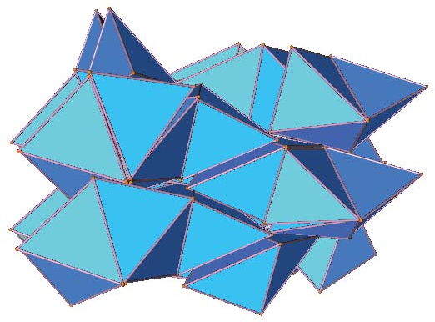
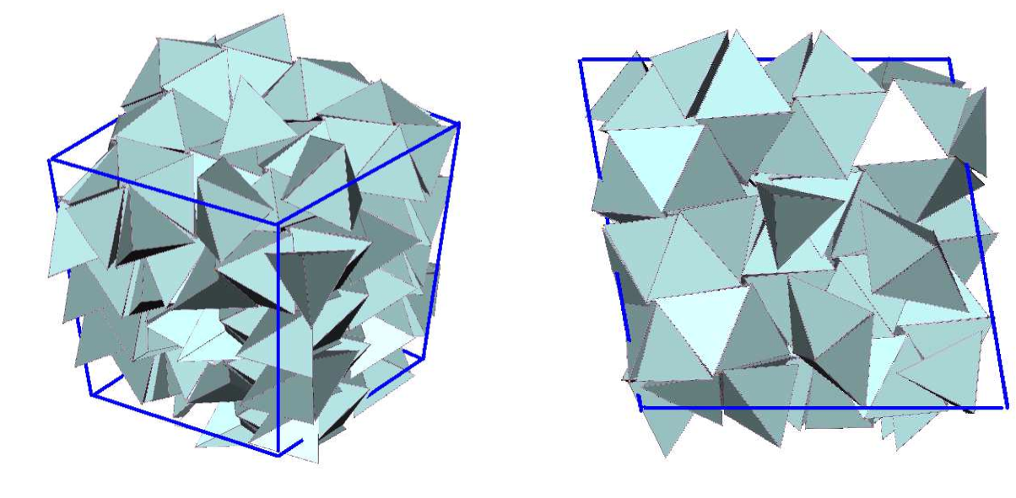
Densest known packings
3. Torquato & Jiao (2009)
Challenge for numerical search: highly frustrated optimization problem
φ = 0.7820 (April)
N = 72
Search often got stuck at local optima
φ = 0.8226 (July)
N = 314
16

Slide 17
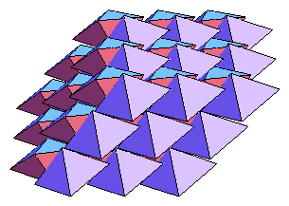
Densest known packings
4. Kallus et al. (2009)
Method: “divide and concur”, designed for highly frustrated problems
φ = 0.8547
N = 4 (!)
All tetrahedra equivalent
(tetrahedron-transitive packing)
5. Chen et al. (2010)
Slight analytical improvement to the above structure: φ = 0.8563
(New, denser, packing is no longer tetrahedron-transitive)
17

Slide 18
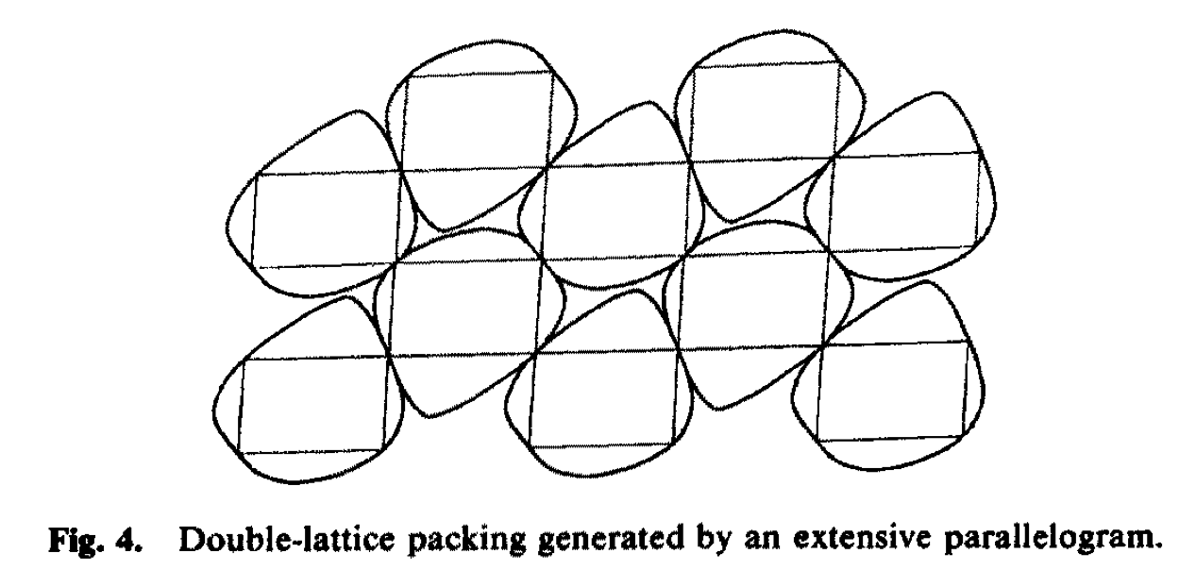
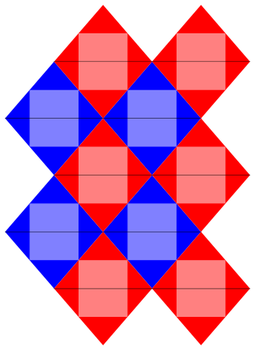
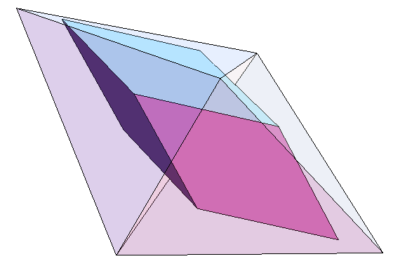
Dimer double lattice
G. Kuperberg & W. Kuperberg (1990):
Any convex planar body can be
packed with density at least .866
by a double lattice.
4D?
2D
3D
18

Slide 19
Hard Tetrahedron Fluid
Large system of hard tetrahedra defined by the thermodynamic ensemble:
Prob. ~ exp(-P V / kBT)
Densest packing corresponds to ground state (kBT / P = 0).
Ordering transitions in hard particle systems:
e.g. spheres: fluid → crystal
cylinders: fluid → nematic → crystal
Kolafa & Nezbeda (1994): “there may be a close similarity between the structural properties of the hard tetrahedron fluid and another 'anomalous' fluid, namely, water”
19

Slide 20
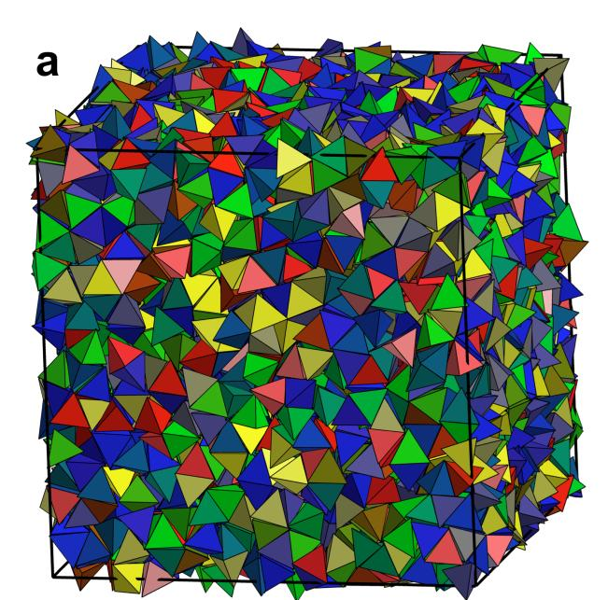
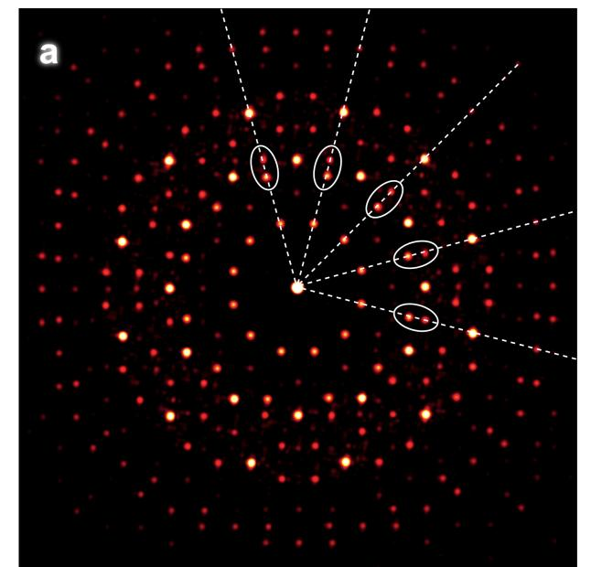
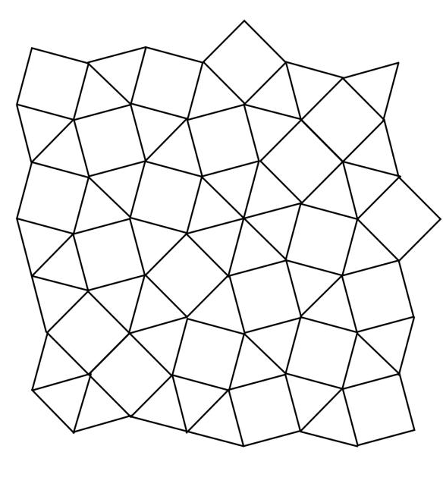
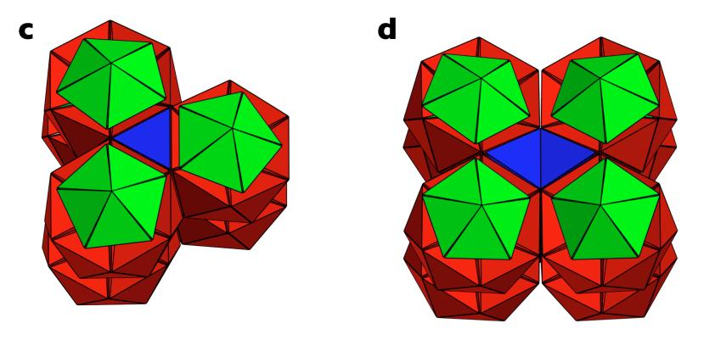
Hard Tetrahedron Fluid – quasicrystal transition
Haji-Akbari, Engel, et al. (2009)
φ = 0.8503
20

Slide 21

Hard Tetrahedron Fluid –
quasicrytal transition
Why doesn't the hard tetrahedron fluid form the dimer double lattice crystal under pressure?
The tetrahedra know something we don't
i.e. there is a yet undiscovered quasicrystalline packing denser than the crystal packing
We know something that the tetrahedra don't
An “ice-nine” hard tetrahedron phase?
21

Slide 22
Summary:
Tight upper bound is hard to achieve.
Dense packings (lower bounds) are hard to search for, due to a “rugged” optimization landscape.
Hard tetrahedron fluid exhibits unexpected and anomalous behavior.
22

