Slide 1
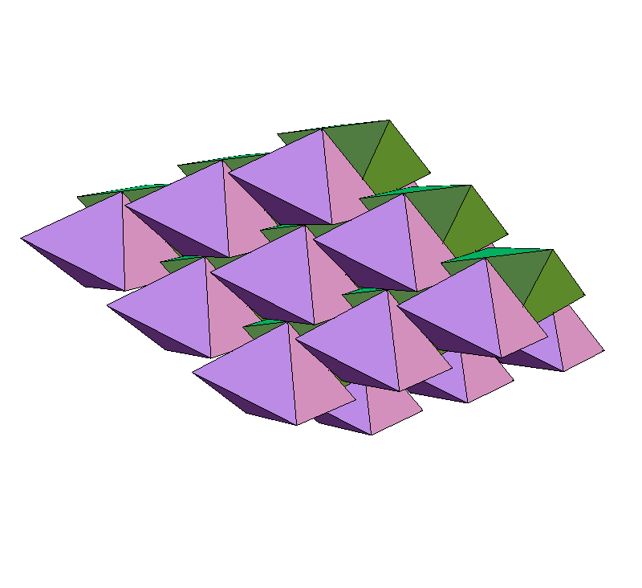
The Divide and Concur
approach to packing
Yoav Kallus
Physics Dept.
Cornell University
j/w:
Veit Elser
Simon Gravel
Shanks Conference
Vanderbilt University May 17, 2010

Slide 2
Packing problems:
Optimization: given a collection of figures, arrange them without overlaps
as densely as possible.
Feasibility: find an arrangement of density > φ
Possible computational approaches:
Complete algorithm
Specialized incomplete (heuristic) algorithm
General purpose incomplete algorithm
e.g.: simulated annealing, genetic algorithms, etc.
Divide and Concur belongs to the last category

Slide 3

Two constraint feasibility
Example:
A = permutations of “ailmopt”
B = 7-letter English words

Slide 4
Two constraint feasibility
Example:
A = permutations of “ailmopt”
B = 7-letter English words
x = “optimal”

Slide 5
More structure
A, B are sets in a Euclidean configuration space Ω
simple constraints:
easy, efficient projections to A, B

Slide 6
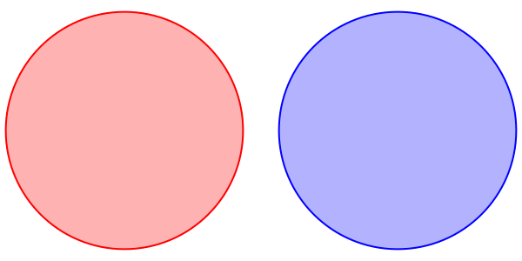
Projection to the packing (no overlaps) constraint

Slide 7
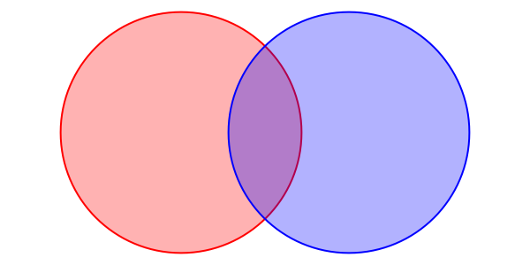
Projection to the packing (no overlaps) constraint

Slide 8
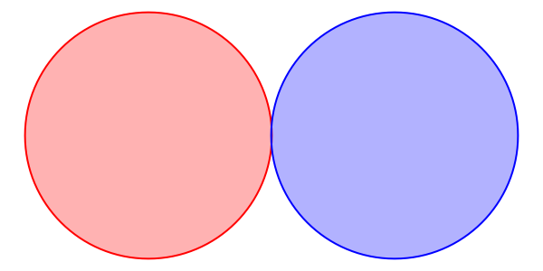
Projection to the packing (no overlaps) constraint

Slide 9
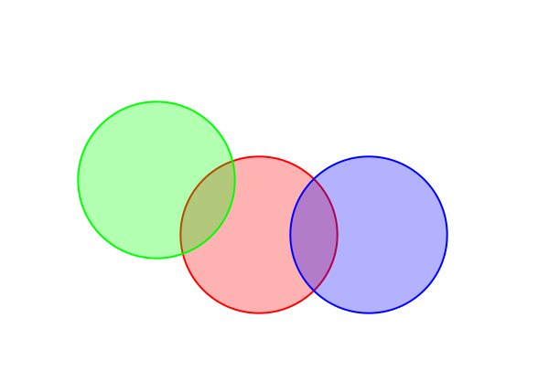
Dividing the Constraints

Slide 10
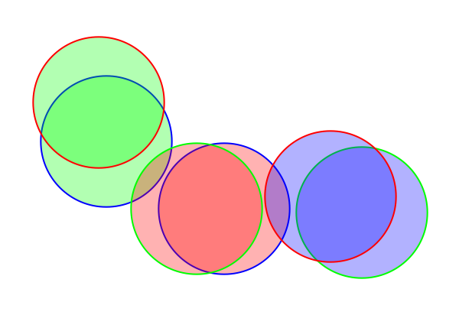
Dividing the Constraints

Slide 11
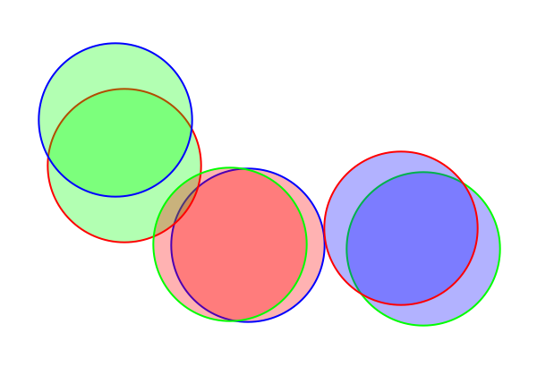
Dividing the Constraints

Slide 12
Projection to concurrence constraint

Slide 13
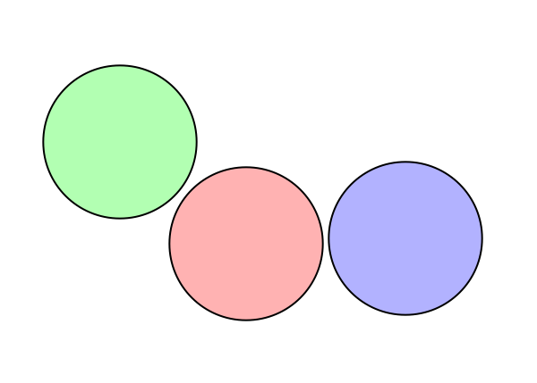
Projection to concurrence constraint

Slide 14
Divide and Concur scheme
A
B
No overlaps between designated replicas
All replicas of a particular figure concur
“divided” packing constraints
“concurrence” constraint

Slide 15
What can we do with projections?
alternating projections:
Douglas-Rachford iteration (a/k/a difference map):

Slide 16
Brief (incomplete) history of
J. Douglas and H. H. Rachford, On the numerical solution of
heat conduction problems in two or three space variables,
Trans. Am. Math. Soc. 82 (1956), 421–439.
splitting scheme for numerical PDE solutions
J.R. Fienup, Phase retrieval algorithms: a comparison, Applied
Optics 21 (1982), 2758-2769.
rediscovery, control theory motivation, phase retrieval
V. Elser, I. Rankenburg, and P. Thibault, Searching with iterated
maps, PNAS 104, (2007), 418-423.
generalized form, applied to hard/frustrated problems:
spin glass, SAT, protein folding, Latin squares, etc.

Slide 17
Finite packing problems
Gravel & Elser, Phys. Rev. E (2008)

Slide 18
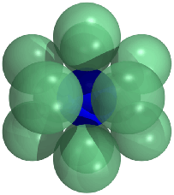


Finite packing problems
The kissing number problem in 10D
Elser & Gravel, Disc. Compu. Geom. (2010)

Slide 19
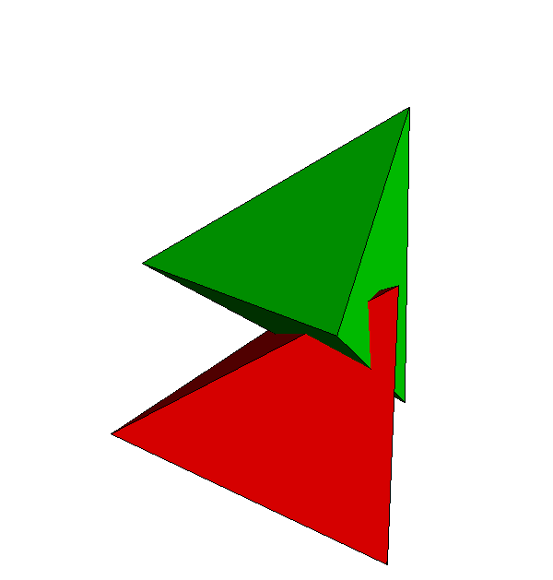
Generalization to non-spherical Particles

Slide 20
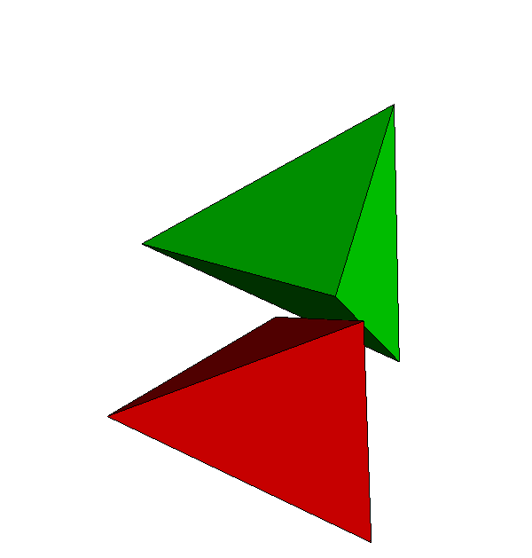
Generalization to non-spherical Particles

Slide 21
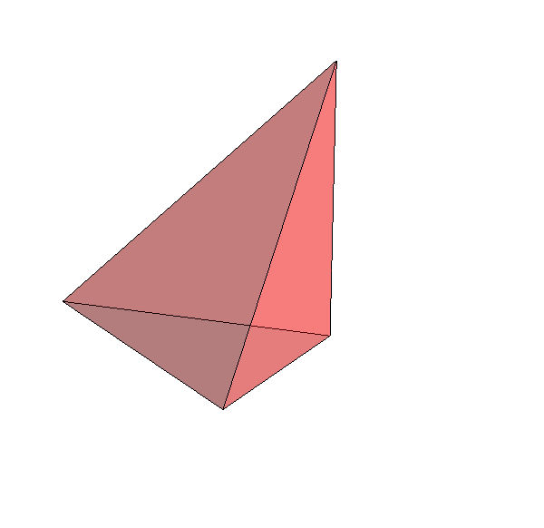
Generalization to non-spherical Particles
A
B
“divided” packing constraints (rigidity relaxed)
“concurrence” + rigidity constraints

Slide 22
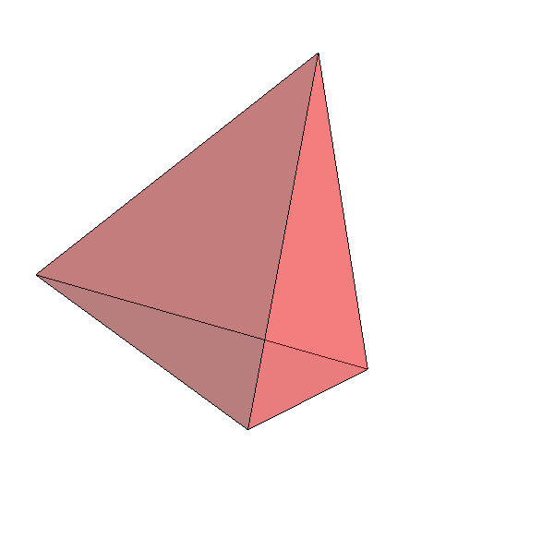
Generalization to non-spherical Particles
A
B
“divided” packing constraints (rigidity relaxed)
“concurrence” + rigidity constraints

Slide 23
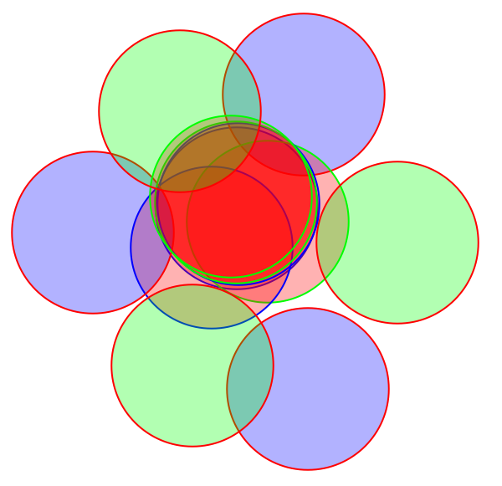
Generalization to periodic packings
replicas
replicas + periodic images

Slide 24
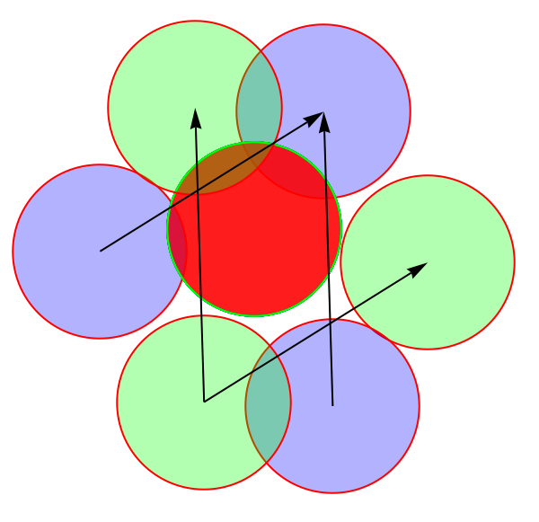
Generalization to periodic packings
replicas
replicas + periodic images

Slide 25
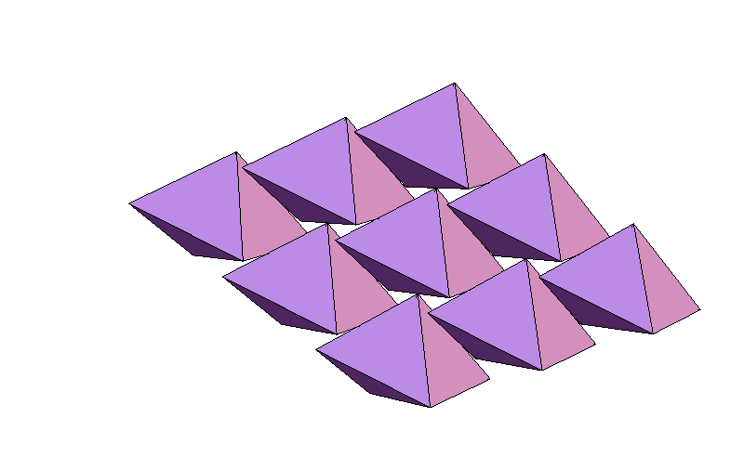
Regular tetrahedron packing
(Stay tuned for next talk)
Kallus, Elser, & Gravel, Disc. Compu. Geom. (2010)

Slide 26
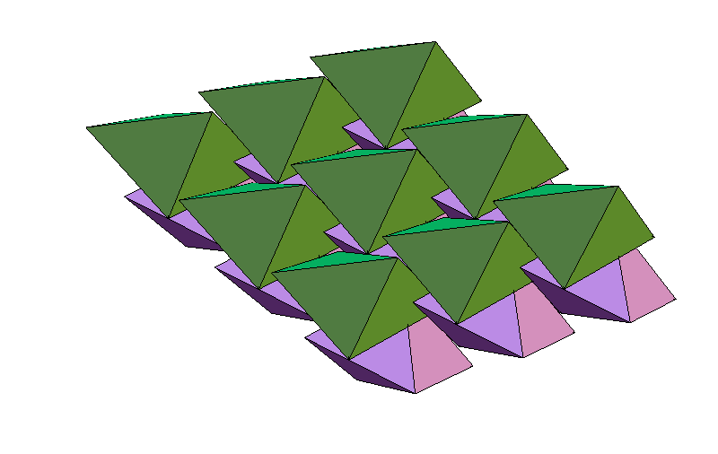
Regular tetrahedron packing
Kallus, Elser, & Gravel, Disc. Compu. Geom. (2010)

Slide 27
Regular tetrahedron packing
Kallus, Elser, & Gravel, Disc. Compu. Geom. (2010)

Slide 28
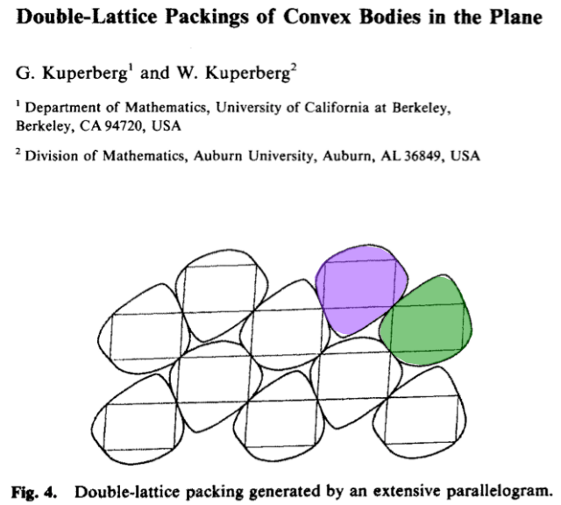
Disc. Compu. Geom. (1990)

Slide 29
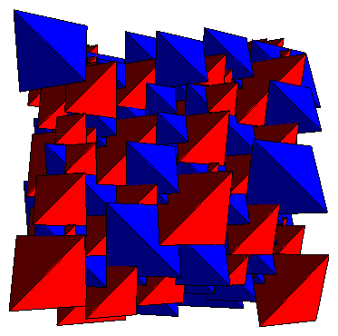
Regular pentatopes!
φ = 128/219 = 0.5845
Kallus, Elser, & Gravel, arXiv: 1003.3301 (2010)

Slide 30
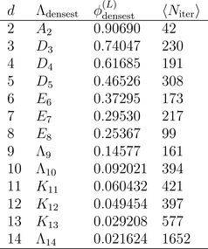
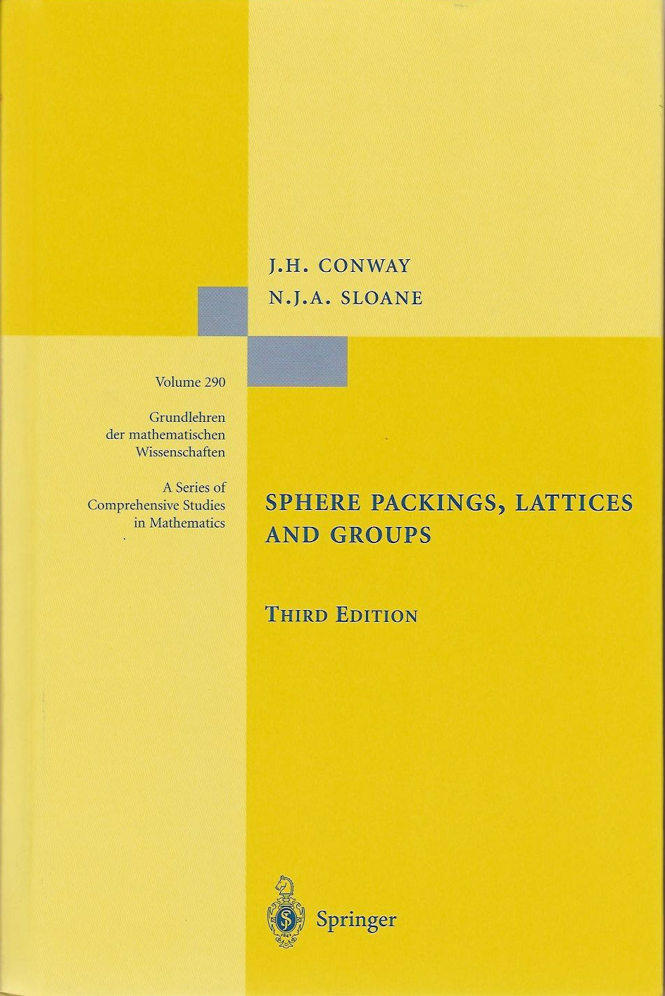
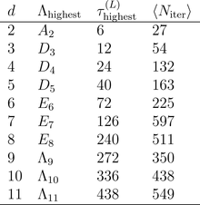
Sphere packing and kissing in higher dimensions
Densest known
lattice packing
in d dimensions:
lattice with highest
known kissing
number in d
dimensions:
Kallus, Elser, & Gravel, arXiv: 1003.3301 (2010)

Slide 31
Tetrahedron packing upper bound
Optimization challenge:
1. Prove φ ≤ 1 – ε, where ε > 0
2. Maximize ε

Slide 32
Tetrahedron packing upper bound
Tetrahedron packing upper bound
Optimization challenge:
1. Prove φ ≤ 1 – ε, where ε > 0
2. Maximize ε
2'. Minimize length of proof
Solution: ε = 5.01... x 10⁻ ² ⁵ (15 pages)
Gravel, Elser, & Kallus, preprint

