Slide 1
SignSpeak AI
Real-Time American + Arabic Sign Language Translation
CSCI435 - University of Wollongong in Dubai
Yousef Kanjo, Member 2, Member 3, Member 4, Member 5

Slide 2
Problem and user story
- Deaf UOWD students rely on a small pool of sign-language interpreters whose availability is constrained. - When an interpreter is unavailable, normal office-hour and lecture conversations break down. - Aisha (deaf, 3rd-year CS) opens SignSpeak AI in any browser. She signs in Arabic Sign Language; the system shows the text on screen and reads it aloud through Web Speech TTS. The hearing professor responds verbally. Conversation flows.

Slide 3
Eight CV capabilities (only 4 required)
1. Image enhancement - CLAHE 2. Image segmentation - MediaPipe Selfie 3. Binary morphological ops - erode + dilate 4. Keypoint detection - MediaPipe Holistic 5. Face detection - 468 face landmarks 6. Edge detection - Canny on hand crop 7. Video processing - optical flow + voting 8. Object recognition - MobileNetV3 + MLP ensemble

Slide 4
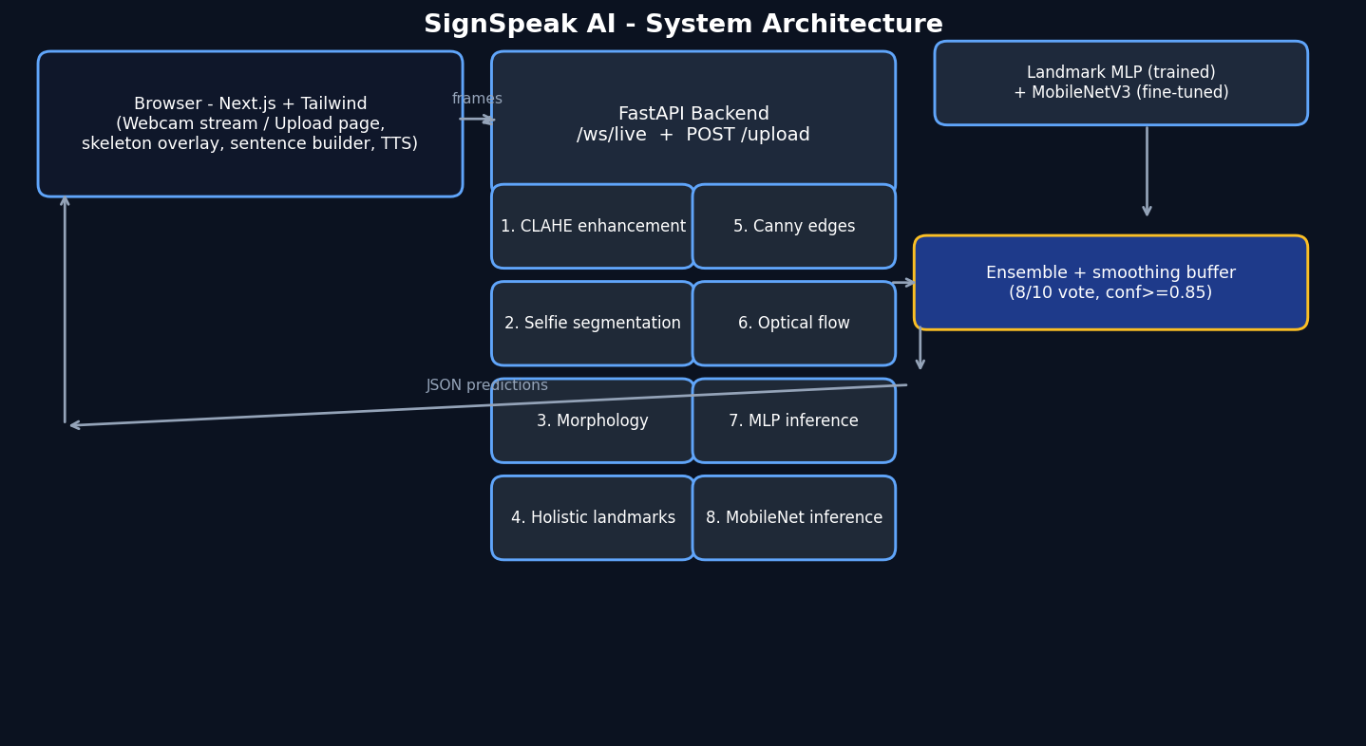
System architecture

Slide 5
Per-frame pipeline
Each WebSocket frame at 15 FPS: 1. CLAHE enhancement on LAB L channel 2. MediaPipe Selfie segmentation -> foreground mask 3. Open + close morphology cleans the mask 4. MediaPipe Holistic -> 21 hand + 468 face + 33 pose keypoints 5. Canny edges on the hand crop (auxiliary) 6. Optical-flow magnitude on consecutive hand landmarks 7. Landmark MLP inference (63-D vector -> 61 classes) 8. MobileNetV3-Small inference (96x96 crop -> 61 classes) Ensemble + 8-of-10 vote + conf>=0.85 -> stable label

Slide 6
Models and training
Landmark MLP (trained from scratch on our curated data) - 63 -> 256 -> 128 -> 64 -> 61, BatchNorm, dropout 0.3 - 20 epochs, AdamW 1e-3, cosine annealing, label smoothing 0.05 - On-line augmentation: rotation +/-10 deg, scale jitter, noise MobileNetV3-Small (ImageNet pretrained, fine-tuned) - Backbone frozen except last conv block - Final classifier replaced with 1024 -> 61 linear - 5 epochs, AdamW, ColorJitter + small rotations Both checkpoints loaded at startup by backend/app/models/ensemble.py.

Slide 7
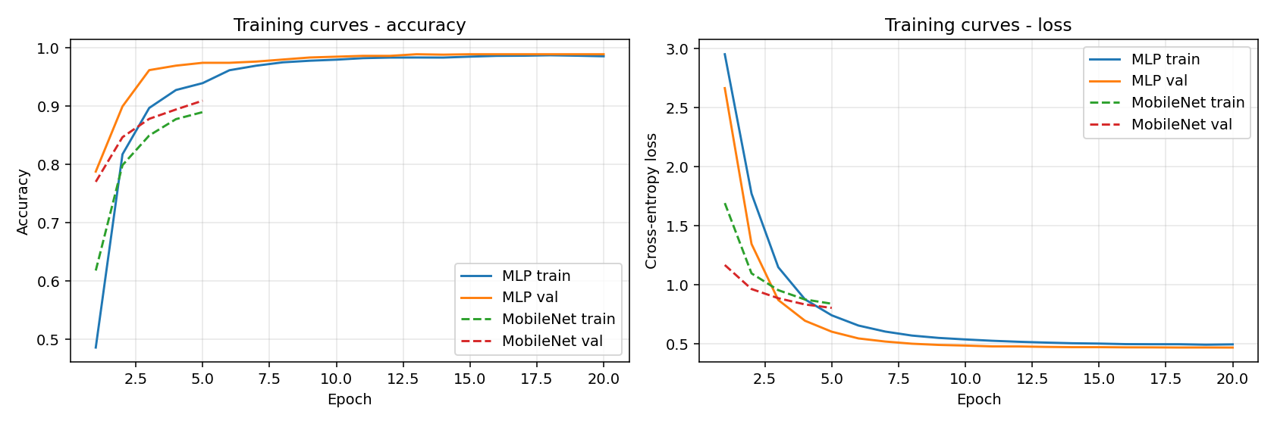
Results - accuracy
Subset | Accuracy | N
Overall (ASL + ArSL) | 0.9888 | 1431
ASL only | 0.9930 | 1421
ArSL only | 0.4000 | 10

Slide 8
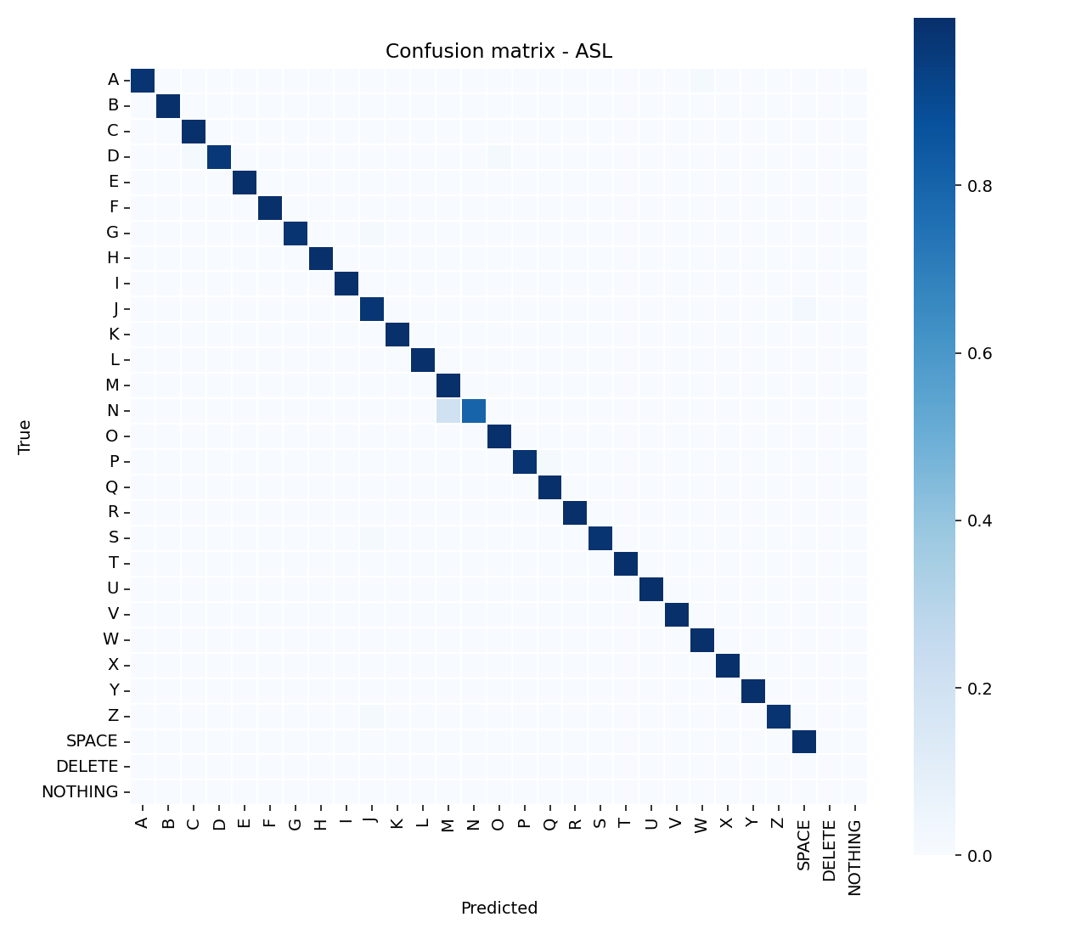
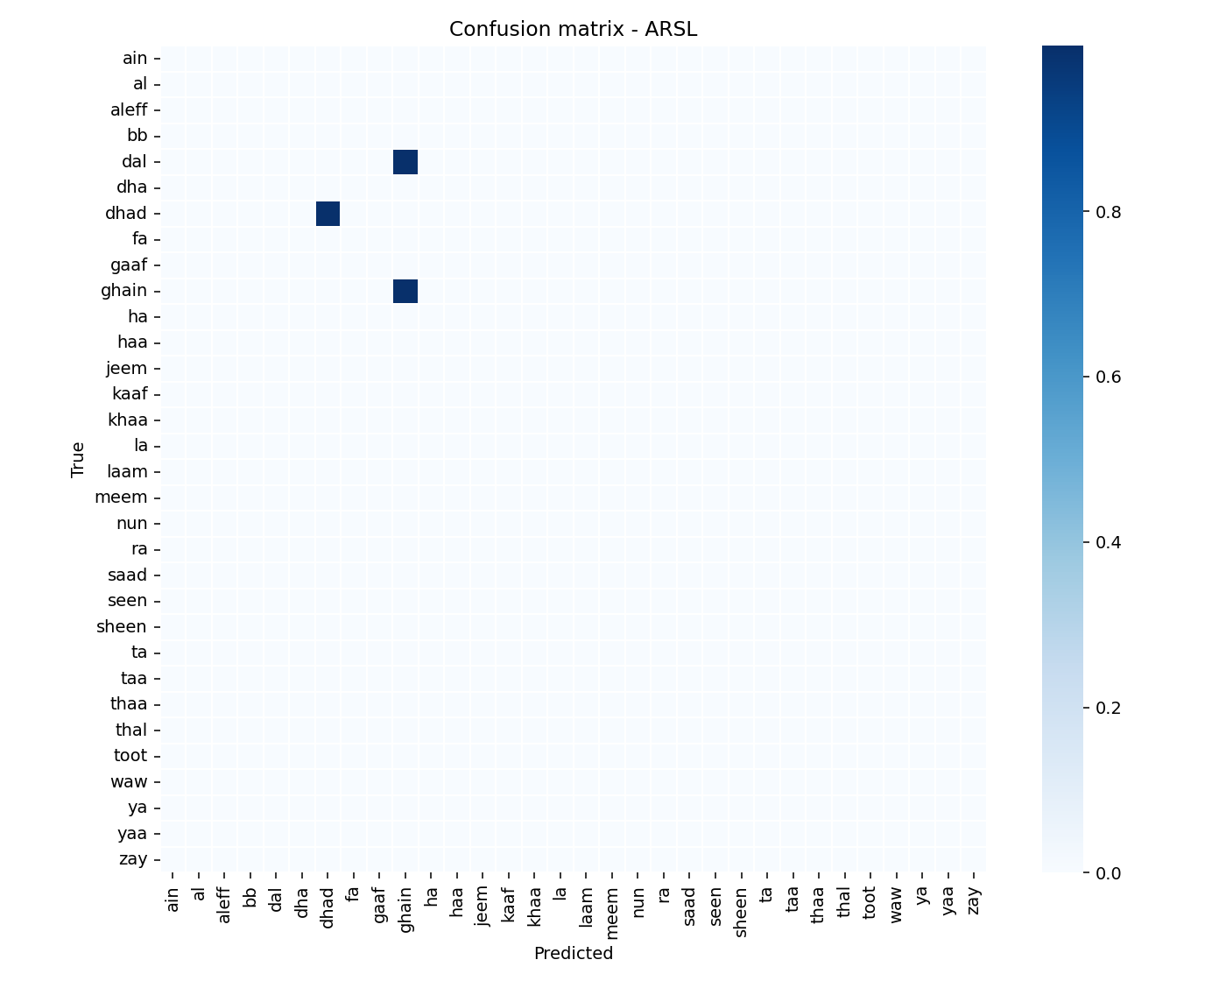
Results - confusion matrices

Slide 9
Results - latency, ablation
Latency & FPS
Ablation study
Metric | Value
Mean latency ms | 42.28
P95 latency ms | 73.26
FPS (sustained) | 23.65
Frames measured | 30
Variant | Accuracy
Landmark MLP (baseline) | 0.9888
Landmark MLP (z=0) | 0.9483
Landmark MLP + 3% noise | 0.9839

Slide 10
Live demo plan
1. Open http://localhost:3000 and click 'Start live mode' 2. Show webcam + skeleton overlay + 25 FPS in stats panel 3. Sign A, B, C in ASL - letters appear; confidence > 95% 4. Spell H-E-L-L-O - sentence builder fills 5. Click 'Speak' - English TTS says 'Hello' 6. Toggle to ArSL - sign 2 Arabic letters - Arabic glyphs appear 7. Switch to 'Upload' page - drop a pre-recorded clip - transcript renders 8. Back to live - dim the lights to show CLAHE robustness 9. Q&A

Slide 11
Limitations and future work
Limitations - Fingerspelling only; no continuous sentence-level signs yet - Single-hand pipeline; two-handed signs are not modelled - 32 ArSL letters supported; ArSL has > 100 dynamic signs Future work - Add WLASL temporal model for whole-word signs - React Native client with TFLite for on-device inference - Bidirectional - text-to-sign avatar for hearing -> deaf direction - Expand custom dataset with UAE community contributions

Slide 12
Thank you
Questions?
github.com/ykanjo04/SignSpeak-AI

