Slide 1
CS230: Deep Learning
Midterm Review
Section 6

Slide 2
Agenda
Gradients + Propagation (Forward + Backward) (Section 2)
Batch Normalization
Overfitting & Underfitting
Overfitting, Training, and Hyperparameters
Accuracy Metrics + Tuning
CNNs
Coding Exercise

Slide 3
Workera Announcment
If you want to practice more for the midterm, you can use the Workera link provided on Ed.

Slide 4
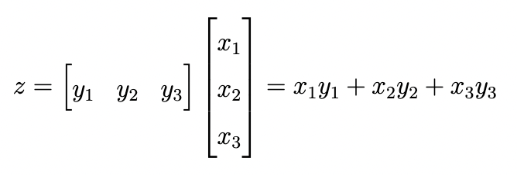
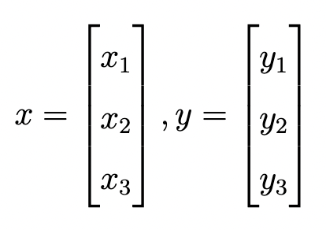
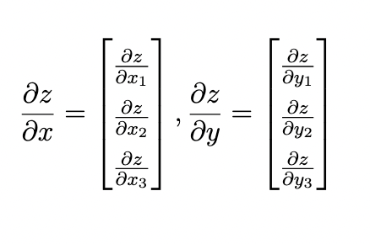
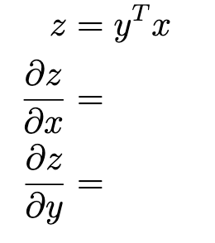
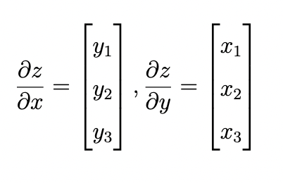

Gradient Review
NOT THE SAME SINCE DIMENSIONS OF X AND dX MUST MATCH SINCE dX IS THE GRADIENT WITH RESPECT TO A REAL-VALUE Z

Slide 5
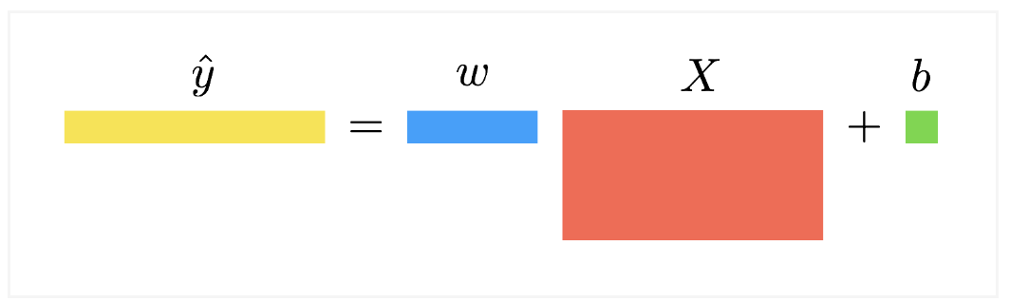
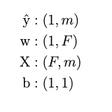
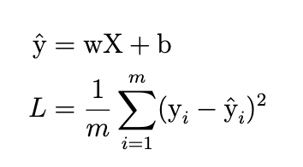
Multi-Variable Linear Regression (Forward + Batched)
Note the importance of the ORDER of matrix multiplication. wX and Xw are NOT the same. Use the dimensions of input and output to see what is correct.
A matrix of size (a x b) multiplied by a matrix of size (b x c) to its right will result in a matrix of size (a x c). We need to make sure the second dimension of the left matrix is equal to the first dimension of the right matrix. In this case, both are b

Slide 6
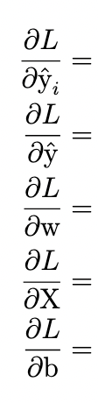
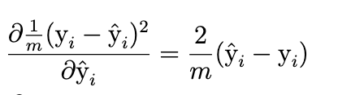


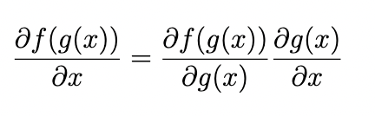

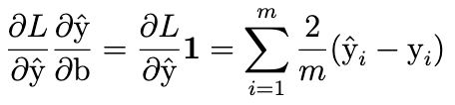
Multi-Variable Linear Regression (Backward + Batched)
Use the chain rule!

Slide 7
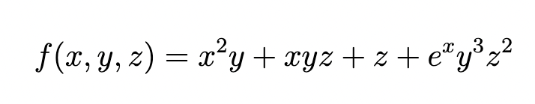
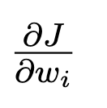
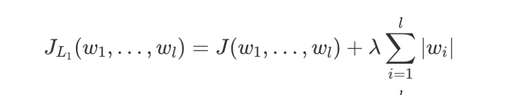
Gradients Exercises
Compute the gradient of the following with respect to x,y,z
Compute the gradient of the following with respect to w_i (leave answer in terms of

Slide 8
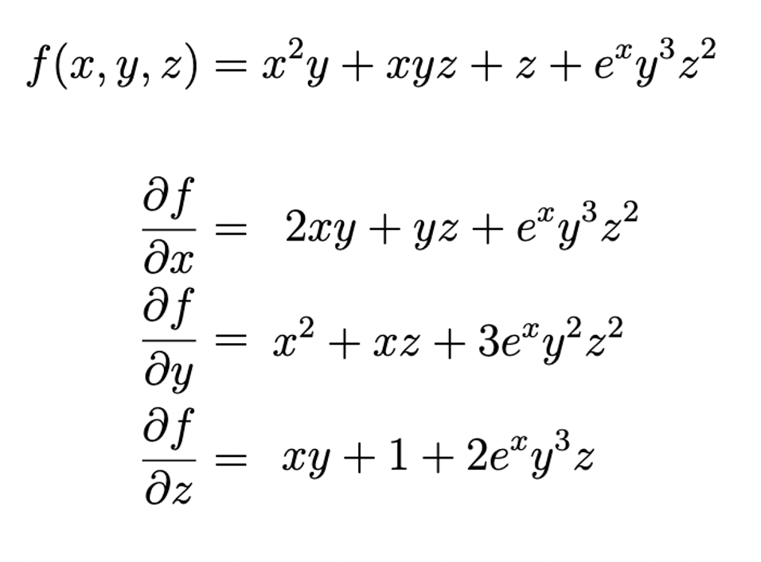
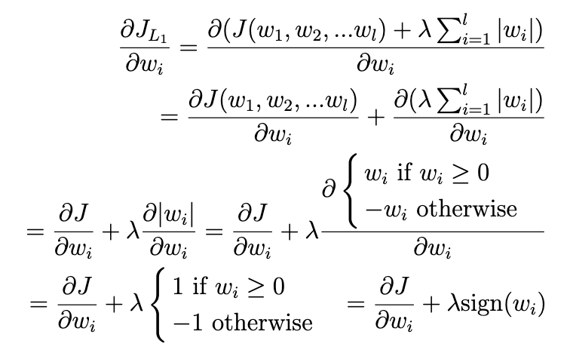
Gradient Exercises

Slide 9
Additional Gradient Computations
Activation Functions -> Used to add non-linearities into models
ReLU
Sigmoid
Tanh
Residual Connections -> Often used to combat vanishing gradients
Common Loss Functions -> Need a function which can be backpropagated on
Mean Squared Error (MSE)
Cross Entropy Loss
Binary Cross Entropy Loss

Slide 10
Batch Normalization
During training, normalize each feature based on the batch it’s in.
Subtract mean, then divide by standard deviation of that batch
Do this for each feature separately
Learn a gamma and beta to re-shift the normalized feature as needed
gamma * feature + beta -> different gamma and beta for each feature
gamma and beta are trainable parameters -> backpropagated
During testing, normalize each feature based on moving average/moving standard deviation of training examples.
Subtract moving mean, then divide by moving standard deviation Multiply by learned gamma and add beta.

Slide 11
Overfitting & Underfitting
Overfitting:
High Variance
Train performance significantly better than test performance
Validation loss increasing after a certain point
Underfitting:
High Bias
Train and test loss nearly identical
High loss, no signs of decreasing

Slide 12
Combatting Overfitting & Underfitting
Overfitting:
Increase amount of data
Utilize data augmentation methods
Decrease model size/complexity
Implement early stopping
Utilize regularization techniques
Underfitting:
Increase model size and complexity
Train for a longer period of time
Reduce regularization techniques

Slide 13
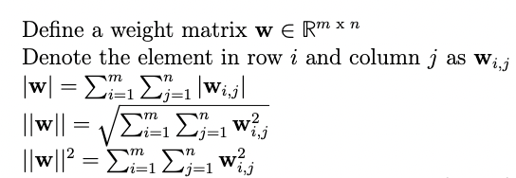
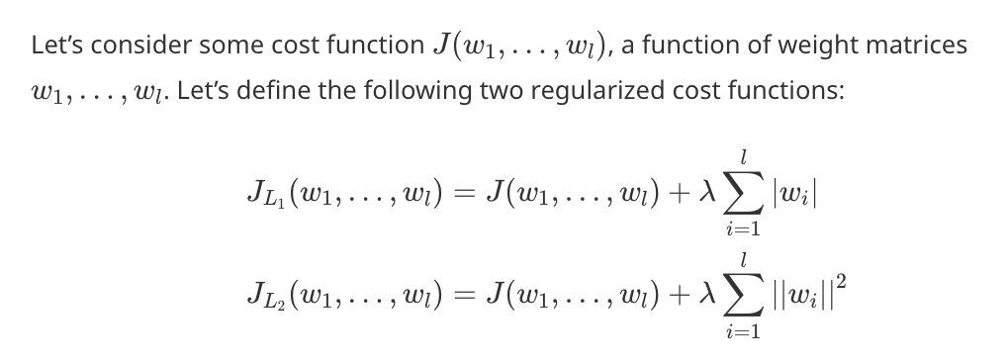
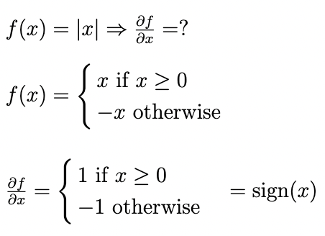
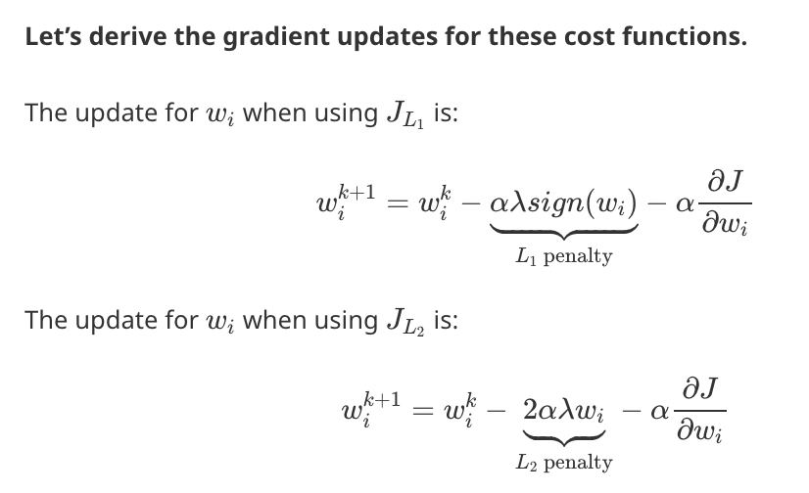

L1 and L2 Regularization
L1 Regularization generally pushes many values to 0 (sparser weights)
L2 Regularization generally more heavily impacts larger values, and doesn’t force many values to 0

Slide 14
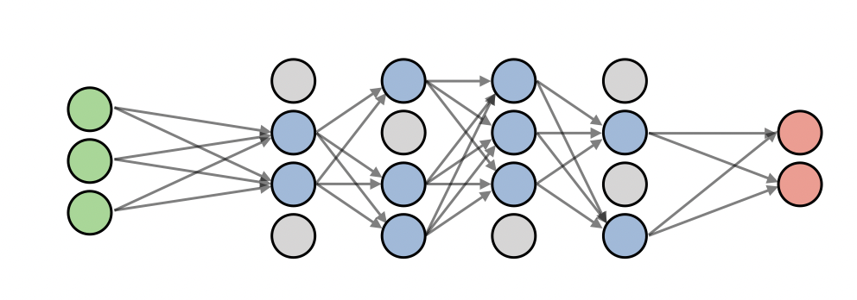
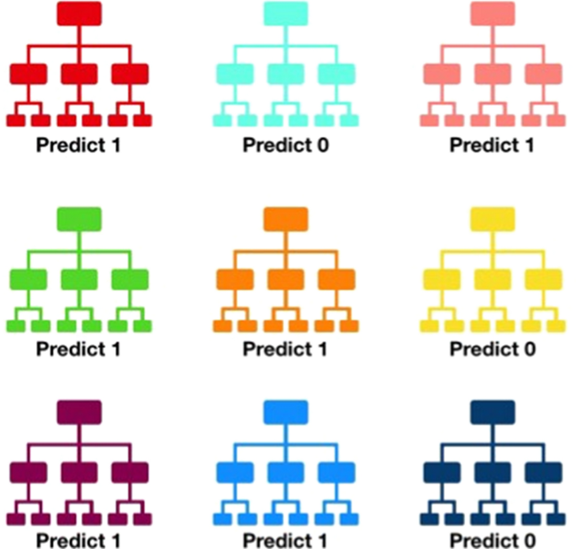
Dropout
With some specified p, drop any given neuron of the neural network with probability p during a training iteration. Do this for each neuron independently.
Only applies during training. During testing, all neurons are turned on and dropout is disabled.
Helps prevent overfitting by making the model more generalizable. Doesn’t improve model’s capacity, rather focuses on generalizability of the model.
Intuitive Explanation:
We are training a forest of models to make our evaluation.
During testing, we bring all these uniquely trained models together and make an aggregate evaluation.
Avoids single neurons becoming overly important and helps equalize capacity/power of each neuron

Slide 15
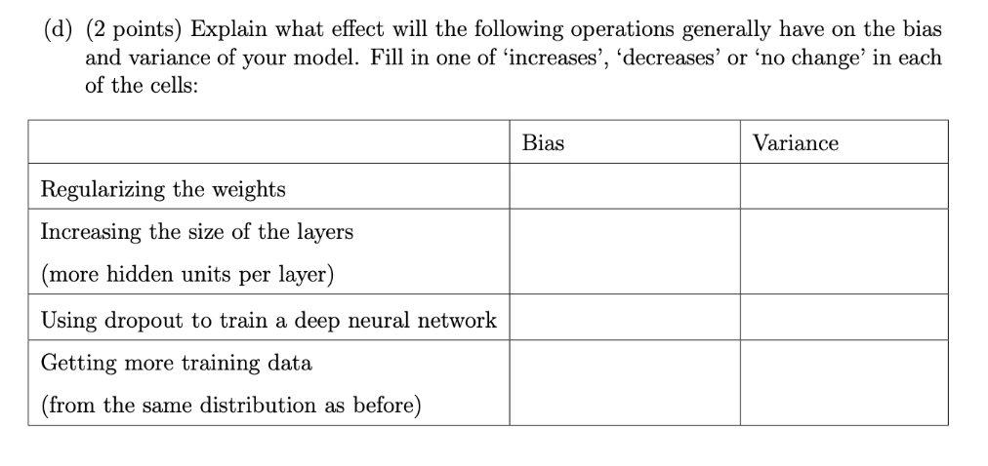
Bias/Variance Tradeoff Exercise

Slide 16
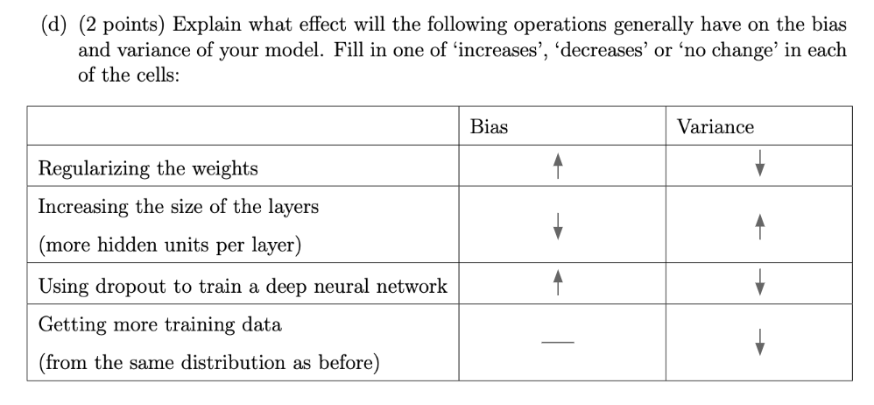
Bias/Variance Tradeoff Exercise

Slide 17
Overfitting, Training, and Hyperparameters Exercise
Assume you have a simple Neural Network with an input dimension of 10 and output dimension of 10. In between, you have 3 hidden layers of size 50 each. There is 0 dropout, and the learning rate is 0.0001. This is the default model.
You observe the following properties during training
At the end of of 5 epochs, train accuracy is 55%, test accuracy is at 50%
At the end of 20 epochs, train accuracy is 85%, test accuracy is at 80%
At the end of 100 epochs, train accuracy is 95%, test accuracy is at 60%
Rank the following four models in descending order:
Default model
Model with hidden dimension increased to 250
Model with dropout set to 0.3
Model with learning rate set to 0.00000001
On the following three categories
Epochs taken to hit train accuracy of 55%
Difference between train and test accuracy at the end of 100 epochs
Test accuracy at the end of 100 epochs

Slide 18
Overfitting, Training, and Hyperparameters Answers
Epochs taken to hit train accuracy of 55%
Model with learning rate set to 0.00000001
Model with dropout set to 0.3
Default Model
Model with hidden dimension increased to 250
Difference between train and test accuracy at the end of 100 epochs
Model with hidden dimension increased to 250
Default Model
Model with dropout set to 0.3
Model with learning rate set to 0.00000001
(3 and 4 could be interchanged, could depend on specific task)
Test accuracy at the end of 100 epochs
Model with dropout set to 0.3
Default Model
Model with hidden dimension increased to 250
Model with learning rate set to 0.00000001
(3 and 4 could be interchanged if 3 is overfit to an extreme enough degree)

Slide 19
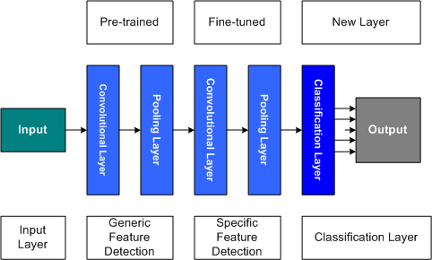
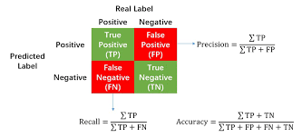
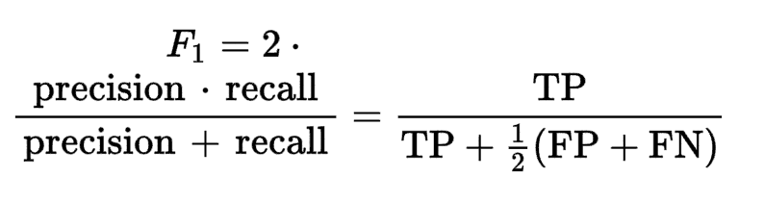
Accuracy + Tuning
With limited data -> utilize transfer learning.
  Freeze early layers and fine-tune the last couple layers
  Helps retain already learned feature mappings/weights
Analyze your task for what metrics are important and prioritize optimizing those
  Consider accuracy, precision, recall, F1 score

Slide 20
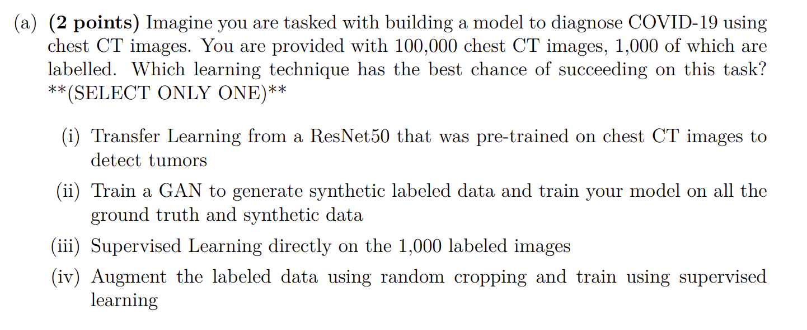
Accuracy + Tuning Exercise

Slide 21
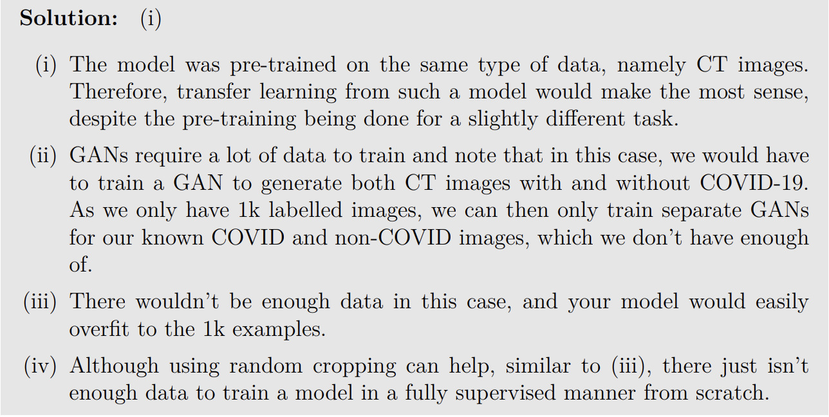
Accuracy + Tuning Exercise Answer

Slide 22
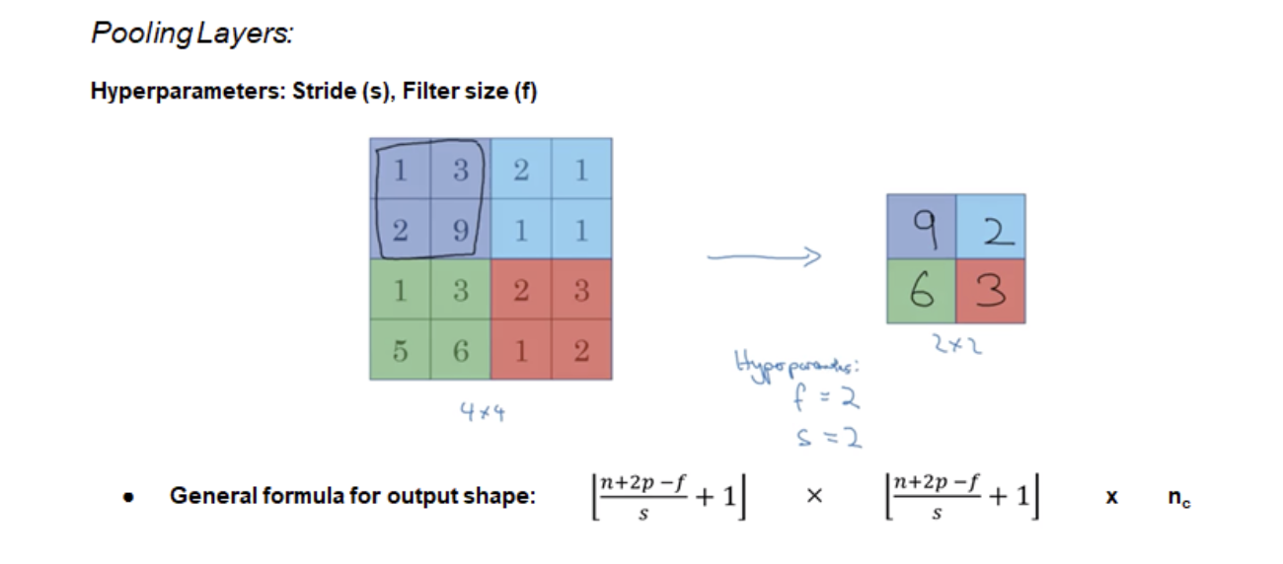
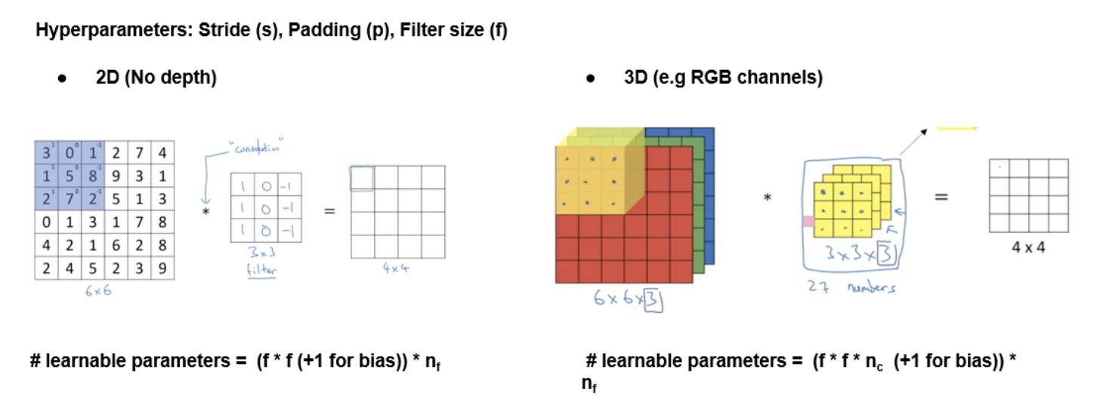
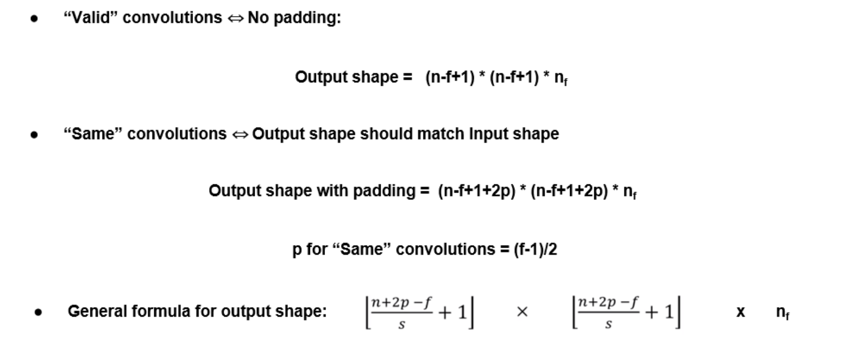
CNNs
General purposes of pooling:
Parameter-efficient way to downsample feature maps and reduce dimensions
Translational invariance makes model robust against specific pixel positions
What is a convolutional layer which uses a 1x1 kernel with stride 1?
Just a per-pixel fully connected layer along channels. Allows for efficient feature mixing along channels.

Slide 23
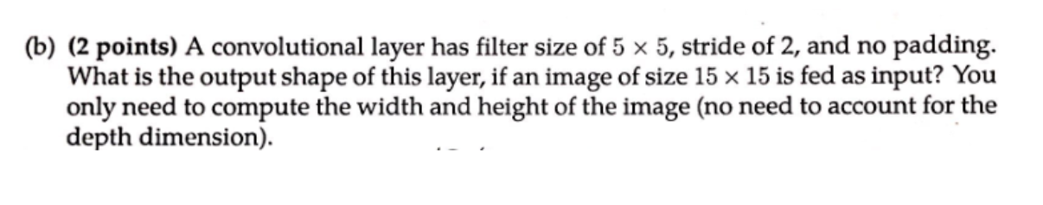
CNN Exercise

Slide 24
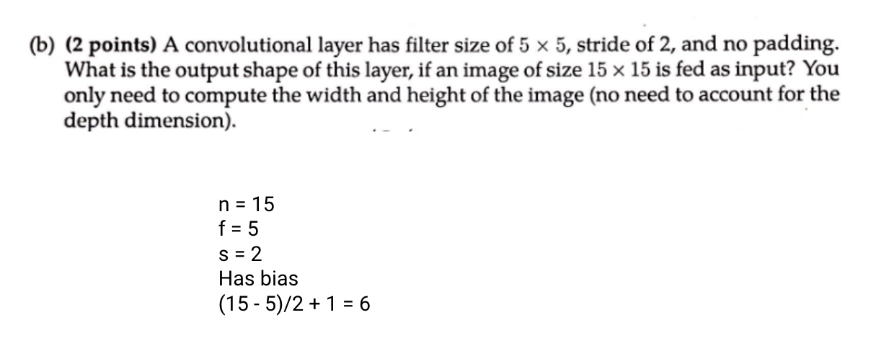
CNN Exercise Answer

Slide 25
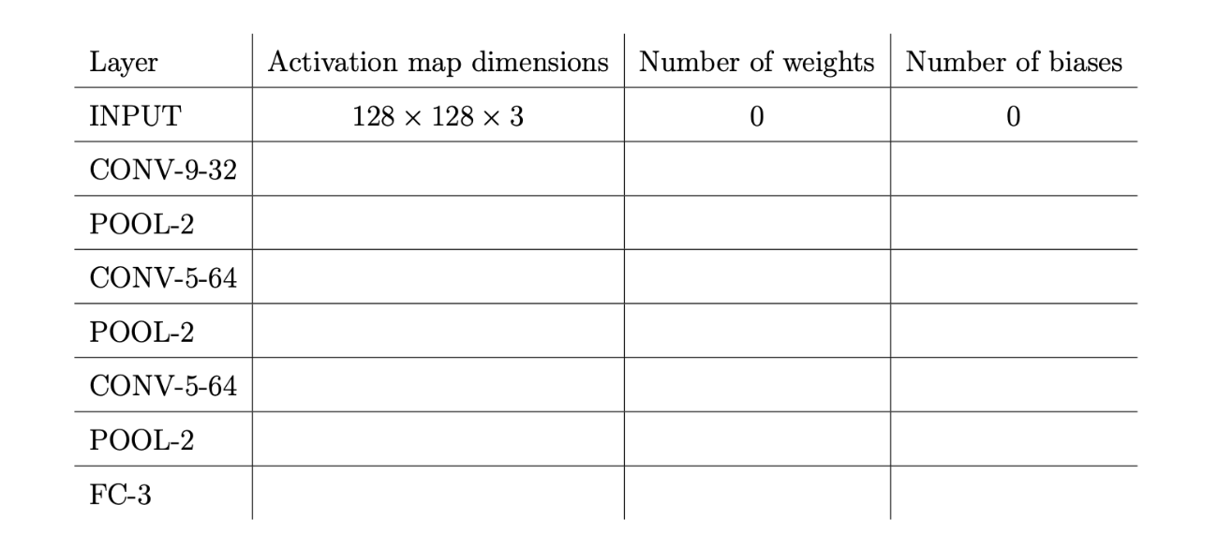
CNN Exercise

Slide 26
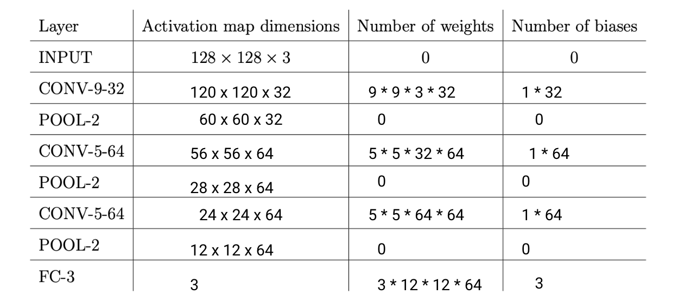
CNN Exercise Answer

Slide 27
CNN Receptive Field Exercise
What are the receptive fields of the following examples:
5 stacked 2x2 Convolutions, Stride: 1
2 stacked 3x3 Convolutions, Stride: 2
1 stacked 6x6 Convolution, Stride: 2
2 stacked 2x2 Convolutions, Stride: 5
Assume there are C input channels, C channels in every layer, and C output channels. What are the total parameter counts for each of the above layers (assume that biases are included)

Slide 28
CNN Receptive Field Exercise Answers
What are the receptive fields of the following examples:
5 stacked 2x2 Convolutions, Stride: 1 -> 6
2 stacked 3x3 Convolutions, Stride: 2 -> 7
1 stacked 6x6 Convolution, Stride: 2 -> 6
2 stacked 2x2 Convolutions, Stride: 5 -> 7
Parameter Counts:
5 stacked 2x2 Convolutions, Stride: 1 -> 5 * (C*C*2*2 + C) = 5 * (4C^2 + C) = 20C^2 + 5C
2 stacked 3x3 Convolutions, Stride: 2 -> 2 * (C*C*3*3 + C) = 2 * (9C^2 + C) = 18C^2 + 2C
1 stacked 6x6 Convolution, Stride: 2 -> C*C*6*6 + C = 36C^2 + C
2 stacked 2x2 Convolutions, Stride: 5 -> 2 * (C*C*2*2 + C) = 2 * (4C^2 + C) = 8C^2 + 2C

Slide 29
Coding Exercise
Assume we have a function which takes in the following numpy matrices:
  A : (50, 100), B: (40, 100), C: (40, 50)
We would like to generate an output using the following steps:
Multiply A^T with B (what should the order be?)
Do an element-wise multiplication of the result from step 1 with C
Take e to the power of each element in the result from 3 (i.e., an element x is now e^x)
Compute the sum across each COLUMN and have our final vector be of size (50,) (notice only 1-dimensional)
Please write the code for this process
Only Python + Numpy Arrays for storage (avoid Numpy functions + Np math operations)
Use Numpy vectorized operations only (no python loops)

Slide 30
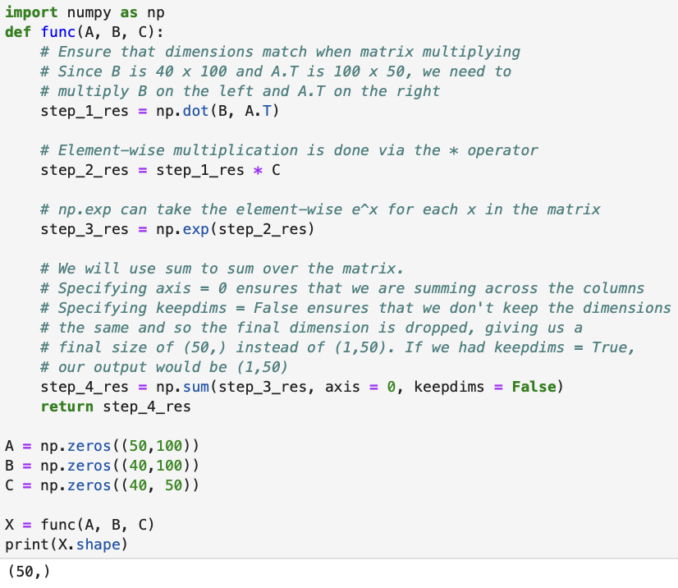
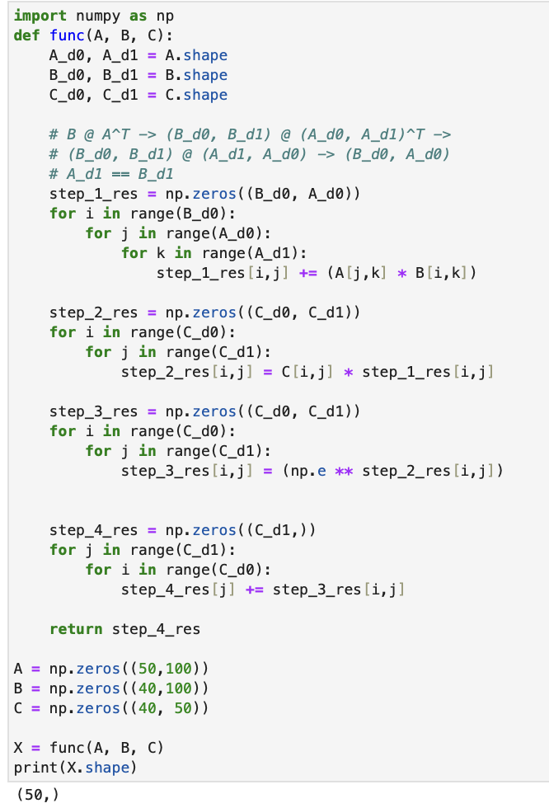
Coding Exercise Answers
Python Loops
Numpy Vectorized

