Slide 1
Module 7: Business Rules

Slide 2
Module Agenda
Introduction to business rules
Additional business rule details

Slide 3
Lesson 1: Introduction to business rules

Slide 4
Business rule overview
Automate and enforce common requirements
Rules created in the context of an entity
Can execute on both client and server, depending on configuration
Provide an alternative to developer code-based rule implementation
Notes:
A video demo is available at the following link: https://youtu.be/lqEIX5MeLAk
You may show the video above, or you may use this demo as an example and provide students with a live demo in your personal environment. Please be aware that the video is publicly hosted on YouTube.

Slide 5
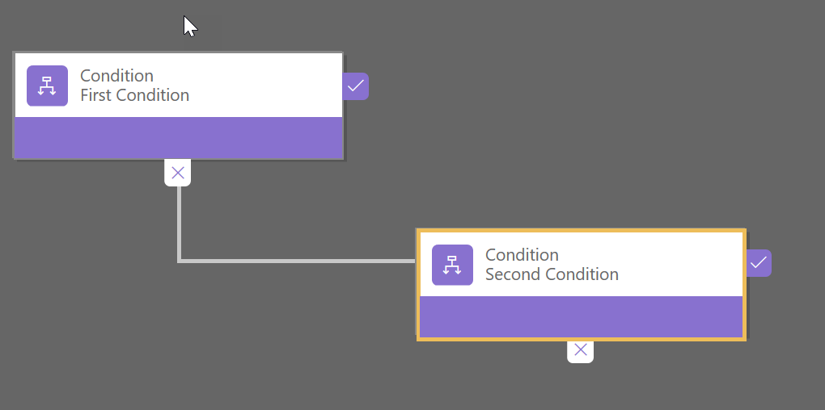
Conditions
Condition: The criteria that must be met to perform the actions associated with the conditions.
Actions run when the condition is true and/or when it is false
Notes:
Conditions are how you express the criteria that must be met to perform the actions associated with the condition. Conditions are a collection of rules. For each rule, you choose a field from the associated entity and compare it to another field from the same entity, a static value or a formula. A condition can have multiple rules and be configured to require all rules to be true, or only one rule to be true.
Note: Make sure after you change any of the condition’s properties that you click the Apply button at the bottom of the properties panel to save the changes.
With one condition you can have actions that run when the condition is true and when it is false. Alternatively, you can add additional conditions on the false side instead of actions causing an additional condition to occur before the default set of actions is executed. The second condition is only evaluated when the first condition is not met (true).

Slide 6
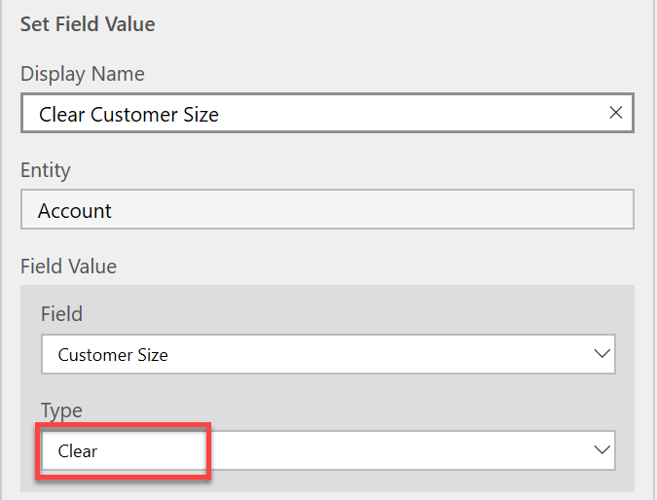
Actions
Action: Step executed once the rules of the conditions are evaluated.
Executed in order
Common actions:
Update values
Show or hide fields
Notes:
Actions are the steps that are executed once the rules of the conditions are evaluated. Actions are executed in order. Using actions, you can update values, show /hide fields as well as make recommendations. In this topic, we explore the different actions.

Slide 7
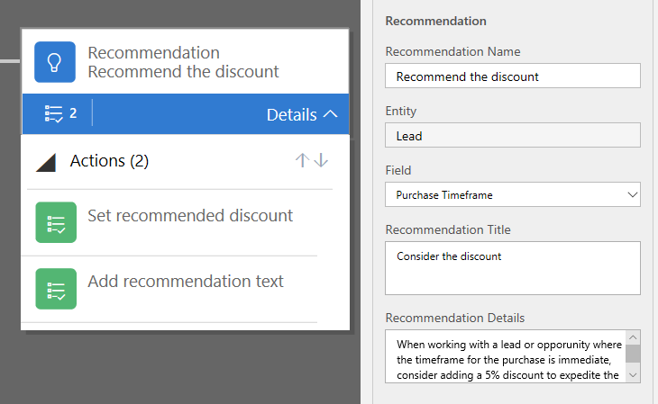
Recommendations
Recommendation: Special type of action that allows business rules to suggest a series of actions to the user, and execute with user consent.
Notes:
Recommendation is a special action that allows business rule to suggest to a user a series of actions and execute these with user consent. You can think of recommendations as a light-weight automated data entry based on the available information and business requirements.
Recommendations include a series of recommended steps based on some conditions. When recommendation action is executed, the model-driven user interface displays an indicator icon that, when clicked, displays preconfigured message and Apply button. If the user selects Apply, the series of preconfigured actions is then executed.
Consider the business requirements that specify that a salesperson should consider a 5% discount for any lead where purchase timeframe is immediate. While we can implement a sophisticated business process flow assisting the salesperson, recommendations allow a very simple alternative implementation of this requirement as part of a business rule

Slide 8
Lesson 2: Applying business rules

Slide 9
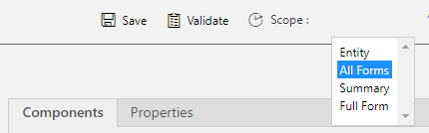
Scope
Scope: Determines when and where the rule executes
Can be set to execute on a single form, all forms or entity
Can be modified at any time (as long as the rule is not active)
Notes:
For each business rule you create you should consider the proper setting the rule execution scope. Scope determines when and where the rule executes. Rules can be set to execute on a single form, all forms or entity. Scope of Entity causes the rule to execute both on all forms and on the server when Common Data Service (CDS) processes record create or update requests.
Single and multiple forms only apply to PowerApps model-driven forms and do not apply to PowerApps Canvas apps. Rules that are scoped to forms are best suited for rules that control the user experience doing actions like hiding and showing fields. Running these types of rules would have no additional impact if enabled for entity scope. Rules that enforce data validation should be evaluated to determine if the rule only applies when a user is using a model-driven form to input the data or if it would apply to all possible data modifications, even those made by other automations or developers using the API. Using either of the form options still requires that all fields required by the rule are present on the form for it to execute. If any of the referenced fields are not present, the rule will silently not run even if properly scoped to the specific form or all forms.

Slide 10
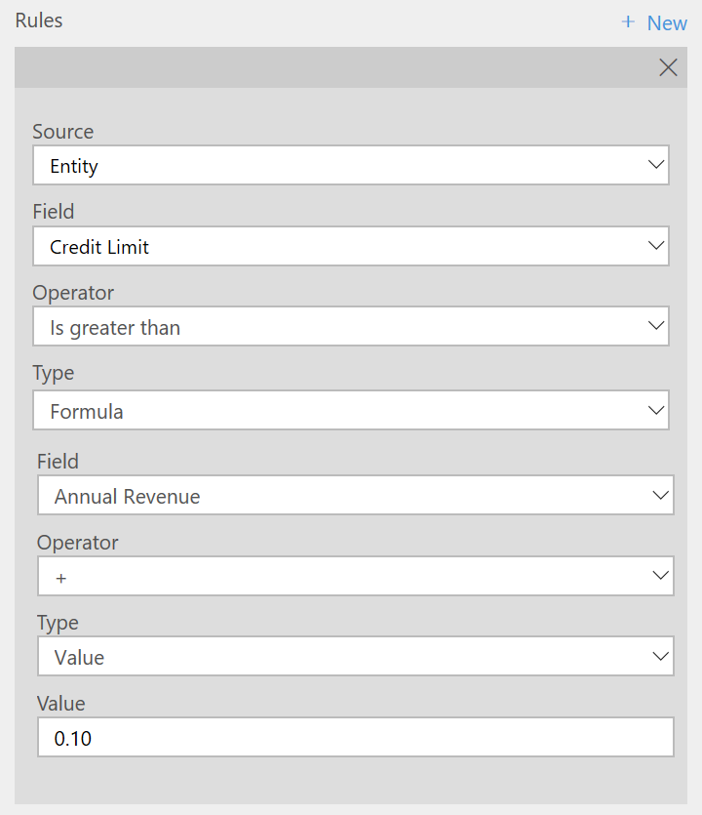
Formulas
Formulas: Can be used in conditions and in actions that set values
Use either the Set Default Value action or the Set Field Value action
Notes:
You can use formulas to set values using either the Set Default Value action or the Set Field Value action. The formula is calculated by selecting a formula source field from the entity’s list of fields that are of similar data type. Then you will choose an operator and the type for the formula calculation. The type can be Field or Value. In the following example, we use the Set Default action to populate the Credit Limit field with 10 % of the account’s annual income.

Slide 11
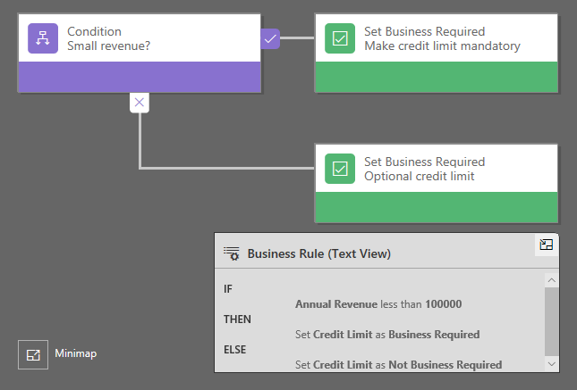
Common patterns and techniques
Don’t forget “else”
New records
Execute on change
Run always
Dependencies
Using calculated fields
Localization

Slide 12
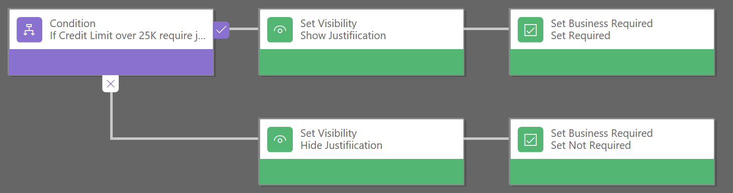
Rules interaction with other automation
Ensure compatibility with other automations (workflows, Power Automate, developer logic)
Rules and developer scripting
Execution order
Notes:
When building business rules, you need to take into consideration other automation (including Workflows, Microsoft Flows, and developer logic) that might exist or might need to be built. Each type of automation that the Power platform offers implements some forms of protections or features that try to minimize the ability for one automation to impact another. For example, business rules won’t trigger another business rule as a result of a change. This prevents rules from looping. Some of the responsibility falls on the implementers to ensure what they build is compatible.

Slide 13
Module 7 Practice Labs:
Configure a new business rule
Advanced business rules

