Slide 1

Breast Cancer Detection Using Logistic Regression
Presented By – Yogesh KUMAR BHATT

Slide 2
Breast Cancer
Breast cancer is now one of the most prevailing cancers that affects humans, especially woman, and early diagnosis would go a long way to reducing the damage done by this cancer on its victims. Breast cancer’s causes are multifactorial and involve family history, obesity, hormones, radiation therapy, and even reproductive factors. Every year, one million women are newly diagnosed with breast cancer, according to the report of the world health organization half of them would die, because it’s usually late when doctors detect the cancer .
Breast cancer can be categorized into two, which are malignant breast cancer and benign breast cancer. The classification of breast cancer as either malignant or benign is possible by scientifically studying the features of breast tumors , lumps, or any abnormalities found in the breast. At the benign stage the cancer has less risk and is not life threatening while cancer that is categorized as malignant is life-threatening .

Slide 3
Computation on the basis of:
These features are computed for each cell nucleus:
a) radius (mean of distances from center to points on the perimeter) b) texture (standard deviation of gray-scale values) c) perimeter d) area e) smoothness (local variation in radius lengths) f) compactness (perimeter^2 / area - 1.0) g) concavity (severity of concave portions of the contour) h) concave points (number of concave portions of the contour) i) symmetry j) fractal dimension ("coastline approximation" - 1)

Slide 4
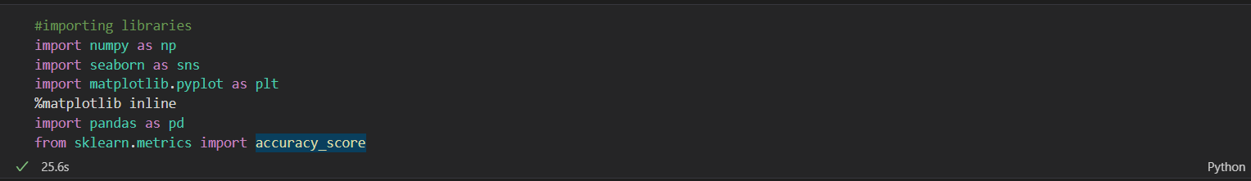
Numpy-it provides a multidimensional array object, as well as variations such as masks and matrices, which can be used for various math operations. seaborn-uses Matplotlib underneath to plot graphs. It will be used to visualize random distributions. matplotlib-Graphical plotting library . Used for creating static, animated, and interactive visualizations in Python . pandas-Pandas is a Python library for data analysis. sklearn-used for data mining and data analysis ,gives data prebuilt .

Slide 5
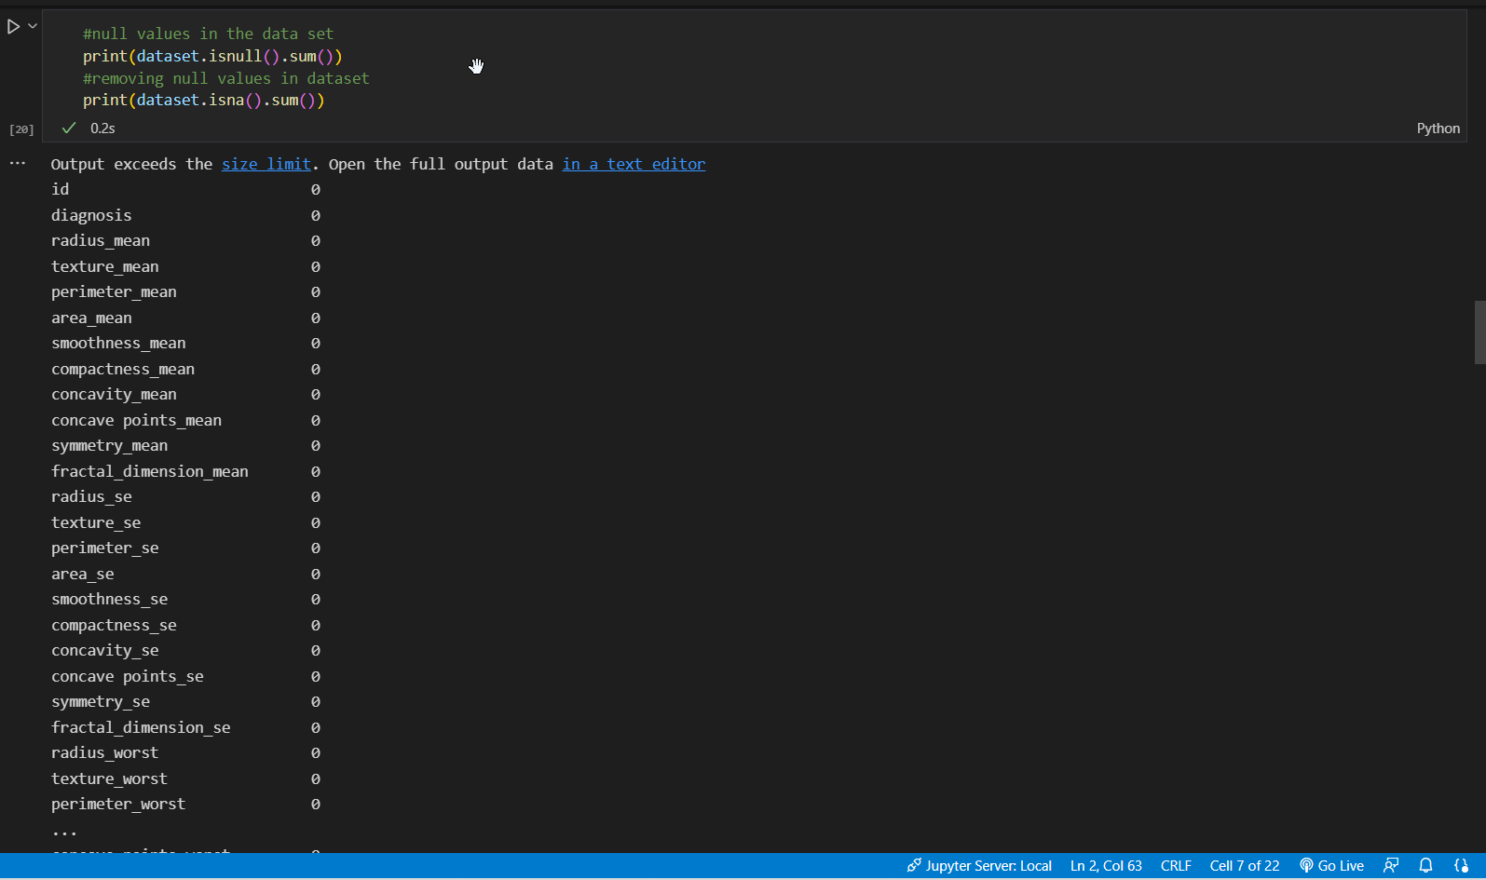
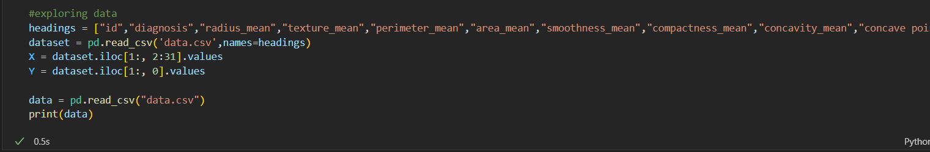

Slide 6
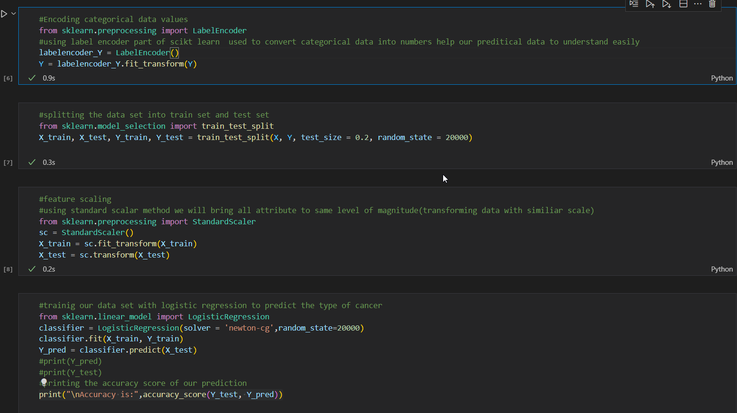
#using label encoder part of scikt learn used to convert categorical data into numbers help our preditical data to understand easily #splitting the data set into train set and test set
#using standard scalar method we will bring all attribute to same level of magnitude(transforming data with similiar scale)

Slide 7
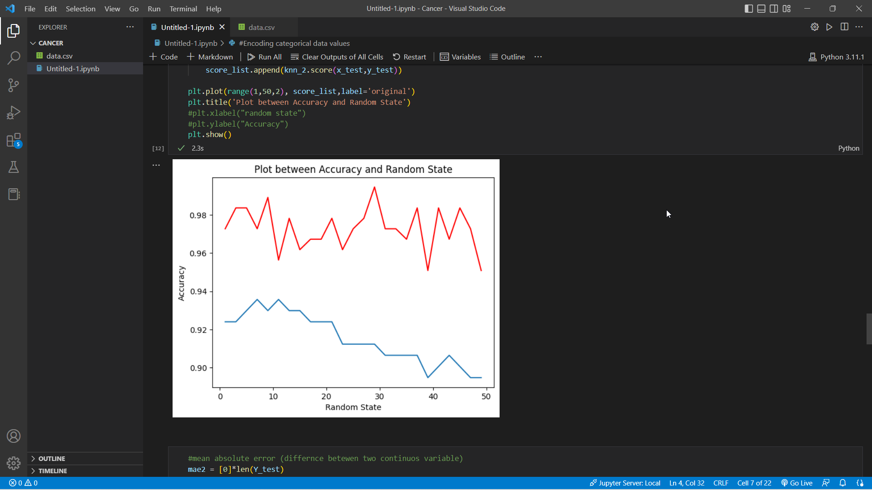
#plotting graph before and after training( blue = before training red=after training)
#plot between accuracy and random state.

Slide 8
Thank You

