Slide 1




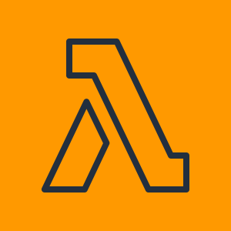


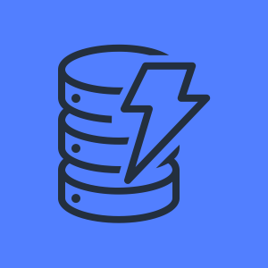


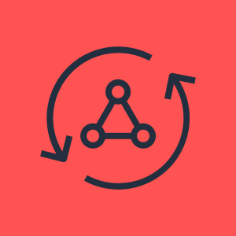


AWS Cloud
Amazon CloudFront
S3
AWS X-ray
Amazon CloudWatch
Custom auth flow
Time-based event triggered by CloudWatch event
Amazon Cognito
AWS Lambda
AWS Lambda
Event (time-based)
Amazon DynamoDB
Web/Mobile
AWS Amplify
AWS AppSync
Amazon DynamoDB
Push Notifications
Amazon Pinpoint
Amazon Kinesis
Amazon S3
Notes:
So, cardspal’s journey to production-grade serverless architecture is not a small and easy feat. It took places over several weeks and months. The very step for us is to diagnose the performance problems found in their app using some of the lambda functions. In that session, we use X-ray to trace and realize that we need to adjust the amount of RAMs given to the function for their code to run faster from 1min to less than 2 seconds. It is still not that fast but it at least allows the app to function much quicker. Next, we deep-dive on AWS Amplify and AppSync where it gives the mobile developer an easier way to query the right amount data he needs from the app while reducing the burden to maintain lambdas that are doing simple jobs. At the same time, they also moved to Cognito for both user authentication and authorization. And that later on, Cognito is used at every AWS resources to provide the right amount of access to the app. Concurrently, when the mobile developer was doing all these. The backend engineer moved his entire codes to a central repository where he can safely stores and manage his codes. And run them via AWS Cloud9 which is an online IDE that AWS provides. That way, if his laptop is gone, we can still run the scripts somewhere. They also migrate the scripts to Step Functions where it can manage state and do retries systemically and automatically on its own. Later on, of course, that script is moved to a proper CI/CD with CodeBuild and CodePipeline. After we did all of these, things started to get more interesting where the team is started to think about analytics and push notifications to engage their users better. That’s where Amazon Pinpoint comes in and they also push the data to Kinesis afterward to do other processing in Lambda. All these hard works are done. Now, Salm, what’s next for CardsPal?

Slide 2
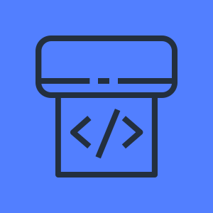
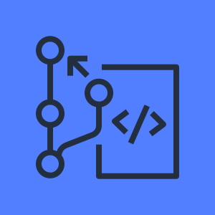
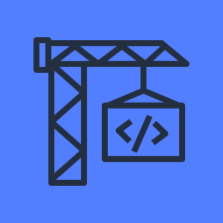

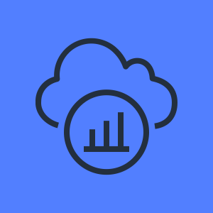
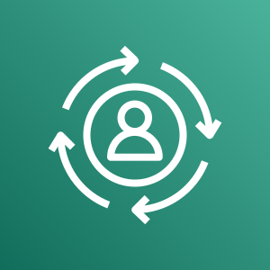

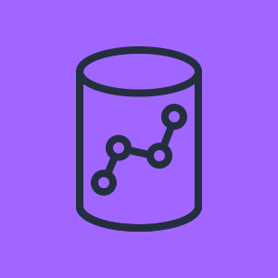
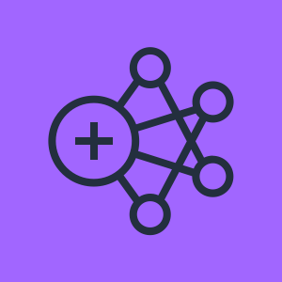
AWS Cloud
Amazon CloudFront
S3
AWS CodePipeline
AWS CodeCommit
AWS CodeBuild
AWS Cloud9
AWS X-ray
Amazon CloudWatch
Custom auth flow
Time-based event triggered by CloudWatch event
Amazon Cognito
AWS Lambda
AWS Lambda
Event (time-based)
Amazon DynamoDB
DynamoDB stream
Web/Mobile
AWS Amplify
AWS AppSync
Amazon DynamoDB
AWS Lambda
AWS Lambda
Amazon Personalize
S3
Glue
Push Notifications
Amazon Redshift
Amazon Pinpoint
Amazon Kinesis
Amazon S3
EMR
Notes:
So, cardspal’s journey to production-grade serverless architecture is not a small and easy feat. It took places over several weeks and months. The very step for us is to diagnose the performance problems found in their app using some of the lambda functions. In that session, we use X-ray to trace and realize that we need to adjust the amount of RAMs given to the function for their code to run faster from 1min to less than 2 seconds. It is still not that fast but it at least allows the app to function much quicker. Next, we deep-dive on AWS Amplify and AppSync where it gives the mobile developer an easier way to query the right amount data he needs from the app while reducing the burden to maintain lambdas that are doing simple jobs. At the same time, they also moved to Cognito for both user authentication and authorization. And that later on, Cognito is used at every AWS resources to provide the right amount of access to the app. Concurrently, when the mobile developer was doing all these. The backend engineer moved his entire codes to a central repository where he can safely stores and manage his codes. And run them via AWS Cloud9 which is an online IDE that AWS provides. That way, if his laptop is gone, we can still run the scripts somewhere. They also migrate the scripts to Step Functions where it can manage state and do retries systemically and automatically on its own. Later on, of course, that script is moved to a proper CI/CD with CodeBuild and CodePipeline. After we did all of these, things started to get more interesting where the team is started to think about analytics and push notifications to engage their users better. That’s where Amazon Pinpoint comes in and they also push the data to Kinesis afterward to do other processing in Lambda. All these hard works are done. Now, Salm, what’s next for CardsPal?

