Slide 1
Modeling Elements from Joint Distribution Decomposition
A taxonomy linking data, model and prediction of manufacturing AI/ML to distribution shift
Good predictions come from good data and good models.
P(X) Good Data
data marginal
covariate shift
P(Y|X) Good Model
conditional relation
concept drift
Chain rule
P(X,Y) = P(Y|X) · P(X)
Marginalization
P(Y) = ∫ P(Y|X) P(X) dX
Manufacturing is X → Y
A shift in P(Y) is mostly the result of a change in P(X) or P(Y|X).
P(Y) Good Prediction
output marginal
prior shift
Model estimator: orthogonal axis, how P(Y|X) is estimated
1 / 3

Slide 2
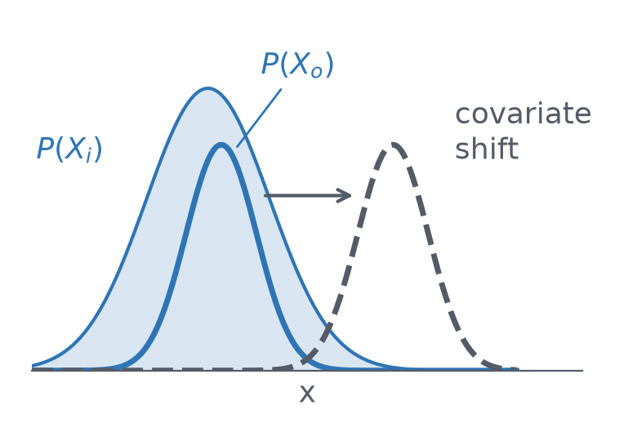
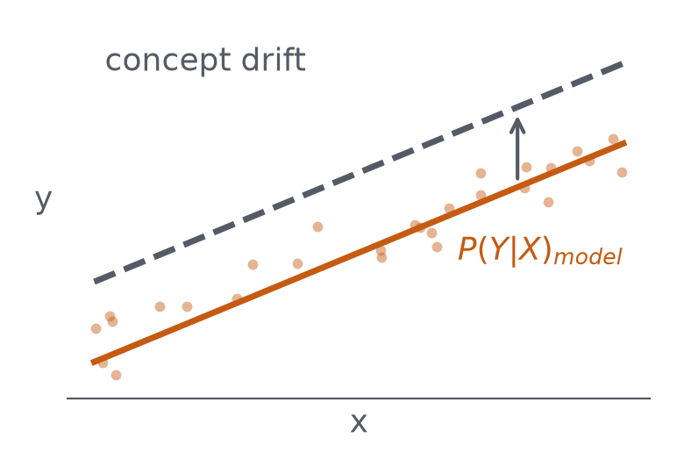
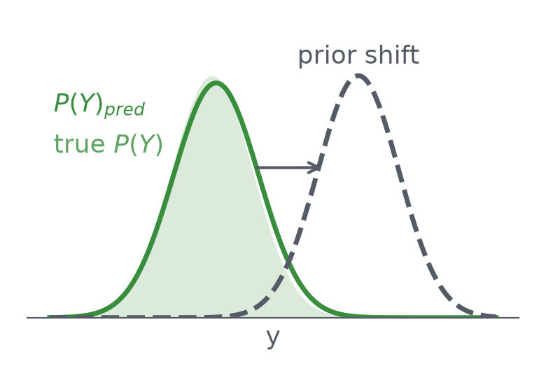
Prediction from the Joint Distribution
Training data Xi (in-sample) and inference data Xo (out-of-sample) kept apart
P(Y)_{pred} = ∫ P(Y | X=x; X_{i})_{model} · P(X_{o}=x)_{true} dx
Good Data
Good Model
Good Prediction
Eq. holds only if X_{o} stays within the range of X_{i} and the true P(Y|X) does not change after training.
2 / 3

Slide 3
Four Axes: Detect, Respond, Validate
Observation pins down when a change happened; levers fit the model while assuming a change
P(X) Covariate shift
Detect: PSI·KS·KL; MMD, domain classifier, Hotelling T²·SPE, autoencoder error
Respond: Importance weighting, domain adaptation, metrology sampling plan
Validate: Adversarial validation
P(Y) Prior shift
Detect: Metrology distribution (KS·PSI), SPC (Shewhart·EWMA), P(Y)pred monitoring
Respond: Target engineering (log, Box-Cox, spatial decomposition), per-group scaling
Validate: Error per spec and per group
P(Y|X) Concept drift
Detect: Binning CDT, residual CUSUM, Page-Hinkley, ADWIN, windowed I(Xk;Y)
Respond: Recent-window retraining, recency weighting, adaptive VM update, Z(t) proxies
Validate: Temporal CV, lot group split
Model estimator (orthogonal)
Detect: Train–validation gap; windowed R²·RMSE
Respond: PLS·ridge·lasso, tree ensembles, GP·conformal, physics hybrid, Optuna
Validate: Lot group split + temporal CV; R², RMSE, interval coverage
3 / 3

