Slide 1

Static Geovisualization Presentation
Where and When People Ride:
Spatial Patterns of Seoul’s Public Bike System
February 25, 2026
Yunsik Kim
GEOG 8005
Open-Source Geovisualization

Slide 2

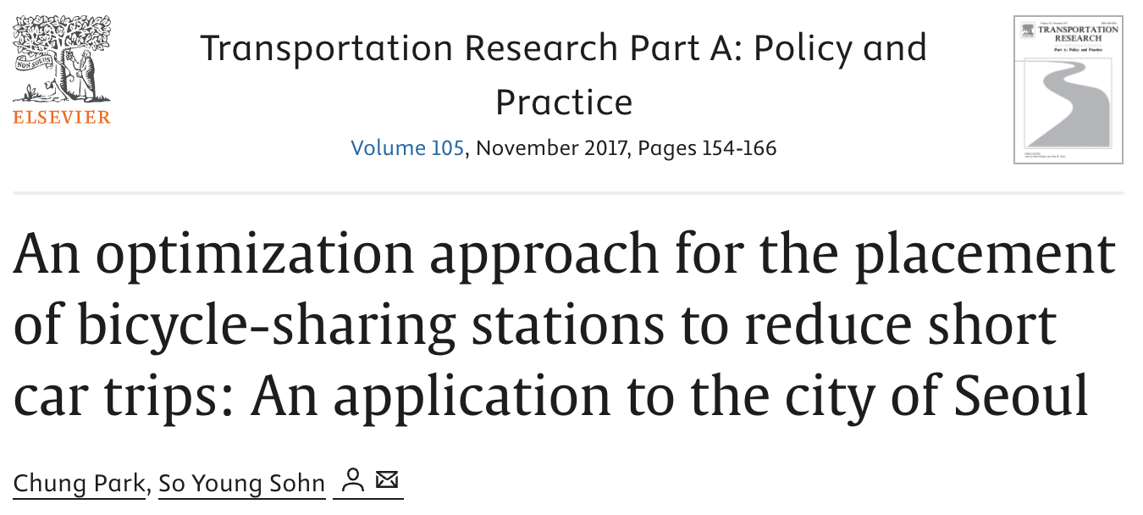
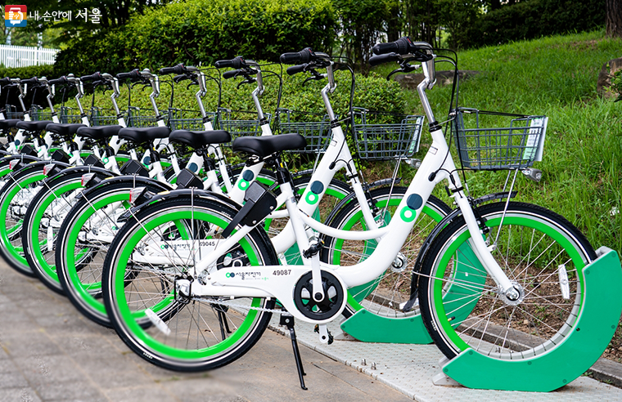
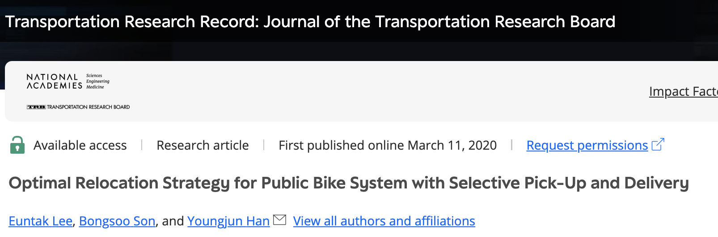

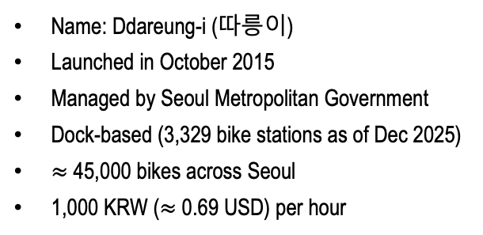
I. Introduction
Public bike-sharing system in Seoul, South Korea
(Source: City of Seoul)
Name: Ddareung-i (따릉이)
Launched in October 2015
Managed by Seoul Metropolitan Government
Dock-based (3,329 bike stations as of Dec 2025)
$≈$ 45,000 bikes across Seoul
1,000 KRW ($≈$ 0.69 USD) per hour
Notes:
First, I would like to briefly introduce Seoul’s public bike-sharing system. Seoul’s public bike system, known as Ddareungi, was launched in October 2015 and has now been in operation for ten years. The system is managed by the Seoul Metropolitan Government and operates as a dock-based system, where bikes are rented from and returned to designated docking stations.
As of December 2025, the system includes approximately 3,300 stations and around 45,000 bicycles distributes across the city. With a relatively low usage fee (about 0.69 US dollars per hour) and rapid infrastructure expansion over the past decade, the system has become an important and widely used mode of transportation within the city.
Public bike systems, and micromobility more broadly, have also attracted significant in academic research. For example, studies have examined operational challenges such as bike relocation, as well as public health issues. In particular, the existence of relocation studies suggests that there are spatial imbalance between supply and demand and that usage patterns are not evenly distributed across space.

Slide 3
I. Introduction
Visualization goal
To reveal how Seoul’s public bike system exhibits spatial concentration and functional differentiation across time and station locations
Notes:
So, for this project, I focus on visualizing the spatial differences and how these patterns shift in the context of temporal dimension, such as between weekdays and weekends, and during peak commuting hours.

Slide 4
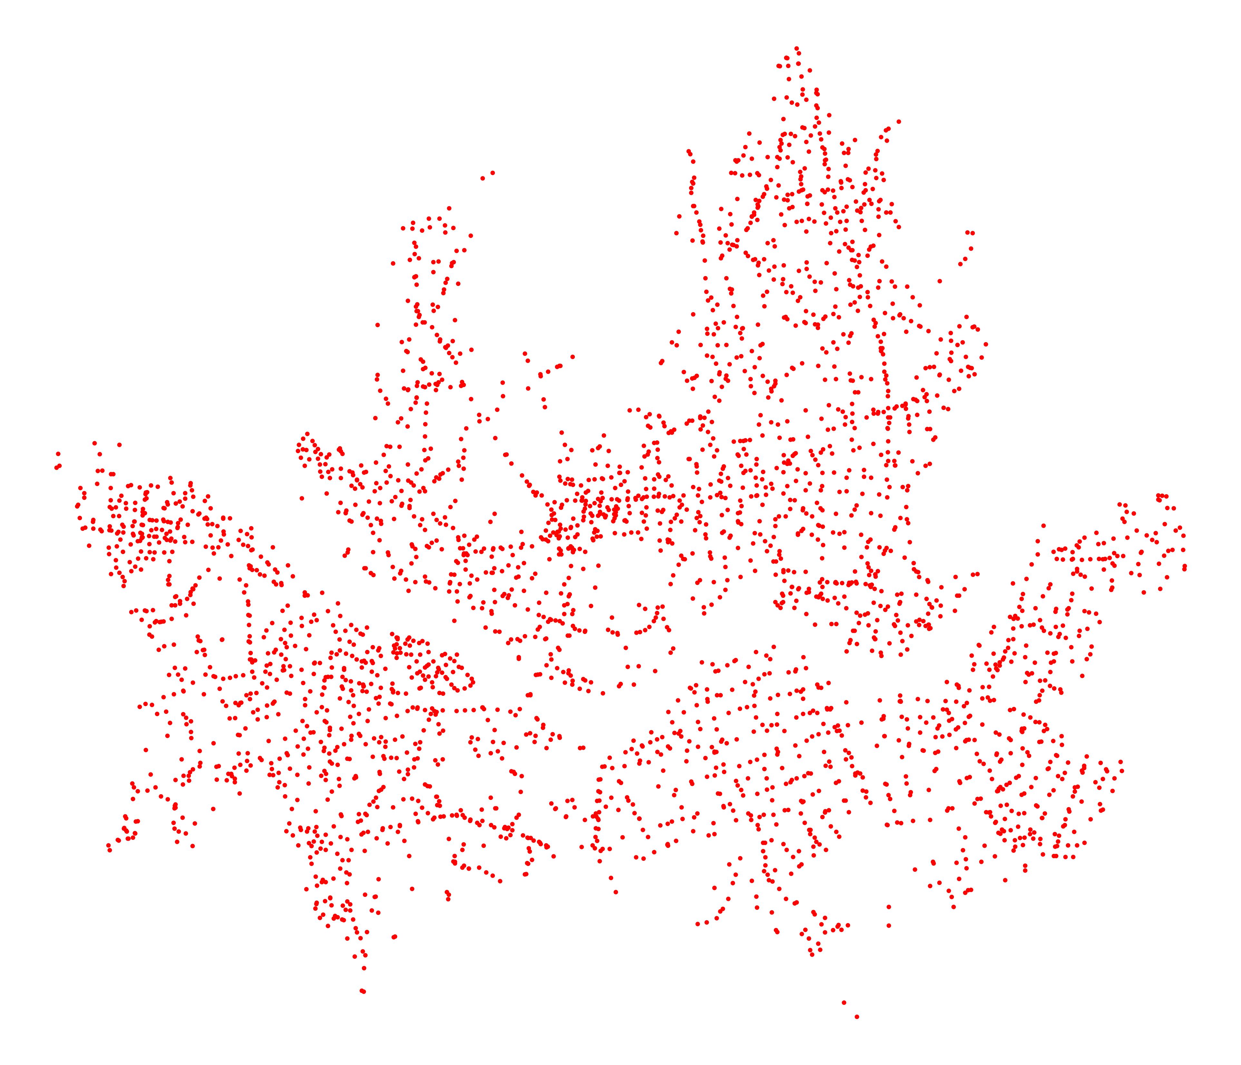
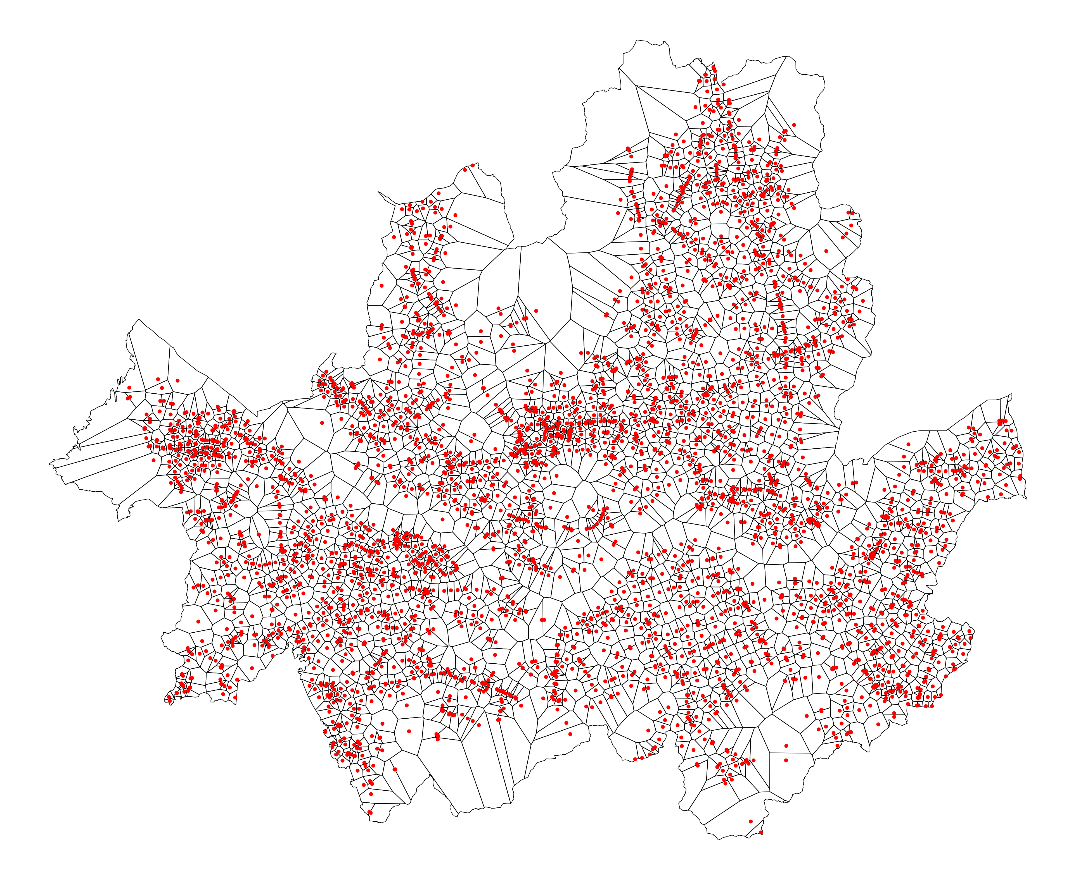
II. Data Source
Visualization goal
To reveal how Seoul’s public bike system exhibits spatial concentration and functional differentiation across time and station locations
Data
Dataset | Data type | Source
Seoul administrative boundary (as of Jun 2025) | Vector (polygon) | Statistical Geographic Information Service, Korea
Seoul stream network | Vector (polygon) | Ministry of Land, Infrastructure and Transport, Korea
Public bike station locations (as of Dec 2025) | Tabular (XY coordinate included) | Seoul Open Data Plaza, Seoul Metropolitan Government
Individual bike trip records (2025) | Tabular
Spatial unit of visualization
Delineate service area
Bike station points
Voronoi (Thiessen) polygons
Notes:
This table summarizes the datasets used in this project, including their data types and sources. I used four main datasets. Two polygon datasets, the administrative boundary of Seoul and the Seoul stream network. And, two tabular datasets: the bike station location data and individual bike trip records. Each dataset was obtained from publicly available sources.
When it comes to the spatial unit of visualization, instead of using administrative units such as census tracts or block groups, I wanted to analyze bike demand at the station level. Therefore, I generated Voronoi, or Thiessen, polygons based on the station point data. These polygons delineate the service area of each station by assigning surrounding space to the nearest station. Using these station-level service areas as the spatial unit, I try to avoid aggregating values by administrative boundaries which are arbitrarily generated.

Slide 5
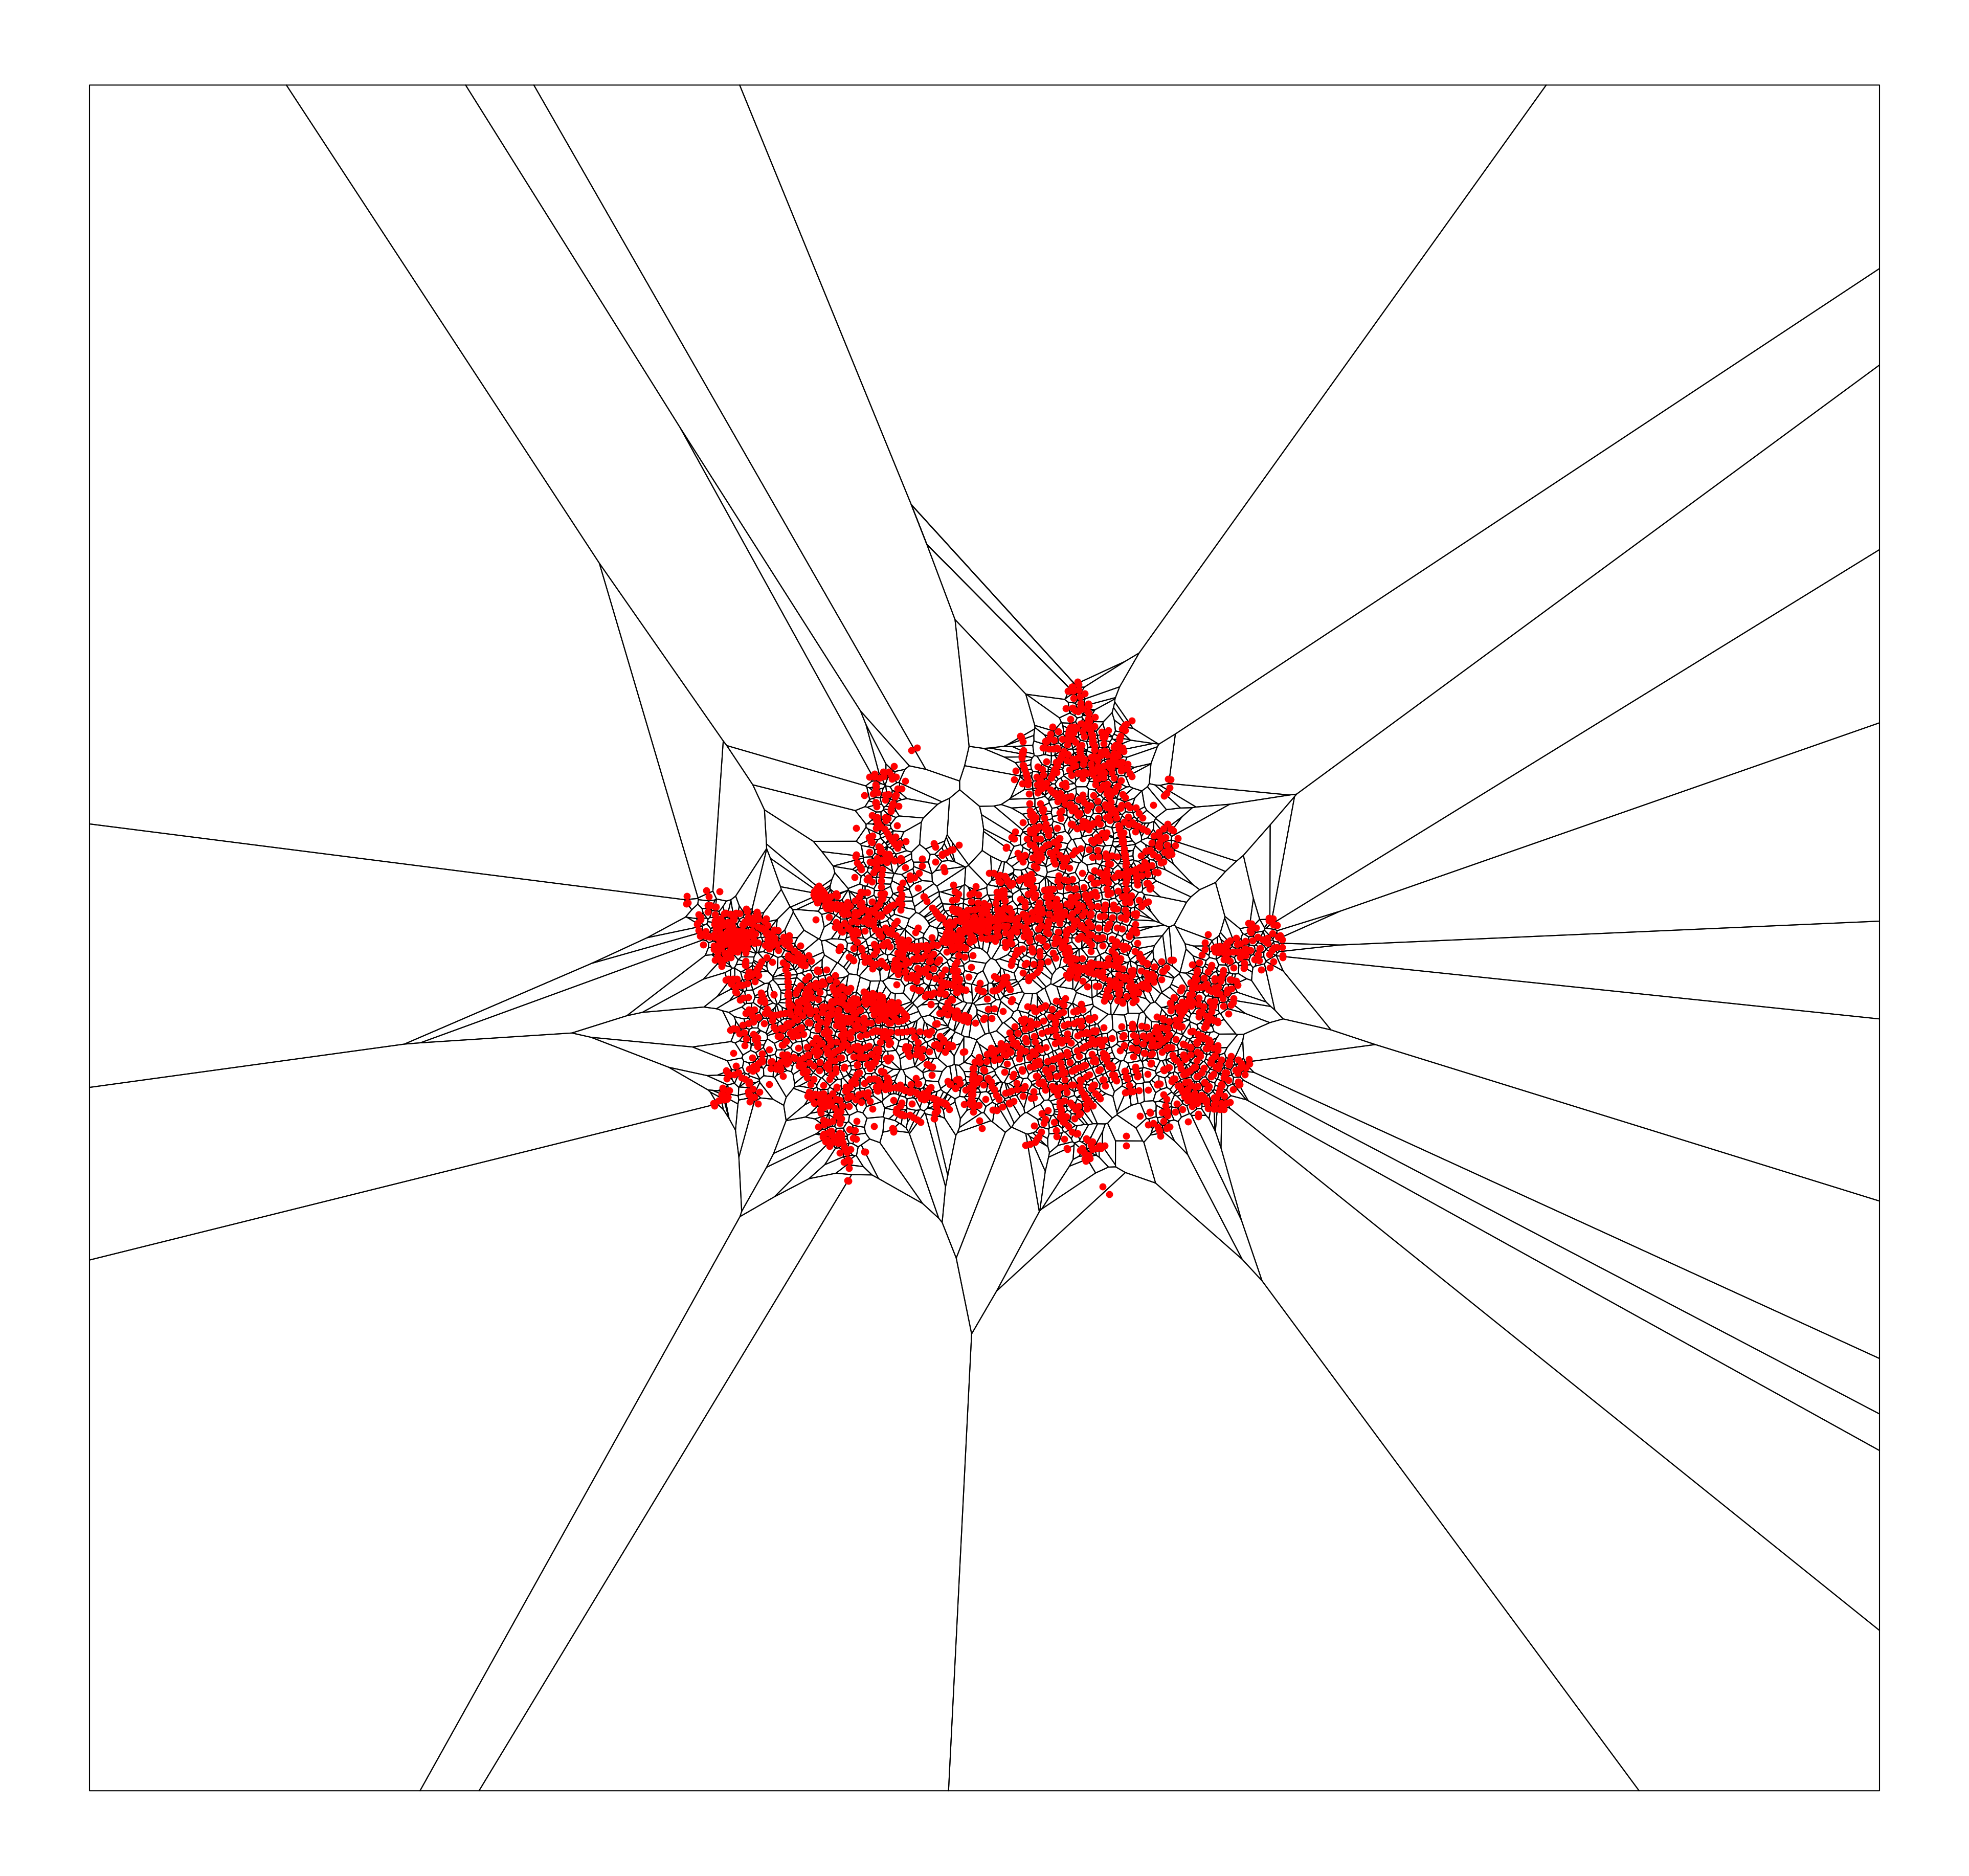
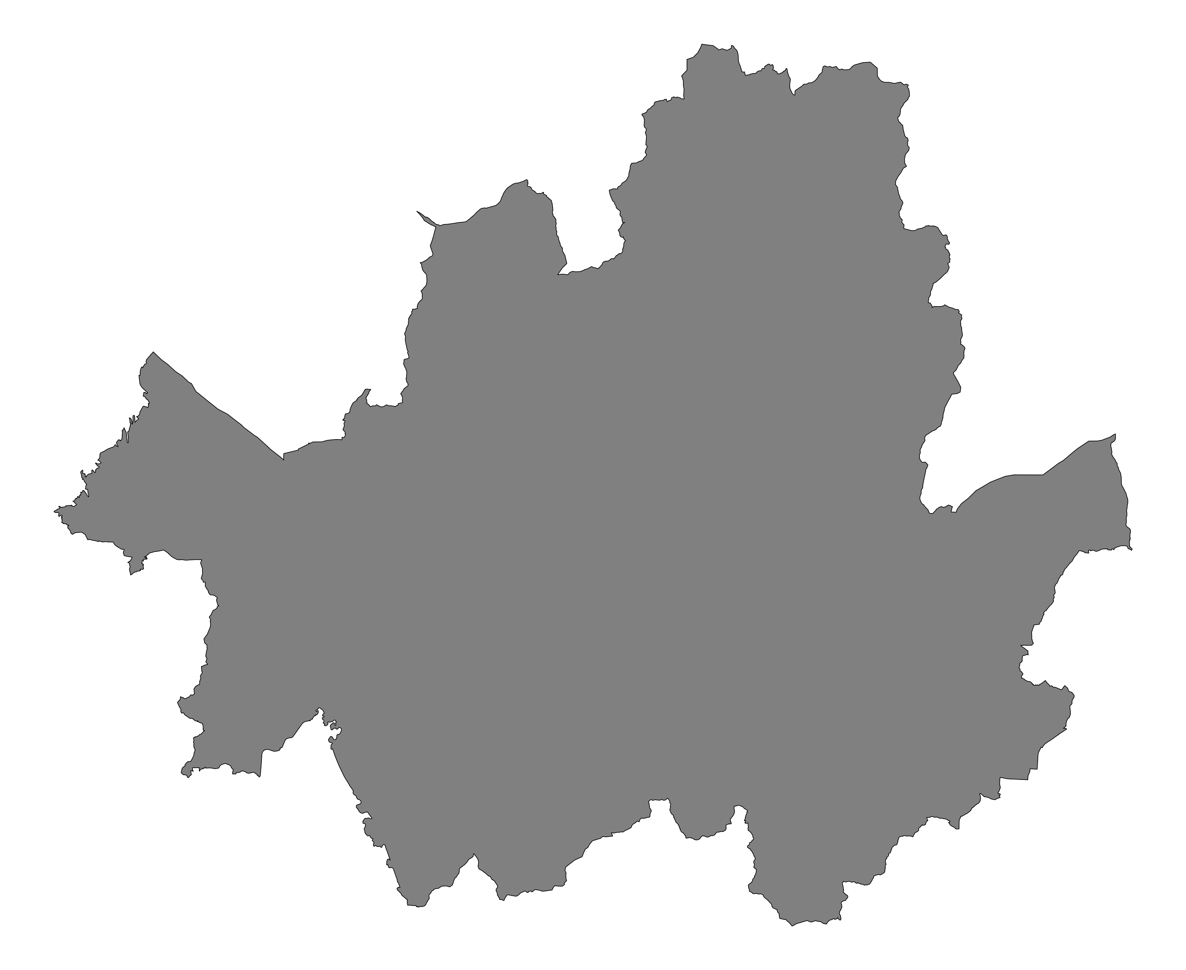
III. Data Processing
Individual bike trips
Join by IDs
---- | ----
-- | --
-- | --
Rent station ID
Return station ID
Timestamp
Distance/duration
…
If distance < 200 m or duration = 0 min., removed
After filtering, 36,298,179 trips in total in 2025
Bike station locations
Create XY points
Create Voronoi polygons
Clip to Seoul boundary
---- | ----
-- | --
-- | --
(Station ID, lat, long)
Comprehensive GeoDataFrame
Station ID | avg_inflow | avg_outflow | week_inflow | ---- | ratio_in_out
--- | --- | --- | --- | --- | ---
--- | --- | --- | --- | --- | ---
--- | --- | --- | --- | --- | ---
Count # of inflows/outflows by station
Spatial join
Notes:
This diagram indicates workflow of data processing. Two tabular data, station and trips, were joined by using station ID. For the trip data, there are some outliers. So, referring to the related studies, I filtered out them if the data has distance less than 200 meters and duration of 0 minutes. After filtering, about 36 million trip records were retained in the year of 2025.
Next, using the location XY coordinates, I created Voronoi polygons and clipped it to make it align with the Seoul boundary. To generate comprehensive inflow and outflow dataframe by time-context, I counted the number of inflows and outflows for each station and calculated annual average values dividing by number of days. So, I used this wide table for visualization.

Slide 6
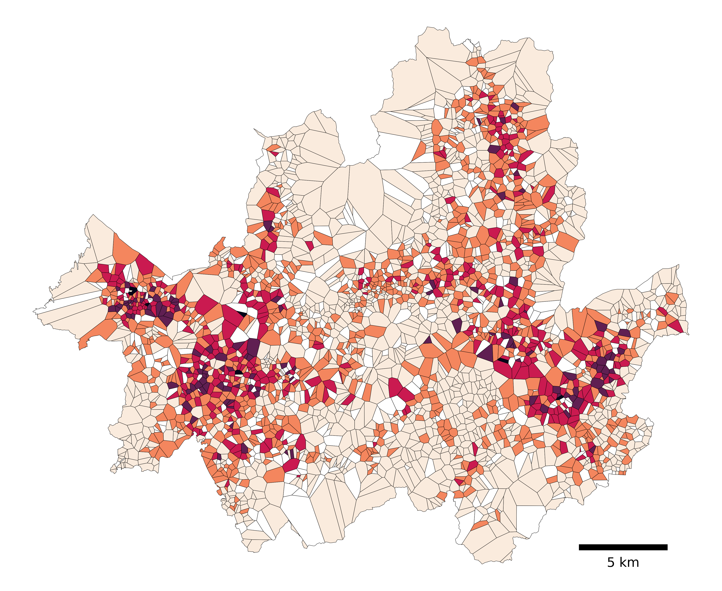
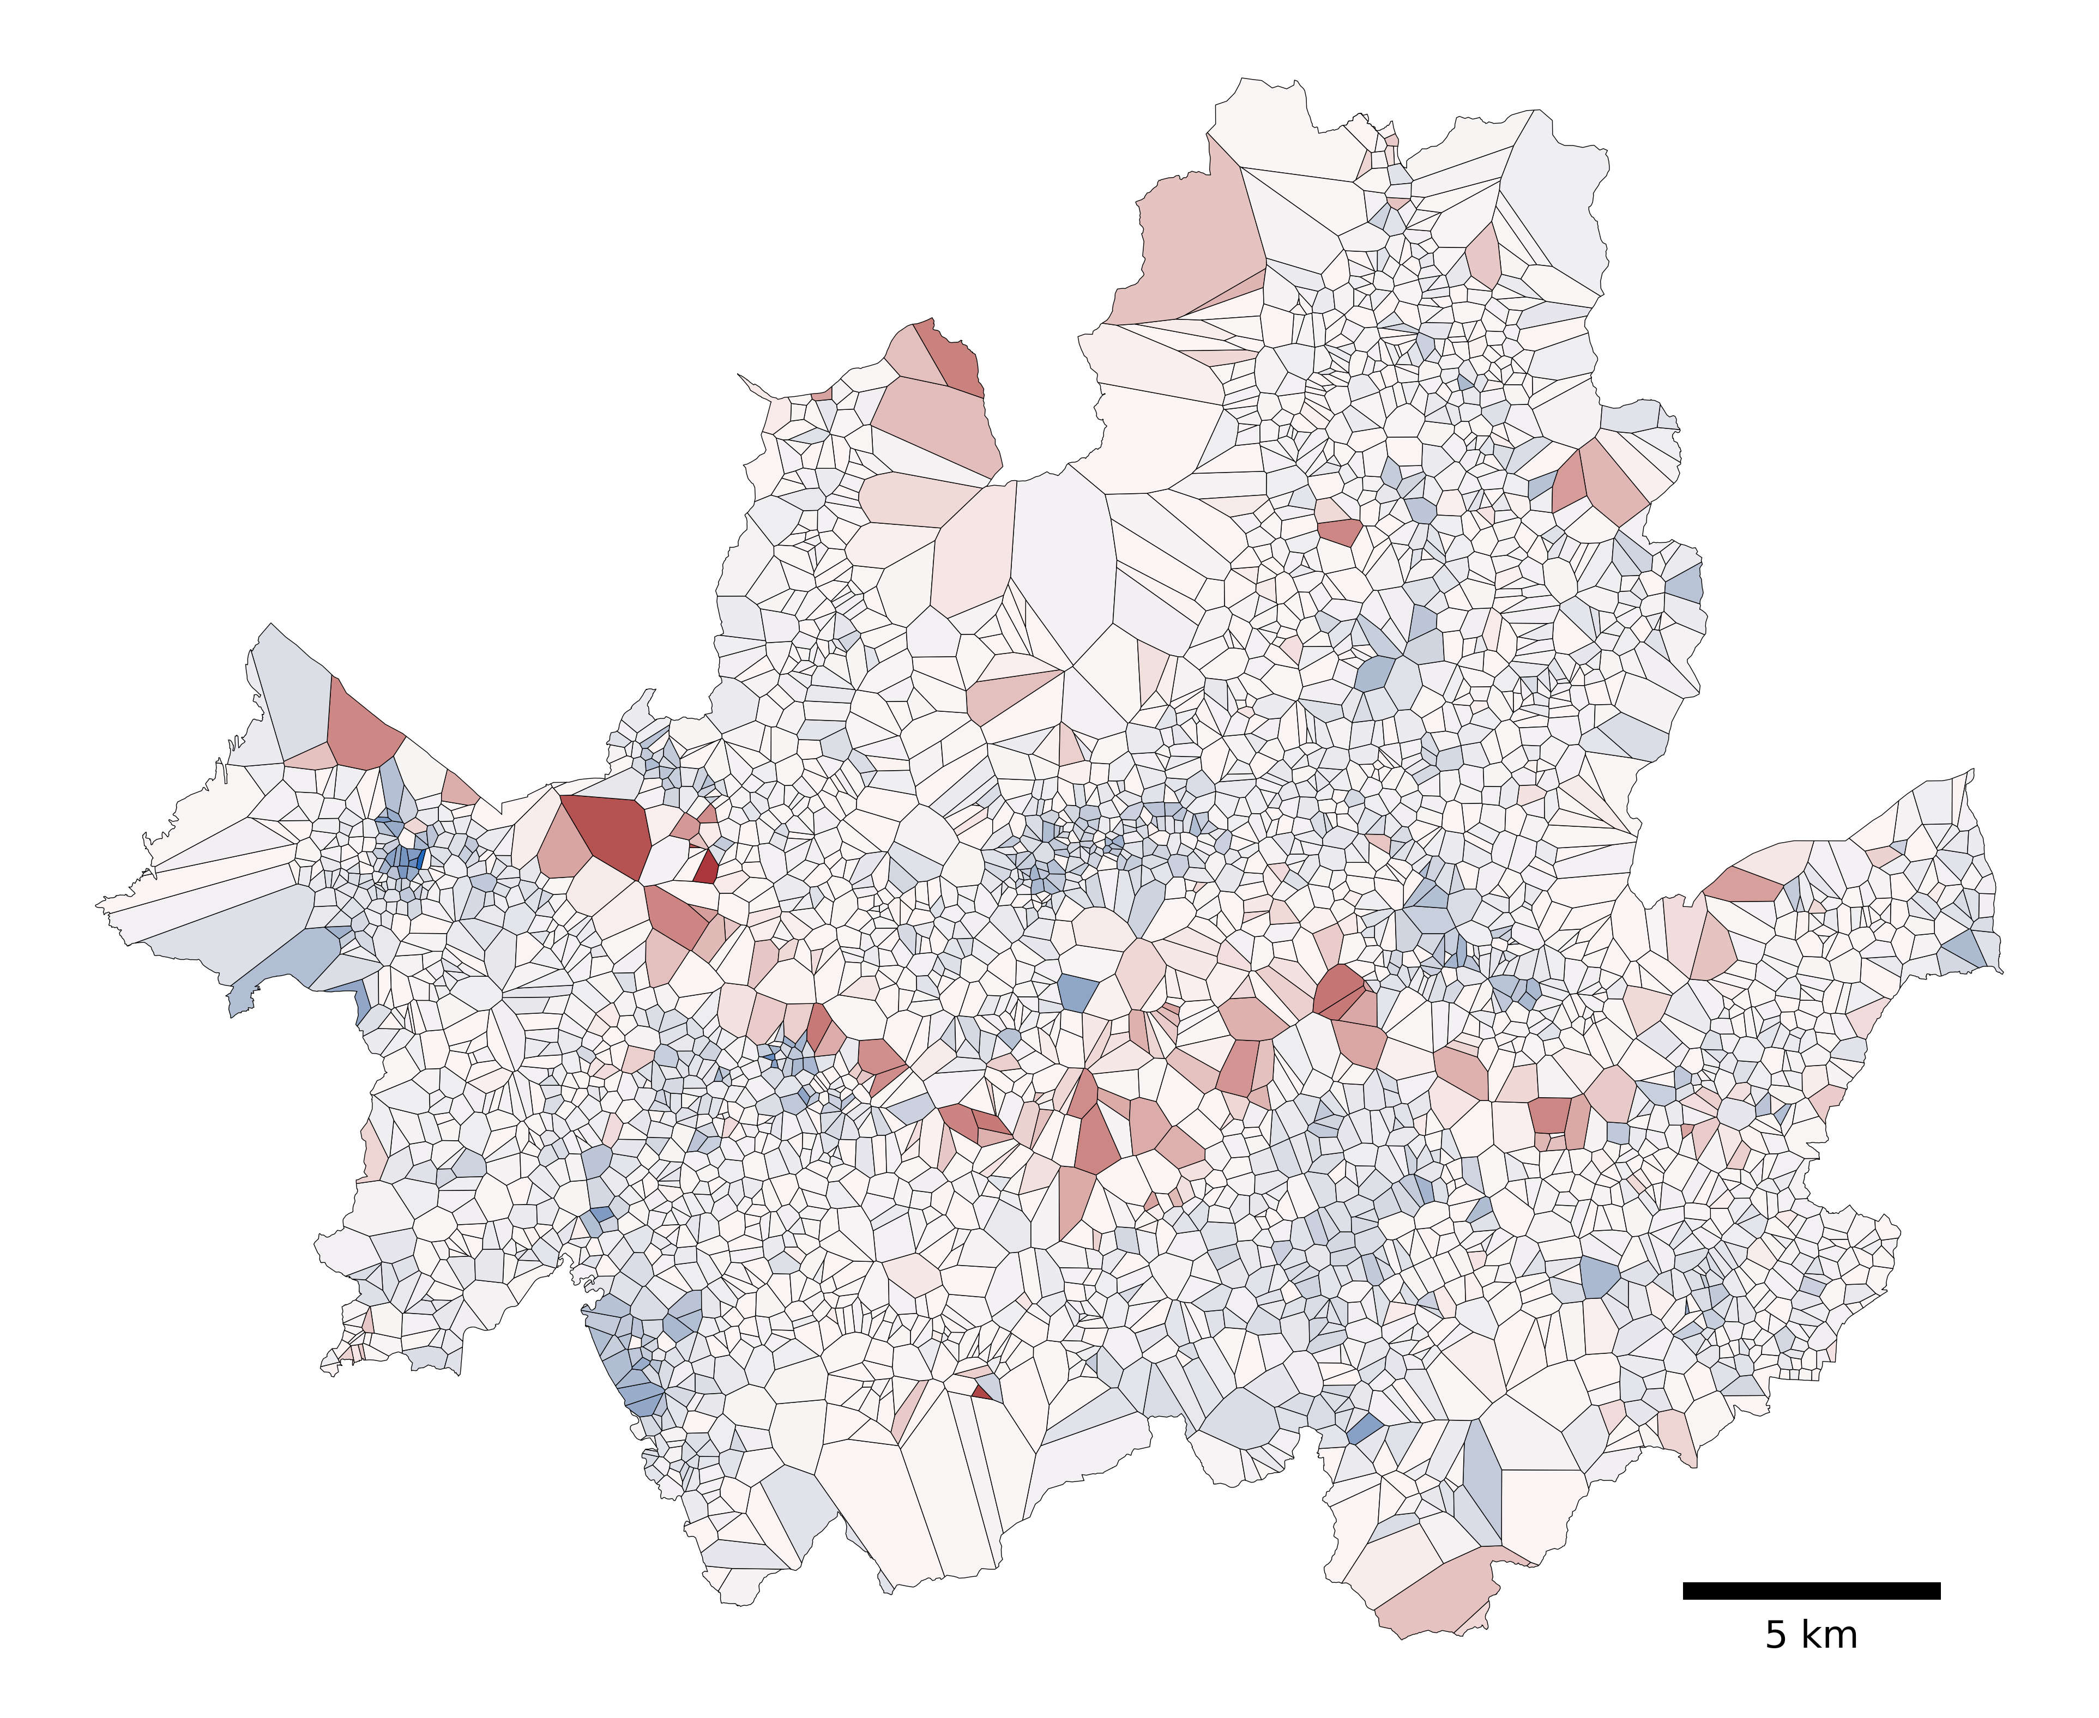

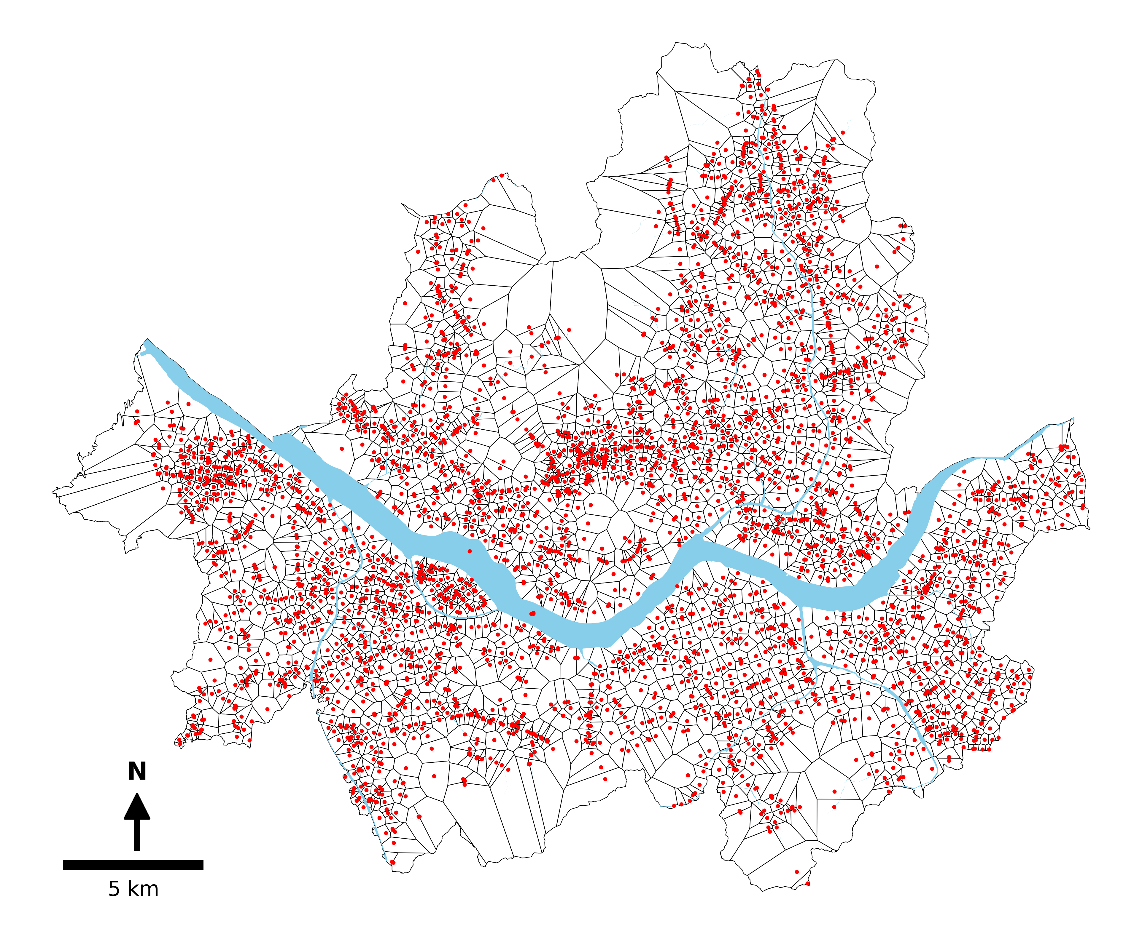
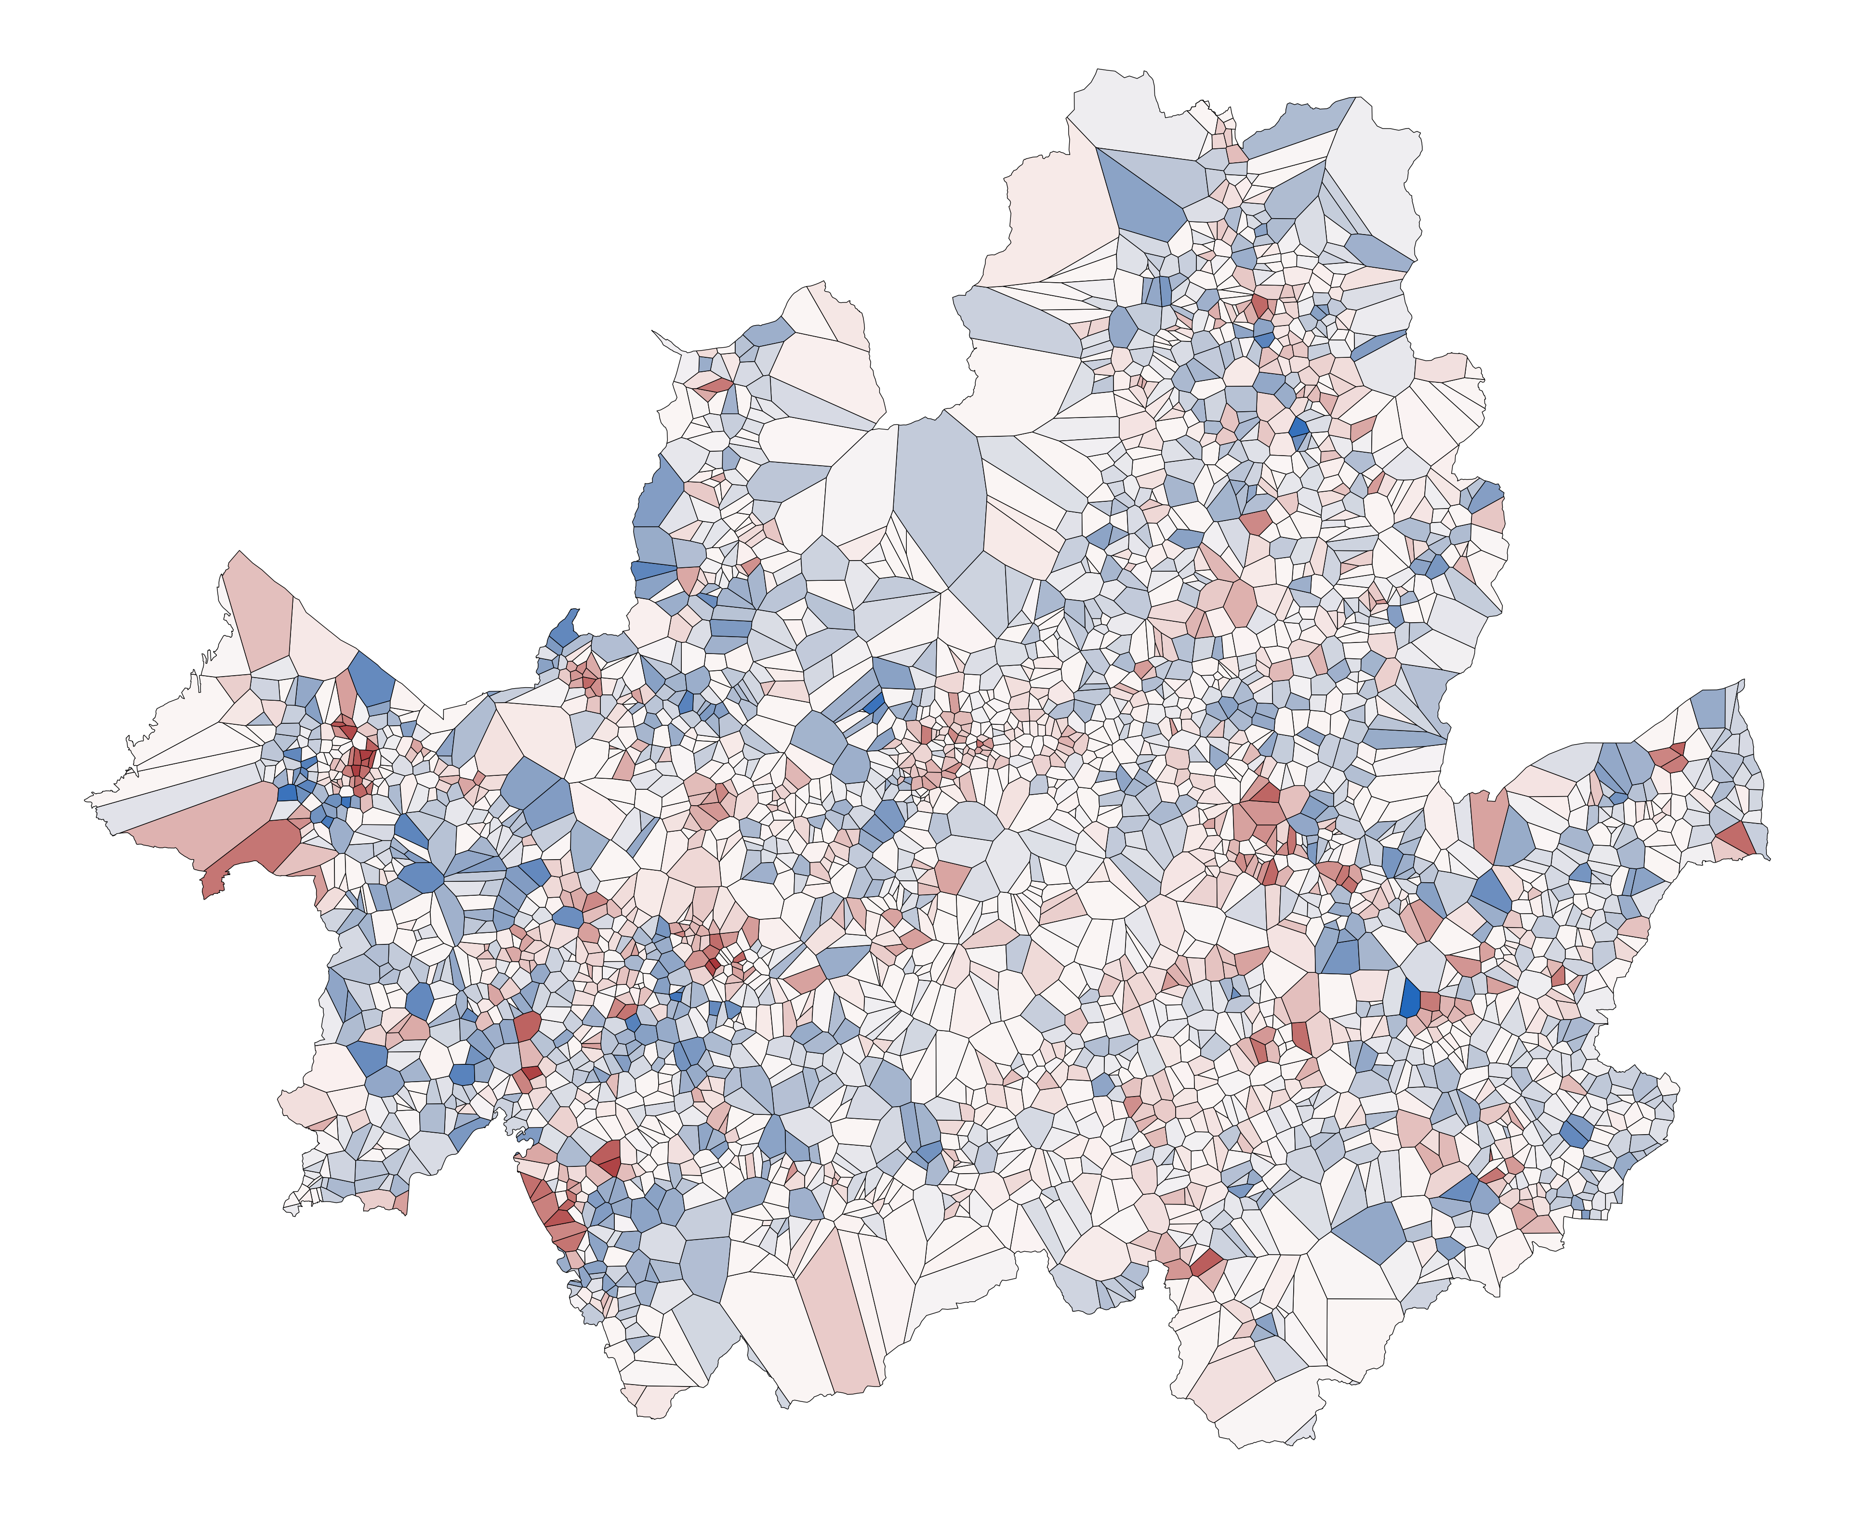
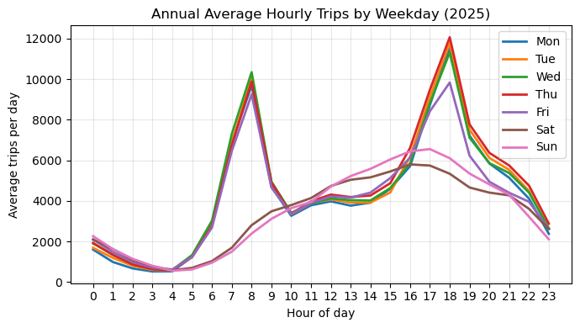
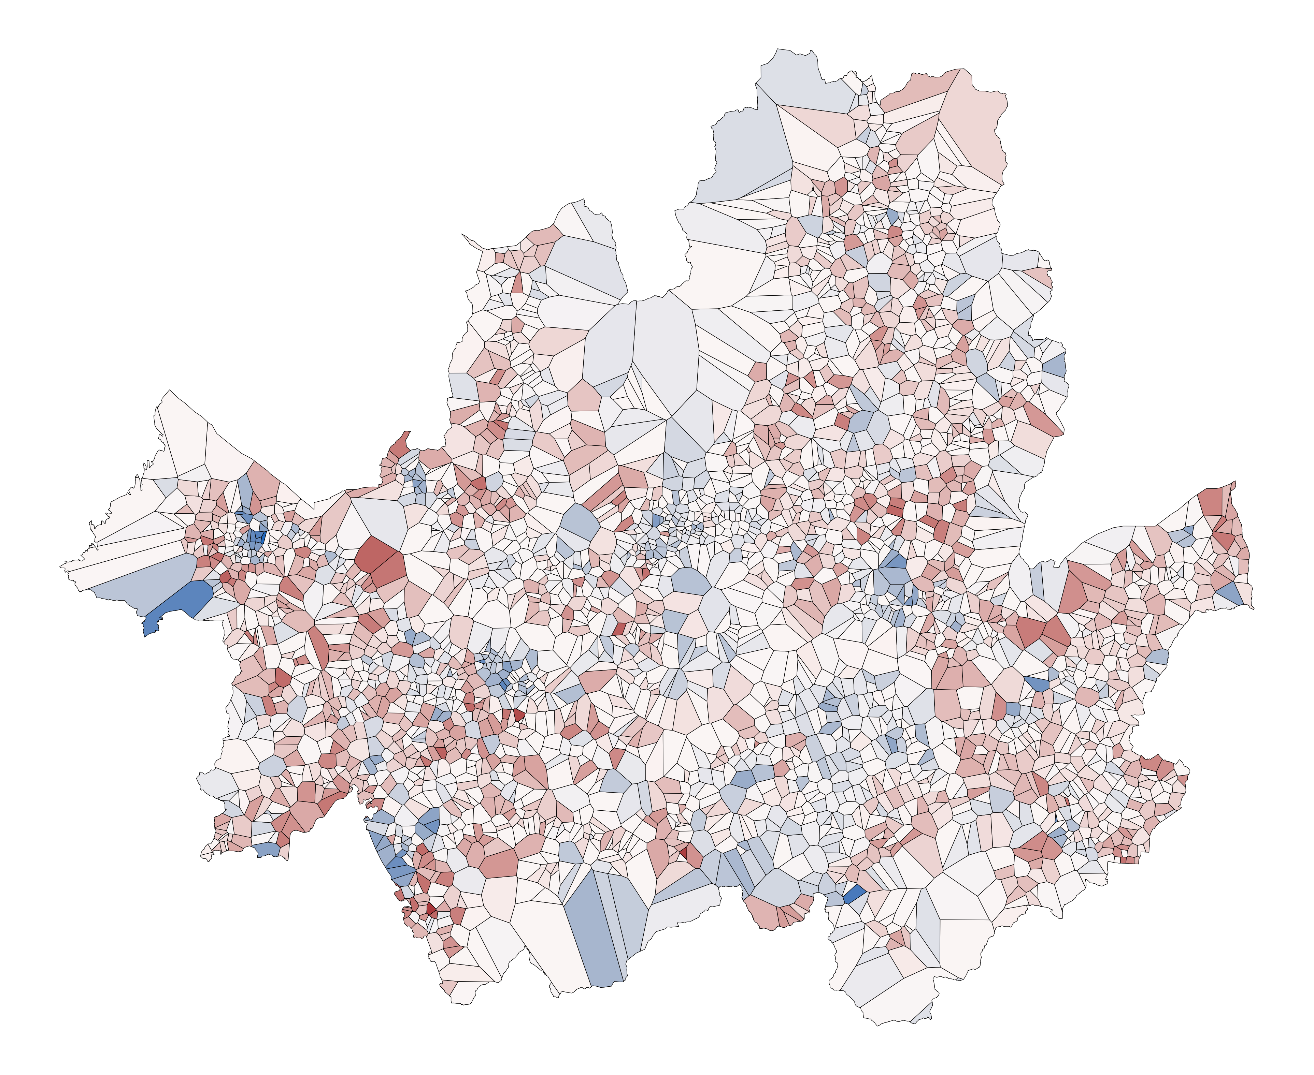
Where and When People Ride: Spatial Patterns of Seoul’s Public Bike System (2025)
< Annual average activity (inflow + outflow) >
0
1.0
0.00–51.20
51.20–110.44
110.44–199.32
199.32–379.72
Log(Weekend / Weekdays)
379.72–880.87
0
Bike station
Service area
-2.5
2.0
Log(Inflow / Outflow) (morning rush hour)
0
< Study area >
-2.0
Overall trip activity is more concentrated in peripheral areas than in the city center
Compared to weekdays, weekend trips are strongly concentrated along the river
Morning and evening rush hours exhibit opposite inflow-outflow ratio patterns, reflecting directional commuting dynamics
1.0
Log(Inflow / Outflow)
(evening rush hour)
0
-2.5
Yunsik Kim | GEOG 8005 | February 25, 2026 | Coordinate system: KGD 2002 / Unified CS (EPSG: 5179) | Data sources: SGIS Korea, Seoul Metropolitan Government, Ministry of Land, Infrastructure and Transportation of Korean Government
Notes:
This is my final visualization output. Excluding the study area map, I arranged four maps. The first map presents the annual average total activity at each station, calculated as the sum of inflow and outflow. The remaining three maps focus on temporal comparisons. These include comparisons between weekdays and weekends, and between inflow and outflow during the morning and evening rush hours. I used ratio maps for the temporal comparison maps by applying log transformation to the ratios in order to create a symmetric scale around zero. In the lower-left corner, I included a line chart showing the annual average number of trips by hour and weekday, illustrating the distinct difference between weekdays and weekends, as well as commuting peaks on weekdays.

