Slide 1
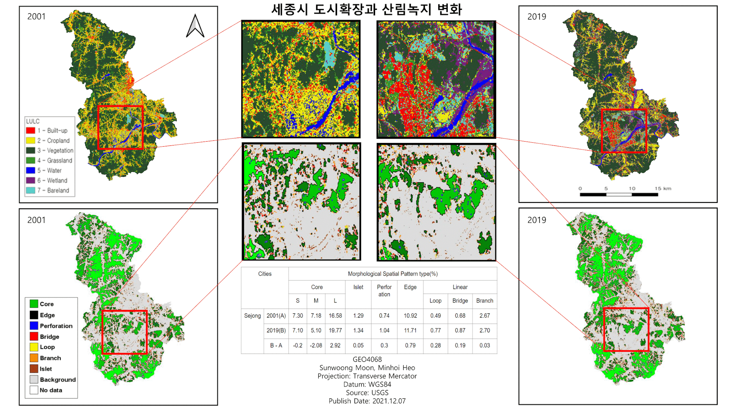
Urban sprawl and green space change in Sejong City, South Korea

