Slide 1
A lightweight
ANPR System
Md. Abdullah Al Muntasir
Md. Minhaj Uddin Raiyan
Imran Yakub
Dept. of Electrical & Electronic Engineering
International Islamic University Chittagong

Slide 2
OUTLINE
Introduction
Objective
Methodology
Result and Analysis
Conclusion

Slide 3
Introduction
What is ANPR?
ANPR (Automatic Number Plate Recognition) is a computer-vision system that automatically detects and reads vehicle license plates from images.
Widely used in:
  Smart traffic & security systems
  Parking management
  Toll collection
Identifying number plates manually is inefficient for modern traffic and security systems, especially because traditional rule-based methods fail under varying lighting, angles, and image quality.
An automated recognition method provides faster, more consistent, and more accurate results.

Slide 4
Objectives
A
To understand the fundamental steps of image preprocessing used in computer vision.
B
To detect the number plate region from a vehicle image using contour-based localization.
C
To extract and crop the detected plate area for further processing.
D
To perform optical character recognition (OCR) to read the alphanumeric text on the plate.
E
To verify the system’s accuracy by testing on multiple images and analyzing results.

Slide 5
Methodology
Step 1: Image Acquisition
How does Canny Edge Detection work?
Reduces noise using Gaussian filter.
Calculates image intensity gradients to detect edges.
Suppresses non-edge pixels.
Uses double thresholding and hysteresis to form continuous edges.
Produces clean boundaries for object detection.
The user uploads an image from their device using “files.upload()”
Step 2: Preprocessing
Convert the image from BGR → Grayscale
Apply bilateral filter
Detect edges using Canny operator to reduce noise while preserving edges
How does Contour Detection work?
Finds continuous boundaries from Canny edge-detected images.
Represents objects as connected point sequences.
Contours are sorted by area.
Polygon approximation identifies rectangular shapes.
Four-sided contours are selected as number plates.
Step 3: Contour Detection
Find all contours
Select top Contours by area
Approximate polygons and identify the one with 4 sides

Slide 6
Methodology (Cont.)
Step 4: Masking & Cropping
How does EasyOCR work?
Uses deep learning to detect text regions.
Crops detected regions automatically.
Recognizes alphanumeric characters using neural networks.
Outputs text with confidence scores.
Works without manual training or templates.
Create a binary mask
Extract only the region of interest (ROI)
Crop tightly around the detected plate
Step 5: OCR Recognition
EasyOCR reads characters from cropped region
Characters are joined into a single string
Fallback Strategy
Step 6: Final Output
If plate contours are not detected in Step-3, OCR is applied directly to the full image in Step-5 to avoid complete system failure
Recognized number is printed
Plate area is highlighted on the original image

Slide 7
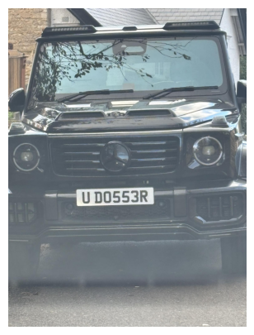
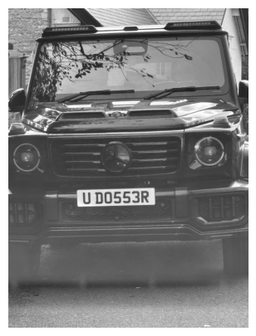
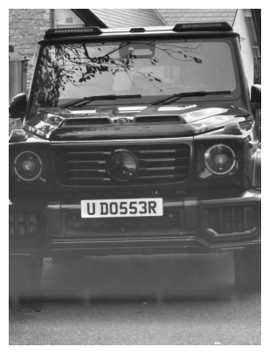
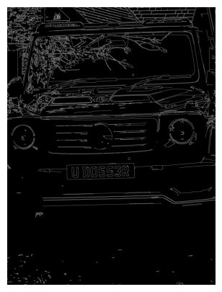
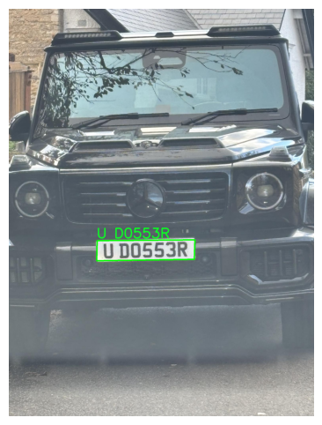
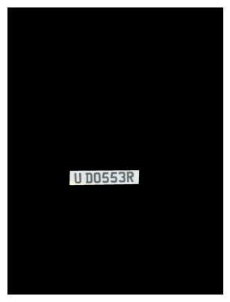
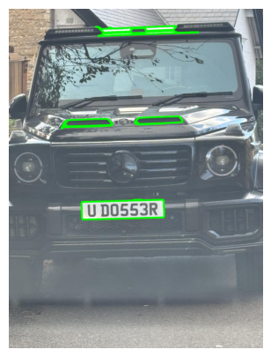
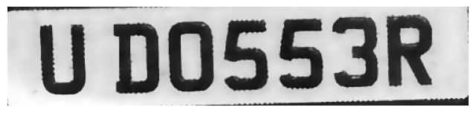
Result and Analysis
Original Image
Grayscale
Noise Reduction
Canny Operator
Final Output
Cropped Plate
Plate Detection
Contour Detection

Slide 8
Result and Analysis (Cont.)
Key Observations:
The system successfully detected the plate region.
EasyOCR correctly recognized alphanumeric characters with high accuracy when the plate was distinct.
The combination of bilateral filtering + Canny edge detection produced clean contours suitable for plate localization.
Limitations:
Low-Light Performance: Accuracy decreases significantly for images captured in poor lighting or nighttime conditions.
Image Quality Dependency: Blurred, low-resolution, or partially occluded plates can cause OCR misinterpretation.
Lack of Skew Correction: The current system does not correct rotation or tilt, reducing accuracy for angled plates.
Complex Background Sensitivity: Contour-based detection may fail when the background contains patterns similar to plate edges. Again, busy plates reduce accuracy as well.
Language and Font Restriction: The system is not optimized for Bangla license plates or non-standard stylized fonts.

Slide 9
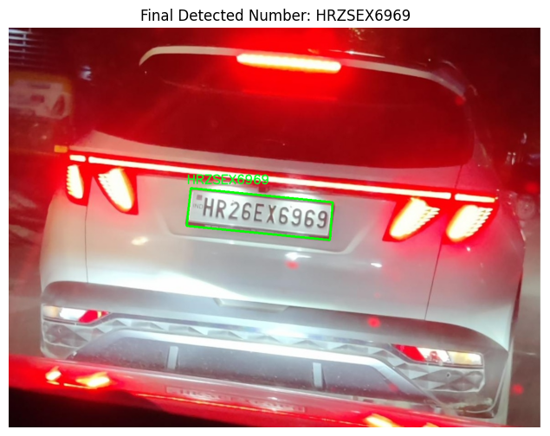
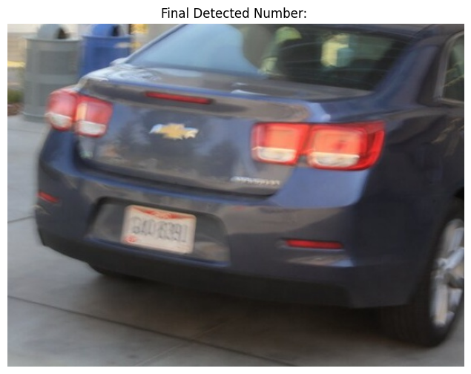
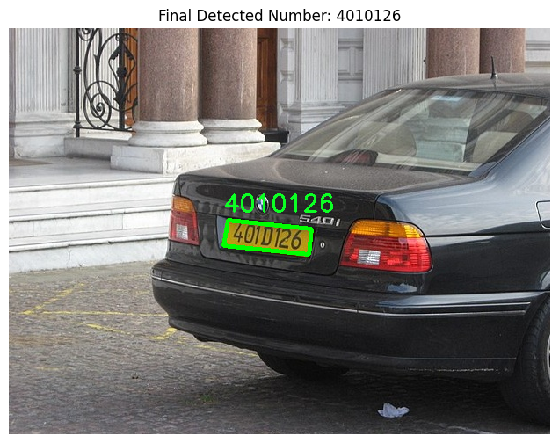
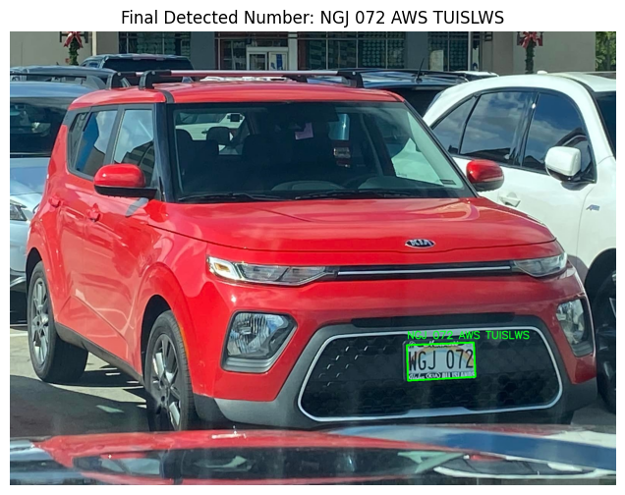
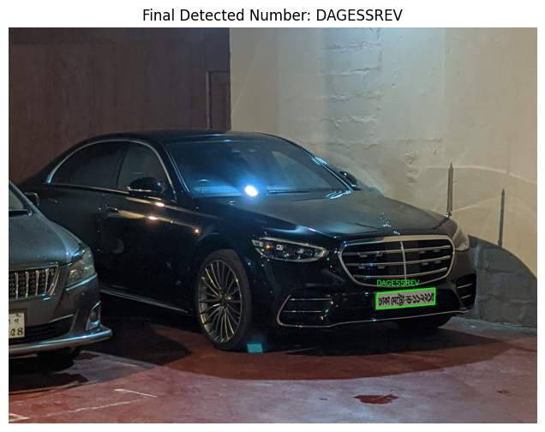
Result and Analysis (Cont.)
Low Light
Low Quality
Angular Distortion
Complex Background
Language

Slide 10
Conclusions
Summary
A working ANPR system was implemented using only classical image processing + EasyOCR.
Successfully detects number plates and extracts characters from vehicle images.
Preprocessing and contour-based detection make the system lightweight and fast.
Comparisons
Deep learning–based ANPR systems are more robust but require training and GPU resources.
This lightweight approach is simpler, faster and ideal for small-scale applications.
Future Improvements
Add deep-learning YOLO-based plate detection
Improve OCR by training a domain specific CNN-based text recognition
Add rotation correction and skew removal
Add Bangla license plate recognition capability

Slide 11

THANK YOU

