Slide 1
MIRAI
Yevgeniy Kiveisha - Jan 2017

Slide 2
Agenda
Bot… What?
Go malicious.
Introduction.
Infection map.
Architecture.
Lets go deeper…
Q&A

Slide 3
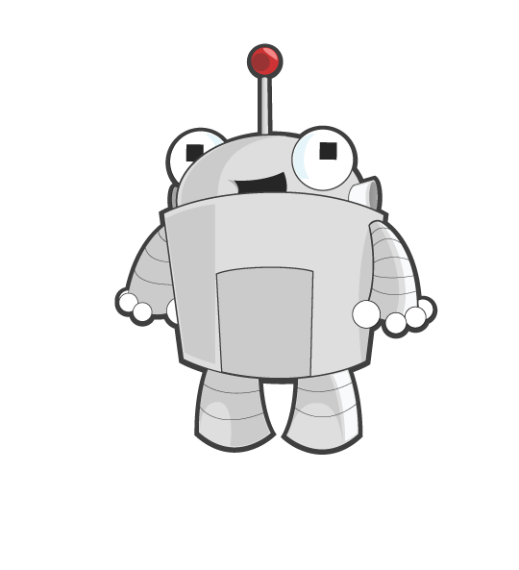
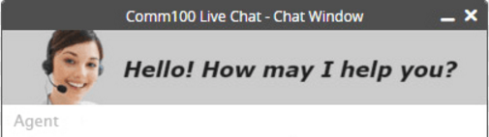
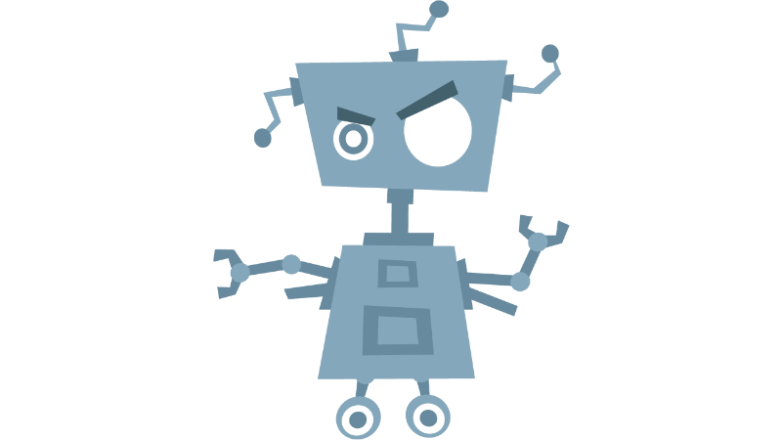
Bot… What?
Software agent – Piece of code working for you…
Buyer agents retrieving information about goods and services, also known as “shopping bots”.
User agents or personal agents
Check your e-mail, play computer games (annoying…), find information for you, Scan Web pages, Fill out forms and more…
And so on…

Slide 4



Go malicious
Not all BOTs (software agents) are good.
Game bots – playing game for your opponent. So annoying…
Automated scanners.
DDOS – Group of agents attacking one target.
Information gathering – After infecting device agent export information.

Slide 5
introduction
Discovered 49,657 unique IPs which hosted Mirai-infected devices.
Mostly Mirai was hosted by CCTC cameras.
Used as a launch platform for DDoS attacks.
C&C code is coded in Go, while its bots are coded in C.
Source code was liked by Anna-senpai.

Slide 6
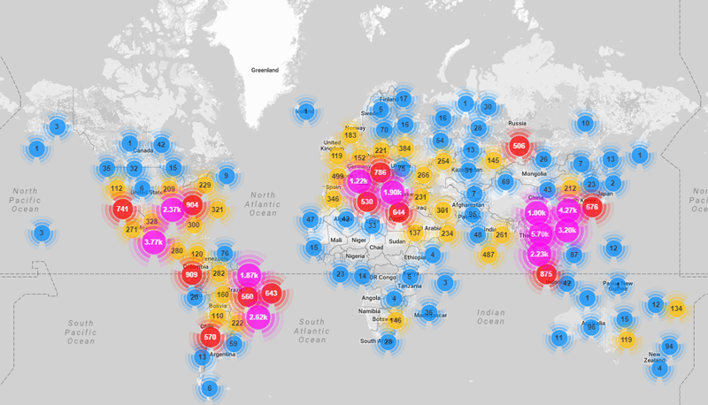
infection Map
Overall, IP addresses of Mirai-infected devices were spotted in 164 countries.

Slide 7


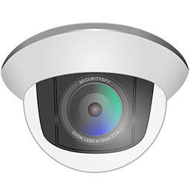
Architecture
Loader
dlr.ARCH (4Kb)
Mirai.ARCH (60Kb)
3. GO script passing the
credentials to loader using
simple STDIN pipe.
Mirai.ARCH (60Kb)
5.2.1 If tools not found
then loader download
using echo load small
binary that connect
loader and receiving
Mirai binary.
5.1. If tools found then
loader download using
shell commands Mirai
binary to the device
and execute.
4. Loader connecting IoT
Device using U/P provided
earlier. Checking if there
are wget and tftp tools.
scanListener.go
2. Once scanner found
potential user, it report
to loader on port 48101.
Scanner
6. Now CNC can launch attacks.
Isn’t it cool?!
5.2.2 Tiny loader loading
Mirai to the device.
1. Scanner searching for devices
with default or known username
and password.
dlr.ARCH (4Kb)
CNC

Slide 8

Lets go deeper…
Internet
Behind NAT
Attacker
Router
IoT
Port forwarded
IoT

Slide 9
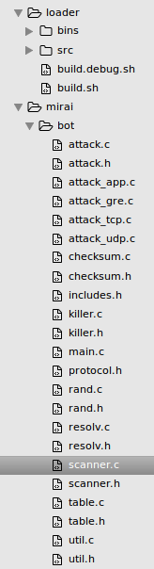

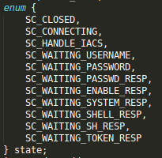
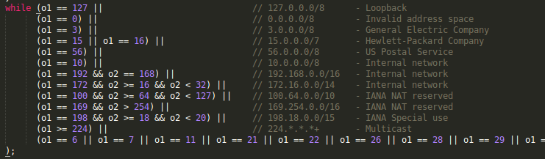
Lets go deeper…
Scanner
Obfuscated username and password saved in table repository
Avoiding list of IP.
Whit list of Ips which will not be scanned.
Not using 3d-party libraries for telnet. Has its own implementation.
Strings were obfuscated to make it more difficult for been detected.
Telnet connection state machine

Slide 10
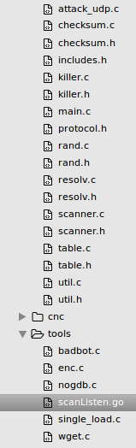
Lets go deeper…
scanListener.go
Scanner
Reporting method. (scanner.h)
GO based server send the reported credentials to the C based handler to make the connection.
GO based server handle the report.
Once the potential device was found scanner report to the loader server.
Loader listener. (scanListen.go)
STDOUT the result. (scanListen.go)

Slide 11
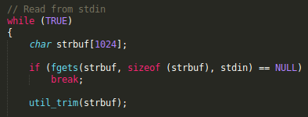
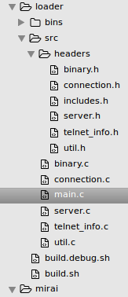

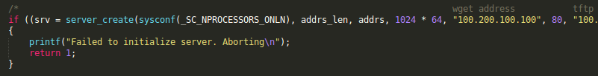
Lets go deeper…
Loader
Receiving data from STDIN sent by scanListener.go
scanListener.go
Getting credentials from STDIN. (main.c)
Queueing the report. (main.c)
After STDIN process done the credentials passed to the server loader via queue.
On loader execution server crerated.
Create loader server. (main.c)

Slide 12
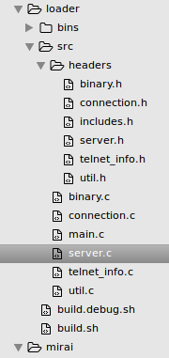
Lets go deeper…
Echo loading the small loader binary. (connection.c)
If device doen’t have wget or tftp tools it will upload 4K binary using simple echo command.
Wget uplaod . (server.c)

Slide 13
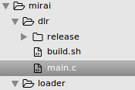
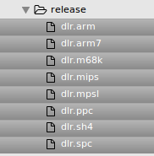
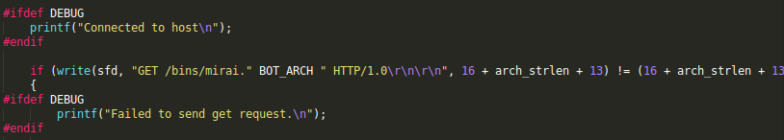
Lets go deeper…
For each CPU architecture the is a binary.
Loader
After loader uploaded the 4K binary and executed it, this binary (ldr) connecting to the loader server to retrieve the real Mirai binary.
Mirai.ARCH (60Kb)
dlr.ARCH (4Kb)
Requesting the real Mirai binary file from the loader server. (dlr/main.c)

Slide 14
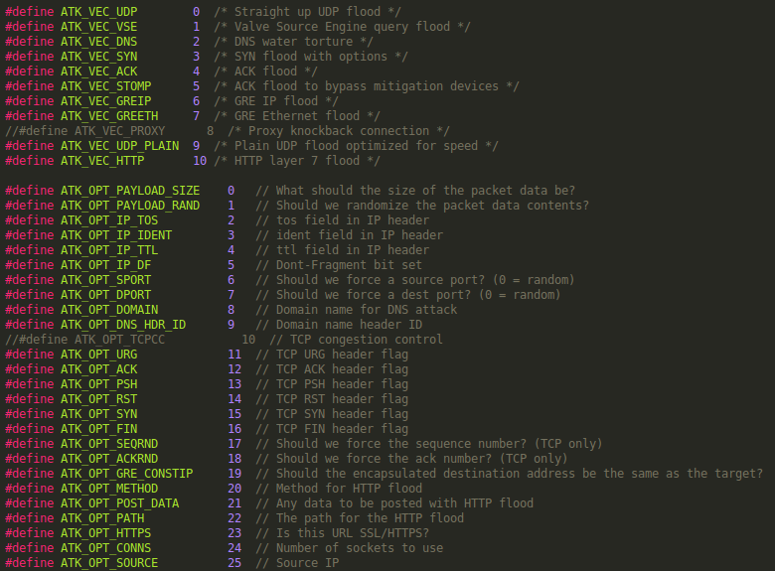
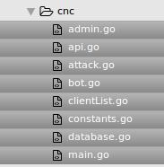
Lets go deeper…
HTTP attack on user. (attack_app.c)
CNC
List of attack listed. (attack.h)

Slide 15


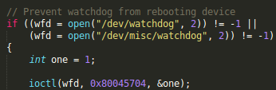


Lets go deeper…
Hiding behind random name. (bot/main.c)
After Mirai uploaded into the memory it delete itself. (main.c)
Preventing watchdog from rebooting device. (main.c)
Weird cyrillic language . (admin.go)
Might say something about the author or it was made to confuse the enemy.
On load Mirai killing the Anime/Kami opponent. (killer.c)

Slide 16
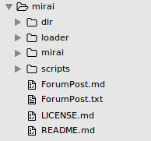
Lets go deeper…
Ensure only one instance of Mirai running.
Killing other processes.
Hide process name behind random name.
Killing opponents processes.
Using anti-debug technics.
Registering to SIGTRAP.
Source code tree,

Slide 17
Q&A

