Slide 1
Baby-wareable

Slide 2
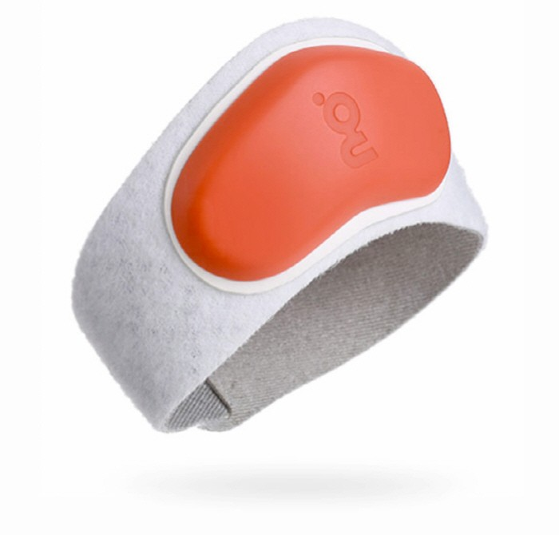

Slide 3
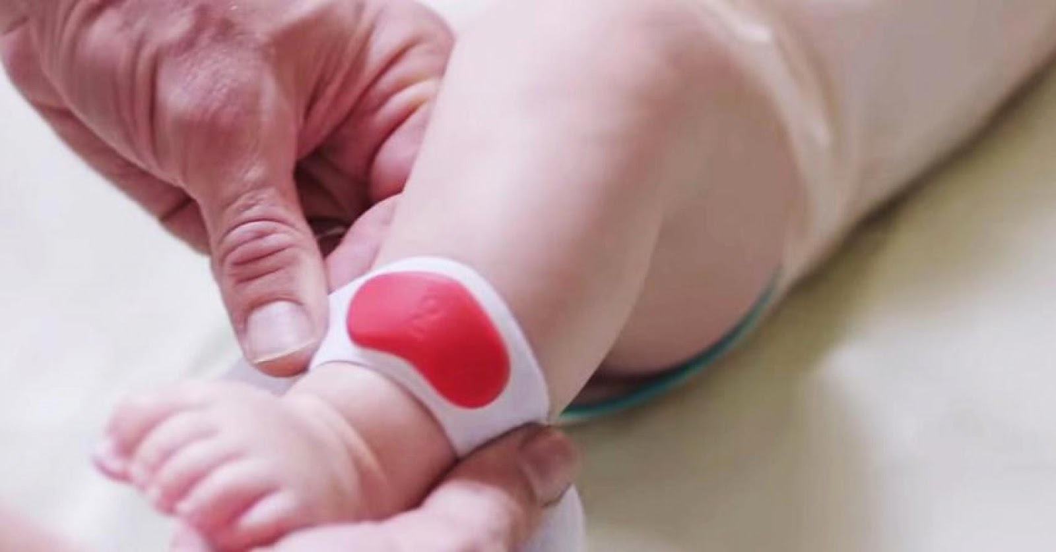

Slide 4
