Slide 1
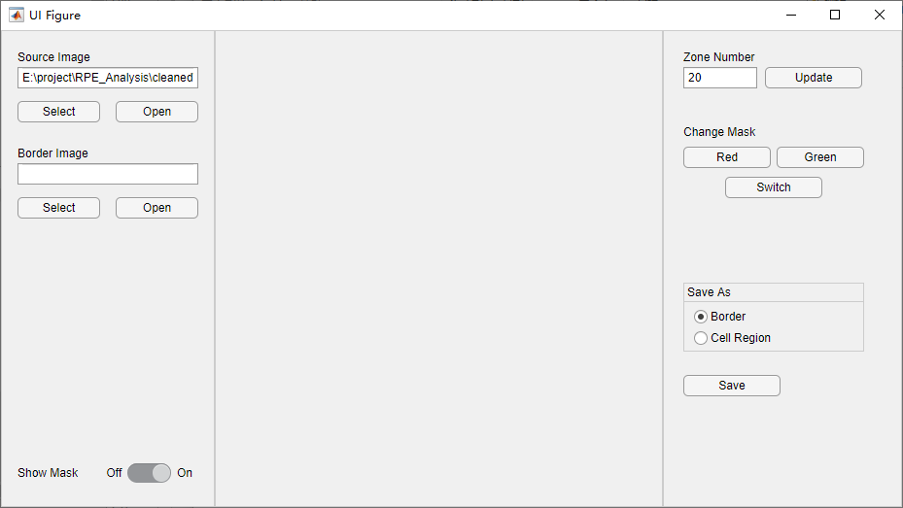
Load reference image. Color image will be converted to gray.

Slide 2
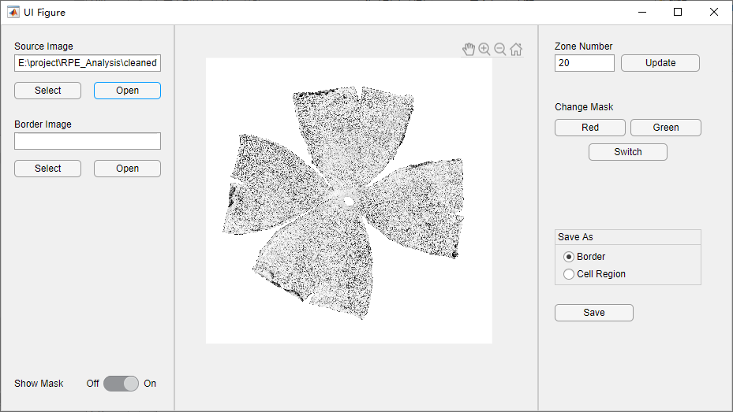

Slide 3
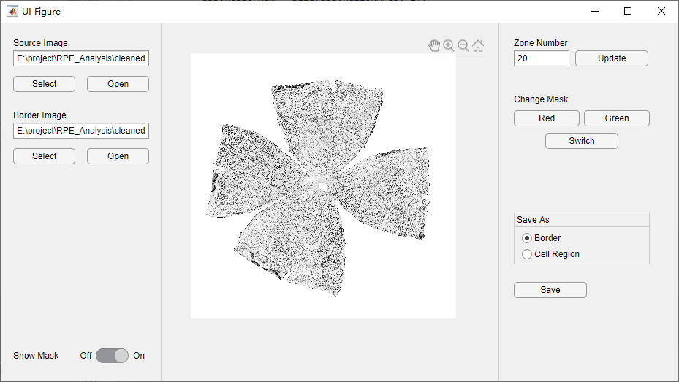
Load border image. The input should be grayscale or binary. Gray image will be binarized by Otsu threshold

Slide 4
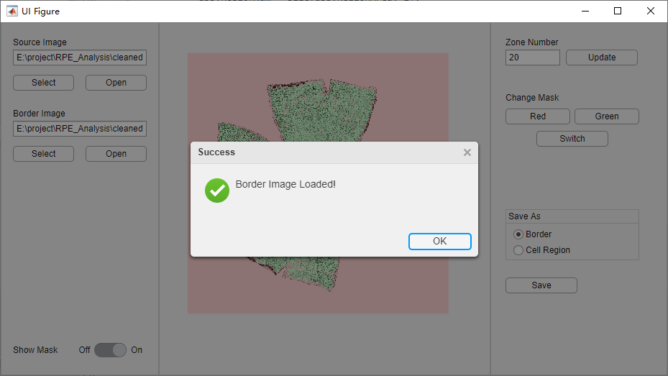
Please wait until the success notification

Slide 5
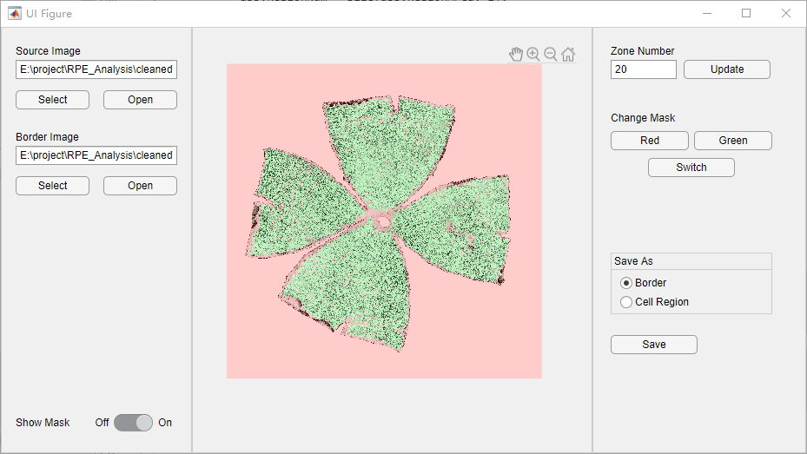
The code marks retained regions as green masks and removed regions as red masks. It will automatically mark the background region and abnormal regions.

Slide 6
The code divide the region into several concentric ring zones. Outliers in each zones would be marked as red. The metrics to decide outliers are area, eccentricity, and solidity.
Note that clicking on ‘Update’ button would reset the masks, so please do the manual selection after zone number is determined.

Slide 7
Zoom in, zoom out, and pan image here
Please ensure that these buttons are not pushed before zooming or panning in the plot region.

Slide 8
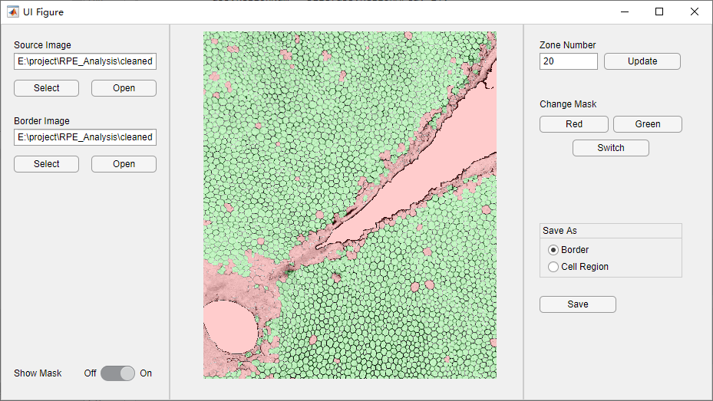

Slide 9
Switch to ‘off’ can hide the masks so that users can observe the reference image more clearly

Slide 10
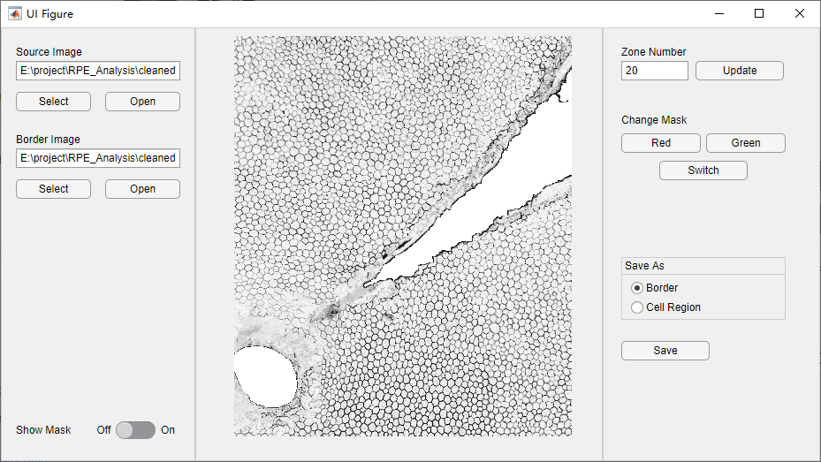

Slide 11
If ‘Switch’ button is pushed, user can click on a single region to switch its state.

Slide 12
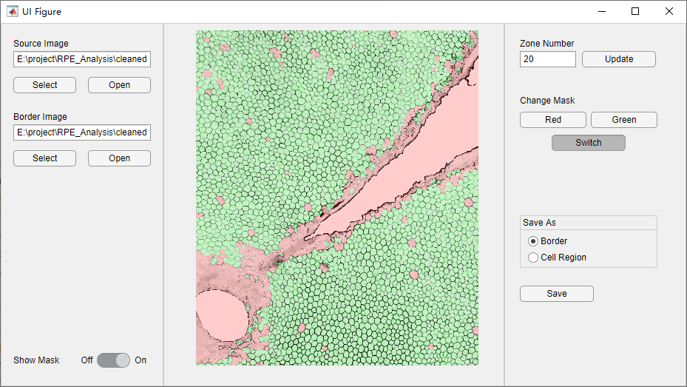

Slide 13
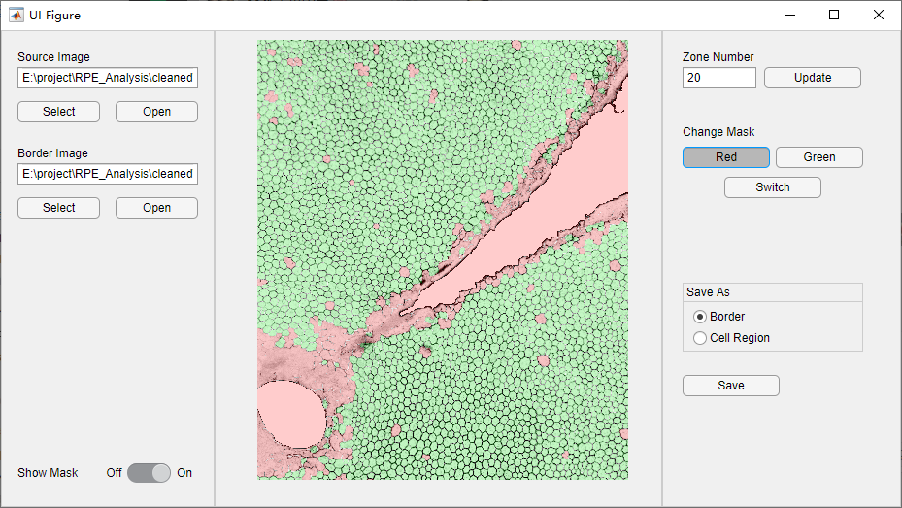
If ‘Red’ button is pushed, user can select a region by holding left mouse button and dragging. All masks intersect with the region would be set to red.
The function of ‘Green’ button is similar

Slide 14
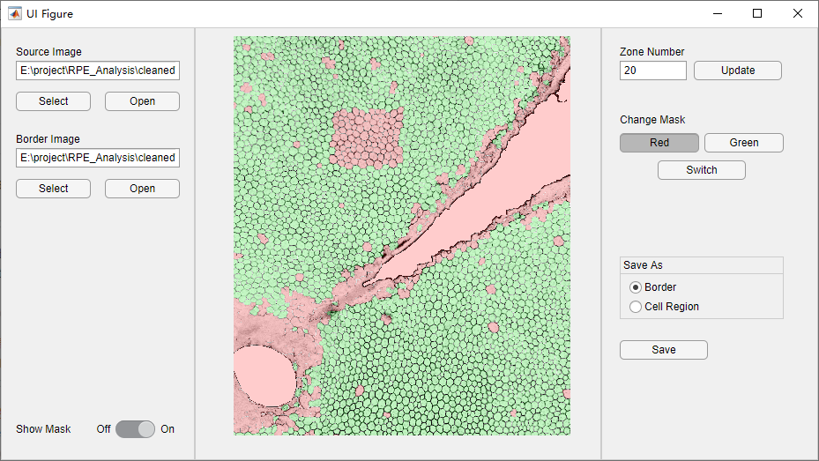

Slide 15
There are two modes for saving the result: save the green masks as foreground, or save the border of green masks as foreground

Slide 16
Result saved in the ‘Border’ mode

Slide 17
Result saved in the ‘Cell Region’ mode

