Slide 1

Hourly Energy Forecasting
RNN vs LSTM Performance Analysis

Slide 2
TL;DR: Motivation, Main Idea & Results
MOTIVATION
MAIN IDEA
RESULTS
Demand forecasting is critical for many use cases. Classical methods (ARIMA or Linear regressing) are interpretable but struggle with complex temporal patterns and rely on manual features and has lots of assumptions.
This project explores if Deep Learning can automatically capture these patterns and generate better forecast.
We compare 4 configurations of Simple RNN and LSTM architectures built in PyTorch using the DOM energy dataset from Kaggle.
Model are RNN and LSTM, baseline and enhanced version with cyclical time embeddings.
The task is one-step-ahead hourly forecasting: given the last 24 hours, predict the next hour's MW demand.
Model
RMSE
R²
MAPE
RNN Base
215.46
0.992
1.44%
LSTM Base
219.30
0.991
1.44%
RNN + Feat
204.17
0.993
1.37%
LSTM + Feat
160.86
0.995
1.07%
Conclusion: LSTM with cyclical features is the clear winner, delivering a 25% RMSE reduction over the baseline. The combination of architecture and feature engineering provides the largest gain.

Slide 3
Literature Review on Related Methods
SIMPLE RNN
LSTM ARCHITECTURE
Designed for sequential data, it updates a hidden state at each step to carry information forward. Reads 24-hour history for next-hour forecasts.
Core weakness: Vanishing gradients make it hard to learn dependencies beyond 10–20 steps.
Fixes the RNN's weakness using a cell state and three learned gates (forget, input, output) to control information flow.
Effectively retains relevant context over hundreds of steps, capturing daily and weekly periodicities.

Slide 4

SECTION 1
Exploratory Data Analysis (EDA)

Slide 5
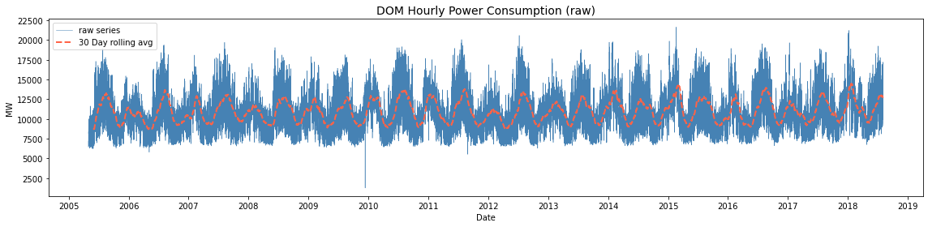
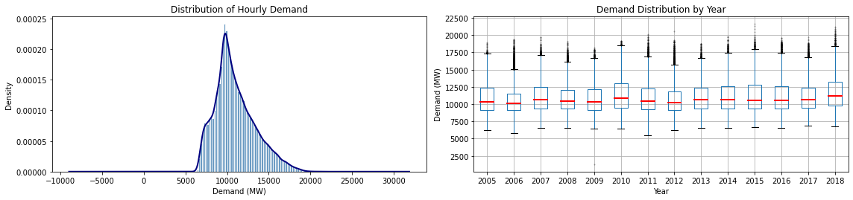
Time Series Trends and Distribution
RAW DEMAND TREND
CONSUMPTION DISTRIBUTION
Notes:
DOM hourly electricity consumption recorded from May 2005 to August 2018

Slide 6
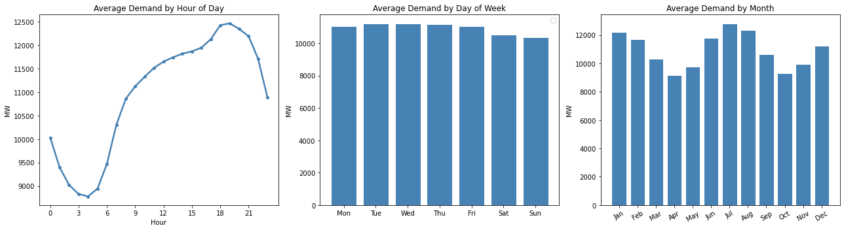
Seasonal Patterns
Analysis reveals strong seasonality in daily, weekly, and monthly.
Morning and evening hourly peak; weekends lowers than weekdays; winter and summer peak;

Slide 7

SECTION 2
Data Preprocessing

Slide 8
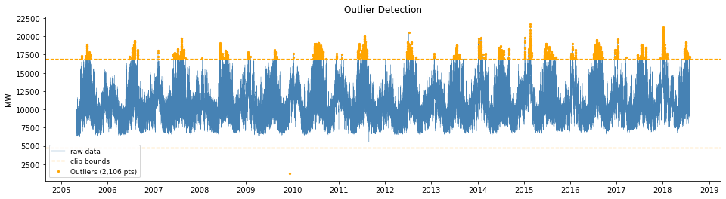
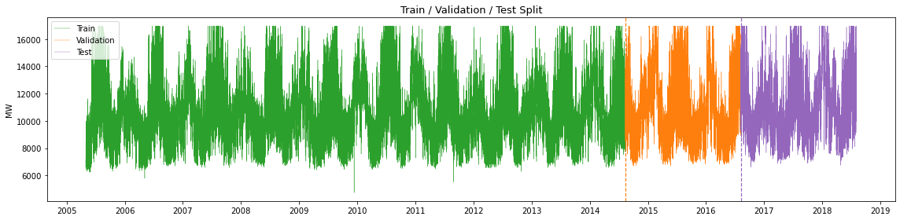
Cleaning and Time-Ordered Splitting
OUTLIER TREATMENT
2,106 extreme points (1.81%) were detected using IQR and clipped to fence boundary
TIME SPLIT
Data is split by time order to prevent data leakage (70% training, 15% validation, 15% test).
Normalized by Min-Max to map value in [0,1], and scaling parameters are fitted only on training data.

Slide 9
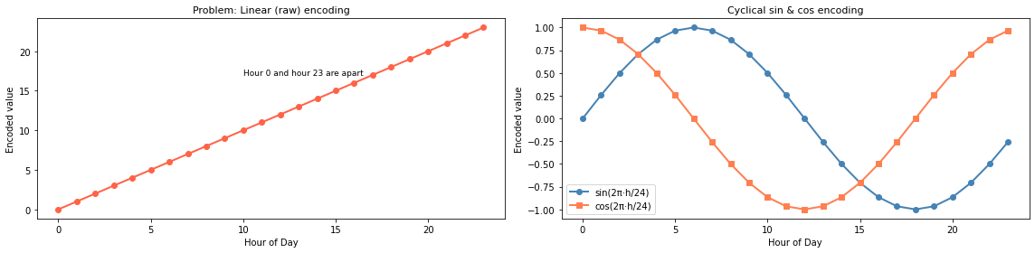
Engineering Cyclical Time Features
IDEA
Enrich feature set for training. Linear encoding (0-23) creates a false distance between hour 23 and hour 0; researched another way called cyclical embedding.
Project time onto a 2D circle using sine and cosine transformations. This preserves the periodic nature of time, where period in 24, 7, 12
x_sin = sin(2 * π * t / period) x_cos = cos(2 * π * t / period)

Slide 10
SECTION 3
Model Setup

Slide 11
Forecasting Architecture and Parameters
MODEL DESIGN
HYPERPARAMETERS
Sliding Window
Each sample uses a 24-hour input sequence as a lag array to predict the single next-hour demand.
Architectures
Comparison between models RNN and LSTM (baseline vs enriched features) to evaluate the model capability.
Parameter
Value
Reason
hidden_size
64
Reasonable default for model to remember
num_layers
3
Depth allows model to learn temporal features
dropout
0.15
Light regularization for large data
optimizer
Adam
Adaptive learning rates, fast convergence
initial lr
1e-3
Standard default start point
epochs
30
Sufficient for convergence on this dataset
batch_size
512
Good for current data size

Slide 12
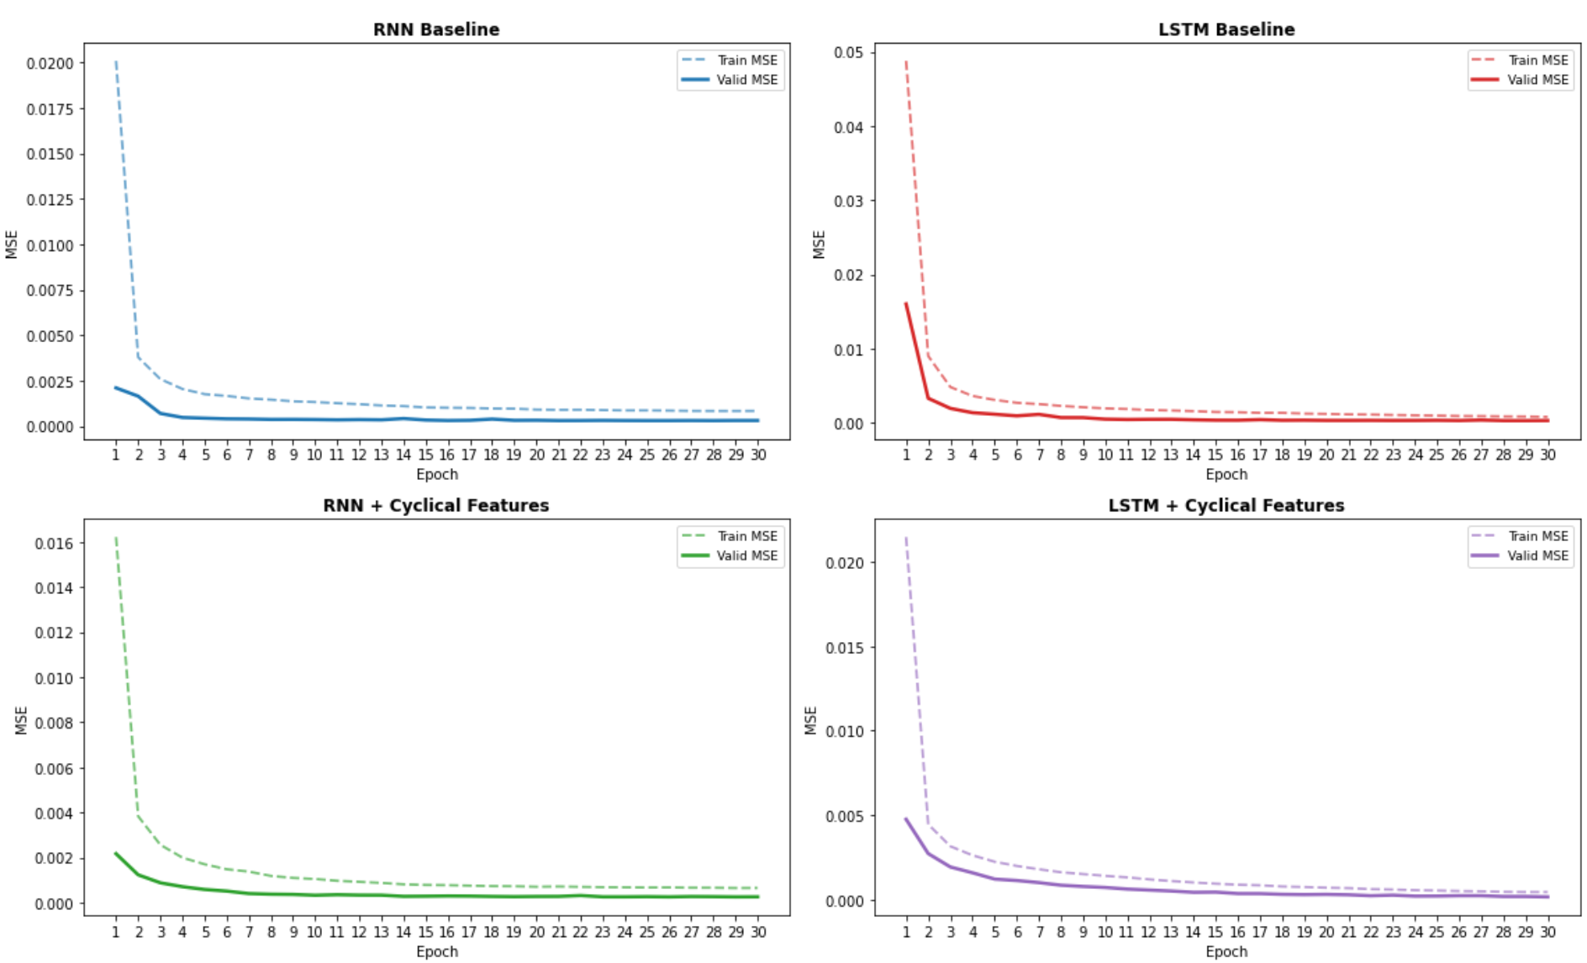
Training and Validation Loss Curves

Slide 13
SECTION 4
Results and Output Comparison

Slide 14
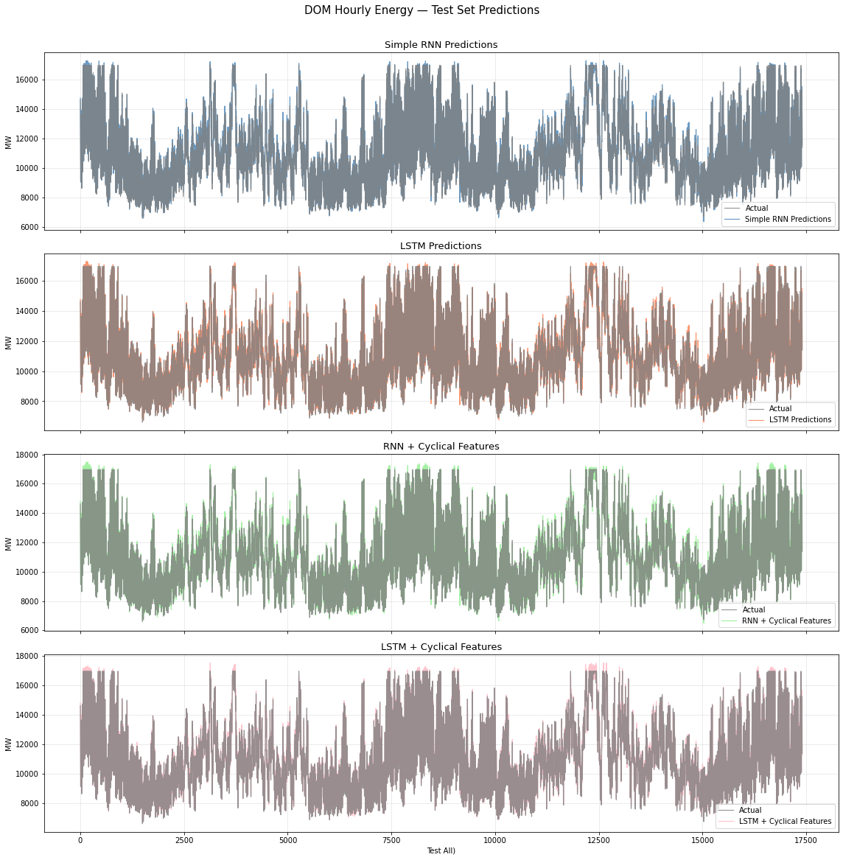
Forecast vs Actuals

Slide 15
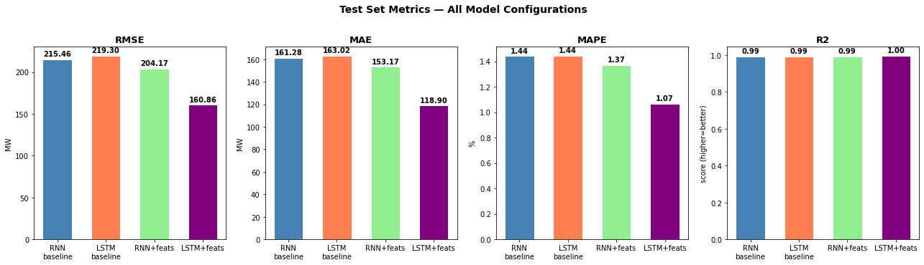
Model Performance Metrics (Test Set)
MODEL CONFIGURATION
RMSE
MAE
R²
MAPE
RNN Baseline
215.46
161.28
0.9917
1.44%
LSTM Baseline
219.30
163.02
0.9915
1.44%
RNN + Cyclical Features
204.17
153.17
0.9926
1.37%
LSTM + Cyclical Features
160.86
118.90
0.9954
1.07%

Slide 16
Key Findings
LSTM wins
The LSTM with cyclical time features is the clear winner.
However, theoretically the LSTM base should outperform than RNN, but it turns not oppositely. The reason is LSTM needs more epochs to converge than RNN because it has 4x more parameters where 30 epochs might not enough.
FEATURE IMPACT
Temporal encoding (sin/cos) significantly reduces forecast error by providing the model with periodic context.
DATA QUALITY
Rigorous outlier cleaning and chronological splitting were essential for stable training and realistic evaluation.

Slide 17
Links and Reference
Result
Github: https://github.com/ykkkw/ai-hw-sp-2026-nn/tree/main/MRP_energy_fcst
Youtube: https://www.youtube.com/watch?v=ttesidRzbk0
Reference
Kaggle data: https://www.kaggle.com/datasets/robikscube/hourly-energy-consumption/data?select=DOM_hourly.csv
Cyclical feature encoding: https://www.kaggle.com/code/avanwyk/encoding-cyclical-features-for-deep-learning
PyTorch RNN docs: https://pytorch.org/docs/stable/generated/torch.nn.RNN.html
PyTorch LSTM docs: https://pytorch.org/docs/stable/generated/torch.nn.LSTM.html
Sequence length discussion: https://stackoverflow.com/questions/49573242/what-is-sequence-length-in-lstm
MinMaxScaler: https://scikit-learn.org/stable/modules/generated/sklearn.preprocessing.MinMaxScaler.html
R² score: https://scikit-learn.org/stable/modules/generated/sklearn.metrics.r2_score.html

