Slide 1

ECSE 428
Assignment A: cdc TDD Steps
Yanni Klironomos, 261233238
Mahad Haider, 261239090
McGill University, Software Engineering in Practice

Slide 2
Tests implemented (in order of development)
# | Test ID | Command-line syntax | Expected output | Written by
1 | T-PUSH-REAL1 | push 5 pop | 5 + j0 | Yanni
2 | T-POP-ERR1 | pop | Error: stack underflow | Yanni
3 | T-ADD-REAL1 | push 2 push 5 add pop | 7 + j0 | Yanni
4 | T-ADD-ERR1 | push 3 add | Error: stack underflow | Yanni
5 | T-SUB-REAL1 | push 5 push 2 sub pop | 3 + j0 | Yanni
6 | T-SUB-ERR1 | sub | Error: stack underflow | Yanni
7 | T-MUL-REAL1 | push 3 push -2 mul pop | -6 + j0 | Yanni
8 | T-MUL-ERR1 | mul | Error: stack underflow | Yanni
9 | T-DIV-REAL1 | push 8 push 2 div pop | 4 + j0 | Yanni
10 | T-DIV-ERR1 | push 1 push 0 div | Error: division by zero | Yanni
11 | T-PUSH-CPLX1 | push -2.5-j0.25 pop | -2.5 - j0.25 | Mahad
12 | T-PUSH-CPLX2 | push 3 + j 4 pop | 3 + j4 | Mahad
13 | T-ADD-CPLX1 | push 3+j4 push 1-j2 add pop | 4 + j2 | Mahad
14 | T-SUB-CPLX1 | push 3+j4 push 1-j2 sub pop | 2 + j6 | Mahad
15 | T-MUL-CPLX1 | push 1+j2 push 3-j4 mul pop | 11 + j2 | Mahad
16 | T-DIV-CPLX1 | push 4+j2 push 1+j1 div pop | 3 - j1 | Mahad
17 | T-DIV-ERR2 | push 1+j0 push 0+j0 div | Error: division by zero | Mahad
18 | T-DEL-REAL1 | push 1 push 2 delete pop | 1 + j0 | Mahad
19 | T-DEL-CPLX1 | push 1+j1 push 2+j3 delete pop | 1 + j1 | Mahad
20 | T-DEL-ERR1 | delete | Error: stack underflow | Mahad
2

Slide 3
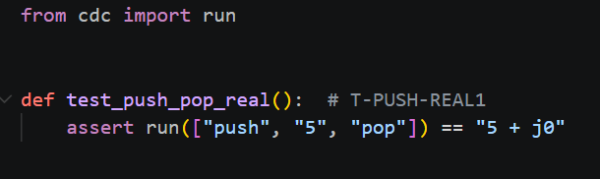

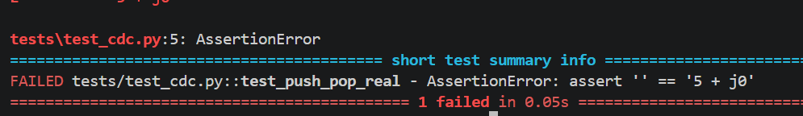

Test ID: T-PUSH-REAL1
Statement of unit test: Verify that pushing a real number onto the stack and popping it returns the same number.
Command: push 5 pop Expected results: 5 + j0
1. Screen capture of unit test code
3. Screen capture of code changes highlighted
5. All previous unit tests still pass after code changes
N/A: no prior tests since this is the 1st test and it passes, as required.
2. Screen capture demonstrating unit test failing
4. Screen capture demonstrating unit test passing
3

Slide 4

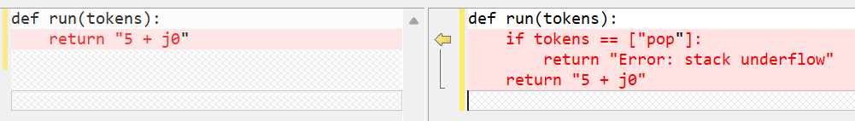
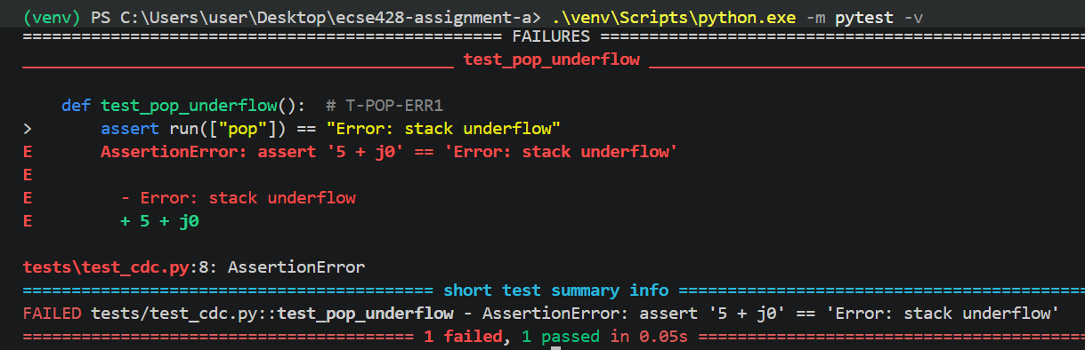
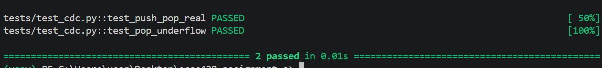
Test ID: T-POP-ERR1
Statement of unit test: Verify that popping from an empty stack produces a stack underflow error.
Command: pop Expected results: Error: stack underflow
1. Screen capture of unit test code
3. Screen capture of code changes highlighted
2. Screen capture demonstrating unit test failing
5. All previous unit tests still pass after code changes
4. Screen capture demonstrating unit test passing
4

Slide 5
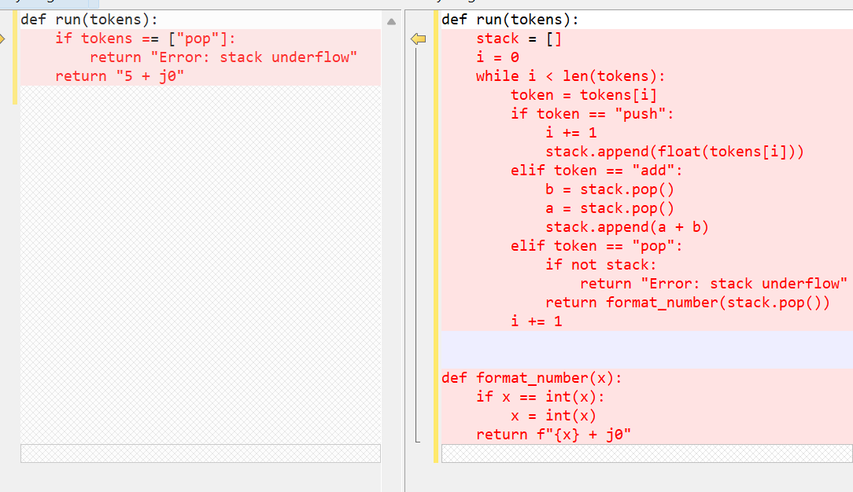
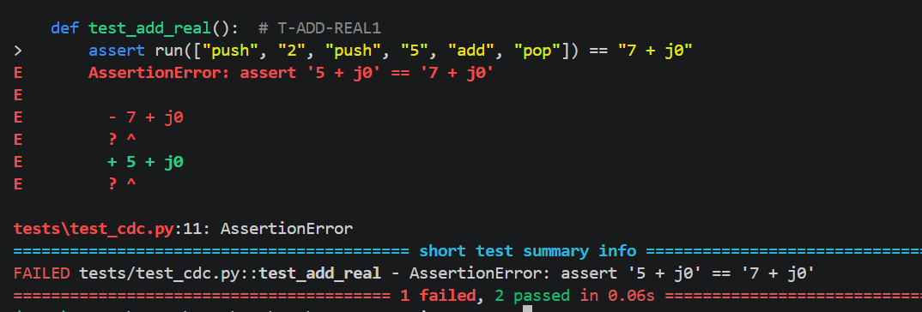
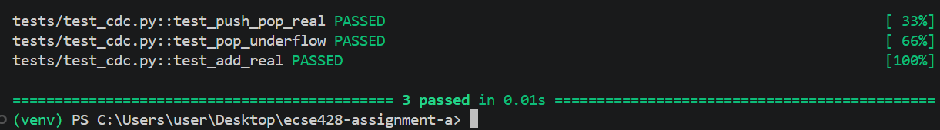
Test ID: T-ADD-REAL1
Statement of unit test: Verify that adding two real numbers (2 and 5) returns the correct result.
Command: push 2 push 5 add pop Expected results: 7 + j0
1. Screen capture of unit test code
3. Screen capture of code changes highlighted
2. Screen capture demonstrating unit test failing
5. All previous unit tests still pass after code changes
4. Screen capture demonstrating unit test passing
5

Slide 6
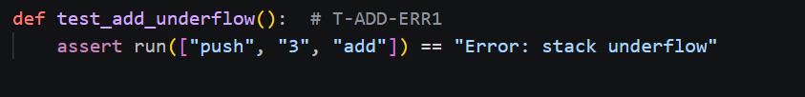
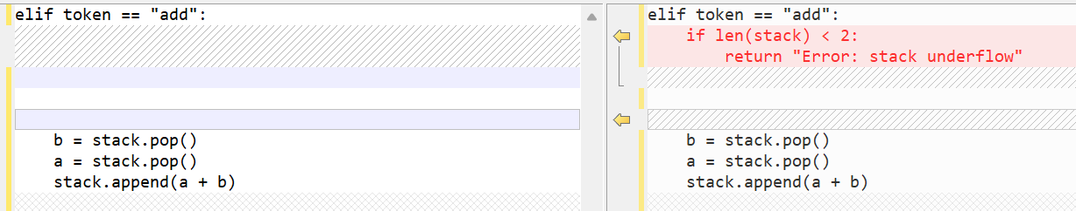
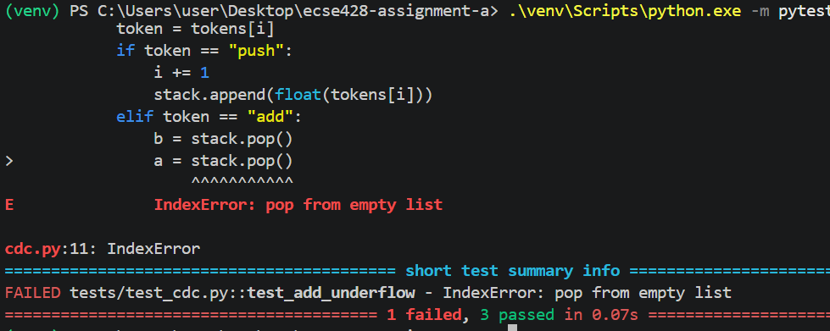
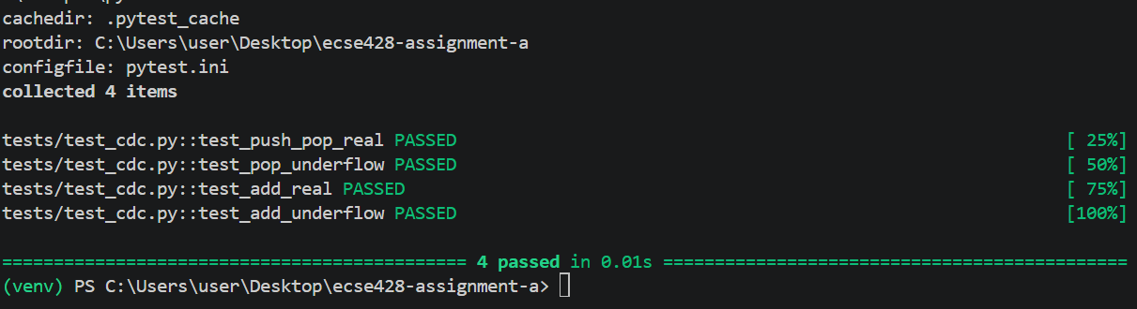
Test ID: T-ADD-ERR1
Statement of unit test: Verify that adding numbers when the stack contains fewer than two operands produces a stack underflow error.
Command: push 3 add Expected results: Error: stack underflow
1. Screen capture of unit test code
3. Screen capture of code changes highlighted
2. Screen capture demonstrating unit test failing
5. All previous unit tests still pass after code changes
4. Screen capture demonstrating unit test passing
6

Slide 7
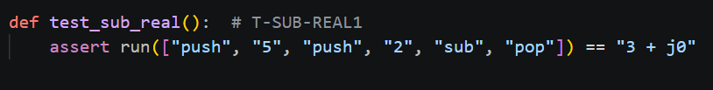
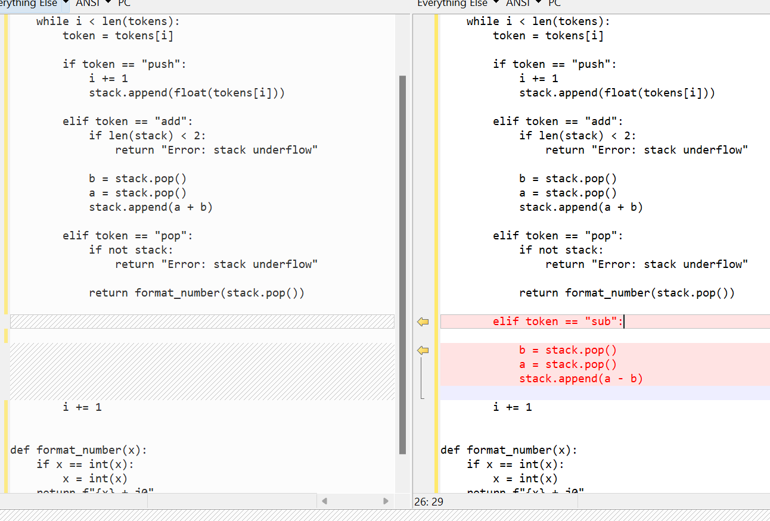
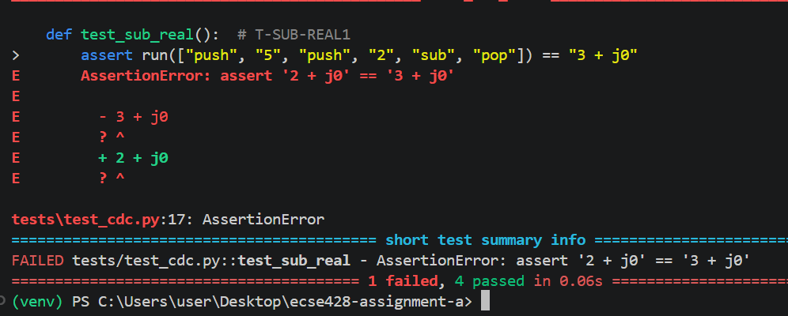
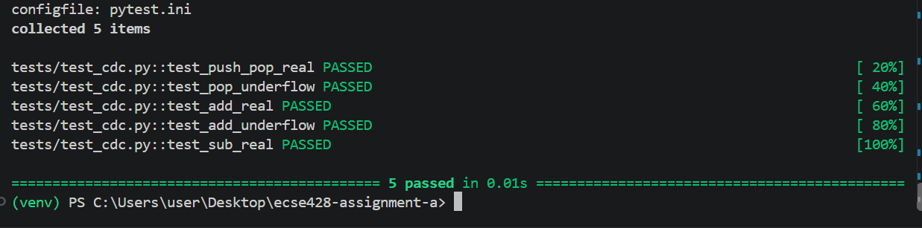
Test ID: T-SUB-REAL1
Statement of unit test: Verify that subtracting 2 from 5 returns the correct result.
Command: push 5 push 2 sub pop Expected results: 3 + j0
1. Screen capture of unit test code
3. Screen capture of code changes highlighted
2. Screen capture demonstrating unit test failing
5. All previous unit tests still pass after code changes
4. Screen capture demonstrating unit test passing
7

Slide 8

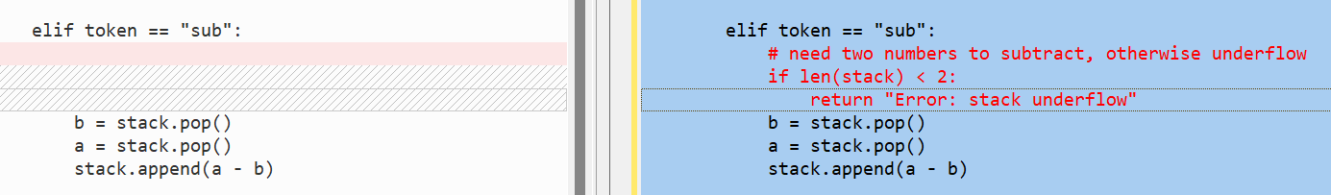
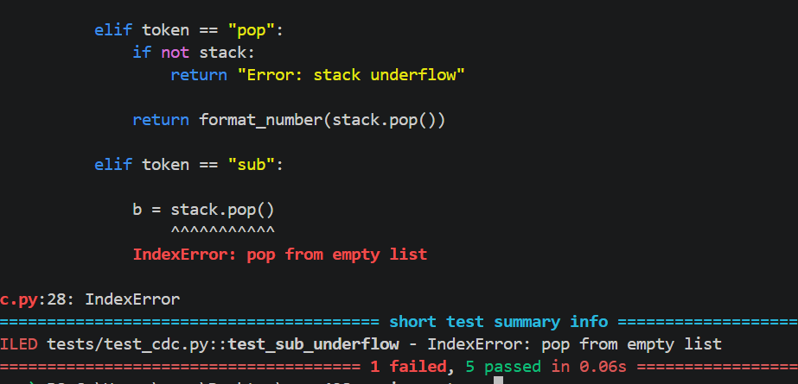
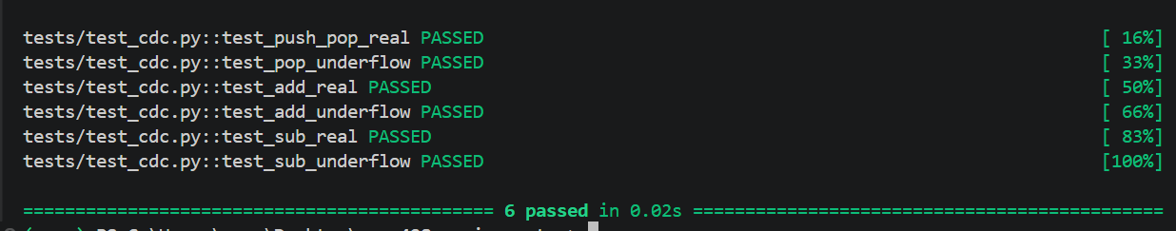

Test ID: T-SUB-ERR1
Statement of unit test: Verify that subtracting when the stack contains fewer than two operands produces a stack underflow error.
Command: sub Expected results: Error: stack underflow
1. Screen capture of unit test code
3. Screen capture of code changes highlighted
2. Screen capture demonstrating unit test failing
5. All previous unit tests still pass after code changes
4. Screen capture demonstrating unit test passing
8

Slide 9
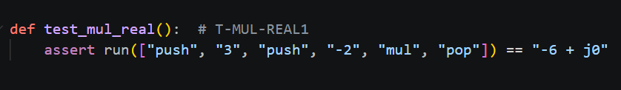
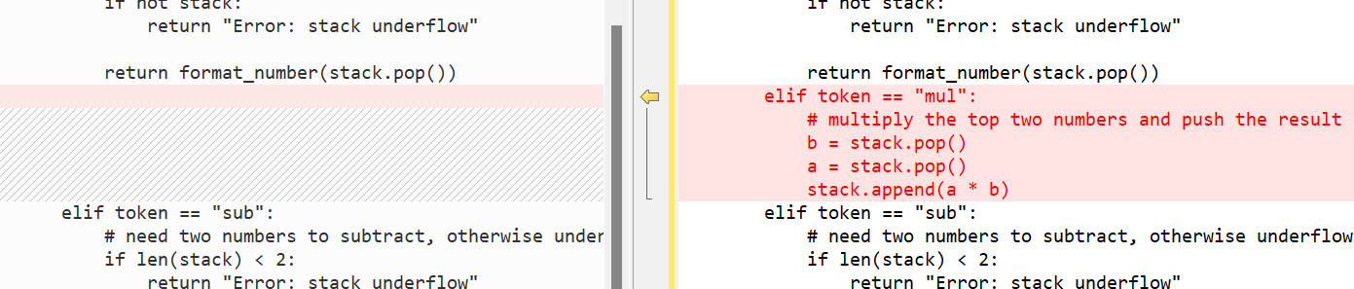
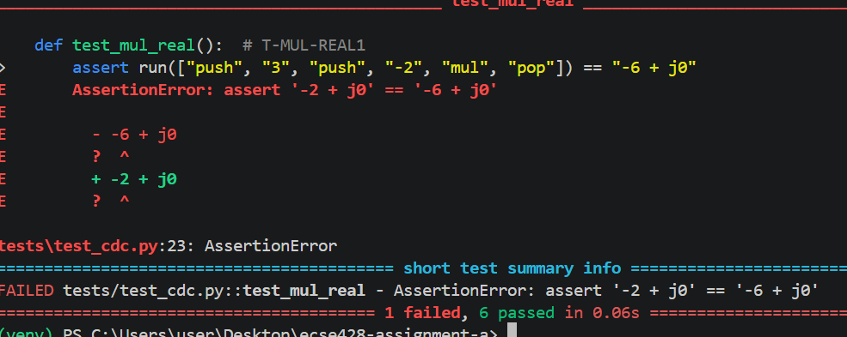
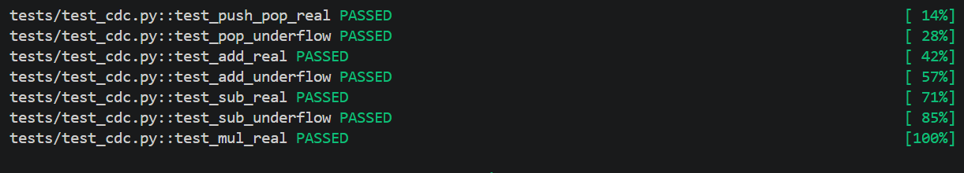

Test ID: T-MUL-REAL1
Statement of unit test: Verify that multiplying 3 by -2 returns the correct result.
Command: push 3 push -2 mul pop Expected results: -6 + j0
1. Screen capture of unit test code
3. Screen capture of code changes highlighted
2. Screen capture demonstrating unit test failing
5. All previous unit tests still pass after code changes
4. Screen capture demonstrating unit test passing
9

Slide 10
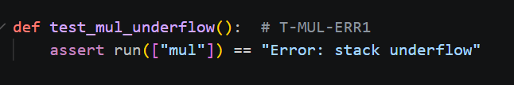
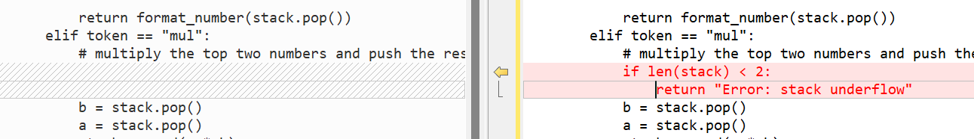
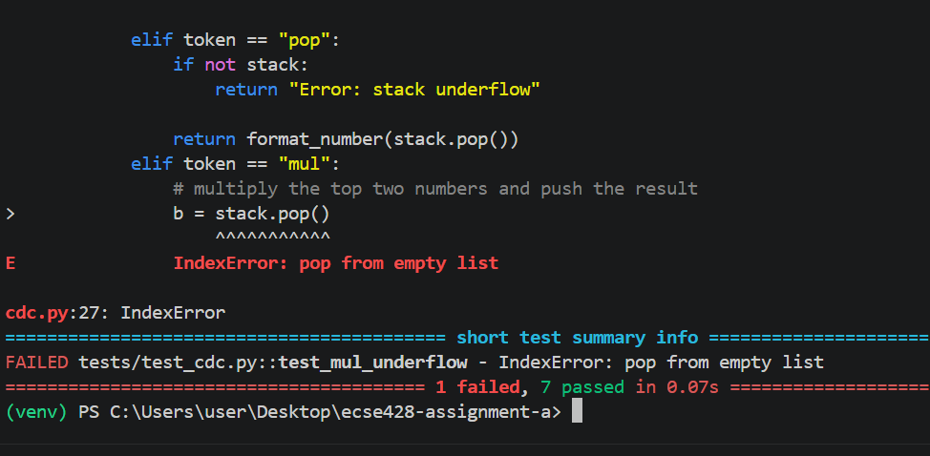
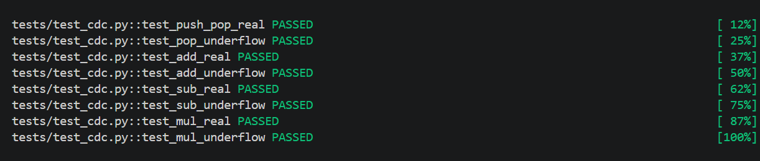
Test ID: T-MUL-ERR1
Statement of unit test: Verify that multiplying when the stack contains fewer than two operands produces a stack underflow error.
Command: mul Expected results: Error: stack underflow
1. Screen capture of unit test code
3. Screen capture of code changes highlighted
2. Screen capture demonstrating unit test failing
5. All previous unit tests still pass after code changes
4. Screen capture demonstrating unit test passing
10

Slide 11
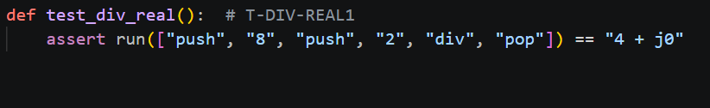
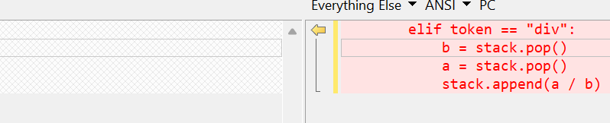
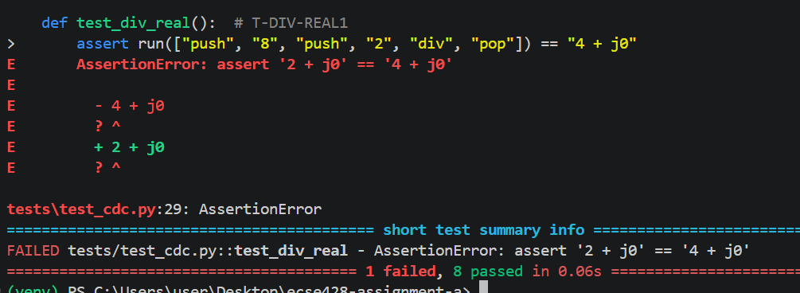
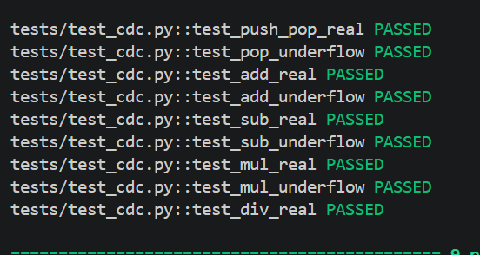
Test ID: T-DIV-REAL1
Statement of unit test: Verify that dividing 8 by 2 returns the correct result.
Command: push 8 push 2 div pop Expected results: 4 + j0
1. Screen capture of unit test code
3. Screen capture of code changes highlighted
2. Screen capture demonstrating unit test failing
5. All previous unit tests still pass after code changes
4. Screen capture demonstrating unit test passing
11

Slide 12
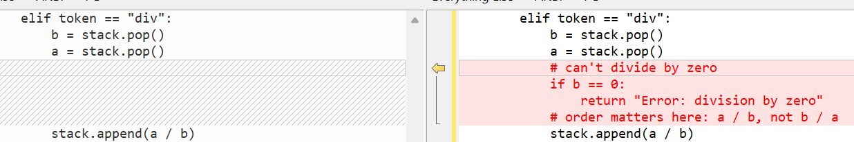
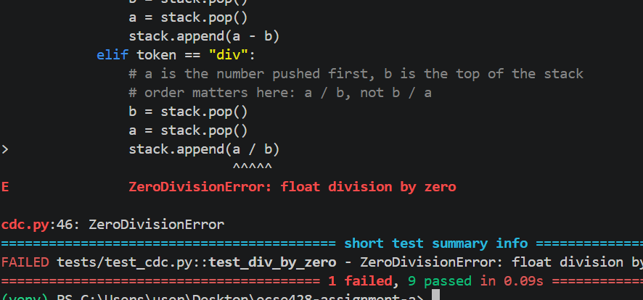
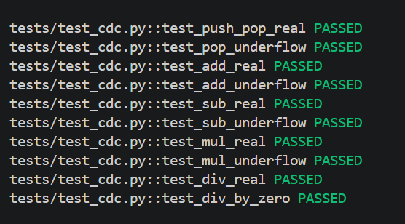
Test ID: T-DIV-ERR1
Statement of unit test: Verify that dividing a real number by zero produces a division-by-zero error.
Command: push 1 push 0 div Expected results: Error: division by zero
1. Screen capture of unit test code
3. Screen capture of code changes highlighted
2. Screen capture demonstrating unit test failing
5. All previous unit tests still pass after code changes
4. Screen capture demonstrating unit test passing
12

Slide 13
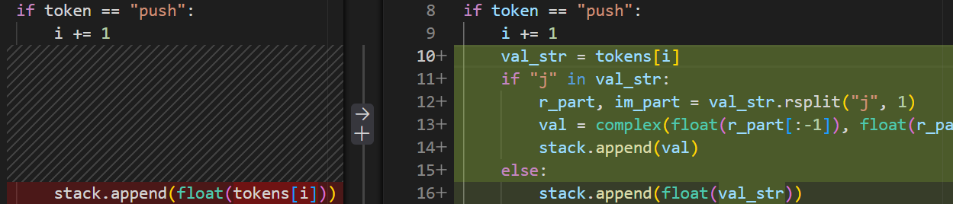
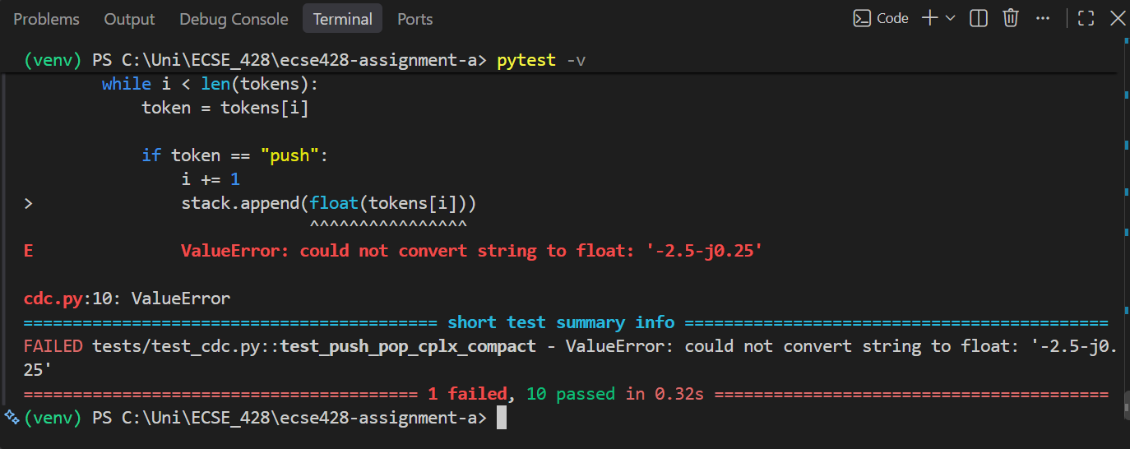
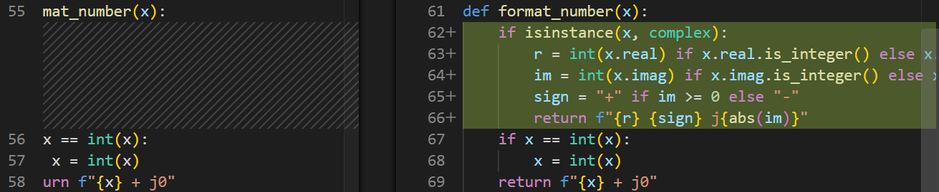
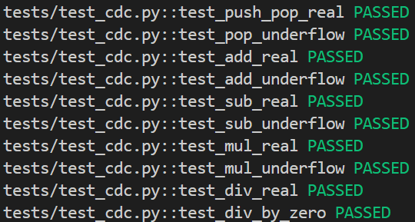
Test ID: T-PUSH-CPLX1
Statement of unit test: Verify that pushing a compact complex number onto the stack and popping it returns the formatted complex number.
Command: push -2.5-j0.25 pop Expected results: -2.5 - j0.25
1. Screen capture of unit test code
3. Screen capture of code changes highlighted
2. Screen capture demonstrating unit test failing
5. All previous unit tests still pass after code changes
4. Screen capture demonstrating unit test passing
13

Slide 14
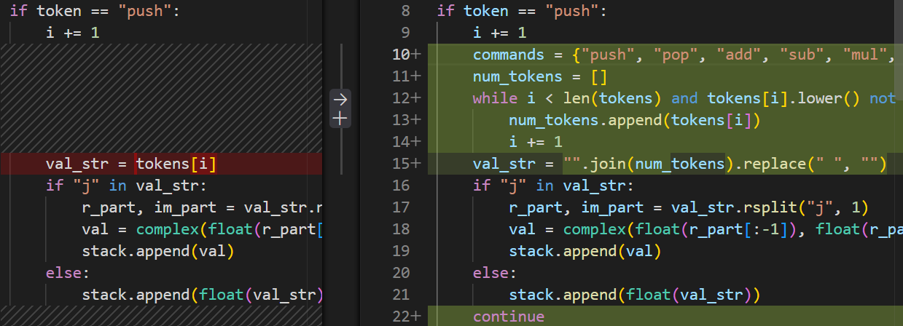
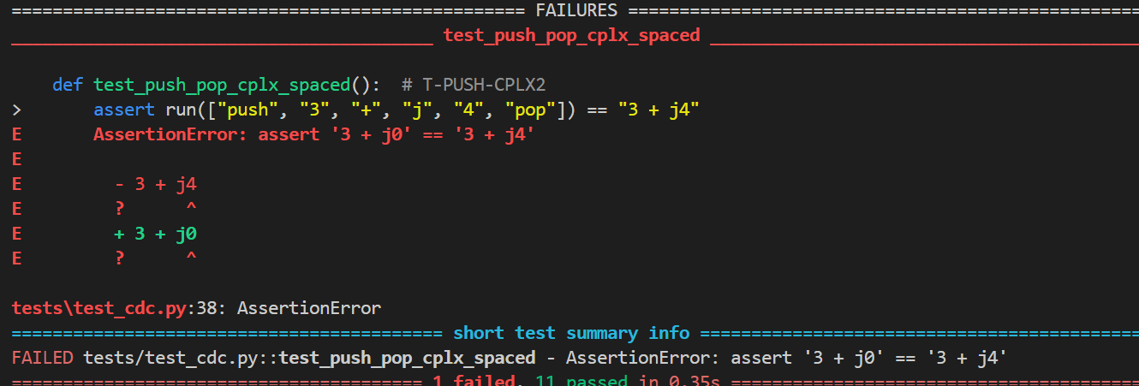
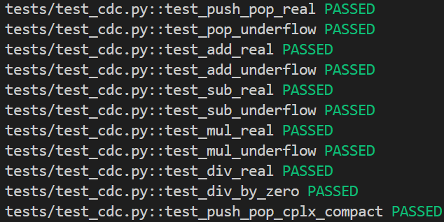
Test ID: T-PUSH-CPLX2
Statement of unit test: Verify that pushing a spaced complex number parses correctly and ignores the spaces.
Command: push 3 + j 4 pop Expected results: 3 + j4
1. Screen capture of unit test code
3. Screen capture of code changes highlighted
2. Screen capture demonstrating unit test failing
5. All previous unit tests still pass after code changes
4. Screen capture demonstrating unit test passing
14

Slide 15
Note: tests that passed on the first run due to Python’s native support of complex types
These six tests passed the first time we ran them: T-ADD-CPLX1, T-SUB-CPLX1, T-MUL-CPLX1, T-DIV-CPLX1, T-DIV-ERR2 and T-DEL-CPLX1.
Once push could handle complex numbers, add, sub, mul and div already worked on them, since Python’s operators work on complex values. The b == 0 check in div also catches 0+0j, and delete just pops whatever is on top. Thus, no code had to change for these, and there was no failing run to screenshot. That is why step 2 says N/A on these slides.
We kept the tests in the suite anyway so complex numbers are covered in the final regression run.
15

Slide 16
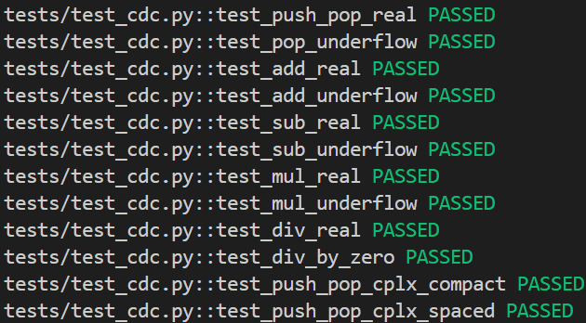
Test ID: T-ADD-CPLX1
Statement of unit test: Verify that adding two complex numbers returns the correct complex sum.
Command: push 3+j4 push 1-j2 add pop Expected results: 4 + j2
1. Screen capture of unit test code
3. Code changes
None required. Python natively handles addition for complex types, so the existing stack.append(a + b) works instantly.
2. Screen capture demonstrating unit test failing
N/A. Passed on the first run, so there was no failing run (see the note on slide 15).
5. All previous unit tests still pass after code changes
4. Screen capture demonstrating unit test passing
16

Slide 17
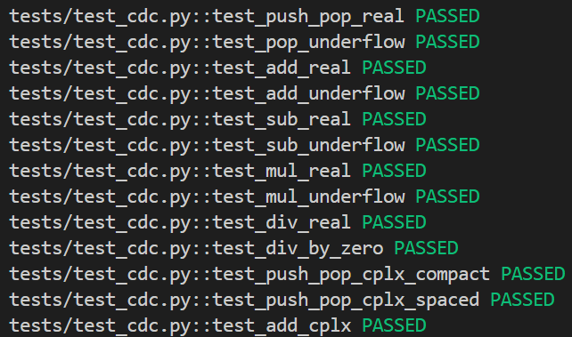
Test ID: T-SUB-CPLX1
Statement of unit test: Verify that subtracting two complex numbers returns the correct complex difference.
Command: push 3+j4 push 1-j2 sub pop Expected results: 2 + j6
1. Screen capture of unit test code
3. Code changes
None required. The existing stack.append(a - b) natively supports complex types.
2. Screen capture demonstrating unit test failing
5. All previous unit tests still pass after code changes
N/A. Passed on the first run, so there was no failing run (see the note on slide 15).
4. Screen capture demonstrating unit test passing
17

Slide 18
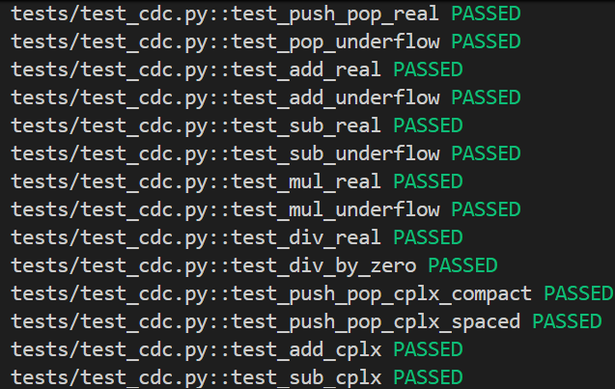
Test ID: T-MUL-CPLX1
Statement of unit test: Verify that multiplying two complex numbers returns the correct complex product.
Command: push 1+j2 push 3-j4 mul pop Expected results: 11 + j2
1. Screen capture of unit test code
3. Code changes
None required. Python’s a * b handles this natively.
2. Screen capture demonstrating unit test failing
5. All previous unit tests still pass after code changes
N/A. Passed on the first run, so there was no failing run (see the note on slide 15).
4. Screen capture demonstrating unit test passing
18

Slide 19
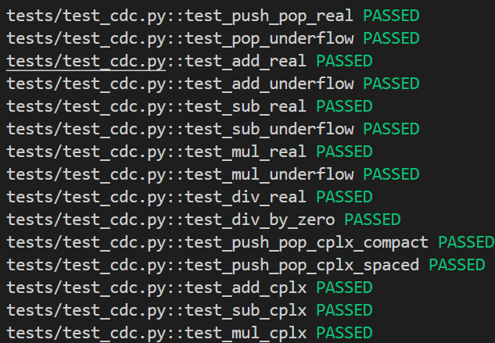
Test ID: T-DIV-CPLX1
Statement of unit test: Verify that dividing two complex numbers returns the correct complex quotient.
Command: push 4+j2 push 1+j1 div pop Expected results: 3 - j1
1. Screen capture of unit test code
3. Code changes
None required. Python’s a / b handles this natively.
2. Screen capture demonstrating unit test failing
5. All previous unit tests still pass after code changes
N/A. Passed on the first run, so there was no failing run (see the note on slide 15).
4. Screen capture demonstrating unit test passing
19

Slide 20
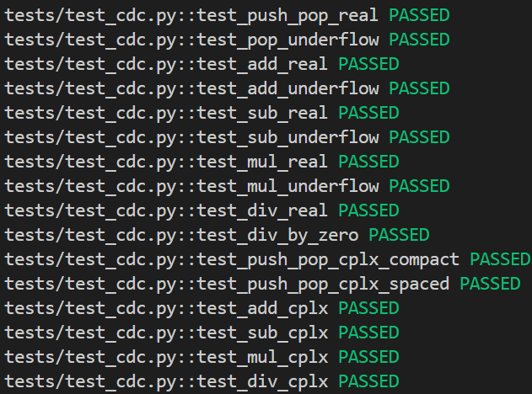
Test ID: T-DIV-ERR2
Statement of unit test: Verify that dividing a complex number by zero produces a division-by-zero error.
Command: push 1+j0 push 0+j0 div Expected results: Error: division by zero
1. Screen capture of unit test code
3. Code changes
None required. The existing check if b == 0: works because Python evaluates 0+0j == 0 as True.
2. Screen capture demonstrating unit test failing
5. All previous unit tests still pass after code changes
N/A. Passed on the first run, so there was no failing run (see the note on slide 15).
4. Screen capture demonstrating unit test passing
20

Slide 21
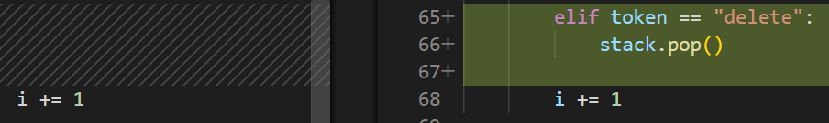
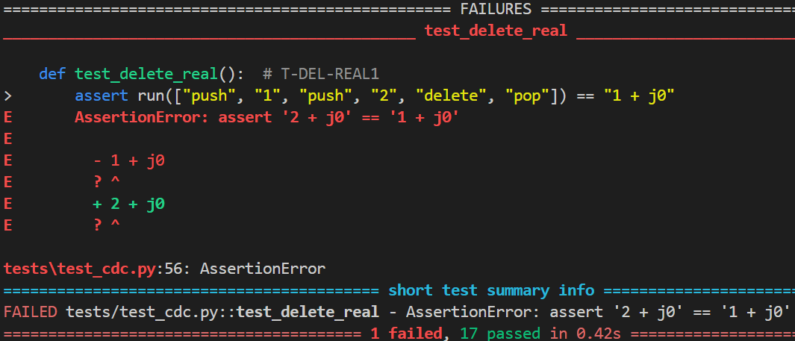
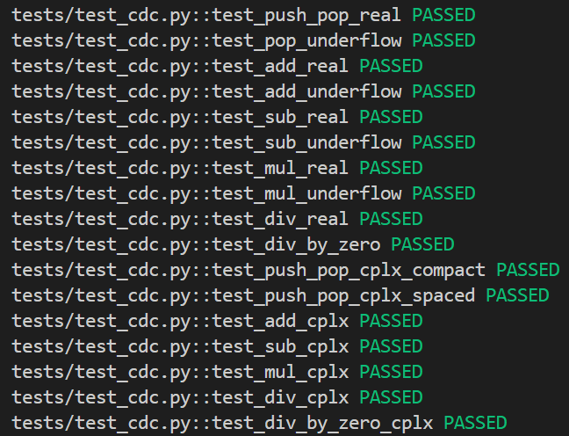
Test ID: T-DEL-REAL1
Statement of unit test: Verify that deleting from the stack removes the top real item without printing it.
Command: push 1 push 2 delete pop Expected results: 1 + j0
1. Screen capture of unit test code
3. Screen capture of code changes highlighted
2. Screen capture demonstrating unit test failing
5. All previous unit tests still pass after code changes
4. Screen capture demonstrating unit test passing
21

Slide 22
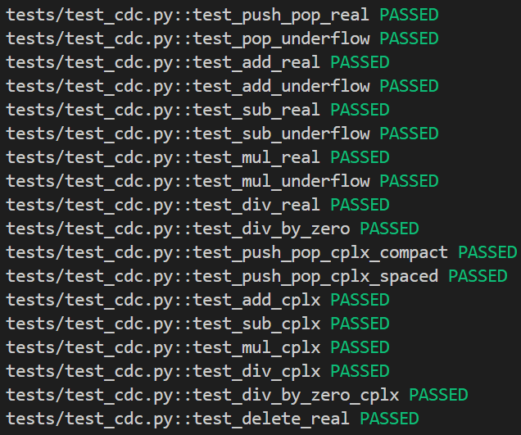
Test ID: T-DEL-CPLX1
Statement of unit test: Verify that deleting from a stack with complex numbers removes the top complex item.
Command: push 1+j1 push 2+j3 delete pop Expected results: 1 + j1
1. Screen capture of unit test code
3. Code changes
None required. stack.pop() naturally removes the top item regardless of whether it is a float or a complex number.
2. Screen capture demonstrating unit test failing
5. All previous unit tests still pass after code changes
N/A. Passed on the first run, so there was no failing run (see the note on slide 15).
4. Screen capture demonstrating unit test passing
22

Slide 23




Test ID: T-DEL-ERR1
Statement of unit test: Verify that calling delete on an empty stack returns a stack underflow error.
Command: delete Expected results: Error: stack underflow
1. Screen capture of unit test code
3. Screen capture of code changes highlighted
2. Screen capture demonstrating unit test failing
5. All previous unit tests still pass after code changes
4. Screen capture demonstrating unit test passing
23

Slide 24

Final regression: all 20 tests passing
pytest -v on the final code
24

