Slide 1
ECSE 428
Assignment A TDD Steps
Yanni Klironomos, Mahad Haider

Slide 2
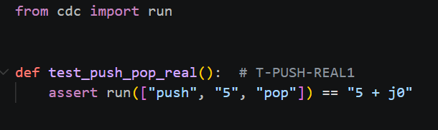
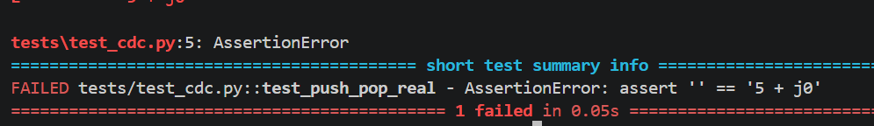


Test ID: T-PUSH-REAL1
Statement of unit test: Verify that pushing a real number onto the stack and popping it returns the same number.
Expected results: 5 + j0
Screen capture of unit test code:
Screen capture demonstrating unit test failing:
Screen capture of code changes highlighted
Screen capture demonstrating unit test passing
Screen capture illustrating all previous unit tests still pass after code changes
N/A: no prior tests since this is the 1st test and it passes, as required.

Slide 3
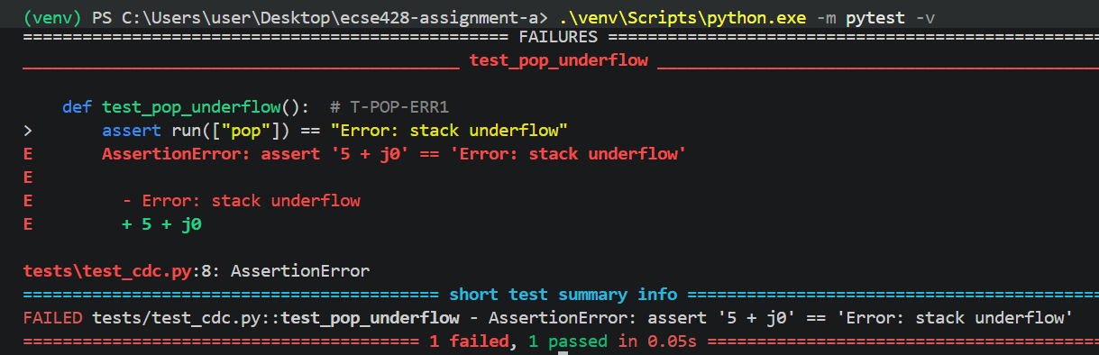
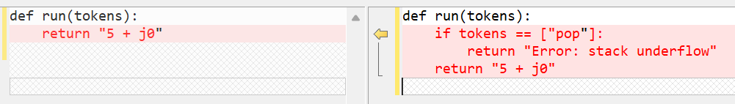

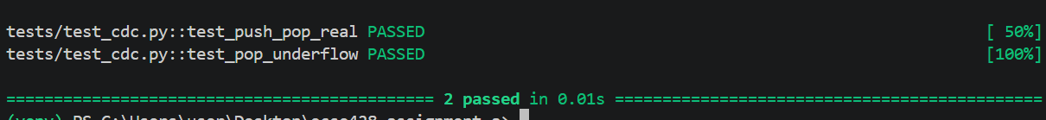
Test ID: T-POP-ERR1
Statement of unit test: Verify that popping from an empty stack produces a stack underflow error.
Expected results: Error: stack underflow
Screen capture of unit test code:
Screen capture demonstrating unit test failing:
Screen capture of code changes highlighted
Screen capture illustrating all previous unit tests still pass after code changes
Screen capture demonstrating unit test passing

Slide 4
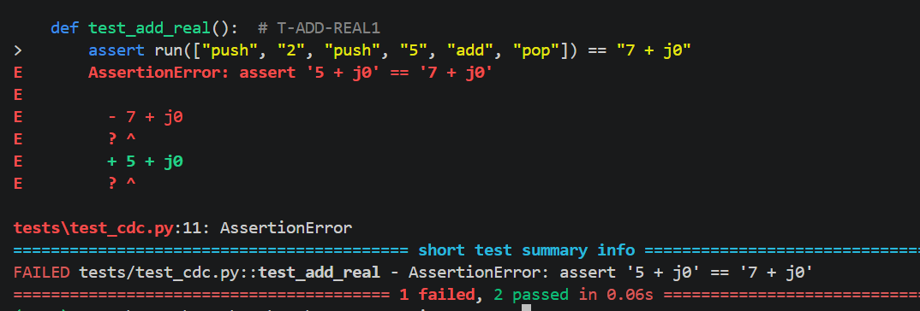
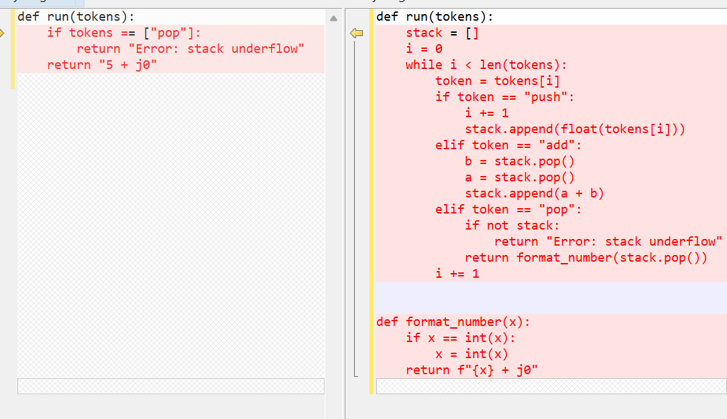
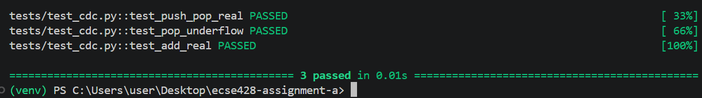
Test ID: T-ADD-REAL1
Statement of unit test: Verify that adding two real numbers (2 and 5) returns the correct result.
Expected results: 7 + j0
Screen capture of unit test code:
Screen capture demonstrating unit test failing:
Screen capture of code changes highlighted
Screen capture illustrating all previous unit tests still pass after code changes
Screen capture demonstrating unit test passing

Slide 5
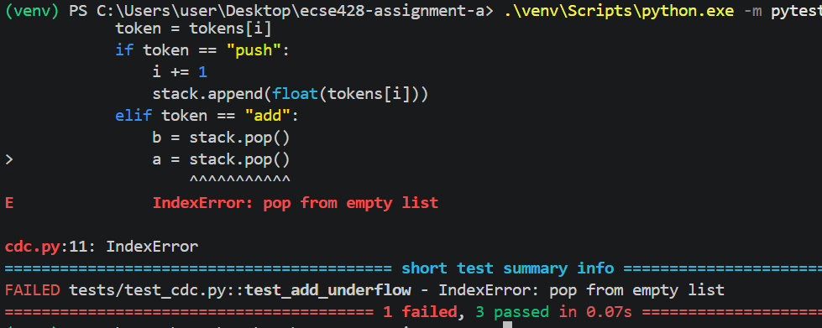
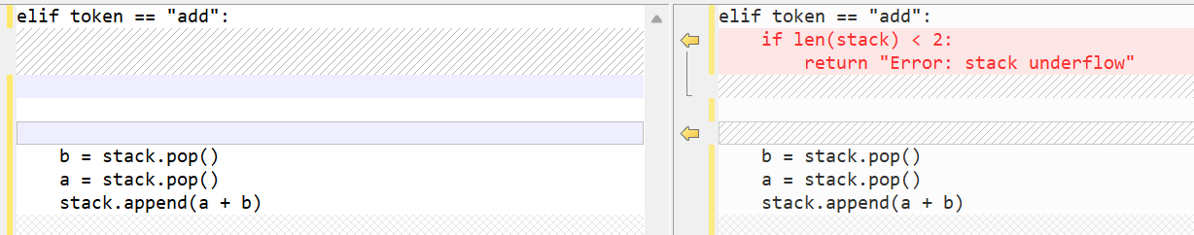
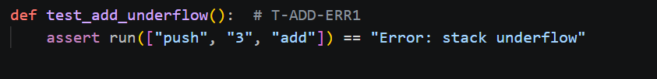
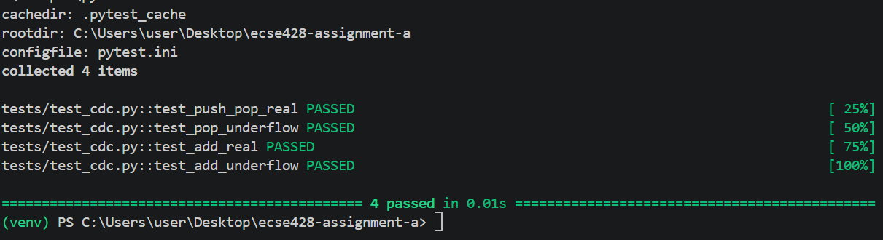
Test ID: T-ADD-ERR1
Statement of unit test: Verify that adding numbers when the stack contains fewer than two operands produces a stack underflow error.
Expected results: Error: stack underflow
Screen capture of code changes highlighted
Screen capture of unit test code:
Screen capture demonstrating unit test failing:
Screen capture demonstrating unit test passing
Screen capture illustrating all previous unit tests still pass after code changes

Slide 6
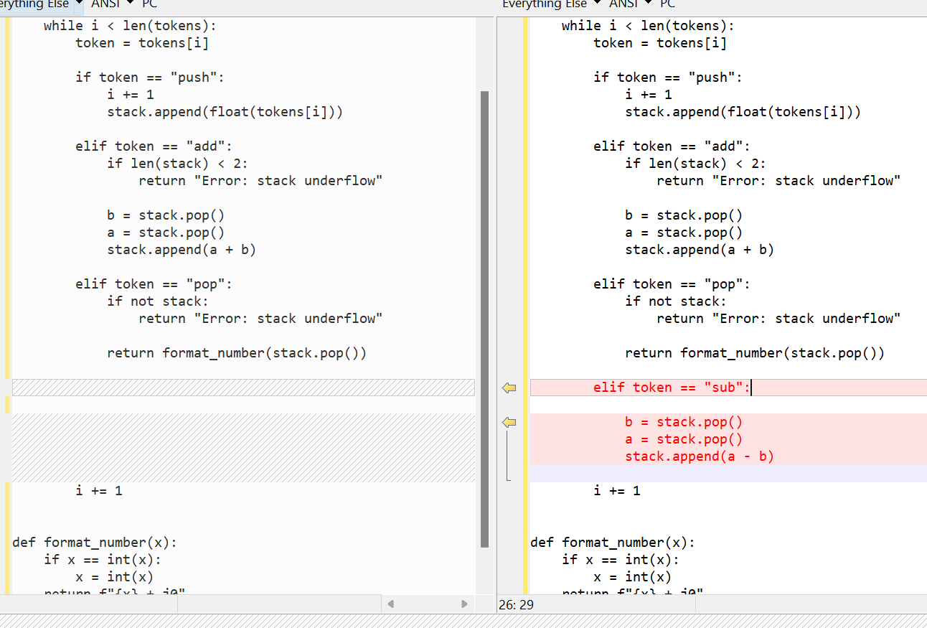
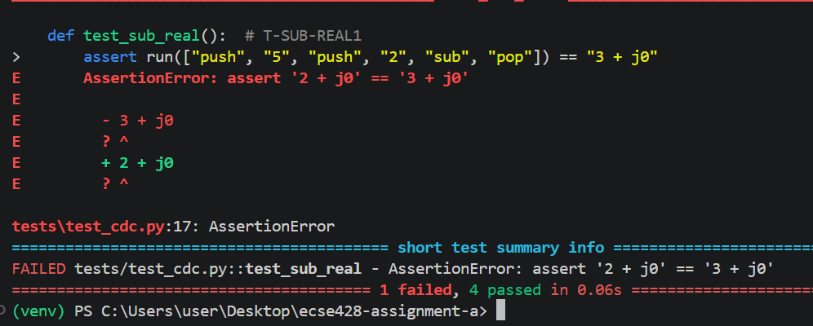
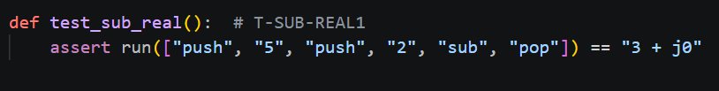
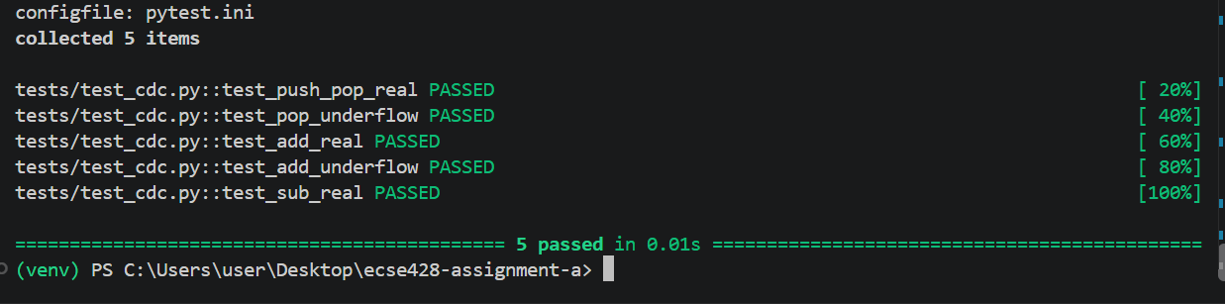
Test ID: T-SUB-REAL1
Statement of unit test: Verify that subtracting 2 from 5 returns the correct result.
Expected results: 3 + j0
Screen capture of code changes highlighted
Screen capture of unit test code:
Screen capture demonstrating unit test failing:
Screen capture demonstrating unit test passing
Screen capture illustrating all previous unit tests still pass after code changes

Slide 7
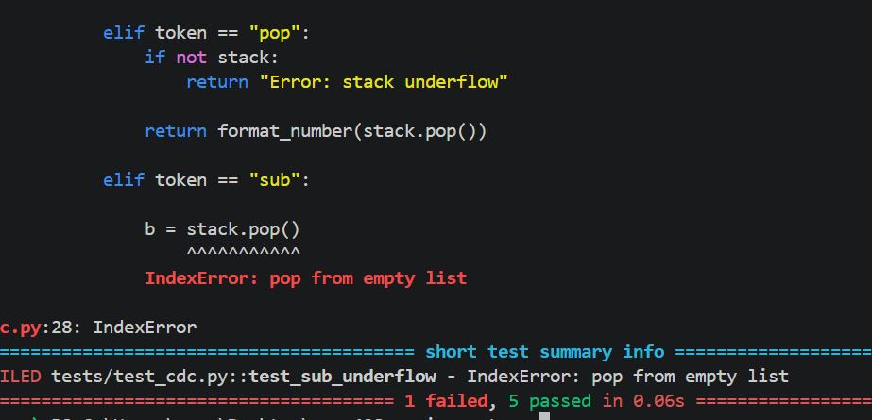

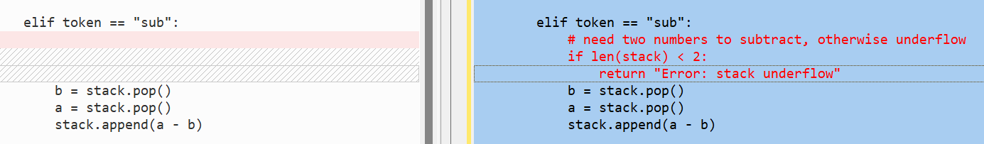

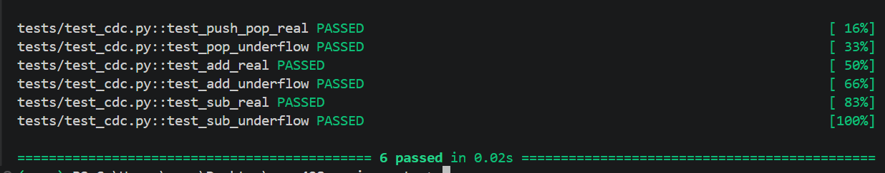
Test ID: T-SUB-ERR1
Statement of unit test: Verify that subtracting when the stack contains fewer than two operands produces a stack underflow error.
Expected results: Error: stack underflow
Screen capture of unit test code:
Screen capture demonstrating unit test failing:
Screen capture of code changes highlighted
Screen capture demonstrating unit test passing
Screen capture illustrating all previous unit tests still pass after code changes

Slide 8
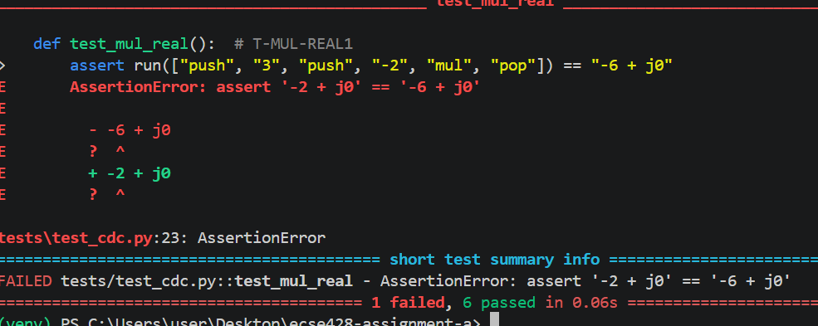
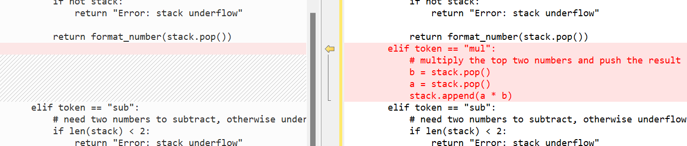
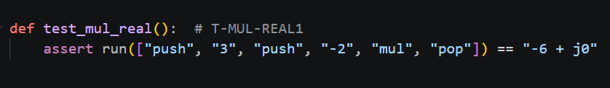
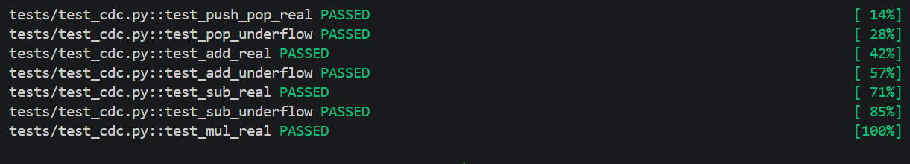

Test ID: T-MUL-REAL1
Statement of unit test: Verify that multiplying 3 by -2 returns the correct result.
Expected results: -6 + j0
Screen capture of unit test code:
Screen capture demonstrating unit test failing:
Screen capture of code changes highlighted
Screen capture demonstrating unit test passing
Screen capture illustrating all previous unit tests still pass after code changes

Slide 9
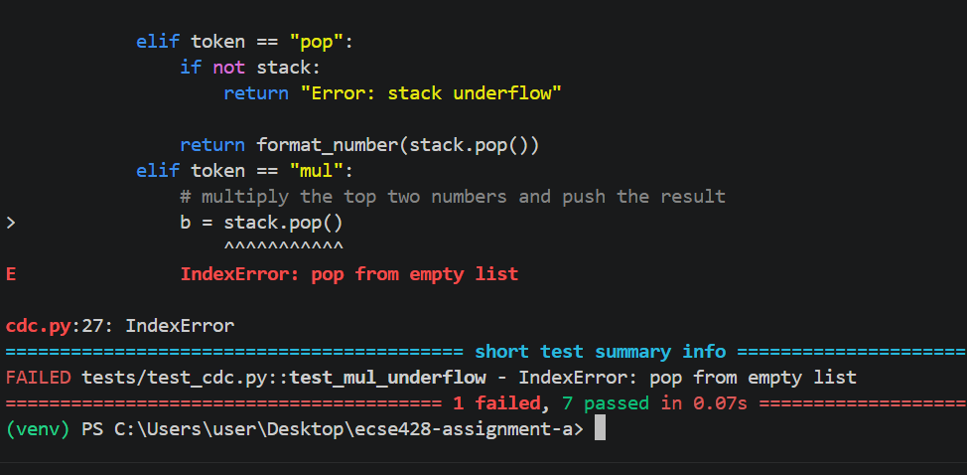
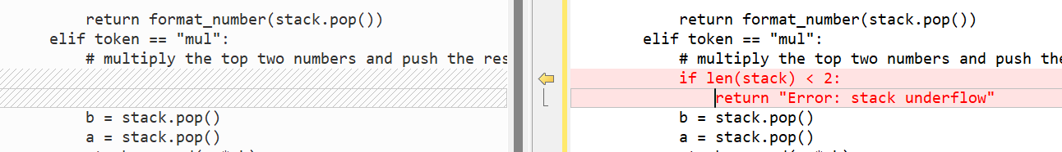
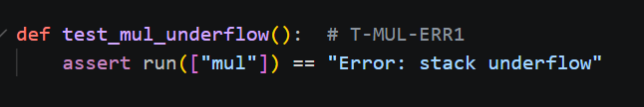
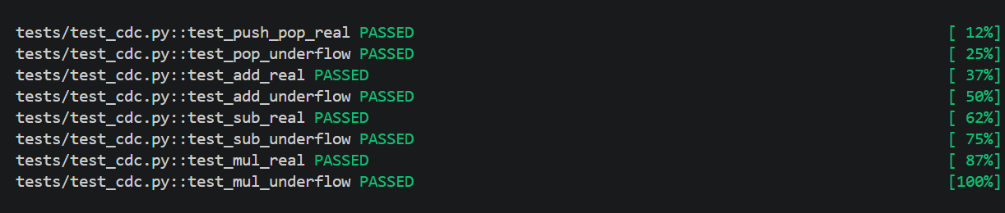
Test ID: T-MUL-ERR1
Statement of unit test: Verify that multiplying when the stack contains fewer than two operands produces a stack underflow error.
Expected results: Error: stack underflow
Screen capture of unit test code:
Screen capture demonstrating unit test failing:
Screen capture of code changes highlighted
Screen capture demonstrating unit test passing
Screen capture illustrating all previous unit tests still pass after code changes

Slide 10
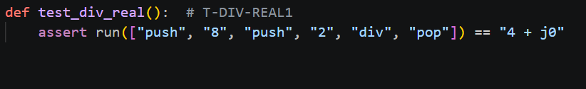
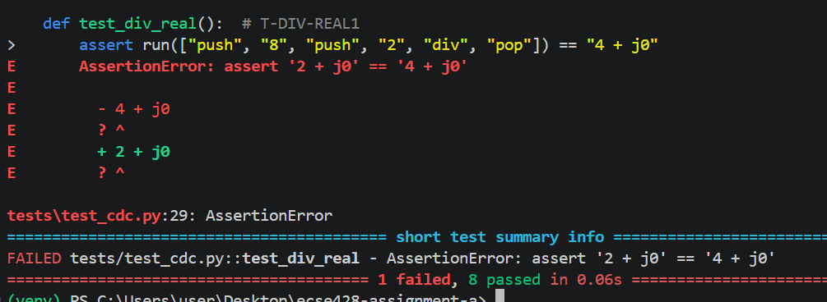
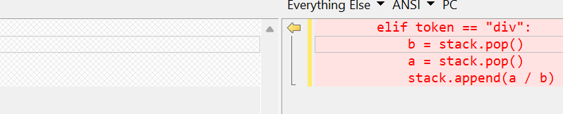
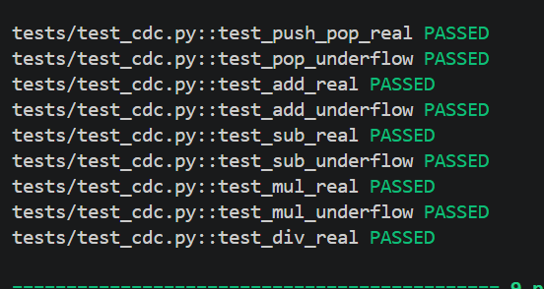
Test ID: T-DIV-REAL1
Statement of unit test: Verify that dividing 8 by 2 returns the correct result.
Expected results: 4 + j0
Screen capture of unit test code:
Screen capture demonstrating unit test failing:
Screen capture of code changes highlighted
Screen capture demonstrating unit test passing
Screen capture illustrating all previous unit tests still pass after code changes

Slide 11
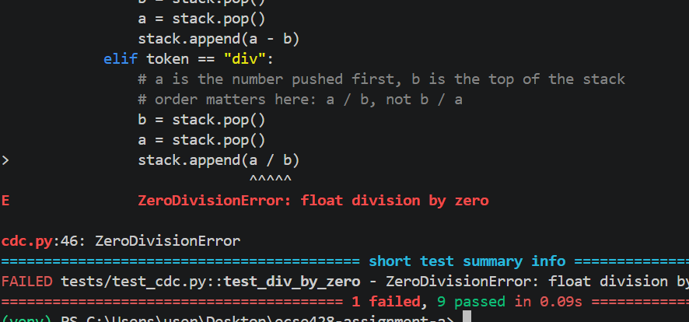
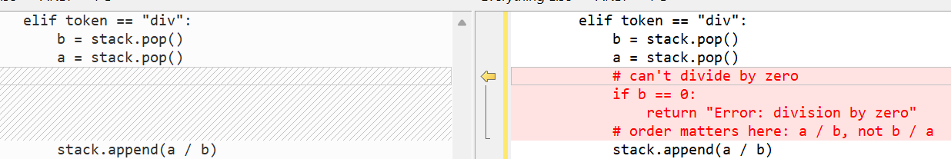
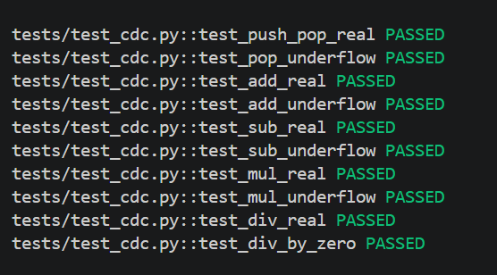
Test ID: T-DIV-ERR1
Statement of unit test: Verify that dividing a real number by zero produces a division-by-zero error.
Expected results: Error: division by zero
Screen capture of unit test code:
Screen capture demonstrating unit test failing:
Screen capture of code changes highlighted
Screen capture demonstrating unit test passing
Screen capture illustrating all previous unit tests still pass after code changes

Slide 12
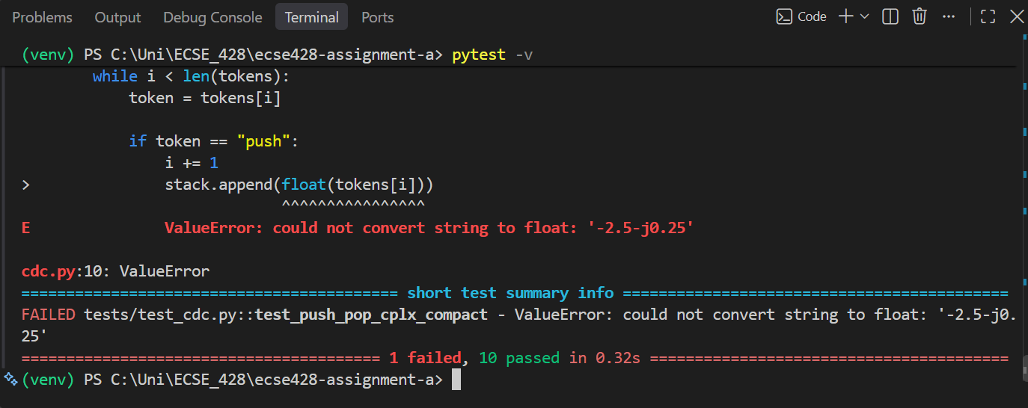
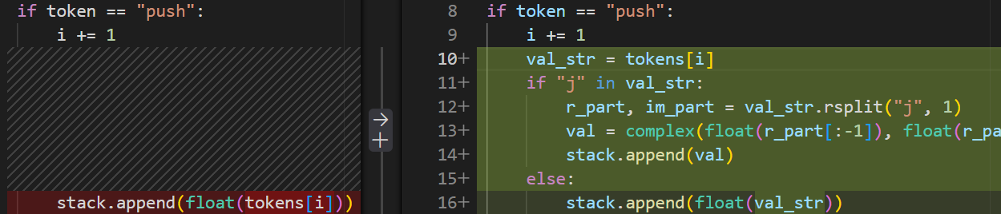
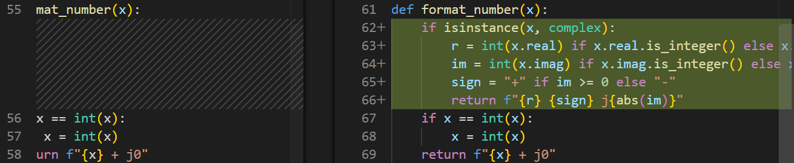
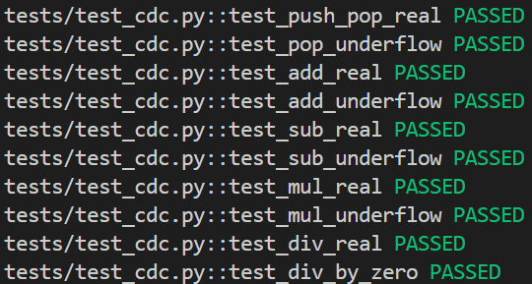
Test ID: T-PUSH-CPLX1
Statement of unit test: Verify that pushing a compact complex number onto the stack and popping it returns the formatted complex number.
Expected results: -2.5 - j0.25
Screen capture of unit test code:
Screen capture demonstrating unit test failing:
Screen capture of code changes highlighted
Screen capture demonstrating unit test passing
Screen capture illustrating all previous unit tests still pass after code changes

Slide 13
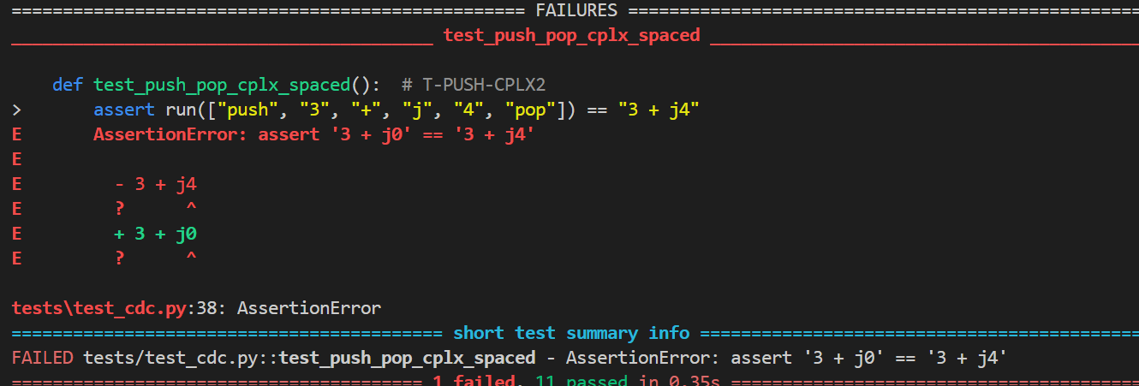
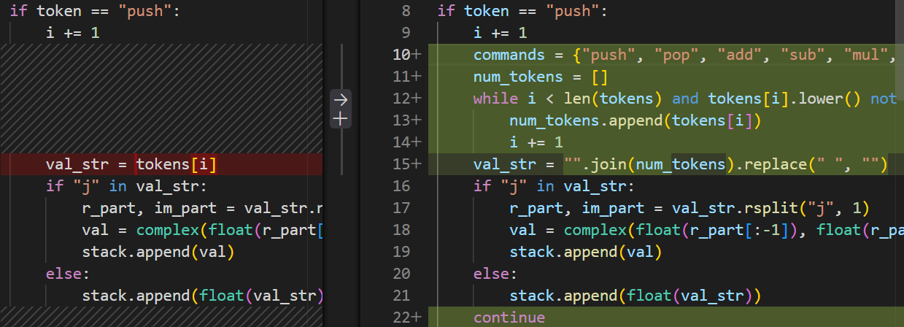
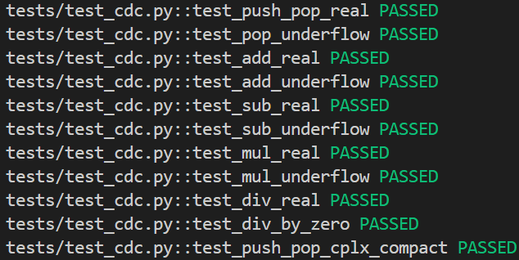
Test ID: T-PUSH-CPLX2
Statement of unit test: Verify that pushing a spaced complex number parses correctly and ignores the spaces.
Expected results: 3 + j4
Screen capture of unit test code:
Screen capture demonstrating unit test failing:
Screen capture of code changes highlighted
Screen capture demonstrating unit test passing
Screen capture illustrating all previous unit tests still pass after code changes

Slide 14
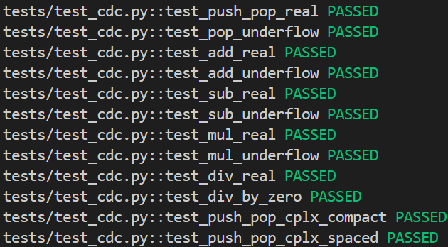
Test ID: T-ADD-CPLX1
Statement of unit test: Verify that adding two complex numbers returns the correct complex sum.
Expected results: 4 + j2
Screen capture of unit test code:
Code changes
None required. Python natively handles addition for complex types, so the existing stack.append(a + b) works instantly.
Screen capture demonstrating unit test passing
Screen capture illustrating all previous unit tests still pass after code changes

Slide 15
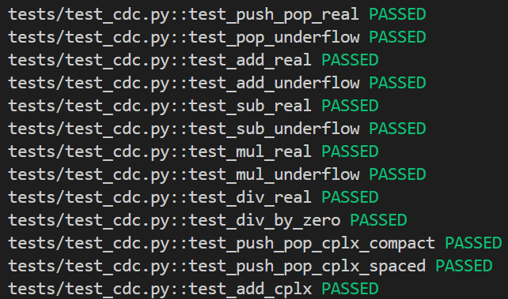
Test ID: T-SUB-CPLX1
Statement of unit test: Verify that subtracting two complex numbers returns the correct complex difference.
Expected results: 2 + j6
Screen capture of unit test code:
Code changes
None required. The existing stack.append(a - b) natively supports complex types.
Screen capture demonstrating unit test passing
Screen capture illustrating all previous unit tests still pass after code changes

Slide 16
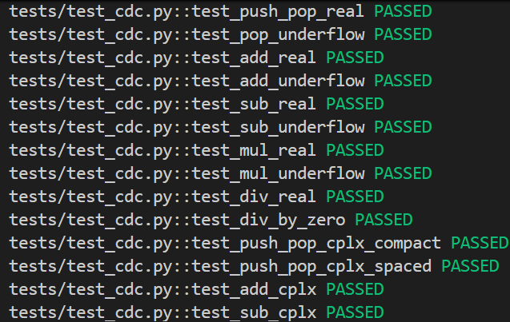
Test ID: T-MUL-CPLX1
Statement of unit test: Verify that multiplying two complex numbers returns the correct complex product.
Expected results: 11 + j2
Screen capture of unit test code:
Code changes
None required. Python's a * b handles this natively.
Screen capture demonstrating unit test passing
Screen capture illustrating all previous unit tests still pass after code changes

Slide 17
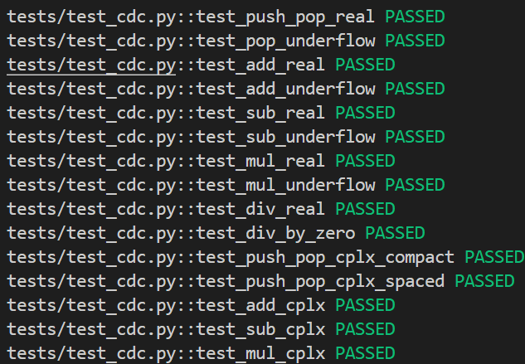
Test ID: T-DIV-CPLX1
Statement of unit test: Verify that dividing two complex numbers returns the correct complex quotient.
Expected results: 3 - j1
Screen capture of unit test code:
Code changes
None required. Python's a / b handles this natively.
Screen capture demonstrating unit test passing
Screen capture illustrating all previous unit tests still pass after code changes

Slide 18
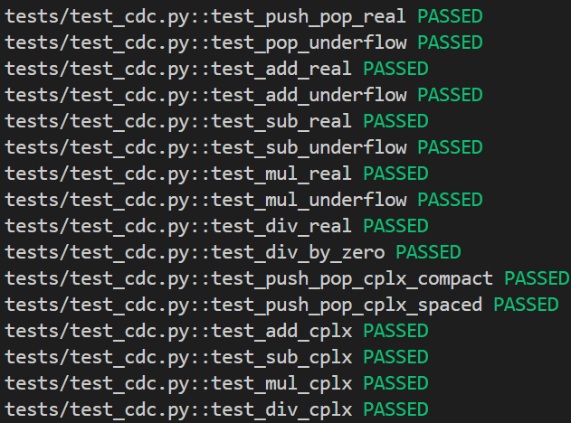
Test ID: T-DIV-ERR2
Statement of unit test: Verify that dividing a complex number by zero produces a division-by-zero error.
Expected results: Error: division by zero
Screen capture of unit test code:
Code changes
None required. The existing check if b == 0: works because Python evaluates 0+0j == 0 as True.
Screen capture demonstrating unit test passing
Screen capture illustrating all previous unit tests still pass after code changes

Slide 19
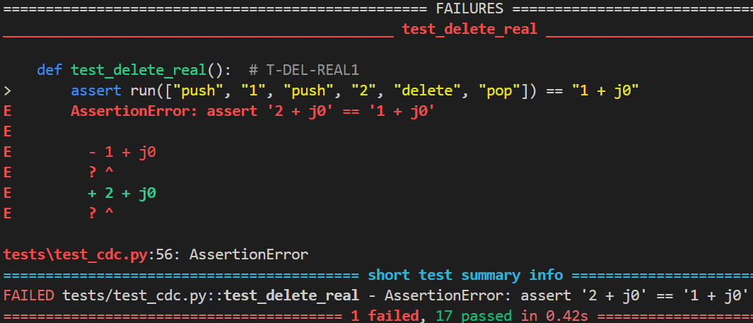
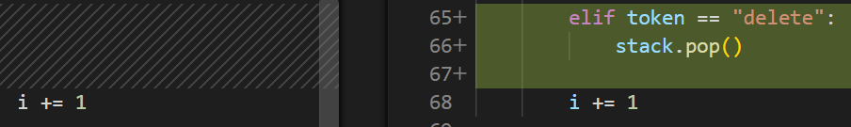
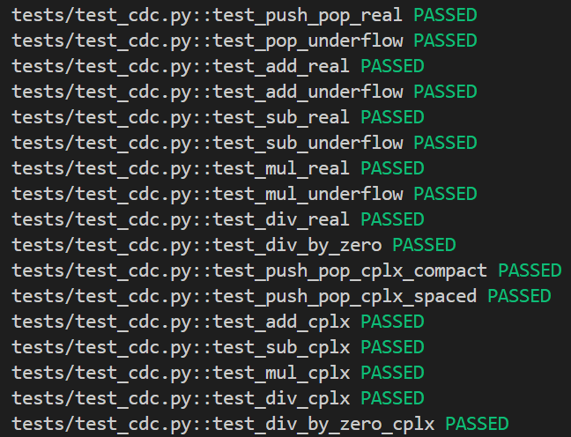
Test ID: T-DEL-REAL1
Statement of unit test: Verify that deleting from the stack removes the top real item without printing it.
Expected results: 1 + j0
Screen capture of unit test code:
Screen capture demonstrating unit test failing:
Screen capture of code changes highlighted
Screen capture demonstrating unit test passing
Screen capture illustrating all previous unit tests still pass after code changes

Slide 20
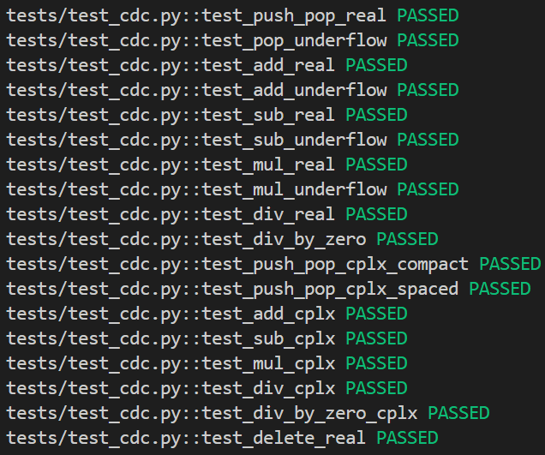
Test ID: T-DEL-CPLX1
Statement of unit test: Verify that deleting from a stack with complex numbers removes the top complex item.
Expected results: 1 + j1
Screen capture of unit test code:
Code changes
None required. stack.pop() naturally removes the top item regardless of whether it is a float or a complex number.
Screen capture demonstrating unit test passing
Screen capture illustrating all previous unit tests still pass after code changes

Slide 21




Test ID: T-DEL-ERR1
Statement of unit test: Verify that calling delete on an empty stack returns a stack underflow error.
Expected results: Error: stack underflow
Screen capture of unit test code:
Screen capture demonstrating unit test failing:
Screen capture of code changes highlighted
Screen capture demonstrating unit test passing
Screen capture illustrating all previous unit tests still pass after code changes

