Slide 1
Docker Overview
Hello, Docker!

Slide 2
Content
Docker Overview and Install
Basic and Flask Python examples
Logging
Setup and work with Docker Registry
Docker Compose

Slide 3
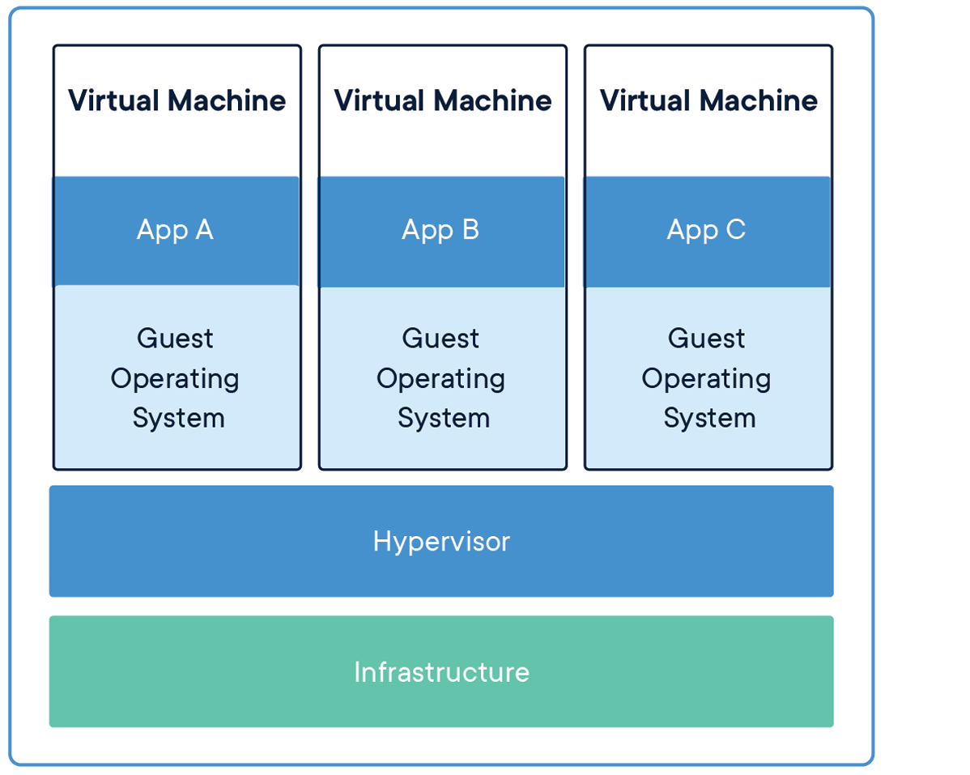
Virtual Machine (VM)
https://www.docker.com/resources/what-container

Slide 4
Virtual Machines
Virtual machines (VMs) are an abstraction of physical hardware turning one server into many servers. The hypervisor allows multiple VMs to run on a single machine. Each VM includes a full copy of an operating system, the application, necessary binaries and libraries - taking up tens of GBs. VMs can also be slow to boot.

Slide 5
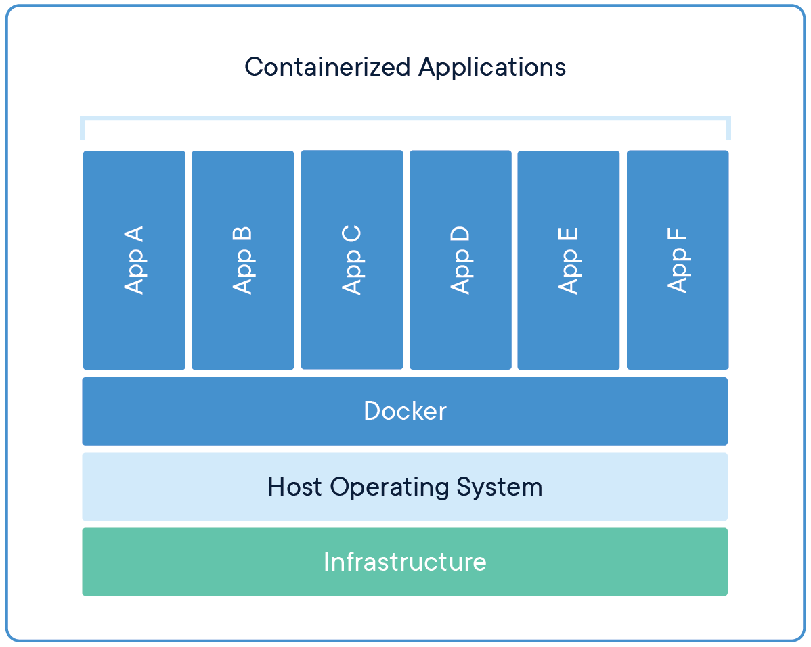
Container
https://www.docker.com/resources/what-container

Slide 6
Containers
Containers are an abstraction at the app layer that packages code and dependencies together. Multiple containers can run on the same machine and share the OS kernel with other containers, each running as isolated processes in user space. Containers take up less space than VMs (container images are typically tens of MBs in size), can handle more applications and require fewer VMs and Operating systems.

Slide 7
Install Docker
Install:
https://docs.docker.com/install/
Post-install (incl. run as non-root user):
https://docs.docker.com/install/linux/linux-postinstall/

Slide 8
Basic Python App
app.py
--------------------------------
import numpy as np
if __name__ == '__main__':
a = np.zeros((3, 3), dtype=np.uint8)
b = a + 10
print(b)
requirements.txt
--------------------------------
numpy

Slide 9
Dockerfile
FROM python:3.5.7-slim-buster
COPY . /app
WORKDIR /app
RUN pip3 install -r requirements.txt
All Dockerfile commands available at:
https://docs.docker.com/engine/reference/builder/

Slide 10
Docker build
$ docker build --tag app:0.1 --force-rm . --file ./Dockerfile
All build options available at:
https://docs.docker.com/engine/reference/commandline/build/

Slide 11
Docker run
$ docker run --rm app:0.1
All run options available at:
https://docs.docker.com/engine/reference/run/

Slide 12
Flask Server Python App
app.py
--------------------------------
from flask import Flask
app = Flask(__name__)
@app.route("/")
def hello():
return "Hello World!"
if __name__ == "__main__":
app.run(host="0.0.0.0", port=int("5000"), debug=True)
requirements.txt
--------------------------------
flask

Slide 13
Docker build
$ docker build --tag app:0.1 --force-rm . --file ./Dockerfile
All build options available at:
https://docs.docker.com/engine/reference/commandline/build/

Slide 14
Docker run
$ docker run -p 8001:5000 --rm --name app_cont app:0.1
Run in detach mode.
$ docker run -d -p 8001:5000 --rm --name app_cont app:0.1

Slide 15
Docker stop / rm
$ docker stop app_cont
$ docker rm app_cont

Slide 16
Logging
By default all STDOUT and STDERR messages outputs to docker logs.
Display all logs (all running containers):
$ docker logs
Display container specific logs:
$ docker logs app_cont
Custom logging driver available:
https://docs.docker.com/config/containers/logging/configure/

Slide 17
Docker Registry
https://docs.docker.com/registry/
Pull and run registry (also docker image):
$ docker run -d -p 5000:5000 --name registry registry:2
Tag created image and push it to registry:
$ docker image tag app:0.1 localhost:5000/app
$ docker push localhost:5000/app
Pull it from registry:
$ docker pull localhost:5000/app

