Slide 1

USA University Recommendation System
Rama Tejaswini Thotapalli (013785681)
Under the guidance of Professor Shih yu Chang

Slide 2
Agenda
Problem Statement
Approach
Data Characteristics
Data Preprocessing
Solution Implementation
Test Evaluation
Summary

Slide 3
Problem Statement
For an aspiring student who wants to apply for higher studies in other countries, university selection process is a challenging task.
Lot of different criteria need to considered during application process based on individual’s requirement.
This problem can be addressed by modeling a recommender system based on various classification algorithms.
In this project based on the Graduate and Undergraduate student dataset and user profile, a list of 10 best universities will be suggested such that it maximizes the chances of a student getting admission into those universities.

Slide 4
Approach
As we have large set of data and User profile, I planned to use Knowledge based recommendation techniques using two different models. For Graduate recmendations it is Case based knowledge recmendation and for Under graduate recommendations its constaint based recommendaton.
K-Nearest Neighbors
Feature weighted algorithms.

Slide 5
K Nearest Neighbors
In KNN, the trained data is compared with test data and distances are calculated using Euclidean distance. It then classifies an instance by finding its nearest neighbors and recommend the top n nearest neighbor universities. Algorithm is stated as below.
Initialize the value of k
For getting recommendation, iterate from 1 to number of trained data.
Calculate distance between test data and each row
Sort the distances in ascending order
Get top k rows and recommend to the user

Slide 6
Feature Weighted Algorithm
The Weightage of all the features are taken and find the similarity score. Based on the similarity score, The universities with highest similarity is recommended.
Suppose w1 and w2 are the weights and f1 and f2 are the features the similarity is calculated by formula
Similarity Score = w1*f1+w2*(1-f1)

Slide 7
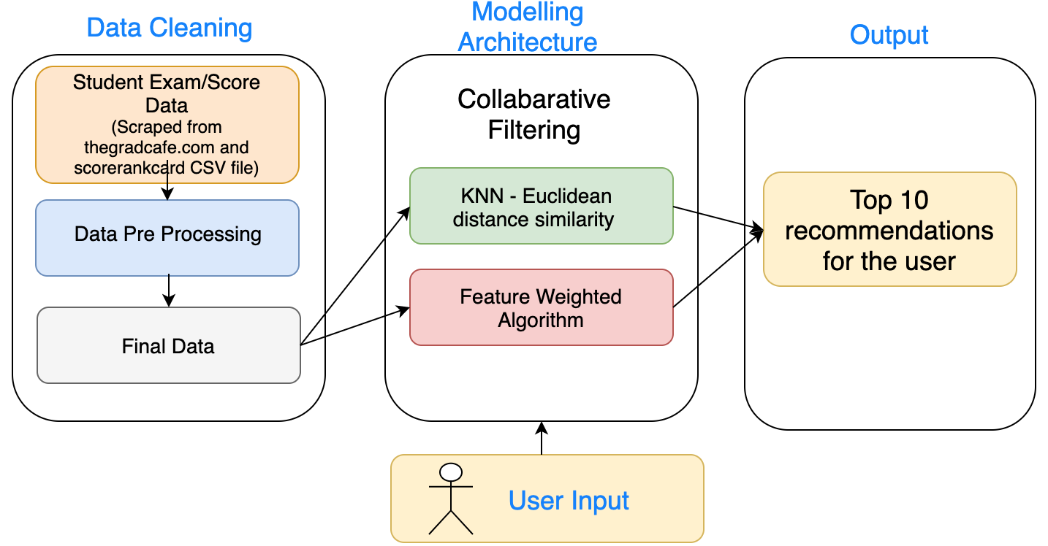
Block Diagram

Slide 8
Dataset
The first step in building any recommendation system is the identification of the data set.
Graduate student data was scraped from www.thegradcafe.com and the Undergraduate student data was scraped from https://collegescorecard.ed.gov/data/.
About 271807 rows of raw student data was obtained as a result of web scraping, which is being processed to use as final dataset.

Slide 9
DataSet Characteristics
The Graduate Student data has the columns related to their GRE and TOEFL scores and University name they got admitted/rejected into.
The UnderGraduate Student data contains the columns related to SAT scores and in which University they got admitted/Rejected into.

Slide 10
Data Pre Processing
In order to use the obtained data for our analysis, preprocessing and cleansing of dataset is required. The following are the data processes we did in our project
Data Scraped from website are loaded into different files. Merged all data.
Data from the admitted student rows are taken and rejected student rows are deleted.
Column names are set to the dataset.
The new/old GRE scores were also cleansed

Slide 11
Data Pre Processing….ctnd
Null values are deleted or filled with appropriate values
GPA scores available were based on different point systems, so all the GPA scores were uniformly scaled to 4 point scale by using normalize functions.
All the unnecessary columns are dropped.
Changed the order of columns making train and test dataset for algorithm

Slide 12
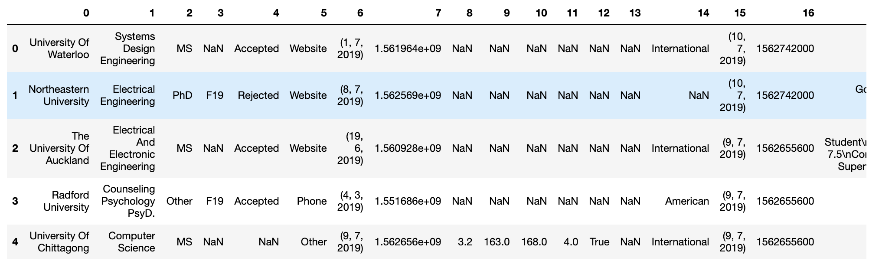
Data Pre Processing….
Initial dataset after web scraping the data and merging the csv files.

Slide 13
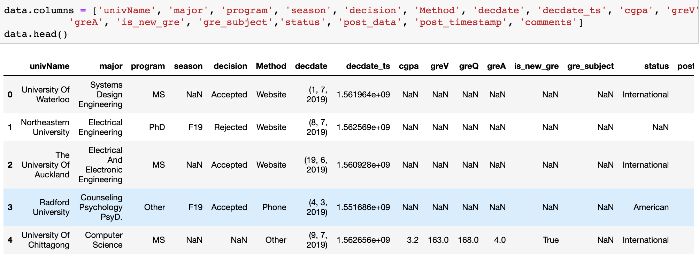
Data Pre Processing….
Dataset after setting the names of the columns

Slide 14
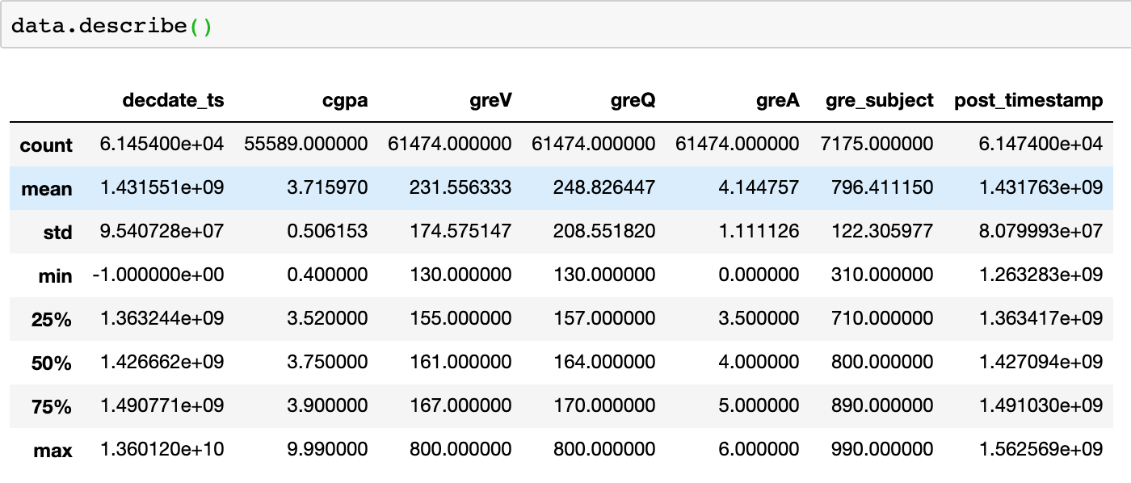
Data Pre Processing….
Description of the numerical data

Slide 15
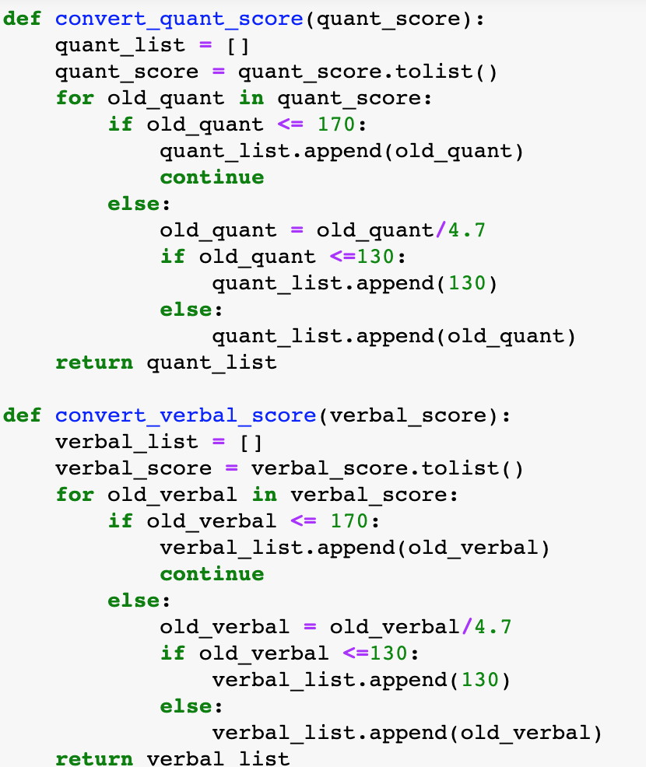
Data Pre Processing….
Converting the
old GRE scores to
new GRE scores

Slide 16
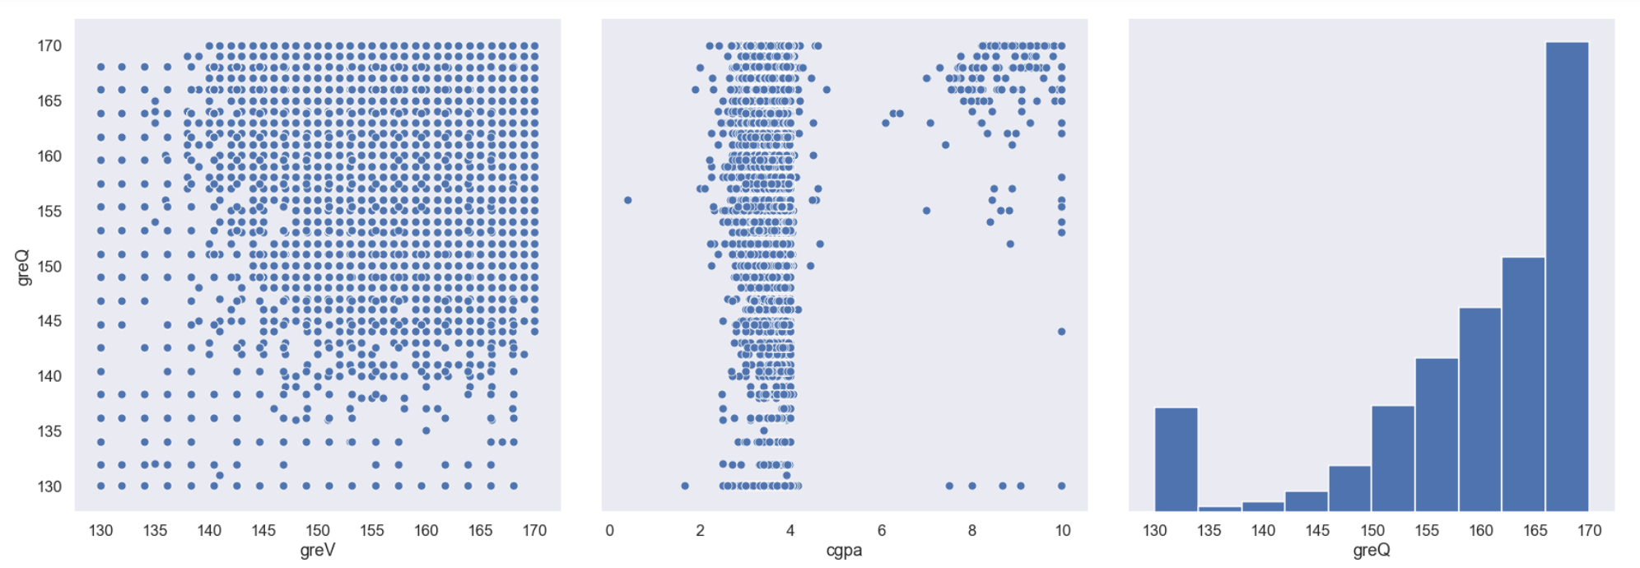
Data Pre Processing….
Plots of the greV and greQ data.

Slide 17
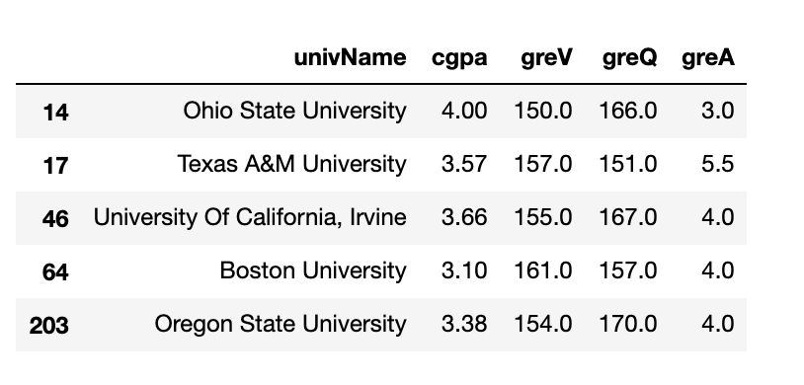
Data Pre Processing….
Processed data which has only University name, gre scores of the user.

Slide 18
Solution Implementation
In KNN, trained and Test data will be sent to algorithm to find the euclidean distance and the top 5 nearest neighbors are taken into consideration.
The features like GREA, GREV, GREQ, CGPA of the user as test data are taken as features and provide weightage to them to find the similarity score. and provide top 5 recommendations to the user.
Developed a User interface where user can easily provide his/her score details to the application and get recommendations.

Slide 19
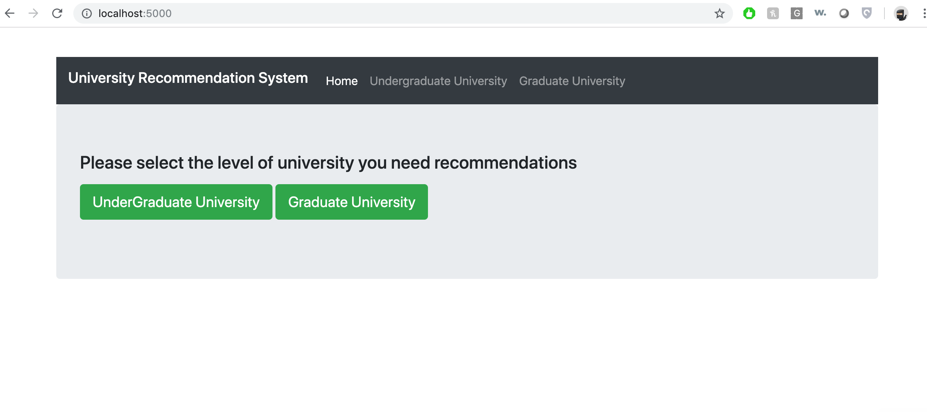
Web Application

Slide 20
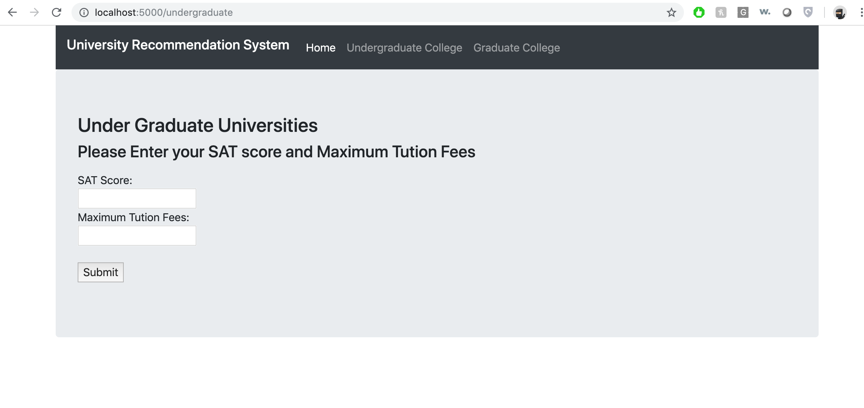
Undergraduate page

Slide 21
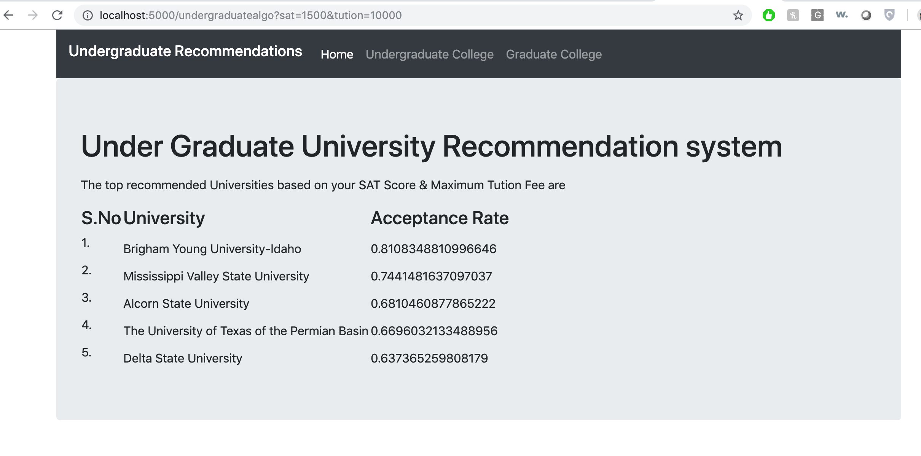
Undergraduate Recommendation page

Slide 22
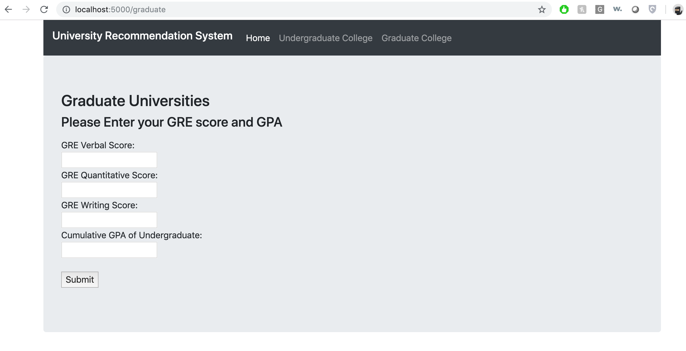
Graduate Home Page

Slide 23
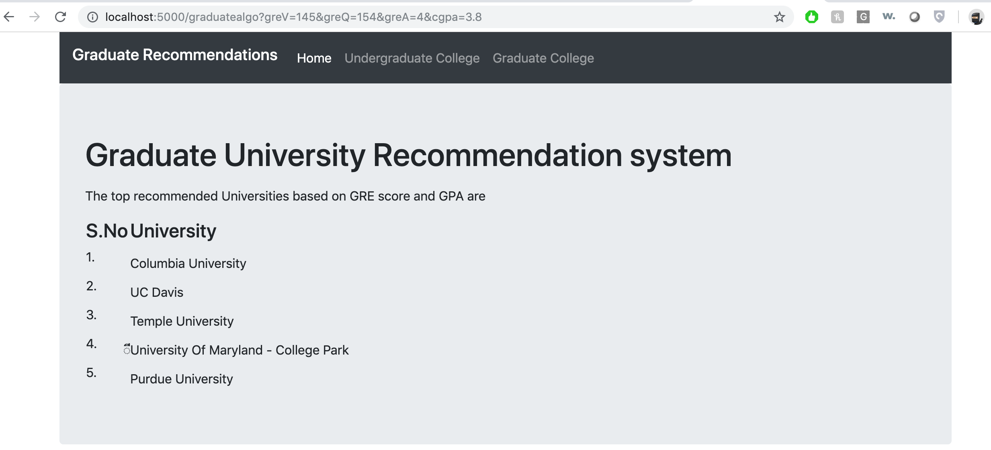
Graduate Recommendation Page

Slide 24
Graduate Home Page

Slide 25
Test Evaluation
As there is User interface to the application, any user can test the website any time.
Planning to develop the feedback page where users can come back and provide feedback to the website and provide data in which University he/she got the admit. (if time permits)
By capturing admission information I can train my algorithm to increase accuracy.

Slide 26

Summary
In short, This project will help students in decision making of which University to choose for their higher education in other countries like USA.
with the User friendly web Interface which takes in test scores, helps students apply to the Universities in which there is a high chance of getting the admit.
Data Mining techniques like KNN and Feature weighted algorithms are used

Slide 27
References
https://www.semanticscholar.org/paper/Recommender-System-for-Graduate-Studies-in-USA- Suresh/22924fda3f293f80a3f62f32799c08d0b81a9b20
http://://ieeexplore.ieee.org/document/7760053

Slide 28
Conclusion
Questions?

