Slide 1

PROJECT 7 · LABORATORY OF INTERNET OF THINGS
Access Control System
and Surveillance with Web Cam
A QR-code-based access control system with MQTT integration,
time-series logging, and optional physical door actuation.
Jacopo Veronese · 257771

Slide 2



THE PROBLEM
Physical keys and static badges don't scale
No easy revocation
No audit trail
Manual provisioning
A lost or shared physical key/badge can't be selectively invalidated without changing the whole lock.
Who entered, and when, is invisible unless a separate logbook is kept by hand.
Granting or removing access requires physical presence at an administration desk.
IoT offers an alternative: a short-lived, digitally-signed credential on a personal device, verified optically, logged automatically, and revocable instantly.
1

Slide 3





PROJECT BRIEF
What Project 7 asked for
QR-code authentication
Raspberry Pi camera
MQTT as main protocol
Telegram notifications
Access list with add/remove UI
Optional: door-lock actuation
2

Slide 4


CONTEXT
Related work: why signed, short-lived QR codes
Static credentials
Signed, time-limited QR
RFID badges, fixed QR codes
This project
Cheap, no reader hardware beyond a camera
HMAC-signed payload, single-use, 15s validity window
Photographable / clonable — the code itself never changes
Instant revocation via an append-only access log
Revoking access means reissuing or destroying the physical badge
No extra reader hardware — a phone screen + a camera
Protocol choices: MQTT over HTTP polling for low-overhead publish/subscribe; InfluxDB over a relational store for natural time-series queries on access events.
3

Slide 5
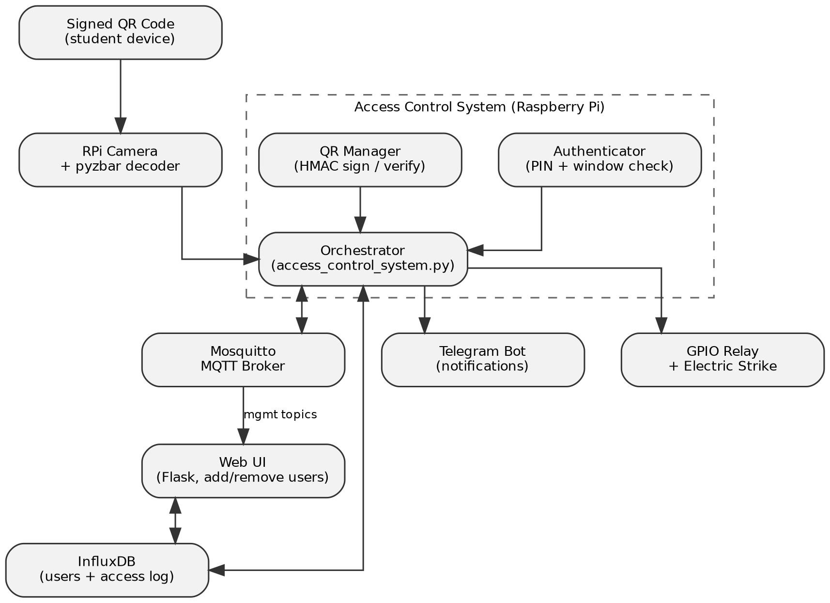
SYSTEM DESIGN
Architecture overview
A signed QR code from the user's device is decoded by the RPi camera.
The orchestrator checks it against the Authenticator and QR Manager.
Valid access is logged to InfluxDB, announced on MQTT, and — optionally — unlocks the door and notifies Telegram.
4

Slide 6
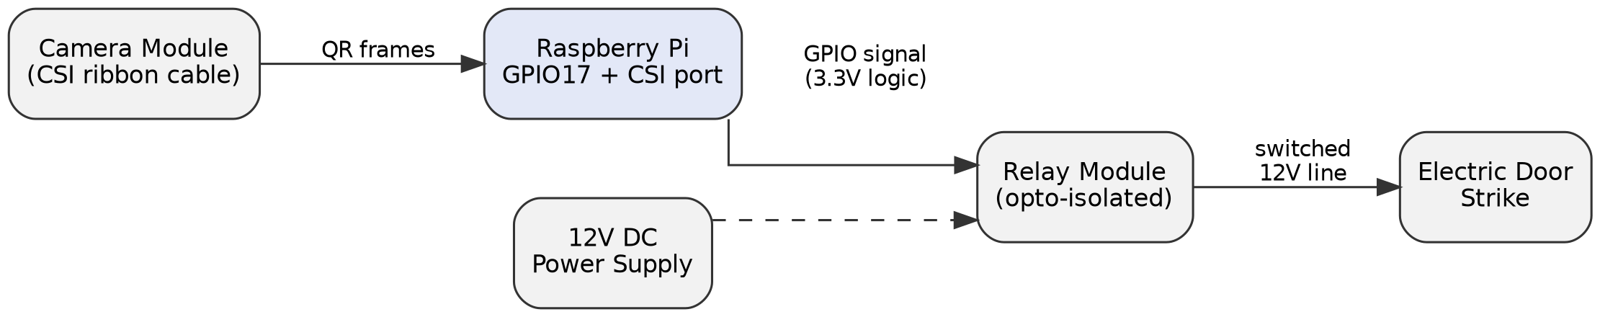
SYSTEM DESIGN
How the physical hardware is meant to work
Scanning
Actuation
Unlock pulse
The Camera Module connects to the Pi's CSI port via ribbon cable. picamera2 continuously captures frames; pyzbar decodes any QR code found in each frame.
GPIO17 drives an opto-isolated relay. The relay's low-voltage side is safely switched by the Pi's 3.3V logic; its high-voltage side switches the strike's own 12V supply — the Pi never touches mains or strike voltage directly.
On valid access, the pin goes HIGH for a configurable duration (5s default), the relay closes, the strike releases — then the pin drops LOW and the door relocks automatically.
Both paths are implemented in code (camera_scanner.py, gpio_lock.py); this diagram documents the intended wiring for the parts not yet physically validated (Section VII-C).
5

Slide 7
SECURITY DESIGN
A QR code that can't just be photographed
1
2
3
4
Generate
Sign
Scan & verify
Expire
PIN-authenticated request creates a JSON payload: user, zone, unique ID, 15s expiry.
HMAC-SHA256 over the payload, keyed by a server-side master secret.
Signature checked with a constant-time comparison; code is single-use.
Any code older than its window is rejected, bounding replay to seconds.
6

Slide 8


IMPLEMENTATION
Technology stack
Raspberry Pi
MQTT / Mosquitto
InfluxDB
Camera + GPIO host running the whole controller
Auth, QR, and access-list request/response API
Time-series store for users and access events
Flask
Telegram Bot API
GPIO relay
Minimal web UI for managing the access list
Notifications on granted / denied access
Optional physical door-strike actuation
7

Slide 9
IMPLEMENTATION
One responsibility per module
database.py
InfluxDB reads/writes — users, revocation, access log
authenticator.py
PIN check, access-window validation, lockout
qr_manager.py
HMAC signing / verification of QR payloads
camera_scanner.py
RPi camera capture + pyzbar decoding
mqtt_handler.py
Request/response API over MQTT
gpio_lock.py
Relay actuation with simulated fallback
web_app.py
Flask management UI
Each module is independently testable — the web UI, for example, reuses only the database layer, with no dependency on MQTT or the camera.
8

Slide 10
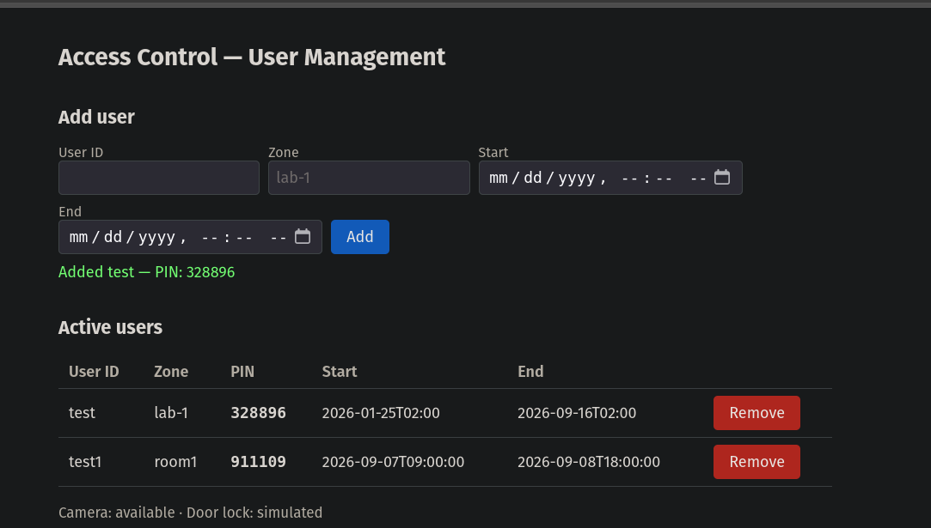
IMPLEMENTATION
Web management interface
Add a user: generates a PIN and writes the grant to InfluxDB.
Remove a user: revokes access immediately.
Reads and writes the same data the CLI and MQTT paths use.
Runs independently of the camera and MQTT client.
9

Slide 11
DEMO
Real terminal output from the deployed Pi
$ python3 main.py
Connected to MQTT broker
=== ACCESS ===
Choose option (1-2): 1
Enter User ID: test
Enter PIN: 328896
Temporary QR generated for test
Valid for 120 seconds
QR saved: ./temp_qr/temp_qr_test_20260910_203245.png
=== ACCESS CONTROL SYSTEM ===
Choose option (1-5): 4 # Manual QR test (no camera needed)
Paste the raw QR payload printed after generating a QR:
> {"data":{"qr_id":"a02eb97e-...","user_id":"test",
"zone":"lab-1", ...}, "signature":"857770..."}
[door-lock] (simulated) unlocking for 5s
ACCESS GRANTED: Access granted - test (lab-1)
Captured directly from the running system — not a mock-up. The matching Telegram notification is shown next.
10

Slide 12
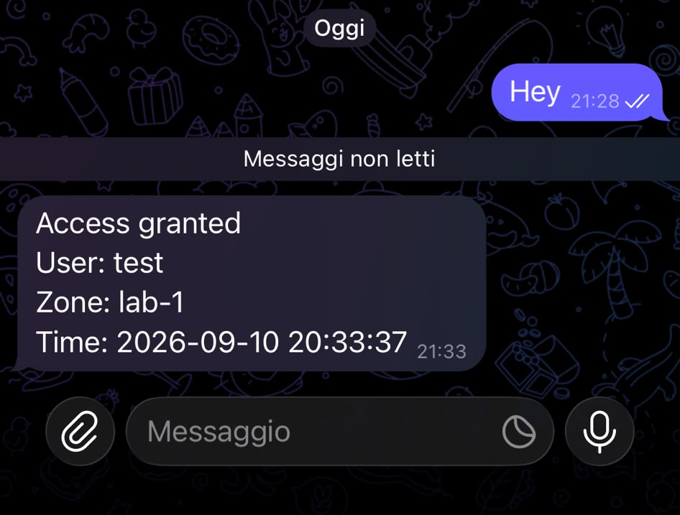
DEMO
The notification, delivered live
Placeholder credentials in .env were replaced with a real bot token and chat ID.
The same manual-test run shown on the previous slide triggered notifier.py for real.
The message arrived on a live device within seconds — not a screenshot of the old prototype.
11

Slide 13
EVALUATION
What's confirmed working
Verified end-to-end
Not yet validated
• MQTT broker connectivity
• Live camera-triggered scan (cable fragile)
• InfluxDB add / list / revoke user
• Physical door-lock relay (simulated only)
• QR generation after PIN auth
• QR validation (manual test path)
• Web UI add / remove user
• Telegram delivery (live message received)
12

Slide 14

EVALUATION
A real bug, found and fixed
Symptom
A revoked-then-re-added user, under a new zone, was rejected as “not found” by authentication — even though the web UI listed them as active.
Root cause
InfluxDB groups points into separate series by full tag set. The lookup only read the first series returned — sometimes the stale, revoked one.
Fix
Scan every returned series and take the point with the latest timestamp overall — verified to resolve the discrepancy.
13

Slide 15
WHAT'S NEXT
Limitations and future work
Secure the CSI cable connection (strain relief / shorter cable) and complete a live camera-triggered test.
Wire a physical relay + electric strike to validate gpio_lock.py on real hardware.
Add an access-log view and live status to the web UI.
Add automated tests around the multi-series lookup behavior.
14

Slide 16
CONCLUSIONS
A modular, MQTT-centric access controller
7
6
2
independent Python modules
MQTT request/response topic pairs
management interfaces (CLI + web)
Authentication, persistence, MQTT, Telegram, and the web UI are implemented and verified end-to-end — including a real concurrency bug found and fixed. The camera cable fault was diagnosed and fixed once; physical door actuation awaits relay hardware.
15

Slide 17
Thank you
Questions?
github.com/yksop/access_control

