Slide 1
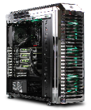

Application Portal Framework
Simulation
Provenance
Collection
(PROV-compliant)
Simulation
Provenance
Data Modeling
Provenance-based
Param. Assistance/
Visualization
Service
Job
Execution
Framework
Simulation
Provenance
Validation
Provenance-based
Simulation Data
Querying/Search
Data-driven
Simulation
Reproduction
Simulation
Provenance
Preservation
Provenance-based Simulation Analytics
(Estimating job-completion time/resource busy time,
performing top-k processing, etc.)
SUPERMAN
Simulation Data
Repository
Infrastructure
: components of the EDISON platform
Notes:
Simulation Provenance Recycling Manager -> SUPERMAN

Slide 2

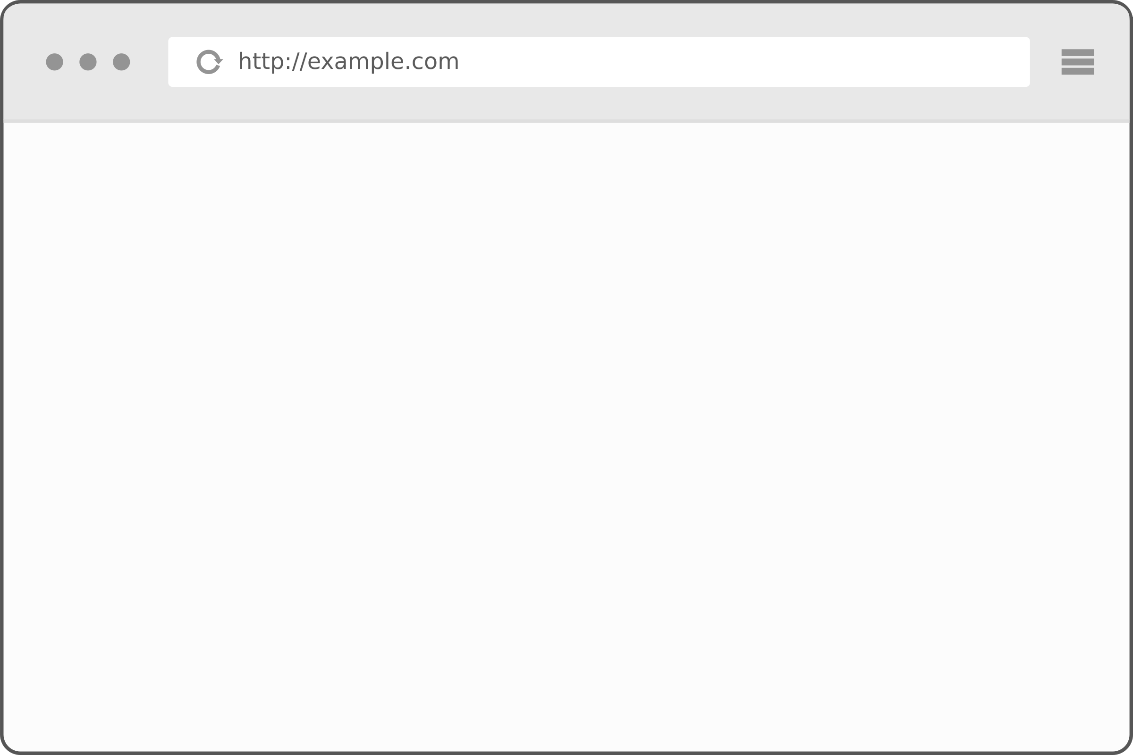

edison
user
PROV
Docs
(in JSON)
Provenance
Search/
Simulation
Request
Solver’s
Sim.
Metadata
(in JSON)
...
Solver’s
Sim.
Metadata
(in JSON)
Application
Superman Service
User Interface
(view.jsp)
Master
Middleware
Superman Service
Layer
EDISON
Superman Portlet
Slave/
Arbiter
Slave
EDISON
Simulation (Portal) DB
(MySQL Database)
SDR
Infra-
structure

Slide 3

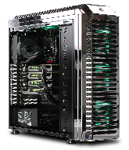
SUPERMAN(IceSheet) Framework
Recommend
Frequent Provenance /
Predict
Simulation
Outcome
Retrieve
Previous
Provenance
Simulation
Provenance
Analytics Agent
Simulation
Request
Result
Response
Request
Existing
Provenance
Check
Existing
Provenance
EDISON
Platform
Retrieve
Provenance
Simulation
Provenance
Retriever
Simulation
Provenance
Matcher
IceSheet
(Provenance Service)
Return
Provenance
Return
Proveance
Pass
Provenance
Record
Raw
Provenance
Return
Matched Provenances
Simulation
Provenance
Loader
Simulation
Provenance
Extractor
Simulation
Re-executor
Return
Simulation
Results
Re-execute
Simulation
Load Provenance
Bring
Raw
Simulation
Provance
Simulation
Execution
Database
(PortalDB)
Computing Resouces
Simulation
Provenance
Repository
Notes:
information
average runtime of runs associated with a simulation
average user counts on that simulation
metadata update?
Actions
Search
Indexing
Loading
Refine

Slide 4
SUPERMAN-Powered EDISON Diagram
Recommend
Frequent Provenance /
Predict
Simulation
Outcome
Retrieve
Previous
Provenance
Simulation
Provenance
Analytics Agent
Simulation
Request
Result
Response
Request
Existing
Provenance
Check
Existing
Provenance
EDISON Platform
Retrieve
Proven-
ance
Request
Flooding
Simulation
Provenance
Retriever
Simulation
Provenance
Matcher
SUPERMAN
Main
Return
Provenance
Return
Proveance
Pass
Approved/
Refined
Provenance
Re-execute
Simulation
Record
Raw
Provenance
Simulation
Provenance
Loader
Simulation
Provenance
Extractor
(Re)Run
Simulation
Return
Proven-
ance
Simulation
Re-executor
Return
Simulation
Results
Load Provenance
Request
Provenance
Validation
Send
Validation
Result
Bring
Raw
Simulation
Provance
Simulation
Result
Database
Computing Resouces
Simulation
Data
Repository
Simulation
Provenance
Validator
Notes:
information
average runtime of runs associated with a simulation
average user counts on that simulation
metadata update?
Actions
Search
Indexing
Loading
Refine

Slide 5
Provenance Use Case 2
Select
a Science App
Search Simulation
Provenance Matching a Specified Condition
Does a Matching Provenance
Exist?
Exist?
y
y
n
n
n
Return the Matching Simulation Results
Run the New Simulation
Reproduction?
y
Auto-filled Parameters
From a Chosen Provenance
Notes:
information
average runtime of runs associated with a simulation
average user counts on that simulation
metadata update?

Slide 6
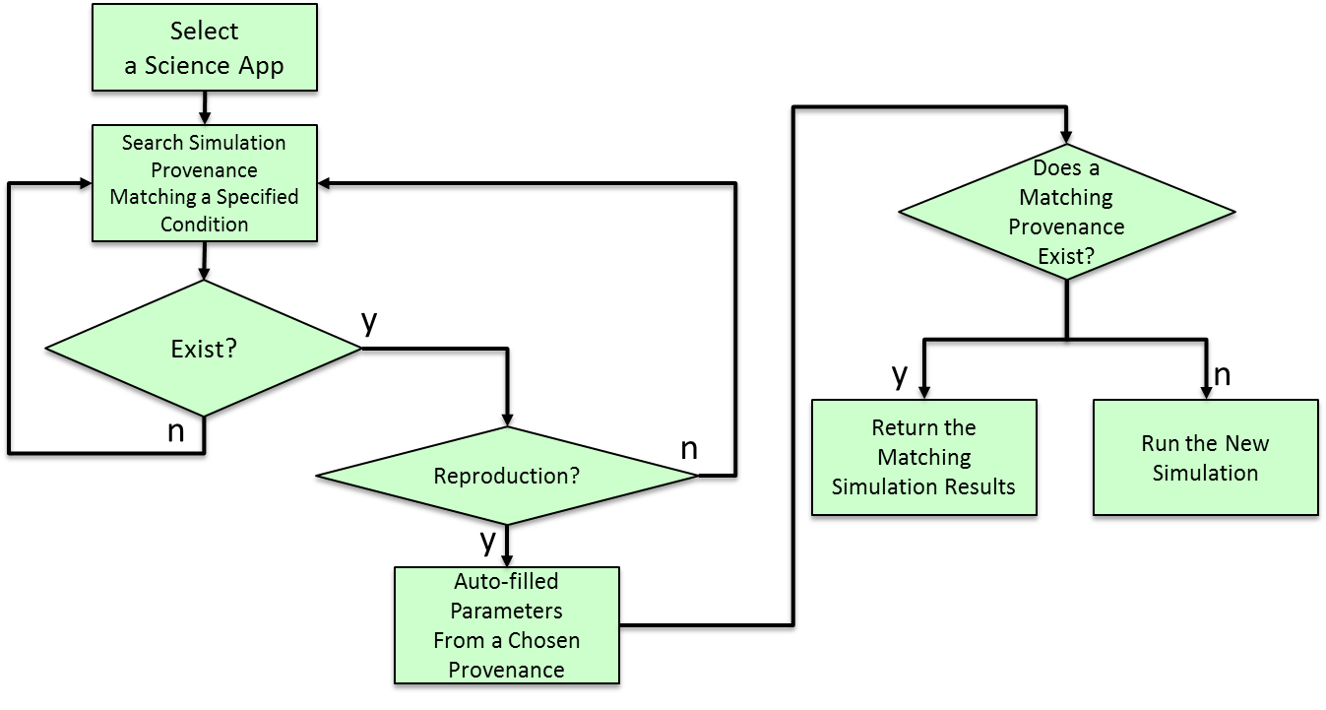

Slide 7
2.2 기술동향 (cont’d) – 이력 관리 프레임워크 비교
 | Chimera | myGRID | CMCS | ESSW | Trio | EDISON-PROV
Applied Domain | Physics, Astronomy | Biology | Chemical Sciences | Earth Sciences | None | General
Workflow Type | Script Based | Service Oriented | Service Oriented | Script Based | Database Query | Science App Based
Use of Provenance | Informational; Audit; Data Replication | Context Information; Re-enactment | Informational; update data | Informational | Informational; update propagation | Re-enactment; Resrc. efficiency; Result Sharing
Subject | Process | Process | Data | Both | Data | Process (not Data)
Granularity | Files (Abstract Datasets) | Abstract resources having LSID | Files | Files | Tuples in Database | Simulation (Files)
Representation Scheme | Virtual Data Lang. Annotation / SQL | XML/RDF Annotations | Dublin Core XML Annotations | XML/RDF Annotations | Query Inversion | JSON (based on PROV)
Semantic Info | No | Yes | Yes | Proposed | No | No
Storage Repository /Backend | Virtual Data Catalog/ Relational DB | mIR repository/ Relational DB | SAM over DAV/ Relational DB | Lineage Server/ Relational DB | Relational DB | MongoDB/ Relational DB
User Overhead | User defines derivations; Automated WF trace | User defines Service semantics; Automated WF Trace | Manual: Apps use DAV APIs; Users use portal | Use Libraries to generate Provenance | Inverse queries automatically generated | No (User-transparent)
Scalability Addressed | Yes | No | No | Proposed | No | Yes
Dissemination | Queries | Semantic browser; Lineage graph | Browser; Queries; GXL/RDF | Browser | SQL/TriQL Queries | Visual Graph/ RESTFul API
- Chimera, myGRID, CMCS, ESSW: workflow-based provenance mgmt. sys.
- Trio: provenance mgmt. sys. through queries in database systems
for lineage
retrieval & management
Notes:
Chimera: data lineage
myGrid:

Slide 8
PROV-Model
wasDerivedFrom
Jobs, Input, Output
(Entity)
wasAttributedTo
actedOnBehalfOf
User,
Simulation SW
(Agent)
wasGeneratedBy
used
wasAssociatedWith
Simulation ID
(Activity)

Slide 9


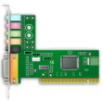
EDISON Platform
Simulation Provenance Matcher
7. Matching
Application Portal Framework
6. Indexing
1. Search Request
Simulation Provenance
Retriever
5. Analyzing
8. Return to Result
Job Execution Framework
2. Connection
4. Gathering
3. Crawling
Infrastructure
Simulation
Data
Repository
HPC
Computing Cluster
GPU
Cluster

