Slide 1

MAVERICSDTU
Inspire Hackathon 2019
Team Members :-
Yash Kumar Gupta, 3rd Year, CSE ,B.Tech, DTU
Salil Manocha , 3rd Year, SE ,B.Tech, DTU

Slide 2
EXECUTIVE SUMMARY
Modern smart grids rely on advanced metering infrastructure (AMI) networks for monitoring and billing purposes. However, such an approach suffers from electricity theft.
Electricity theft results in high ﬁnancial losses for several countries such as the United States ($6 billion/year) and India ($17 billion/year) . Other developing countries lose almost 50% of their electricity revenue due to theft .
Here we present an approach to identify the suspect customers, using the customer power usage pattern.

Slide 3
SMART METER DATA ANALYSIS
In this theme , we propose to implement
Machine Learning Algorithm for Efficient Power Theft Detection using Smart Meter Data
The AMI networks rely on smart meters located in the customer’s premises to regularly report their energy consumption. This approach has the potential to hinder traditional physical electricity theft attacks including linehooking or meter tampering [4].

Slide 4
Stakeholders
The Electricity Distribution companies through local region-wise substations to detect fraudulent customers.
Consumers can also use their power usage patterns to keep a check on power wastage and hence reducing electricity bills.

Slide 5
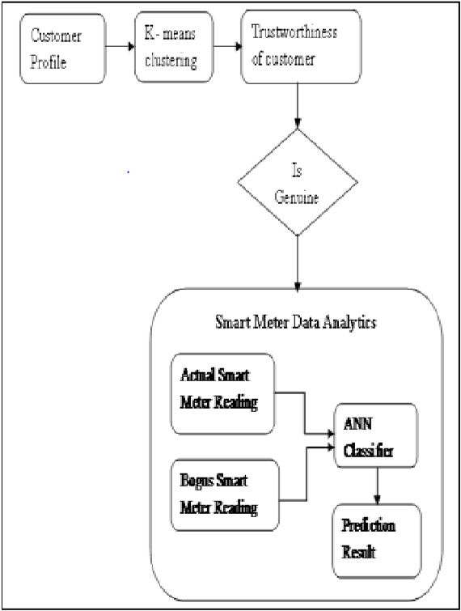
SOLUTION
The k-means clustering algorithm will cluster these customers into k clusters. The customer’s profiles that belong to the largest cluster are chosen for further investigation into the power usage patterns. These customers are identified as trustworthy customers.
The selected genuine customer’s profile data are the input to the smart meter data analytics system.
Three types of bogus data are obtained from dataset .Then the classifier is trained to categorise the normal and bogus data that was included into the actual genuine dataset while training the neural network . The performance of the classifier is measured and evaluated.
Architecture for electricity theft detector

Slide 6
APPROACH
Trustworthiness of Customers – It is believed that all the customers of the selected region are genuine profiled. The percentage of trustworthy customers is identified by using K – Means Clustering. For this purpose, a sample customer’s smart meter reading for every 30 minutes in (KWH) for 28 days is considered and later the readings are verified manually.
The three bogus data is also collected experimentally by generating use cases for the types of tampering with meters and these were classified into 3 broad classes(T1, T2,T3) that are mathematically represented by the following equations for generalisation:
T1(Dt) = α Dt : α = Random (0, 1)
T2(Dt) = β Dt β = Random (0.1, 0.8)
T3(Dt) = Ƴ Dt Ƴ= mean (Dt)

Slide 7
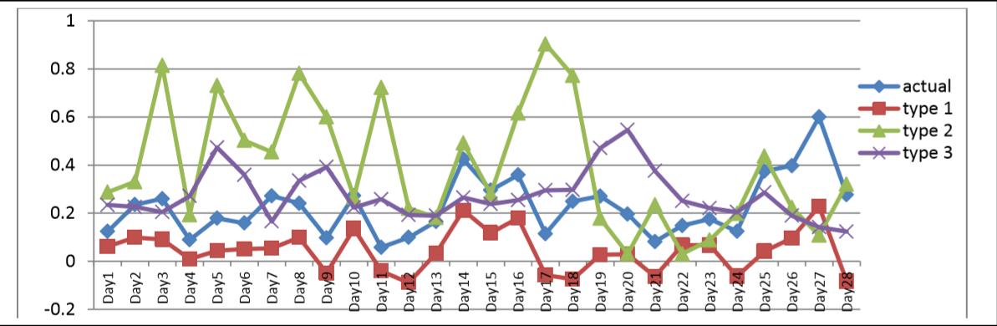
BOGUS DATA
TYPE 1
TYPE 2
TYPE 3
Original Data

Slide 8
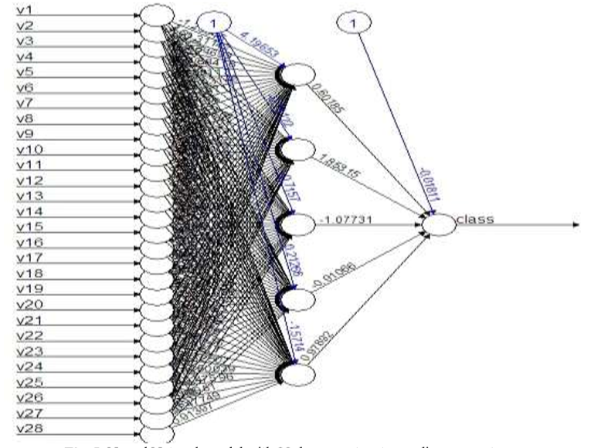
3. CLASSIFICATION
The genuine profiled customers are considered for the classification model by including the bogus data into actual data.
The prediction is made by the ANN classification model. The performance of the proposed system is using parameter namely accuracy.
Our Implemented Accuracy comes as 76% .

Slide 9
TECHNOLOGY STACK
Python 3.6
Libraries :-
Tensorflow – For Deep Learning Layers
Keras – Implementing Tensorflow
Numpy – Basic Numerical Operations
Matplotlib – To Visualize the data plot
sklearn - For using k-means algorithm
Jupyter Notebook

Slide 10
Future Scope
The Current Approach gave an Accuracy of 76% on a Dataset(readings of 5 days for 1000 consumers) with 2 Features (Power consumption, Periodic Readings). But accuracy can be increased further with a larger dataset and more layers in ANN.
For a larger dataset with more number of features, a time-series based model can be trained( using LSTM and GRU) for fine tuning of hyperparameters to recognise highly complex, time variant power usage patterns and determine fraudulent customers.
After analysis of Power usage patterns of different localities with more features, the system can be used by the authorities at higher levels in hierarchy.
With the knowledge of power usage patterns, specific power demand for future can be predicted which can help reduce transmission losses and installation of power storage infrastructure at specific locations.

Slide 11
THANK YOU

Slide 12
REFENCES
[1] P. Jokar, N. Arianpoo, and V. C. Leung, “Electricity theft detection in AMI
using customers’ consumption patterns,” IEEE Transactions on Smart
Grid, vol. 7, no. 1, pp. 216–226, 2016.
[2] S. K. Singh, R. Bose, and A. Joshi, “Entropy-based electricity theft
detection in AMI network,” IET Cyber-Physical Systems: Theory &
Applications, 2017.
[3] P. Antmann, “Reducing technical and non-technical losses in the power
sector,” World Bank, Washington, DC, 2009.
[4] P. Pickering, “E-Meters Offer Multiple Ways to Com-
bat Electricity Theft and Tampering,” Last accesed: Nov
2017. [Online]. Available: http://www.electronicdesign.com/meters/
[5] J, Jeyaranjani; D, Devaraj. Machine Learning Algorithm for Efficient Power Theft Detection using Smart Meter Data. International Journal of Engineering & Technology, [S.l.], v. 7, n. 3.34, p. 900-904, sep. 2018. ISSN 2227-524X

