Slide 1


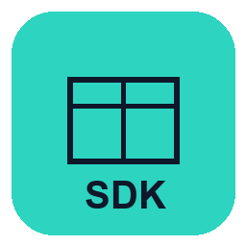

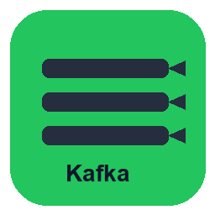


LedgeRX · System Architecture
sim
CTO · 1 / 2
Upstream → SDK → Product engine → Landing · Add-ons extend the core
1
Upstream
2
Integration
3 LedgeRX Product Engine = Reward System
5
Add-ons
4
Landing
Client systems of record
LedgeRX SDK
Purchasable loyalty + multi-currency ledger · modular services · in-cluster
Extend core without forking
One UAF layer (see slide 2)
UAF
One client for every upstream
Customer Onboarding
Wallet · owner · currencies
Referrer Management
Referral / affiliate rules
REST
useCases · catalog · dry-run
Wallet Tiering
Segments · benefits
Unified hub
Only interface
Credit Card
Spend · auth · MCC
Posting Engine
Double-entry · settle
Ledger Books
Balances · multi-currency
→ CBP / Gift
…
Loan
Drawdown · DD · load
Kafka / MQ
Async event stream
Campaign packs
TBC
Account Rules (COA)
Chart of accounts · profiles
Points Calculation
Rates · fixed rewards · tiers
→ Notify
…
App / CRM
Yes UA · sim apps
File / batch
Bulk ingest jobs
Future modules
TBC …
Runtime: Event → Rules & calculation → Posting → Ledger books → Outbound
→ XAPI
…
No ledger logic here. Business events only.
Idempotent · ownerId + code No hand-built JSON
UA “Reward System”: points ledger · redemption rules · reward outcomes Ops configures once · Upstream calls use-case codes via SDK only
UAF · sim · SDK · REST · Kafka · one Landing interface · UAF fan-out behind hub
Confidential

Slide 2

Landing · One unified interface to LedgeRX
sim
CTO · 2 / 2
LedgeRX talks to a single UAF layer only · that layer applies UAF logic · then fans out internally
OUR PRODUCT
LedgeRX = UA “Reward System”
Emits: balance.updated · reward redemption request · ledger outcomes (Kafka / HTTP callbacks)
sole interface
ONLY INTERFACE · UAF-owned
Unified Landing Layer · collect results + UAF business logic
1 · Collect
2 · Decide
3 · Dispatch
Subscribe LedgeRX events / APIs
UAF policies · eligibility · routing
Call CBP · Gift · Notify · CRM
Internal UAF systems — LedgeRX never integrates to these directly
ONE DOWNSTREAM
Gift system
Notification
XAPI / CRM
E-coupon / CBP
Fulfillment triggered after routing
Push · SMS · inbox
Balances · apps (Yes UA · sim)
Central coupon platform inventory · issue / redeem · track
UAF-owned
UAF-owned
UAF-owned
UAF-owned
↓ COD · other partners
Pitch: Buy LedgeRX. Integrate once to the Landing hub. CBP / Gift / Notify stay behind your layer.
Official UAF · sim · Yes UA logos (CTO-approved) · LedgeRX ↔ one UAF interface Hub runs UAF logic then fan-out · apps sit behind XAPI / CRM

