Slide 1
UA FINANCE · REWARD SYSTEM
Applying LedgeRX into your landscape
From whiteboard (CC + Loan) → target architecture + event mapping skeleton
for CTO & Internal IT
Draft for alignment · Not a commercial proposal

Slide 2
As discussed — whiteboard summary
UAF Reward System (CC + Loan) · In / New / Out
IN
NEW (green box)
OUT
Channels / events
Reward core · whiteboard intent
Downstream / cores
e6 web (CC)
Ledger + SDK v1
Integration surface for IT
Existing Loan:CC
Onboarding
Member / wallet setup
~21 CC events
Existing Loan:Loan
Referrer MGT
Referral programme
Mobile (Loan)
New: E-Coupon
Posting
Post points / movements
N Loan events
New: Adapter
Account Rules
Eligibility / decisioning
→ cc-xapi (existing)
Calculation Config
Rates / formulas
New: Stock
→ loan path (TBD)
Ledger × N (yellow)
Multiple books drawn
Other adapters…
Config Rules (bottom)
Runtime policy layer
LedgeRX × UA Finance · Confidential
2/10

Slide 3
Wishlist from sticky notes
Phase ownership — honest split
Capability
Wave
Owner
Note
Real-time cashback
Phase 1
LedgeRX + xapi
Event → Door→Brain→Books
LP stack / balances
Phase 1
LedgeRX
Wallet multi-ccy + history
Reward redemption
Phase 1–2
LedgeRX + Coupon/Stock
Burn/hold in ledger; fulfil outside
Customer tier / ranking
Later
UAF CRM / loyalty
Not LedgeRX core
Promotion / merchandising
Later
Campaign
Win → post event to ledger
Referrer management
Parallel
UAF New service
May emit earn events only
LedgeRX × UA Finance · Confidential
3/10

Slide 4
Target landscape — LedgeRX applied
One domain service · SDK · CC + Loan books
IN
EXISTING EDGE
NEW · LedgeRX
OUT
Single domain service
e6 / digital
ledger-engine + Java SDK v1
Loan:CC
cc-xapi
Existing core
CC events (~21)
normalize 21 events
→ SDK
Door
Brain
Ingest policy
Rules + calc
Loan:Loan
Mobile / loan
Existing core
Loan events (N)
loan adapter
Books
COA
DE posting
CC / Loan schemes
E-Coupon
normalize N events
→ SDK
New fulfil
CRM
Admin = configuration plane · Own PostgreSQL
ownerId source
Stock / Adapter
Anti-corruption
layers
New fulfil
NOT 3 ledger microservices — multi-book inside one SoR
LedgeRX × UA Finance · Confidential
4/10

Slide 5
Whiteboard box → LedgeRX mapping
What replaces the yellow Ledger × 3
Whiteboard
LedgeRX / decision
Implication
Ledger : SDK v1.0
★ ledger-engine-sdk
Internal IT primary integrate surface
Ledger (yellow ×N)
★ One LedgeRX + COA profiles
CC stream vs Loan stream — not N services
Posting
★ Books / DE shooter
Earn burn hold → movements + legs
Account Rules
★ Brain (digestion)
Eligibility filters + priority
Calculation Config
★ Brain formula JSON
RATE / FIXED / LINEAR runtime
Configuration Rules
★ Admin + APIs
Door / Brain / COA no redeploy
Onboarding
⚠ Wallet onboard only
Full KYC/referrer stays UAF
Referrer MGT
○ Outside
Emit earn events into LedgeRX
cc-xapi
○ Keep existing
Adapter → SDK
E-Coupon / Stock
○ Outbound New
Ledger burns; they fulfil
LedgeRX × UA Finance · Confidential
5/10

Slide 6
Runtime path (CC example)
Same pattern for Loan with different COA / ruleset
1
2
3
4
5
6
7
Event
cc-xapi
SDK
Door
Brain
Books
Out
e6 cc purchase
map fields
ingestEvent
accept?
rule+pts
DE post
balance / burn
CTO one-liner
Keep cc-xapi and loan cores. Put one LedgeRX in the green box. Internal IT integrates with the Java SDK. Configuration Rules = Door + Brain + COA — not a second rules platform.
LedgeRX × UA Finance · Confidential
6/10

Slide 7
Event mapping skeleton — how to use
CC ~21 events · Loan N events → Brain rules
Column
Meaning
eventCode
UAF / e6 stable code (source of truth from xapi)
channel
CC | LOAN | BOTH
samplePayload
Key fields after xapi normalize
mapsToEventType
LedgeRX TransactionalEvent.eventType
brainRuleCode
digestion_rule.code (or NEW)
formulaIntent
RATE / FIXED / NONE (informational only)
coaProfile
CC stream vs LOAN stream
phase
P1 dry-run · P1 live · P2 · OUT
owner
UAF IT / Biz / LedgeRX support
status
TODO · MAPPED · UAT · LIVE
LedgeRX × UA Finance · Confidential
7/10

Slide 8
CC event map (skeleton 1–12)
Fill codes with UAF e6 catalogue — placeholders shown
#
eventCode (UAF)
→ eventType
Brain rule
Formula
COA
Phase
01
CC_PURCHASE_POSTED
PURCHASE
CC_EARN_BASE
RATE %
CC
P1
02
CC_PURCHASE_AUTH
AUTH
CC_HOLD_OPT
NONE/HOLD
CC
P2
03
CC_PURCHASE_CAPTURE
CAPTURE
CC_EARN_BASE
RATE %
CC
P1
04
CC_REFUND
REFUND
CC_BURN_REFUND
RATE/AMT
CC
P1
05
CC_CHARGEBACK
CHARGEBACK
CC_BURN_CB
AMT
CC
P1
06
CC_FX_MARKUP
PURCHASE
CC_EARN_FX
RATE
CC
P2
07
CC_CASH_ADVANCE
CASH_ADV
SKIP_OR_RATE
TBD
CC
P2
08
CC_FEE_POSTED
FEE
SKIP
NONE
CC
P1
09
CC_PAYMENT_RECV
PAYMENT
SKIP
NONE
CC
P1
10
CC_INTEREST_POST
INTEREST
SKIP
NONE
CC
P1
11
CC_MCC_GROCERY
PURCHASE
CC_EARN_MCC_5411
RATE+
CC
P1
12
CC_MCC_DINING
PURCHASE
CC_EARN_MCC_5812
RATE+
CC
P1
LedgeRX × UA Finance · Confidential
8/10

Slide 9
CC map (13–21) + Loan skeleton
Complete with real UAF codes in workshop
#
eventCode (UAF)
→ eventType
Brain rule
Formula
COA
Phase
13
CC_MCC_TRAVEL
PURCHASE
CC_EARN_TRAVEL
RATE+
CC
P2
14
CC_ONLINE_ECOM
PURCHASE
CC_EARN_ONLINE
RATE
CC
P1
15
CC_INSTALMENT
INSTALL
CC_EARN_OR_SKIP
TBD
CC
P2
16
CC_REWARD_REDEEM
REDEEM
CC_BURN_REDEEM
AMT
CC
P1
17
CC_REWARD_EXPIRE
EXPIRE
CC_BURN_EXPIRE
AMT
CC
P2
18
CC_ADJUSTMENT_CR
ADJ_CR
CC_EARN_ADJ
AMT
CC
P1
19
CC_ADJUSTMENT_DR
ADJ_DR
CC_BURN_ADJ
AMT
CC
P1
20
CC_CARD_ACTIVATION
SIGNUP
CC_EARN_WELCOME
FIXED
CC
P1
21
CC_ANNUAL_FEE_WAIVE
FEE_WAIVE
SKIP_OR_FIXED
TBD
CC
P2
L1
LOAN_DISBURSE
DISBURSE
LN_EARN_OR_SKIP
TBD
LOAN
P1
L2
LOAN_REPAYMENT
REPAY
LN_EARN_REPAY
RATE/FIXED
LOAN
P1
L3
LOAN_EARLY_SETTLE
SETTLE
LN_EARN_BONUS
FIXED
LOAN
P2
L4
LOAN_OVERDUE
OVERDUE
SKIP_OR_HOLD
NONE
LOAN
P2
L+
… (N-4 more)
TBD
TBD
TBD
LOAN
TBD
LedgeRX × UA Finance · Confidential
9/10

Slide 10
Recommended next workshop (Internal IT + Biz)
Turn skeleton → production matrix
1
Lock event catalogue
Export real e6 21 codes + loan N list into the sheet
2
Normalize contract
Agree xapi → TransactionalEvent field map (amount, mcc, eventId…)
3
Rule design
For each P1 row: Brain rule + formula + skip reasons
4
COA decision
CC vs Loan profile codes; ownerId strategy if split books
5
SDK spike
cc-xapi calls dry-run for 5 golden events
6
Outbound
Redemption: burn API vs coupon adapter sequence diagram
LedgeRX × UA Finance · Confidential
10/10

Slide 11
APPENDIX
Earn · Process · Burn
Full sequence board — 2 halves (leave-behind)
A1: Pay → Ingest → Calculate → Earn
A2: Result → Burn + summary cards

Slide 12
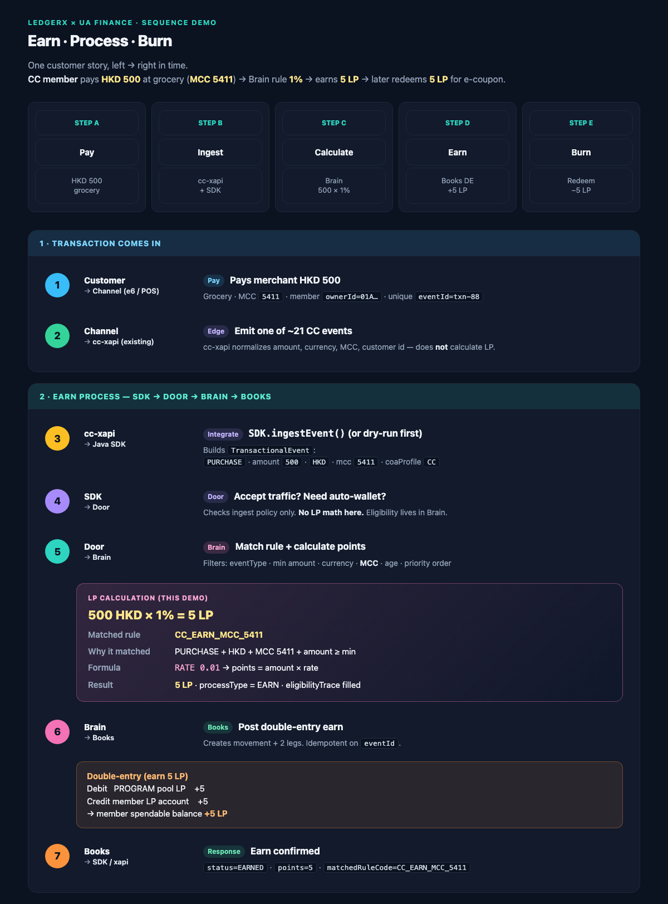
APPENDIX A1 · Sequence board (1/2) · Transaction → Earn

Slide 13
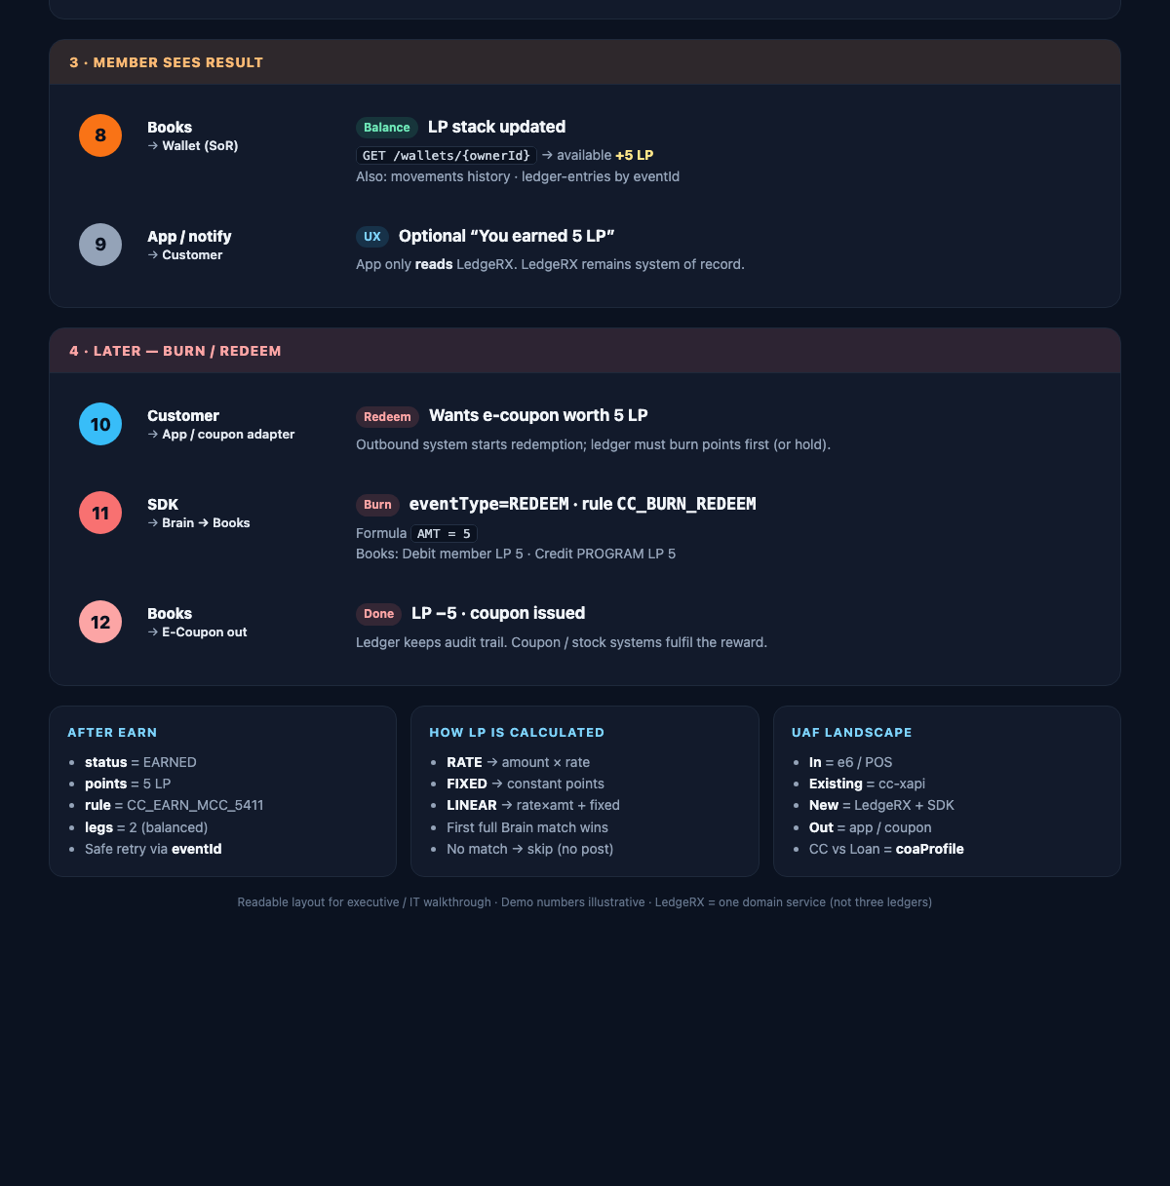
APPENDIX A2 · Sequence board (2/2) · Result → Burn + summary

Slide 14
UA FINANCE
Main deck = landscape apply. Appendix = earn/process/burn sequence board.
Ask: SDK · sandbox · IT workshop · event matrix

